Slide 1
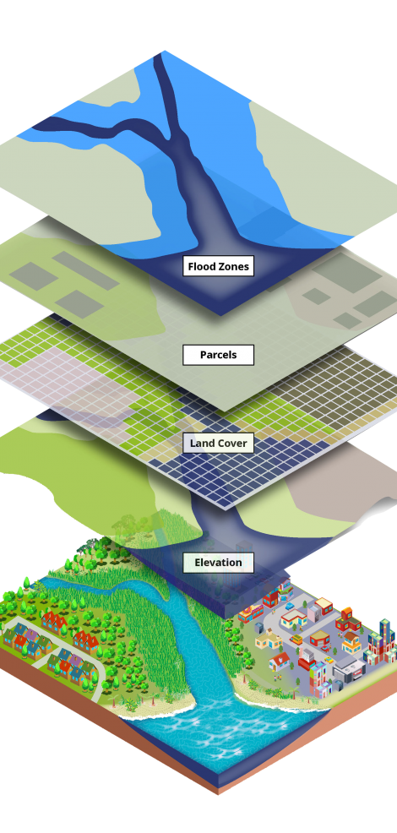
Intro to GIS for Social and Environmental Analysis
SPRING 2024, WEEK 14
Dr. Dirk Kinsey
dkinsey@brynmawr.edu
Office Hours: Tues 12-1pm and Thurs 1-2pm

Slide 2
Course Goals
Hands-on training in a technical skill set
Learning to use the software in a real-world research context
  How do we ask a question with GIS? How do we answer it?
Learning how to approach a given question spatially
  The “why of where”
Learning to think critically about the geospatial technology/geospatial data, its production and application

Slide 3

I HAD ONE BIG GOAL
Help you learn as much as possible without making you overly stressed

Slide 4
Become proficient with basic GIS file management and vector operations
Become familiar with introductory raster operations
Understand core concepts in geospatial analysis
Understand how to make choices about symbology based on the distribution of a dataset
Develop skills in critiquing spatial representation and analysis, especially in terms of data and analysis limitations and the impact of visualization choices
Become familiar with a variety of publicly available data sources
Practice managing your own time, balancing competing needs, planning to complete the work, and communicating about your schedule
Cultivate an attitude of “playing around” – trying things out and backtracking and trying new approaches when the first attempt does not work
See how to use a variety of tools – ArcGIS help files, youtube videos, and general Google searches – to keep learning GIS operations and troubleshoot problems

Slide 5
MAPS ARE ARGUMENTS
By choosing what information to include and what information to omit, every cartographer is making implicit and or explicit arguments about what is important and what is not.

Slide 6
    LINES
    DO
    WORK
EXCLUDE
INCLUDE
DIVIDE
DIFFERINTIATE
CREATE THINGS
ERASE THINGS

Slide 7
  Space as a social construct, space as produced
    Interactions
    Interconnections
    Implications
  The way that maps describe space defines spatial relationships with material implication
MAPS
DESCRIBE
SPACE
MAPS
PRODUCE
SPACE
MAPS
DESCRIBE
SPACE
MAPS
PRODUCE
SPACE

Slide 8
Technology
is political
Data is political
  How we design and build our geospatial technology and how we collect, manage and analysis our data reflect our assumptions, biases and differing versions of an ideal world.
  And that’s okay!

Slide 9

GIS LETS US ASK SPECIFIC QUESTIONS,
NOT ALL QUESTIONS

Slide 10
Key Concepts and Ideas – first half
Layers
Spatial and attribute data
GIS (Geographic Information Systems)
Common GIS applications
Geometric representation
Map Scale: Large vs. small scale
Level of measurements
  Nominal, ordinal, interval, ratio
Types of maps
Choropleth Mapping

Slide 11
Key Concepts and Ideas – first half
Relational database management systems (RDBMS)
Records & fields
Primary key & Foreign key
Relational algebra
    Join, projection, selection
Shapefile
Geodatabase
Attribute table
Raster and vector data model
Spaghetti vector data model
Vector topologic data model
Data Classification
  Natural breaks, equal interval, quantile
Sequential and diverging color schemes
Thematic map elements
Geographic coordinate system
Cartesian Coordinate System
Map Projections
Datum
UTM , State Plane

Slide 12
Key Concepts and Ideas – SECOND half
Vector Analysis
  Select by attribute / by location
  Join operations
  Measurement
  Classification
  Buffer
  Overlay
    Point-in-polygon
    Line-in-polygon
    Polygon-on-polygon
      Intersection
      Union
      Identity

Slide 13
Key Concepts and Ideas – SECOND half
Discrete vs. continuous data
Raster Data
  Grid cells / pixels
  Resolution
  Raster types
Raster Analysis
  Boolean Raster
  Map Algebra
  Hillshade
  Slope
  Masking
  Zonal statistics
  Feature to raster
  Reclassify
Geocoding
  Address geocoding / address matching
  Process and requirements
  Applications
  Scoring and hit rate
  Common issues
GIS and Ethics
  Key ethical principles
  Georeferencing scanned image

Slide 14
What remains fuzzy?
On your index card, write down one or two concepts, functions or ideas that are the least clear to you.

Slide 15
Round Robin
Everybody stand up
Find someone who thinks they can explain your unclear concept to you AND find someone that you can explain their unclear concept to
We’ll go through 3 rounds

