Slide 1
GERM/HART/COML/JWST 245
Under Surveillance:
Literature and Visual Culture from The Enlightenment to the Present
Dr. Margaret Strair
Lecturer of German
Bryn Mawr College
mstrair@brynmawr.edu
Office Hours: Fridays 1:30 -3:30 PM, OL 139

Slide 2
Course description
Introductions
Why literature and visual culture? Why surveillance? What is surveillance?
Learning Community and Classroom Guidelines
Putting this into practice
Intro to next session
Homework:
-Excerpts from Surveillance Readers
-Course survey
-German speakers/German credit seekers: German hours survey
Please sign-in on attendance log, and make a name placard with your preferred name in class and pronouns

Slide 3
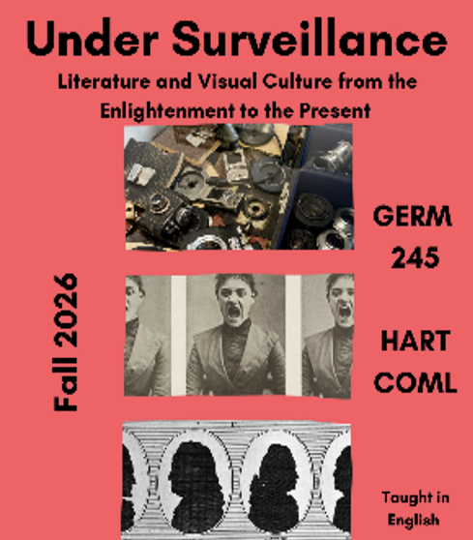

Slide 4
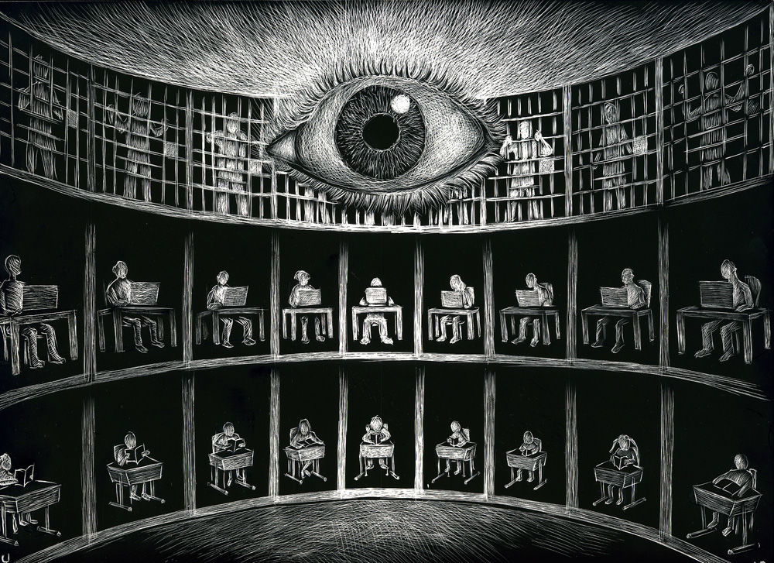
Surveillance: “Focused, systematic routine attention to persona details for the purposes of influence, management, protection or direction” (Lyon)
Visual Culture: “Visual forms and practices within a society, including those of everyday life, popular culture, and high culture, together with the processes of production and consumption or reception associated with them. This includes all visual media (visual art, photography, film, television, posters, etc.). See also aestheticization; codes of looking; flâneur; gaze; ocularcentrism; picture perception; spectacularization; surveillance; visual anthropology; visual consumption; visual imperative; visualism; visuality; visual merchandizing; visual practices; visual semiotics.” (Oxford References)

Slide 5
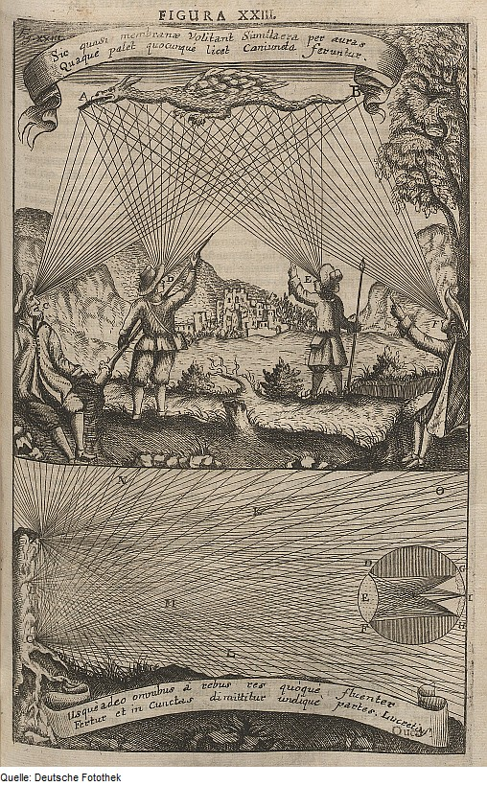


Acts of Seeing, Control and Scopophilia in the Premodern
Augon
Invidere – den Bösen Blick Unheil bringen
Mystical visions of universal order sanctioned by the divine
Scientific/Extromission models of vision
Social Coding and performance/surveillance
Notes:
ocular metaphors for power dynamics and social structures that reflect key epistemological limitations on viewing and the subject

Slide 6
Scopic Regime of Reason and Empirically Proven/ Ocularcentrism
Christian Wolff, Vernünfftige Gedancken von Gott, Der Welt und der Seele des Menschen, Auch allen Dingen überhaupt, den Liebhabern der Wahrheit ( 1720)
[Deutsche Metaphysik//
German Metaphysics]
LUCEM POST NUBILA REDDIT
Bring the light back from the darkness
Notes:
little interiority

Slide 7
18th --- 19th --- 20 th---21st Centuries
Shifting loci of power (political, labor/economic, social, racial, psychological)
MODERN “SURVEILLANCE”
Economic – Marx → worker monitoring,
fragmentation of labor, subordinating labor to capital
(Taylorism)
Moral – Nietzsche : “God is dead”
Civil/Social – Panopticon institutions (Bentham, later revisited by Foucault)→ centralized, internalized (invisible) structures of discipline; social conformity; confined
------------------------------------------------------------------
POSTMODERN
General: decentralized, control, body-objectifying, everyday
body as data points
How do literary texts disrupt or intervene in these techniques and paradigms on issues of gender, race identity?

Slide 8
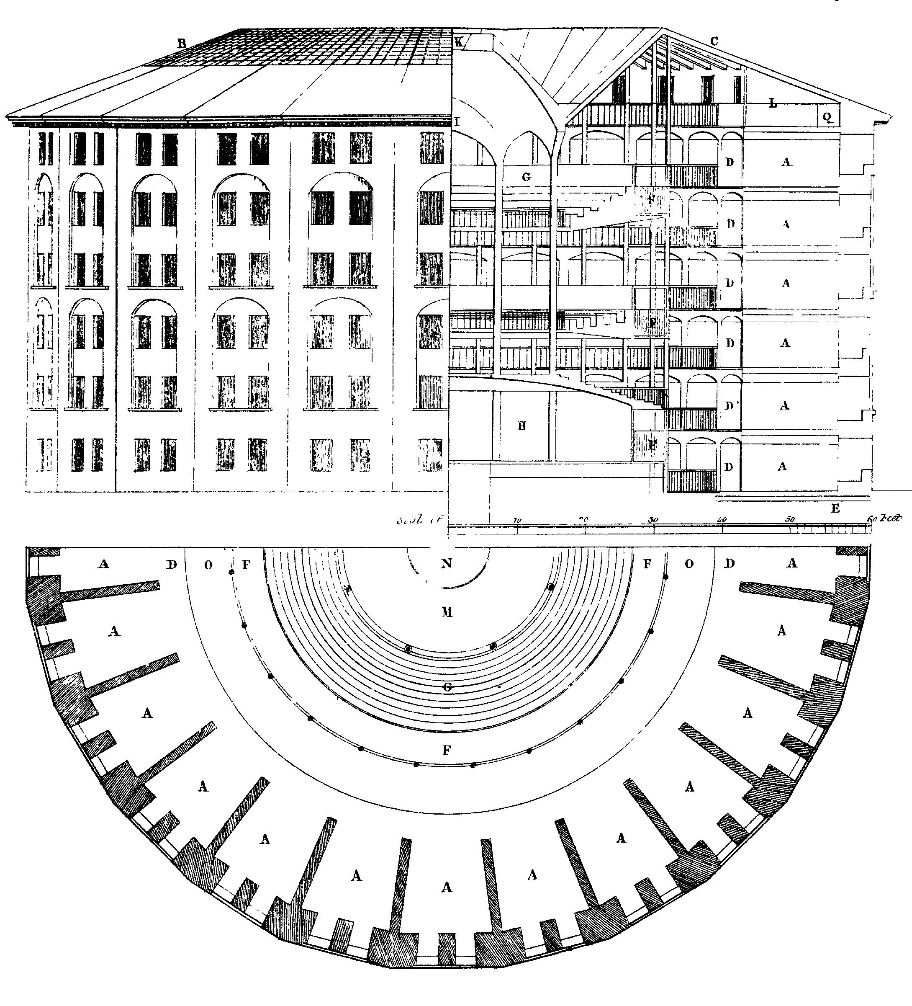
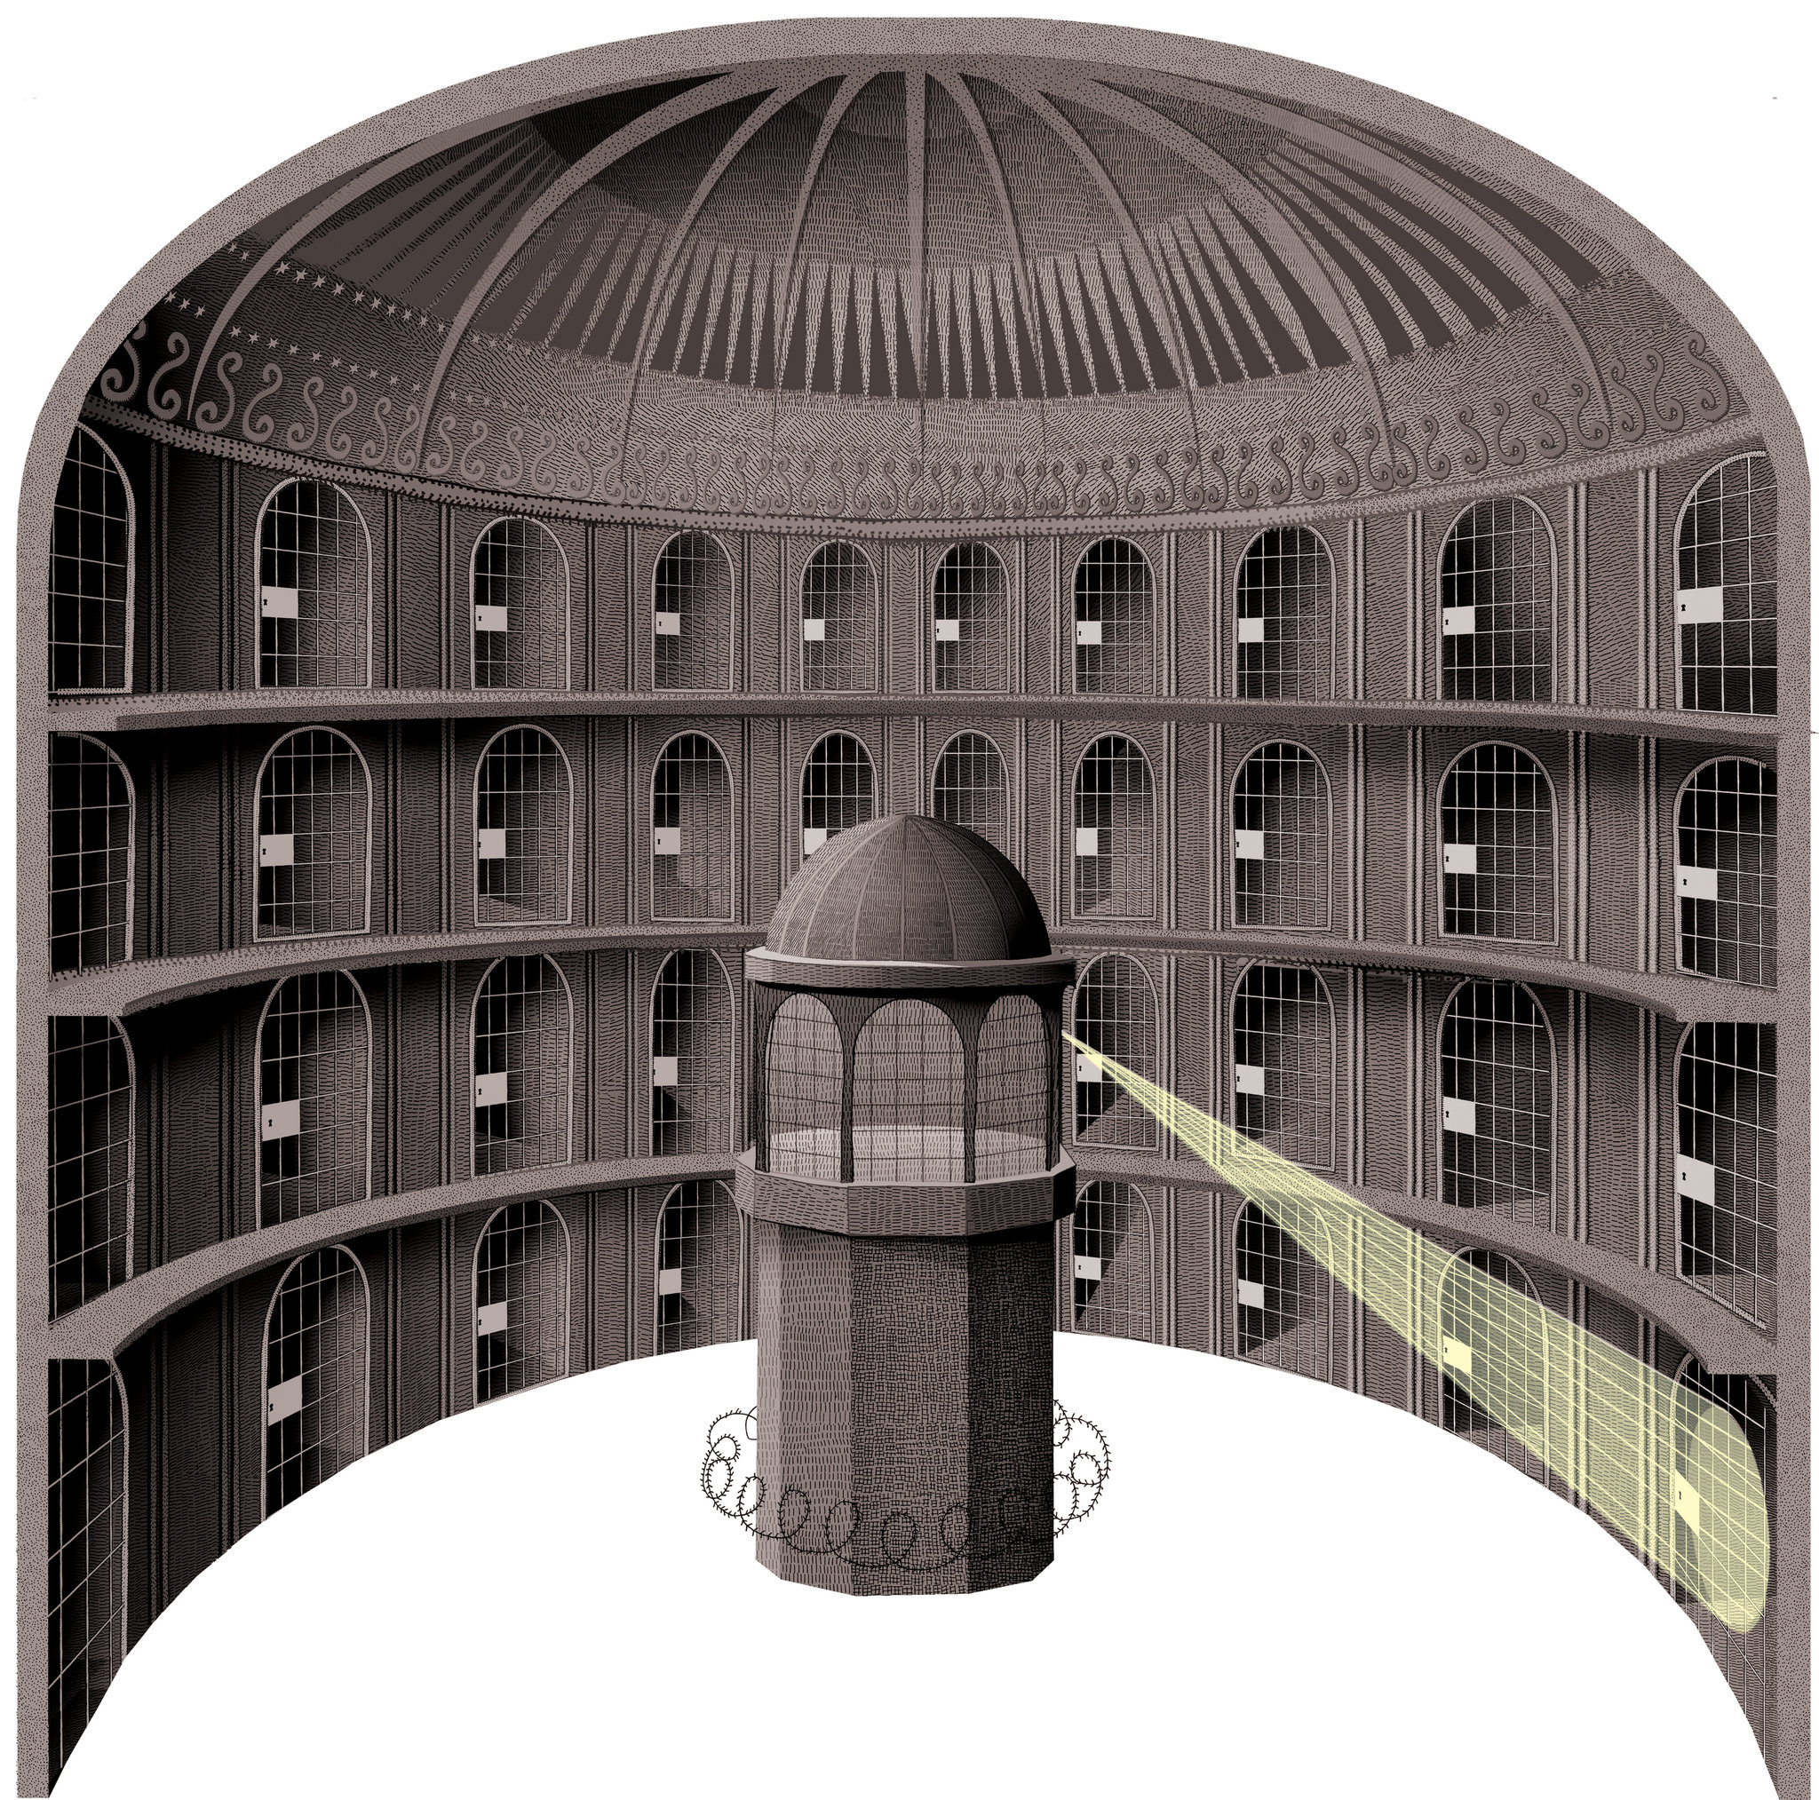
Panopticon
Notes:
Panopticon is not only a model for a kind of prison, it is also a episteme or paradigm for how we visualize how we structure knowledge about the world and ourselves.

Slide 9
Topic of Investigation:
Cultures and Sites of Visibility, Hyper-visibility, and Invisibility
as Powers and Products of the Gaze
How does our perception of the world impact our knowledge of ourselves and the world itself?
How are the powers of the gaze reflected in and reflected through different artistic practices and media?

Slide 10
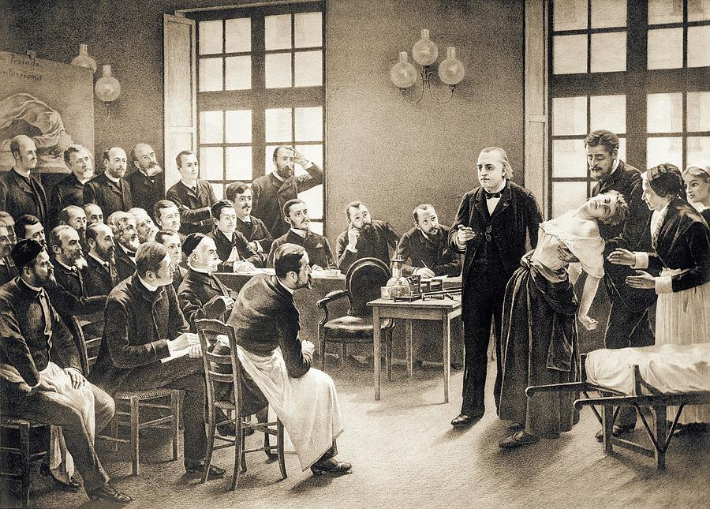
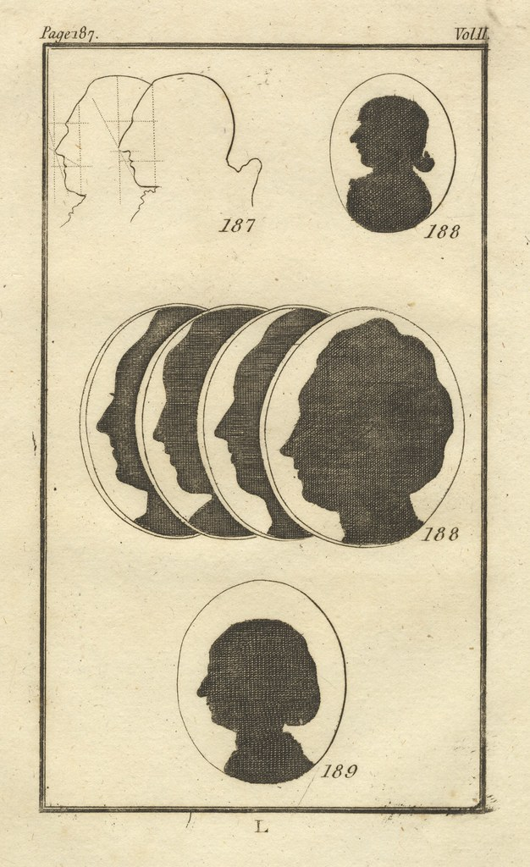
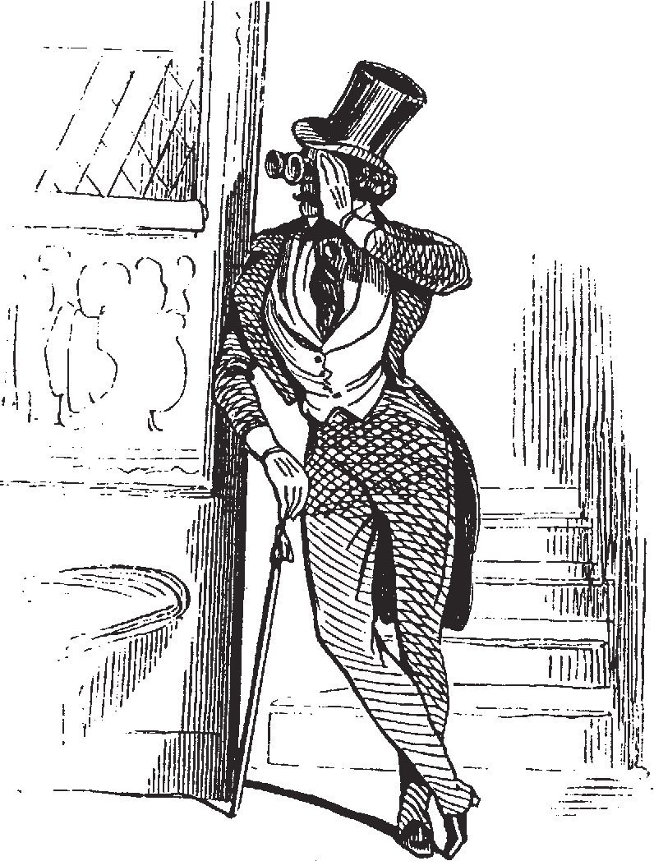
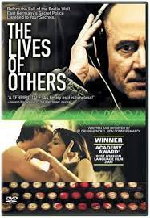
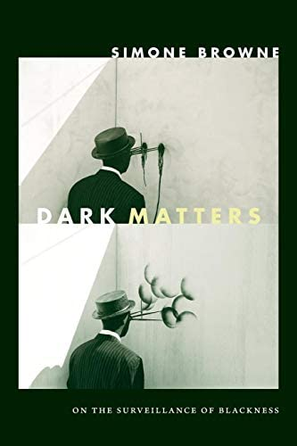
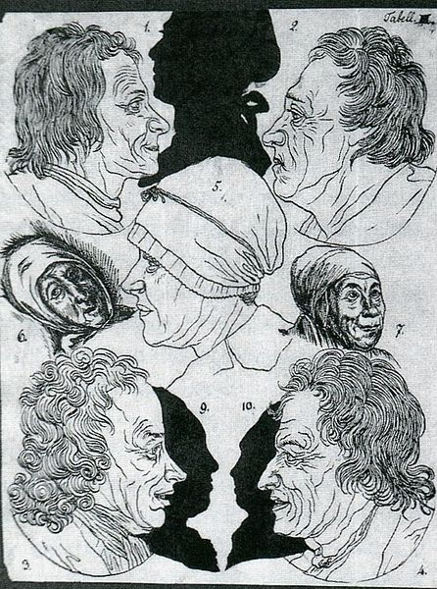
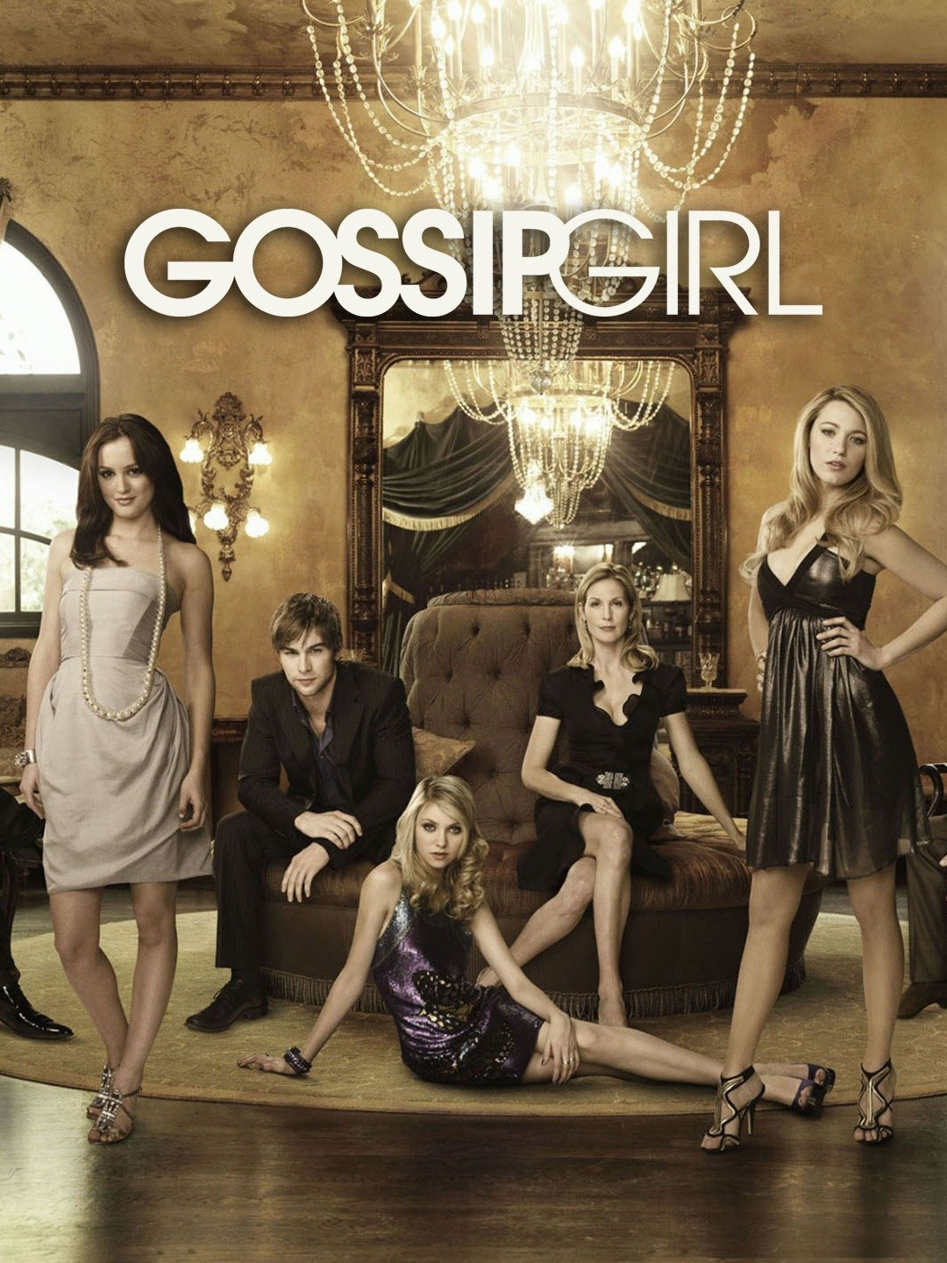
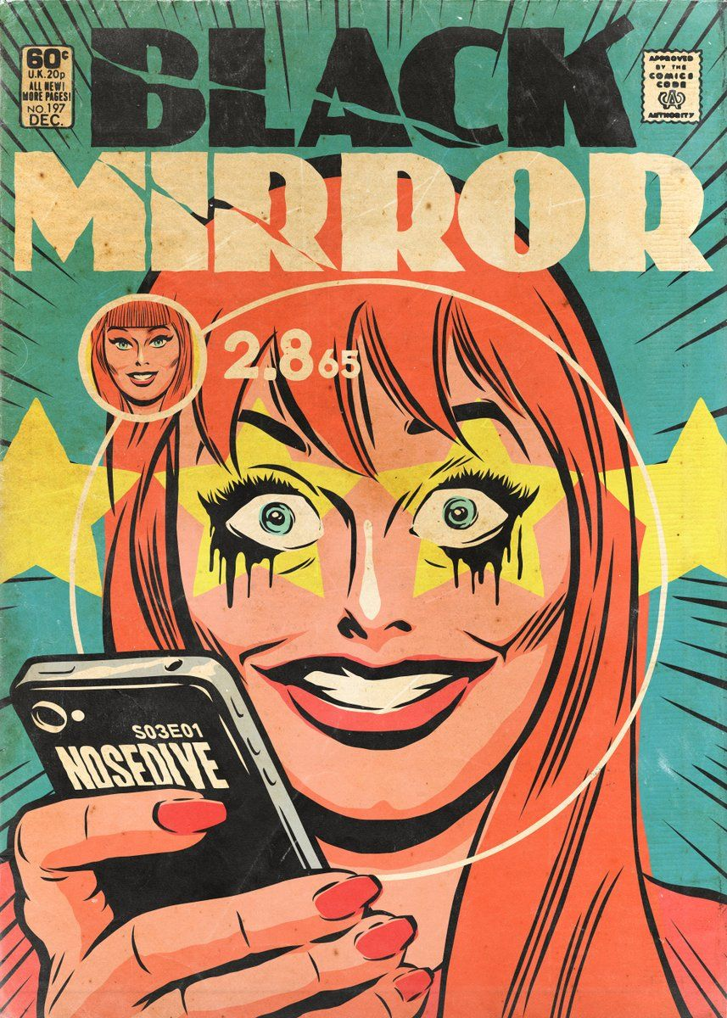
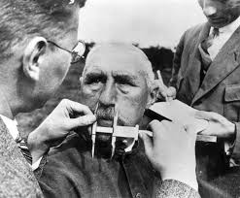
Social Gazes in the Age of Reason
Gendered Gazes of the Supernatural
Biopolitics and Medicalized Gazes into the Subconscious
Cityscapes, Dystopic Labyrinths, and the Mobile Gaze of the Flaneur
Under Totalitarian Regimes: Surveilled by Others and the Self
Reviewing Paradigms Today and Looking Ahead

Slide 11
Assessments, Opportunities, and Policies
Categories | Notes
Online Assignments and Preparation : 20% | Due by 12 PM on T or TH (write if late), please write your thoughts in the forum (doesn’t need to be more than a few sentences)
Active Participation: 15% | (Further discussion later today)
2 Shorter Essays: 30% (15% each) | 3-4 pages, second draft optional to improve grade
Reflection Activity from Field Trip: 5% | (See next slide)
Creative Project and Write-Up: 10% | Due last days of classes
Final Essay: 20% | 5-7 pages, due by the end of exam period in Moodle
*Extra Credit Forum and Opportunities*
No more than 2 absences per term, alternate arrangements made if needed.

Slide 12
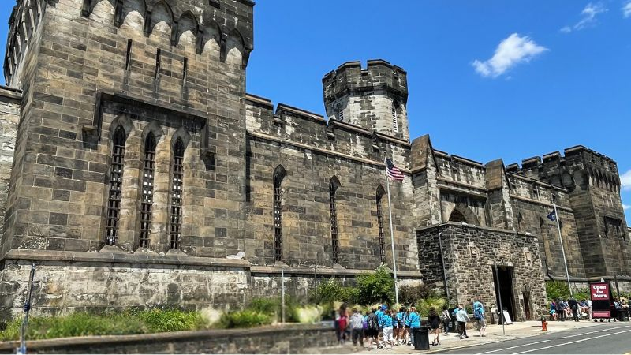
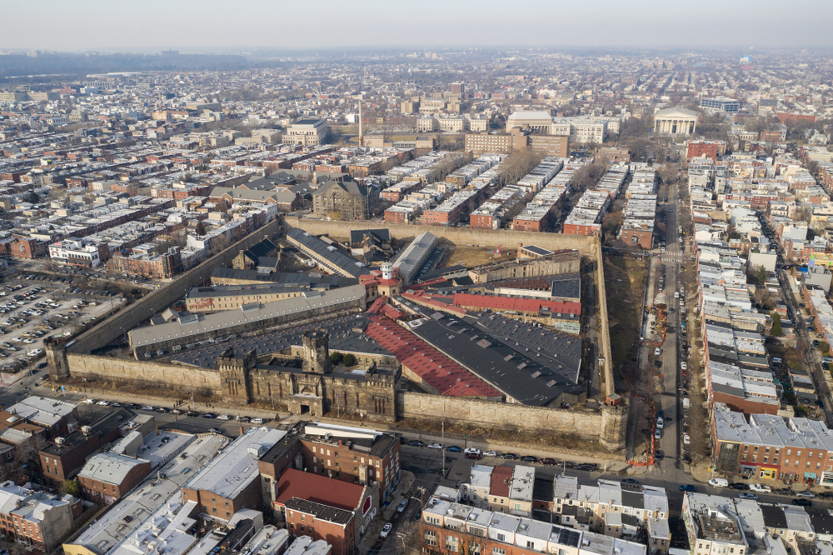
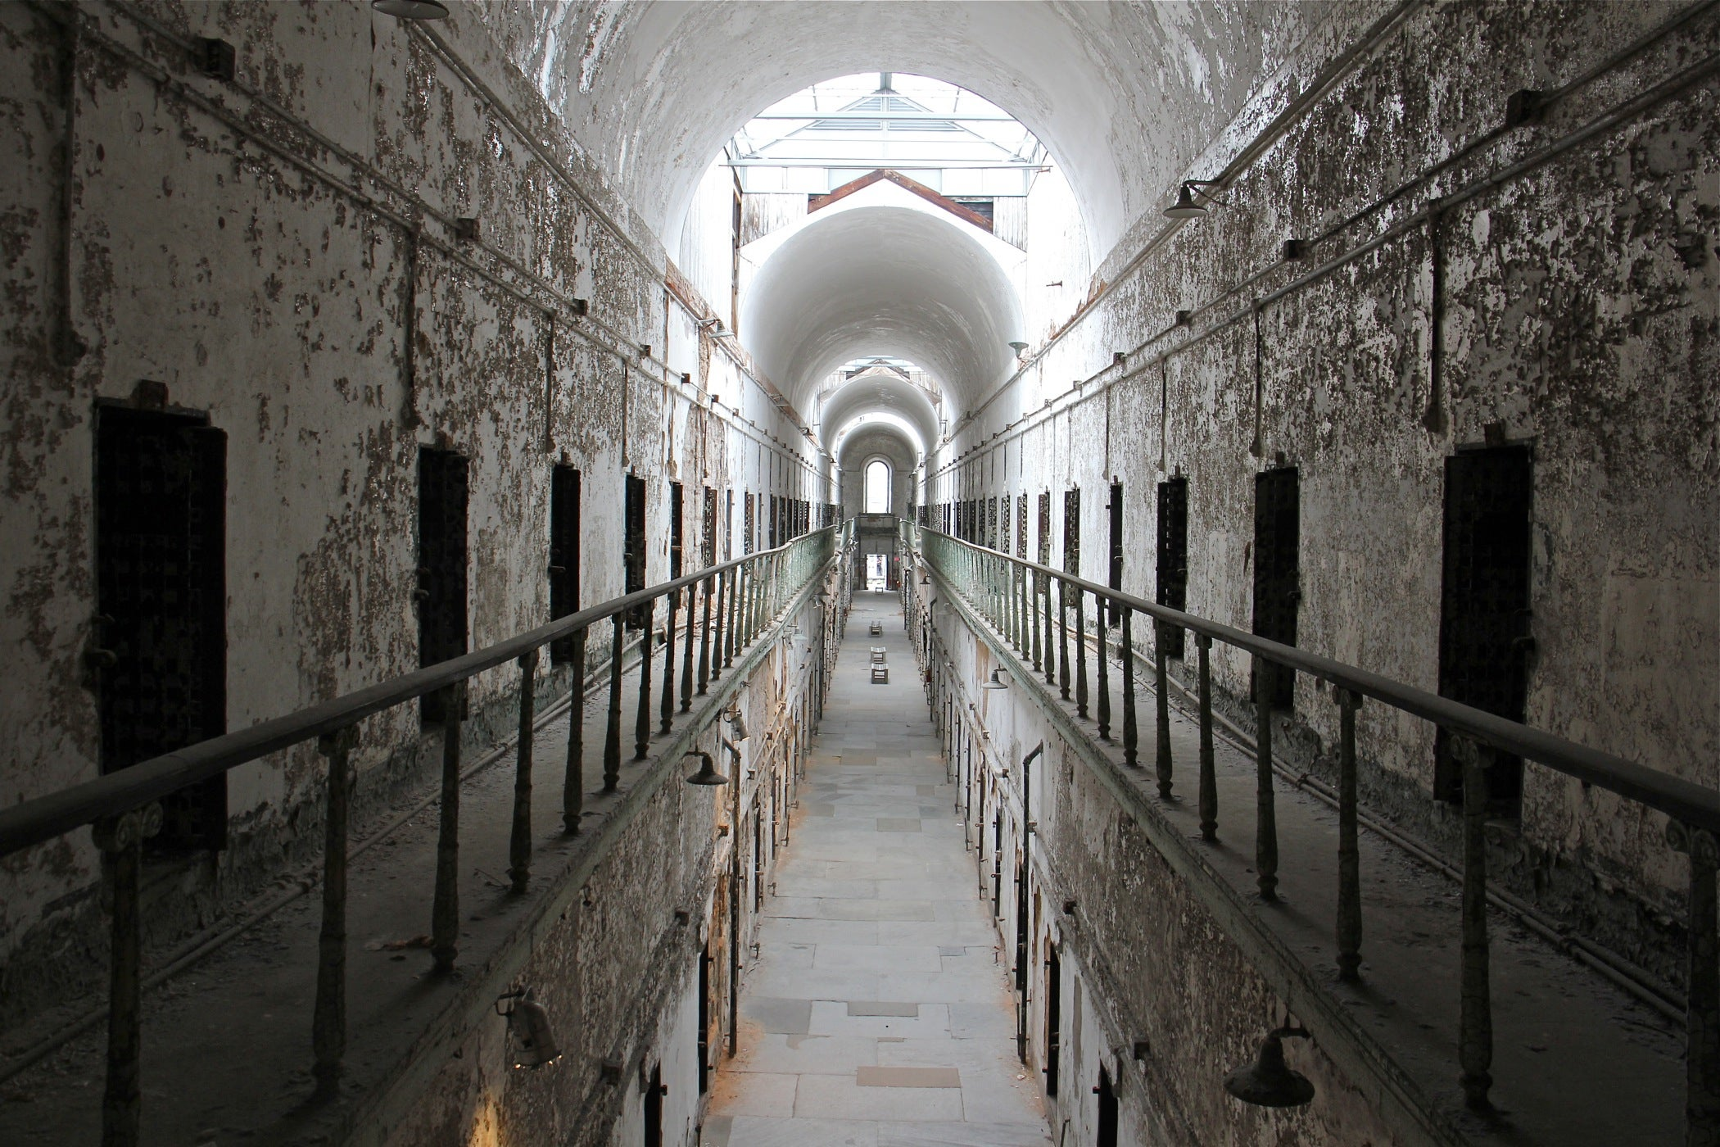
Philadelphia Engagement Grant:
Eastern State Penitentiary
Field trip time and date to be determined no later than next week
Saturday afternoon in October or November (Can’t make it? See me for an alternate assignment)
Appetizers at a restaurant

Slide 13
German Credit Seekers
Extra discussion section in German with level-appropriate tasks, grammar and vocabulary review
  Little preparatory work (occasionally a Moodle Post, small creative activity)
Gain exposure to language and build strategies for working with authentic and historic materials
Modified course assignments
  One of two short essays completed in German
  Additional 1-2 page reflection assignment due every other week
Dates and Time TBD (fill out survey by next Tuesday)

Slide 14
Name and Pronouns
Year
Major/Minor
Why interested in taking this course/what brings you here today?

Slide 15

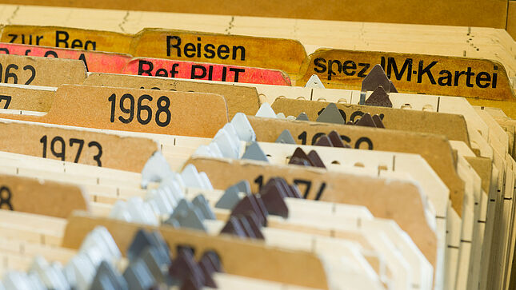
Small Group Discussions (c. 5 minutes)
-How is your semester going so far/which classes are you taking?
-Which of these images interests you and why?

Slide 16
Co-Creating Our Learning Community and Discussion Guidelines
What does active participation look like? | How do we show respect for our peers? | What can we hope to gain from our time in class together?
Does it look the same for everyone? What are some things we can do or agree on to promote active participation? | What could be some guidelines for discussion that support how we show respect for our peers? | What would you like to leave each class session with?

Slide 17
Surveillance: “Focused, systematic routine attention to persona details for the purposes of influence, management, protection or direction” (Lyon)
Sousveillance: the watching from below: bottom up, recording or attention from civilians or those not in power (Lyon)
What fictional works (of any medium or genre) are you familiar with that thematize or feature surveillance or sousveillance as a main part of the story (or where there are interventions or variations to those practices)? How is the act of watching depicted or embedded in the work?

