Slide 1
3. September
-Organizational (guidelines/aspirations)/Collection of Course Surveys
-Works of surveillance literature? Film?
-History of surveillance?
-Modern v Postmodern Surveillance
-Modern Surveillance: Social observation in the Enlightenment
HW for 8. Sept:
Lavater (pages TBD! Processing PDF)

Slide 2
Small Group Brainstorming
Surveillance: “Focused, systematic routine attention to persona details for the purposes of influence, management, protection or direction” (Lyon)
What fictional works (of any medium or genre) are you familiar with that thematize or feature surveillance as a main part of the story (or where there are interventions or variations to those practices)?
How is the act of watching depicted or embedded in the work?
From which perspectives were those works told? From the watcher or the watched?
What themes or topics are linked to surveillant practices?

Slide 3

“Across domains, from state security agencies to social media sites, surveillance regulates boundaries and relations. It reinforces separation and different treatment along lines of class, race, gender, sexuality, age, and so on. Regardless of context, surveillance is never a neutral process. There are always value judgements and power imbalances, and they usually reproduce social inequities” (xx).

Slide 4
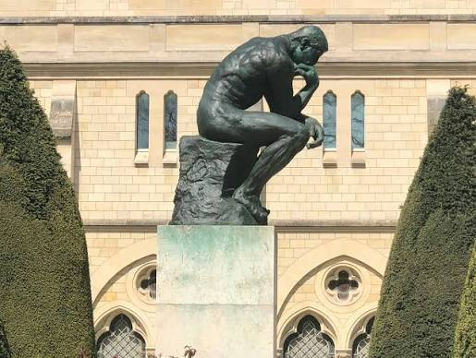
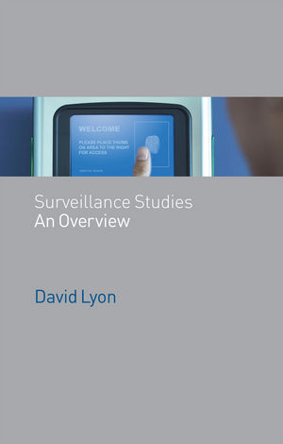
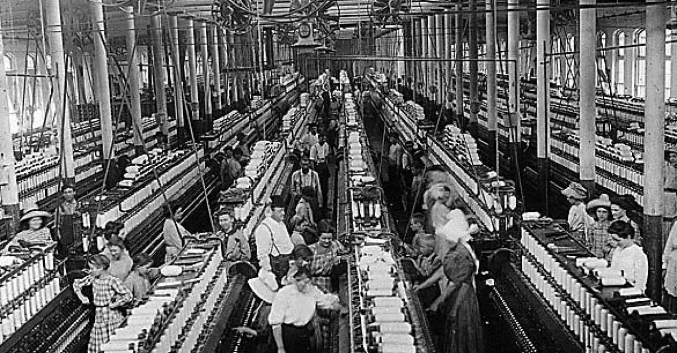
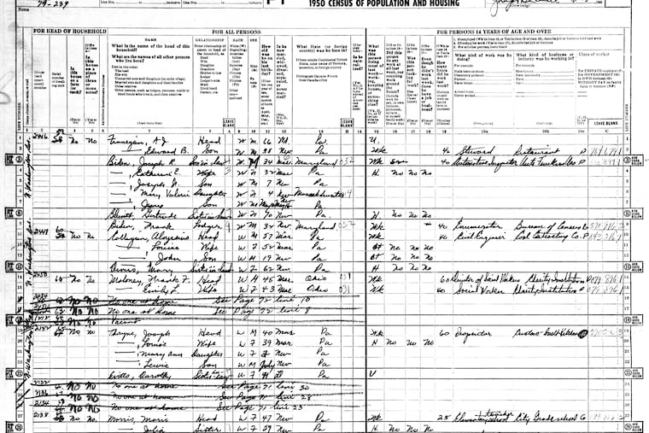
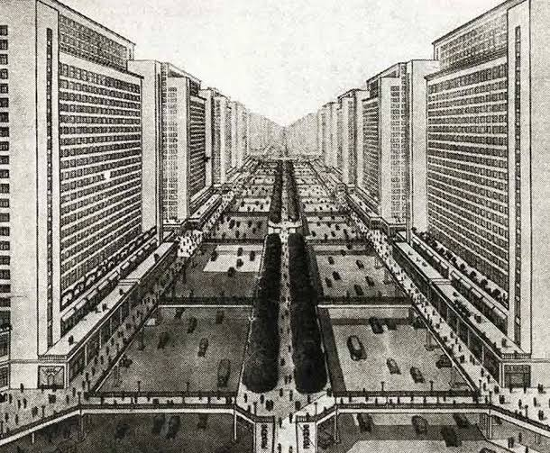
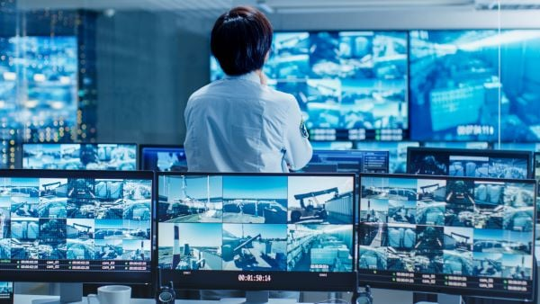
“It is one of those major social processes that actually constitute modernity as we know it” (Lyon, 14).
Individuals? Social relations? Aesthetics? Politics/political structures? Economics?
What is “modernity”? What is the “modern”?

Slide 5
Modern / “Traditional” Surveillance (up to mid- 20th century)
Nation, State, Capital
Timeline | The watcher/the watched; the surveillant/the subject | Techniques, technologies, and practices
Lyon introduces Based on the timeline offered Monahan and Wood on pages xxii and xxiii, which historical events or epochs have the largest impact on or resonate with your understanding of the term and practice “surveillance”? | What is the dynamic between the watcher and watched like? What behaviors or dynamics exist between the watcher and the watched? Is this dynamic put towards a specific end? | What practices, technologies, or techniques are implemented to uphold a watcher/watched dynamic? What are common sites of surveillance?

Slide 6
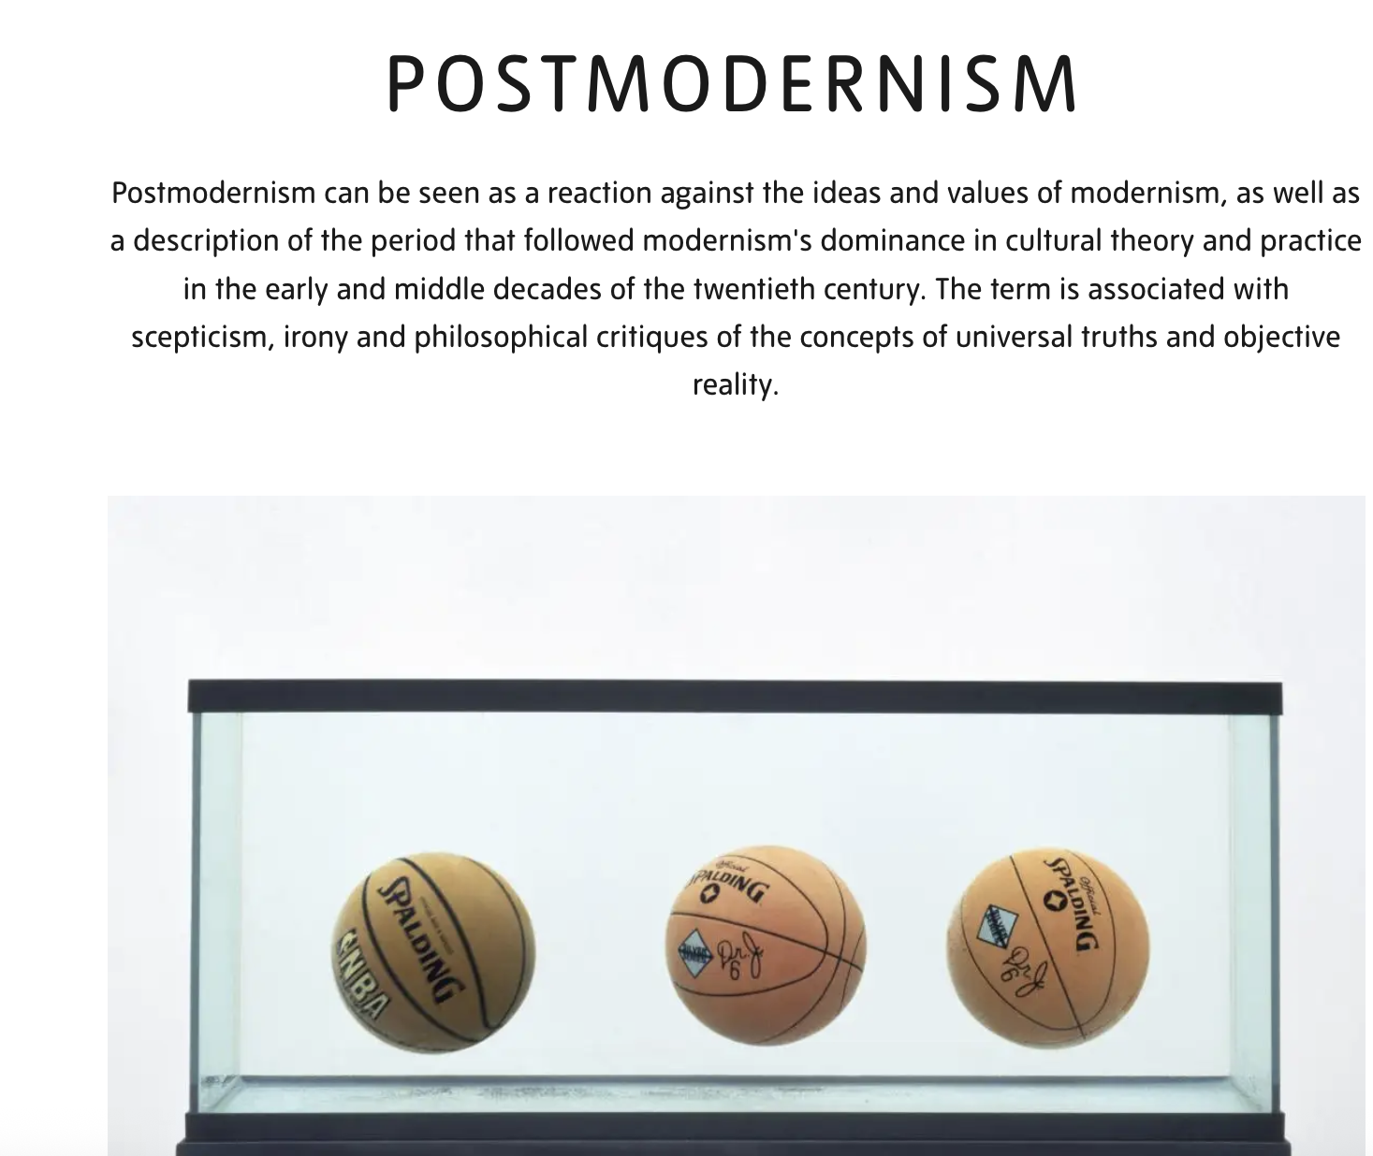
Sourced from: The Tate

Slide 7
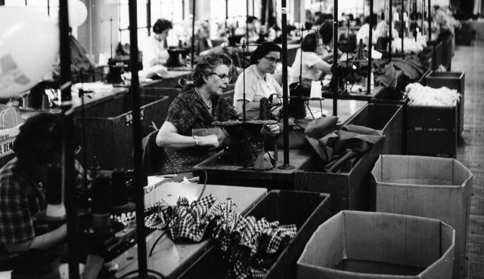
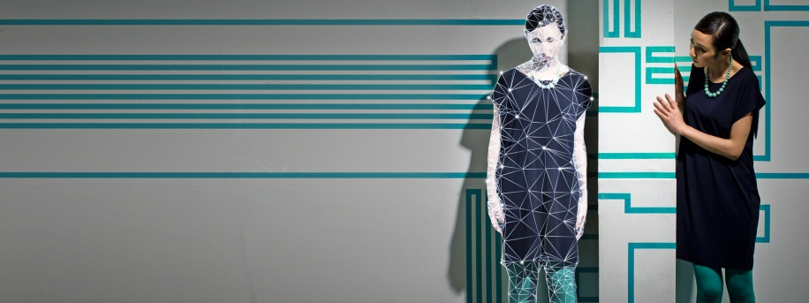
MODERNITY: centralization, consolidation of absolute truths, rationalization, efficiency, organization, hierarchy CAPITALISM: extractive practices, driven by efficiency, competition and profit (need systems to support this!), fragmentation of tasks, subordinate labor to capital
POSTMODERNITY: dispersed control mechanisms, human-machine interfaces, DE territorialized subjectivity, data doubles, decentralization of power, automated, LATE CAPITALISM: maximally extractive, extreme commodification of all aspects of everyday life, extreme globalization

Slide 8
Adapted from Gary T. Marx
1. Unaided senses/extended senses
2. Visible/less visible or invisible
3.higher proportion involuntary/lower proportion involuntary
4. less coercive/more coercive (think in terms of confrontation
5. individual/ individual or categories of interest
6. past, present, future / present
7. acontextual/contextual
8. Direct and simulation/ direct representation
9. Single point or intermittent/continuous or omnipresent
Dimensions | modern/ traditional surveillance | postmodern/ new surveillance
1. senses
2. visibility
3. consent | lower proportion involuntary | higher proportion involuntary
4. ethos
5. object of collection
6. time period (for observation)
7. context | contextual | acontextual
8. realism
9. timing

Slide 9
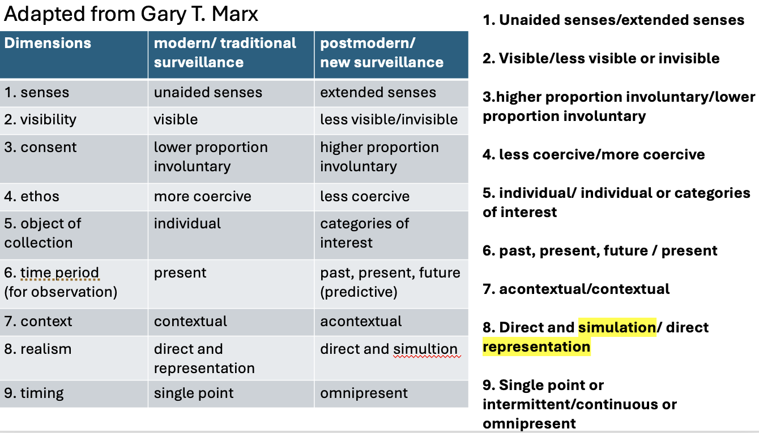
direct and simulation

Slide 10
How would you characterize the relationship between the traditional surveillance and new surveillance?
Do these practices co-exist?
Describe something in your everyday life through these terms (Fitness trackers, Your recommendations in Amazon,

Slide 11
Modern/Traditional Surveillance…?

Slide 12
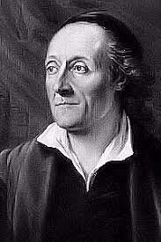
1741-1801
Swiss theologian
Notes:
accused of superstition and hypocrisy by Johann Wolfgang von Goethe. He’s an interesting man – very educated, learns under two famous philsosophers Bodmer and Breitinger. Traffics in a lot of the intellectual circles of the Enlightenment. But – his zealotry kind of gets him at one point. The 1770s and 1780s were a time of robust intellectual exchange through letters, and brief and biding tolerance for the Jewish intellectuals in the city of Berlin. One in particular Moses Mendelsohn is known as the Socrates of Berlin, gains international repute for his philosophical writings. Intellectualizes religion, and praises Christian ethics without subscribing to them. Well Lavater makes him a demand to convert.
Several chapters dilate on important and anguished episodes, starting with the two-year long Lavater affair that began with incendiary remarks Lavater published in his preface to the translation of Charles Bonnet’s La Palingénésie philosophique (1769; in the 1787 English title, Philosophical and Critical Inquiries Concerning Christianity.) Attracted by Mendelssohn’s positive view of the ethical teachings of Jesus, Lavater turned the tables by arguing that until the conversion of the Jews there could be no expectation of the advent of a messiah. This was a not so private hope that Mendelssohn would set an example by converting. The provocation attracted articles, pamphlets, and letters by the preeminent intellectuals of the day including Lessing, Nicolai, Herder, Hamann and others, and while there was little consensus Bonnet wrote to Mendelssohn apologetically about the unauthorised preface.
I digress. the important thing ist hat Lavater is actually a theologian. And as such is concerned with the system and practice of religion. interested in physiognomy

Slide 13
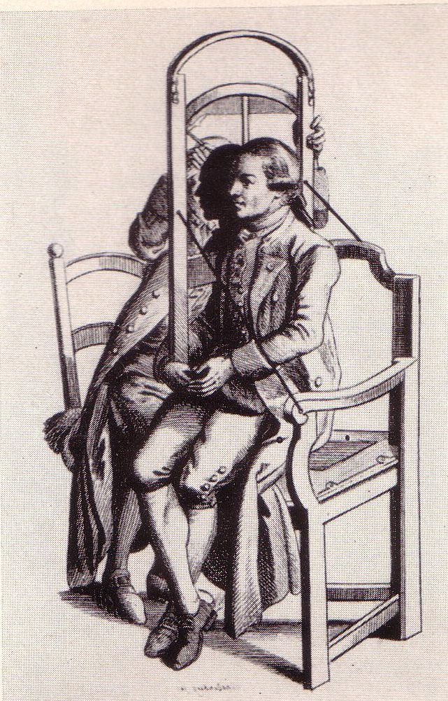
,,Lavater sieht hinter der Fassade, liest verborgenes in den Geschichtern, kämpft die Verstellungskunst einer höflichen Gesellschaft. Die Sprache, die Gesten, die Mimik - sie verhüllen den wahren Charakter.
…..
Die Deutung des Gesichts wird Mode… Jeder möchte sein Porträt als Schattenriss – möchte deuten und gedeutet werden. Das Gegenüber zu beurteilen wird notwendige Übungen in einer Gesellschaft zunehmender Mobilität.”
Lavater looks behind the façade, reads the hidden in faces, and fights the art of disguise of a polite society. The language, the gestures, the facial expressions—they
encompass the true character.
The interpretation of the face comes into fashion– each and every person wants his portrait as a silhouette—wants to interpret and be interpreted. To judge one’s counterpart becomes an indispensable activity in a society of increasing mobility.
,,Die Sprache des Gesichts”
**Semiotics!**
https://www.youtube.com/watch?v=ukL2DXxnRN4

Slide 14
“Taking it in its most extensive sense, I use the word physiognomy to signify the exterior, or superficies of man, in motion or at rest, whether viewed in the original or by portrait.
Physiognomy (Physiognomie), or as more shortly written Physiognomy (Physiognomik) is the knowledge of the correspondence between the external and internal man, the visible superficies and the invisible contents.”

Slide 15
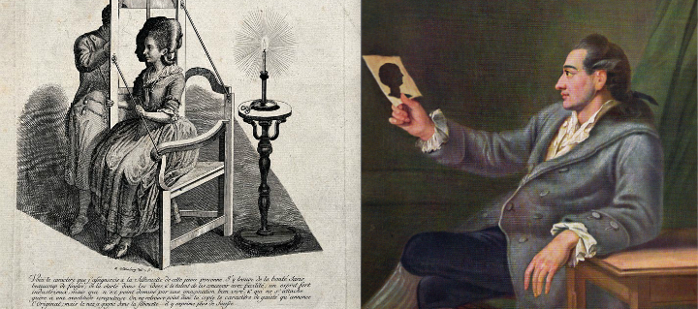
Notes:
What kind of a technique of reproduction is this?

Slide 16
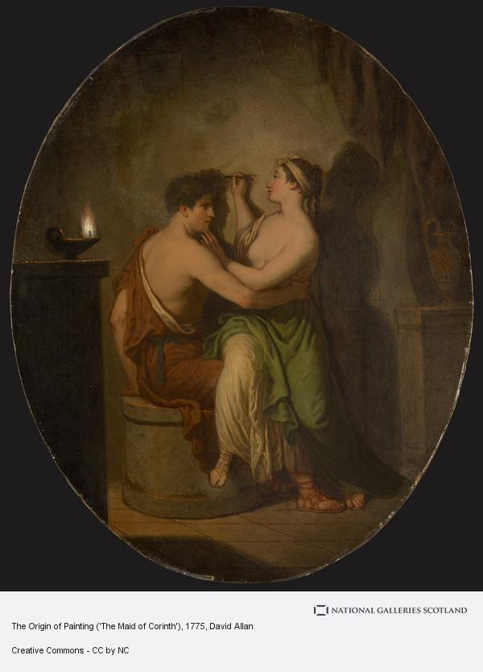
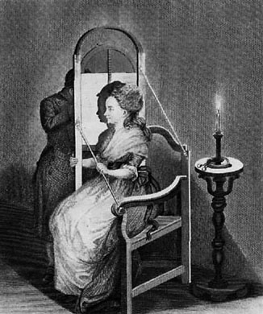
Notes:
Notice anything different- the origin of paiting
versus this image of the silhouette being done?
something more egalitarian done

Slide 17
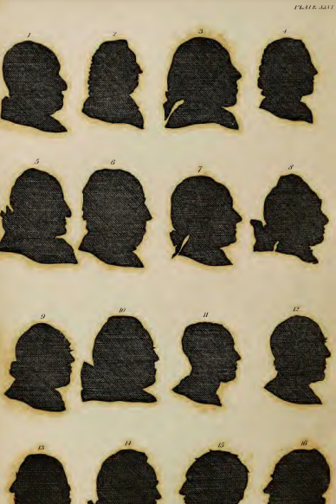
“On Shades”
Shades are the weakest, most vapid, but, at the same time,
when the light is at a proper distance, and falls properly on
the countenance to take the profile accurately, the truest re- presentation that can be given of man.—The weakest, for it is not positive, it is only something negative, only the boundary line of half the countenance. The truest, because it is the immediate expression of nature, such as not the ablest painter is capable of drawing, by hand, after nature. What can be less the image of a living man than a shade ? Yet how full of speech ! Little gold, but the purest.
I have collected more physiognomonical knowledge from
shades alone than from every other kind of portrait ; have improved physiognomonical sensation more by the sight of them, than by the contemplation of ever mutable nature
Shades collect the distracted attention, confine it to an outline, and thus render the observation more simple, easy, and
precise.—The observation, consequently the comparison.
Physiognomy has no greater, more incontrovertible certainty of the truth of its object than that imparted by shade.
If the shade, according to the general sense and decision of
all men, can decide so much concerning character, how much
more must the living body, the whole appearance, and action
of the man ! If the shade be oracular, the voice of truth, the word of God, what must the living original be, illuminated by
the spirit of God !
Notes:
How would you characterize Lavater’s form of observation?

