Slide 1
8. September
-Organizational (reading check-in, office hours, google doc or Moodle messages? )
-Review of Key Points: Fictions of Observation → Entry points into literary and theoretical works
-Lavater and the Enlightenment
-Lavater’s Physiognomy
-Lavater/Physiognomy as Modern/Traditional or Postmodern/New Model?
-Intro to Hoffmann → finding entry points into the texts?
HW:
ETA Hoffmann, “My Cousin’s Corner Window” (1822) (c. 28 pages)
Survey for Field Trip to Eastern State Penitentiary (due 10 Sept)
German Session Survey (due 10 Sept)

Slide 2
rationalism, efficiency and organization
capitalism
human reason
anthropromophized divinity (hierarchy maintained)
centralization of universal laws
individuals within an organized society (collective), individual variations accounted for, systematized
transparency of all seen things → occularcentrism, we see all things

Slide 3
What is a good slogan?
Sapere Aude! (Dare to be wise!)
Deus ex machina (from God machine)
cogito, ergo sum (I think, therefore I am)
Nosce te ipsum (know thyself)
Et si male nunc, non olim sic erit (though things are bad now they will not always be)

Slide 4
Physiognomische Fragmente,
zur Beförderung
der Menschenkenntnisse und Menschenliebe.
von
Johann Caspar Lavater.
Gott schuf den Menschen sich zum Bilde!
Physiognomic Fragments,
for the Advancement
of the Knowledge of Human Nature
and Love of Mankind
God created man in his own image!

Slide 6
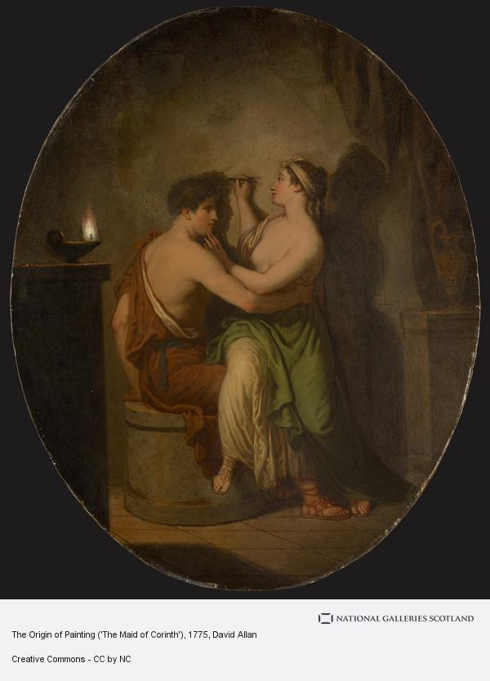
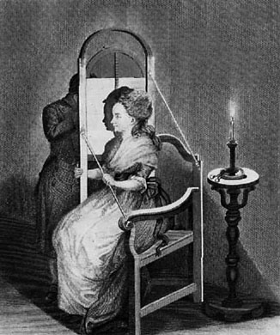
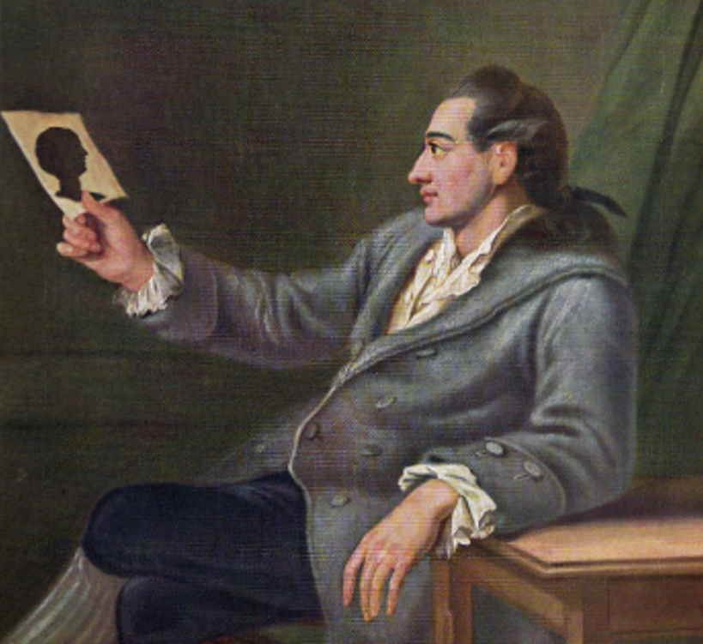
Notes:
Here you have the origins of painting
then an illustration of how the sihlouettes are done
and finally Goethe admiring the shihlouette of a girlfriend
-reproducible, disseminate,

Slide 7
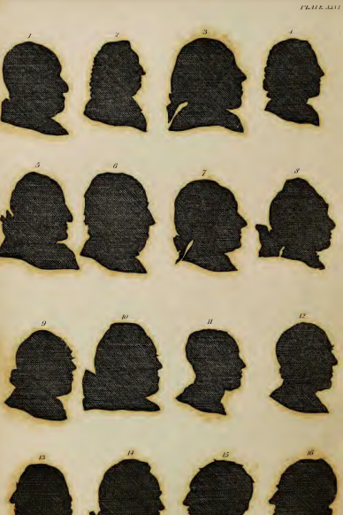
“On Shades”
Shades are the weakest, most vapid, but, at the same time,
when the light is at a proper distance, and falls properly on
the countenance to take the profile accurately, the truest re- presentation that can be given of man.—The weakest, for it is not positive, it is only something negative, only the boundary line of half the countenance. The truest, because it is the immediate expression of nature, such as not the ablest painter is capable of drawing, by hand, after nature. What can be less the image of a living man than a shade ? Yet how full of speech ! Little gold, but the purest.
I have collected more physiognomonical knowledge from
shades alone than from every other kind of portrait ; have improved physiognomonical sensation more by the sight of them, than by the contemplation of ever mutable nature.
Shades collect the distracted attention, confine it to an outline, and thus render the observation more simple, easy, and
precise.—The observation, consequently the comparison.
Physiognomy has no greater, more incontrovertible certainty of the truth of its object than that imparted by shade.
If the shade, according to the general sense and decision of
all men, can decide so much concerning character, how much
more must the living body, the whole appearance, and action
of the man ! If the shade be oracular, the voice of truth, the word of God, what must the living original be, illuminated by
the spirit of God !
Notes:
What do shades do? How effective are they as representations?
What kind of a viewing experience do they elicit?

Slide 8
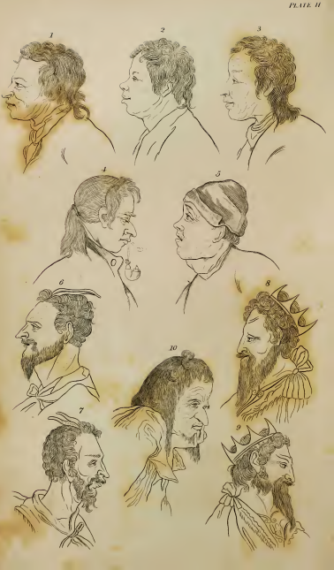
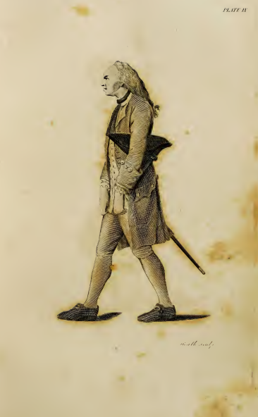
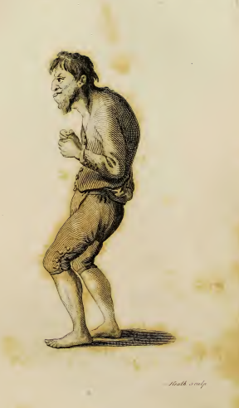
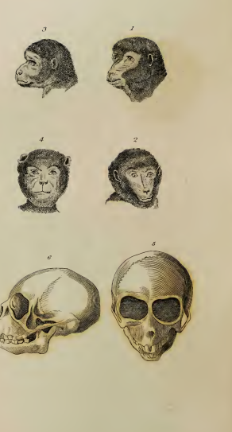
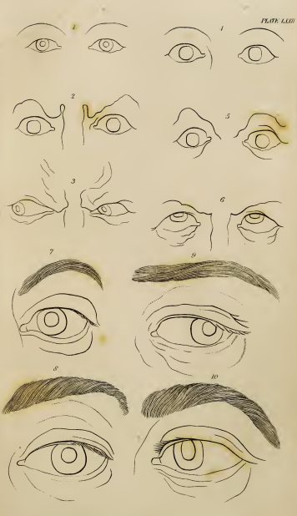
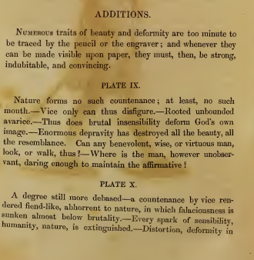
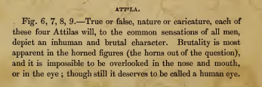
Notes:
What do you notice about the images?
Serialization
From lest to right small incrememnts

Slide 9
What is physiognomy?
“Taking it in its most extensive sense, I use the word physiognomy to signify the exterior, or superficies of man, in motion or at rest, whether viewed in the original or by portrait.
Physiognomy (Physiognomie), or as more shortly written Physiognomy (Physiognomik) is the knowledge of the correspondence between the external and internal man, the visible superficies and the invisible contents” (11)
“Physiognomy is a source of the purest, most exalted sensations: an additional eye, wherewith to view the manifold proofs of divine wisdom and goodness in the creation, and while thus viewing unspeakable harmony and truth, to excite ecstatic love for their adorable Author” (43)
“Physiognomy is the terror of vice” (44)
“Physiognomy is the is the very soul of wisdom…” (44)

Slide 10
Introduction (pp. 1-3)
A Word Concerning the Author (pp. 4-6)
On the Nature of Man, Which is the Foundation of the Science of Physiognomy (pp. 6-11)
Physiognomy, Pathognomy (pp. 11-12)
Of the Truth of Physiogonomy (pp. 13-18)
On the Universality of Physiognomic Sensation (pp, 31-37)
Physiognomy as a Science (pp.37-41)
The Advantages of Physiognomy (pp. 41-45)
The Disadvantages of Physiognomy (pp.45-50)

Slide 11
Lavater’s World and Physiognomy
The Human philosophy/epistemology – how we know things) | Illustration and Interpretation (aesthetics, representation, realism) | Daily life (Economic, Political) | Lavater’s Project (as a narrator, as theologian)
What is the relationship between individuals and large groups in viewing the world physiognomically? What assumptions are made about the relationship between mind and body? | Lavater makes references to artists such as Holbein and Raphael among others in explaining physiogonomy. How can physiognomy be understood in terms of art and beauty? What can images do that words don’t? | What kind of world/what kind of a society is most useful for physiognomic practices? Who can use physiognomy? What economic system? Social classes? How to people react to physiognomy? | What kind of an audience is Lavater addressing? What are the stakes of raising moral and theological issues in presenting this practice? Comment also on his writing style!
Takeaway points/key ideas in answers to questions, a quote, and which sections of text were most helpful for exploring your question.

Slide 12
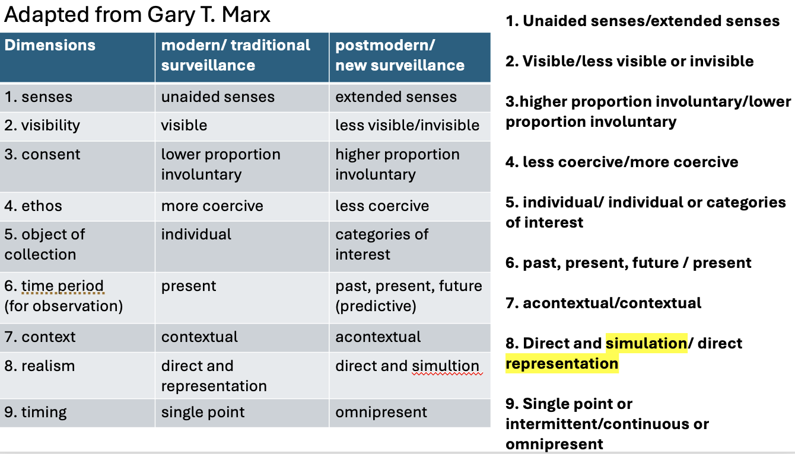

Slide 13
Der Talisman,
oder:
Trau, Schau, Wem?
-----------
Neuestes, scherzhaftes
Nimm mich mit!
um männliche und weibliche Charaktere aus den Gesichtszügen
leicht und treffend zu erkennen.
Nach Grundsätzen
des
J. C. Lavater.
Mit 80 Brustbildern aus dem Leben, und 78 physiognomischen Positionen.
Notes:
a reading public as product of the enlightenment
a reading public that gazes into faces just as they do books

Slide 14
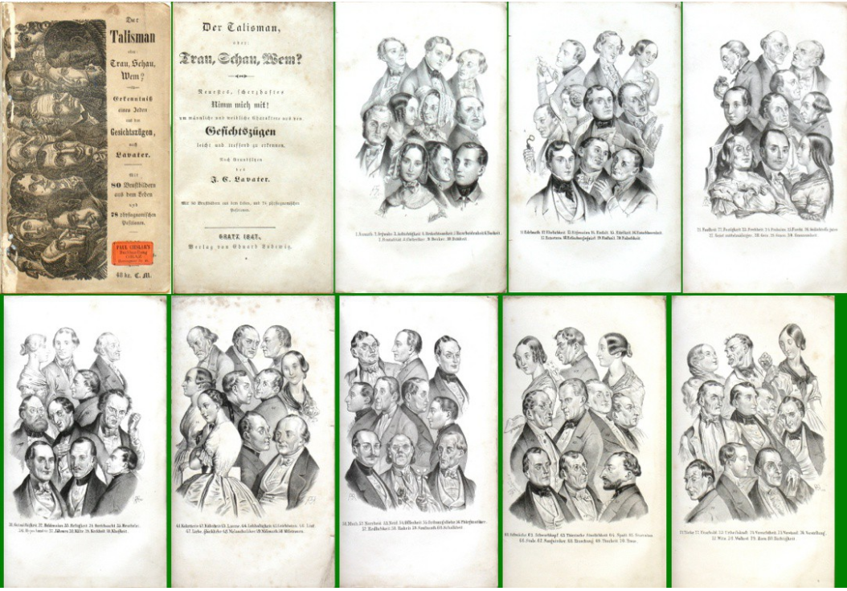
https://www.antikvariatkrenek.com/cs/knihy/6903-der-talisman-oder-trau-schau-wem-14823-1847.html

Slide 15
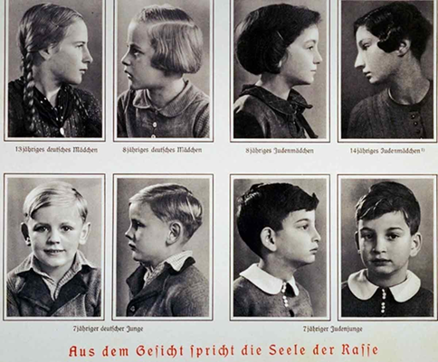
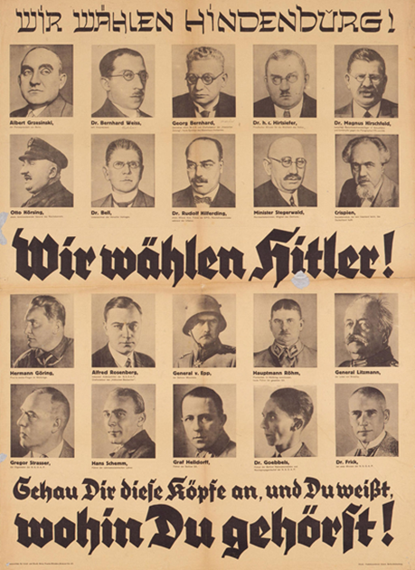

Slide 16
To what extent is Lavater successful in positioning physiognomy as a practice to promote knowledge of human nature and demonstrate a love of mankind?
What kinds of “physiognomic” practices exist today? In what medium are they used?

Slide 17
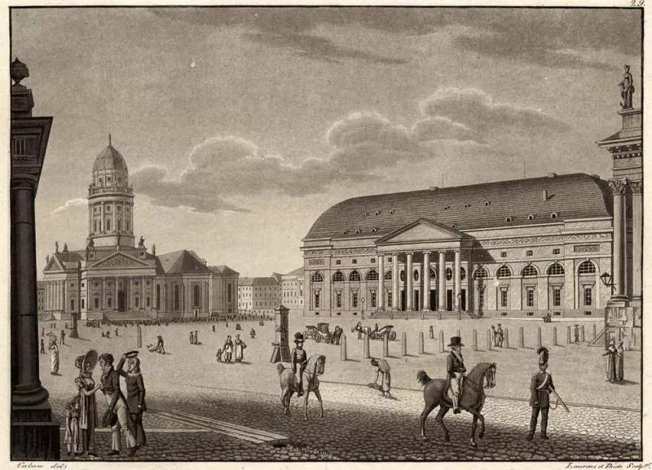
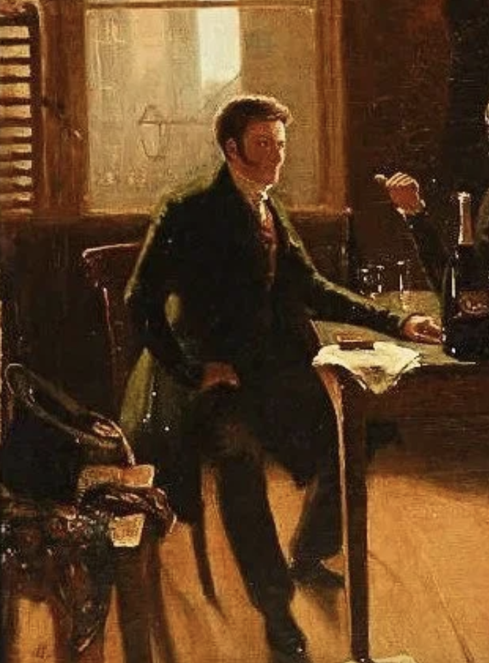
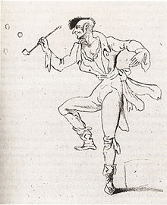
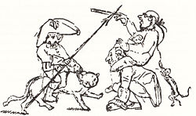
ETA Hoffmann, “My Cousin’s Corner Window/Des Vetters Eckfenster” (1822)
ETA Hoffmann (1776 -1822) Jurist by week, poet and composer on the weekend reality and a fantasy world existing side-by-side with one another | My Cousin’s Corner Window A man visits his cousin who is confined to his bedroom (paralyzed war veteran, also author) overlooking Berlin’s Gendarmenmarkt dialog between the man (narrator) and his cousin about learning to see commentary on people in the market (gender, class) key episodes: cousin describing encounter with a girl who read his books, beggar, woman with flowers key considerations: how to points of observation shift? Focus on narration, sequencing of events, role of description (spatial) v. narration (temporal) imagination (extrapolation from reality, removal from reality) versus observations with high degree of realism position of narrator, type of narrative, perspective

Slide 18
Differentials of knowledge between the watcher and watched
Paranoia – something you can’t see pursuing you
  hierarchy (hierarchies with shifting locations of power – the divine, the sovereign, the people)
  observer (invisible, omniscient/omnipresent) in pursuit of observed (limited knowledge of observer, but hypervisible to observer)
spectacle → punishment → individual as stand-in for the collective
observing as mode of discerning/separating out individuals by gender, race, class, ethnicity etc.
Narcissistic desire/projection onto subject
--------------------------------------------------------------------------------------------------
Narrative style (dialog? Direct discourse? In direct discourse)
Description v narration

