Slide 1
10. September
-Organizational (Collection of Surveys, Discussion Questions, Readings)
-Warm Up: Lavater’s observations
-Coordinates of Surveillance and Physiognomy
-ETA Hoffmann and Seeing (Romantic Imagination v. Grotesques)
-My Cousin’s Corner Window
-Narrative Theory and Focalization in Texts
HW:
Selections from Jeremy Bentham’s Panopticon and Foucault’s Discipline and Punish
Office Hours on Friday cancelled, TODAY at 5 PM

Slide 2
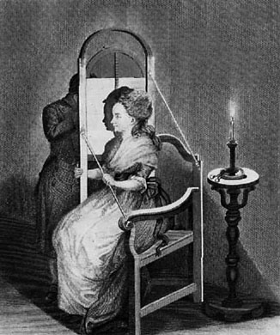
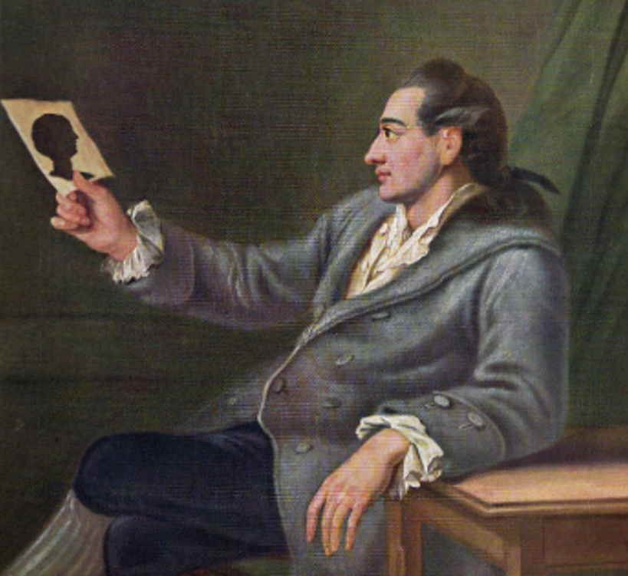
"When the science shall have the good fortune to become more general and shall have taught superior accuracy to the feelings of men" (Lavater, 48)
Use in everyday life – all walks of life
judgments of good, more versatile than art
human creation is an act of physiognomy (created in image of the divine)
internal and external correspond to one another
types, but also differences and gradations between individuals
culturally conditioned
Faces/facial features as markers of class, race, character
outline/silhouette as most essential nature

Slide 3
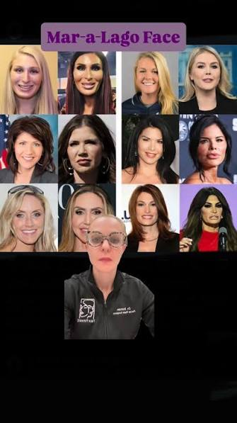
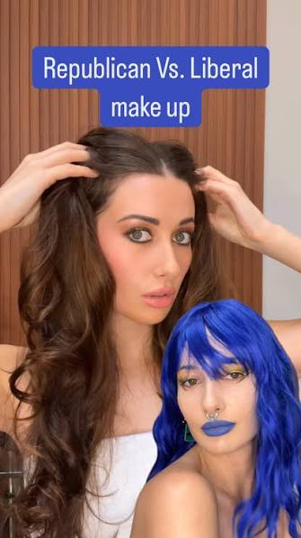

Slide 4
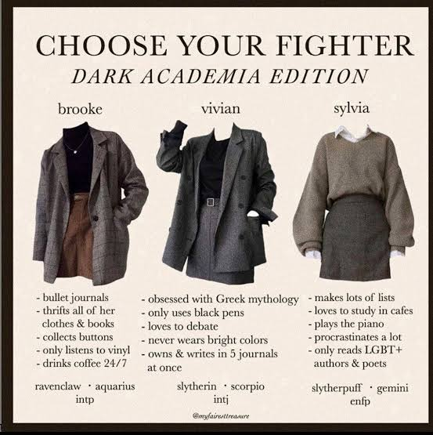
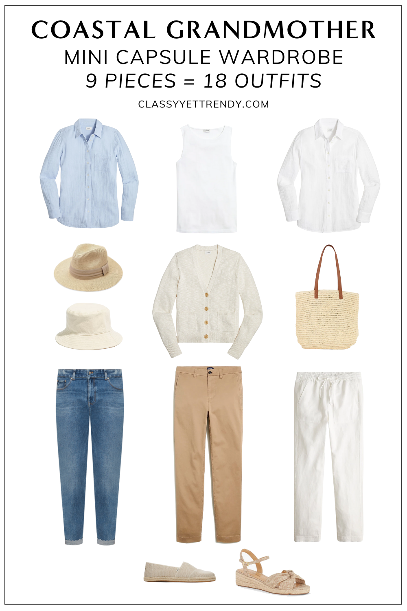

How does this compare to Lavater’s physiognomy? How do “starter packs,” “aesthetics/ -core” or other visual assemblages resemble or depart from physiognomy.

Slide 5
Dimensions | modern/ traditional surveillance | postmodern/ new surveillance
1. senses | Unaided senses | Extended senses
2. visibility | visible | Less visible
3. consent | Lower proportion involuntary | Higher proportion involuntary
4. ethos | More coercive | Less coercive
5. object of collection | individual | Individual/categories of interest
6. time period (for observation) | present | Past, present, future
7. context | contextual | Acontextual
8. realism | Direct representation | Direct and simulations
9. timing | Single pt or intermittent | Continuous

Slide 6
To what extent is Lavater successful in positioning physiognomy as a practice to promote knowledge of human nature and demonstrate a love of mankind?
  Does the philosophical construction and foundation of the text, his case for physiognomy, intended audience) help advance these goals?

Slide 7
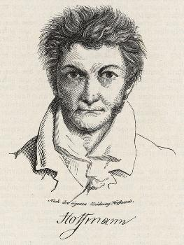
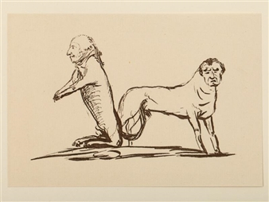
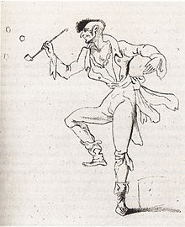
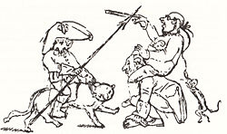
ETA Hoffmann (1776 – 1822)
“Hoffmann, with all his bizarre grotesques, still always keeps a firm grip on earthly reality” – Heinrich Heine
Notes:
A very differentmotivation – not for the love of mankind necessarily, but for the sake of developing some kind of artistic vision

Slide 8
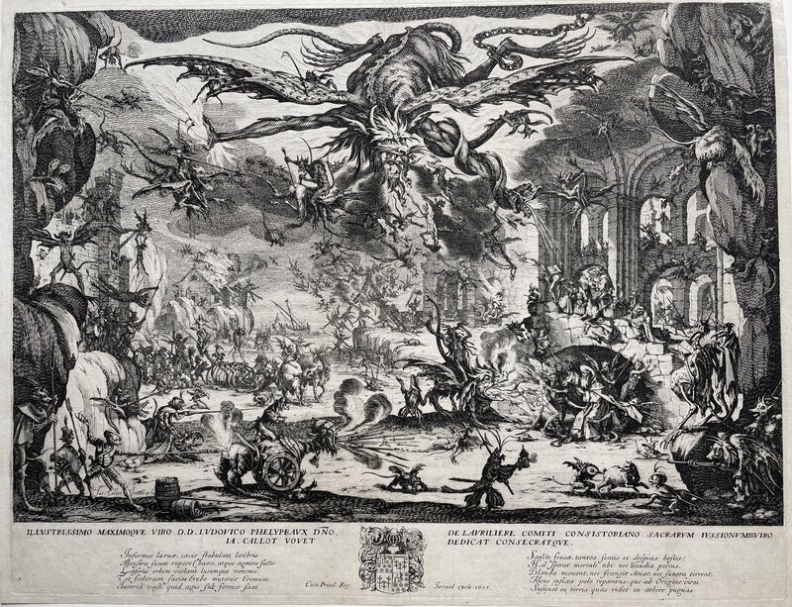

Slide 9
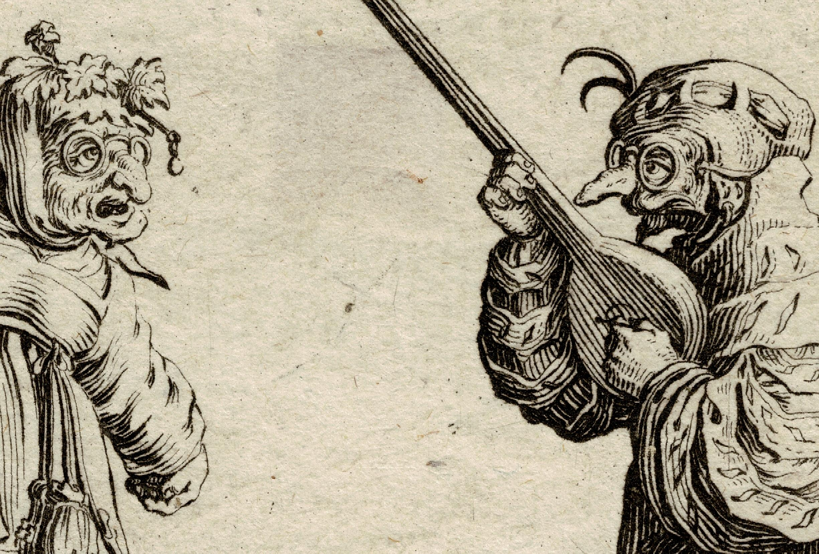
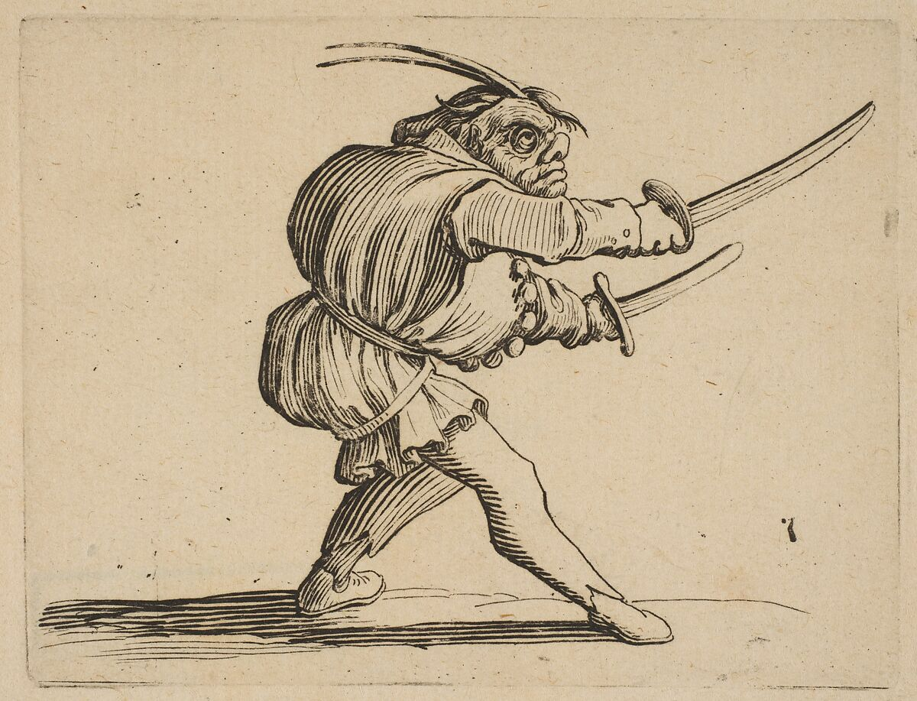
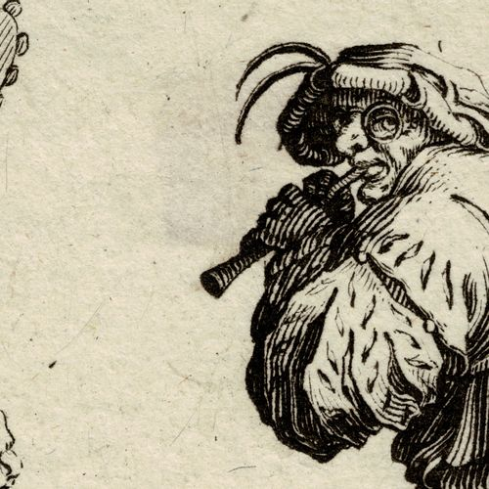
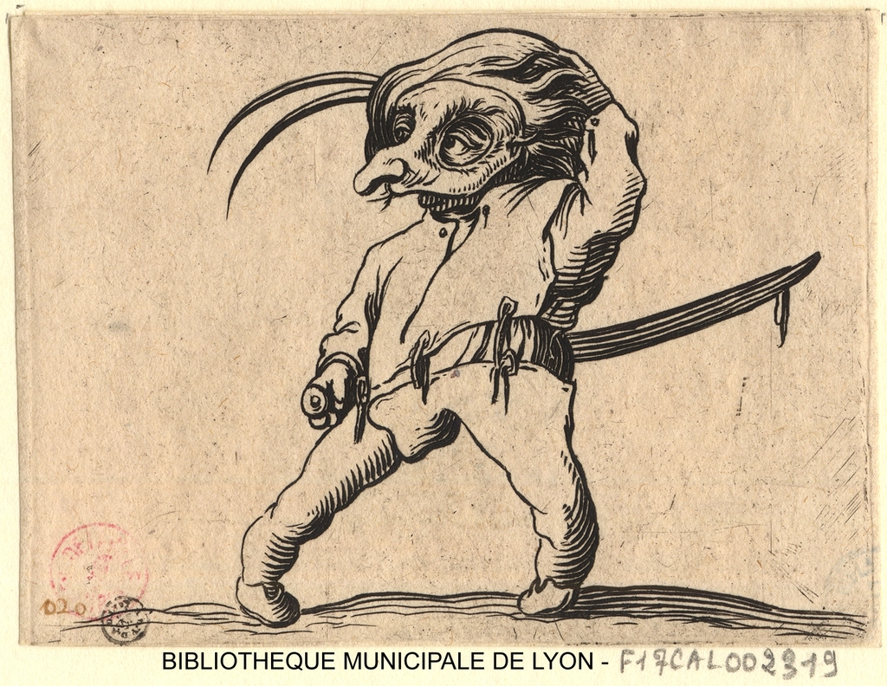
“Irony, in that it sets man and animal in conflict, derides man with his paltry works and endeavors; it resides only in a profound soul, and Callot’s grotesque forms, created out of animal and man, reveal to the serious deeper-seeing all the hidden meanings that lie beneath the cloak of absurdity”

Slide 10
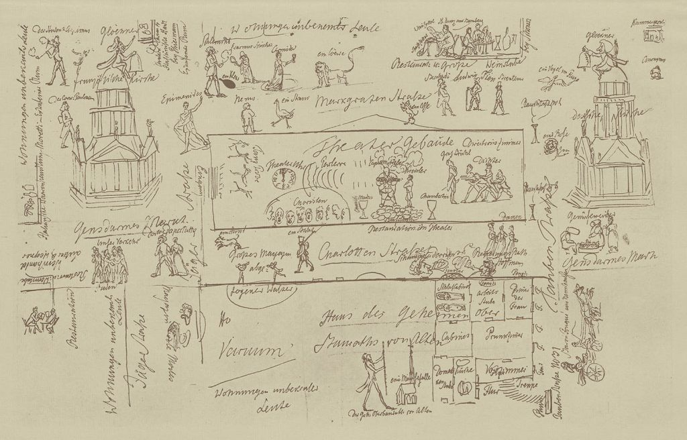
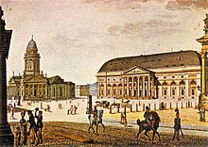
ETA Hoffmann, “My Cousin’s Corner Window/Des Vetters Eckfenster” (1822)
Literature as mixed/hybrid medium
Narrative prose/dialog
  Polyvocal
Mise-en-abyme
  Story within a story
Text and image
Description (space) and narration (time)
----------------------------------
Mixing of classes, shapes, colors and more

Slide 11
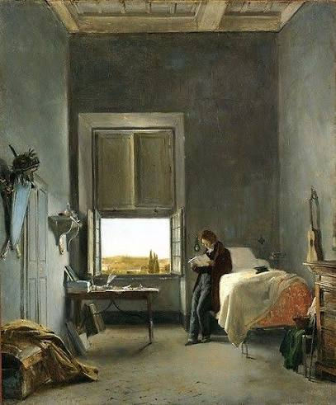
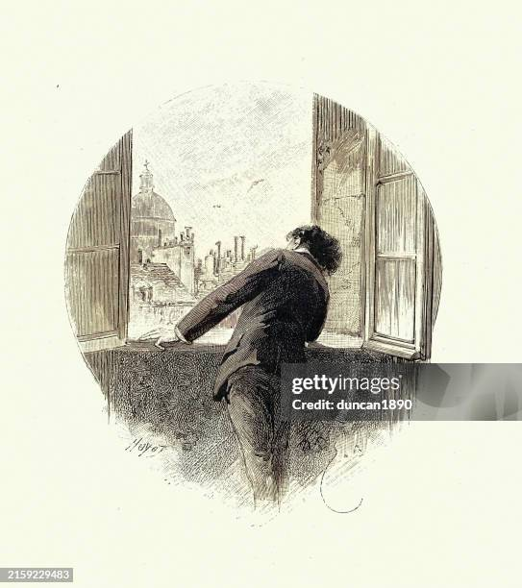
MY COUSIN. But this window is my comfort; it is here that life in all its colour has been revealed to me anew and I feel at home with its incessant activity. (p. 379)
MY COUSIN. Cousin, cousin! I now see clearly that you haven’t the tiniest spark of literary talent. You lack the first pre-requisite for treading in the footsteps of your worthy paralyzed cousin: an eye that can really see! … (p. 380)
MY COUSIN. Good, cousin; you have to focus your attention if you are to see distinctly. But instead of giving boring lessons in art which can hardly be learnt, let me draw your attention to all sorts of diverting things which are being revealed before our eyes” (p. 381)
The Cousin (My Cousin) and the Narrator (Me)
What kind of seeing is the cousin doing? What else is his seeing tied to? What kind of seeing is the narrator learning?
Notes:
Setting itself is significant – a place of economic encounter, urbanism, mixing of classes, it is also fairly internation. allusinos to French because of in the wake of Napoleonic wars

Slide 12
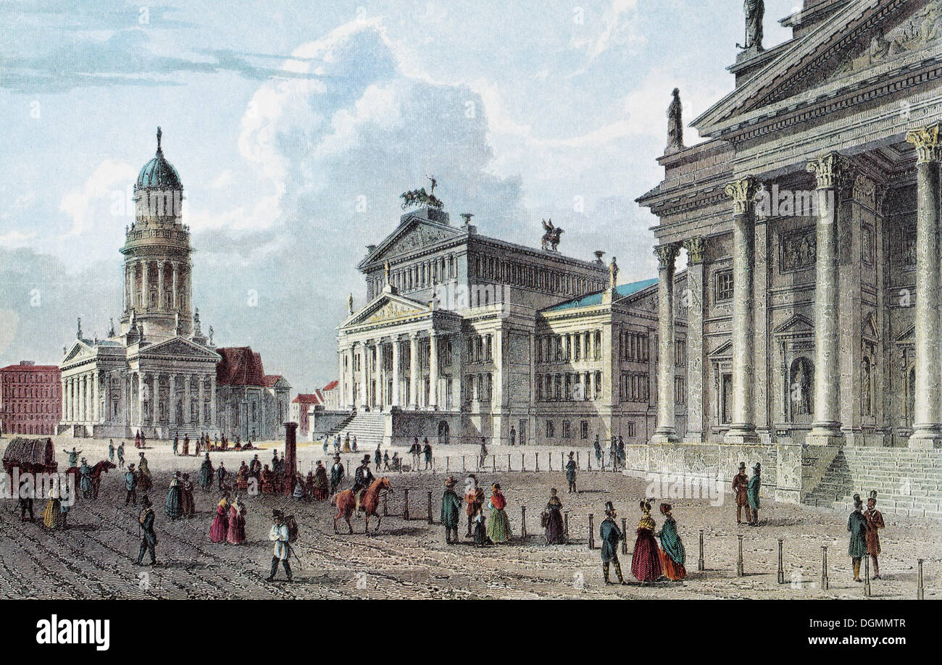

Slide 13
The Exotic man (390-392)
The Blind man (393)
The flower girl (387-389)
ME. It may be, dear Cousin, that not one word of all your conjectures is true, but as I look at the old women, your vivid description sounds so plausible that I am compelled to believe it, willy-nilly.
What role does pre-existing knowledge play in these observations?
How is gender and class considered in this observation? Or the market place? (Watch word choice!)
Senses invoked in description?
What assumptions or inferences are being made? Where are they from/what shapes them?
What temporalities are being utilized in the observation?
Purpose of observation?

Slide 14
Et si male nunc, non olim sic ecrit
My poor cousin!
P. 379 & P.401

Slide 15
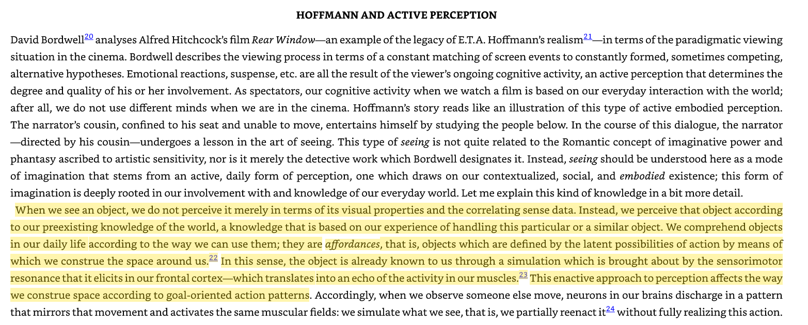

Slide 16
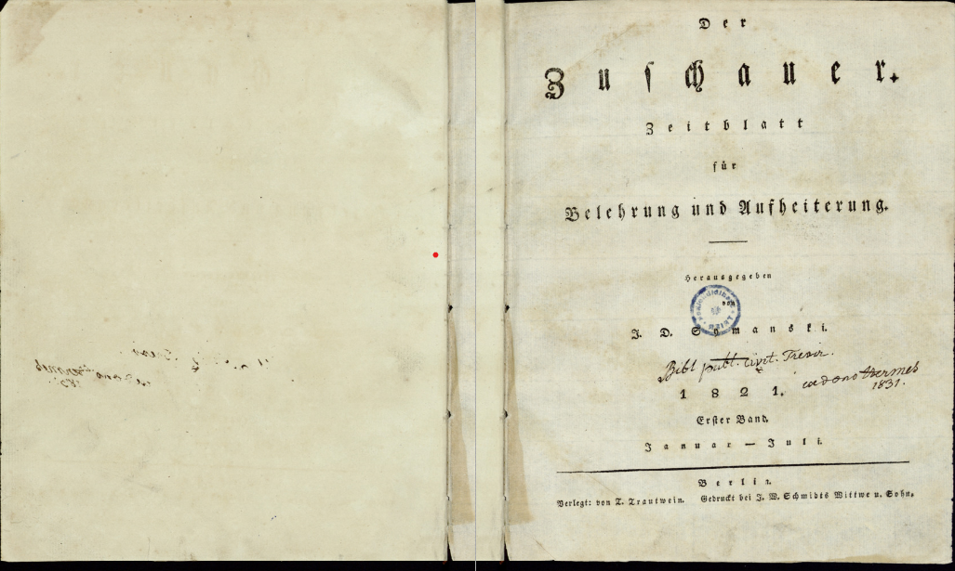
Der
Zuschauer
Zeitblatt
fuer
Belehrung und Aufheiterung
------------------------------
The Viewer
A Journal
for
Instruction and Brightening Up

