Slide 1
PAL Training:
Workday

Slide 2
What is Workday?
It's where we do payroll now!
Instead of submitting paper timesheets, you will submit your hours electronically via workday.
This is the link to Bryn Mawr's Workday page: https://wd12.myworkday.com/brynmawr/d/home.htmld
  Make sure you can log in and are set up with your BMC email and password.
  Take a moment now to log in and make sure you see the home screen

Slide 3
Student Hours
Undergrad Student Employees are allowed to work a MAXIMUM of 17.5 hours per week across all on-campus jobs.
If you have more than one job with OAS or more than one on-campus job, you should not be working more than that number of hours each week.
Remember, you are a student first.

Slide 4
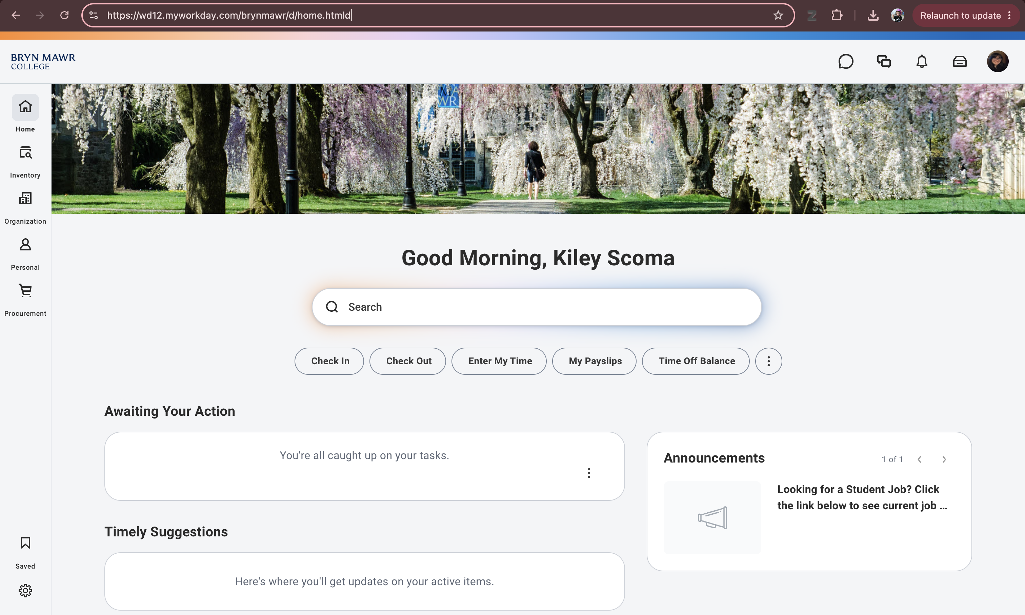

Slide 5
Logging Your Time
There's 3 basic steps to submitting your time:
  Log your hours
  Review and Fix
  Save!

Slide 6
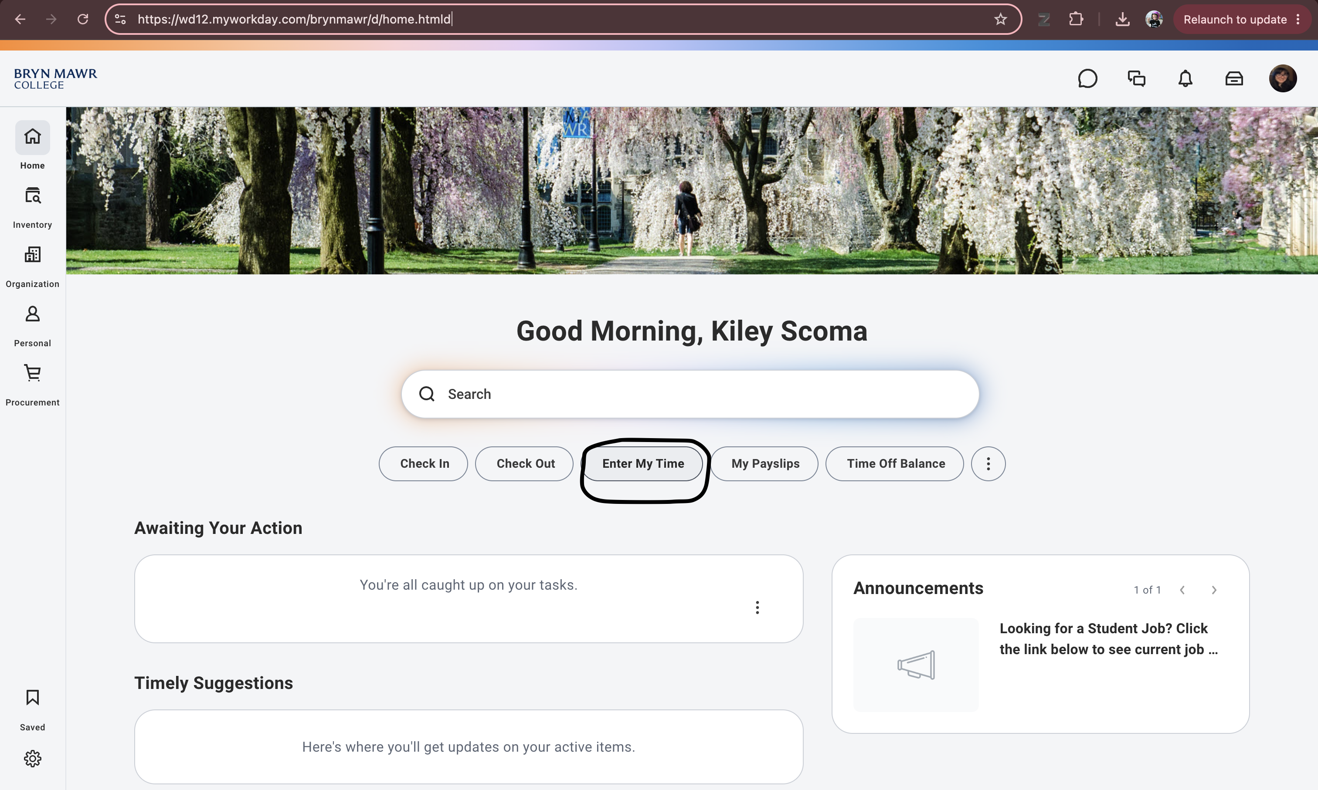

Slide 7
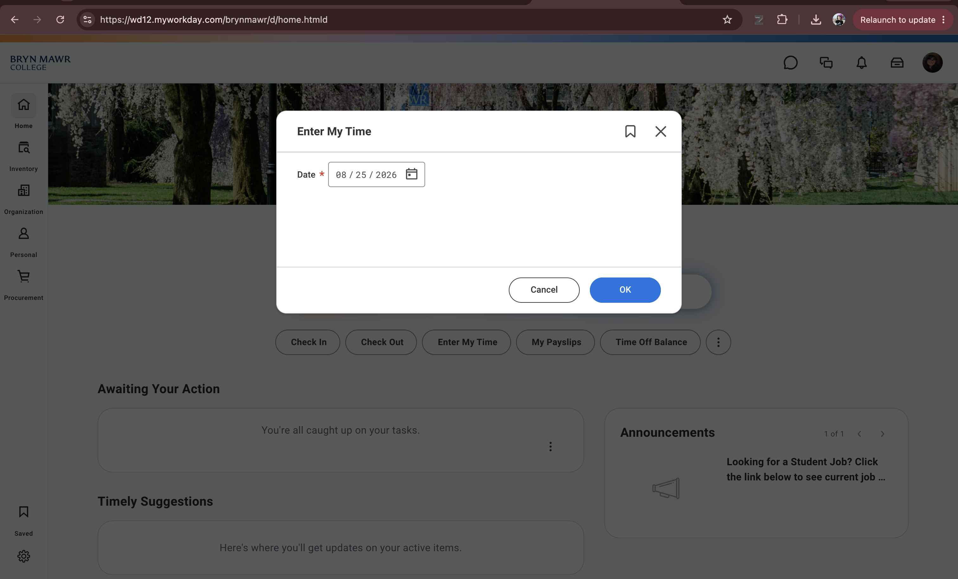

Slide 8
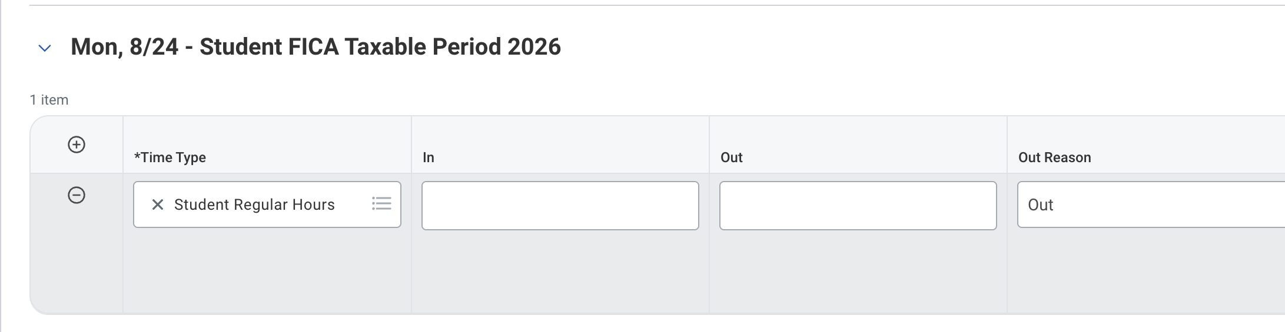
Find the date you worked (You may have to scroll through the pay period if it's the second week)
Enter the time your appointment/work task started in "In"
Enter the time you finished in "Out"
  Note for Peer Tutors: Don't forget to log your prep time!
The "Out Reason" can remain as "Out"

Slide 9
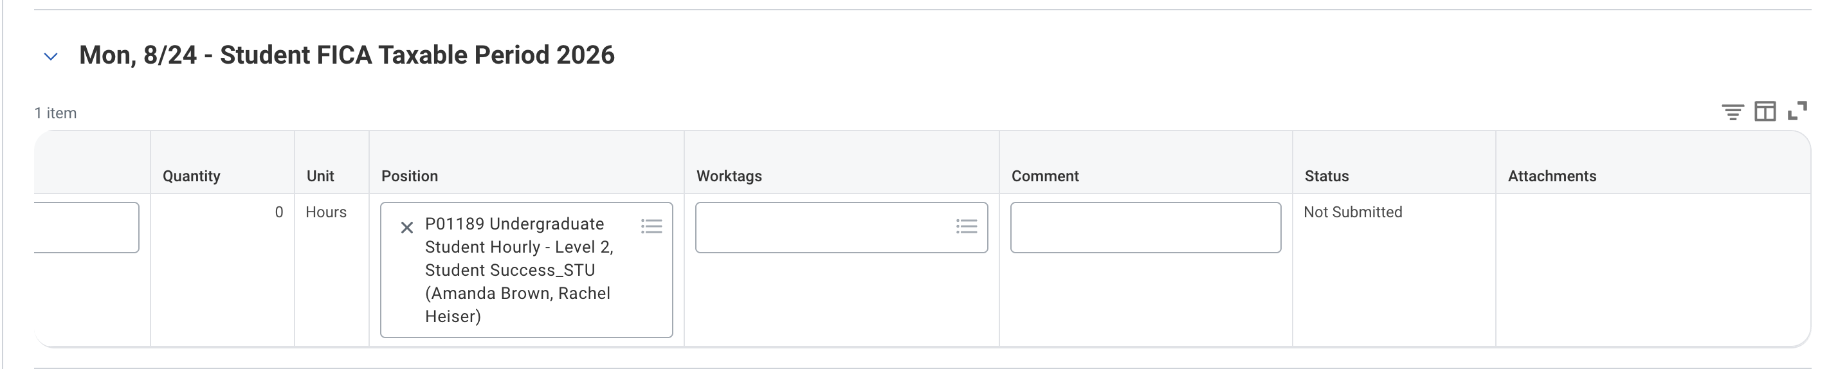
Scroll to the right!
Now, make sure your position is correct if you have multiple jobs on campus.
  If you have any questions about which position is which, talk to your supervisor or head!
You don't need to do anything in Worktags
In the comments, be sure to include:
  Your Position (eg. "Peer Tutor")
  The work you did (eg. "Student Meeting") - This does not need to be super descriptive
  If you met with a student, include their name (eg. "Sarah Wickes")
  If you are backlogging hours, include that in the comment! ("This is backlogging hours from 6/7/26")

Slide 10
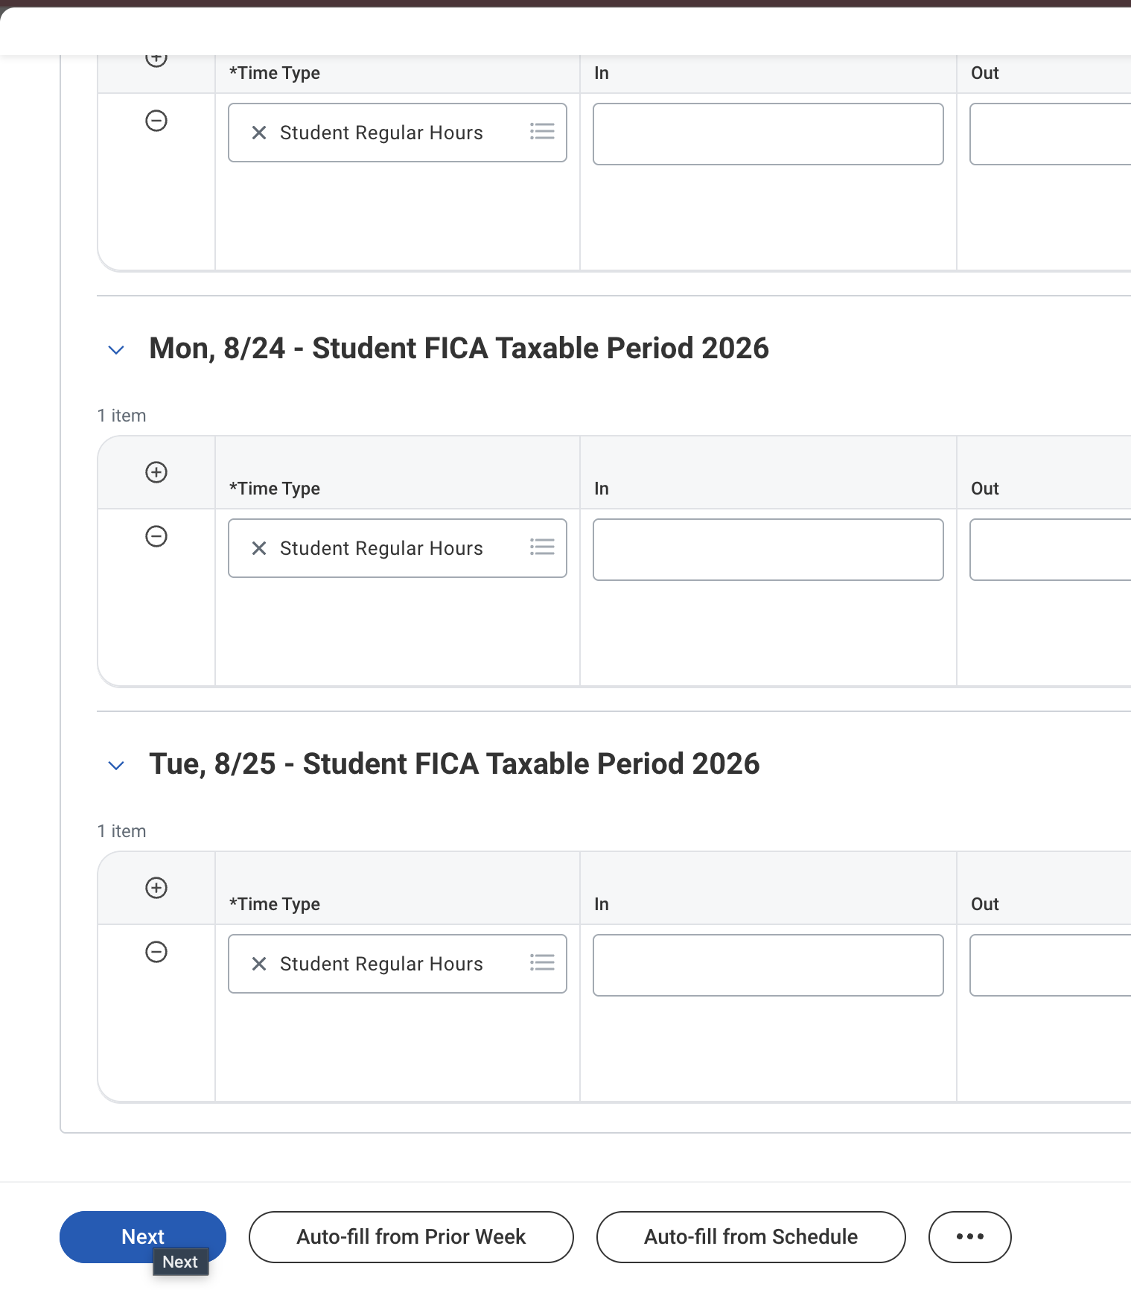
Once you finish logging your hours, scroll down and click next.
This is where you will save your work (even if you are not submitting yet!)

Slide 11
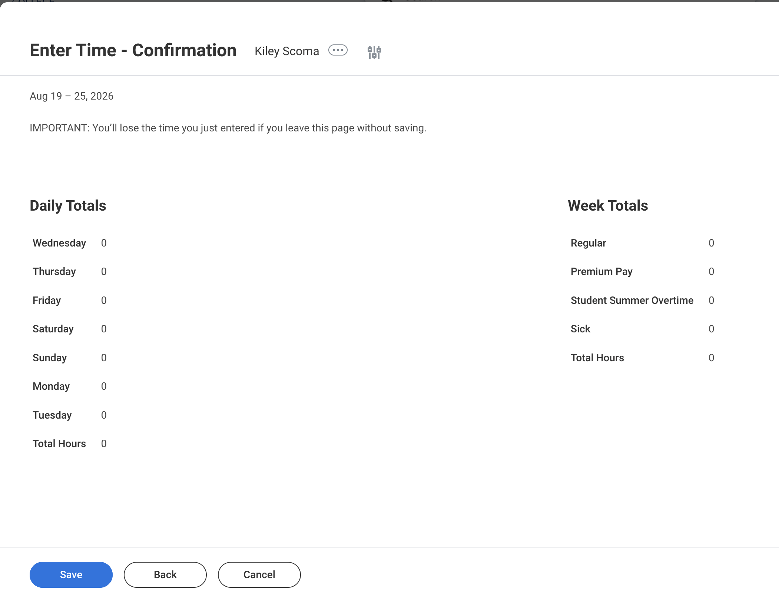
Here, you will save your hours!
You did it!
Congrats!!

