Slide 1


WCOnline & Student Meeting Documentation Training
August 2026

Slide 2
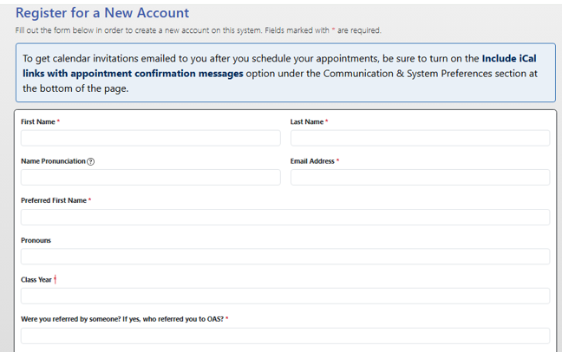
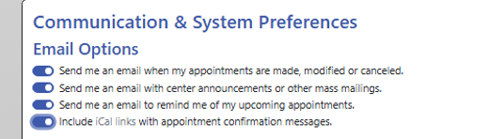
Registering Your Account
  If your PAL role includes meeting with students, you will need to make sure that you have registered an account in WCOnline.
  You can find the link to register in the Training Moodle.
  To receive calendar invitations for the appointments students schedule with you, make sure that you turn on the “Include iCal links with appointment confirmation messages” email options preference.
    If you’ve already registered your account, you will be prompted to update your Profile & Communication Options page.

Slide 3
Full Administrator Access
  If you already had an WCOnline account last year, your Supervisor will have already updated you to Full Administrator Access level.
  If you just registered your account, your Supervisor will update your access to Full Administrator now.
  Full Administrator access means that you will be able to set your starting availability and manage your blackout times without consulting the Supervisor when scheduling conflicts arise.

Slide 4
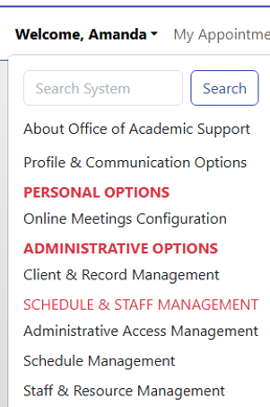
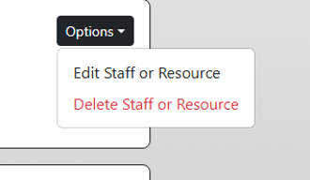
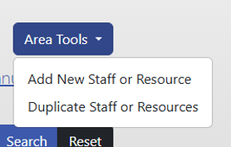
Staff & Resource Management
  All PALs with student-facing roles will need to make sure that they are registered as a Staff or Resource for the correct Fall 2026 Schedule.
    If you already had an WCOnline account last year, your Supervisor will have already assigned you to the correct Fall 2026 schedule.
    For PALs who registered their WCOnline account today, you will need to be added as a New Staff or Resource after you’ve been given Administrator access by your Supervisor.
  Navigate to the Staff & Resource Management page in the “Welcome, Name” dropdown menu.
    If you were already a Staff/Resource, search for your name and make any necessary edits to your Staff/Resource Settings.
    If you are a new PAL, under Area Tools, select “Add New Staff or Resource” to register as a Staff/Resource. Make sure that you’re registered to the correct Fall 2026 Schedule.

Slide 5
Staff & Resource Setting Management
  When updating your Staff / Resource settings, make sure that you are assigned to the correct Fall 2026 PAL Schedule.
  The starting date and ending date for both Fall 2026 PAL schedules should be 9/14/2026 to 12/11/2026.
  Appointment minimum length should be set to 30 minutes.
    Appointment maximum length should be set to 30 minutes for PACs or up to 60 minutes for Peer Tutors.
  You are encouraged to write a short bio about yourself. When students create an appointment with you, they will see that bio.
    Leave the Resource Short Bio & Location boxes empty and set Tentative Appointments to no.
  Under modality, decide if you are going to meet with students In Person, By Zoom, or By Zoom & In Person.
    Do not click on any of the options in the dropdown that includes eTutoring.
  If you will meet with students by zoom, put your zoom link in the “custom link url” box.

Slide 6
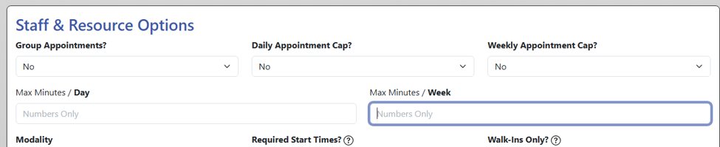
Managing Your Availability
  If you have more than one student-facing PAL role, you will need to set your availability for both Fall 2026 PAL Schedules.
  Undergrad Student Employees are allowed to work a MAXIMUM of 17.5 hours per week across all on-campus jobs.​
  If you have more than one job with OAS or more than one on-campus job, you need to be mindful about how many hours you’re working each week.
  In the Staff & Resource Options section, you can set the max minutes per day or per week you’re available to meet with students.

Slide 7
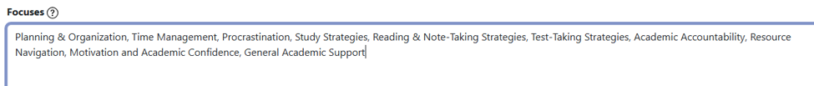

Staff / Resource Focuses
  When editing your Staff / Resource settings, enter focuses according to the Fall 2026 PAL Schedule you’re a staff / resource for.
    Peer Tutors should list the courses they tutor for in the focuses box. Example: CHEM B103, CHEM B104
    PACs should list Planning & Organization, Time Management, Procrastination, Study Strategies, Reading & Note-Taking Strategies, Test-Taking Strategies, Academic Accountability, Resource Navigation, Motivation and Academic Confidence, General Academic Support in the focuses box.
      PACs who have returned from leaves of absence and/or resolved warning/probation, you can also add Return from Leave Mentorship and/or Navigating Warning & Probation

Slide 8
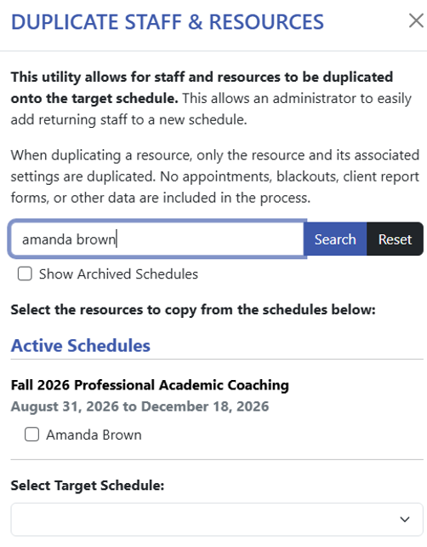
Have More than One Student-Facing Roles?
  If you are both a PAC and a Peer Tutor, after making sure you are a Staff / Resource for one of the Fall 2026 PAL Schedules, select “Duplicate Staff or Resources” under the Area Tools dropdown menu.
    Enter your name in the “Filter by Resource” and hit search.
    Check off your name under your current active schedule.
    Select the other Fall 2026 PAL Schedule as the target schedule.
    Hit save.
  Make sure that you update the Staff / Resource settings for the second schedule, like changing the focuses and maximum appointment lengths.

Slide 9
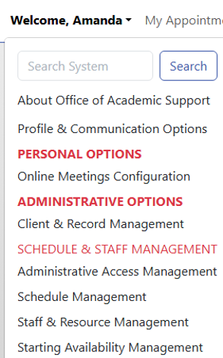
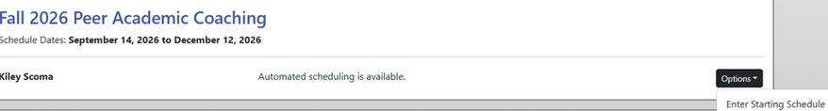
Starting Availability Management
  After you’re registered as a Staff/Resource for the appropriate Fall 2026 PAL schedule(s), navigate to the Starting Availability Management page under the “Welcome, Name” dropdown menu.
  Find your name under the correct Fall 2026 Schedule(s), and select “Enter Starting Schedule” under the Options dropdown menu.
  This is where you will set your recurring availability each week for appointments.
    Please note, you will uncheck the boxes to indicate you’re available for appointments.

Slide 10
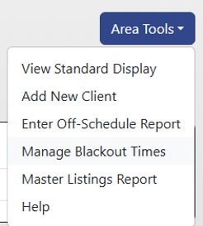
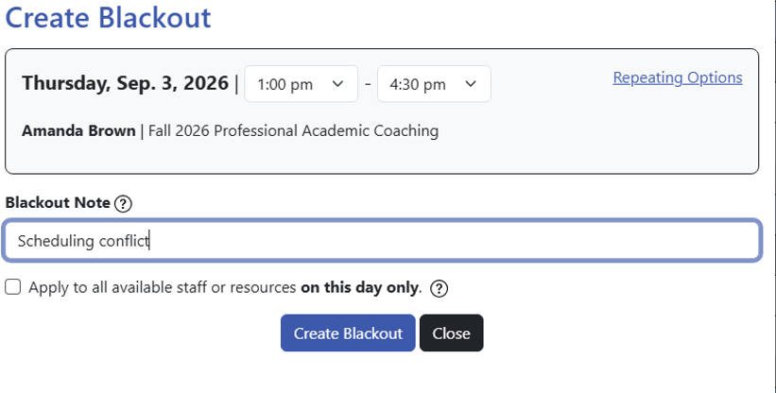
Temporary Scheduling Conflicts & Changes
  If you have a scheduling conflict come up that overlaps with your normal appointment times, you can create a blackout so that students cannot schedule a meeting with you on that specific day / time.
    Under the Area Tools dropdown, select Manage Blackout Times.
    Select the day/time when the blackout needs to occur.
    Edit the start and end times for the blackout.
    Under blackout note, enter scheduling conflict. Entering a specific reason for creating the blackout is optional.
    Hit create blackout to block off your availability.
  Alternatively, you can open up your availability for a specific day & time in the Manage Blackout Times settings.
    Select the blocked out time you would like to open up.
      Do one of the following:
        Select Edit Blackout if you need to adjust the blackout start and end times.
        Select Cancel Blackout to cancel the blackout as is.
          This will prompt you to confirm you want to cancel the blackout and if the cancelation should be repeated.

Slide 11
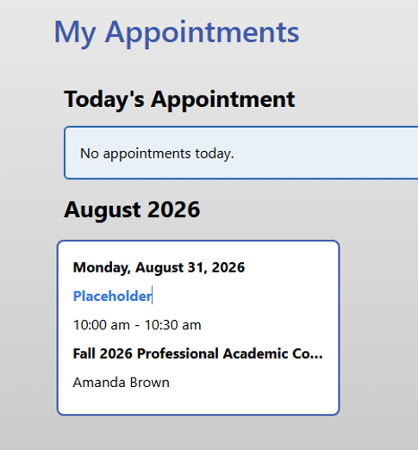
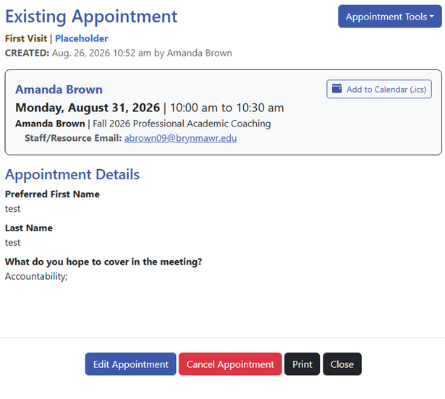
My Appointments
  All upcoming appointments will be listed on the My Appointments page.
  If you need to review the details of the scheduled appointments, you can click on the appointment block and a new window will open up with the appointment details.
  After you meet with students, this is how you will report your meeting notes.

Slide 12
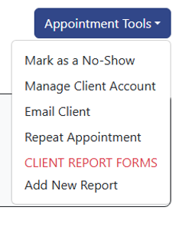
Managing Student Appointments
  Click on the appointment that you need to enter the student meeting notes for.
  Under the Appointment Tools dropdown menu, you can
    mark the student as a no-show if they did not come to the meeting.
    send an email to the student.
    repeat the appointment if it will be recurring meeting between you and student.
    add a new report to create a meeting note for the appointment.
  Be sure to keep this information up-to-date, as it is important for assessment purposes.
    Mark no-shows the same day they miss.
    Enter meeting reports as soon as you complete an appointment.

Slide 13
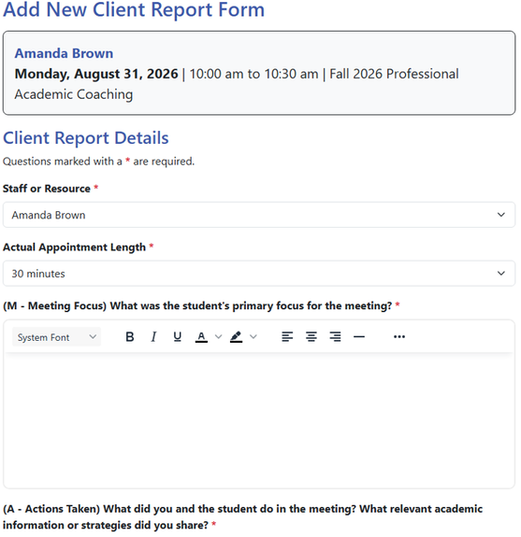
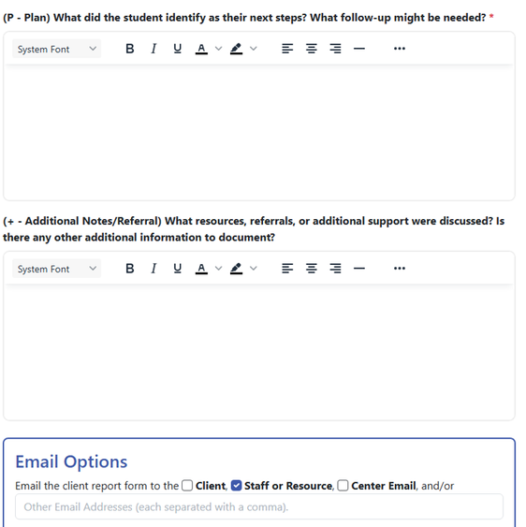
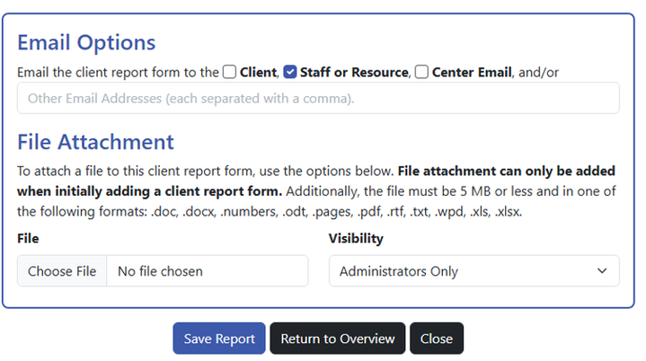
Documenting Student Meetings
  To enter student meeting notes, select add a new client report form.
  Complete the form using the MAP+ notetaking system.
    M - Meeting Focus: What was the student's primary focus for the meeting?
    A - Actions Taken: What did you and the student do in the meeting? What relevant academic information or strategies did you share?
    P - Plan: What did the student identify as their next steps? What follow-up might be needed?
    + - Additional Notes/Referral: What resources, referrals, or additional support were discussed? Is there any other additional information to document?
  Under email options, you can select who will receive the note and attach files (if applicable).
  Your Supervisor will monitor to make sure you’re completing appointment notes.

Slide 14
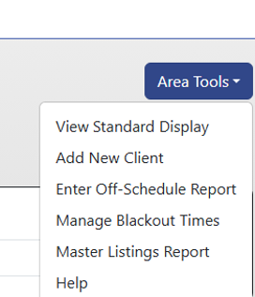
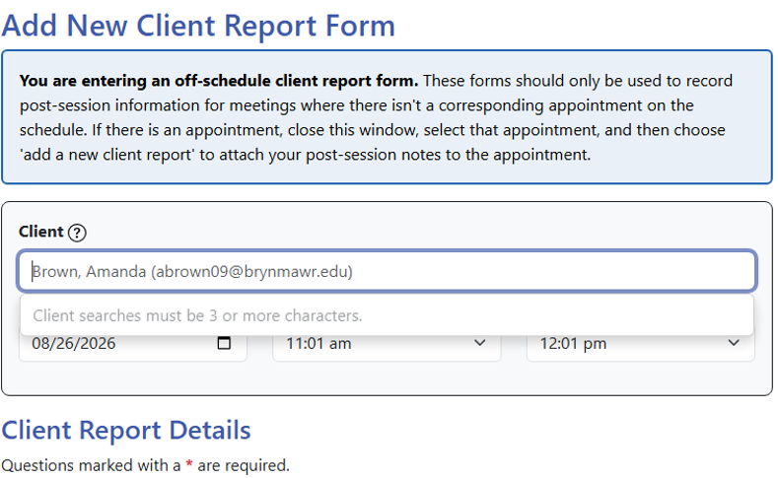
Let’s Practice!
  Using the person you worked with for the role plays yesterday, let’s create a meeting note / client report form.
    Go to the appropriate Fall 2026 PAL schedule.
    Under the Area Tools dropdown menu, select “Enter Off-Schedule Report.”
    Search for the PAL you worked with to make them the “client.”
    Enter the date and time for yesterday’s roleplay training slot.
    Then use the MAP+ format to create a meeting note about your roleplay.
    Decide if you want to email the note to them or just yourself.
  The Enter Off-Schedule Report is how you should track any interactions you have with students outside of scheduled appointments, such as at workshops/programs, drop-in/office hours, or study hours.

Slide 15
Questions?

