Slide 1
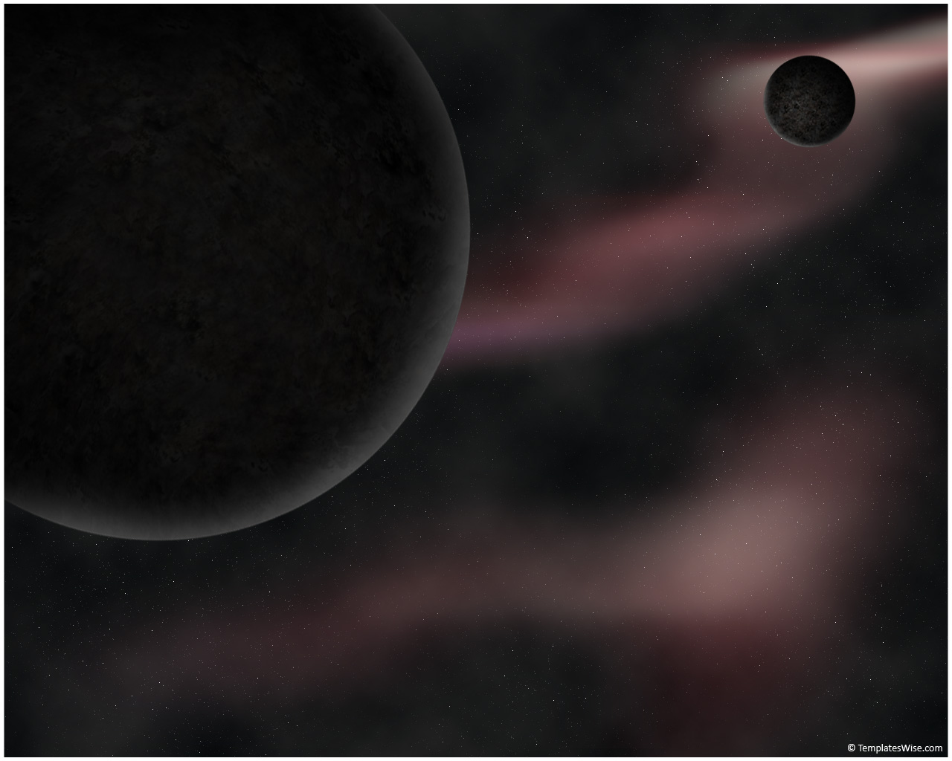
Introduction to Science Fiction
Prof. DiPasquale

Slide 2

What is Science Fiction?
Science fiction is a genre of fiction that “represent[s] an imagined reality that is radically different in its nature and functioning from the world of our ordinary experience” (Abrams 323).
It is often grouped with other fantastical genres (superhero fiction, horror, fantasy, alternate history, etc.) under the term “speculative fiction.”
Frequently called a “literature of ideas.”

Slide 3

Basic Characteristics of “Sci-Fi”
Setting:
  planet earth in the future
  planet earth in a fictional past
  another planet
  an entirely different universe
References:
  known or imagined scientific principles
  futuristic advances in science and technology
  space travel
  time travel
  extraterrestrial life

Slide 4
General Issues and Themes Explored in “Sci-Fi”
Identity
Ethics
Science
Gender
Aesthetics
History
Social Structure
Psychology
Utopias
Reality
“Otherness”
Morality
Technology
Sexuality
Symbolism
Politics
Power
Sociology
Dystopias
Alternative Reality

Slide 5

A Brief History of Science Fiction
Mary Shelley’s Frankenstein (1818) is considered a precursor of science fiction and perhaps the first sci-fi novel.
A more developed science fiction literature did not emerge until later in the 19th century, including such writers as Jules Verne and H.G. Wells.
Much of early science fiction was called “scientific romance” (the word “romance” here meaning an adventure narrative)

Slide 6
A Brief History, continued
Timeline of science fiction’s history:
  “Scientific Romance”
    1818-late 1800s
  “The Pulp Era”
    1920s-1930s
  “The Golden Age”
    1938-1946*
  “The New Wave”
    1960s-1970s
  Recent/Contemporary
    1980s-2010s
*Some consider the 1950s as part of the Golden Age, while others consider that decade a transitional period between the Golden Age and the New Wave of science fiction.

Slide 7
Prominent Sci-Fi Authors and Works
Mary Shelley
  Frankenstein (1818)
Jules Verne
  Journey to the Center of the Earth (1864)
H.G. Wells
  The War of the Worlds (1898)
Ray Bradbury
  The Martian Chronicles (1950)
Isaac Asimov
  Foundation (1951)
Arthur C. Clarke
  2001: A Space Odyssey (1968)
Frank Herbert
  Dune (1965)
Philip K. Dick
  Do Androids Dream of Electric Sheep? (1968)
Ursula K. Le Guin
  The Left Hand of Darkness (1969)
Douglas Adams
  The Hitchhiker’s Guide to the Galaxy (1979)
William Gibson
  Neuromancer (1984)
Neal Stephenson
  Snow Crash (1992)

Slide 8
Works Cited
Abrams, M.H., and Geoffrey Galt Harpham. A Glossary of Literary Terms. 9th ed. Boston: Wadsworth, 2009. Print.

