Slide 1
Identification in the Cinema
Session 1: Introduction

Slide 2
Program
Welcome
Introductory
Moodle
Syllabus
Paper #1 Still Image Analysis
Who are you?
Discussion Prompt

Slide 3
Introductory
Matthew Feliz
mfeliz@brynmawr.edu
Old Library 218
Modern and Contemporary: Video, Film, Performance, Installation
Fiction (New York Review of Books),
Film: (Alien, Blade Runner, The Matrix, Up, Midsommar, )TV: (Breaking Bad, Westworld)
Music: (classical, jazz, funk,hip-hop, pop, heavy metal)
Running, Cycling, Traveling, Rock Climbing, Coaching
Four Boys 14-17yrs

Slide 4
Moodle
Critical Reception. Class forum
Syllabus
Powerpoint Lectures
Readings
Paper Prompts: Still Image Analysis
Exam Review

Slide 5
Syllabus
Learning Goals
Required Texts
CourseRequirements
  4 Papers
  2 Exams
Screenings

Slide 6
Paper #1
Still image analysis
Three pages, double spaced, 1 inch margins, 12 point font

Slide 7
Who are you?
Name
Year (major if you have one). Prior experience with visual analysis.
Favorite films/ genres? Other media that you consume.
Reasons for taking the course.
Anything else you want us to know about you.

Slide 8
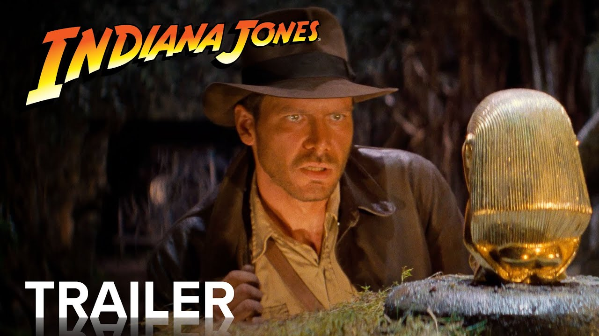


Discussion
What is identification?
Why and how does it inform/condition our appreciation/interpretation of film?

