Slide 1
Identification in the Cinema
Session 2: Mise-en-Scène
My Fair Lady (George Cukor, USA, 1964) starring Rex Harrison and Audrey Hepburn

Slide 2
Agenda
Key terms
Mise-en scène
  Props
  Performance
Discussion Question

Slide 3
Key Terms
Mise-en-scène:
    Setting vs. set
    Scenic realism
      Physical accuracy-Cultural accuracy-historical accuracy
    Denotation vs. connotation
    Props
    Performance
      Actors: (leading vs. supporting vs. character)
      Blocking
      Performative development
    Costume
Lighting
        Natural-Set- Directional
        Key lighting(high vs. low)
        Fill lighting
        Highlight
        Backlighting (edge)
        Three point lighting
        Frontal- side-under-top
        Texture: (hard vs. soft)

Slide 4
Mise-en-scène
As an external condition
As a measure of value
Defines the material possibilities of the space. What can be done?
Defines social/political/ethical conditions reflected in and through set and settings
Physical Horizon
Ideological /Cultural Horizons
Set/Setting
Denotation
Connotation
Actors
Actors
Blocking
Performance
Costume
Props
Once Upon a Time in Hollywood, (Quentin Tarrantino, US, 2019)

Slide 5
Naturalistic mise-en-scène
Historical
Everyday
Amadeus, (Milos Foreman, USA, 1984)
Goonies, (Richard Donner, USA, 1985)
Theatrical mise-en-scène
Expressive
Constructive
The Cabinet of Dr. Caligari, (Robert Weine, Germany, 1921)
Synecdoche, New York, (Charlie Kaufman, USA, 2008)

Slide 6
Lights 1
3 Point Lighting

Slide 7
Lights 3
Key Lighting
Fill Lighting
Highlighting
Backlighting

Slide 8
Lights 2
High key
Low key
Her, (Spike Jonze, US, 1913)
Blade Runner, (Ridley Scott, US, 1982)

Slide 9
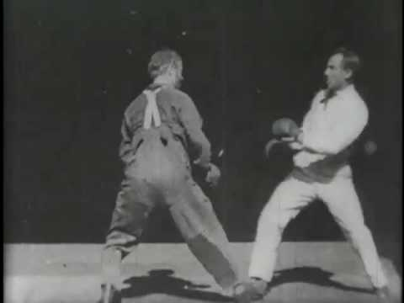
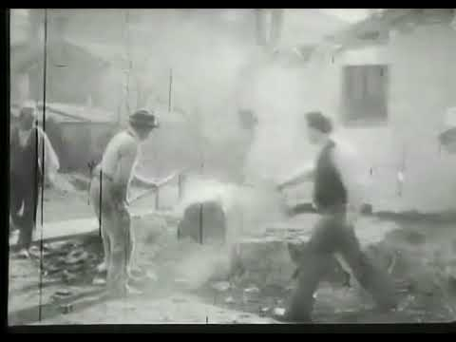
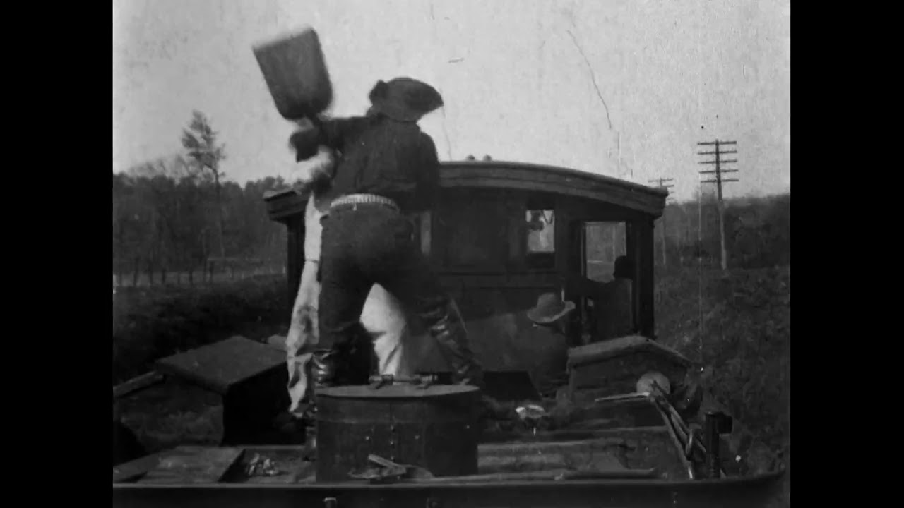
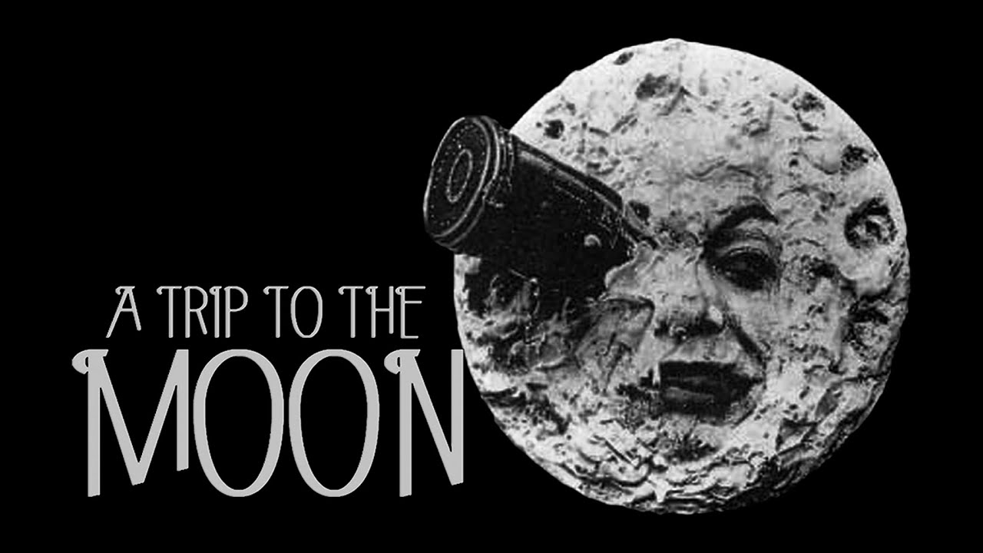
Early Cinema
Glenroy Brothers No. 2 (Edison Manufacturing Co, USA, 1894)
The Demolition of a Wall (Lumière Brothers, France, 1896
A Trip to the Moon, (Georges Méliès, France,1902)
The Great Train Robbery, (Edwin S. Porter,USA,1903)

Slide 10
For further consideration
Provide an example of the ways in which elements of mise-en-scène highlight performative development.
What is the difference between the way that props function as character highlights and narrative markers? Illustrate your answer with an example.

