Slide 1
Identification in the Cinema
Session 4: Munsterberg and Arnheim

Slide 2
Agenda
Wednesday Wrap Up- Dialectic and Alienation
Cinematography: Camera Distance
Munsterberg, “Why we go to the movies”
Arnheim, “Film as Reality” (1925)
Discussion

Slide 3
Dialectic. (Plato to Hegel)
  Proposition(Thesis) -> Negation(Antithesis)-> (Negation of Negation)Synthesis
Time
Thesis
  Antithesis
  Synthesis/Thesis 1
  Antithesis1
Synthesis1/ Thesis 2

Slide 4
    Dialectical relationship between stasis and movement
    Magic Lantern Theater
    Cinema
    Vitascope, (Thomas Armat and Thomas Edison, 1896)

Slide 5
Alienation(128)
“aesthetic of distraction” vs. “illusion of absorption” (Gunning, 127)
as condition of modern subjectivity (economic/political/social)
as condition of modernist aesthetics/theories of representation

Slide 6
Camera Distance
Medium Long Shot
Power of the Dog (Jane Campion, USA, 2021)
Longshot
Extreme Longshot
Medium Shot
Extreme Close up
Close up
Medium Close-up

Slide 7
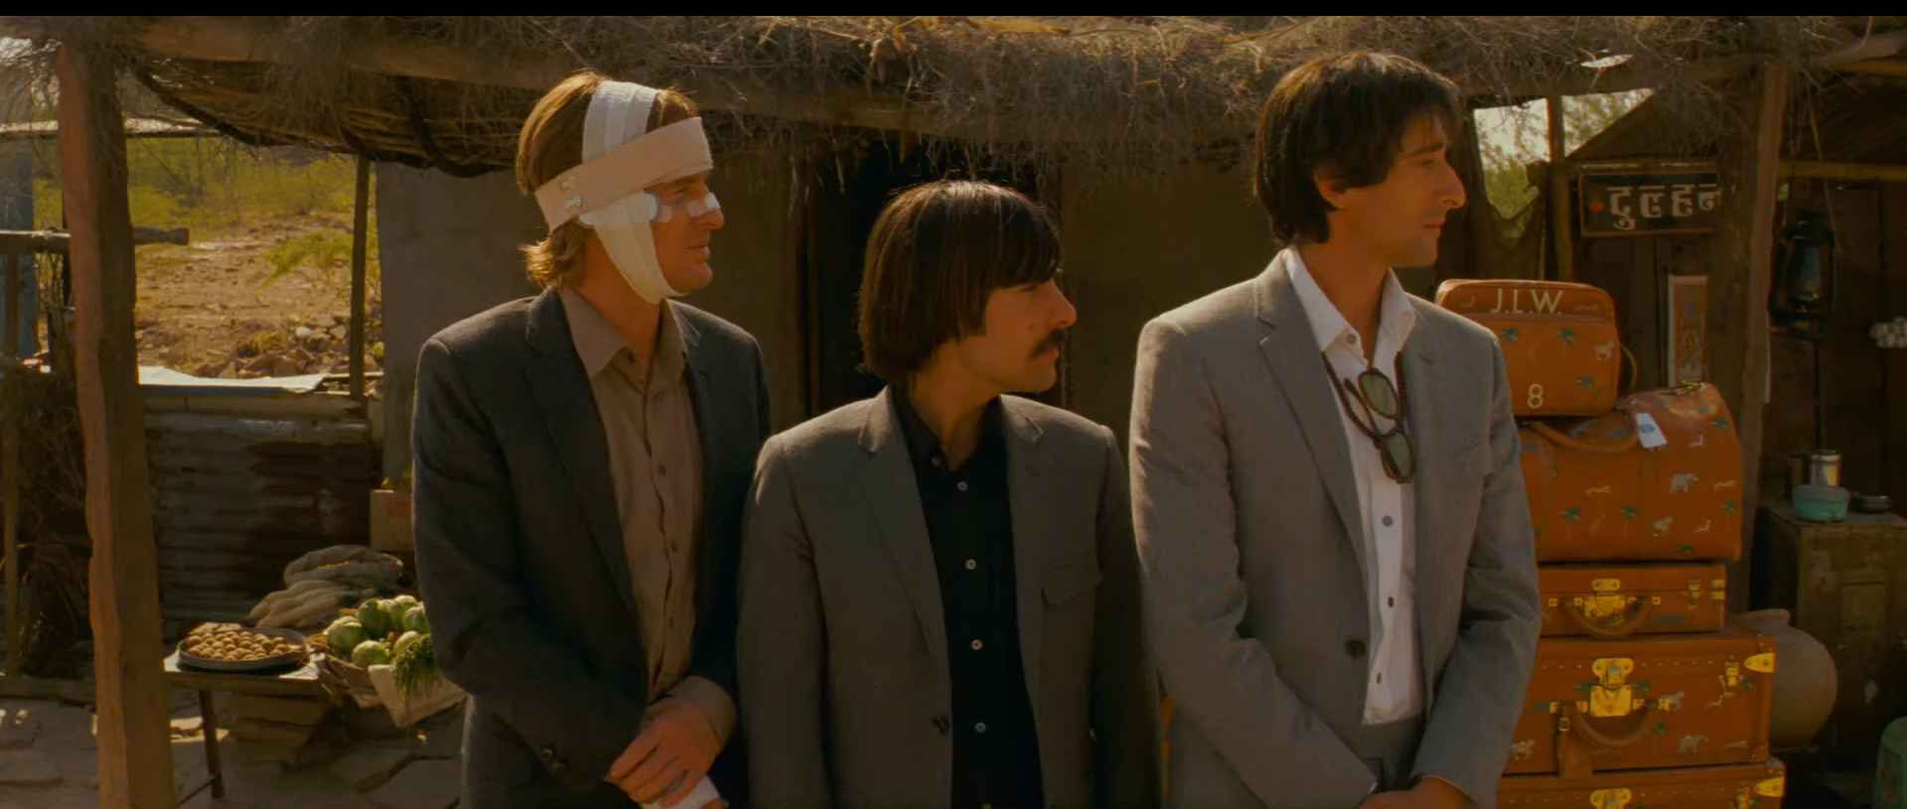
Camera Movement
Tracking Shot/ Dolly Shot
Taxi Driver (Martin Scorsese, 1976 )
Tilt Shot
Blade Runner 2049 (Dennis Villeneuve, USA, 2017)
Crane Shot
Touch of Evil (Orson Welles, USA, 1958
Panning Shot
The Darjeeling Limited (Wes Anderson, USA,2007

Slide 8
Hugo Münsterberg, “Why We Go to the Movies,” (1915)
Education and instruction (rational/ technical)vs. Entertainment (Affective/psychological)
A question of medium specificity (173)
  Art doesn’t imitate other art
  Art doesn’t imitate life
    Showing vs. expressing 179-180
War Memorial Opera House, San Francisco, CA
Edward Hopper, First Row Orchestra, 1951
John Quincy Adams Ward, William Shakespeare, 1870

Slide 9
The evolution of the “meaning of the ‘movies’” (Munsterberg 174)
  Theater/vaudeville/cinema of attractions (technical virtuosity)
  Mass media
  Photoplay reveals something entirely different about the world
    Overcoming of material limitations of the stage (175)
      Of space
      Of motion
      Of the performer
https://youtu.be/JRXkAhMYKEc

Slide 10
Editing
  177- temporal liberation
    The performance /visualization of memory
    “order of the picture becomes the order of our mental narrative” (178)
https://youtu.be/JRXkAhMYKEc

Slide 11
Rudolph Arnheim, “Film as Reality,”
Makes the case for the aesthetic potential of film based on the way in which the medium’s unique technical qualities impact the psychology and visual perception of the viewer to produce “the unreality of the film picture”:
Effective photographic projection of a three dimensional object in two dimensions depends on the proper placement of the camera in relation to the object
“Flatness” of the film image vs. the stereoscopic image: The movement inherent in the medium opens up the possibility for the production of different types of images (“three-dimensional image” vs “plane image”) and their synthesis within a single medium.
Film image
stereoscopic image

Slide 12
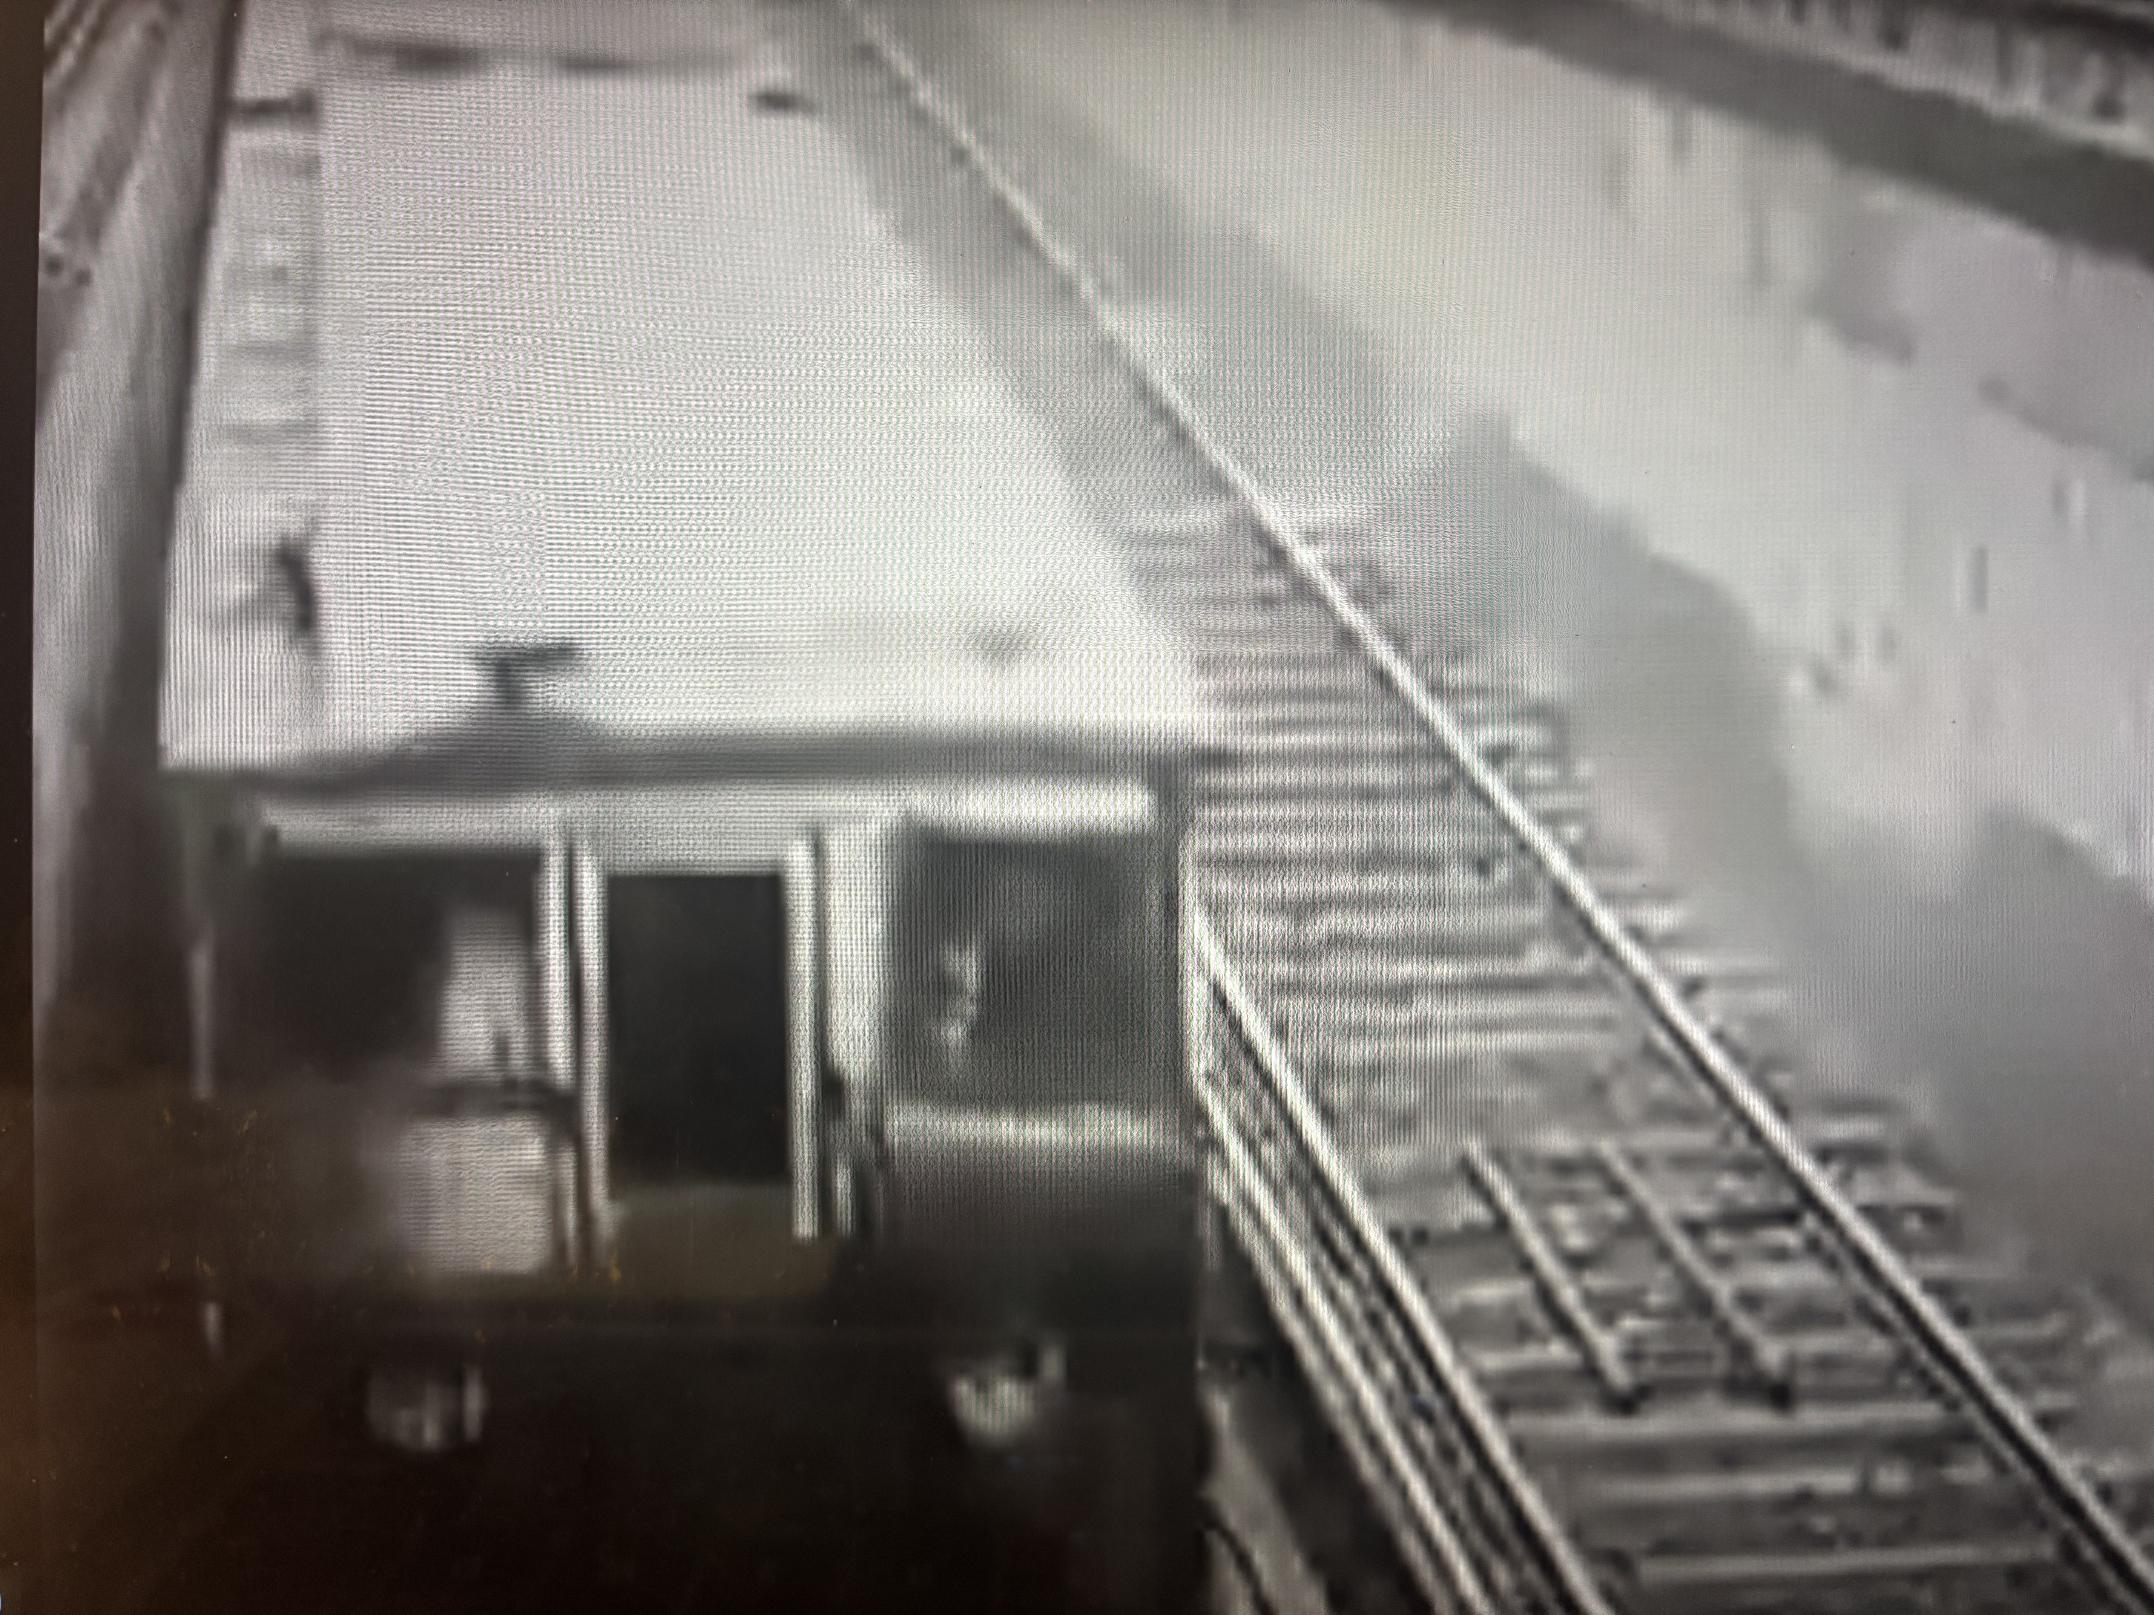
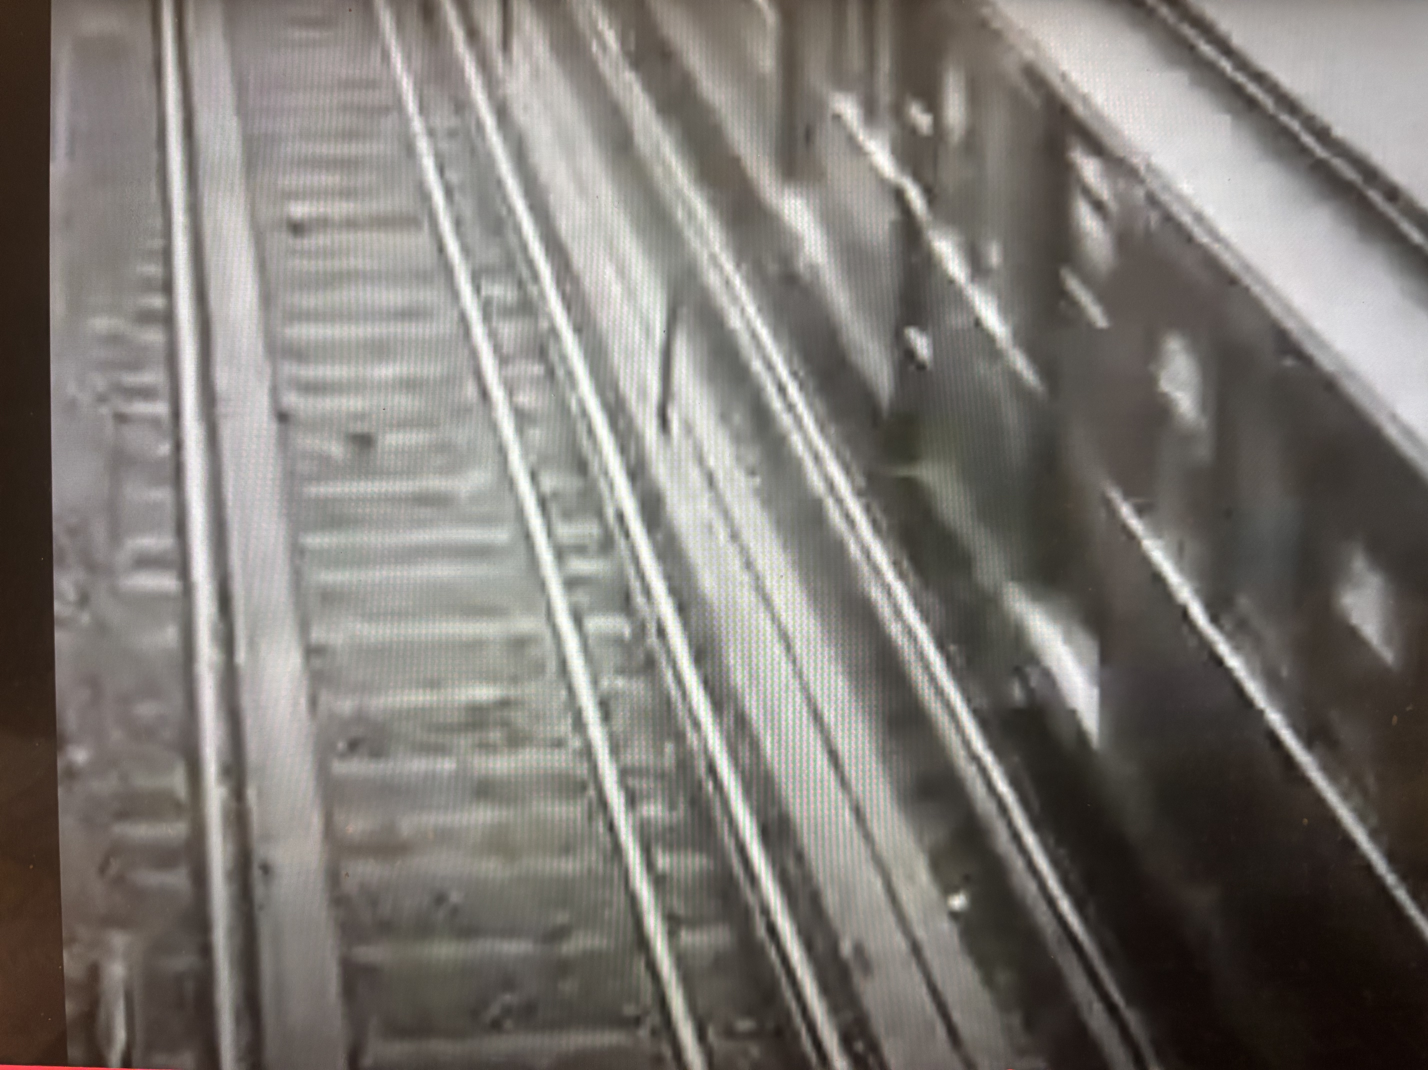
The Reduction of Depth
“How do our eyes succeed in giving us three-dimensional impressions…?” (Arnheim 208)
The Stereoscopic Image
“The effect of film is neither absolutely two-dimensional nor absolutely three-dimensional…In Ruttman’s film Berlin there is a scene of two subway trains passing each other in opposite directions. The shot is taken looking down from above onto the to trains. Anyone watching this scene realizes…that one train is coming toward him and the other going away from him (three dimensional image). He will then also see that one is moving from the lower margin of the screen toward the upper and the other from the upper toward the lower (plane image). This second impression results from the projection of the three-dimensional movement onto the screen surface… p. 209
Walter Ruttmann, Berlin: Symphony of a Great City, 1927 (00:34:56)
https://www.youtube.com/watch?v=5kf7mq3uAgA

