Slide 1
Identification in the Cinema
Session 12: Psycho and Identification

Slide 2
Key Terms
    Alienation effect (Brecht)
    Grand Guignol
    Affect
    The thrill (Hitchcock)
    Horror vs. thriller (Hitchcock)
    Terror vs. Suspense (Hitchcock)

Slide 3
The Imaginary Signifier
Mirror Stage
It Should Happen to You (George Kukor, USA, 1954)
Imitation of Life, (Douglas Sirk, USA, 1959)
Psycho, (Alfred Hitchcock, USA, 1960)
Screen/Mirror
Phantasy
Projection
Introjection
Cinematic Signifier
Camera/Spectator
Image/Reflection

Slide 4
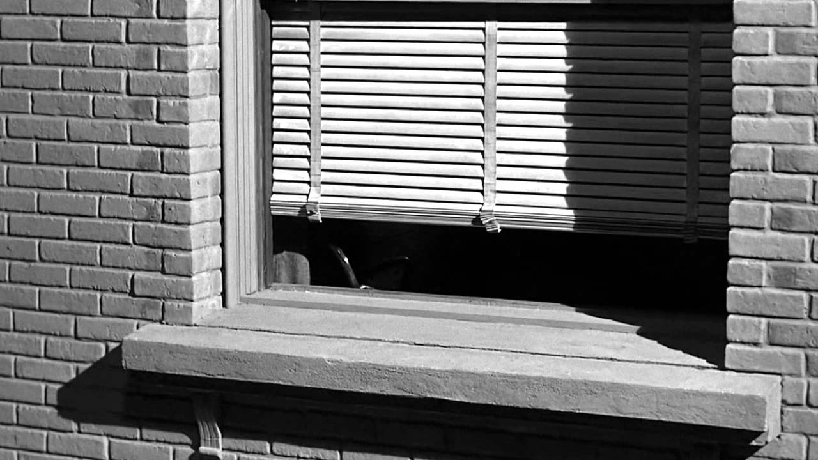
Primary Identification
Identification with the perspective of the Camera (606-607). It establishes the viewer as “The all perceiving subject” and invites identification with the act of perception itself(Metz, 605)
What do we identify with? How does the opening illustrate Metz’ definition of primary identification?
Psycho, (Hitchcock, USA, 1960)

Slide 5
Secondary Identification
Identification with the “looks” (perspectives) of the characters. Establishes the chains of connections between characters and objects within the diegesis.
Who do we identify with? Why? How does primary identification inform/affect secondary identification?

Slide 6
What does Wood’s mean when he says that “the camera becomes subjective” on page 146?

Slide 7
According to Woods what ways does the “spectator” “participate” in film?
How does “participation”/identification contribute to the production of the cinematic “thrills”?
Participation and Identification
Hell's Angels (Howard Hughes, USA, 1930)
1:00:00-1:00:34
Projection: audience projects itself into the consciousness of the character
Disavowal: “In this there is no harm, because in our subconscious we are aware that we are safe, sitting in a comfortable armchair, watching a screen.” Hitchcock, p. 110
The Sublime: The cinema can leave the spectator with a subconscious assurance of absolute safety, and yet surprise his imagination into playing tricks on him.

Slide 8
Horror
The Sublime
Suspense
What is seen vs. what is imagined
Le Théâtre du Grand-Guignol, 1897-1962
Caspar David Friedrich, Wanderer Above the Sea of Fog, c. 1818

Slide 9
“The whole sequence, with its discoveries in the bedroom, attic, and cellar has clear Freudian overtones.” (Woods, p. 147)
Mise-en-scene

Slide 10
Semiotics and Psychoanalysis: The Three Registers of the Subject
SIGN: communication
SUBJECT: identification
Charles S. Peirce
Ferdinand de Saussure
Sigmund Freud
Jacques Lacan
Symbol
Symbolic
The connection to the referent is arbitrary and secured by convention.
“Law abiding citizen”
Literate
Socialized
Statistic
Icon
Imaginary
The connection to the referent is secured through resemblance.
Appearance
Images
Index
A direct causal relationship exists between the referent and the sign
Real
Escapes Symbolic and Iconographic representation. (Semiotics)
Disrupts the Symbolic and Imaginary registers of the Subject. (Psychoanalysis)
But it also holds everything together.

Slide 11


Real
A Psychoanalytic Reading: Lacan and Psycho
Imaginary
Binary
Image
Symbolic
Tripartite
Language
Traumatic Event
Missed Encounter
Escapes
representation.
Subject (Psychoanalysis)
Sign (Semiotics)
Film (Theory)
Disrupts
representation

Slide 12
Psycho (Hitchcock, USA, 1960
In what ways does the shower scene illustrate Wood’s use of Brecht’s “alienation effect” (WOODS p.146)?
Shot 6
Shot 7
Shot 13
Shot 15
Shot 16
Shot 25

