Slide 1
Identification in the Cinema
Session 13: On Suture and Tutor-Code of Classical Cinema

Slide 2
Key Terms
    Mirror Stage
    “Tutor Code”
    Suture- Shot/reverse shot
      Shot/reverse shot (Dayan)
      Process of Negation (Stephen Heath p. 204)
      Structuring Losses that subtend film (Silverman p. 205)
      Suture and Story (Silverman)
      Cinematic space transformed into dramatic space
          Idealist Critique
          Phenomenological Critique
          Structuralist Critique
          Semiotic/Marxist Critique
    Fiction (“organization of film content”) vs Filmic Enunciation (“system that negotiate the viewer’s access to the film- the system that ‘speaks’ the fiction.”)
    Ideology

Slide 3


Real
A Psychoanalytic Reading: Lacan and Psycho
Imaginary
Binary
Image
Symbolic
Tripartite
Language
Traumatic Event
Missed Encounter
Escapes
representation.
Subject (Psychoanalysis)
Sign (Semiotics)
Film (Theory)
Disrupts
representation

Slide 4
Dayan, The Tutor Code of Classical Cinema
Dayan’s theorization of cinematic representation is grounded in Michel Foucault’s epistemological approach to Classical Representation:
Figurative System
Painting:
Mirror:
Embodiment of the glance of the subject
Represents the viewer
Diego Velázquez, Las Meninas, 1656

Slide 5
The Filmic Image
The Painted Image
Who is Watching this? Who is ordering these shots?
Who is looking at this? Whose “look” is structuring this painting?
Frame
Diego Velázquez, Las Meninas, 1656
The Absent One/the other (Oudart)

Slide 6
Real
The System of the Absent One: Shot/Reverse Shot
On Screen
Shot 1
Imaginary
Suture
Spectator
Off Screen
On Screen
Shot 2
Off Screen

Slide 7
Suture: Silverman
According to Silverman, Jean Pierre Oudart and Daniel Dayan base their definition/description of suture on the shot revers shot structure.
Reverse Shot
Shot
““Although camera movements, entrances into and exits from the frame ….all function as devices aiding in the organization of the film object…the shot transition [remains] the basic element of [that organization].” Shot relationships are seen as the equivalent of syntactic ones in linguistic discourse.” 201

Slide 8
Suture: Silverman
According to Silverman, Stephen Heath suggests that the shot/reverse shot structure is “only one element in a much larger system, and emphasizes features of the editing process that are common to all shot transitions.” (201)
S6
S15
S7
S16
For Heath this is about the processes of negation that occur with a film’s positive assertions(205)
The unseen apparatus of enunciation (The camera)-> Primary Identification (Metz)
The subjects willingness to become absent to itself and identify with character or point of view
The camera’s operations of cutting and excluding: the frame never reveals everything all at once.
The cut becomes the primary agent of disclosure. “The cut guarantees that both the preceding and subsequent shots will function as structuring absences to the present shot.” (205)

Slide 9
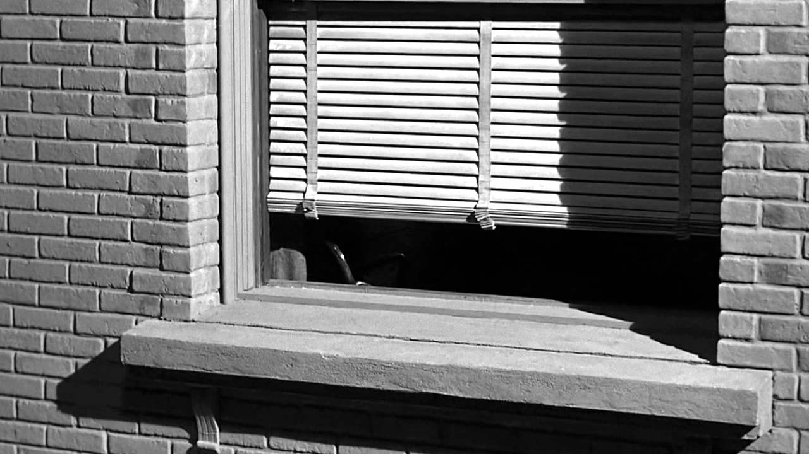
Suture: Silverman
Silverman goes on to discuss the ways in which the processes of negation of the frame and the cut relate to other positive elements of cinematic suture
Camera movement: opening sequence (p206)
Sound: (210)
Narrative diegesis and story (213)

Slide 10
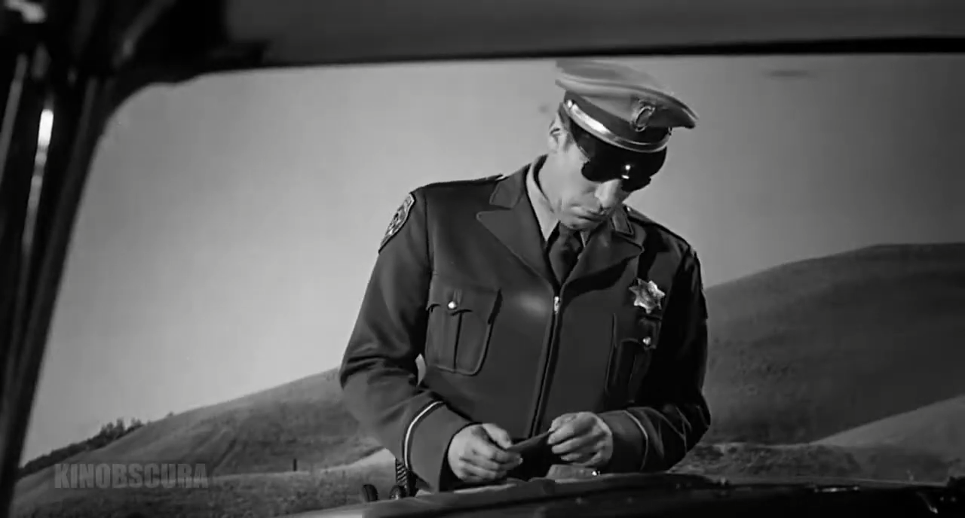
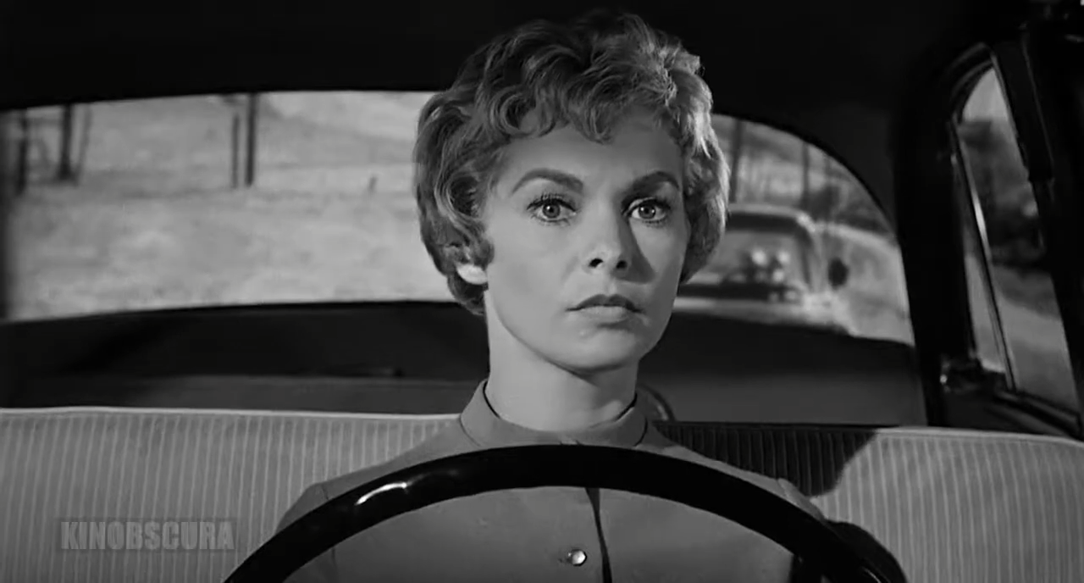
Suture: Silverman
The inscription of the law into the fictional level of the film through the figure of the policeman
1. Opening long shot
2. Establishing the officers POV
3. POV- police officer
4. Shot Reverse Shot Sequence
5. The license: this Shot Reverse Shot pattern inscribes Marion as a passive object:.“The reverse shot discloses not Marion, but the license plate which seems to speak for her with greater authority, and to do so through a legal discourse which renders her even more passive.” Silverman

