Slide 1
Identification in the Cinema
Session 16: The Puzzling Film- Blow-Up Suture and the Alienation Effect
“You never figure out who the murderer is? What kind of movie is that then?”

Slide 2
Key Terms
    Identification- idiopathic (antagonistic identification of a threat)
    - heteropathic (positive identification)
    “Tutor Code” (Dayan) and Ideology
    Suture (Silverman)
    Shot/reverse shot (Dayan)
      Process of Negation (Stephen Heath Silverman p. 204)
      Structuring Losses that subtend film (in Silverman p. 205)
      Suture and Story (Silverman)
      Cinematic space transformed into dramatic space
          Distancing (alienation) effect
          Auteur-

Slide 3
Suture: Silverman
According to Silverman, Jean Pierre Oudart and Daniel Dayan base their definition/description of suture on the shot revers shot structure: “Although camera movements, entrances into and exits from the frame ….all function as devices aiding in the organization of the film object…the shot transition [remains] the basic element of [that organization].”
“Shot relationships are seen as the equivalent of syntactic ones in linguistic discourse.” 201
Shot
Reverse Shot

Slide 4
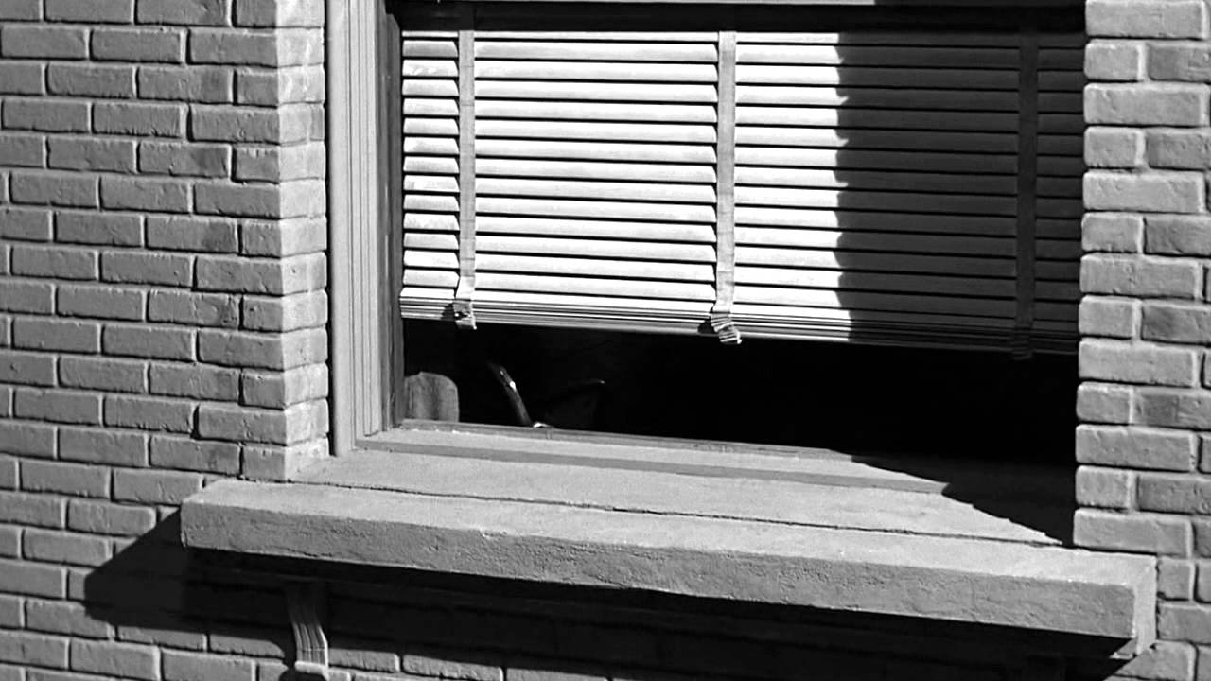
Suture: Silverman
Silverman goes on to discuss the ways in which the processes of negation of the frame and the cut relate to other positive elements of cinematic suture
Camera movement: opening sequence (p206)
Sound: (210)
Narrative diegesis and story (213)

Slide 5
Auteur Theory
“The art cinema foregrounds the author as a structure in the film ’s system. Not that the author is represented as a biographical individual…but rather the author becomes a formal component, the overriding intelligence organizing the film for our comprehension…Within the frame of reference, the author is the textual force “who” communicates (what is the film saying?) And “who” expresses (what is the artist’s personal vision?).” Bordwell, 584
Alain Resnais, Last Year at Marienbad, 1961
Ingmar Bergman, Cries and Whispers, 1972
Robert Altman, Three Women, 1977

Slide 6
Strike a pose there’s nothing to it: The Cultural Milieu
Mary Quant
Jean Shrimpton
Veruschka and Richard Avedon

Slide 7
Alienation Effect
Bertolt Brecht, “Alienation Effect in Chinese Acting,” 1936
-derived from Russian Formalist device of “making strange”
-Rejection of naturalism: foregrounding the illusionistic devices (artifice) of theater (proscenium stage, mise-en-scène, script, acting)
-alienate/distance (prevent) the viewer from passive acceptance and enjoyment of the spectacle
-encourage critical (self)reflection on the ideological manipulations of theater
-encourage viewer to question the myth of the ideological neutrality of the medium,

Slide 8
Applying Brecht to Blow-Up: Mise-en-Scene
“The efforts in question were directed to playing in such a way that the audience was hindered from simply identifying itself with the characters in the play. Acceptance or rejection of their actions and utterances was meant to take place on a conscious plane, instead of, as hitherto, in the audiences subconscious.”
“embody an act of alienation”
“the Chinese artist never acts as if there were a fourth wall besides the three surrounding him. He expresses his awareness of being watched.”
“…he will occasionally look at the audience…he also observes his own arms and legs…”
“The artists object is to appear strange and even surprising to the audience. He achieves this by looking strangely at himself and his own work.”

Slide 9
Real
Applying Brecht to Blow-Up: Cinematography and the Disruption of Suture
Shot 1
On Screen
Imaginary
Spectator
Off Screen
Suture
Shot 2
On Screen
Real
Off Screen
Suture

