Slide 1
Identification in the Cinema
Session 17: Blow-Up Art Cinema and Ambiguity of Visual Appearance

Slide 2
Key Terms
    Metacinema (aesthetic critic/critique of structures of visuality)
    “Giallo” (italian pulp fiction, yellow covers)
    Textualization
    Intertextuality (open work)
    Discourse
    Simulation
    Alienation effect
    The fourth wall
Key Themes
    Distraction vs. attention (Chatman 140)
    The decomposition of the surface (image) as a vessel for visual truth, (Chatman141 152)
    Ambiguity of visual appearances (Chatman 144)
      The tension between surface and depth (Chatman 142, 153)
      Technical limits of visibility (Chatman 152)
    Social record vs. aesthetic vision
    Reality vs. realistic illusion

Slide 3
Mothlight (Stan Brackage, USA, 1963)
Experimental film. (Bordwell p. 580)

Slide 4
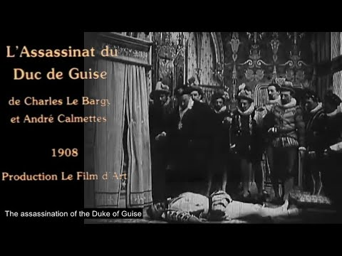
The Assassination of the Duke de Guise (Charles le Bargy and Andre Calmettes, France, 1908)
Pre WWI- Film d’art (581)

Slide 5
The Bicycle Thieves (Vittorio di Sica, Italy, 1948)
Postwar European Film (581)
Italian Neo-realism
Lack of narrative resolution

Slide 6
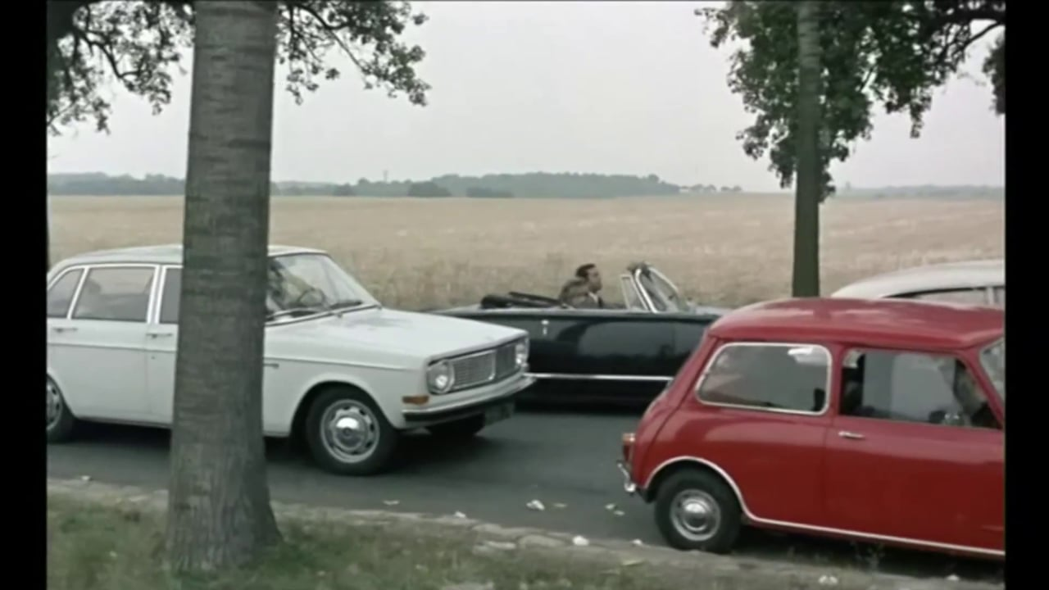
Weekend, (Jean-Luc Godard, France, 1967)
Postwar European Film (581)
French New Wave
The single tracking shot

Slide 7
Features of the Art Film (582)
Realism- “real spaces” and “real problems”
  Spatiotemporal construction allows for the violation of classical film conventions (583)
  Psychological ambiguity, transgressive sexuality
  Thematic of the human condition (583)
“Authorial expressivity” (auteur)
  The author functions at the level of form
  Formal elements become associated with a distinct author
  “Stylistic signature” (584)
Last Year at Marienbad (Alain Resnais, Sweden 1972)
Cries and Whispers (Ingmar Bergman, Sweden 1972)

Slide 8
Bordwell
The author is the “overriding intelligence” of organization/ structure .Bordwell p584
The Enigma of the classic detective film vs the Enigma of the art film (p. Bordwell 585)
  Story- Who committed the crime? How did they do it? Why did they do it?
  Plot- Who is telling the story? How is it being told? Why is it being told

Slide 9
Real
Applying Brecht to Blow-Up: Cinematography and the Disruption of Suture
Shot 1
On Screen
Imaginary
Spectator
Off Screen
Suture
Shot 2
On Screen
Real
Suture
Off Screen

Slide 10
Shot 3:
Temporal and Spatial Ambiguity in the Mime Sequence
Against cause and effect: why is the camera doing what it is doing?
Bordwell 582-84
Chatman, p. 157
Ellipsis
Realism-location vs. distraction
Jump Cuts produce a complex layering of subject positions, looks
Shot 1:
Shot 2:
Cinematography/ Sound
Wandering Narrative:
Point of View? Eyeline Match?
Shot 4-6:
Pan Left
Blow-Up (Michelangelo Antonioni, U.K., 1966)

Slide 11
Chatman
The Enigma that Blow-Up wrestles with has to do with the “ambiguity of visual appearance.” The relationship between the photographic image and the reality that it represents is tenuous. The truth claims of the image depend on the ways in which the image is contextualized (as a sign within a signifying system) Chatman 144
The darkroom sequence illustrates this process of Textualization
  Surface and Distraction
  Depth and Absorption
“textualization.”
MS- “narrative array” Semiotic Structure- chains of signifiers. Chatman 146
MS- Performing the zoom. Chatman 146
The Formation of Narrative.. Chatman 149
CU: The Gaze. Chatman 149-150

Slide 12
The Puzzle of Visual Reality
Blow-Up (Michelangelo Antonioni, U.K., 1966)
The Three Orders of Phenomena. Chatman 145
1. The Event (Visual Perception)
    Reality vs. realistic illusion
2. The Image (Photographic Representation)

Slide 13
The Puzzle of Visual Reality
The Three Orders of Phenomena. Chatman 145-
3. Narrative (Textual Reconstruction)

