Slide 1
Identification in the Cinema
Session 20: The Conversation, Sound and the Phantasmatic Body
“There is always something uncanny about a voice that emanates from a source outside the frame”

Slide 2
Key Terms
Corrigan and White
    Melodrama
    Synchronous sound vs non-synchronous sound
    Parallel vs contrapuntal (counterpoint) sound
    Diegetic vs nondiegetic sound
    Direct sound vs reflected sound
    Postproduction sound
    Room tone
    Automated dialog replacement (ADR)/looping
    Sound bridge
    Overlapping dialog
    Underscoring
    Narrative cueing
Mary Ann Doane, The Voice in the Cinema
    Phenomenology
    The phantasmic body (276)
    “Aura” Walter Benjamin (277)
    Presence (277)
    Room tone (278)
    Reverberation(278)
    Sound Perspective(278)
    Voice-off (278)
    Voice over (278-79)
    Sonorous envelope (283)
Key Themes
    Heterogeneity of filmic space 280
      -Virtual space of the diegesis
      -Visual space of the screen
      -Acoustic space of the theater
      Overhearing and voyeurism 282

Slide 3
The Heightened Gesture in Silent Film
A trip to the Moon, (Georges Méliès, France, 1902)
Birth of a Nation (Griffith, 1915, USA)
Sherlock Jr., (Buster Keaton, USA, 1922)

Slide 5
The phantasmic body (p276)
The body reconstituted by technology and practices of the cinema

Slide 6
A History of Sound in the Cinema
The production of the phantasmic body through the technological reunification of the voice and the image of the body:
— Automated dialog replacement (ADR)/looping
—synchronizers
—Moviola
— Flatbed Editing Table

Slide 7
    The Phenomenology of Cinematic Space (p 280)
    The Space of the diegesis: unconfined virtual space constructed by the film (audible+visible)

Slide 8
    The Phenomenology of Cinematic Space
    The Visible Space of the Screen
    Receptor of the image. Non audible.
    The acoustical space of the theater
    Visible to the spectator but inaccessible to the visual projection of the diegesis
Hiroshi Sugimoto, AL. Ringling Baraboo, 1996

Slide 9
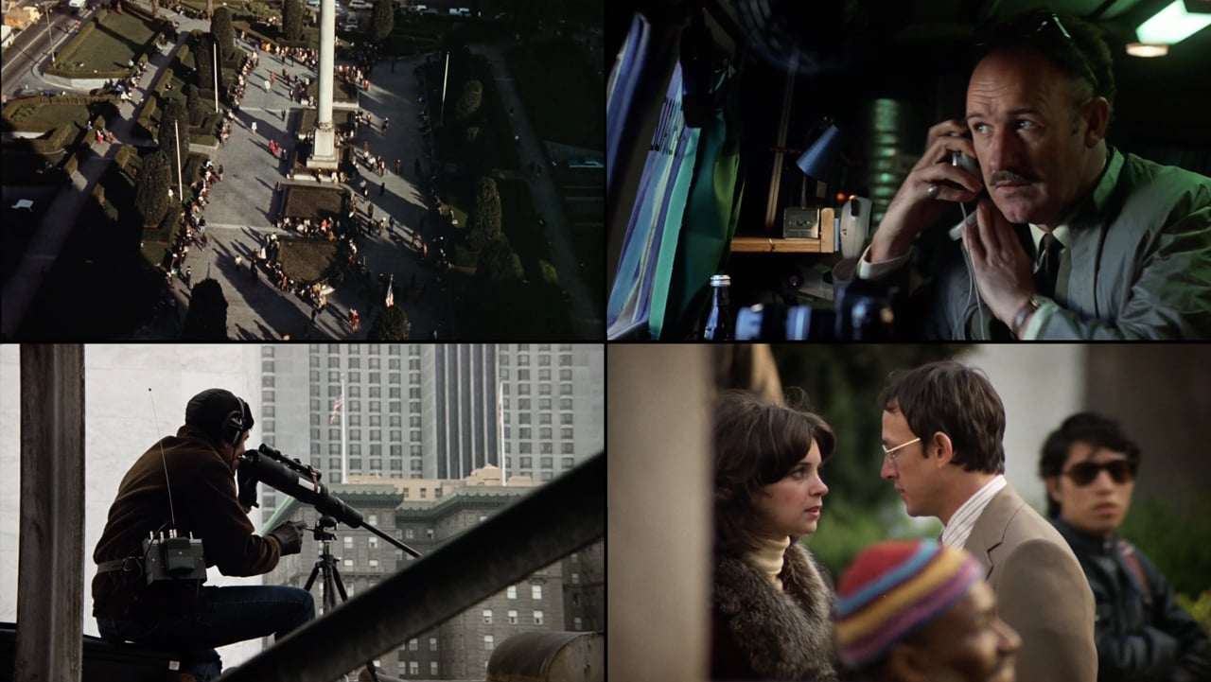
The Conversation (Francis Ford Coppola, 1974)
The Uncanny Nature of the Voice-off in The Conversation (p280-281)
“As soon as the sound is detached from its source, no longer anchored by a represented body, its potential as a signifier is revealed. There is always something uncanny about a voice which emanates from a source outside the frame…the voice-off is always “submitted to the destiny of the body” because it belongs to a character who is confined to the space of the diegesis, if not to the visible space of the screen. Its efficacy rests on the knowledge that the character can easily be made visible by a slight reframing which would reunite the voice and its source.”

