Slide 1
Identification in the Cinema
Session 21: The Conversation, Sound Ideology

Slide 2
Key Terms
Mary Ann Diane, The Voice in the Cinema
    Overhearing and voyeurism 282
    Sonorous envelope (283)
Jonathan Kirshner
New Hollywood Cinema
Louis Althusser
State Ideological Apparatuses
Ideology

Slide 3
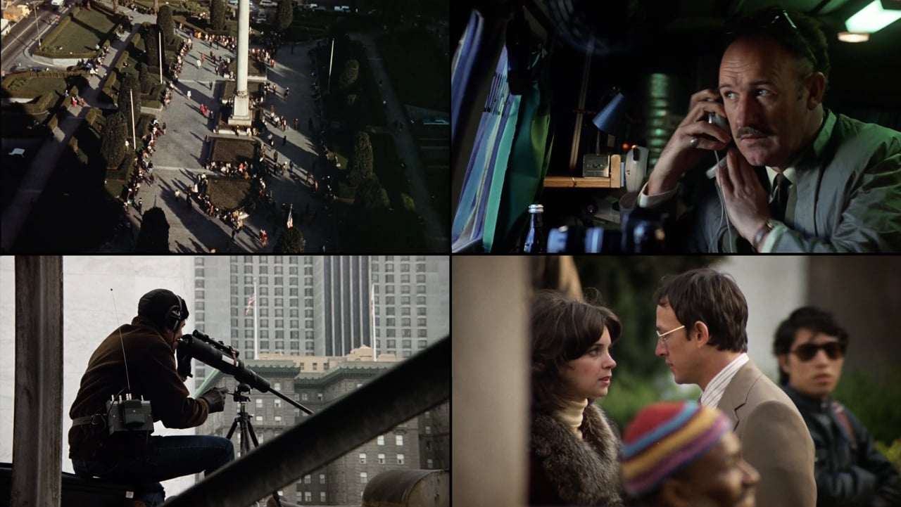
The Conversation (Francis Ford Coppola, 1974)
The Uncanny Nature of the Voice-off in The Conversation (Doane, p281)
“As soon as the sound is detached from its source, no longer anchored by a represented body, its potential as a signifier is revealed. There is always something uncanny about a voice which emanates from a source outside the frame…the voice-off is always “submitted to the destiny of the body” because it belongs to a character who is confined to the space of the diegesis, if not to the visible space of the screen. Its efficacy rests on the knowledge that the character can easily be made visible by a slight reframing which would reunite the voice and its source.”

Slide 4
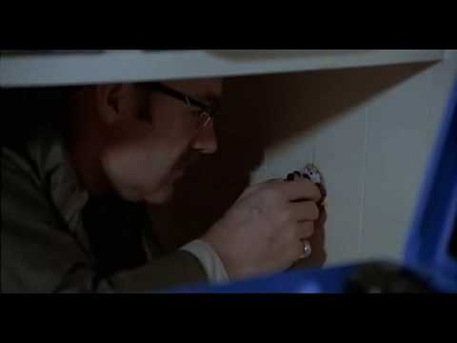
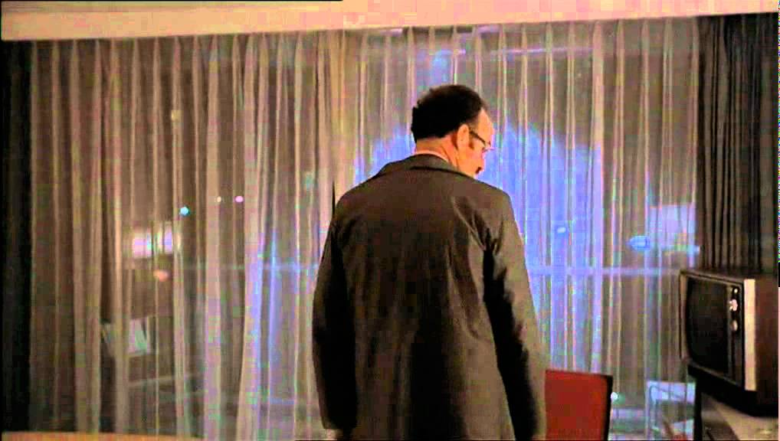
The Voice vs. The Look (Doane p. 283)
Space, for the child, is defined initially in terms of the adible, not the visible…The first differences are traced along the axis of sound: the voice of the mother, the voice of the father. Furthermore, the voice has greater command over space than the look- one can hear around corners, through walls…In comparison with sight… the voice is reversible: sound is simultaneously emitted and heard, by the subject himself…

Slide 5
The Sonorous Envelope (Doane p. 283-284)
Imaginary Unity
Symbolic Separation
The voice …traces forms of unity and separation between bodies. The mother’s soothing voice, in a particular cultural context, is a major component of the “sonorous envelope” which surrounds the child and is the first model of auditory pleasure. An image of corporeal unity is derived from the realization that the production of sound by the voice and its audition coincide. The imaginary fusion of the child with the mother is supported by the recognition of common traits characterizing the different voices…
Yet, the imaginary unity associated with the earliest experience of the voice is broken by the premonition of difference, the division, effected by the intervention of the father whose voice, engaging the desire of the mother, acts as the agent of separation and constitutes the voice of the mother as the irretrievably lost agent of desire. The voice, far from being being the narcissistic measure of harmony, is the voice of interdiction.
The voice thus understood is an interface of imaginary and symbolic, pulling at once toward the signifying organization of language and toward original and imaginary attachments, “representable in the fantasm by the body, or by the corporeal mother, the child at her breath”

Slide 6
New Hollywood Cinema and the Paranoid Style in American Films of the 1960s and 70s
Straw Dogs (Sam Peckinpah, 1971)
The Parallax View (Alan Pakula, 1974)
Three Days of the Condor, (Sidney Pollack, 1975)
Taxi Driver (Martin Scorcese, 1976)
Blow Out, (Brian De Palma, 1981)
Historical Milieu
1968: Assassination of Bobby Kennedy
1969: Extrajudicial assassination of Fred Hampton
1970: Kent State Shootings
1971: Pentagon Papers
1971: Cointelpro (Citizens ‘Commission to Investigate the FBI)
1972-74: Watergate Scandal

Slide 7
Louis Althusser
Infrastructure vs Superstructure
Ideological State Apparatuses
Ideology
Dream/Illusion/Image: Ideology is the representation of the Imaginary Relationship of the individual to their
Real Conditions of Existence
Interpellation

Slide 8
How might we apply Althusser’s concepts of Ideological State Apparatuses and Interpellation to a reading of The Conversation?

