Slide 1
Identification in the Cinema
Session 28: Bound

Slide 2
Key Terms
Castration anxiety: 1. Child becomes aware of sexual difference (Mother’s lack of a penis)
2. Desire for the mother/identification with the mother) registers as guilt.
3. Fear that the father will remove child’s penis as punishment for guilt.
Castration anxiety marks the Phalic Stage in which the child enters “the world of law and language(” (Mulvey) and submits to the “Name/No of the Father.” (Lacan)
Phallus: An object, image, symbol that represents the penis. Please note that a phallus is NOT a penis.
        In psychoanalysis: Freud describes the phallus as a symbol of the active/productive power of
        male agency (subject)vs. the passiveness of the female object.
    Narcissism: Mis/recognition of the image in the mirror/on the screen
                Mirror Stage (please note Mulvey’s description of the fact that the mirror stage involves
                a crisis of interpretation over the status of the image that I see in the mirror: Is the
                image that stare’s back at me a reflection of myself? A projection of an “other”? )
Identification with the image on the screen.
Symbolic

Slide 3
Dear Students,
Much of the explanation of psychoanalytic theory included in this powerpoint will sound sexist, chauvinistic, Phallocentric ….and that’s because it is. PLEASE REMEMBER AS WE WORK THROUGH THE SLIDES, THAT THEY OFFER EXPOSITION OF PSYCHOANALYTIC THEORY THAT MULVEY IS USING AGAINST ITSELF AS A WAY TO OFFER A CRITIQUE OF THE PHALLOCENTRIC NATURE OF PSYCHOANALYSIS AND NARRATIVE CINEMA.
For her it is a useful tool that she is using against itself in an attempt to foster new non phallocentric approaches to cinema and cinematic critique.
My use of the traditionally gendered and chauvinistic language is not meant as any endorsement of it, but is rather provided as a way to indicate the critical/ethical/political urgency with which Mulvey wrote her essay. I also hope that this problematic discourse might serve as a provocation to us to continue to find ways to critically adapt, redefine, redeploy theoretical concepts in ways that account for the multiple threads of identity and personal experience that enrich the wonderfully diverse tapestries of our local, national and global communities.
It is also my hope that we might apply Mulvey to a reading of Bound that might be sensitive to the intersectionality of the subjects that it represents. (Gender, Sexuality, Race, Economic and Social Class).

Slide 4
Key Terms
Castration anxiety: 1. Child becomes aware of sexual difference (Mother’s lack of a penis)
2. Desire for the mother/identification with the mother) registers as guilt.
3. Fear that the father will remove child’s penis as punishment for guilt.
Castration anxiety marks the Phalic Stage in which the child enters “the world of law and language(” (Mulvey) and submits to the “Name/No of the Father.” (Lacan)
Phallus: An object, image, symbol that represents the penis. Please note that a phallus is NOT a penis.
        In psychoanalysis: Freud describes the phallus as a symbol of the active/productive power of male agency (subject)vs. the passiveness of the female object.
    Scopophilia: 1. Treating other people as objects.
    2. Subjecting the object to a “controlling and curious gaze.” (Mulvey)
3. Freud-> ex. Voyeurism: private and forbidden looking)
                4. Visual pleasure is derived from the subjection of an unwitting/unwilling object to active and controlling looking.
    Narcissism: Mis/recognition of the image in the mirror/on the screen
                Mirror Stage (please note Mulvey’s description of the fact that the mirror stage involves a crisis of interpretation over the status of the image that I see in the mirror: Is the image that stare’s back at me a reflection of myself? A projection of an “other”? )
Identification with the image on the screen.
Symbolic

Slide 5
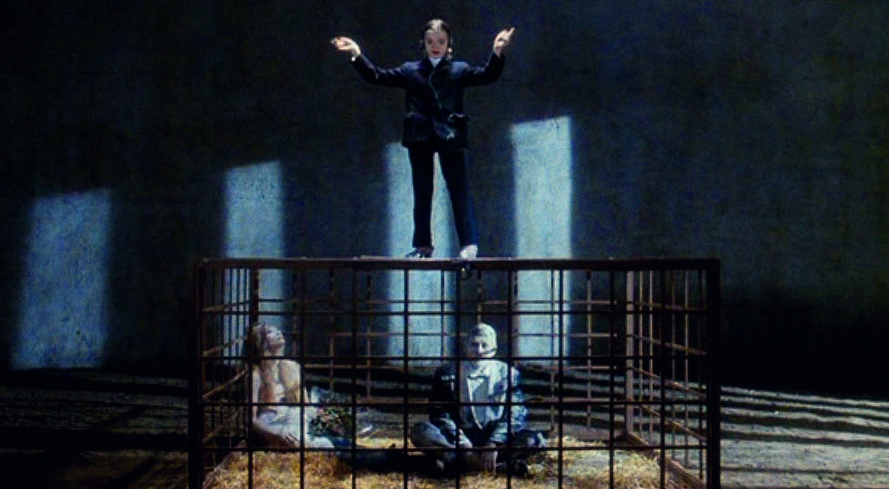
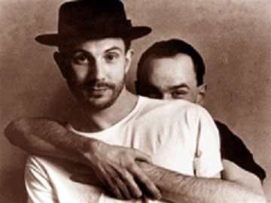

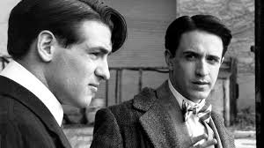
    New Queer Cinema
Derek Jarman, Edward II, 1991
Laurie Lynd, R.S.V.P., 1991
Gregg Araki, The Living End, 1992
Tom Kalin, Swoon, 1992

Slide 6
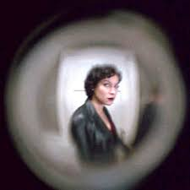
    Bound (The Wachowskis, USA, 1996): Complicating cinematic regimes of visuality
Scopophilia
            Scopophilia: Visual pleasure is derived from the subjection of an unwitting/unwilling object to active and controlling looking.
    1. Treating other people as objects.
    2. Subjecting the object to a “controlling and curious gaze.” (Mulvey)
Voyeurism
Exhibitionism

Slide 7
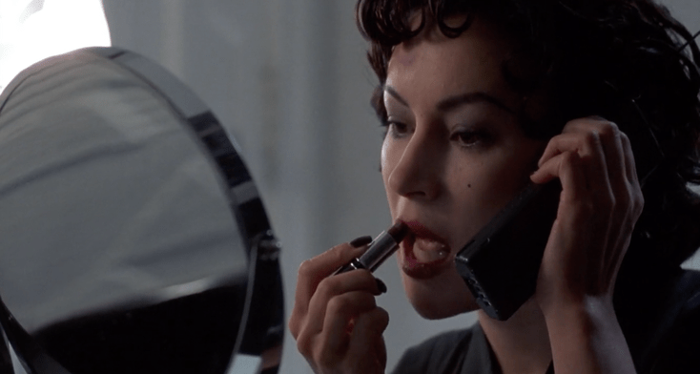
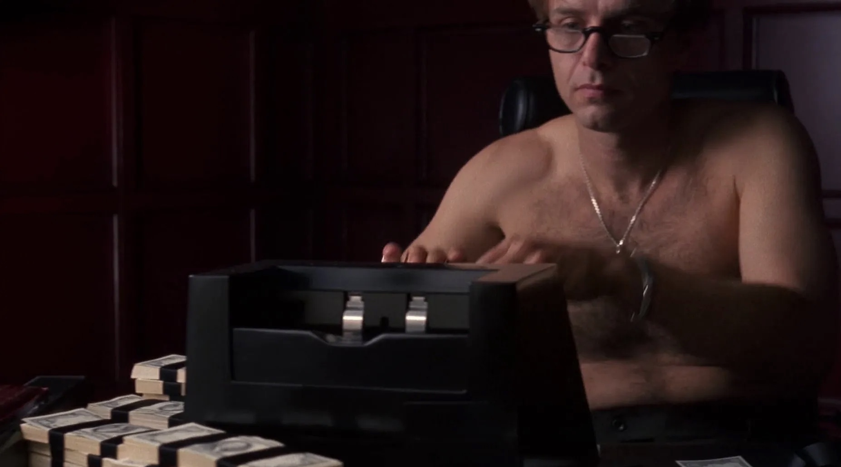
Narcissism and the Imaginary

Slide 8
Love at First Sight: The Gaze and The Look
Hans Holbein, The Ambassadors, 1533
Diego Velazquez, Las Meninas, 1656

Slide 9
Love at First Sight: The Gaze and The Look
Corky’s look
Violet’s look

Slide 10
    The Overhead Shot

Slide 11
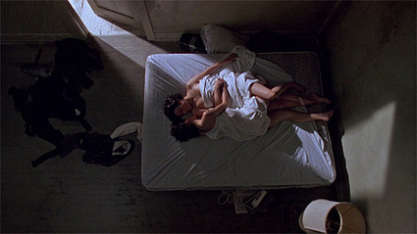
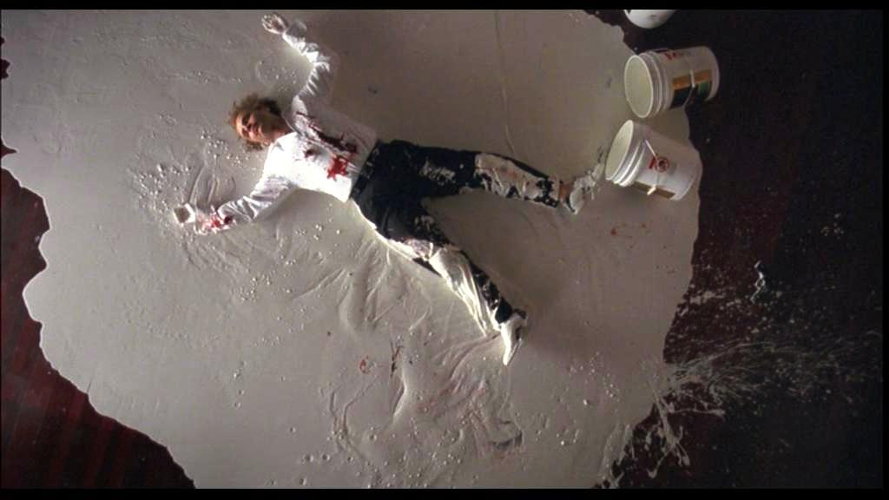
    How is the overhead shot deployed throughout the film?

