Slide 1
Identification in the Cinema
Session 3: The Incredulous Spectator

Slide 2
Agenda
Lecture: Tom Gunning “An Aesthetics of Astonishment”
Discussion

Slide 3
Tom Gunning, “An Aesthetics of Astonishment,” (1989)
    “Although I have my doubts about whether actual panic took place in the Grand Café’s Salon Indien, there is no question that a reaction of astonishment and even a type of terror accompanied many early projections…
…I therefore don’t intend to simply deny this founding myth of the cinema’s spectator, but rather to approach it historically.” p. 116
Auguste and Louis Lumière, L’Arrivee d’un train en gare de la Ciotat, 1895

Slide 4
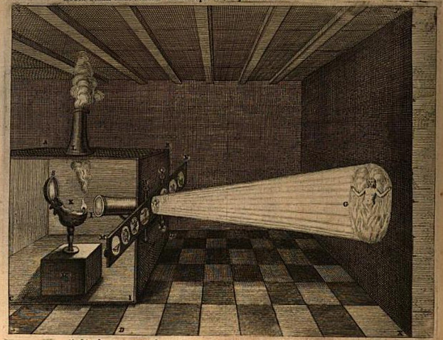
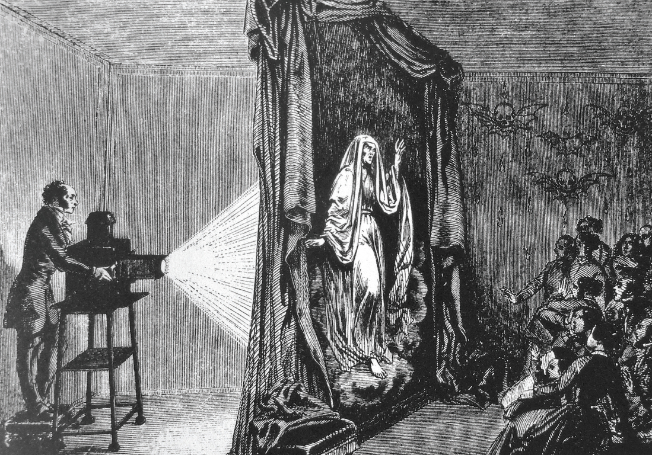
The Magic Lantern
    Marvelous vs. the curious (Gunning, 117, 121, 125)
Illustration of the projection of hellfire or purgatory from Athanasius Kircher, Ars Magna Lucis et Umbrae, 1671
Etienne Gaspard Robertson, Phantasmagoria, 1797

Slide 5
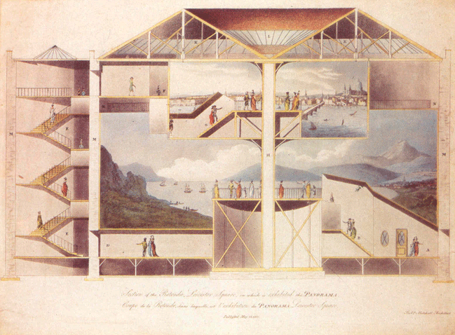
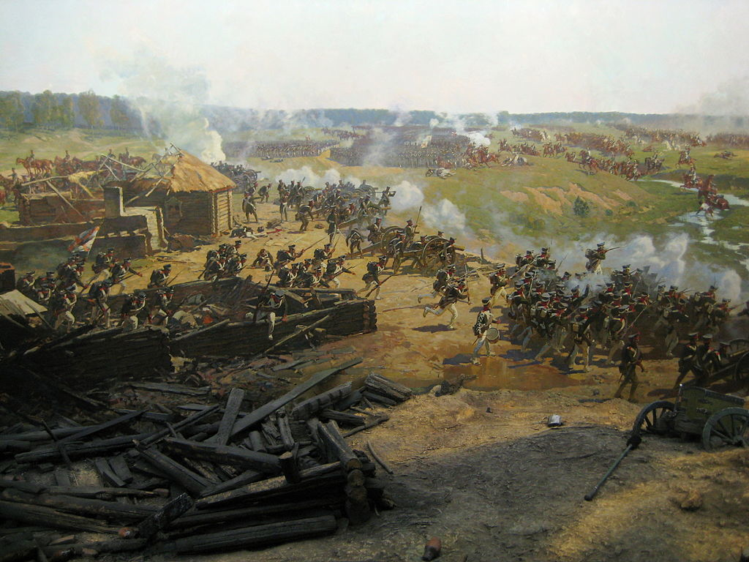
    19th Century Technologies of Visual Representation
Panorama
Cross section of Robert Barker's two-level panorama at Leicester Square.
Colored aquatint by the architect, Robert Mitchell, c. 1793. British Museum, London.
Franz Roubaud, Battle of Borodino 1912

Slide 6
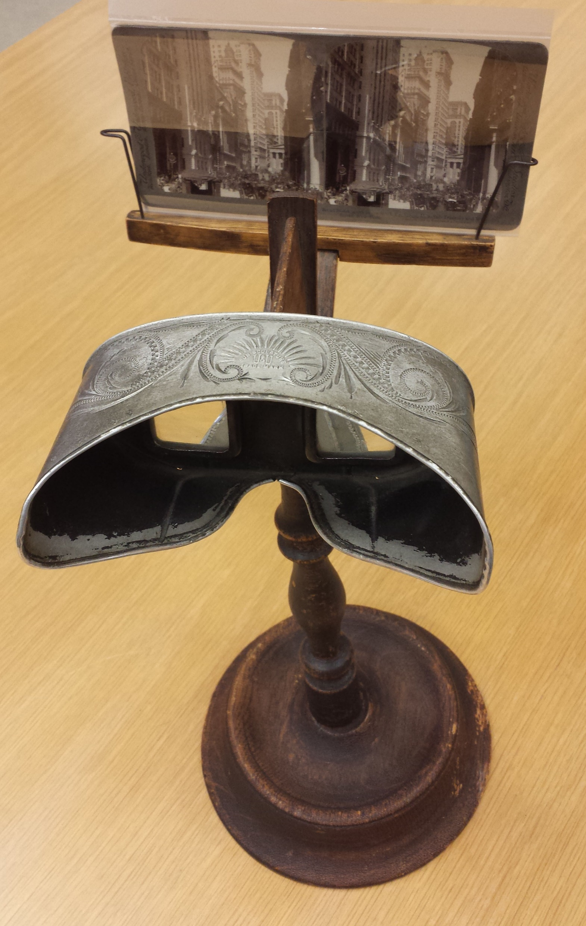
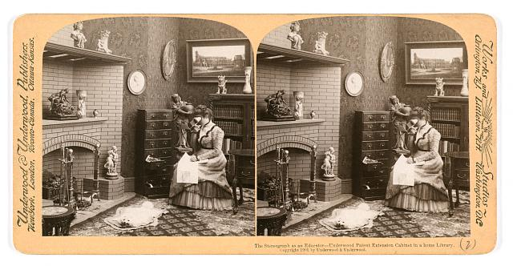
    19th Century Technologies of Visual Representation
Stereoscope
The stereograph as an educator – Underwood patent extension cabinet in a home library. Stereograph copyrighted by Underwood & Underwood, 1901
Underwood & Underwood stereoscope and stereograph card

Slide 7
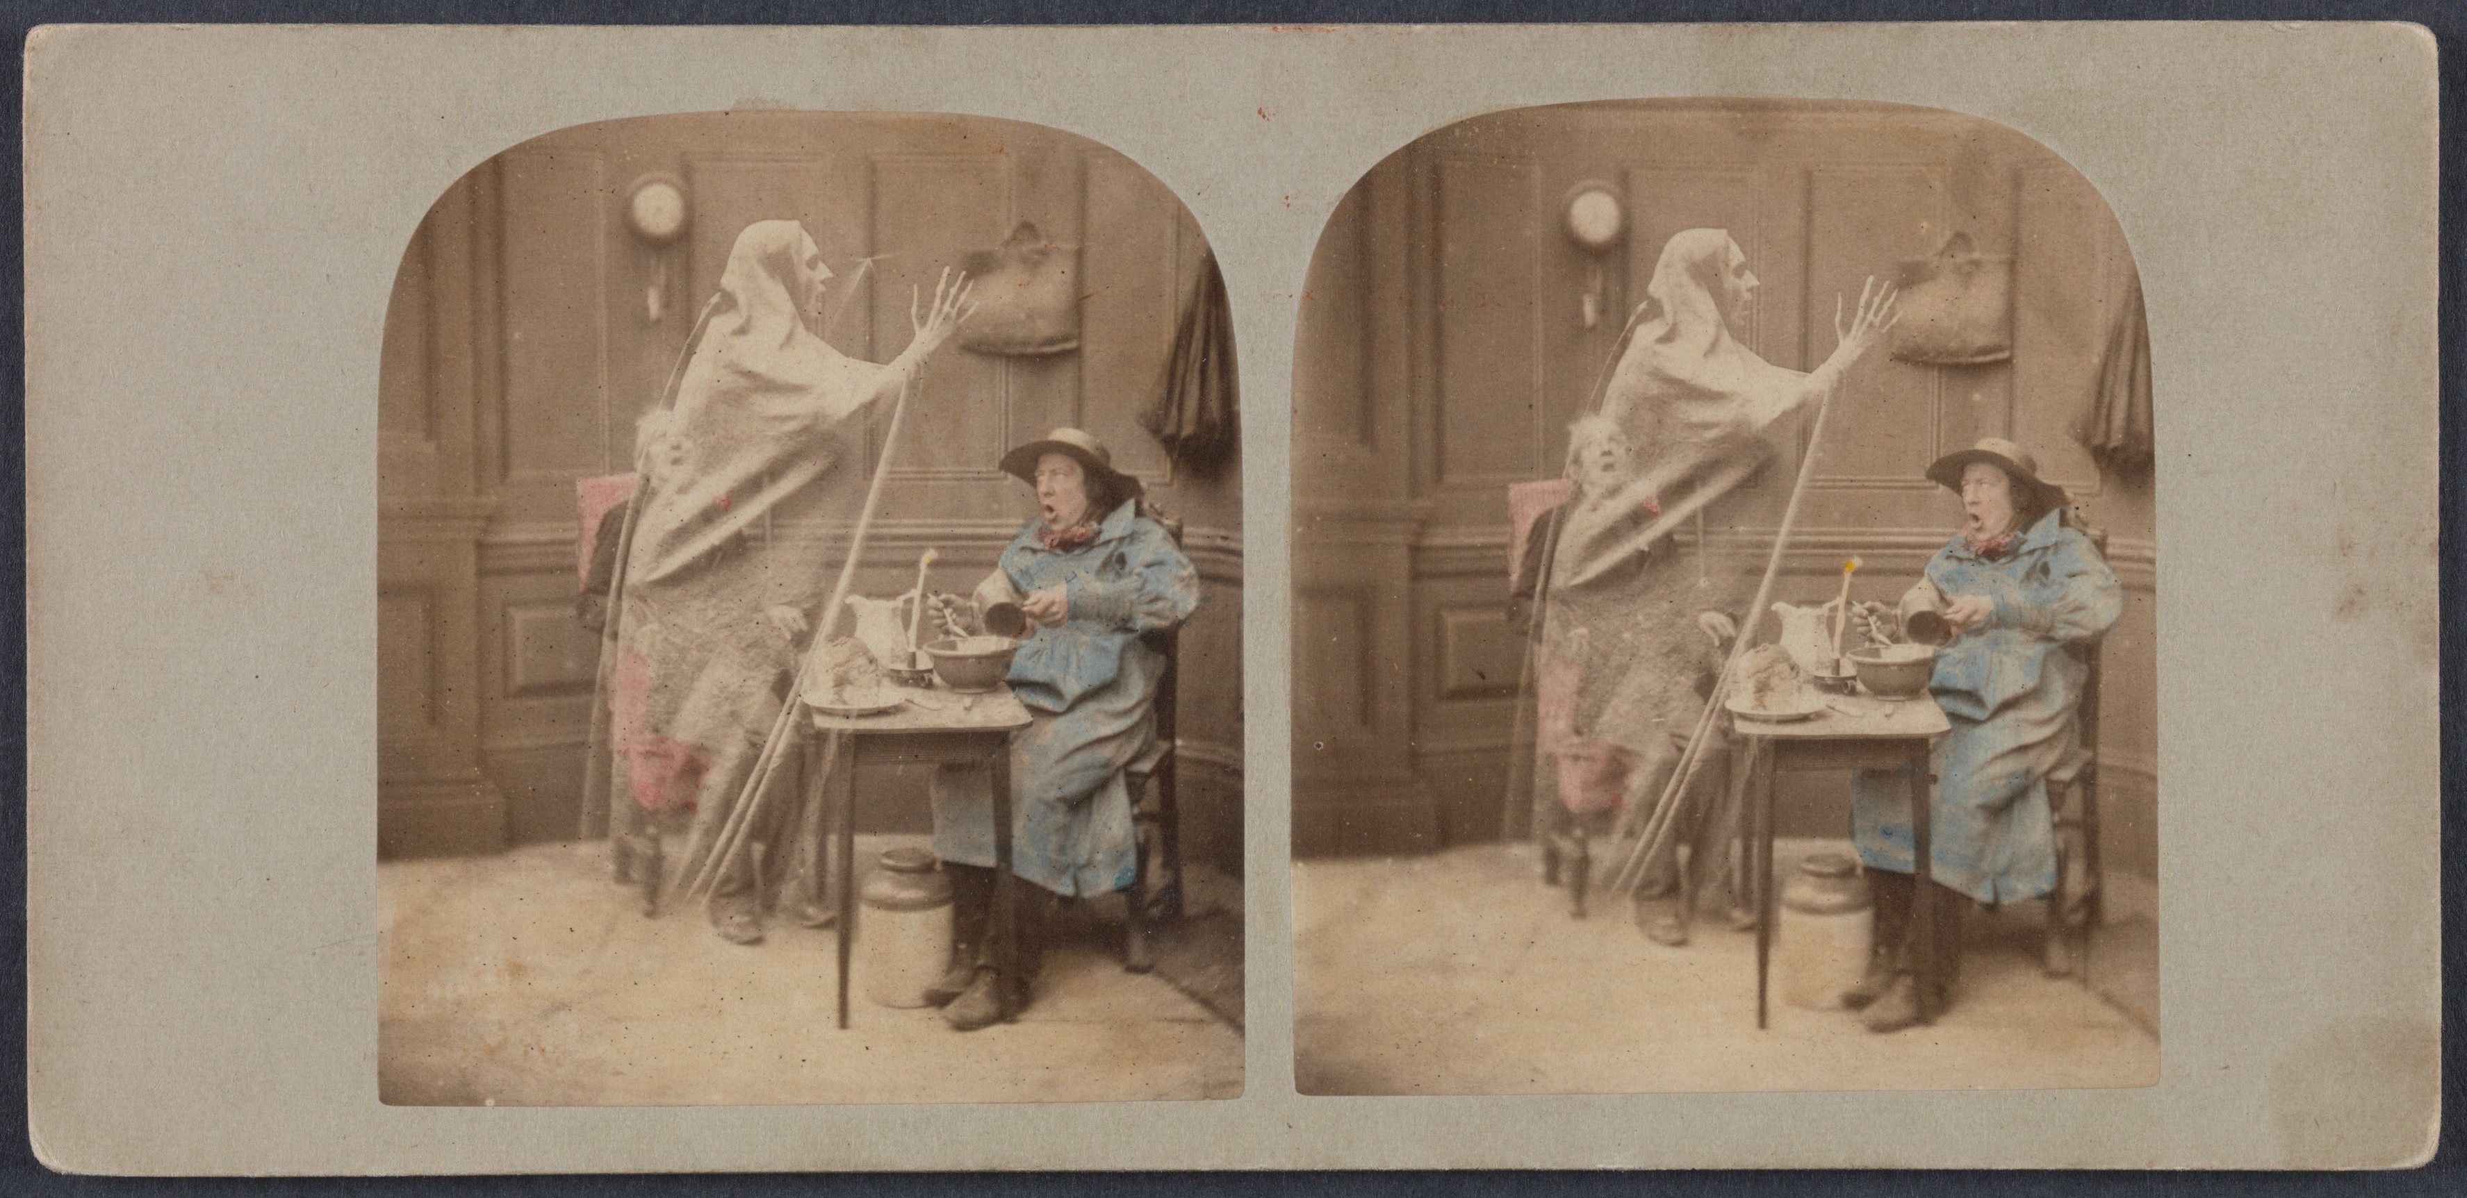
London Stereoscopic Company, The Ghost in the Stereoscope, c. 1856

Slide 8
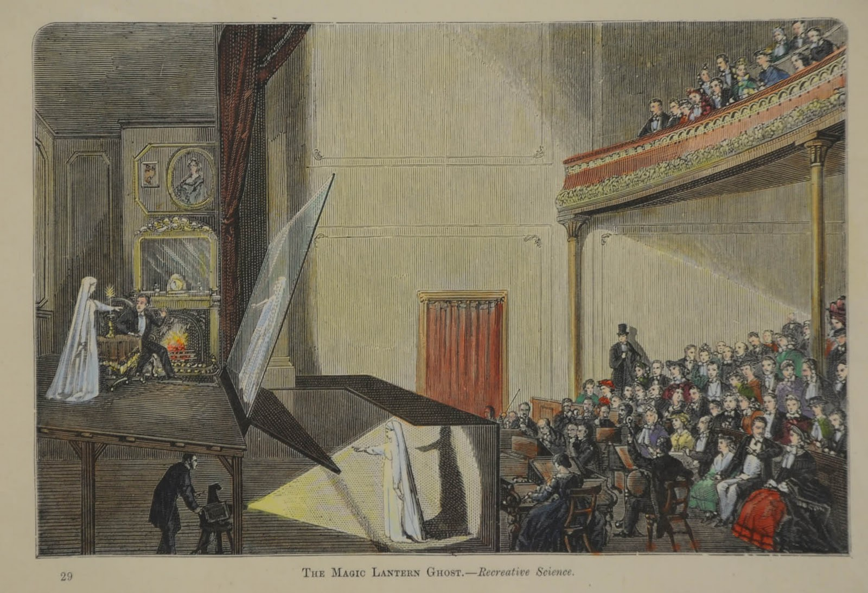
From the Magic Lantern to the Magic Theater
Pepper’s Ghost, 1862

Slide 9
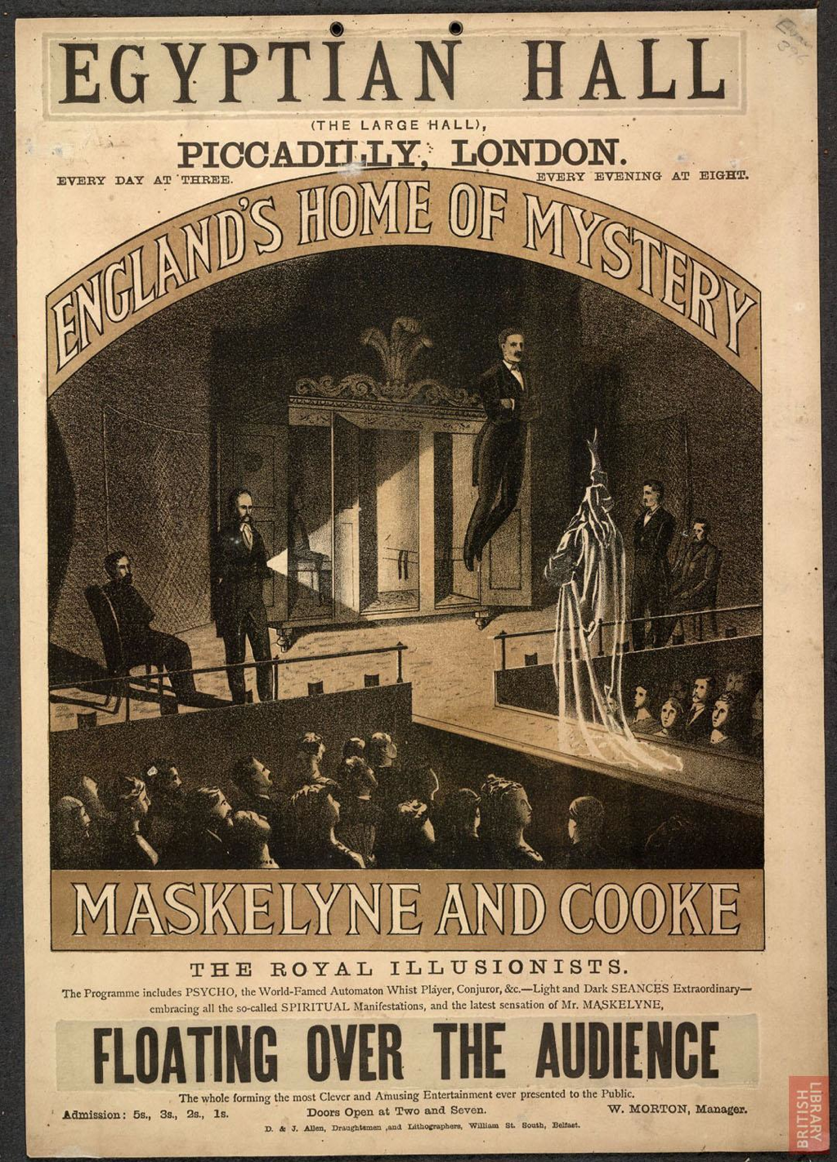
    Magic theater (Gunning, 116) vs. Cinema
    Dialectical relationship between stasis and movement (118)
Auguste and Louis Lumière, L’Arrivee d’un train en gare de la Ciotat, 1895
Egyptian Hall, Piccadilly. Maskelyne & Cooke, 1876
Auguste and Louis Lumière, Demolition of a Wall, 1896

Slide 10
Alienation(128)
as condition of modern subjectivity (economic/political/social)
as condition of modernist aesthetics/theories of representation
“aesthetic of distraction” vs. “illusion of absorption” (Gunning, 127)

Slide 11
In what ways does Keaton’s film support/ illustrate Gunning’s arguments about the visual sophistication of early film spectatorship?
How does the film play with genre?
https://youtu.be/JRXkAhMYKEc

