Slide 1
Identification in the Cinema
Session 6: Editing (Part 1)
Time Duration and the Image

Slide 2
Agenda
Cinematography Review
Editing
Duration
Semiotics: Metz and Wollen

Slide 3
Camera Angle
High Angle Shot
Psycho (Alfred Hitchcock, USA,)
Eye Level Shot
Low Angle Shot

Slide 4
Camera Angle
Overhead Shot
The Matrix Reloaded(The Wachowskis, USA, 2003)
Shoulder Level Shot
Vertigo (Hitchcock, USA, 1958)
Hip Level Shot
Vertigo (Hitchcock, USA, 1958)
Shoe/Ground Level Shot
The Matrix (The Wachowskis, USA, 1999)

Slide 5
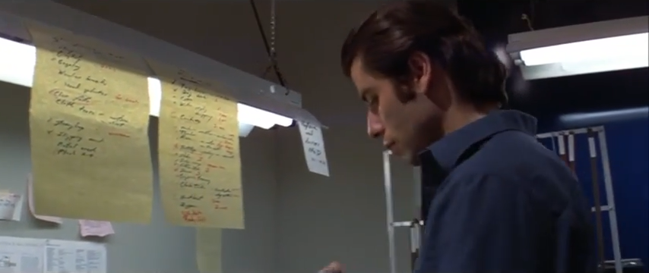
Cinematography
Blow Out (Brian De Palma, 1981)

Slide 6
Shot: continuous take/ continuously exposed piece of film. Continuous point of view between two edits.
  Average shot length (ASL):
  Long take (sequence shot): shot of longer duration than the pace (ASL/tempo) either of the film or of films in general. Often contains complex camera movement and blocking.
Edit
  Cut
  Editing transitions
    Fade-out/fade-in
    Dissolve/Wipe
  Crosscutting (parallel editing): cutting between two actions, implying that they are occurring simultaneously
  Ellipsis: the shortening of the plot time by deliberately omitting intervals or sections of story time or action; marked by transitions (fade-out/in, dissolve, wipe, change of scene)
  Overlapping editing: shot-changes that depict multiple shots of the same action
Disjunctive Editing
    Jump cut
    Montage
Editing

Slide 7
Duration
Length of time required to represent an event or action
Narrative Duration
  Scene vs
  Sequence
  Pacing:
  Narrative frequency:
Single shot or series of shots that depict a unified/ continuous space and time.
Synthesis of any number of shots or scenes that depict an action or motif regardless of their temporal or spatial unity
    Tempo at which film moves. Rhythm/flow of the dialogue/action in conjunction with the overall scene or sequence
  Number of times a shot is shown

Slide 8
Duration
Twelve Monkeys (Terry Gilliam, UK/ USA, 1995)
The narrative “space” occupied and experienced by the characters. It encompasses all aspects of internal world of the film whether they actually appear on screen, exist offscreen (spatially temporally). (Metz p57)
Diegesis:
Temporality: (narrative frequency/flashback/flashforward)
  Story duration::
  Plot duration:
  Screen time:
  Order, duration, frequency and sequence of all the events pertinent to the narrative whether they are shown to us or not.
  Length of time depicted in a film. Plot time shows us selected story events but only refers to others. It usually covers a shorter span than the complete story.
  Length of the film
Story Duration
Story Duration
Screen Time: 129 min.
1917
1990
1996
2035
Story Duration: 118 years

Slide 9
Axis of Action
The implied line perpendicular to the camera
Continuity Style:
180 Degree Rule
The Shining (Kubrick, USA,
—Camera remains on the same side of the Axis of Action in order to preserve the apparent spatial relationships of the characters and objects to each other.
—When the action cuts, the camera can take up a position anywhere along the 180 degree arc on the same side of the axis of action.
Violating the 180 degree rule will produce visually disorienting effects: -“reverse cut:” reversal of spatial relationship between objects in the visual field
-dizzying effect of 360 degree camera tracking shots
—an intermediate (“buffer”) shot and/or camera movement can move across the line in ways that preserve the spatial orientation of the viewer

Slide 10
Continuity Style:
30 Degree Rule
Camera must move at least 30 degrees between cuts
Violation of the 30 Degree Rule-> Jump cut
Breathless, (Jean-Luc Goddard, France, 1960)

Slide 11
Continuity Editing 2: Point of View Sequence
Scarface, (Brian De Palma, USA, 1983)
High angle, medium shot
Camera cuts to
Low angle, long shot
(an eyeline match)

Slide 12
Graphic Match:
Continuity Editing 3: Match on Action/Graphic Match
North By Northwest (Hitchcock, USA, 1959)
Match on Action:
Direction/motion picked up in subsequent shot depicting the continuation of the shot. Editor cuts from one shot to another view that matches the first shot's action.
Psycho, (Hitchcock, USA, 1959
Dominant formal element (pattern, shape, mass, line) provides a transition to similar formal element in the next shot

Slide 13
Semiotics: “theory of signs”. Attempt to understand how meaning is encoded and transmitted
Gilbert Harman “Semiotics and the Cinema: Metz and Wollen
Metz
Ferdinand de Saussure
SIGNIFIER
+
SIGNIFIED
SIGN=
REFERENT
Importance of the narrative/feature-length film (related to novelistic fiction)
Basic units of semiotics of the film- “film image” (Metz- syntagma)
    —montage(editing)
    —camera movement
    —scale of the shot (camera distance)
    —sound (speech…but also sound effects and music)
    —sequences (scenes… other larger structures)

Slide 14
    Linguistic vs. Cinematic Denotation
    Codification of language is conventional (arbitrary).
    Lacks “natural meaning”
    Codification of film language is based on a natural/immediate relationship between image and meaning
Lacks syntax: image already at the level of the paragraph
Codification of film techniques “syntagmatic categories” “denotative codes”
—Pan and tracking shot (camera movement)
—Dissolve, fade in (editing)
—Close ups
Syntax
Birth of a Nation (Griffith, 1915, USA)

Slide 15
Semiotics of Denotation vs. Semiotics of Connotation
What do we see and hear? How does film present its plots?
How is it presented? What is implied? What types of impressions associations are suggested?
The Third Man (Carol Reed, 1949, US/UK)

Slide 16
Wollen
—Disagrees with Metz’ “misguided” investment in realism.
      —Metz takes the linguistic analogy to seriously.
—Semiotics of the cinema is not about studying the order and function of the “main signifying units in the filmic message”
—because film does not carry messages in a conventional sense
—Bases his theory on the 19th century philosopher Charles Sanders Pierce:
The connection to the referent is arbitrary and secured by convention.
Symbol
Icon
Index
The connection to the referent is secured through resemblance.
A direct causal relationship exists between the referent and the sign
—The goal is to uncover the hidden codes exploited in film (connotation) to produce the “poetry” of the cinema.

Slide 17
What are some of the problems that Harman identifies in both Metz and Wollen?
List

Slide 18
Structuralist Reading
Post -Structuralist Reading
It Should Happen to You (George Kukor, USA, 1954)
Signifying system (Film is a text to be read)
  Lighting
  Camera position
  Camera movement
  Blocking
  Character function (Propp)
Ideological Critique (Althusser)
Kennedy-Nixon Debates, (Televised), 1960
Intertextuality (Film is an “unfinished” text)
  Reading and writing functions are blurred
Intersubjectivity
Symptomatic Reading (progressive text)

