Slide 1
Identification in the Cinema
Session 9: Apparatus Theory
Imitation of Life

Slide 2
Agenda
Slide 3 Review Semiotics
Slide 4 Key Terms
Slide 5-8 Baudry: Identification and Apparatus Theory
Slide 9 Freud and Identification

Slide 3
Semiotics
Charles S. Peirce (1839-1914)
Theorization of the relationship between the sign and the referent
Symbol
Icon
Index
The connection to the referent is arbitrary and secured by convention.
The connection to the referent is secured through resemblance.
A direct causal relationship exists between the referent and the sign
Ferdinand de Saussure (1857-1913)
SIGNIFIER
+
SIGNIFIED
=SIGN
REFERENT
Roland Barthes, Mythologies (1915-1980)
Representation as a sign system
Myth: “…second-order semiological system. That which is a sign (namely the associative total of a concept and an image) in the first system, becomes a mere signifier in the second.” Barthes, Myth Today, p. 113
Signifier 2.Signified
3. Sign
Language
Myth
Signifier II. Signified
III. Sign

Slide 4
Key Terms: Psychoanalysis, Apparatus Theory and Spectatorship
Metapsychology: discourse about psychology. With regard to Freud this is about the structure of the psychoanalytic subject (id->ego->superego) concepts of psychoanalytic theory
Apparatus Theory
    Plato’s Cave:
    Ideological critique of cinema (space, technology, spectatorship)
    Anthropocentrism of single point perspective
Spectatorship (cinematic subject)
    The hallucinatory nature of cinema (immersive)
    The impression reality
Psychoanalysis
    Conscious (CS), Proconscious (PCS), Unconscious (UCS)
    Desire
    Subjectivity (Lacan)
        Imaginary
            Mirror Stage
        Symbolic
            Signification/Language
        Real
            Trauma

Slide 5
Shot 3:
Identification and Apparatus Theory
Cinematic representation is ideological
-> Techniques of production(camera and editing) are ideological
-> Conditions of display (movie theater) are ideological
Experiencing the world of the film as if it were reality
All that Heaven Allows, (Douglas Sirk, USA, 1955)
Shot 1:
Establishing Shot
Shot 2:
Pan left. Tilt down
Crane Shot/High Angle
Mise en Scène
Shot 4:
Pan Left

Slide 6
Plato and the Allegory of the Cave (Baudry, 151-154)
    The “philosophical” apparatus: space+techniques of projection+spectator
Jan Saenredam after Cornelis van Haarlem, Plato’s Allegory of the Cave, 1604

Slide 7
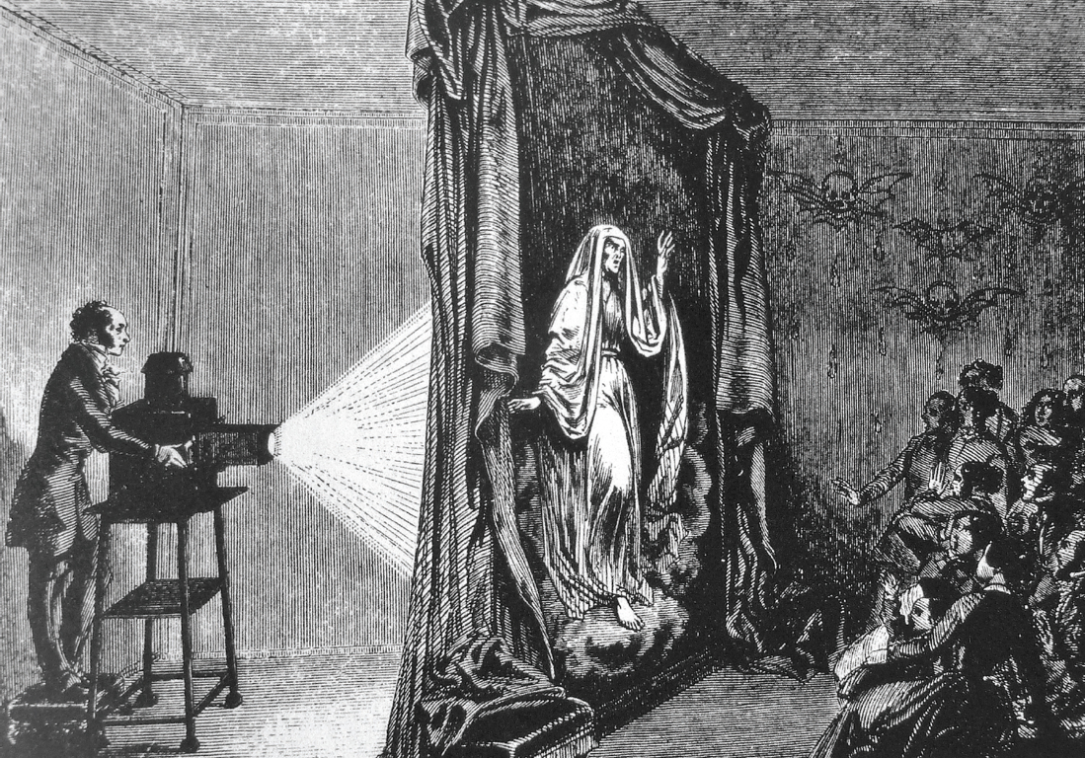
The precinematographic apparatus
“We can thus propose that the allegory of the cave is the text of a signifier of desire which haunts the invention of cinema and the history of its invention.” Brandy p.156
Athanasius Kircher, Camera obscura, 1646
Jan Saenredam after Cornelis van Haarlem, Plato’s Allegory of the Cave, 1604
Etienne Gaspard Robertson, Phantasmagoria, 1797

Slide 8
Cinematographic Apparatus and the Psychical Apparatus
It Should Happen to You (George Kukor, USA, 1954)
Imitation of Life, (Douglas Sirk, USA, 1959)
The Dream and the Psychical Apparatus of the Cinema
“the scene of the cave (and of cinema) is perhaps quite different from that of the activity of representation in a state of wakefulness.” (Brady, 156). It is more like a dream.
Spatial dynamics of the unconscious as represented in the dream: “If the unconscious, insofar as it belongs to waking thought, needs to be represented in dreams, it is represented in them in underground places” (Freud, Interpretation of Dreams in Braudy, 156)
Temporal regression: return to the womb- rest, warmth, isolation
Topical regression: blurring of the boundaries between Cs, Pcs, Ucs systems (thoughts->images)

Slide 9
Freud and Identification
It Should Happen to You (George Kukor, USA, 1954)
Imitation of Life, (Douglas Sirk, USA, 1959)
Cathexis: investment of emotional or mental energy in a subject, object (material or ideological
Narcissism (p. 159
Projection and the dream screen (Braudy p. 159-160)
The cinema as a simulation apparatus (Braudy p161)
Analyzing the impression of reality- perception vs. representation “perception of the image passing for perception (Braudy p. 163)

