Slide 1
Identification in the Cinema
Session 29: Get Out – Richard Dyer- Lighting for Whiteness
“Power in contemporary society habitually passes itself of as embodied in the normal as opposed to the superior.” Dyer 127
Ontology…does not permit me to understand the being of the black man. For not only must the black man be black; he must be black in relation to the white man.” Fanon, the Fact of Blackness” p. 110

Slide 2
Key Terms
The invisibility of whiteness
Shadow Archive- Alan Sekula
Visualization vs. counter visuality (Nicholas Mirzoeff)
Existential Psychology (Jean Paul Sartre, Simone de Beauvoir, Franz Fanon) Dyer 130
Scientific racism
Ontological resistance (Fanon)

Slide 3
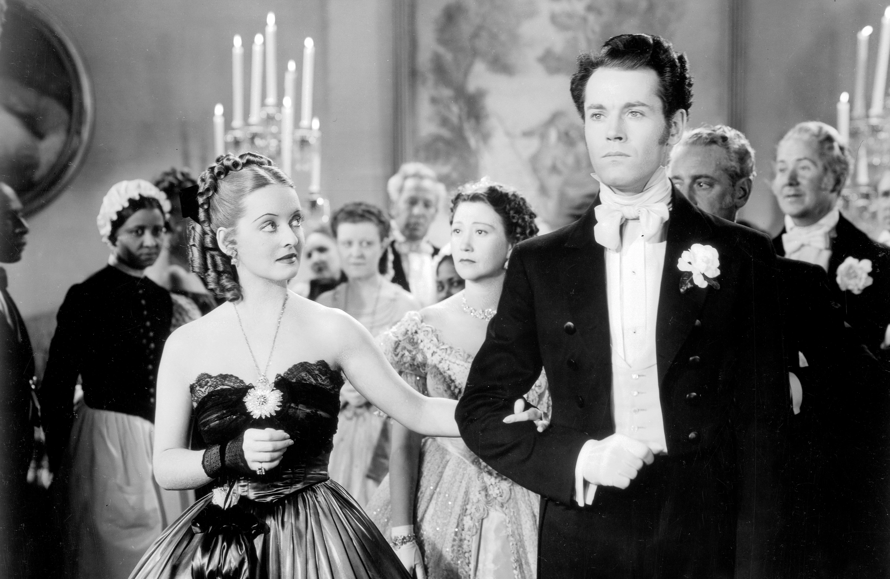
The Invisibility of Whiteness
“the assumption that a normal face is a white face runs through most published advice given on photo-and cinematography…”. -Dyer, 660
Blond Venus (Josef von Sternberg, USA, 1932)
Jezebel (William Wyler, USA, 1938)

Slide 4
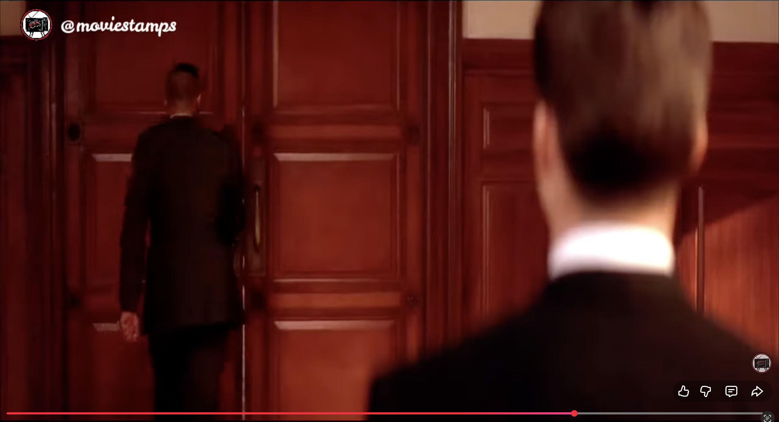
The Racial Politics of Whiteness
Movie lighting in effect discriminates on the basis of race. As the rest of this chapter will argue, such discrimination has as much to do with the conceptualization of whiteness…” Dyer 666
A few Good Men (1992)

Slide 5
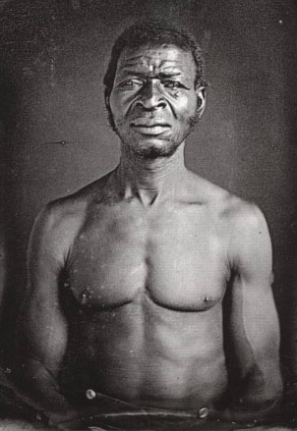
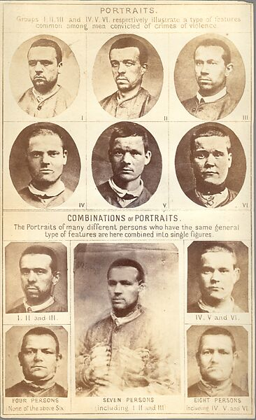


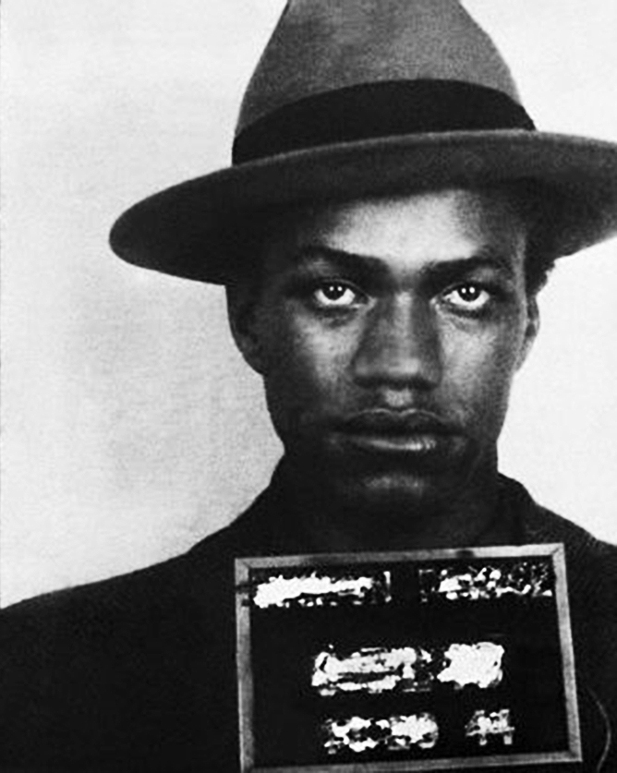
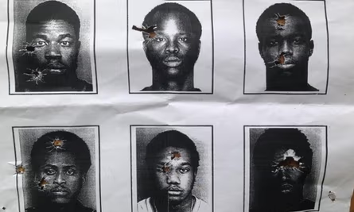
Lighting and The Shadow Archive (Allan Sekula)
“For black actors, if you are not lit correctly, your skin tone can look very odd” Joe Morton quoted in Dyer 661

Slide 6



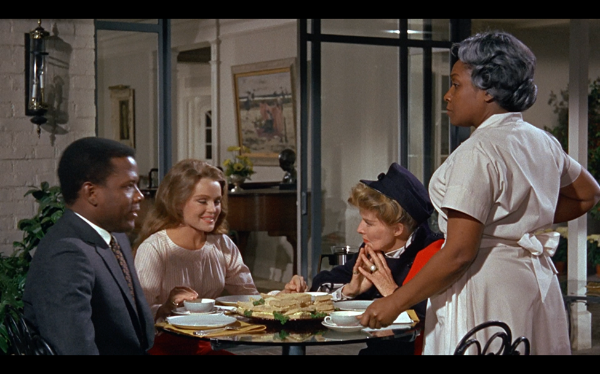

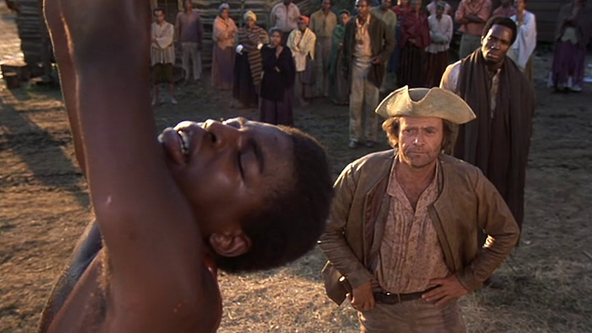
The Shadow Archive (Allan Sekula)

Slide 7
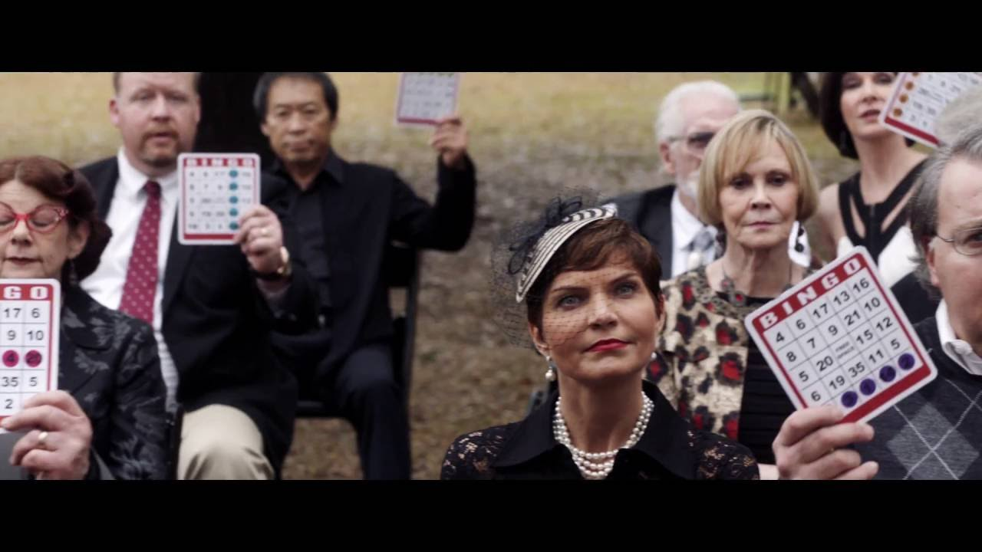


Scientific Racism
Seeing race as anything other than a political structure is to decontextualize the oppression perpetuated by that structure. McNally 213
Get Out (Jordan Peele, USA, 2017)

Slide 8
Dehumanization
“Scientific racism requires that its subject- in this case black people- is rendered object” McNally 214

Slide 9


Whiteness as a tool

Slide 10
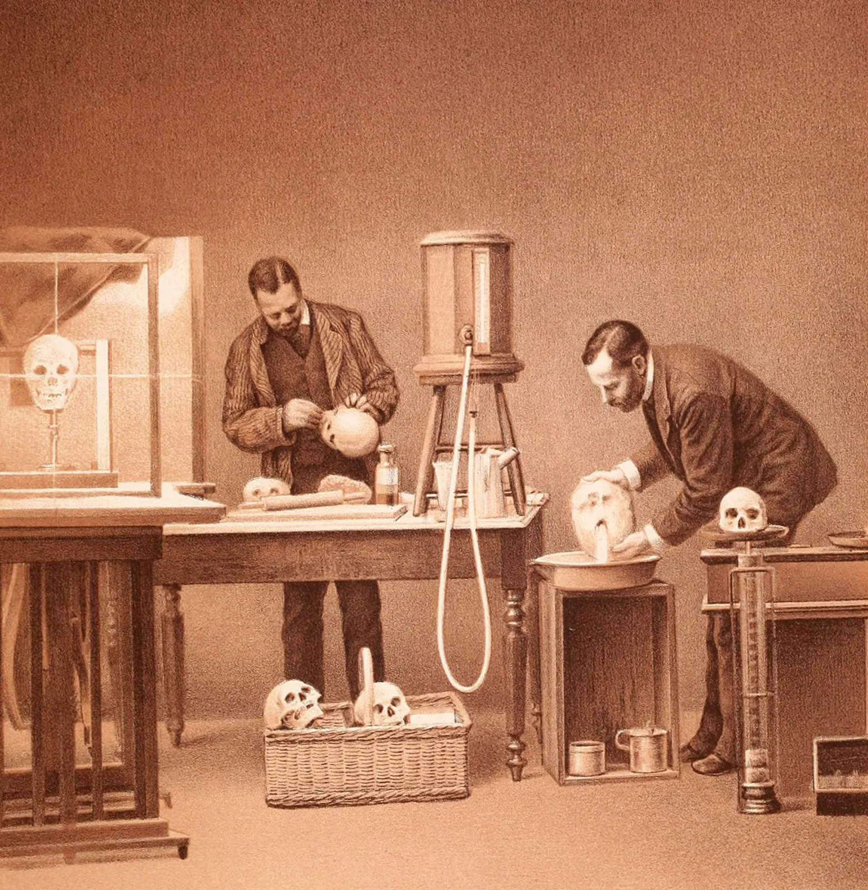
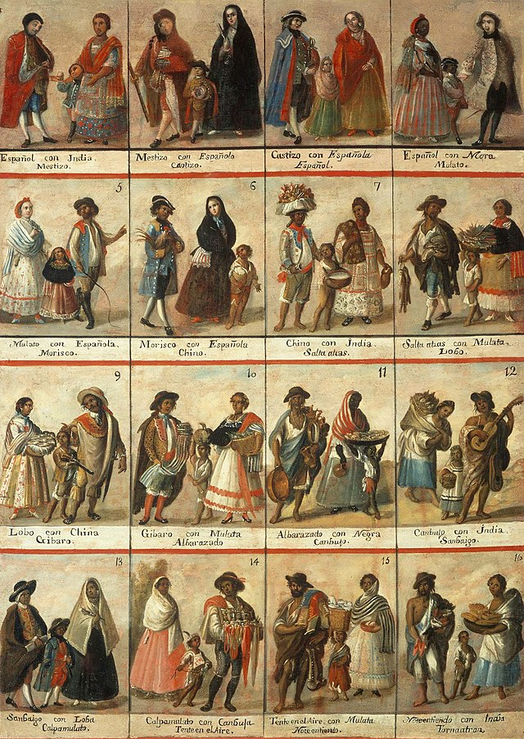
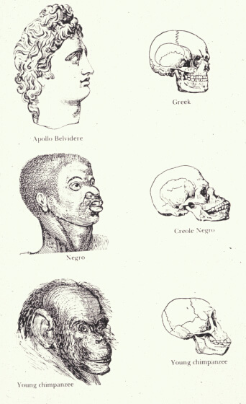
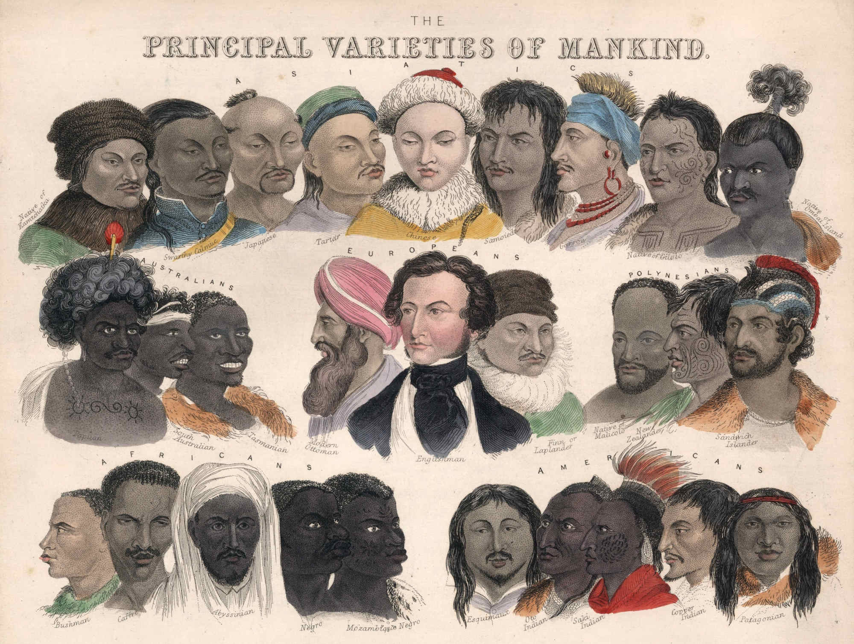
The Mutability of the concept of Race

Slide 11

Reclaiming the look
“The Black man has no ontological resistance in the eyes of the white man… In the white world the man of color encounters difficulties in the development of his bodily schema. Consciousness of the body is soley a negating activity. Fanon, p. 110

