Slide 1

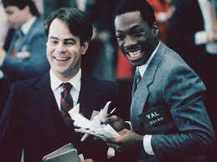
Identification in the Cinema
Session 29: Get Out – Manthia Diawara’s Resisting Spectatorship
Ontology…does not permit me to understand the being of the black man. For not only must the black man be black; he must be black in relation to the white man.” Fanon, the Fact of Blackness” p. 110

Slide 2
Key Terms
Resisting Spectatorship vs. Passive Spectatorship
Narcissism- (Mirror stage)
Oppositional film-making
Shadow Archive- Alan Sekula
Visualization vs. counter visuality (Nicholas Mirzoeff)
Disavowal- suspension of disbelief-ideology
Ontology- philosophical exploration of “being”
Metapsychology- if psychology has as its subject of study the psyche of the human subject, then metapsychology has as its subject of study the structure/system of psychology.
Cinema of the Real
LA Rebellion

Slide 3
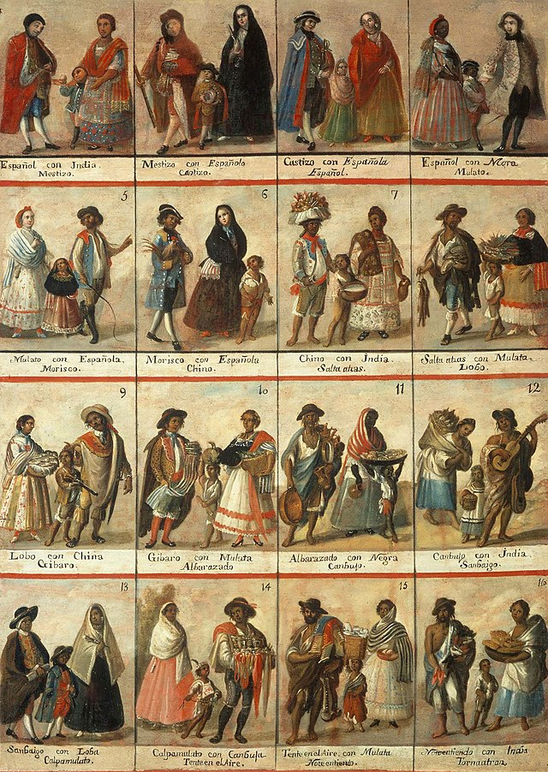
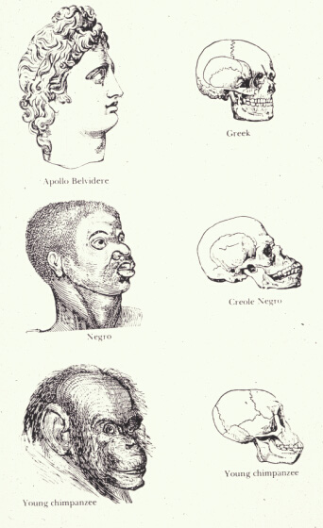
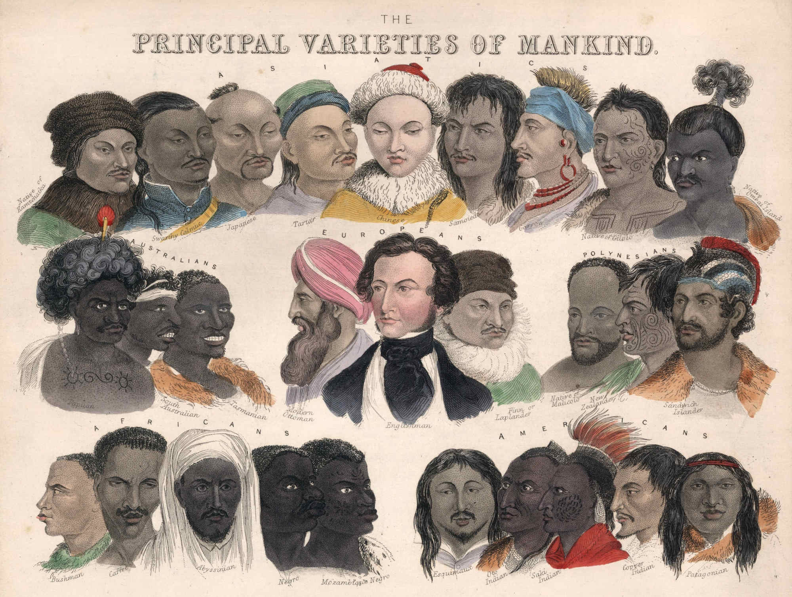
The Concept of Race
Seeing race as anything other than a political structure is to decontextualize the oppression perpetuated by that structure. McNally 213

Slide 4
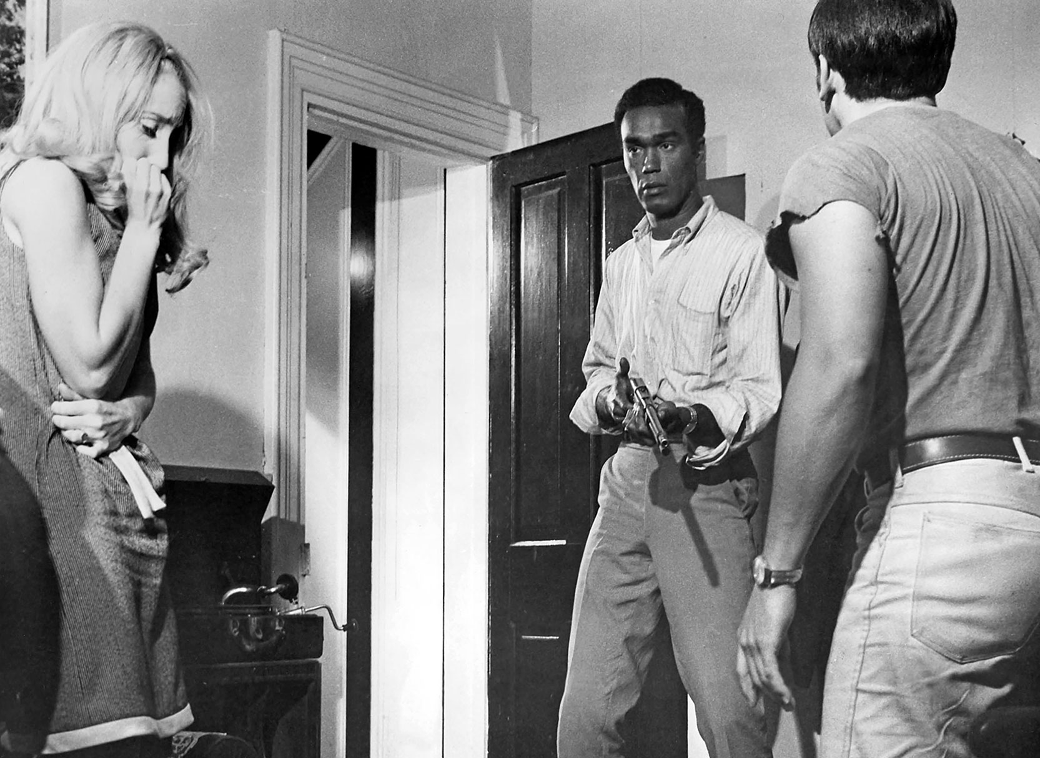
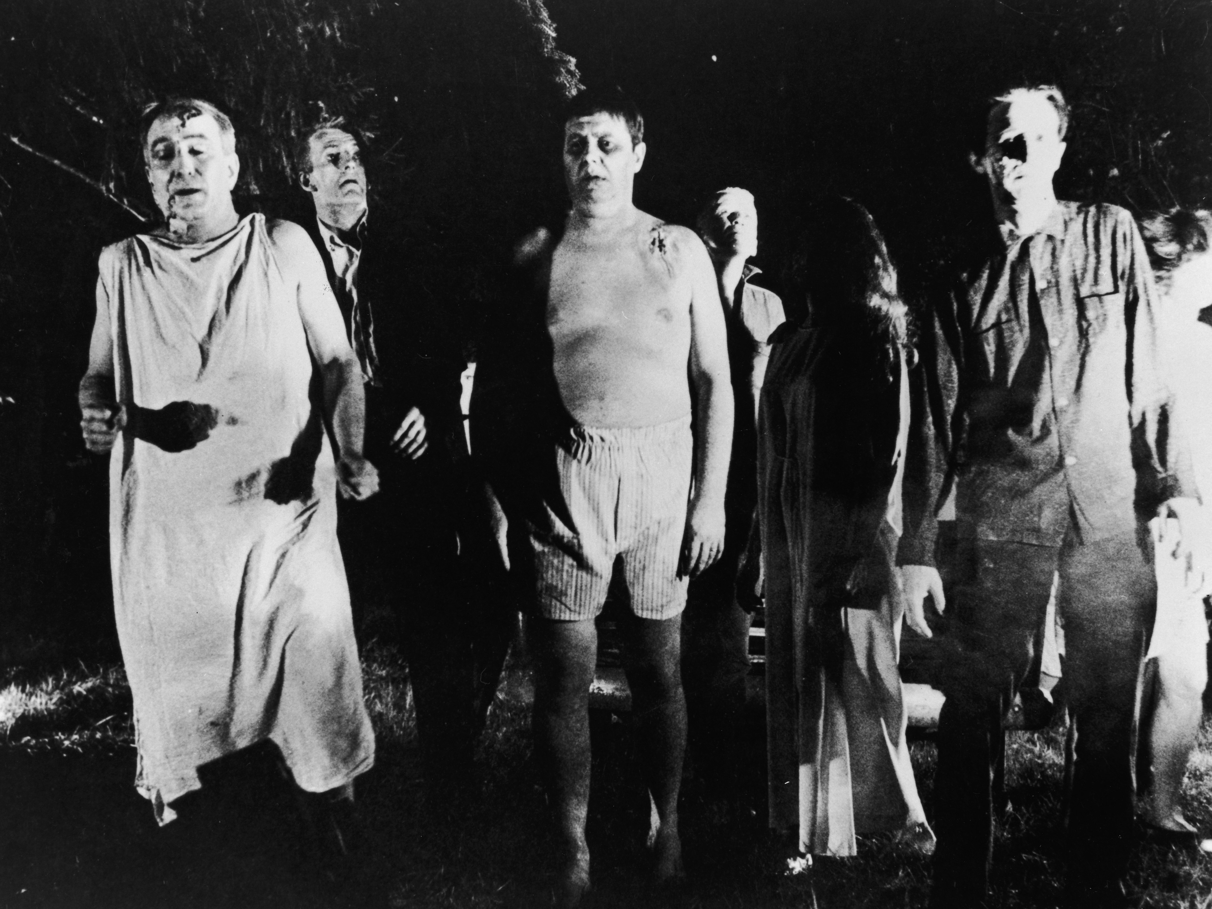
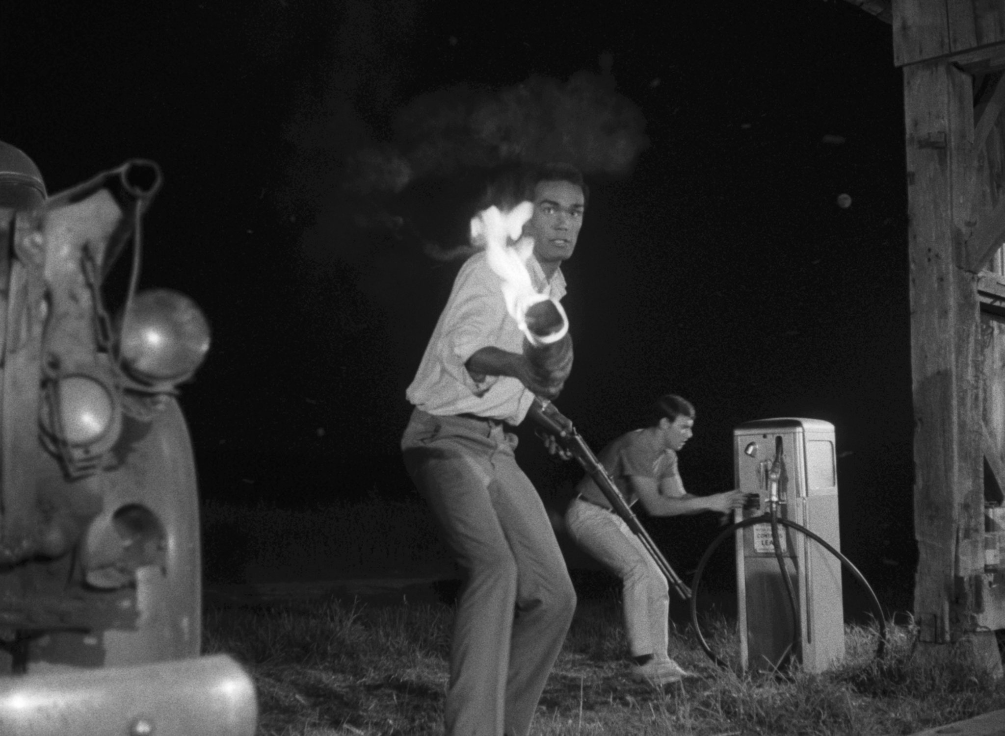
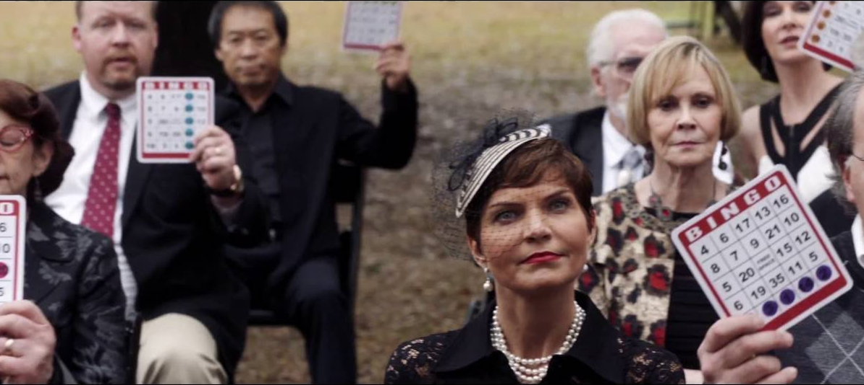
The Racial Politics of Whiteness
Night of the Living Dead (George A Romero, 1969)
‘The fear of one’s own body, of how one controls it and relates to it’…and the fear of not being able to control other bodies, those bodies whose exploitation is so fundamental to capitalist economy, are both at the heart of whiteness. (Dyer 145)

Slide 5
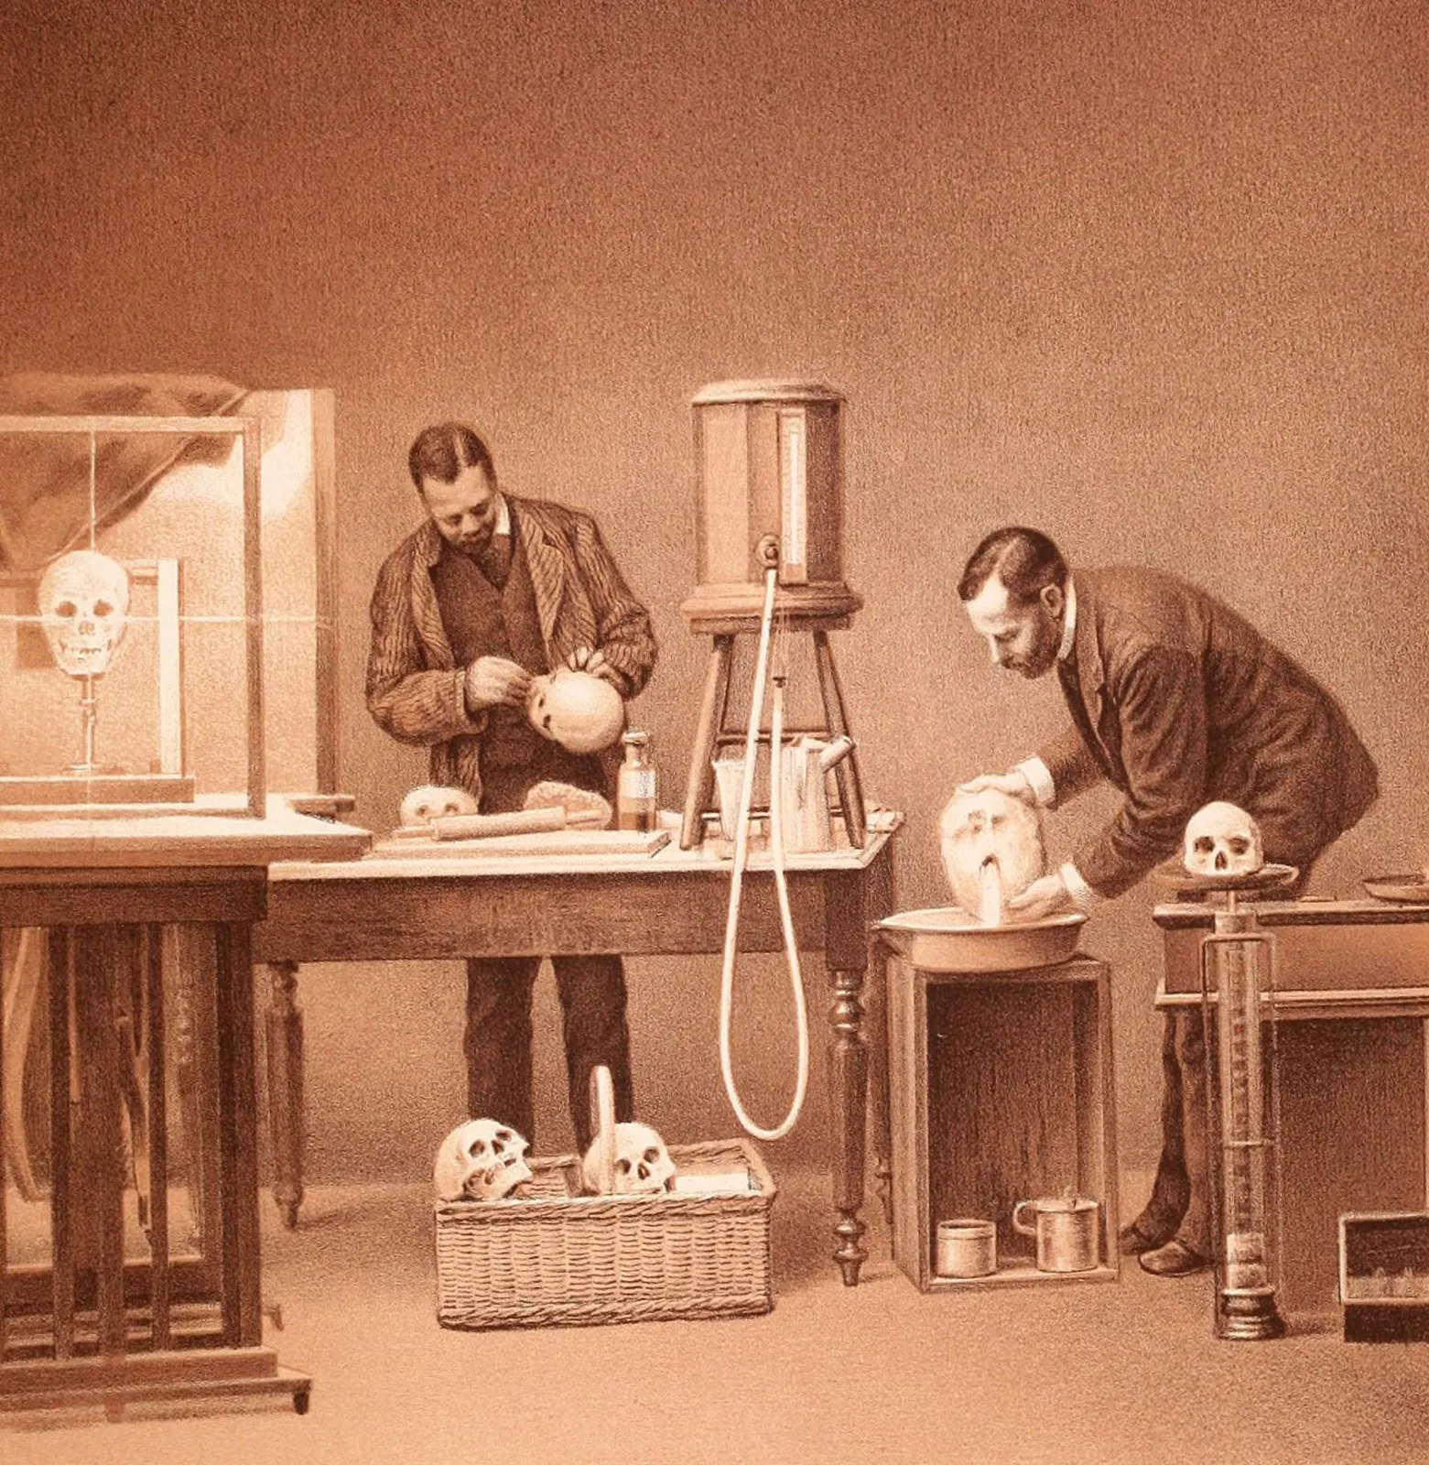
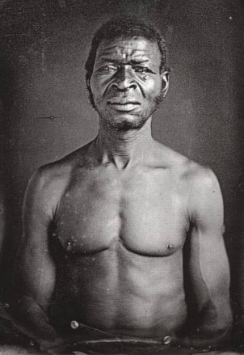
Control Objectification
“Scientific racism requires that its subject- in this case black people- is rendered object” McNally 214

Slide 6
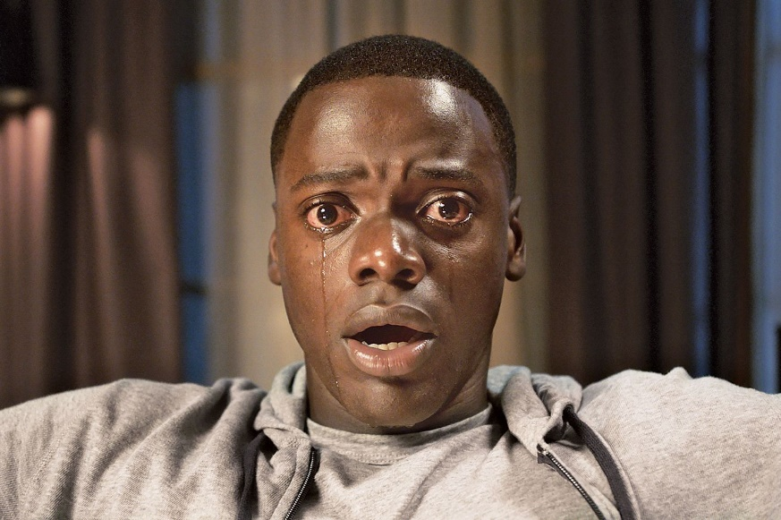
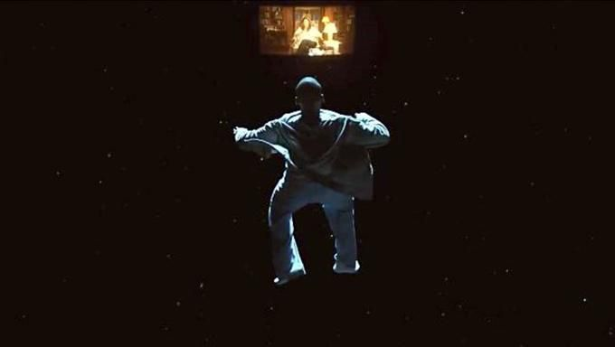
Ontological Resistance
“The Black man has no ontological resistance in the eyes of the white man… In the white world the man of color encounters difficulties in the development of his bodily schema. Consciousness of the body is soley a negating activity. Fanon, p. 110

Slide 7


Whiteness as a Tool: the dialectic of sight and sound (Dyer)
The Warm Voice of the Mother
The Cold Vision of the Father

Slide 8
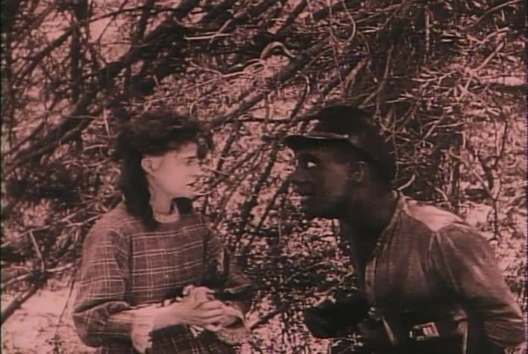
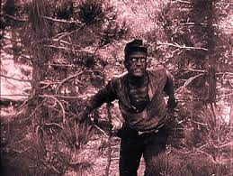
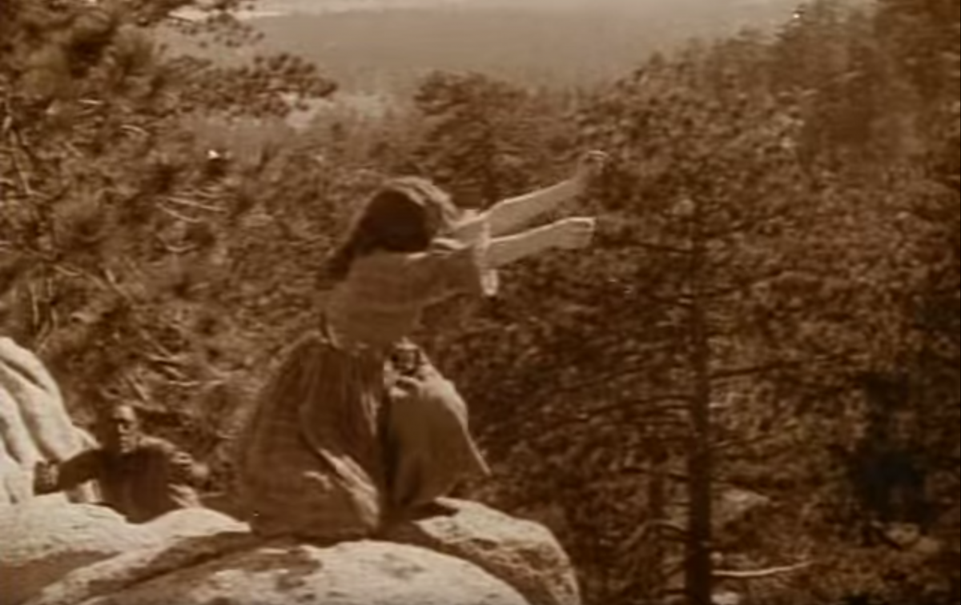
Spectatorial Identification and the Symbolic Order: Classical Hollywood Cinema and White Supremacy
Birth of a Nation (Griffiths, USA, 1915)
“Gus’s desire for Little Sister is a transgression: the narrative of miscegenation links …with the Oedipal narrative of incestuous desire, an assault on the symbolic order of the Father which merits the most serious punishment- lynching. At the level of spectator identification, the narrative…position[s] the spectator as the subject who desires to see, in the words of the intertitle, the ‘punishment and discipline of Gus and the Black race he symbolizes’. -Diawara, 675

Slide 9
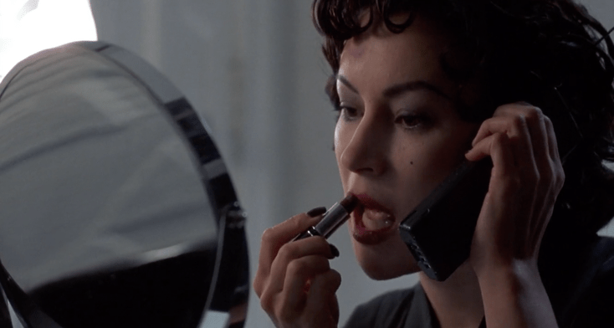
The Metapsychology of Identification and Ontology
The position of the spectator … has been described by recourse to the … mirror phase, suggesting that the metapsychology of identification (with the camera as the point of enunciation) entails a narcissistic … state similar to the infant’s illusion of a unified ego. But since spectators are socially and historically as well as psychically constituted, it is not clear whether the experiences of black spectators are included in this analysis. Diawara, 673
The Shadow Archive (Allan Sekula)

Slide 10
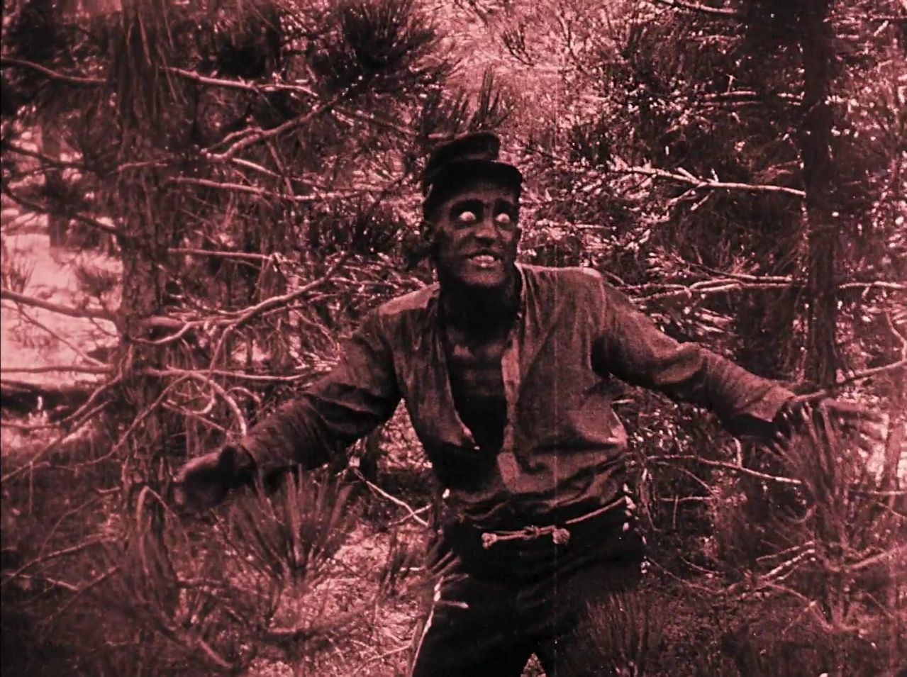
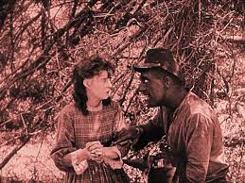

The Problem of Identification in Classical Hollywood Cinema for the Resisting Spectator
“Alongside the textual deracination or isolation of blacks, the narrative pattern of blacks playing by hegemonic rules and losing also denies the pleasure afforded by spectatorial identification. In terms of the Oedipal analogy in the structure of such narrative patterns, the black male subject always appears to lose in the competition for the symbolic position of the father or authority figure. And at the level of spectatorship, the black spectator, regardless of gender or sexuality, fails to enjoy the pleasures which are at least available to the white male heterosexual spectator positioned as the subject of the films’ discourse.” (Diawara, 677)

Slide 11
Cinema of the Real
The cinema of the Real produces viewing positions that bring the strategies of passive identification employed by Hollywood films into critical focus.
“Black directors such as… Warrington Hudlin practice a ‘cinema of the real’ in which there is no manipulation of the look to bring the spectator to a passive state of uncritical identification. The films show a world which does not position the viewer for cathartic purposes, but one which constructs a critical position for him or her in relation to the ‘real’ and its representation.” —Diawara, p.76
Real
physical violence
Representation
House Party (Warrington Hudlin, USA, 1990)

Slide 12
Strategies of Resisting Spectatorship- Decolonizing the Mirror, Reclaiming the Gaze

Slide 13
Strategies of Resisting Spectatorship- Liberating the Look
Punishment/Discipline
Enjoyment/Pleasure

Slide 14
Power of the Gaze- Rethinking Ontological Resistance

Slide 15
Cinema of the Real
The Cinema of the Real produces viewing positions that bring the strategies of passive identification employed by Hollywood films into critical focus.
How do Peele’s representations of police throughout the film illustrate Diawara’s description of the Cinema of the Real?

