Slide 1
Identification in the Cinema
Session 34: Daughter’s of the Dust and Oppositional Spectatorship
““We wear our scars like armor for protection”. — Eula

Slide 2
Key Terms
Oppositional Spectatorship (bell hooks)
LA Rebellion
“Cinema of the Real” (Diawara)
“Relations of power”(Foucault) p.682
Critical Black female spectatorship (hooks, 691)

Slide 3
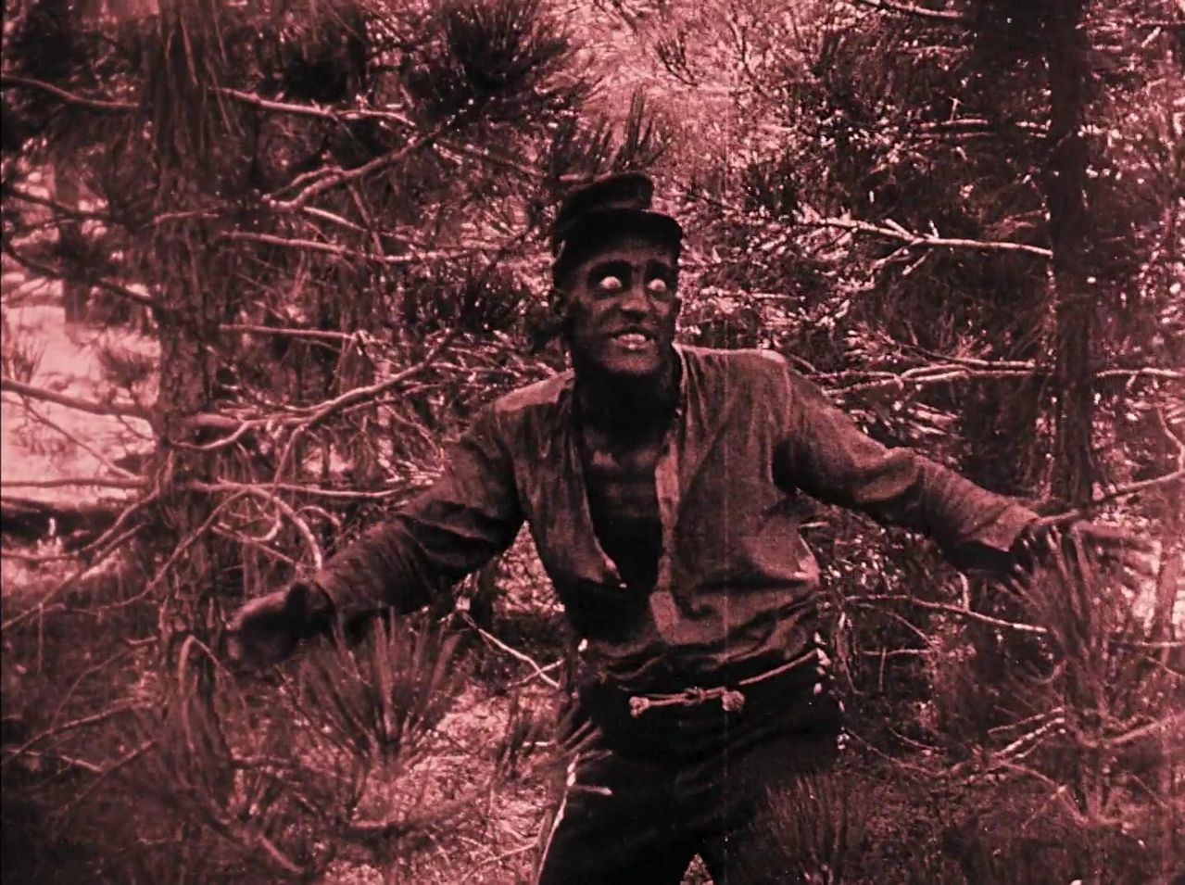
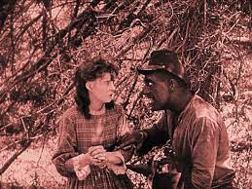

The Problem of Identification in Classical Hollywood Cinema for the Resisting Spectator
“Alongside the textual deracination or isolation of blacks, the narrative pattern of blacks playing by hegemonic rules and losing also denies the pleasure afforded by spectatorial identification. In terms of the Oedipal analogy in the structure of such narrative patterns, the black male subject always appears to lose in the competition for the symbolic position of the father or authority figure. And at the level of spectatorship, the black spectator, regardless of gender or sexuality, fails to enjoy the pleasures which are at least available to the white male heterosexual spectator positioned as the subject of the films’ discourse.” (Diawara, 677)

Slide 4
Cinema of the Real
The cinema of the Real produces viewing positions that bring the strategies of passive identification employed by Hollywood films into critical focus.
“Black directors such as… Warrington Hudlin practice a ‘cinema of the real’ in which there is no manipulation of the look to bring the spectator to a passive state of uncritical identification. The films show a world which does not position the viewer for cathartic purposes, but one which constructs a critical position for him or her in relation to the ‘real’ and its representation.” —Diawara, p.76
Real
physical violence
Representation
House Party (Reginald Hudlin, USA, 1990)

Slide 5
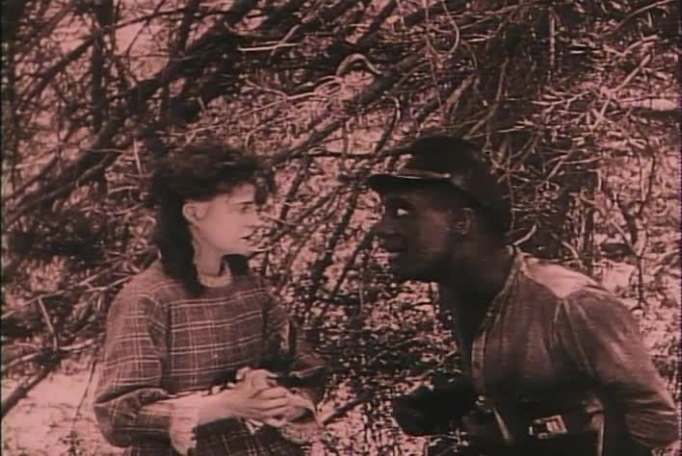
Strategies of Resisting Spectatorship- Liberating the Look
Punishment/Discipline
Enjoyment/Pleasure

Slide 6
Resisting Spectatorship vs. The Oppositional Gaze
“Not all Black women spectators submitted to that spectacle of regression through identification called for by Hollywood. Most of the women I talked with felt they consciously resisted identification with films- that this tension made moviegoing less than pleasurable, at times it caused pain. Hooks, 686

Slide 7
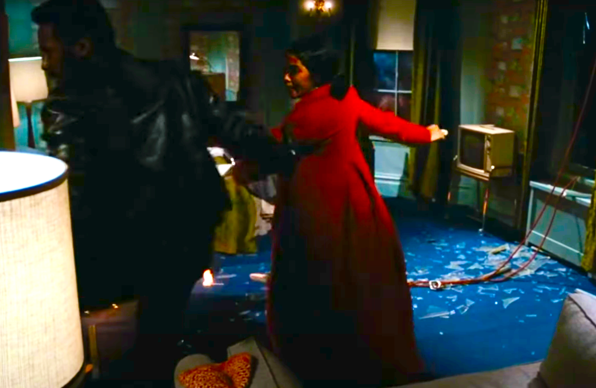
The Limits of Resisting Spectatorship: Oppositional Spectatorship and Black Female Identification
Every Black woman spectator I talked to, with rare exception, spoke of being “on guard” at the movies. Talking about the way being a critical spectator of Hollywood films influenced her, Black woman filmmaker Julie Dash exclaims, “I make films because I was such a spectator!” Looking at Hollywood cinema from a distance, from that critical politicized standpoint that did not want to be seduced by narratives reproducing her negation, Dash watched mainstream movies over and over again for the pleasure of deconstructing them.” Hooks, 690
Enjoyment/Pleasure
Shaft (Gordon Parks, USA, 1971)
Enjoyment/Pleasure

Slide 8
Cinema of the Real
The Cinema of the Real produces viewing positions that bring the strategies of passive identification employed by Hollywood films into critical focus.
How does Daughters of the Dust illustrate Diawara’s description of the Cinema of the Real and answer hook’s call for an oppositional form of spectatorship?

Slide 9
Strategies of Resisting Spectatorship and the Oppositional Spectatorship Reclaiming the Gaze
Even in the worse circumstances of domination, the ability to manipulate one’s gaze in the face of structures of domination that would contain it, opens up the possibility of agency… Michel Foucault insists on describing domination in terms of “relations of power” as part of an effort to challenge the assumption that” power is a system of domination which controls everything and which leaves no room for freedom.” Emphatically stating that in all relations of power “there is necessarily the possibility of resistance,” he invites the critical thinker to search those margins, gaps, locations on and through the body, where agency can be found.
  bell hooks in Braudy and Cohen ed 8 (p.682)
Lacan: the Gaze
“the possibility of resistance “…?
Foucault: systems of power

Slide 10
Power of the Gaze- Rethinking Ontological Resistance
“Thinking about Black female spectators. I remember being punished as a child for staring, for those hard, intense, direct looks children would give grown-ups, looks that were seen as confrontational, as gestures of resistance, challenging authority. The “gaze” has always been political in my life.

Slide 11
Power of the Gaze- Ontological Resistance

Slide 12
Trula and Yellow Mary

Slide 13
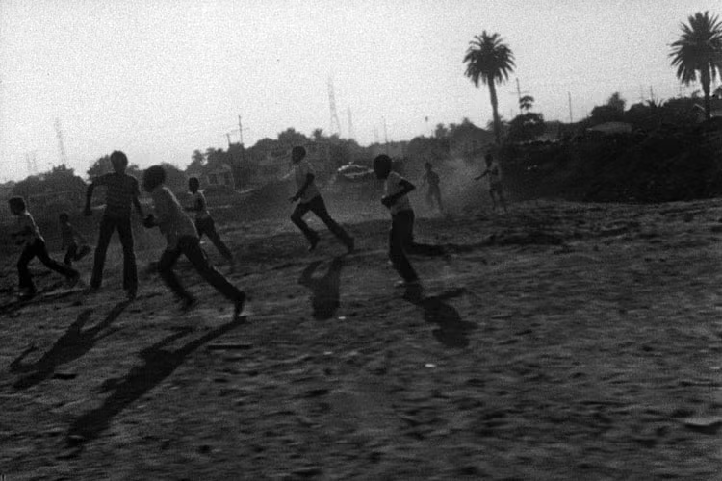
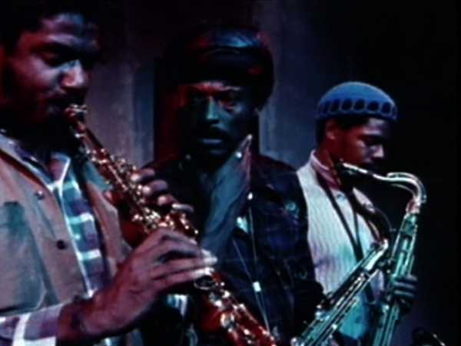
LA Rebellion
Charles Burnett, Killer of Sheep, 1978
Larry Clark, Passing Through, 1977

