Slide 1
Identification in the Cinema
Session 36: Mad Men: Identification and Television

Slide 2
Key Terms
Society of the Spectacle, (Guy Debord): late capitalism+ mass media(advertising and television) +liberal state-> commodification of human relations. (personal consumption aligns with market principles)
Social Alienation (Marx): the estrangement of people from their lifeworlds
Being vs. Posessing
Nostalgia and the Uncanny (Freud)
Commodity: use value (utility/need) + exchange value (abstration/desire)
Commodity Fetishism- the translation of the social dimension of economic transaction into a relationship among commodities
Spectacle: social structure in which aesthetic value has been transformed into commercial value (commodity)

Slide 3
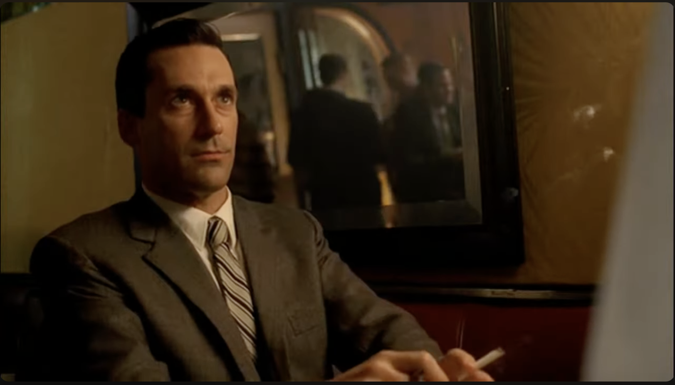
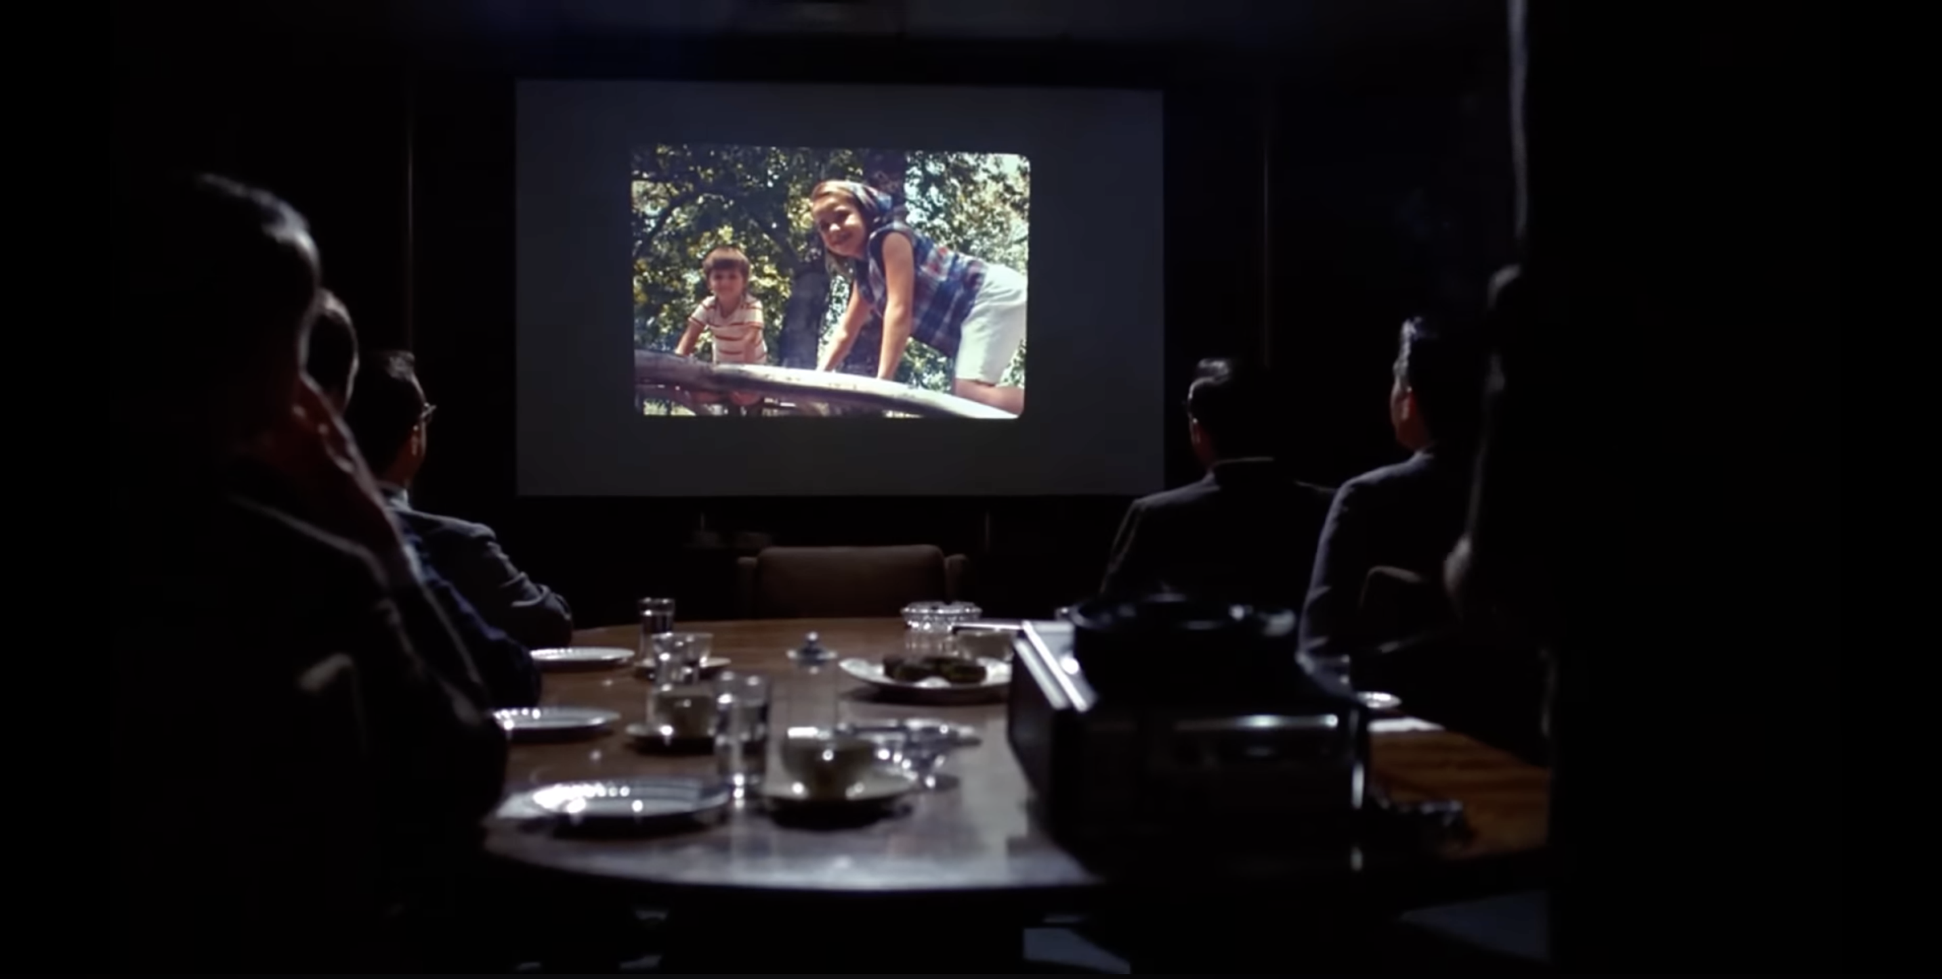
Nostalgia—Sentimentality—Memory
“In this hatred of the present or the immediate present, [there is] a dangerous tendency to invoke a completely mythical past.” -Foucault
https://www.youtube.com/watch?v=XOnZjo8PX2o
https://www.youtube.com/watch?v=rq3n2sJ43Hg

Slide 4
The Dream of the Perfect Home
Nostalgia-nostos (return/home)+ Lagos (pain) “pain from an old wound” —trauma
Bigger than Life (Nicholas Ray, USA, 1956)
Far from Heaven (Todd Haynes, USA, 2002)
“All of Mad Men’s central characters have troubled home lives and uneasy relationships to traditional marriage “expressed through the repressed housewife, the philandering husband, the mistress/secretary, the single mother, the closeted homosexual and the inter-racial couple.”
The Man in the Grey Flannel Suit (Nicholas Ray, USA, 1956)
Revolutionary Road (Sam Mendes, USA, 2008

Slide 5
“Home is an image that we carry with us, like a snapshot, of people and of places that are always changing. We may have a fixed image, but its contents are already a part of the past.” -Mark Taylor

Slide 6
Advertising builds on our personal needs and preoccupies itself with generating images of the perfect life, the perfect family and the perfect home.”-Mark Taylor
Eichler Home
The House that Home Built, (mid-1950s)
William Pahlmann Designer, Simpson AD: Rift-Grain Redwood Plywood Walls, 1957
Honeywell Kitchen Computer, 1969

Slide 7
The Commodity
Marx: The social relationships of their labors are and appear … as objectified relationships of persons, or social relationships of objects.
Need (Use value)
Desire (Exchange Value)
Nostalgia: Representation
“Advertising is based on just one thing: happiness….”
1961 Frank Gifford Ad
"It's Toasted" Mad Men, Season 1
1930 Doctor Ad
Death Wish: Repetition

Slide 8
The dialectic of the Network and the Commodity
Object becomes a commodity
Network becomes a commodity
Cathode Ray tube monitor becomes a television set
Systems of Electronic communication become television networks

Slide 9
Mass Media and Consumer Culture: The Society of the Spectacle

Slide 10
The Life Cycle of Commodification in The Society of the Spectacle
In the society of the spectacle social life is colonized by the commodity through “the decline of being into having, and having into merely appearing."Debord
Being
Possessing
Appearing
Four Roses Ad, 1961
Four Roses Ad, 1963
Jim Beam Ad, 1966

Slide 11
Being vs. Possessing
“All that once was directly lived has become mere representation."Guy Debord

Slide 12
The dialectic of being and having
Appearing
“Kitchen Debates”: Soviet Premier Nikita Khrushchev pointing finger at visiting U.S. Vice Pres. Richard Nixon (2R) during heated ideological debate beside model kitchen display at American National Exhibition, Sokolniki Park, Moscow,1959
Nixon-Kennedy Debate: Chicago on September 26, 1960, at the CBS studio. The first televised Presidential debate, attracting 60% of American households with televisions.

