Slide 1
Identification in the Cinema
Session 37-38-39: Ex-Machina- Science fiction film

Slide 2
Key Terms
Profilmic (mise-en scène) vs filmic (diegesis)
Mise-en-abyme- (infinite regress)
Pastiche
Simulation/ Simulacra (Baudrillard)
Mulatto cyborg

Slide 3
Science Fiction
Metropolis
2001: A Space Odyssey
Alien
Blade Runner
War Games
Terminator
Short Circuit
The Matrix
Her
Chappie
Interstellar
Marvel Cinematic Universe

Slide 4
Theoretical Critique
Ideological Semiotic Psychoanalytic Identity (Race/Gender/Sexuality)
Panopticon-Surveillance-Data Mining
    Jeremy Bentham, Panopticon: the Inspection House, 1791
    Michel Foucault, Discipline and Punish, 1975
Aura
  Walter Benjamin, “The Work of Art in the Age of Mechanical Reproduction,” 1935
Cybernetics -Systems Aesthetics
  Norbert Wiener, Cybernetics: Or Control and Communication in the Animal and the Machine, 1948
  Jack Burnham, “Systems Esthetics,” Artforum (1968)
Automata-Cyborg
Donna Haraway, “A Cyborg Manifesto,” Socialist Review,(1985)

Slide 5
Ex- Machina: Session 1
The Commodity and the Network

Slide 6
Formal Elements
Diegesis
Genre
Characters
Plot points
Mise-en-scene
Cinematography
Color
Sound
Soundtrack
https://www.youtube.com/watch?v=mAtmopQxu0o

Slide 7
The Uncanny: The Dream of the Perfect Home Garden
“In this hatred of the present or the immediate present, [there is] a dangerous tendency to invoke a completely mythical past.” -Foucault
Eichler Home
“Oh fuck I’m in someone else house…”
The House that Home Built, (mid-1950s)

Slide 8
The Commodification of Social Life- the image of a mythical present
Advertising builds on our personal needs and preoccupies itself with generating images of the perfect life, the perfect family and the perfect home.”-Mark Taylor
Eichler Home
The House that Home Built, (mid-1950s)
William Pahlmann Designer, Simpson AD: Rift-Grain Redwood Plywood Walls, 1957
Honeywell Kitchen Computer, 1969

Slide 9
The Life Cycle of Commodification in The Society of the Spectacle
In the society of the spectacle social life is colonized by the commodity through “the decline of being into having, and having into merely appearing."Debord
Being
Possessing
Appearing
Four Roses Ad, 1961
Four Roses Ad, 1963
Jim Beam Ad, 1966

Slide 10
Being vs. Possessing
“All that once was directly lived has become mere representation."Guy Debord

Slide 11
The dialectic of being and having
Appearing
“Kitchen Debates”: Soviet Premier Nikita Khrushchev pointing finger at visiting U.S. Vice Pres. Richard Nixon (2R) during heated ideological debate beside model kitchen display at American National Exhibition, Sokolniki Park, Moscow,1959
Nixon-Kennedy Debate: Chicago on September 26, 1960, at the CBS studio. The first televised Presidential debate, attracting 60% of American households with televisions.

Slide 12
The dialectic of the Commodity and the Network
Television: Set
Television: Programming
Television: the Consumer
Object becomes a commodity
Network becomes a commodity
Systems of Electronic communication become television networks
Cathode Ray tube monitor becomes a television set

Slide 13
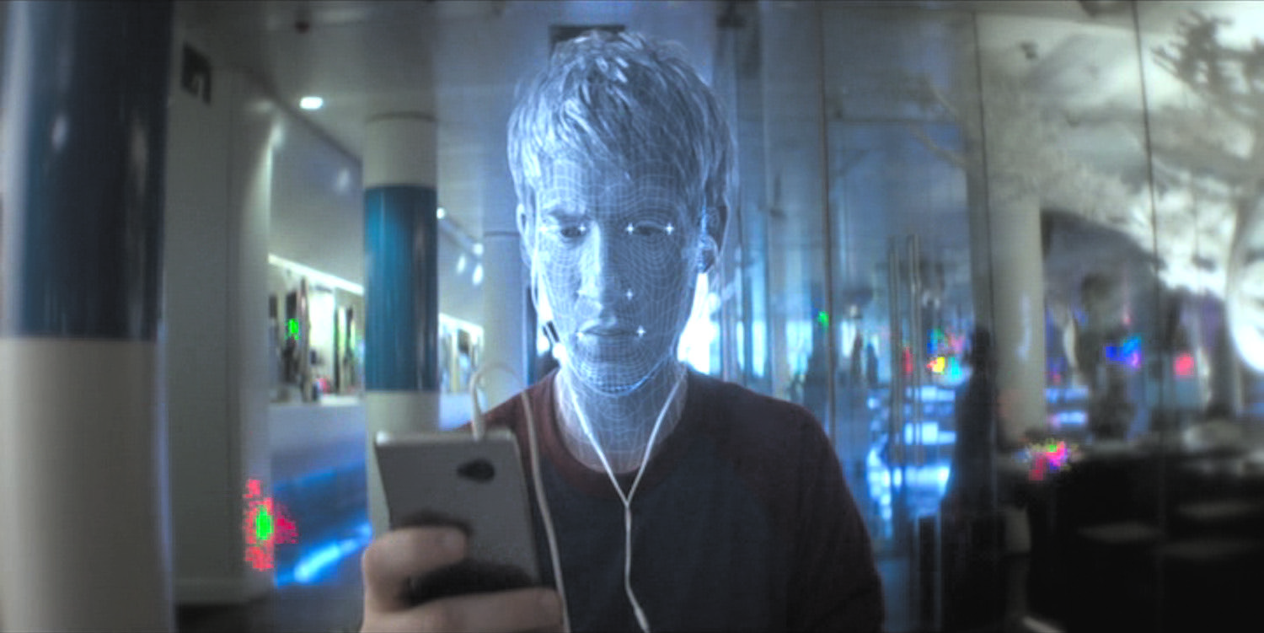
The Networked Subject
Panopticon-Surveillance-Data Mining
Cybernetics -Systems Aesthetics
Her (Spike Jones, USA, 2013)

Slide 14
Ex- Machina: Session 2
The Paradigm of the Mirror

Slide 15
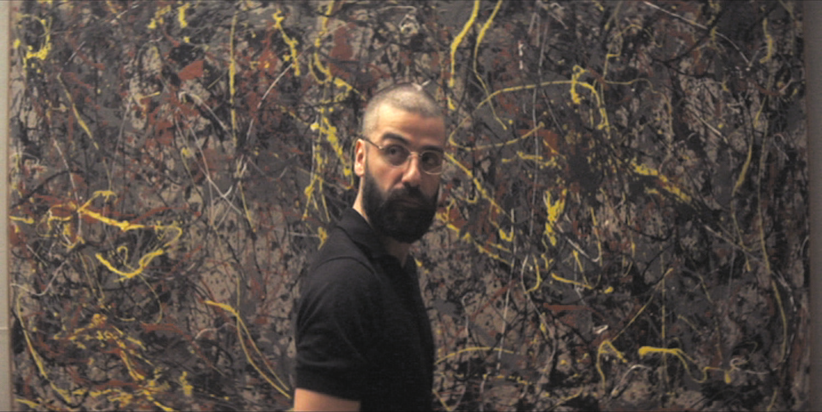
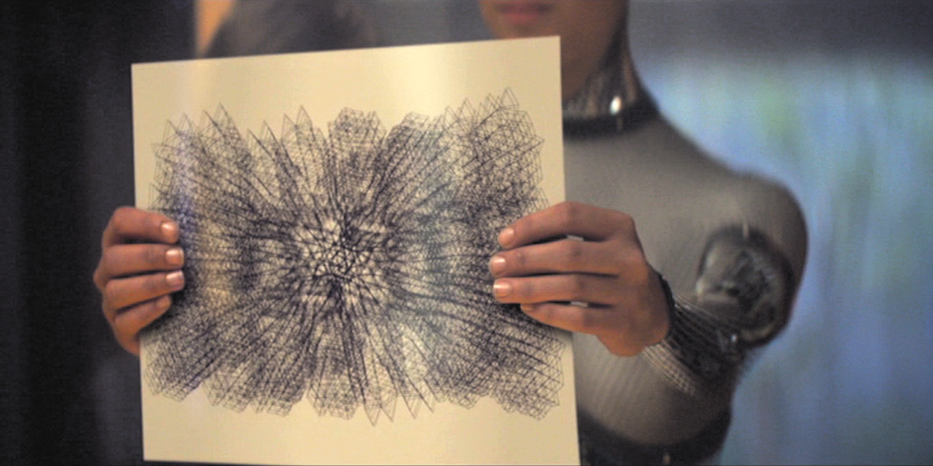
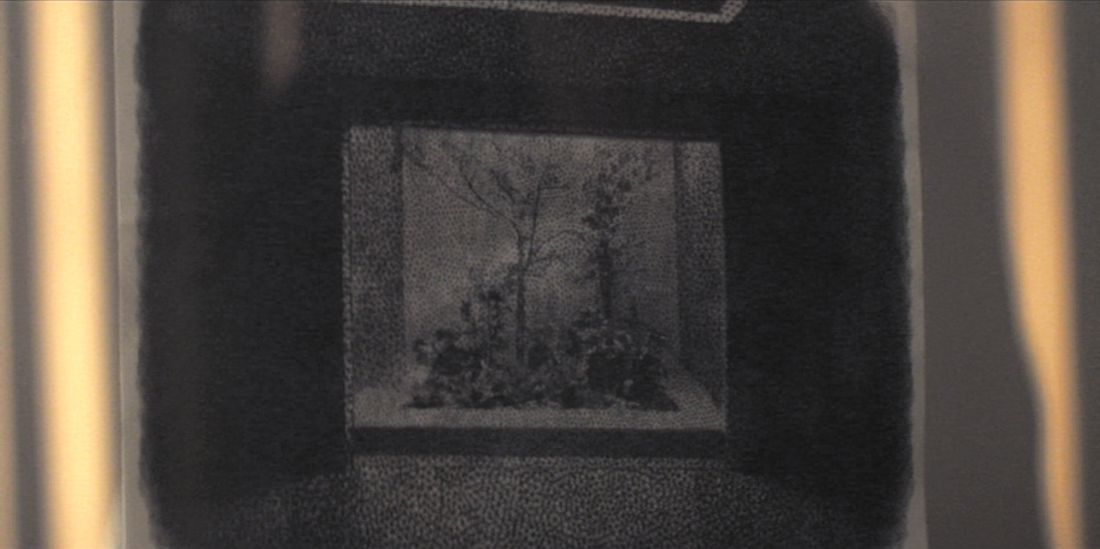
Art Historical Imaginary
Machine Aesthetics
Abstraction
Gego, Untitled, 1968
Digital Aesthetics
Figuration
George Seurat, La Grande Jatte, 1884

Slide 16
Mise-en-abyme- The infinite regress of appearances
The Paradigm of the Mirror

Slide 17
Mise-en-abyme- The infinite regress of appearances
The Paradigm of the Window
The Paradigm of the Screen
It’s the windows. You’re thinking there’s no windows. It’s subterranean. It’s not cozy. It’s claustrophobic…“Caleb, there’s a reason there’s no windows in the room… this building isn’t a house. It’s a research facility…

Slide 18
Mise-en-abyme- The infinite regress of appearances
Ex Machina - Ava: Session 1 (Caleb Meets Ava)

Slide 19
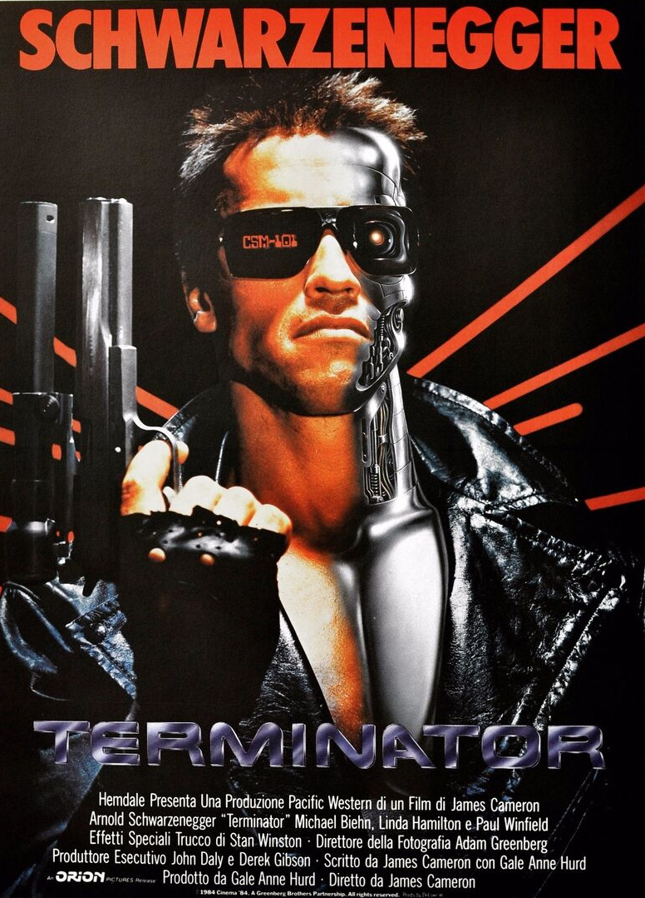
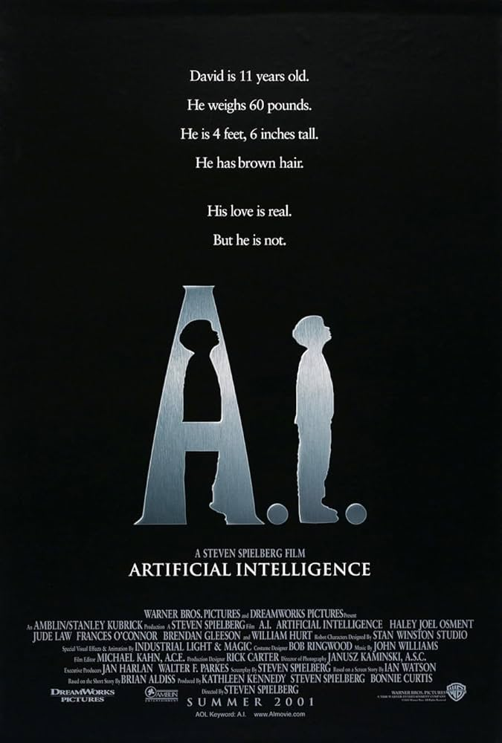
The Terminator (James Cameron, 1984
A.I. (Steven Spielberg, 2001)
Robocop, (Verhoeven, USA, 1987)
Ex- Machina: Session 3
and the Mulatto Cyborg
Robocop (José Padilha, USA 2014)
Transcendence, (Wally Pfister, USA, 2014)
Lucy, (Luc Besson, USA, 2014)

Slide 20
“While cyborgs are part of our everyday reality…they also exist in the realm of the imaginary. They reside in the liminal, in-between spaces that survive at the borders and frontiers of the social order. They subvert the dream of purity and offer instead a future of mutual contamination. If, as Jennifer González claims, the anxieties and fantasies of a culture are projected onto the image of the cyborg, then the cyborg must be read as a powerful metaphor for the historical bogeyman of contamination-racial mixing.” Nishime, 694
“As a hybrid, the cyborg is not completely the Other. Rather, its narrative power comes from its ability to blur boundaries by blending the Other and the human. As Vivian Sobchack has pointed out, science fiction is preoccupied with the relationship between the strange and the familiar. This uncanny mixture infects the portrayal of both mixed-race people and cyborgs.” Nishime, 695

Slide 21
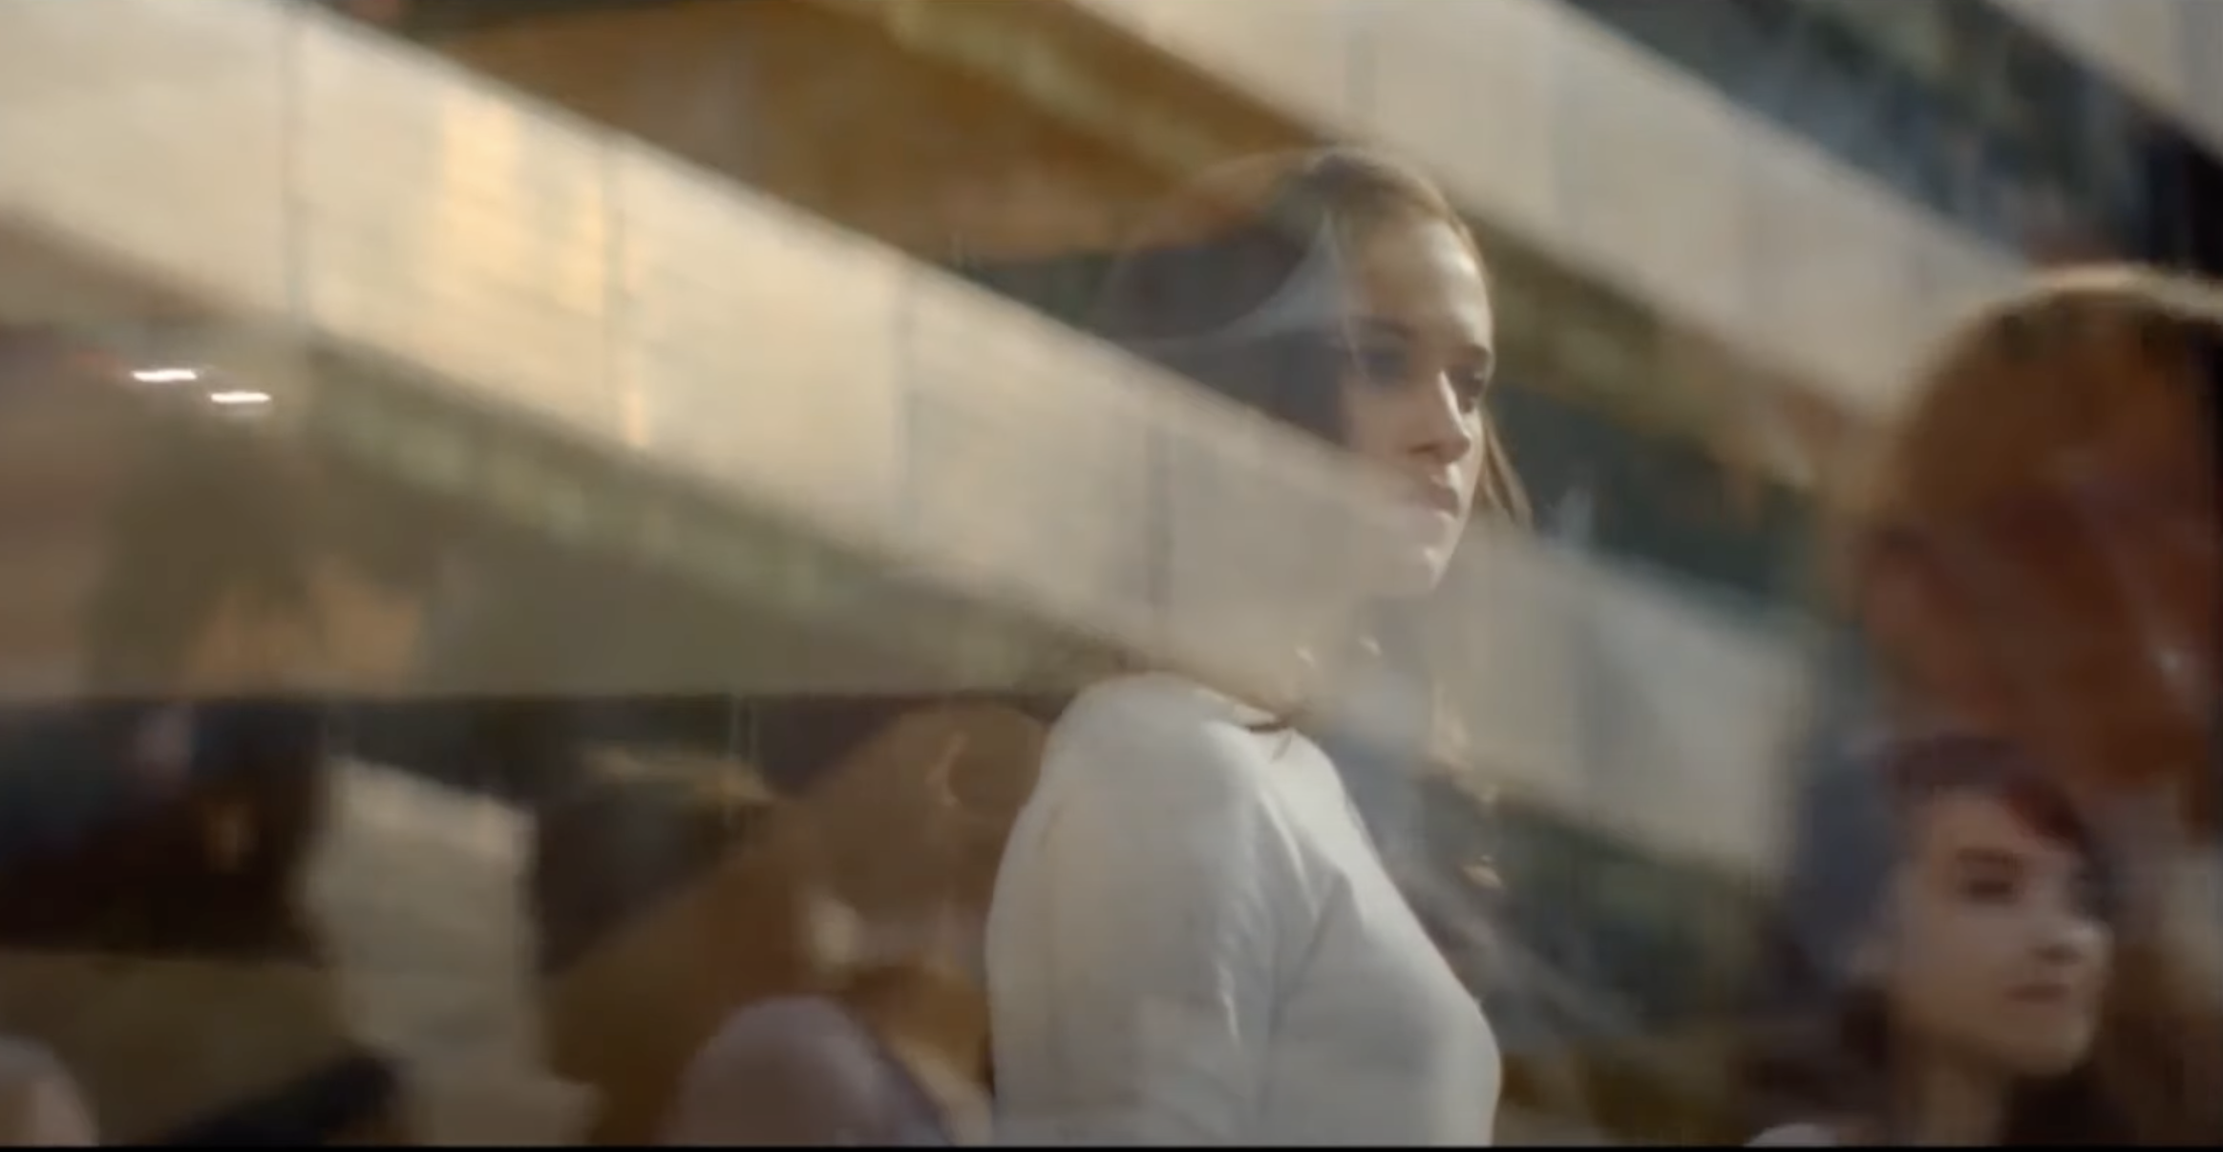
The Cyborg and the Post-Human
“The cyborg does not dream of community on the model of the organic family, this time without the oedipal project. The cyborg would not recognize the Garden of Eden; it is not made of mud and cannot dream of returning to dust."Harraway
Eve
Ava
“You’re the first man she’s met that isn’t me. And I’m like her dad…” -Nathan
Blade Runner (Ridley Scott, USA,1982)

Slide 22
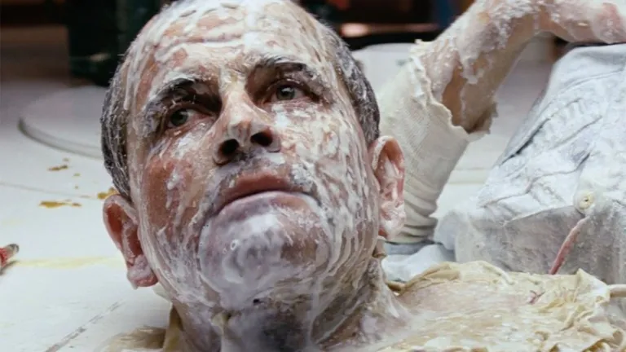
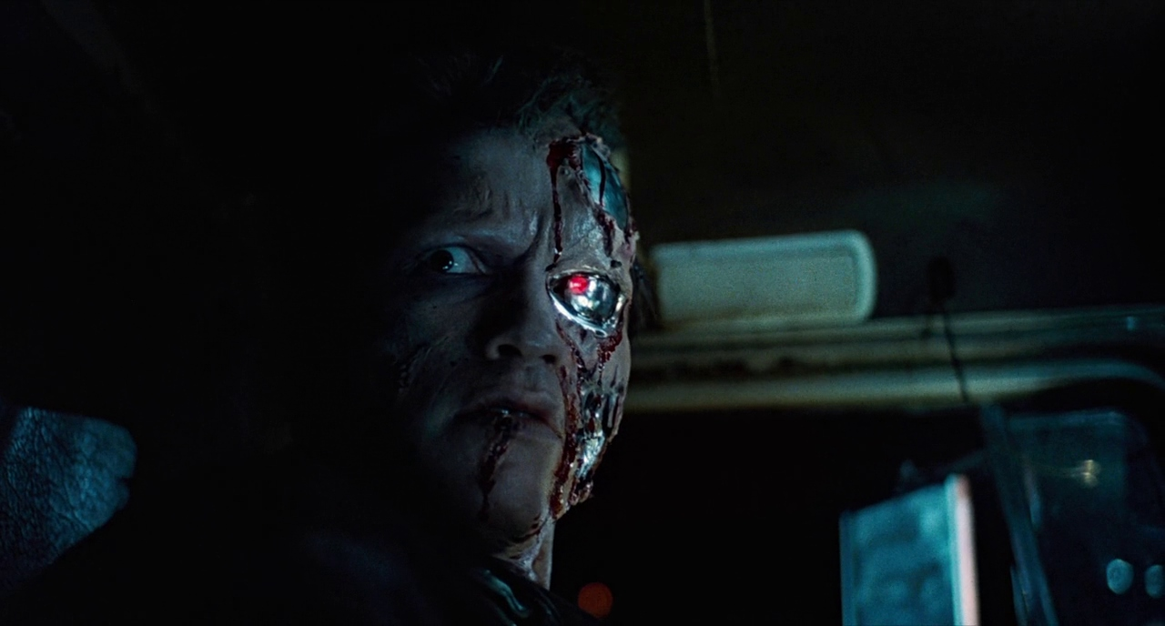
The three categories of cyborg representation
Bad Cyborgs
“In both Alien and The Terminator…no matter how human the cyborgs may seem, they are actually machines… The split is complete since humanity is, literally, only skin deep. Within a cultural logic that equates human with white European, this simplistic conception of cyborgs most closely follows the infamous “one drop” rule.” Nishime, 699
Ash’s shocking reversion. Alien (Ridley Scott, 1979)
The cyborg unmasked. (The Terminator (James Cameron, 1984)

Slide 23
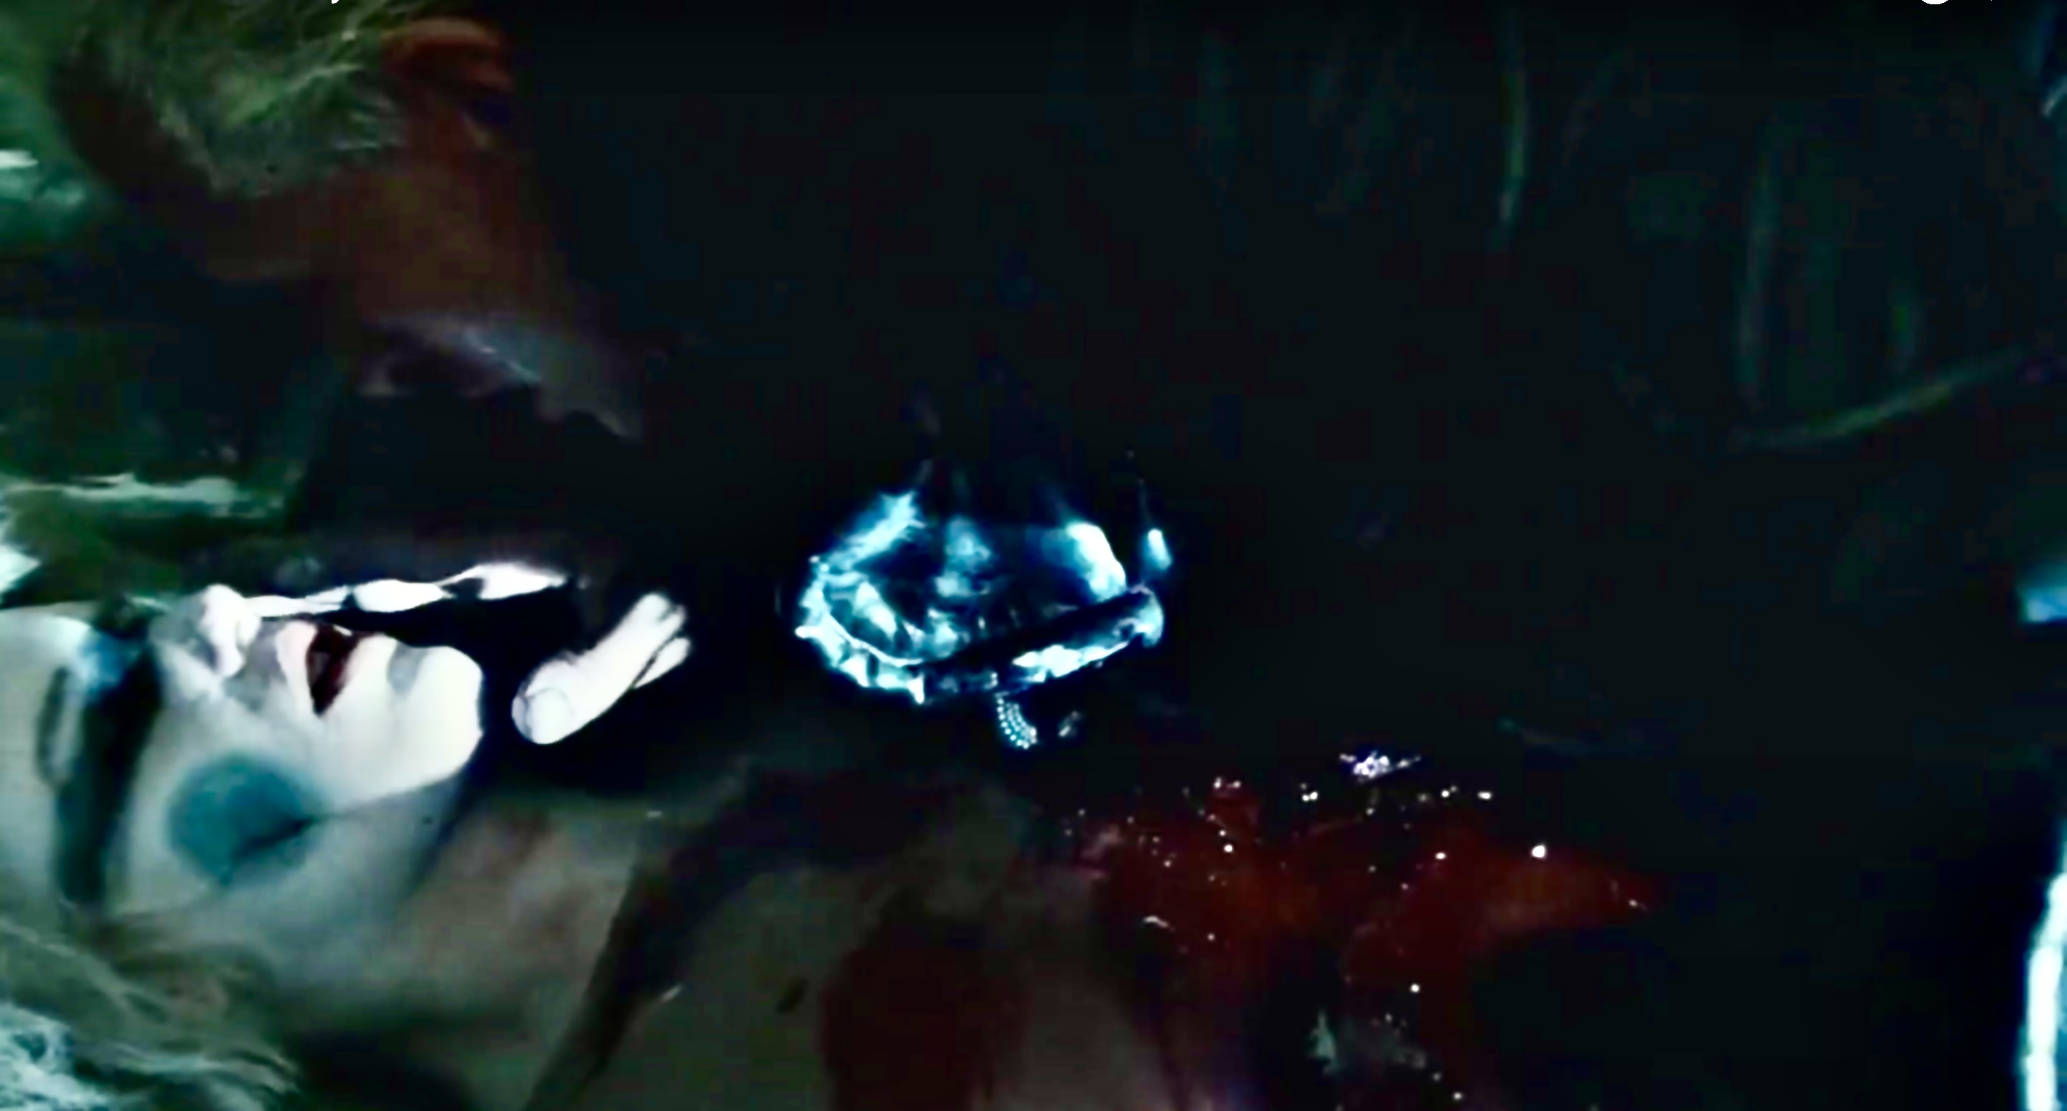
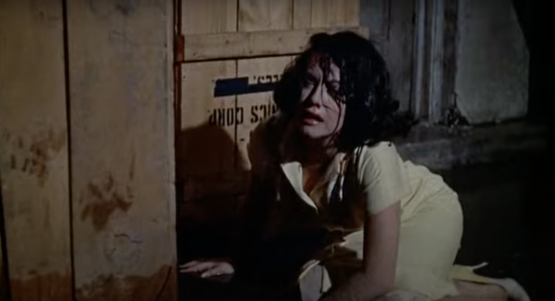
The three categories of cyborg representation
2. Good Cyborgs, passing and the stereotype of the tragic mulatto/a
“[The good cyborg] wants to be human. Neither human nor machine, he is doomed to and eternal search for belonging…As completely synthetic beings, androids can hardly be called cyborgs…they are autonomous beings who gain experience and, in many representations, feel emotions and pain. More than any other kind of cyborg, androids force the question of what defines someone as human…In the same way, when one “passes” for white, all racial categories come into question.” Nishime, 700-701
The pathos of Pris’ passing. Blade Runner (Ridley Scott, 1982)
The failure of Sara Jane’s passing. Imitation of Life (Douglas Sirk, 1959)

Slide 24
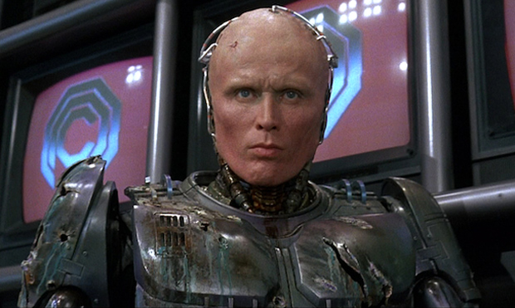
The three categories of cyborg representation
3. Mulatto Cyborgs
“Like the good cyborg, the mulatto cyborg lives in the chaotic spaces between organic and artificial. But unlike, the good cyborg, the mulatto cyborg is stripped of romanticism and nostalgia. He mocks the liberal humanist invitation to pass as human. He cannot access the coherent identity promised by an embrace of the real, so he cobbles together the fragmentary self required of life in the imaginary…Instead of suppressing hybridity or retreating from it…the mulatto cyborg..unflinchingly confronts and exposes hybridity… [The Mulatto Cyborg’s] subjectivity most closely resembles that of [Gloria] Anzaldúa’s celebrated mestiza, who rejects any essentialist or reductionist singular identity.”
Robocop/Murphy’s clear-eyed mestizaje. RoboCop (Paul Verhoeven, 1987)

