Slide 1
19th Century Art
Session 3: Noble Simplicity and Quiet Grandeur

Slide 2
Key Terms
The Age of Enlightenment
Salon
Prix de Rome
Storming of the Bastilles (1789)
The Terror
The Directorate
Metier
Patriotism
Virtue
Baroque
Rococo
  Rocaille
Neo-Classicism
  Thoughts on the Imitation of Greek Works in Painting and Sculpture (1755)

Slide 3
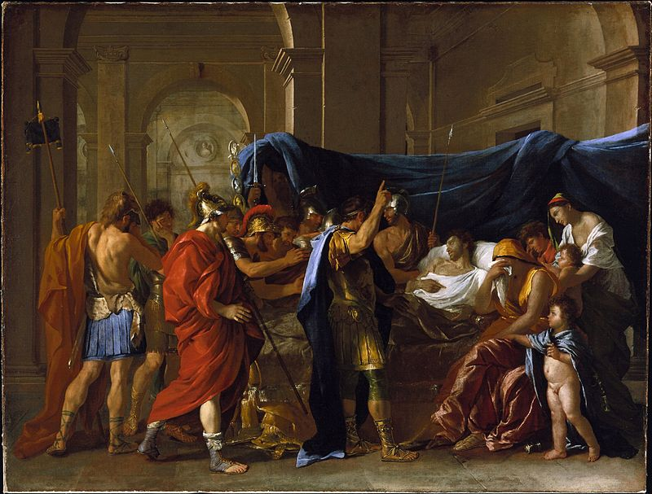
Baroque
Rococo
Neo Classicism
Nicholas Poussin, Death of Germanicus, 1628
Jean-Antoine Watteau, Pilgrimage to Cythera, 1717
John-Germain Drouais, Christ and the Canaanite Woman, 1784
Hall of Mirrors, Palace of Versailles
Salon de la Princesse, Hôtel de Soubise, Paris
Dining Room, Château de Malmaison

Slide 4
Élisabeth Louise Vigée Le Brun, Self Portrait in a Straw Hat, 1782
Adélaïde Labille-Guiard, Self Portrait with Two Pupils, 1785

Slide 5
Neo-Classicism
"Finally, the universal and predominant characteristic of the Greek masterpieces is a noble simplicity and quiet grandeur, both in posture and expression.” Johann Joachim Winckelmann, Reflections on the Painting and Sculpture of the Greeks, 1755
Jacques Louis-David, Socrates at the Moment of Grasping the Hemlock, 1787
Anne Vallayer-Coster, The Attributes of the Arts, 1769

Slide 6
Art Pedagogy and Patronage in the Ancient Regime
The Academy, the Studio and the Salon
Metier
John-Germain Drouais, The Dying Athlete
Jean-Germain Drouais, Marius at Minturnae, 1786

Slide 7
Patriotism and Civic Virtue
Jacques Louis David, The Death of Marat, 1793
Anne-Louis Girodet, Portrait of Jean-Baptiste BElley, 1797

