Slide 1
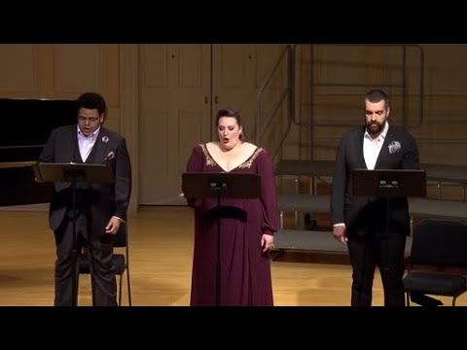
Modern Art
Caspar David Friedrich, Chalk Cliffs on Rügen, 1818
Session 4: Romanticism and 19th Century Visual Culture

Slide 2
Key Terms
Ancient/Modern/Contemporary
Binocular Vision
Persistence of vision
Parallax
Alienation/ Estrangement
Self/consciousness/Self-reflexivity/self referentiality/
Parallax
Projection
Cultural absolutism vs. hybridity
Single Point Perspective (Leon Battista Alberti 15th century)
  Linear Perspective vs. Atmospheric Perspective
Rückenfigur
Romanticism
Sublime vs. Picturesque
Camera Obscura
Daguerreotype vs calotype
Nude vs. Naked

Slide 3
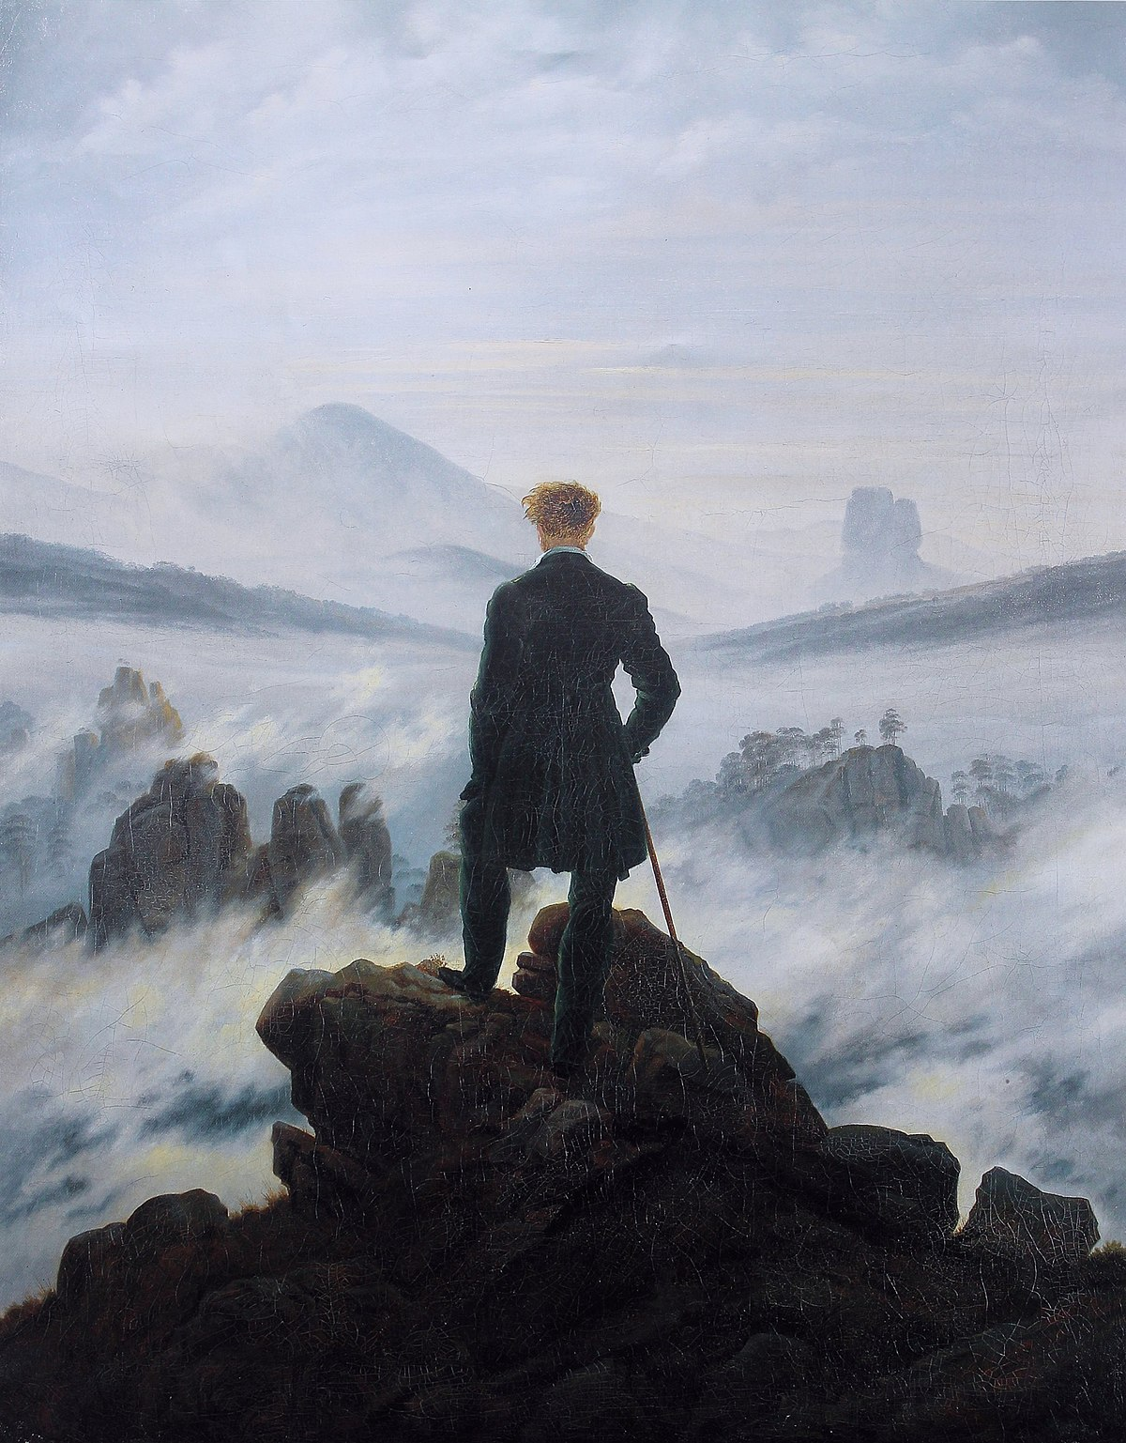
Alienation/ Estrangement
“We who are homeless…We children of the future, how could we be at home in this today? We feel disfavor for all ideals that might lead one to feel at home even in this fragile broken time of transition…we ourselves who are homeless constitute a force that breaks open ice and other all to thin “realities.”
---Nietzsche
Humanism
Romanticism
Rückenfigur
Johannes Vermeer, The Art of Painting, 1666-68
Caspar David Friedrich, Wanderer above the Sea of Fog, 1818

Slide 4
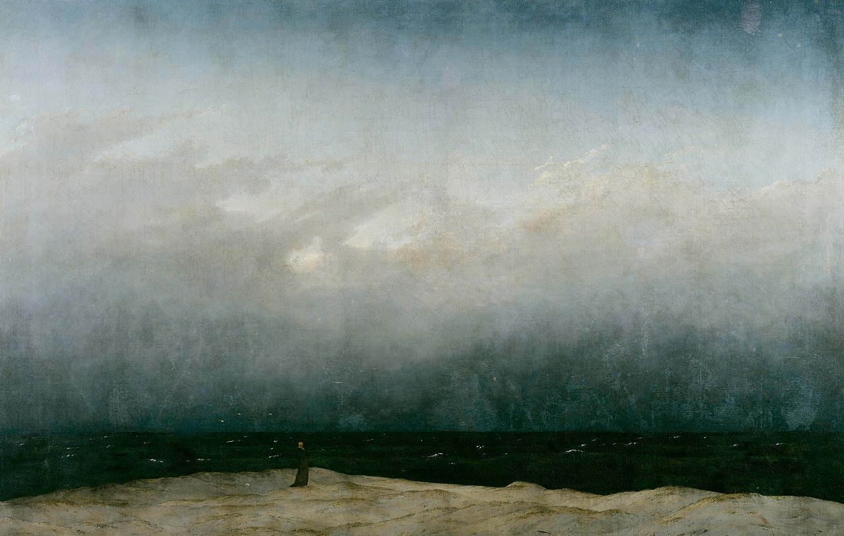
Seascape
Staffage
Caspar David Friedrich, Monk by the Sea, 1808-1810
Caspar David Friedrich, The Sea of Ice, 1823-24

Slide 5
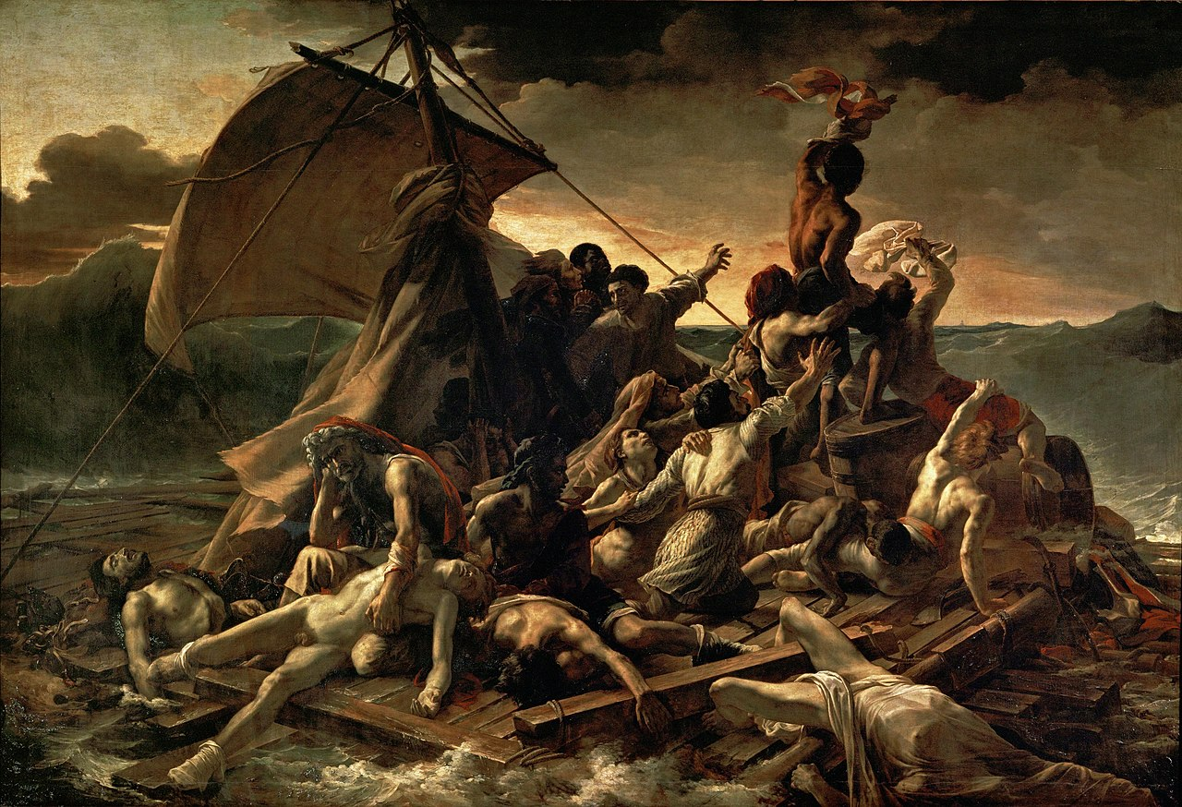
The Sublime
Neoclassical
Romantic
Claude-Joseph Vernet , The Shipwreck, 1772
Jean-Louis André Théodore Géricault, the Raft of the Medusa, 1819

Slide 6
17 June 1816: Frigate Medusa sets sail from Rochefort bound for St. Louis (Senegal) with at total of 400 on board
2 July 1816: Meduse runs aground
5 July 1816: Hastily constructed raft (known as the machine) cut loose with 146 men and 1 woman
17 July 1816: 15 survivors rescued by the Argus
Jean-Louis André Théodore Géricault, the Raft of the Medusa, 1819

Slide 7
Eugène Delacroix, The Barque of Dante, 1822
Eugène Delacroix, The Death of Sardanapalus , 1827

Slide 8
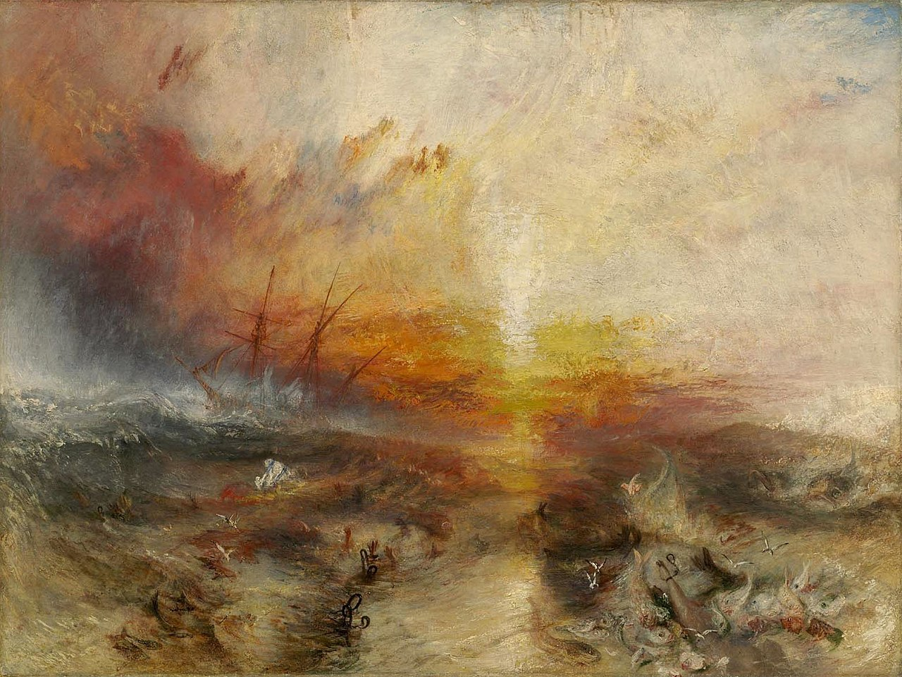
Joseph Mallord William Turner Slavers throwing overboard the Dead and Dying — Typhoon coming on ("The Slave Ship"), 1840

Slide 9
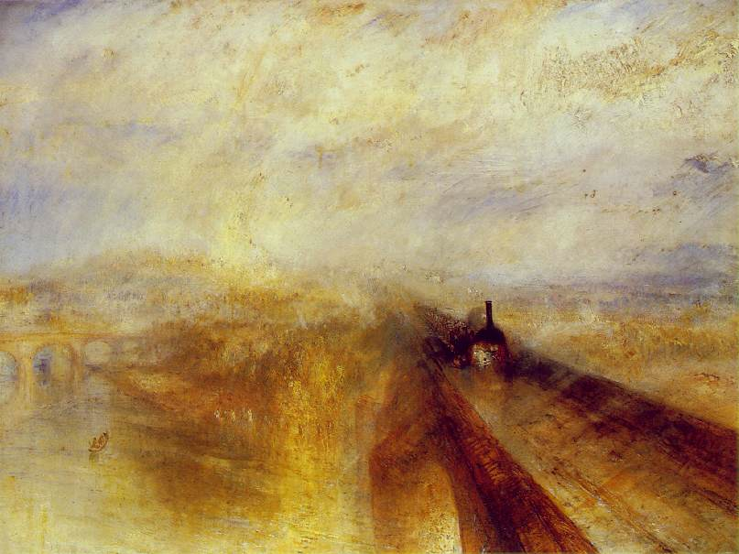
J.M.W. Turner, Rain Steam, Speed, 1844

Slide 10
Self/consciousness/Self-reflexivity/self referentiality
On the notion of modernity. It is is a vexed question… Is not every era “modern” in relation to the preceeding one? It seems that at least one of the components of “our” modernity is the spread of the awareness we have of it. The awareness of our awareness (the double, the second degree) is our source of strength and our torment.
----Edouard Glissant
Physics-Optics
Physiology-Sensation and Perception
Athanasius Kircher, Camera Obscura, Ars Magna Lucis Et Umbrae (1645)
Goethe, first plate of Zür Farbenlehre (Theory of Colors), 1810

Slide 11
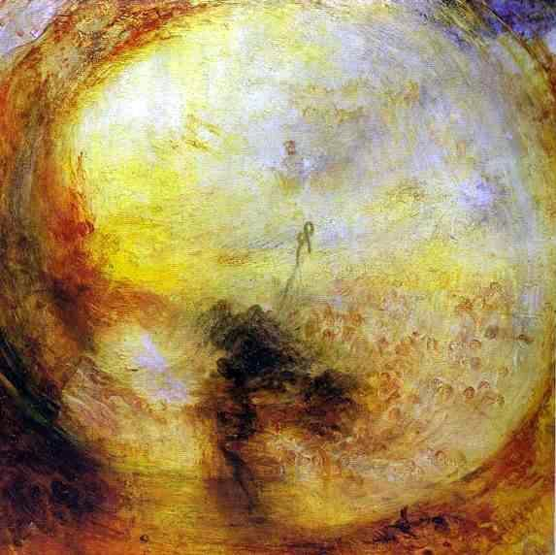
J. M. W. Turner, Light and Color (Goethe’s Theory)-the Morning after the Deluge-Moses Writing the Book of Genesis, 1843

Slide 12
    19th Century Technologies of Visual Representation
Persistence of Vision
Thaumatrope, 19th Century
https://www.nps.gov/articles/make-a-thaumatrope.htm

Slide 13
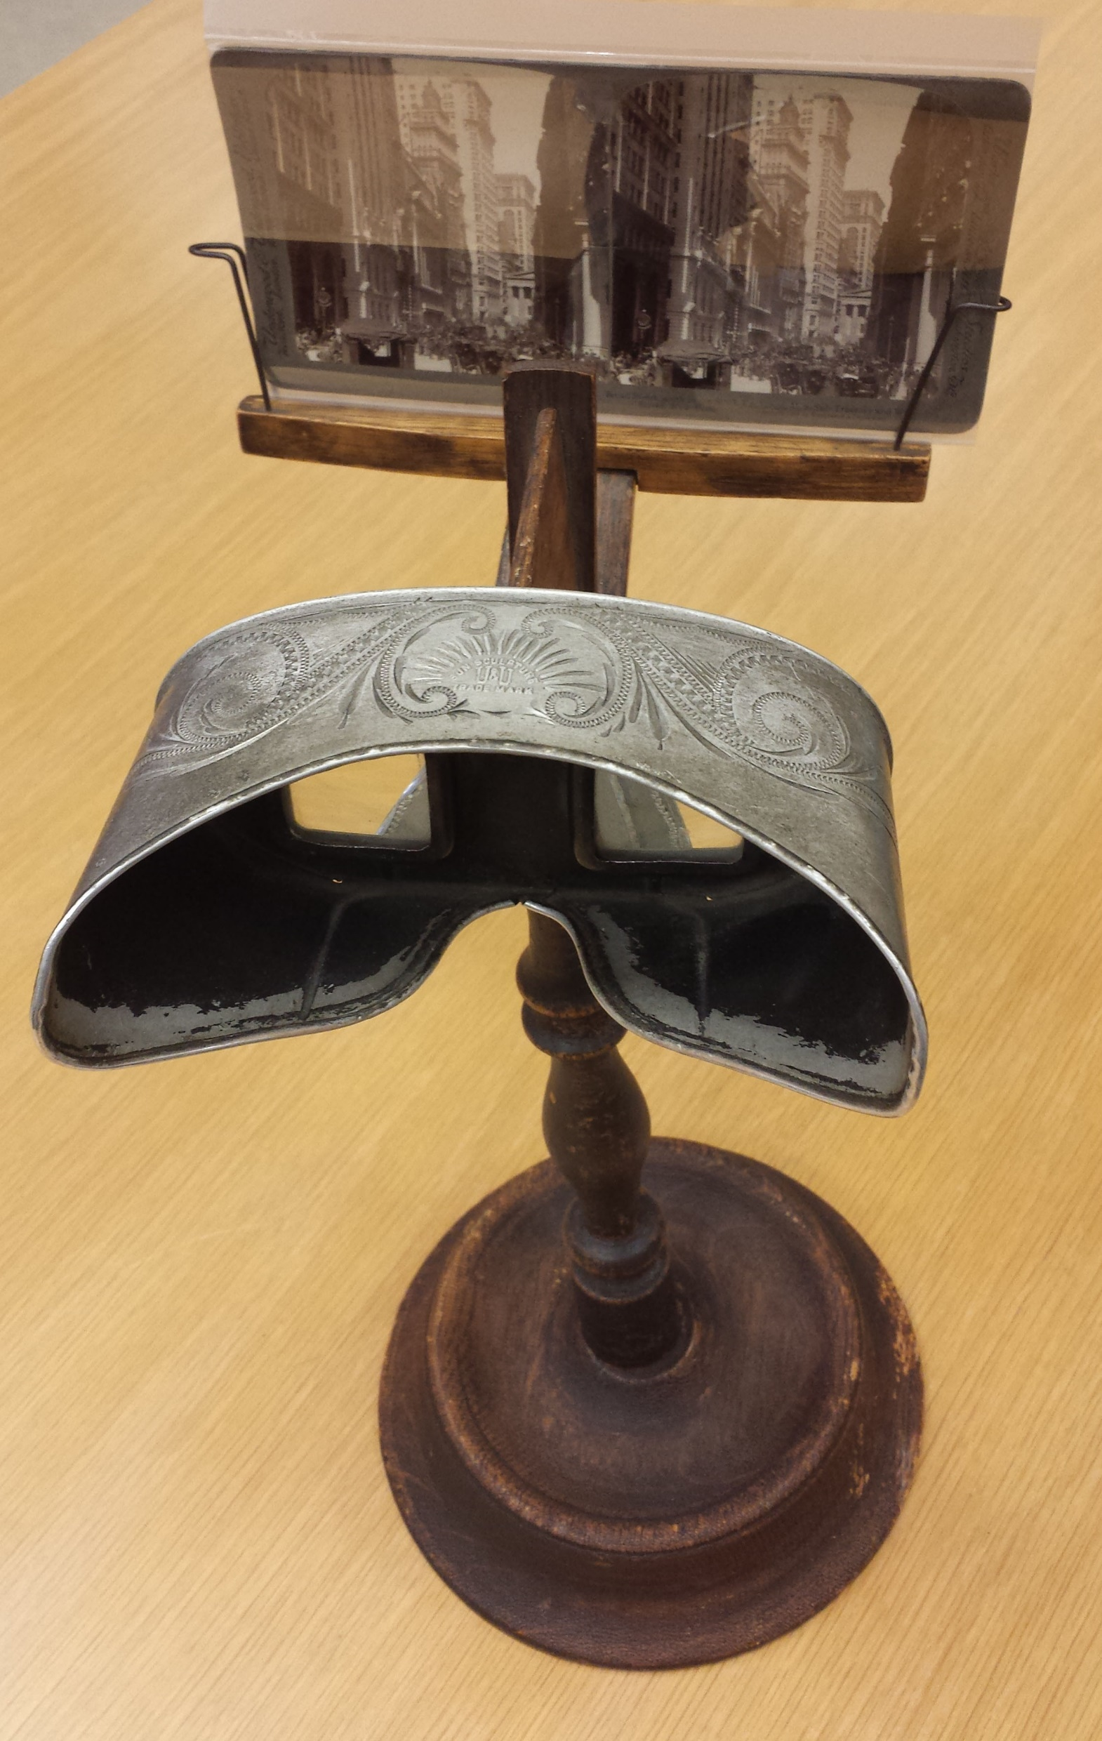
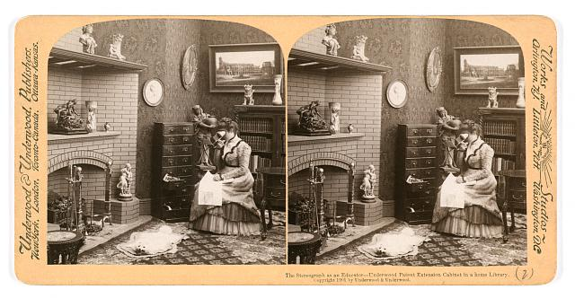
Stereoscope
Binocular vision
The stereograph as an educator – Underwood patent extension cabinet in a home library. Stereograph copyrighted by Underwood & Underwood, 1901
Underwood & Underwood stereoscope and stereograph card

Slide 14
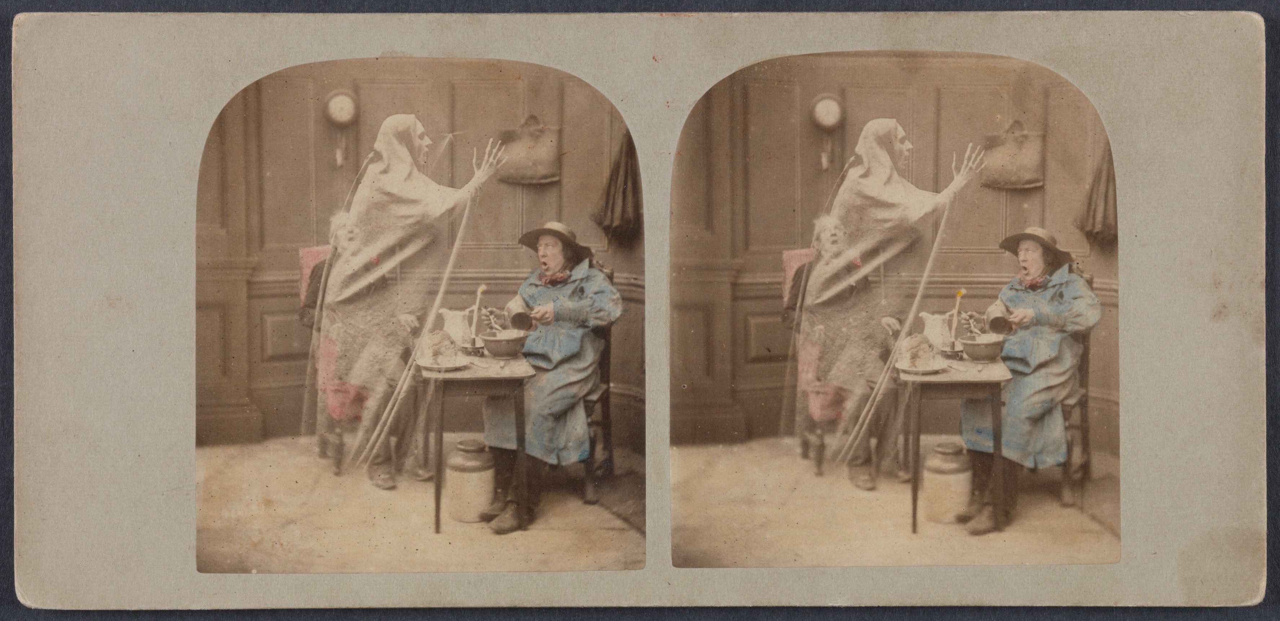
Parallax
London Stereoscopic Company, The Ghost in the Stereoscope, c. 1856

Slide 15
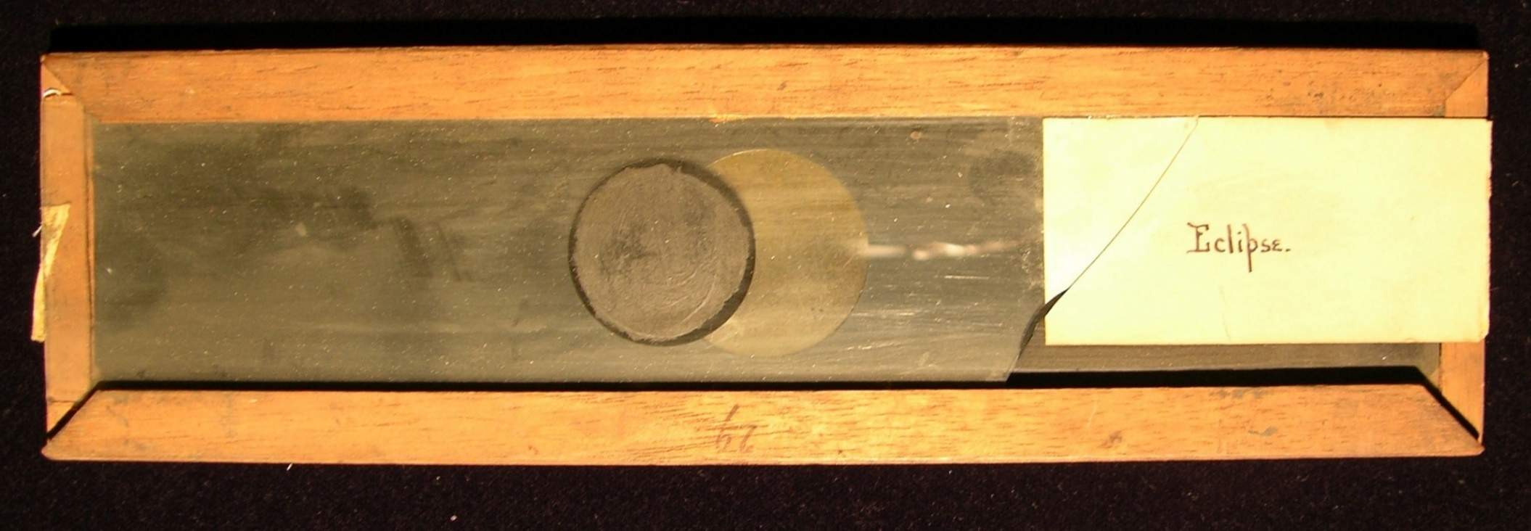
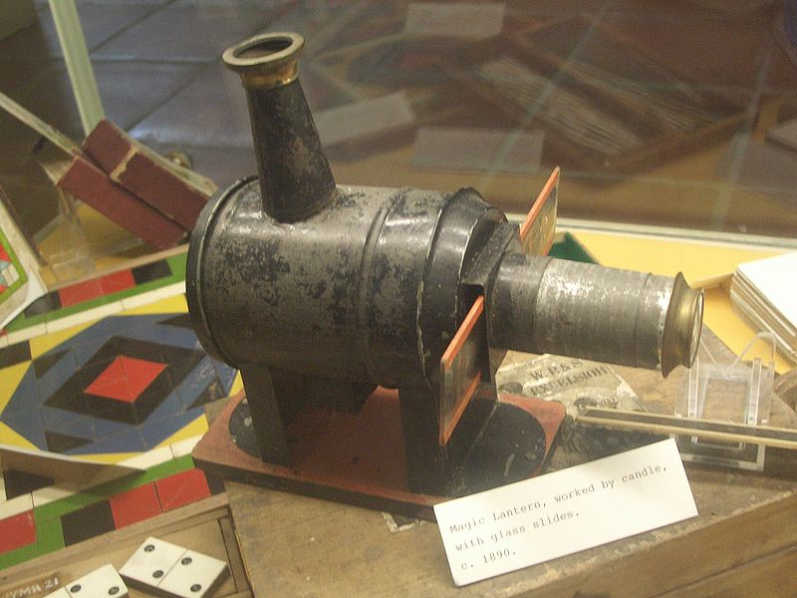
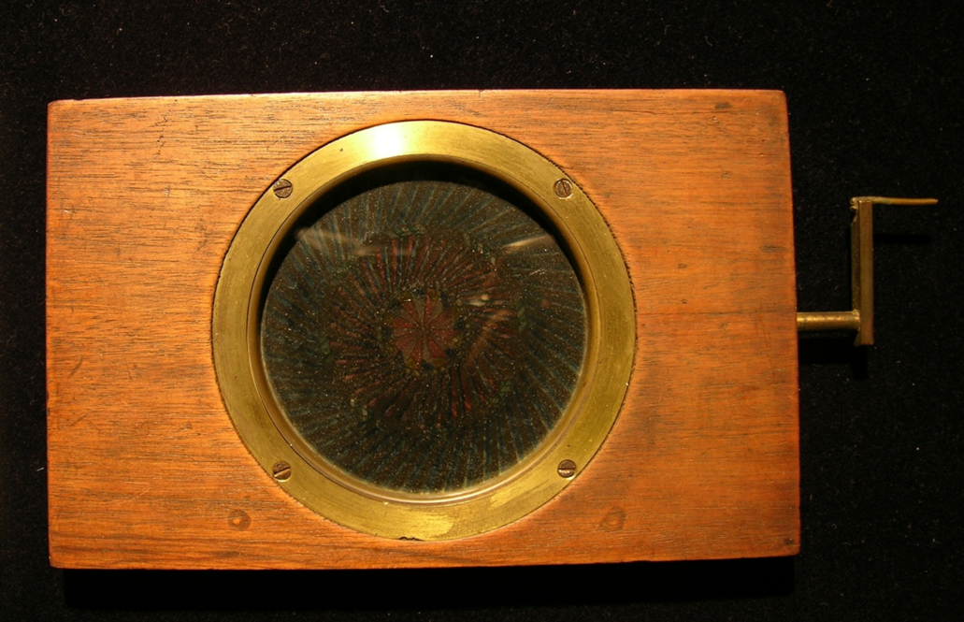
Magic Lantern
Projection
Magic Lantern Slide
Chromatrope

Slide 16
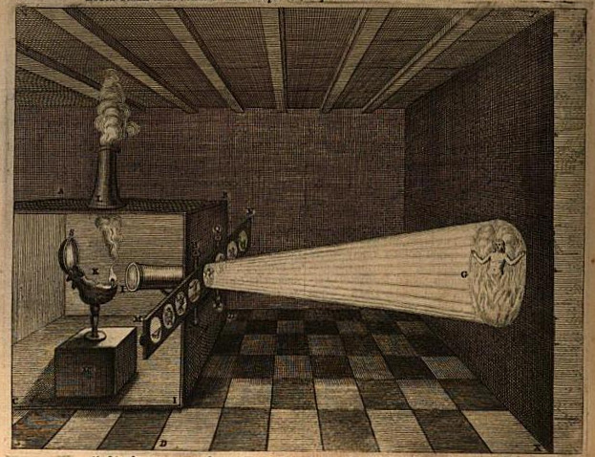
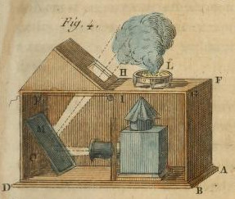
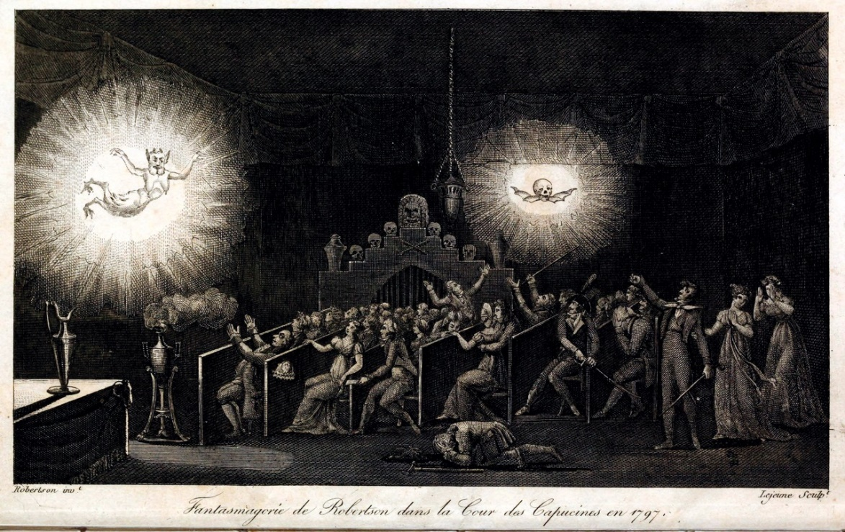
The Magic Lantern
Phantasmagoria
    Wondrous and Marvelous vs. the curious
    Horror
Illustration of the projection of hellfire or purgatory from Athanasius Kircher, Ars Magna Lucis et Umbrae, 1671
Edme-Gilles Guyot, Nouvelles récréations physiques et mathématiques (1770)
Etienne-Gaspard Robert, phantasmagoria at the Cour des Capucines in 1797

Slide 17
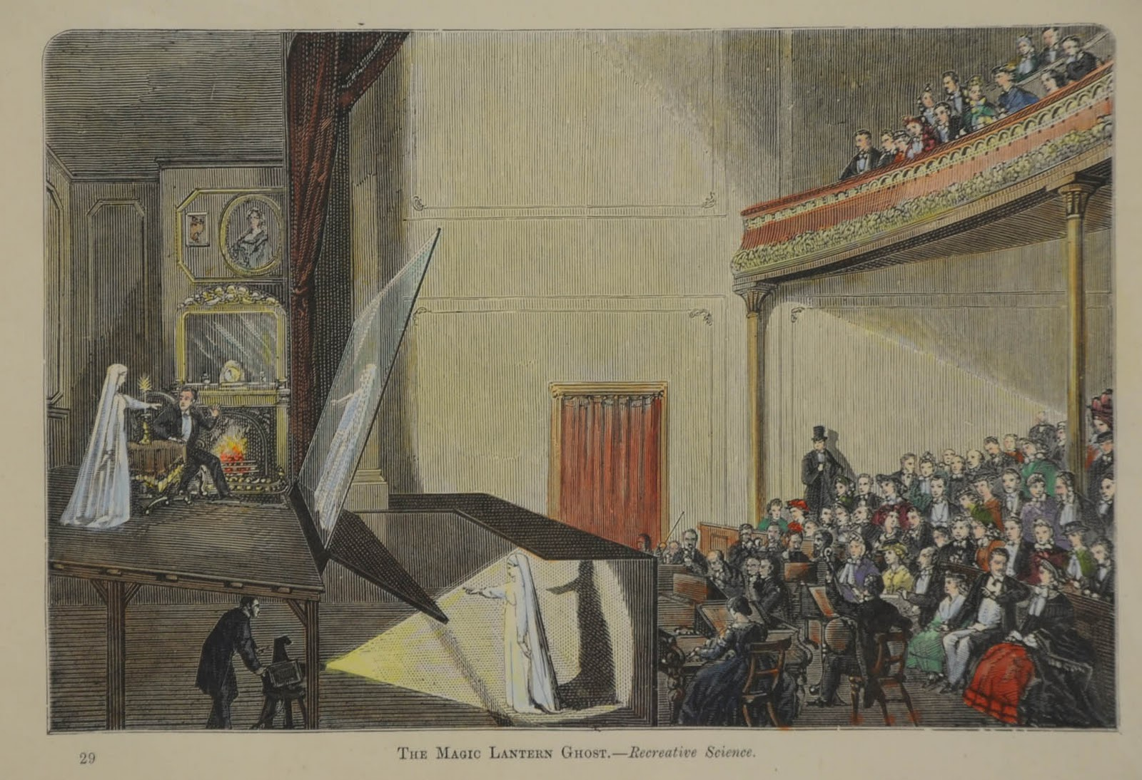
Pepper’s Ghost, 1862

Slide 18
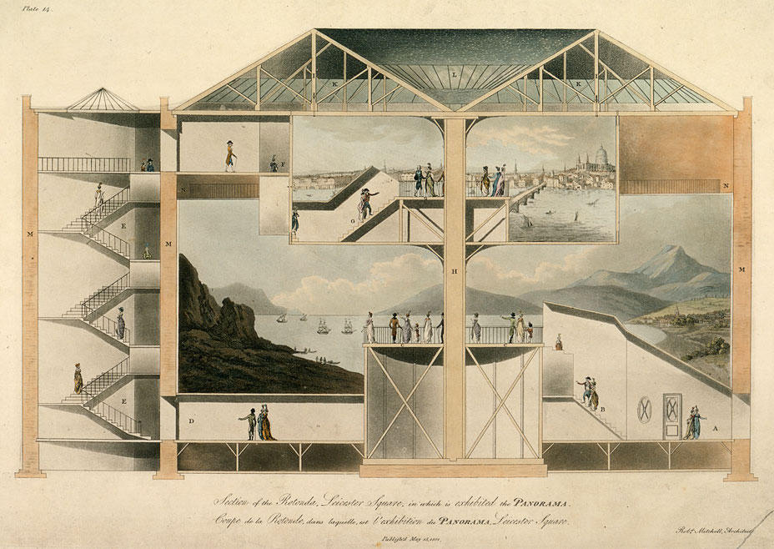
The Panorama
    Immersion
Robert Barker’s Panorama in Leicester Square, View of the Rotunda, 1801

Slide 19
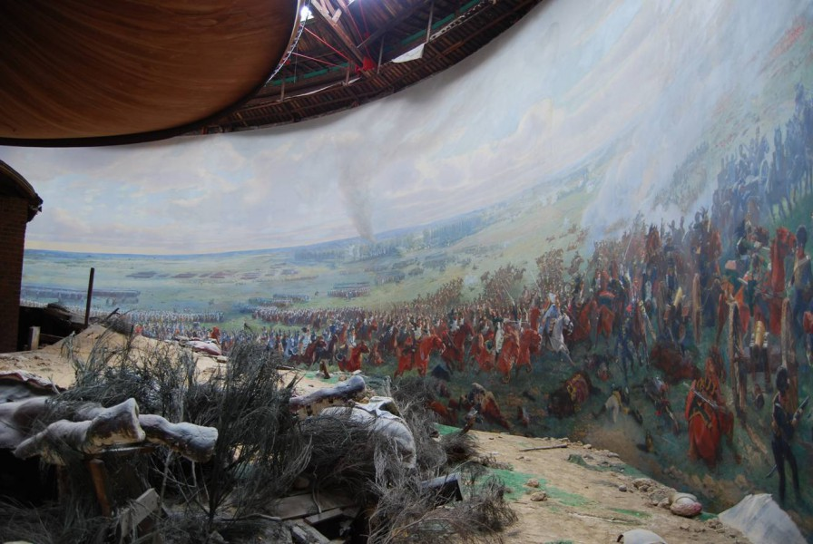
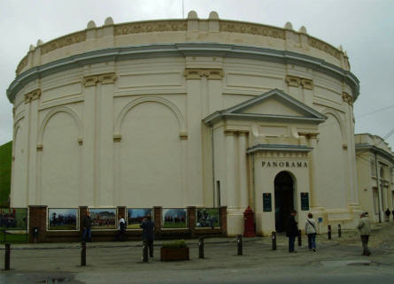
Rotunda
Louis Dumoulin, The Battle of Waterloo, 1915

Slide 20
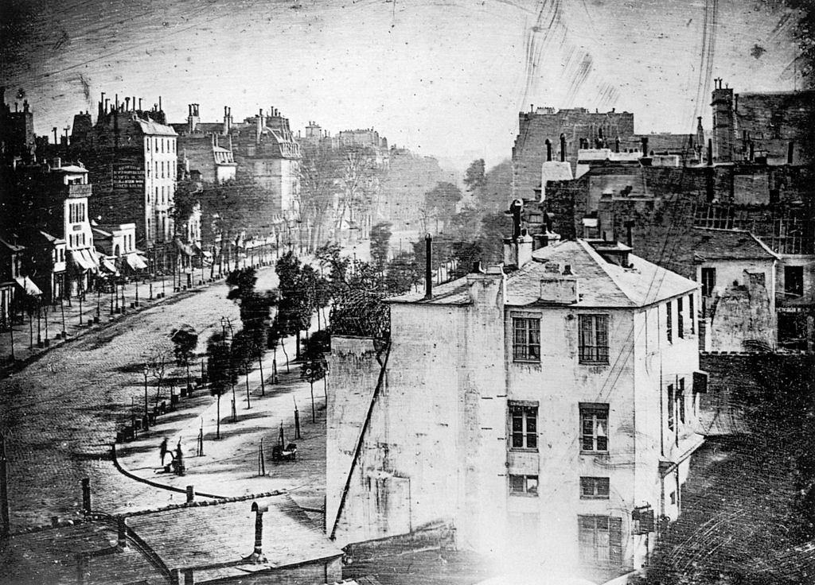
Daguerreotype
Louis-Jacques-Mandé Daguerre, "Boulevard du Temple,”1838

Slide 21
Calotype
William Henry Fox Talbot, An oak tree in winter, c 1842-43
Calotype negative and salted paper print

Slide 22
Unknown maker, Daguerreotype of a Daguerreotypist Displaying Daguerreotypes and Cases, 1845
Unknown maker, Frederick Douglass, c. 1855

Slide 23
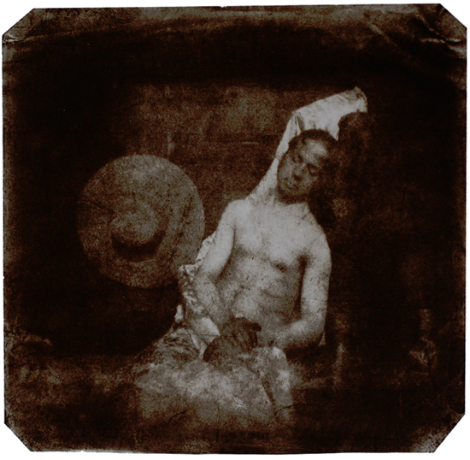
Jean-Baptiste Sabatier-Blot, Daguerreotype of Louis Daguerre, 1844
Hippolyte Bayard, Self Portrait as a Drowned Man, 1840

Slide 24
Nude
Naked
Eugéne Delacroix, Studies, 1855
Marcantonio Raimondi, The Judgment of Paris, ca. 1510–20
Eugéne Durieu, Studies, calotype, 1854
J.T. Zealy, Renty, Congo, on plantation of B.F. Taylor, Columbia, S.C, daguerreotype, 1850

Slide 25
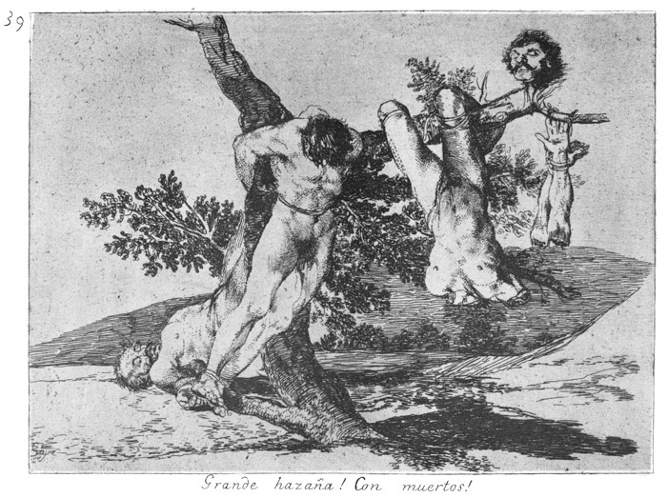
Francisco José de Goya y Lucientes, Great Deeds Against the Dead, plate #39 from The Disasters of War 1810–20

Slide 26
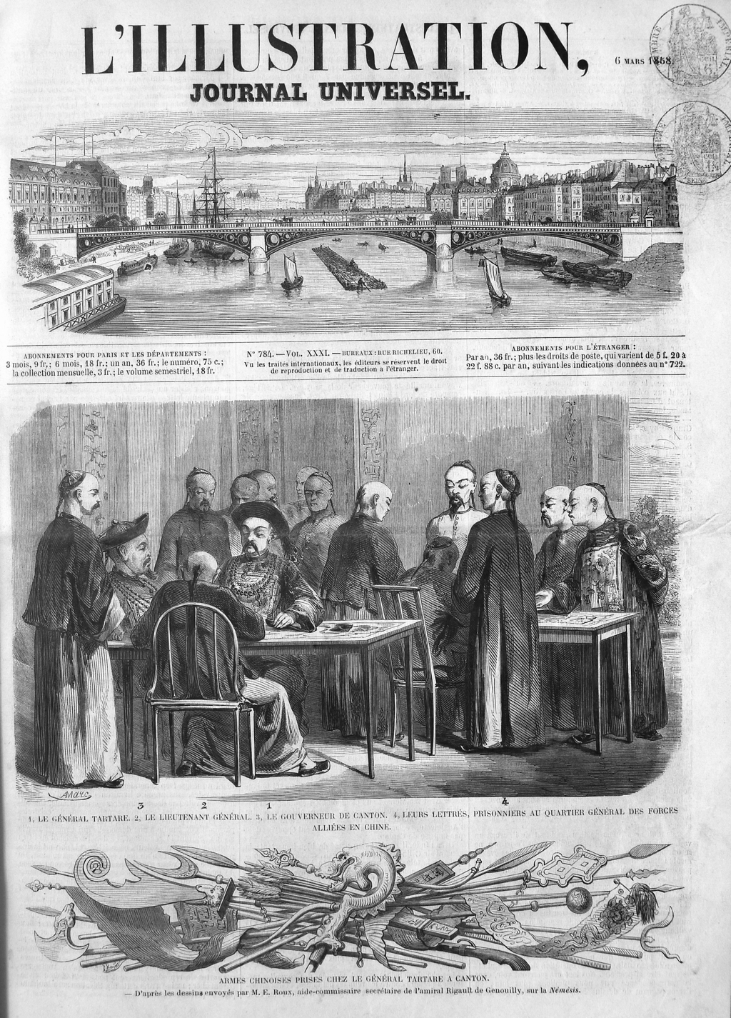
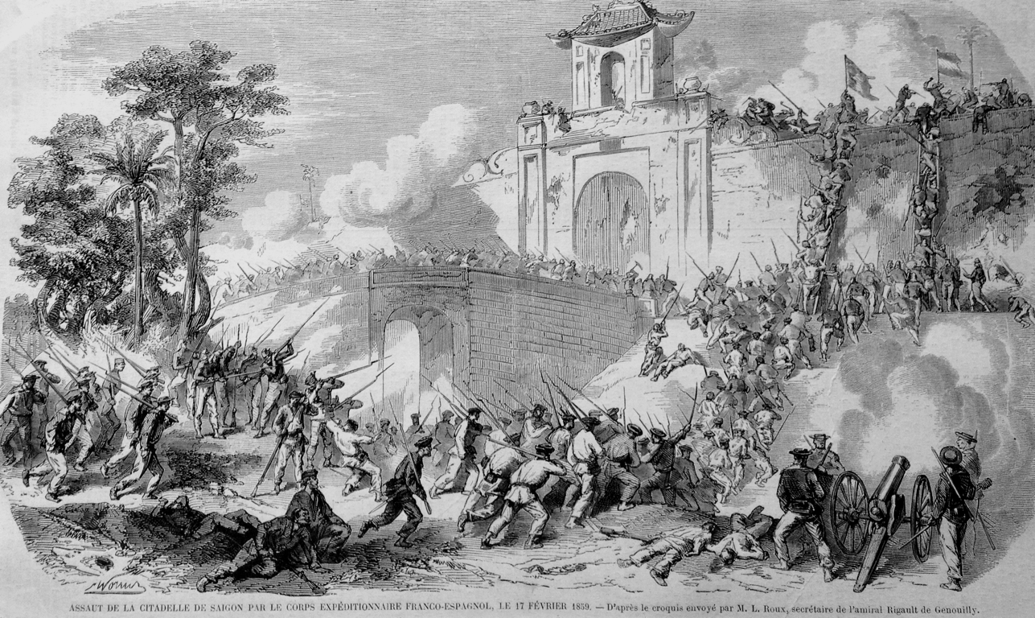
“French Capture of Saigon in 1859,” L’Illustration, (April 23, 1859)
1843-1944

Slide 27
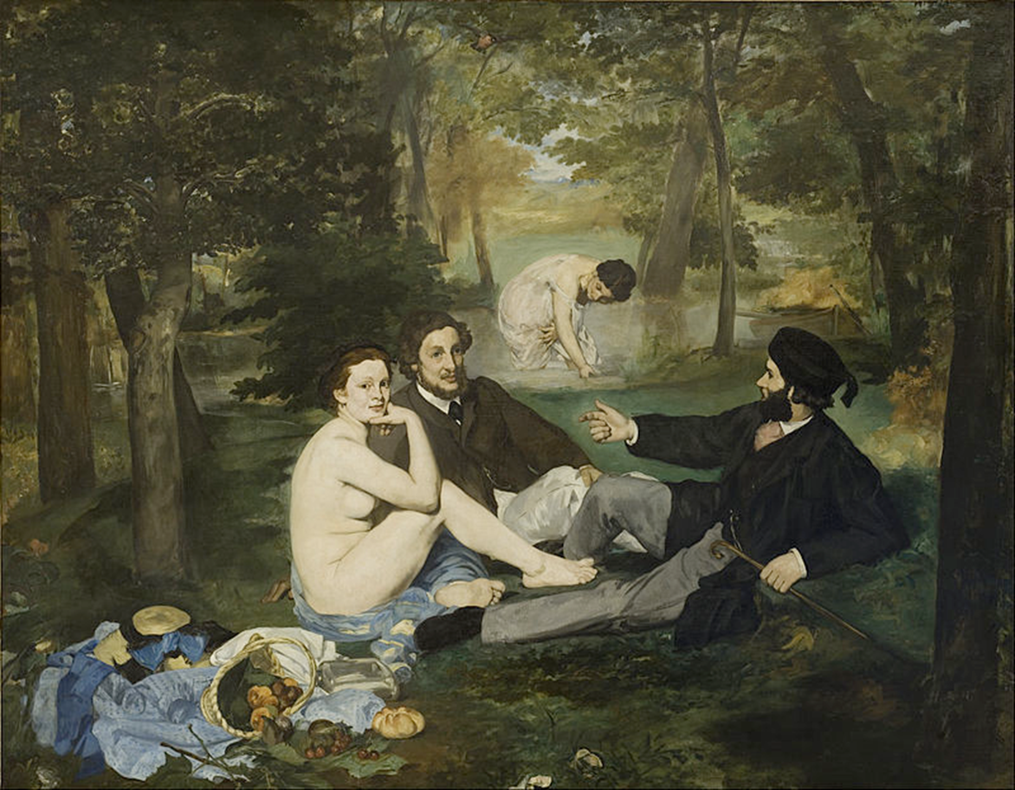
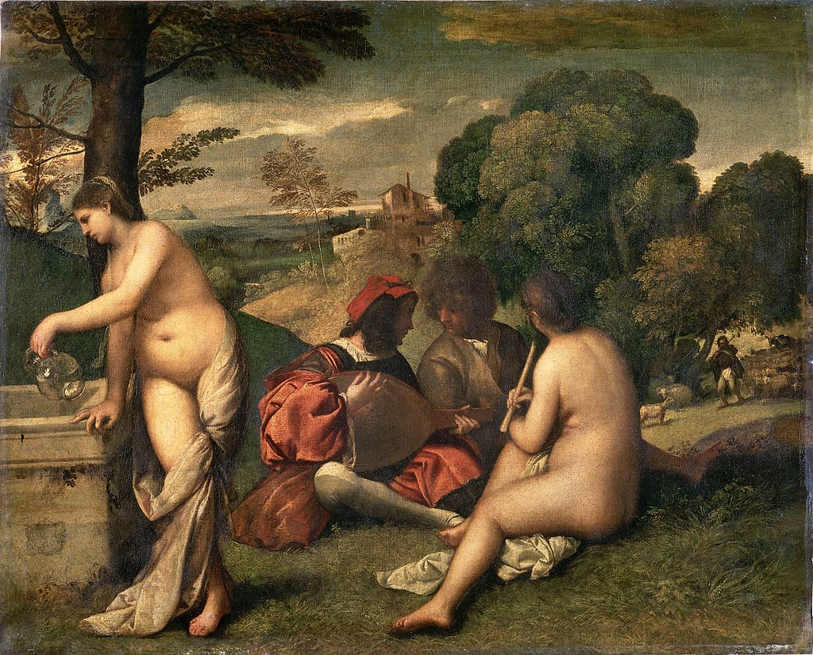
Édouard Manet, The Luncheon on the Grass, 1862-1863
Att. Titian or Giorgione, the Pastoral Concert, c. 1509

