Slide 1
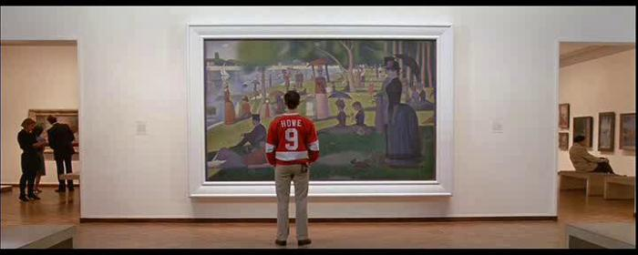
“All Was Simulacrum”
The Anti-utopian Science of Color 19th Century Architecture and World’s Fairs

Slide 2
Key Terms
Eclecticism
Gothic Revival
Chicago School
Chicago Fire 1871
Cornice
Discursive practice
Heterotopia
Ethnographic display

Slide 3
Discussion Question
What is utopia?
What does Nochlin mean when she claims that Seurat envisions utopia as a problem rather than a ready-made solution? P. 148
How is the Grande Jatte anti-utopian? In what ways does Seurat’s formal language offer an anti-utopian critique of modernity? …an aesthetic critique of the utopian impulses of the avant-garde? (Realism, Impressionism, Post-Impressionism)
In what ways is the crisis of modernity reflected in architectural trends of the 19th century?
How did Worlds Fairs consolidate and advance the cultural and political identities of the countries that hosted them? (architecture, materials, layout)

Slide 4
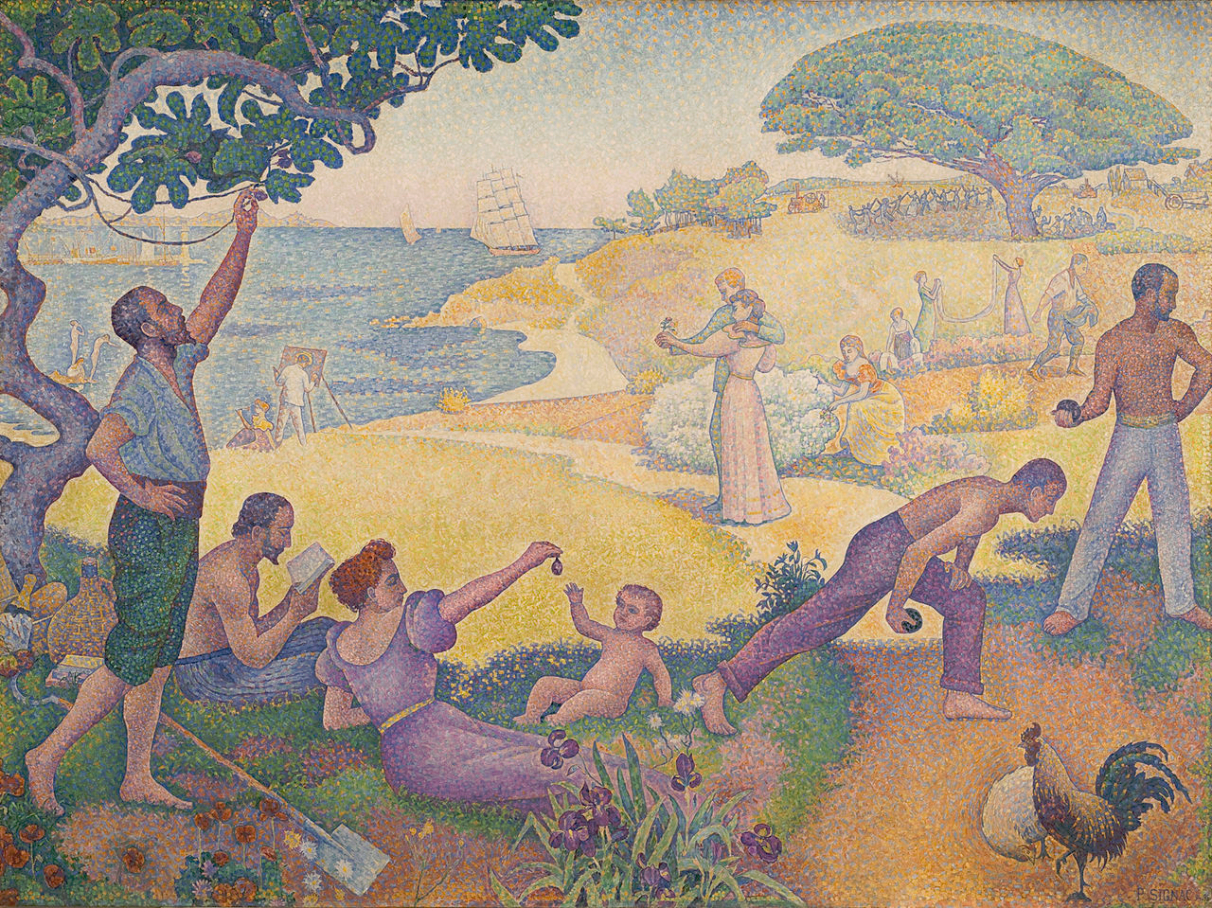
Utopia?
Anarchism
melange optique
"...the separated elements will be reconstituted into brilliantly colored lights.“ Signac
Paul Signac, In the Time of Harmony. The Golden Age is not in the Past, it is in the Future, 1893-95

Slide 5
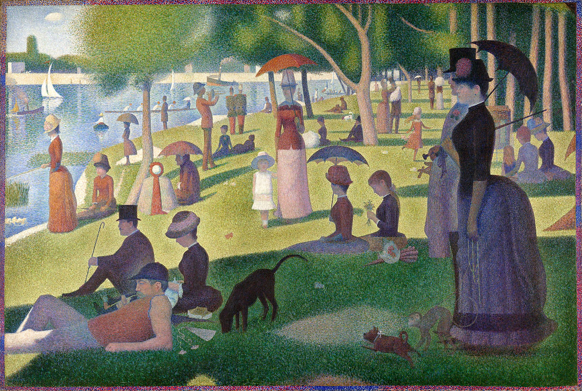
Utopia?
Dystopia?
Georges Seurat, Sunday Afternoon on the Island of the Grande Jatte, 1884
https://www.youtube.com/watch?v=RbkRmGUGSEU

Slide 6
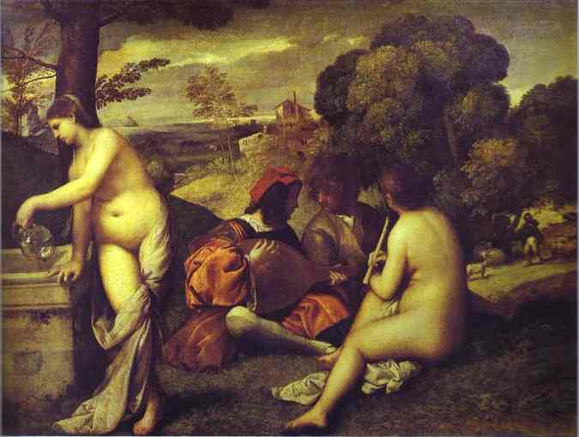
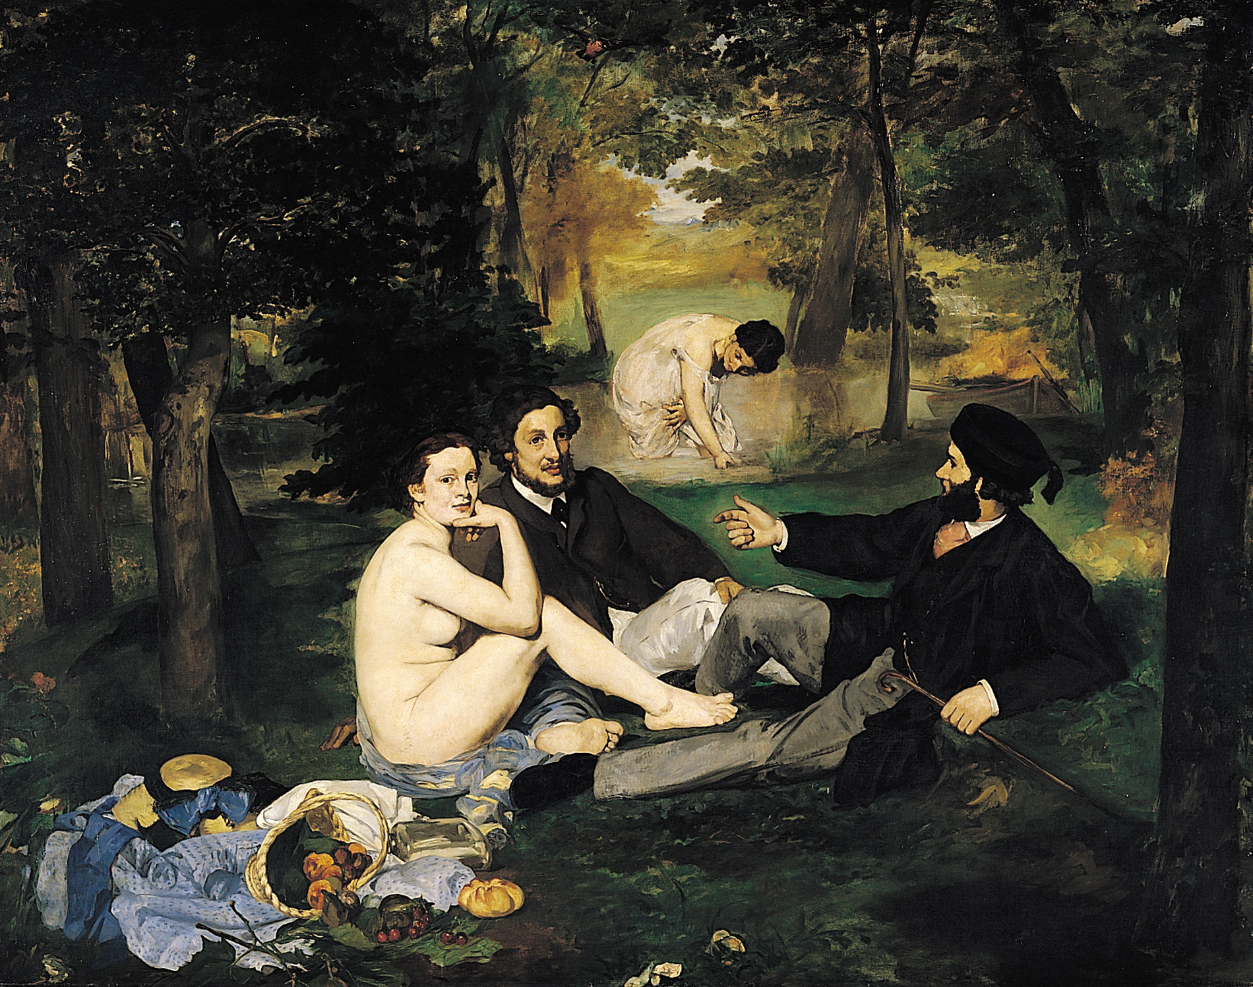
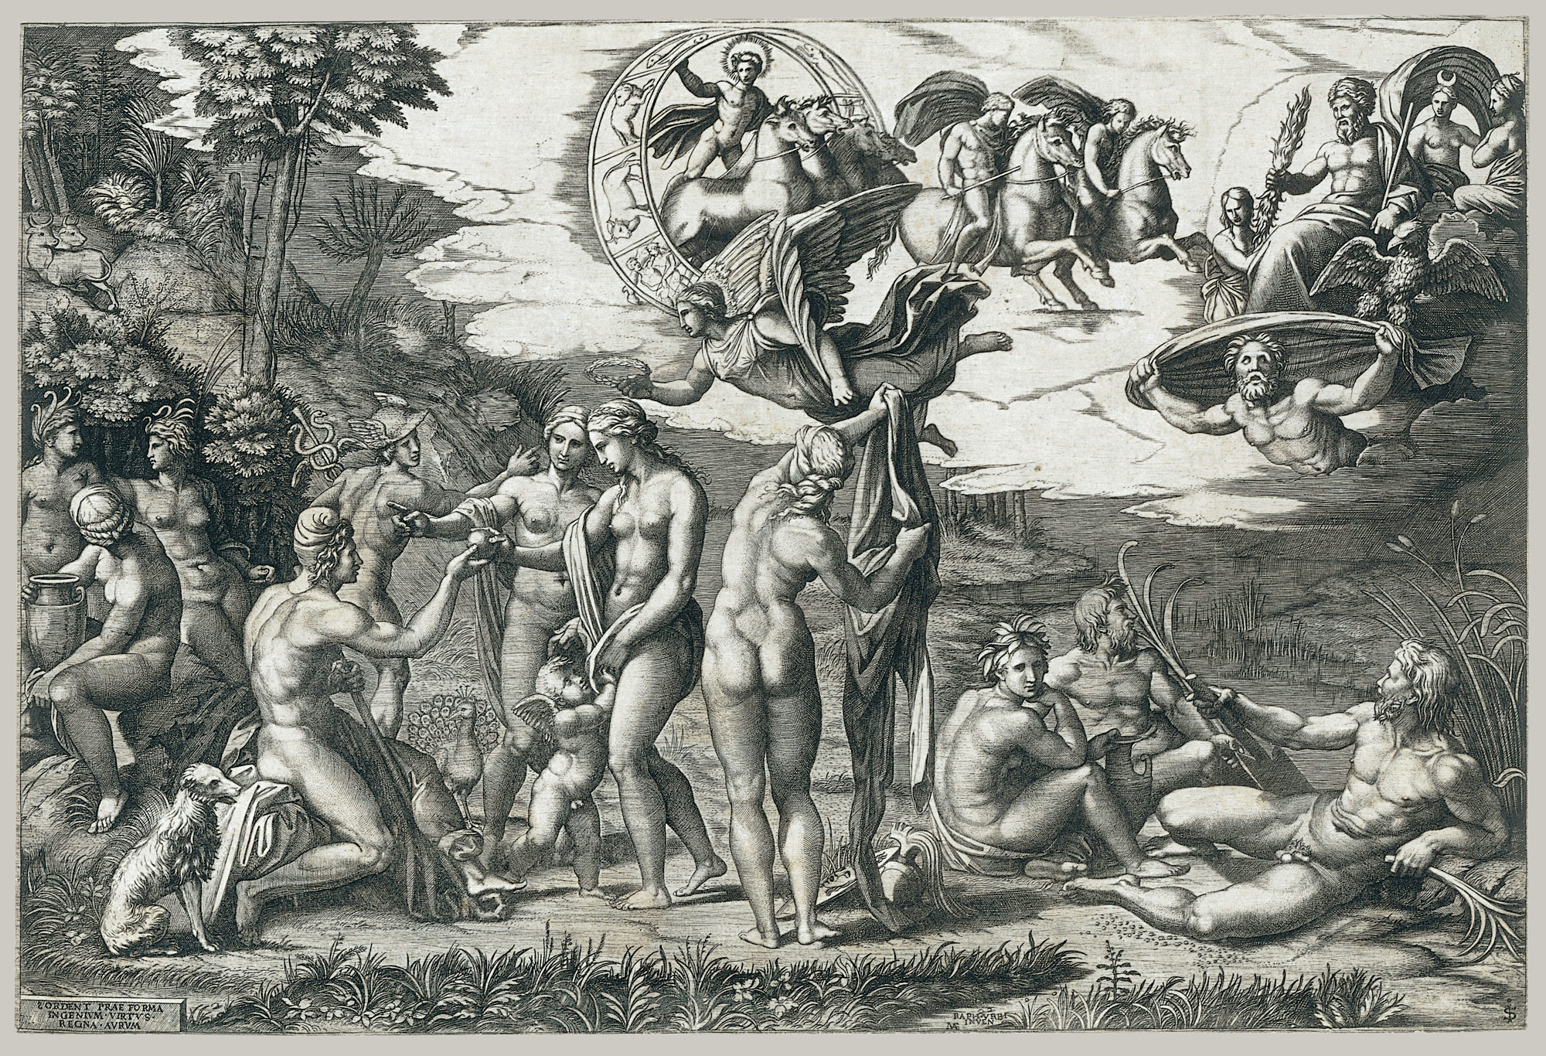
Titian, Patoral Concert, 1508-09
Marcantonio Raimondi, The Judgment of Paris;, c. 1510-20
Edouard Manet, Le Déjeuner sur l'herbe, 1863

Slide 7
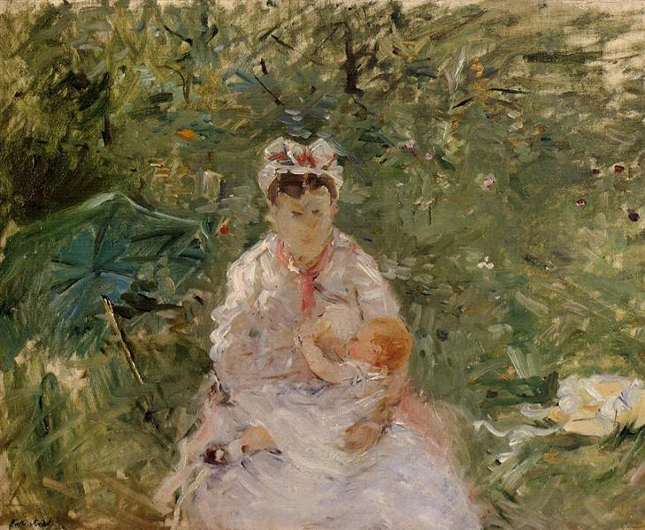
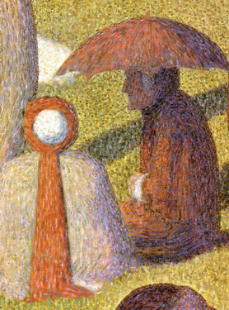
Berthe Morisot, Nursing, 1879

Slide 8
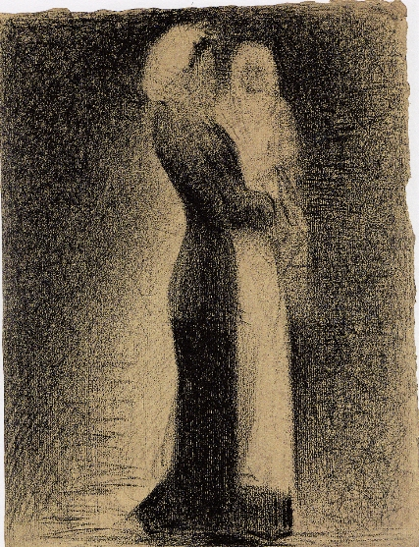
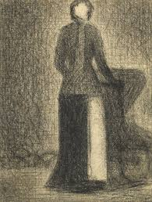
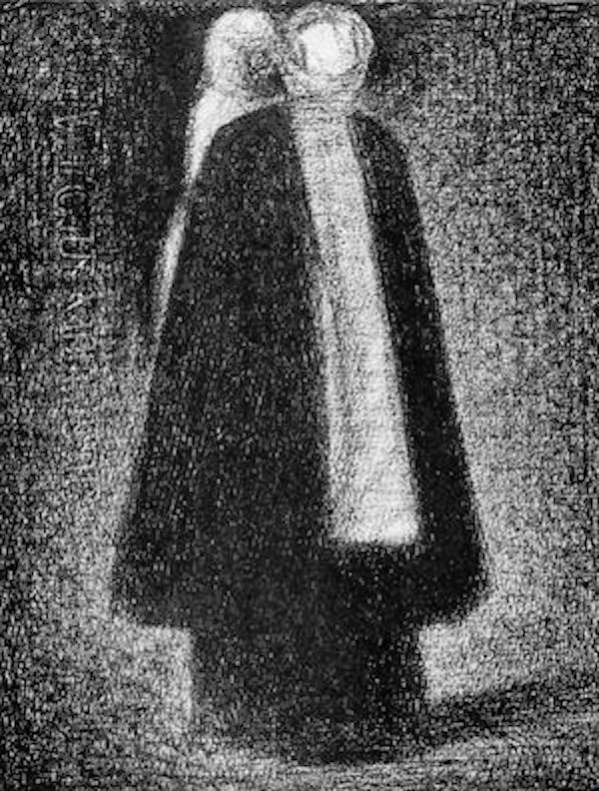
Seurat, Nurse in Profile, c. 1882
Seurat, Nurse with Carriage, c. 1884
Seurat, Back View with Baby, c. 1884

Slide 9
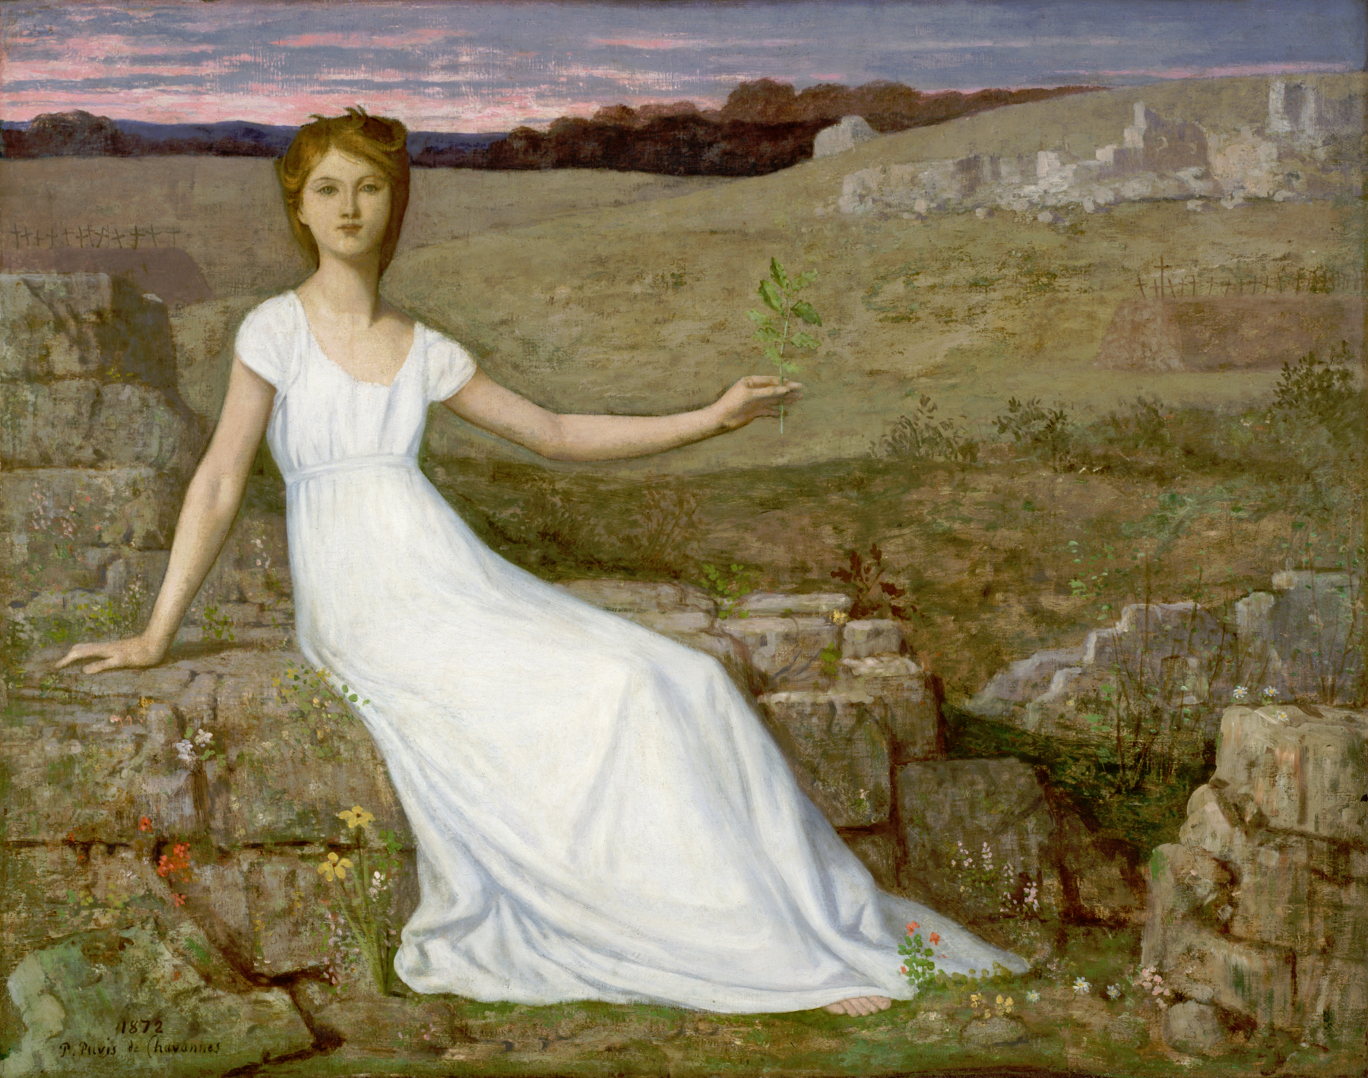
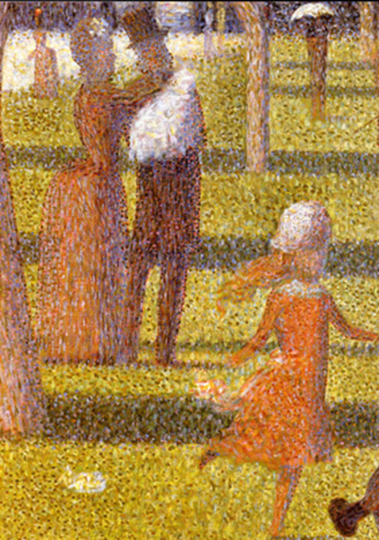
Pierre Puvis de Chavannes, Hope, 1872
Notes:
http://www.musee-orsay.fr/en/collections/works-in-focus/painting.html?no_cache=1&zoom=1&tx_damzoom_pi1%5BshowUid%5D=1837

Slide 10
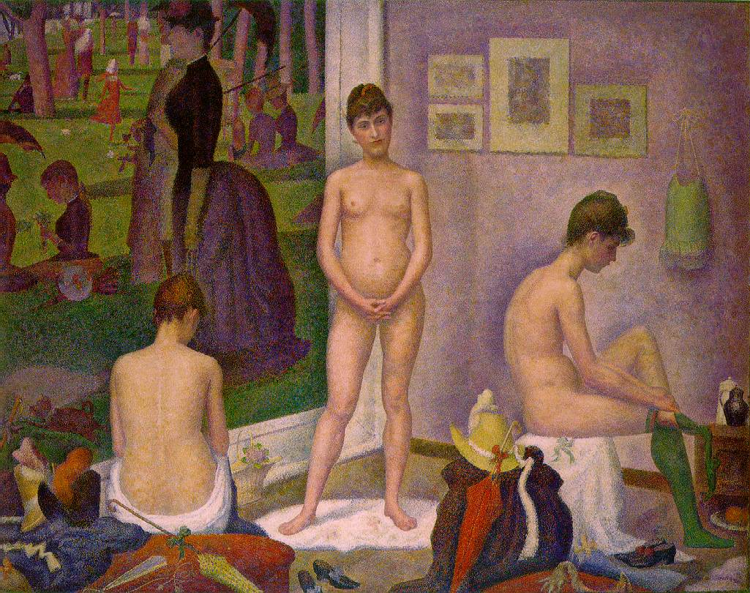
Georges, Seurat, The Models, 1887-88

Slide 11
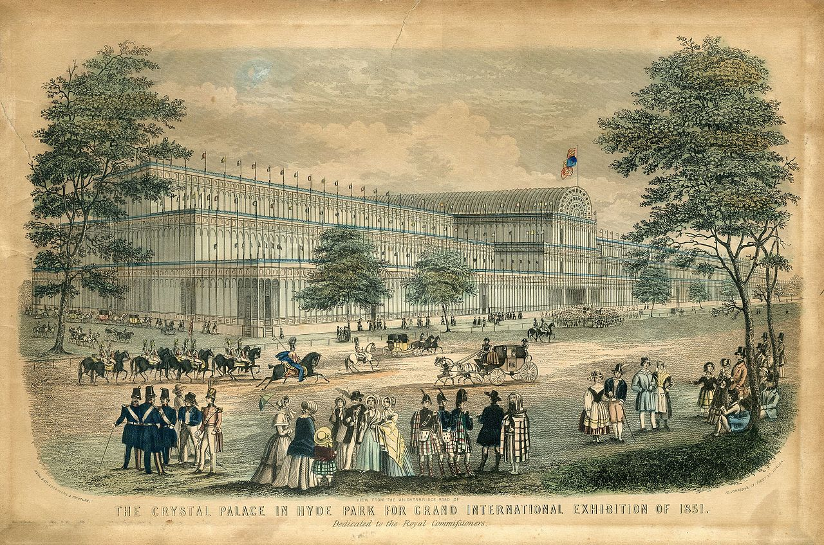
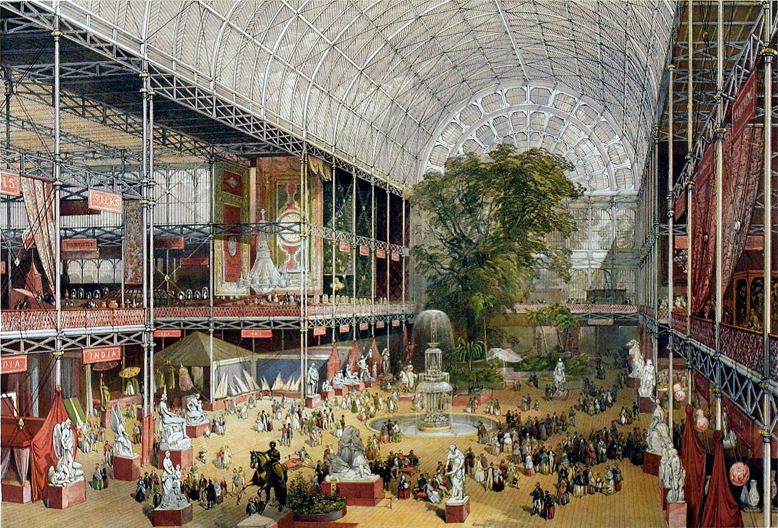
Read & Co. Engravers & Printers, View from the Knightsbridge Road of The Crystal Palace in Hyde Park for Grand International Exhibition of 1851, 1851
J McNeven,The transept from the Grand Entrance, Souvenir of the Great Exhibition, 1851

Slide 12
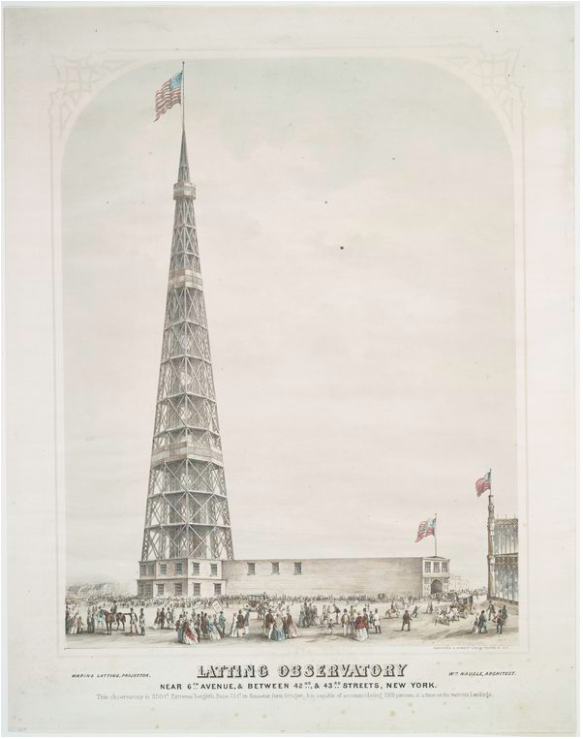
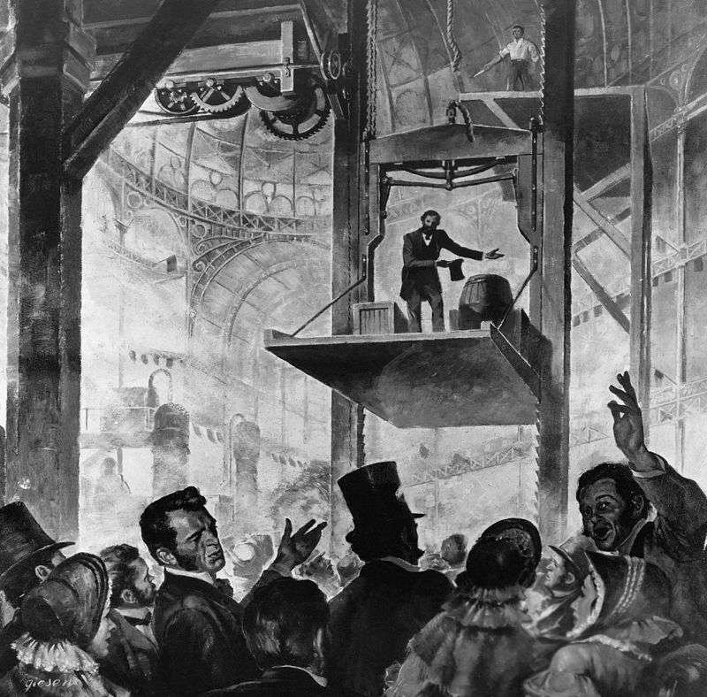
Latting Observatory, Exhibition of the Industry of All Nations, 1853
Elisha Otis free-fall safety demonstration in 1853

Slide 13
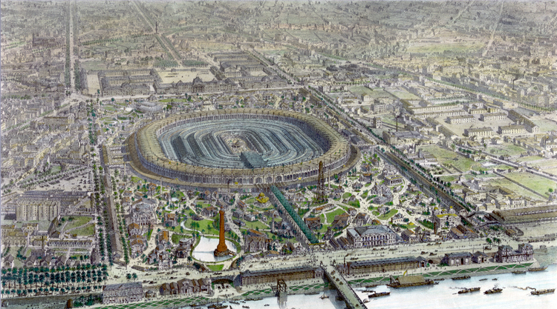
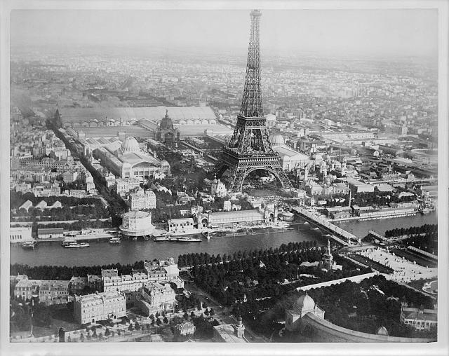
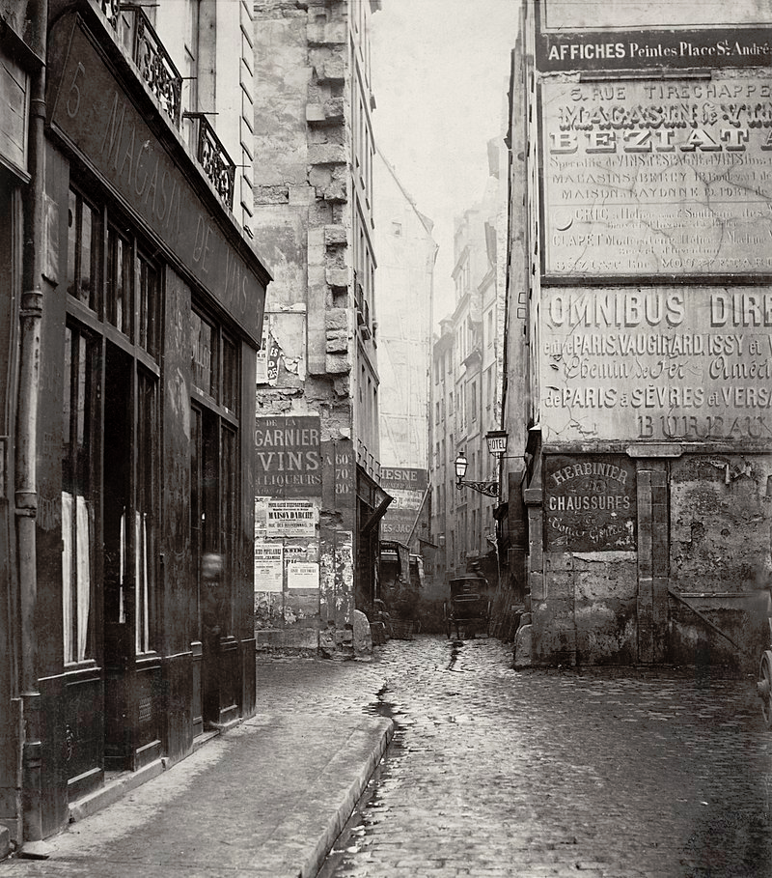
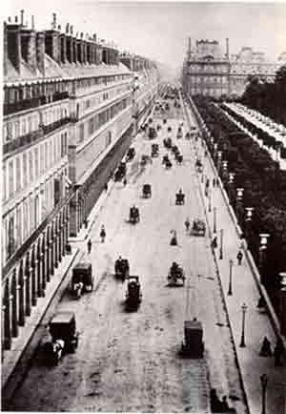
Panorama of the main exposition building, Exposition Universelle, Paris 1867
A Liebert, Aerial view of Paris, France, from a balloon, showing the Seine River and the Eiffel Tower at center, and buildings of the Exposition universelle, 1889

Slide 14
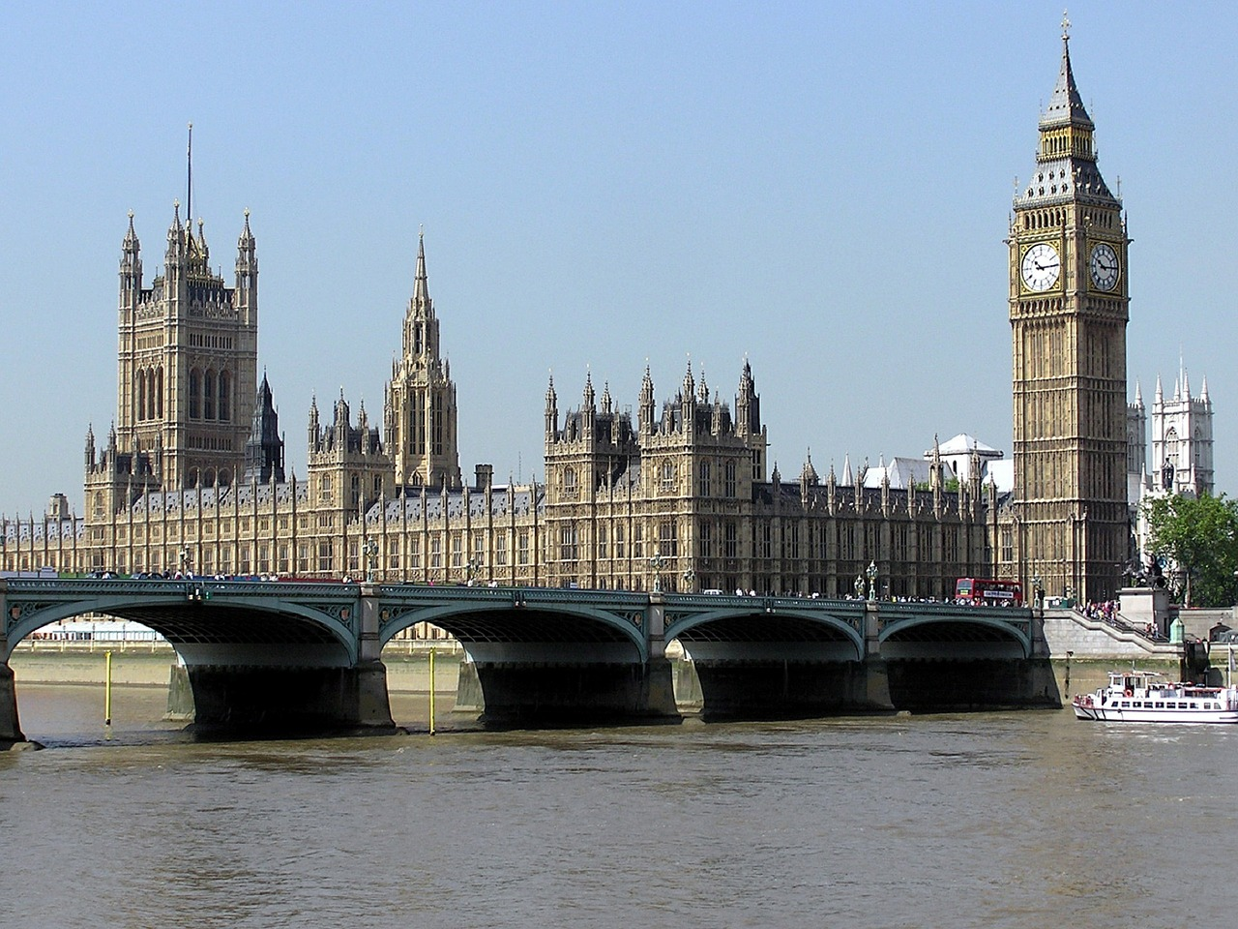
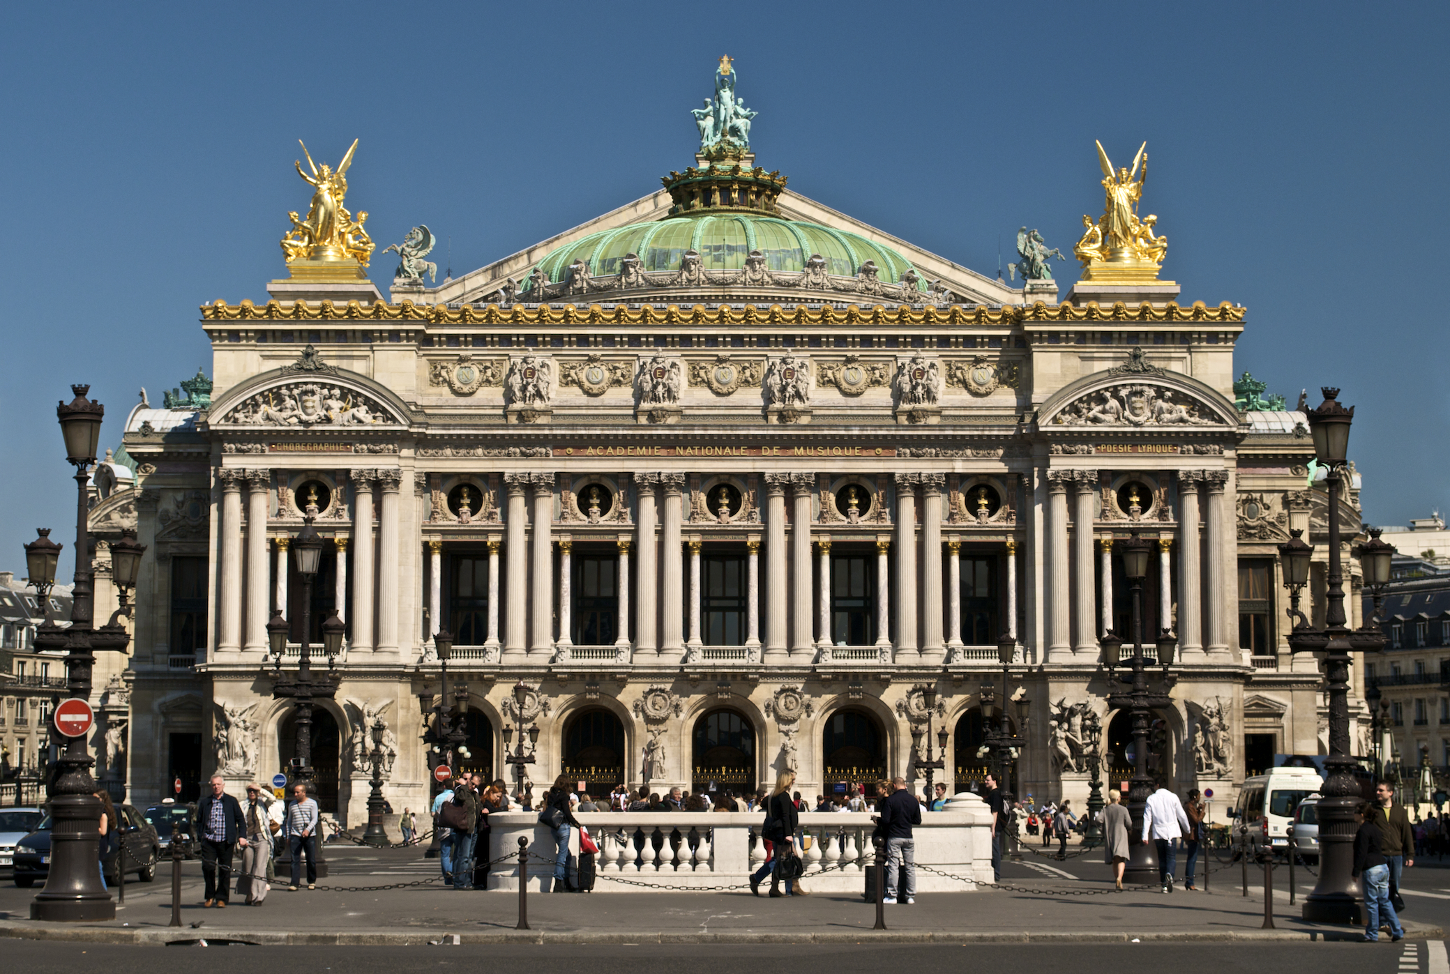
Gothic Revival
Eclecticism
Charles Barry and Augustus W. N. Pugin, Houses of Parliament, 1836-58
Charles Garnier, Palais Garnier, 1861-74

Slide 15
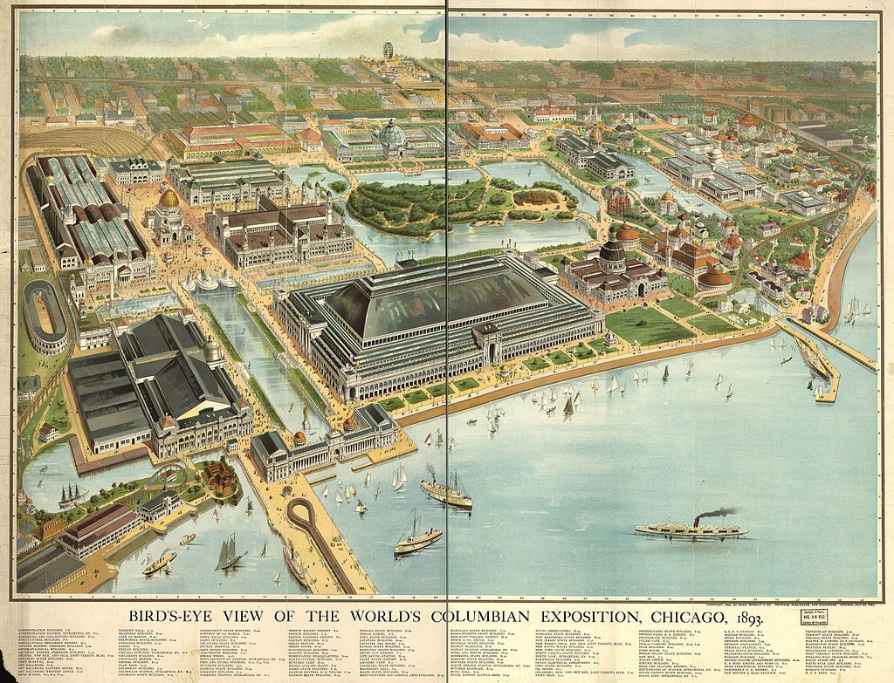

Slide 16
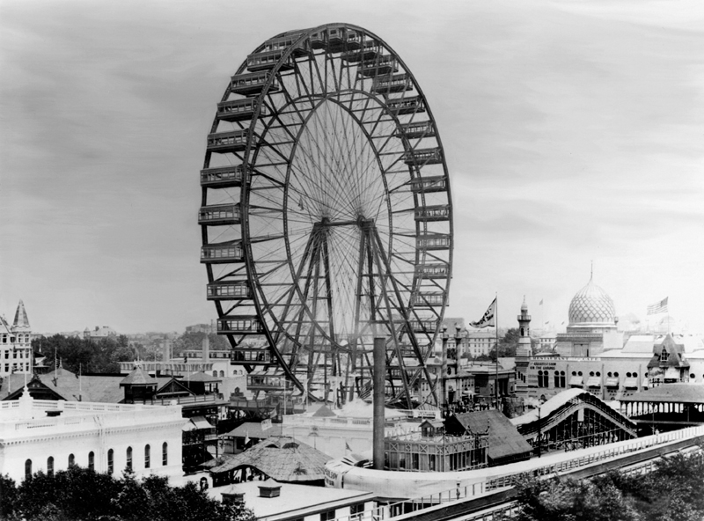
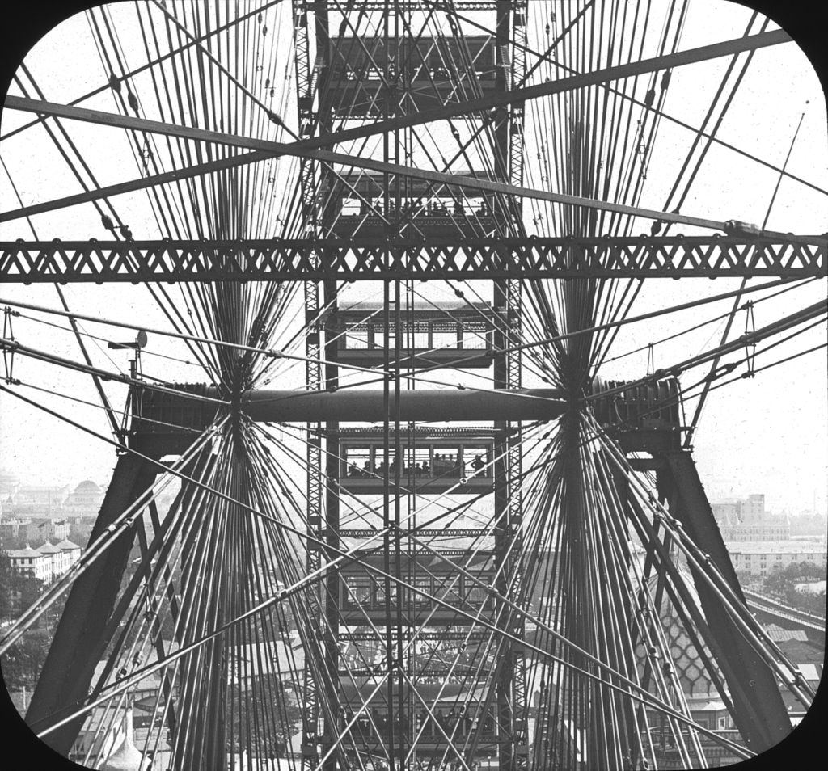
George Washington Gale Ferris Jr., The Original Ferris Wheel, 1893

Slide 17
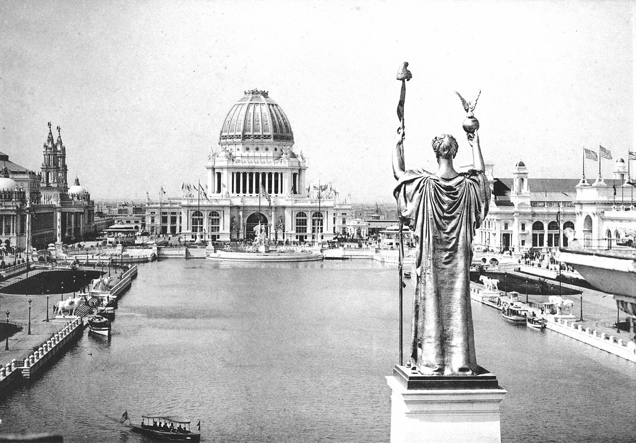
Looking West From Peristyle, Court of Honor and Grand Basin of the 1893 World's Columbian Exposition

Slide 18
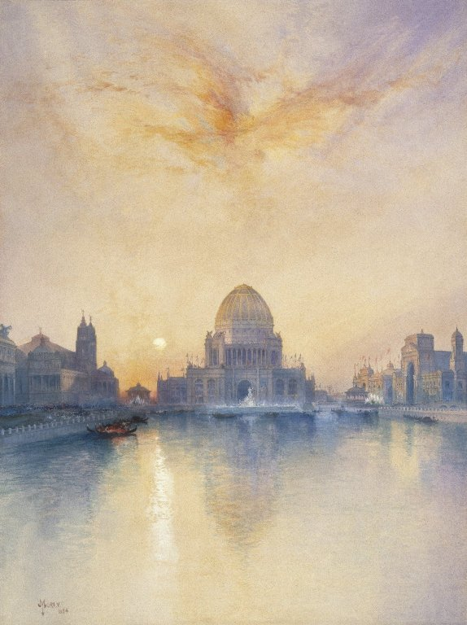
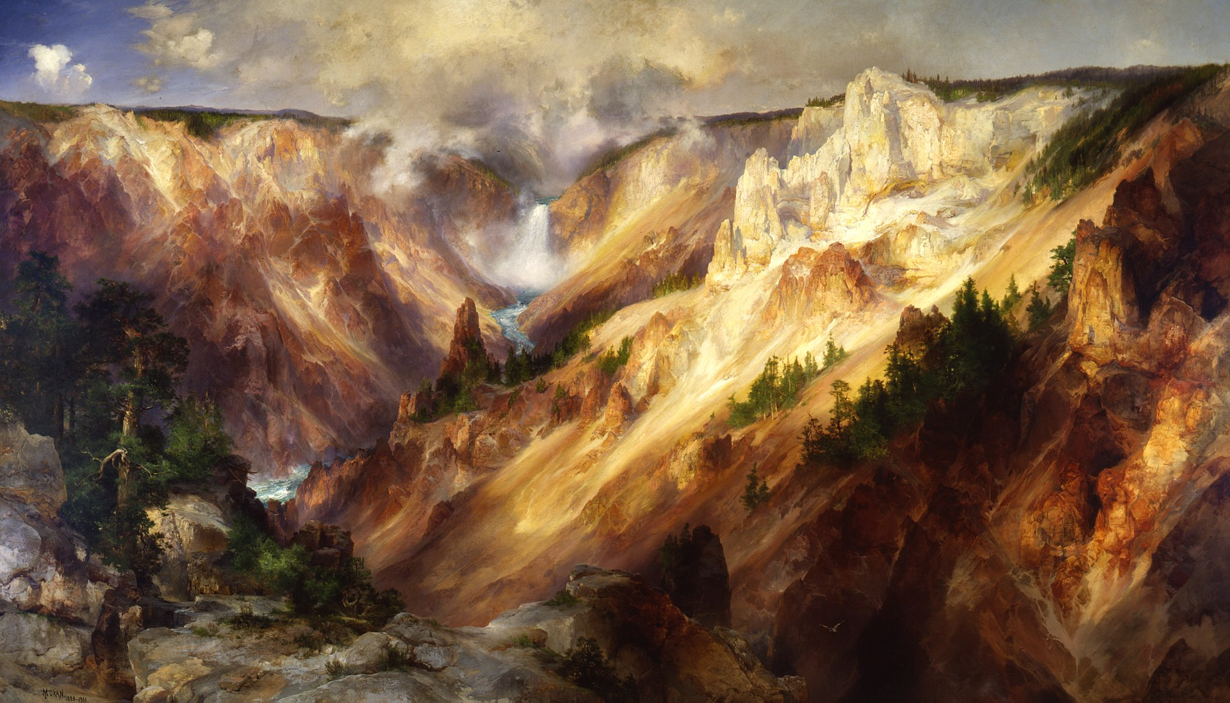
Thomas Moran, Grand Canyon of the Yellowstone, 1872
Thomas Moran, Chicago World’s Fair, 1894

