Slide 1
“All the World’s a Stage”
The Spatial Politics of 19th Century Architecture and World’s Fairs

Slide 2
Key Terms
Eclecticism
Gothic Revival
Chicago School
Chicago Fire 1871
Cornice
Discursive practice
Heterotopia
Ethnographic display

Slide 3
Discussion Question
In what ways is the crisis of modernity reflected in architectural trends of the 19th century?
How did Worlds Fairs consolidate and advance the cultural and political identities of the countries that hosted them? (architecture, materials, layout)
As we view these works, do our acts of critical viewership also implicate us in the dynamics of pleasure and power intrinsic to their creation?

Slide 4
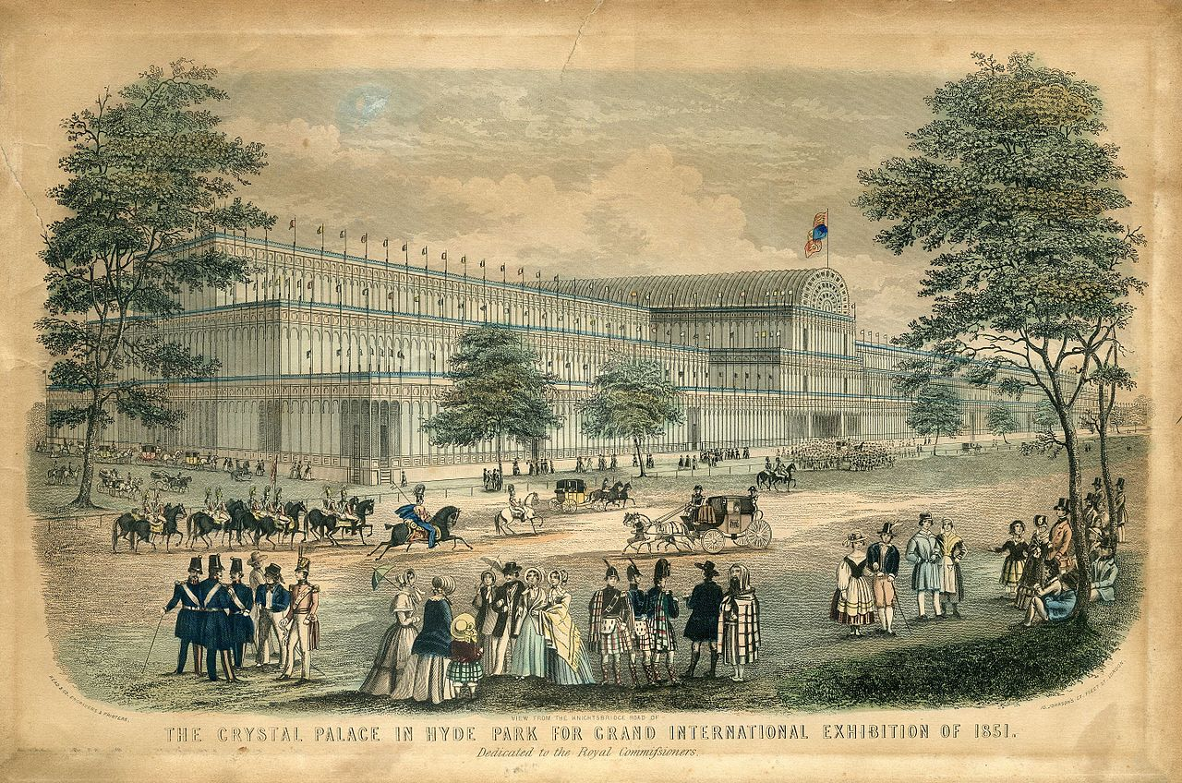
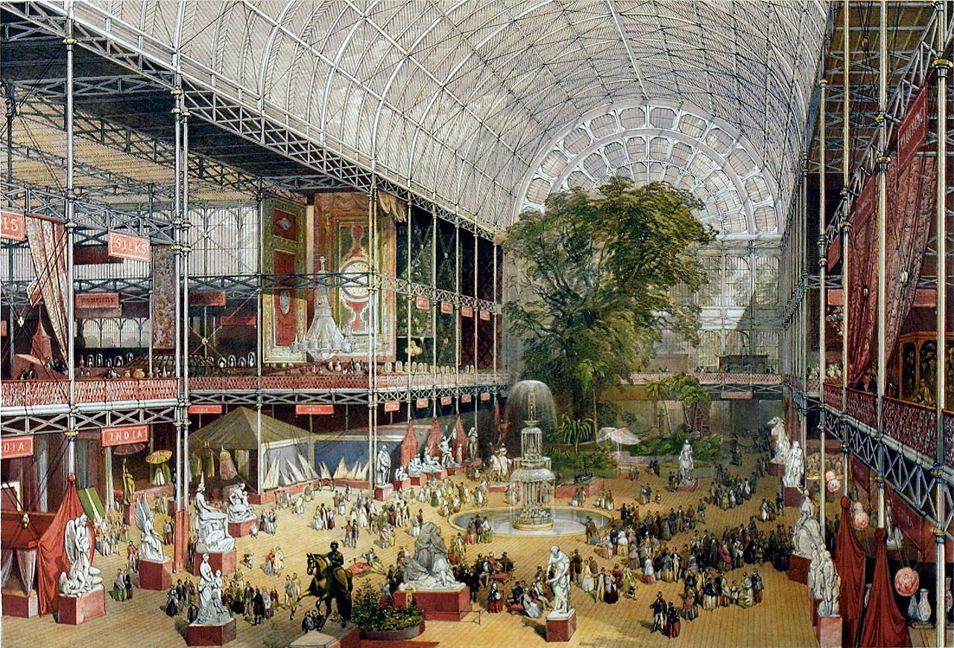
Read & Co. Engravers & Printers, View from the Knightsbridge Road of The Crystal Palace in Hyde Park for Grand International Exhibition of 1851, 1851
J McNeven,The transept from the Grand Entrance, Souvenir of the Great Exhibition, 1851

Slide 5
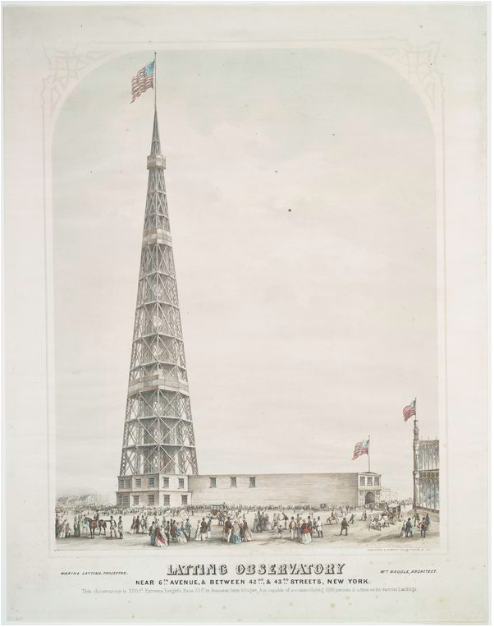
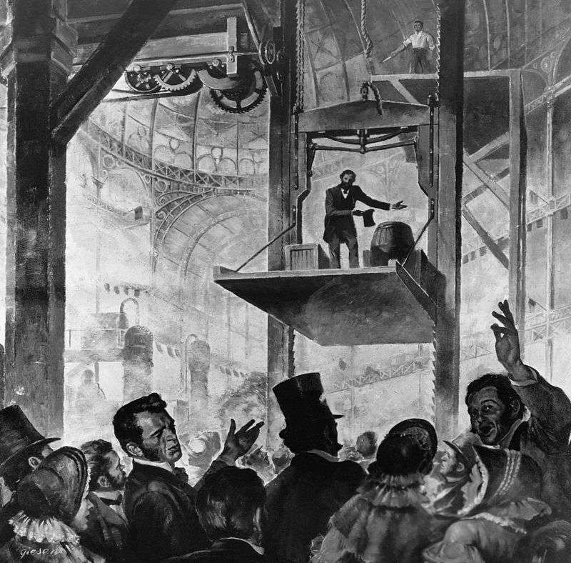
Latting Observatory, Exhibition of the Industry of All Nations, 1853
Elisha Otis free-fall safety demonstration in 1853

Slide 6
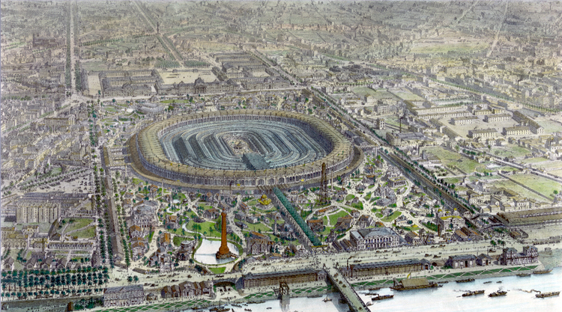
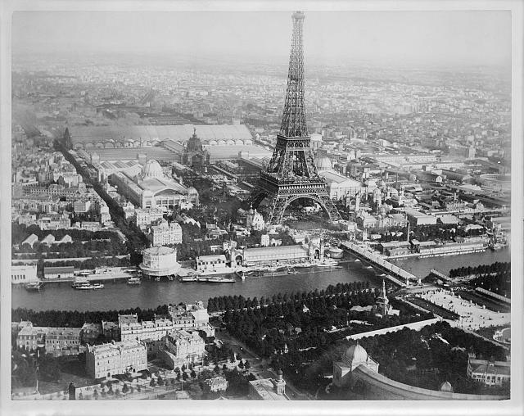
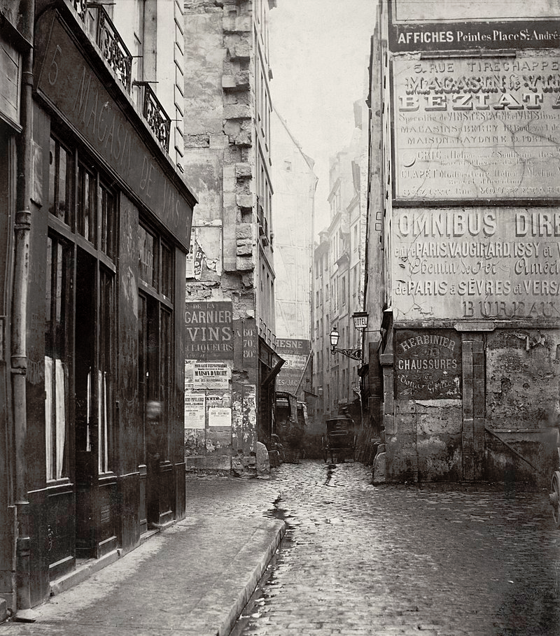
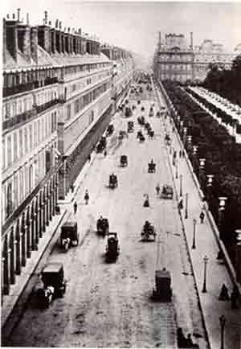
Panorama of the main exposition building, Exposition Universelle, Paris 1867
A Liebert, Aerial view of Paris, France, from a balloon, showing the Seine River and the Eiffel Tower at center, and buildings of the Exposition universelle, 1889

Slide 7
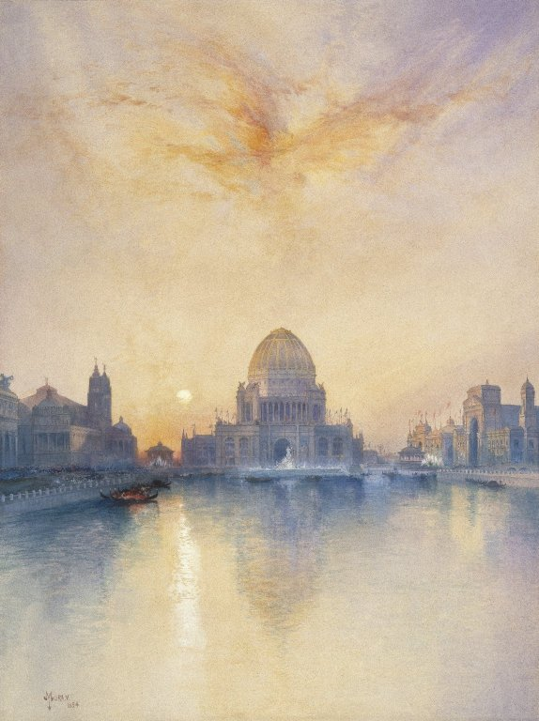
Edouard Manet, View of the 1867 Exposition Universelle, 1867
Thomas Moran, Chicago World’s Fair, 1894

Slide 8
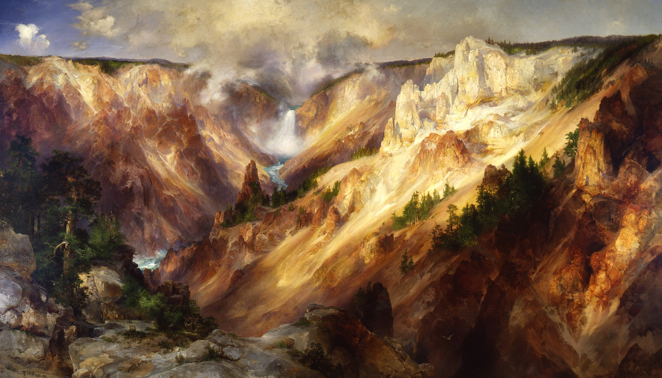
Thomas Moran, Grand Canyon of the Yellowstone, 1872
Thomas Moran, Chicago World’s Fair, 1894

Slide 9
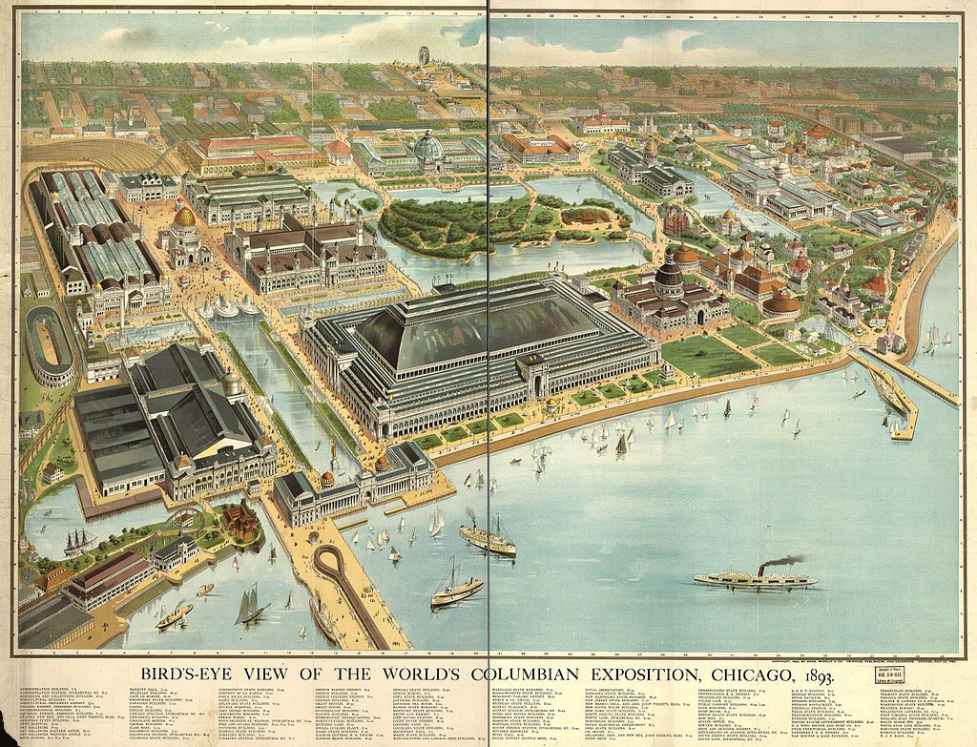
A Liebert, Aerial view of Paris, France, from a balloon, showing the Seine River and the Eiffel Tower at center, and buildings of the Exposition universelle, 1889

Slide 10
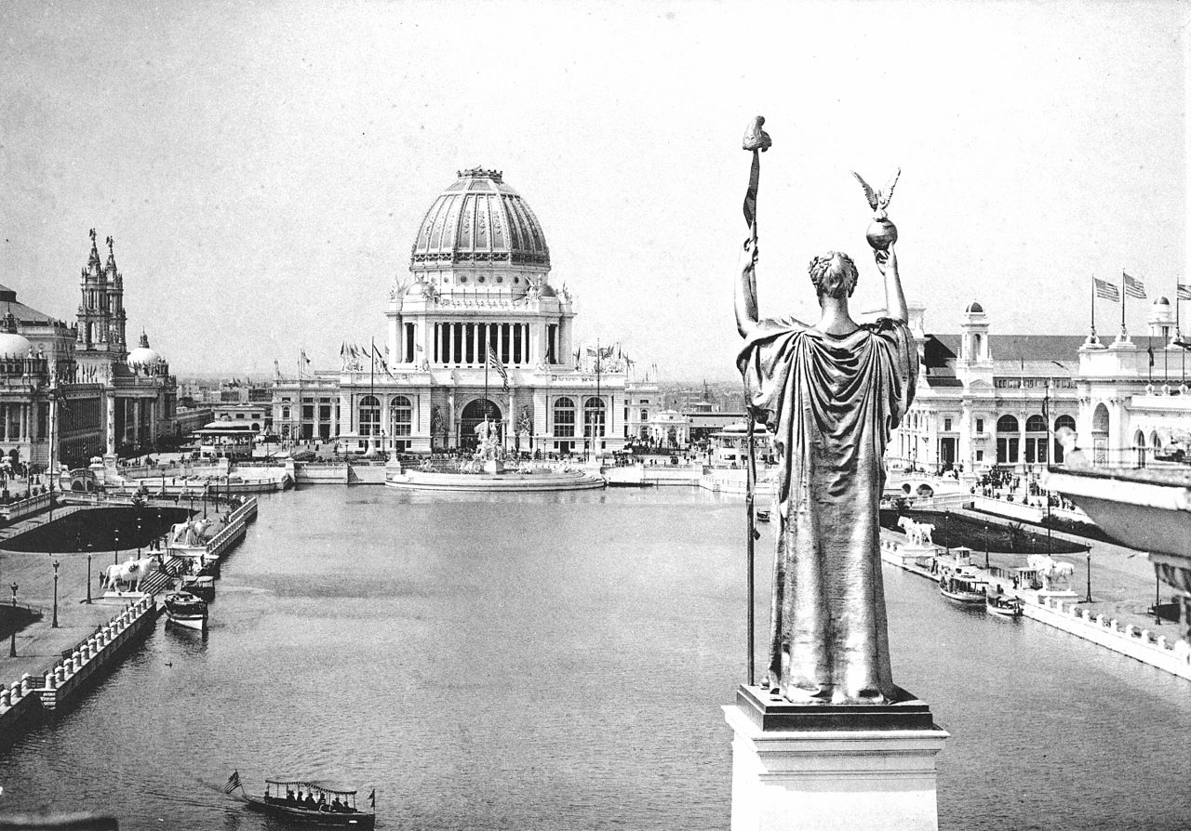
Looking West From Peristyle, Court of Honor and Grand Basin of the 1893 World's Columbian Exposition

Slide 11
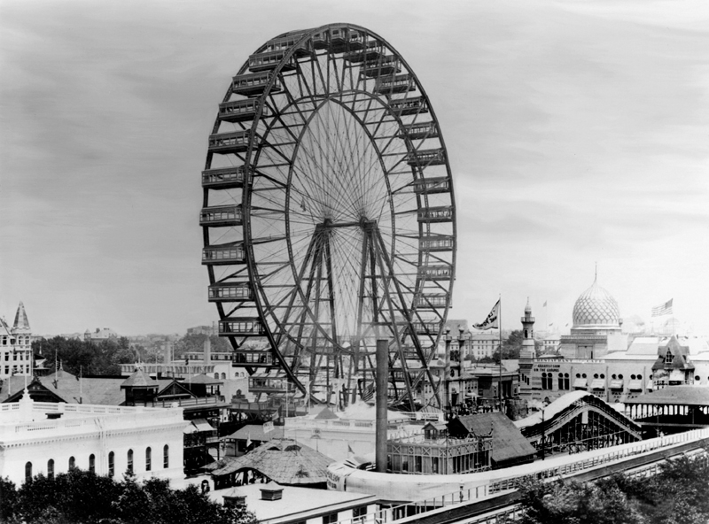
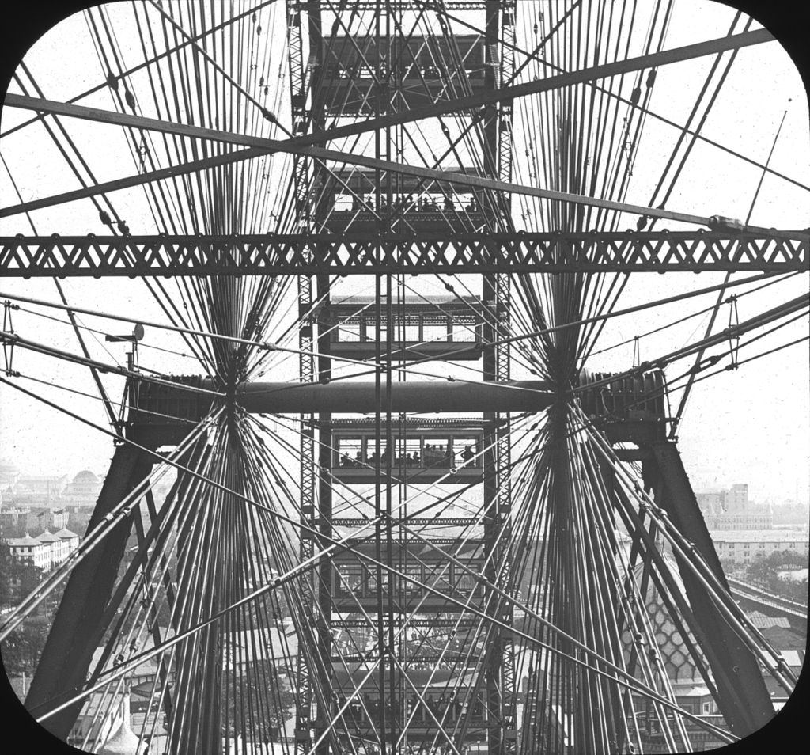
George Washington Gale Ferris Jr., The Original Ferris Wheel, 1893

Slide 12
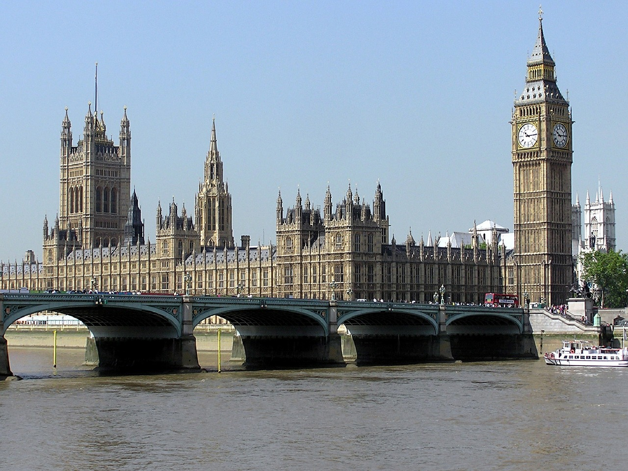
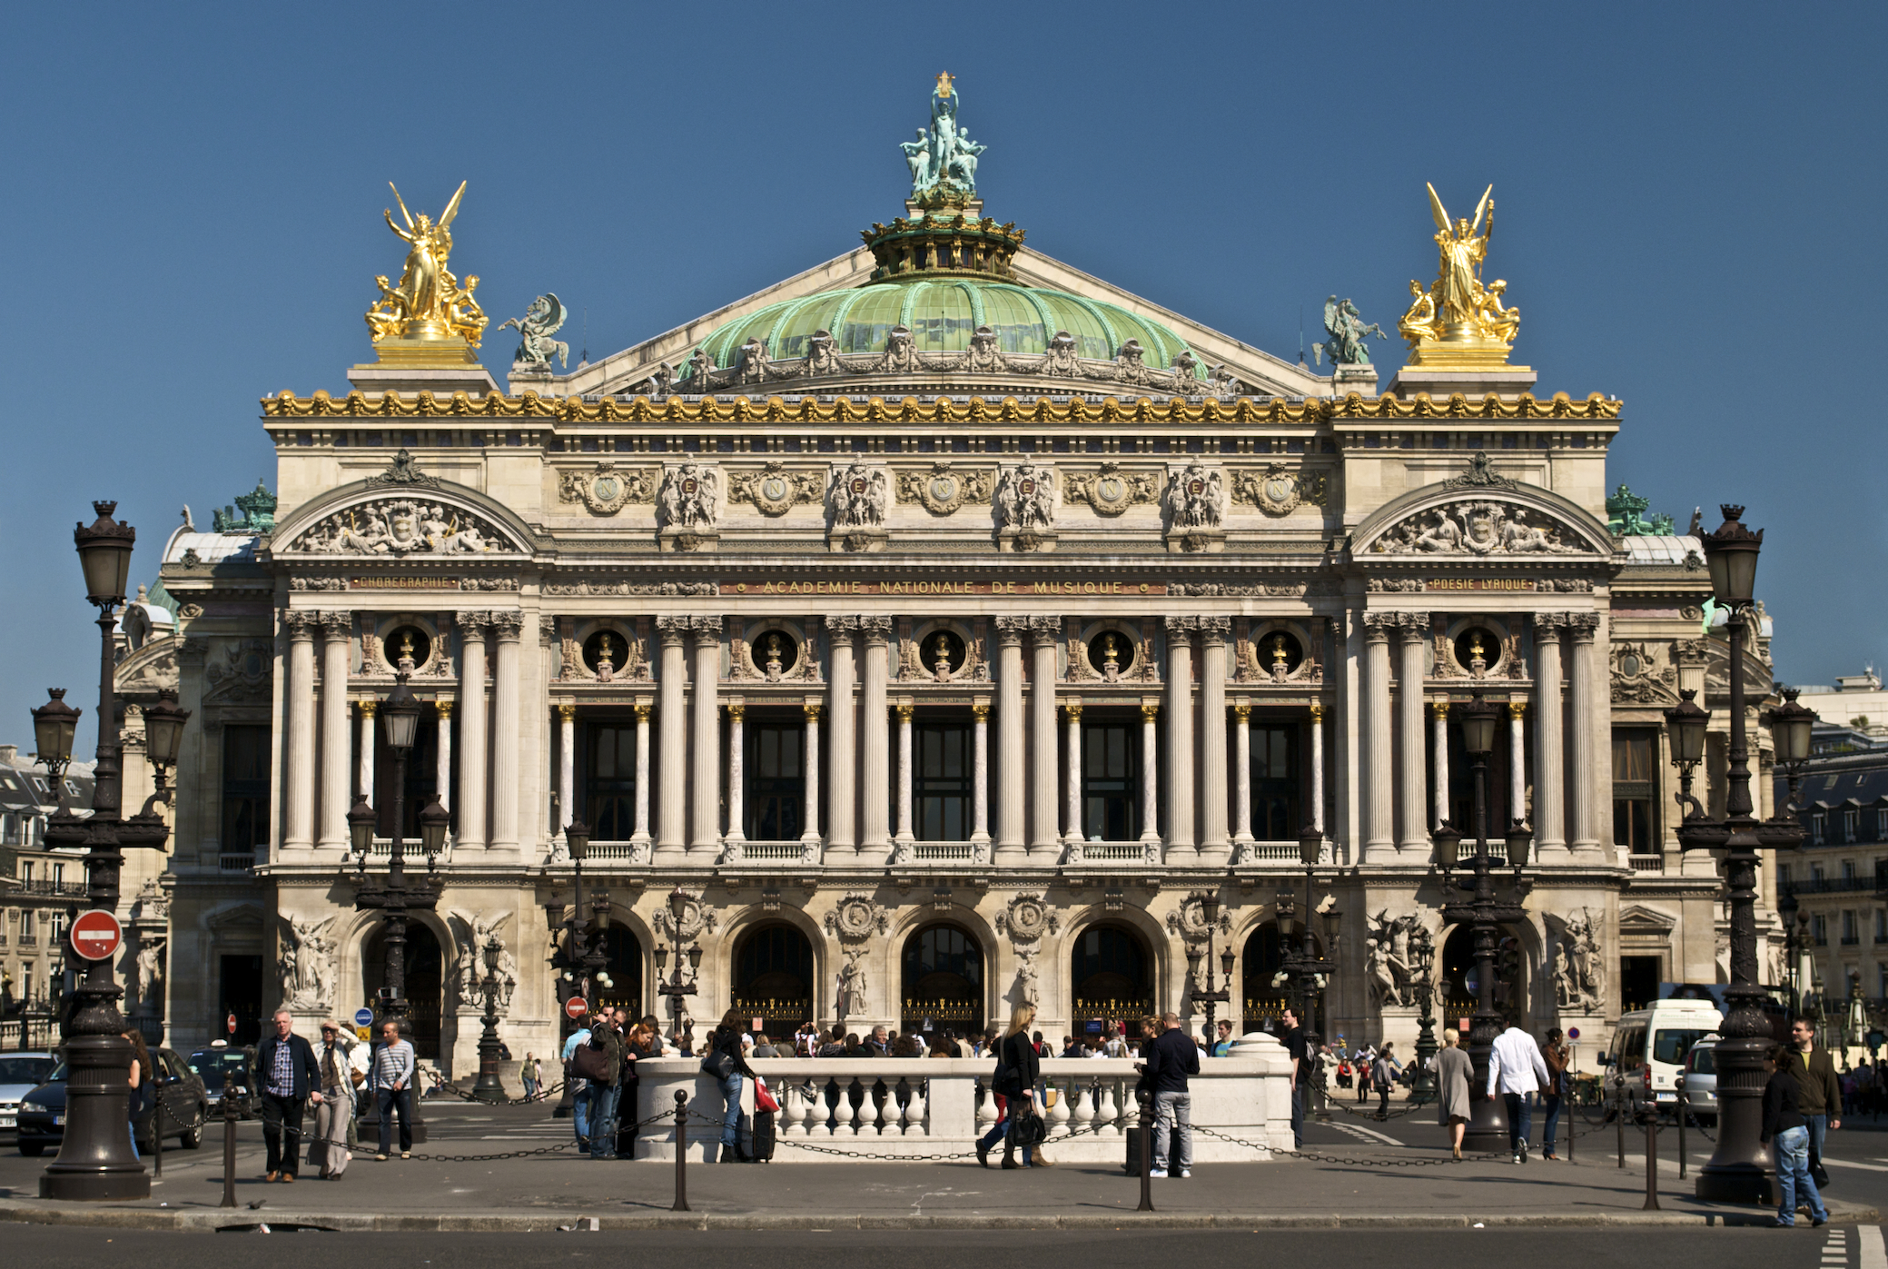
Gothic Revival
Eclecticism
Charles Barry and Augustus W. N. Pugin, Houses of Parliament, 1836-58
Charles Garnier, Palais Garnier, 1861-74

Slide 13
Jean- Baptiste Carpeaux, The Dance, 1868
Charles Garnier, Palais Garnier, 1861-74

Slide 14
Jean- Baptiste Carpeaux, The Dance, 1868
Johann Justin Preissler, Allegories of the Four Continents (after Edme Bouchardon), 1730-91

Slide 15
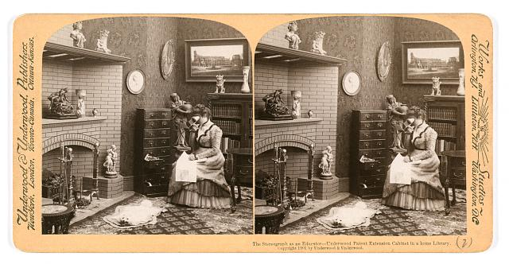
The stereograph as an educator – Underwood patent extension cabinet in a home library. Stereograph copyrighted by Underwood & Underwood, 1901

Slide 16
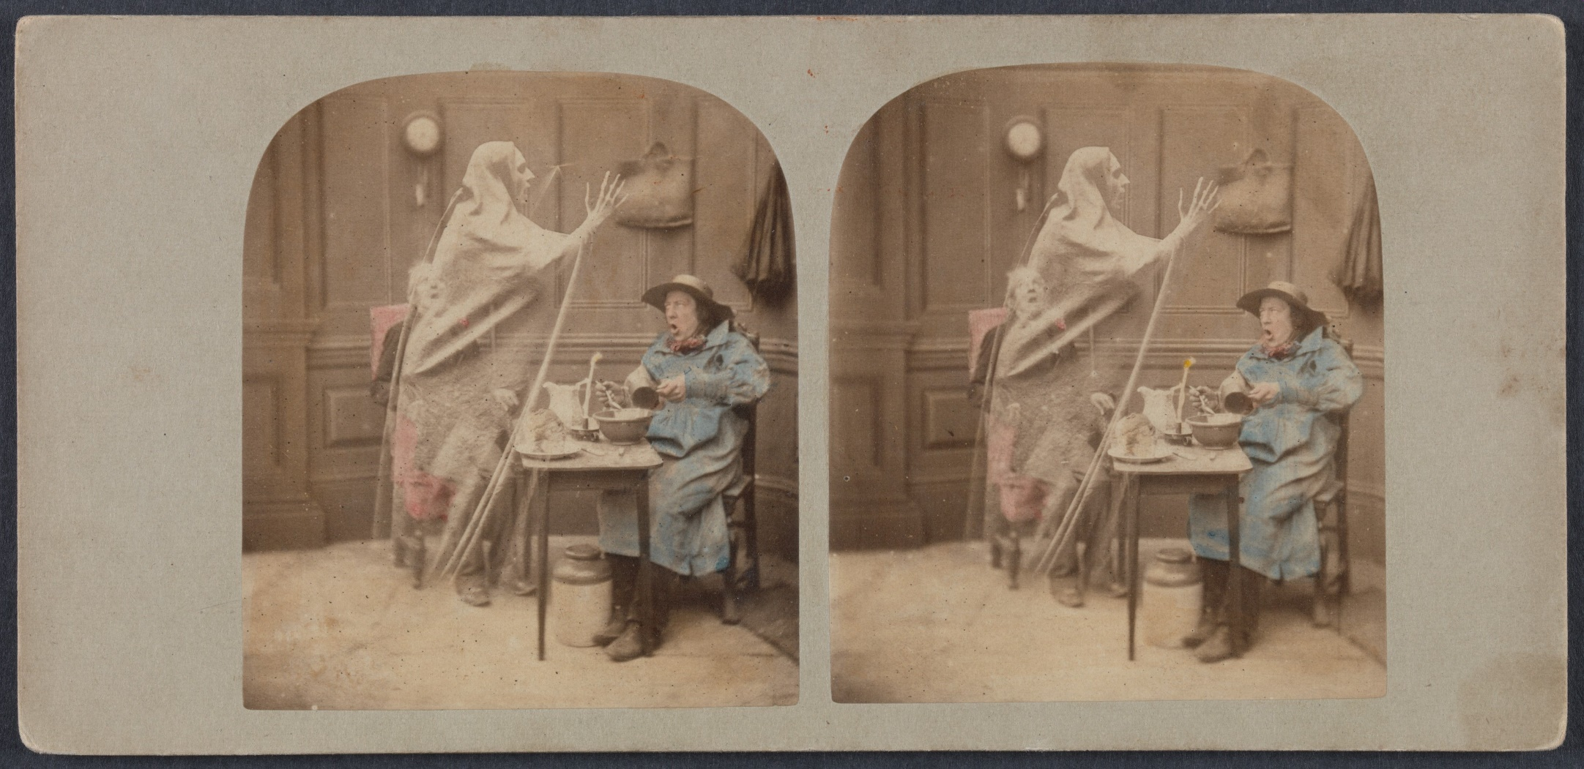
London Stereoscopic Company, The Ghost in the Stereoscope, c. 1856

Slide 17
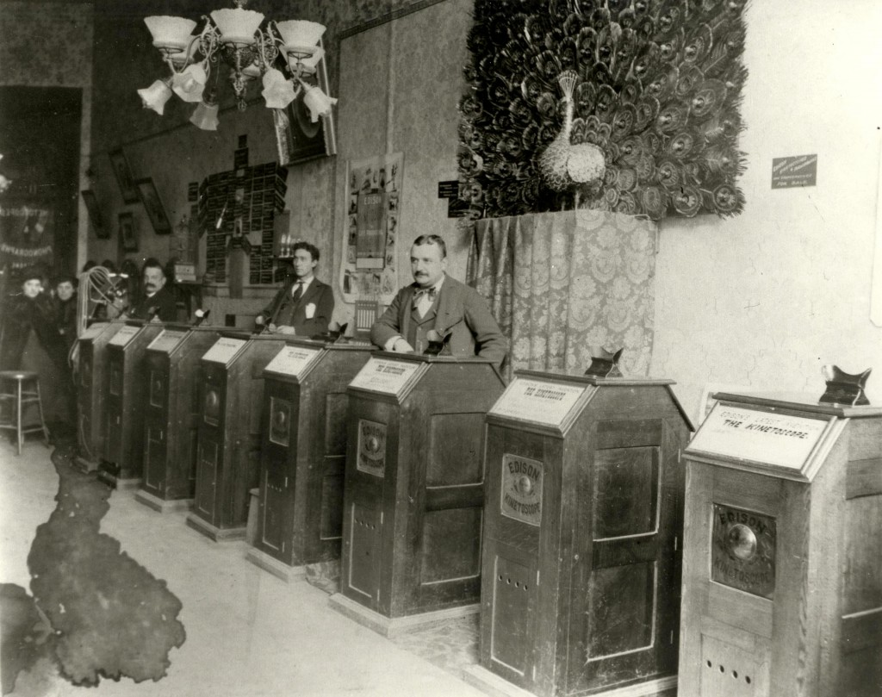
Bacigalupi’s Kinetoscope and phonograph parlour, Market Street, San Francisco
Notes:
http://www.wired.com/2014/05/kinetoscope/#slide-4

Slide 18
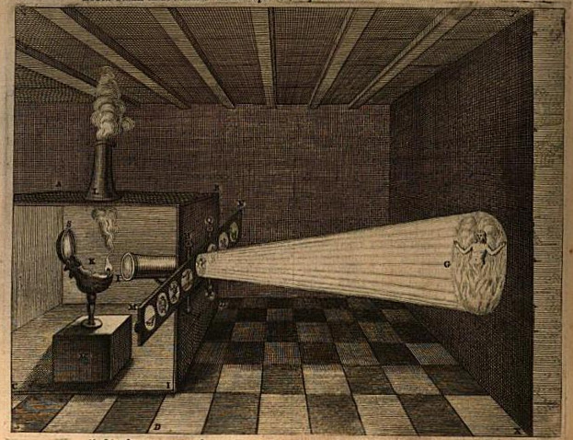
Illustration of the projection of hellfire or purgatory from Athanasius Kircher, Ars Magna Lucis et Umbrae, 1671

Slide 19
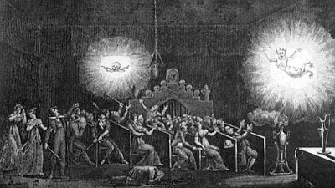
Etienne Gaspard Robertson, Phantasmagoria, 1831

Slide 20
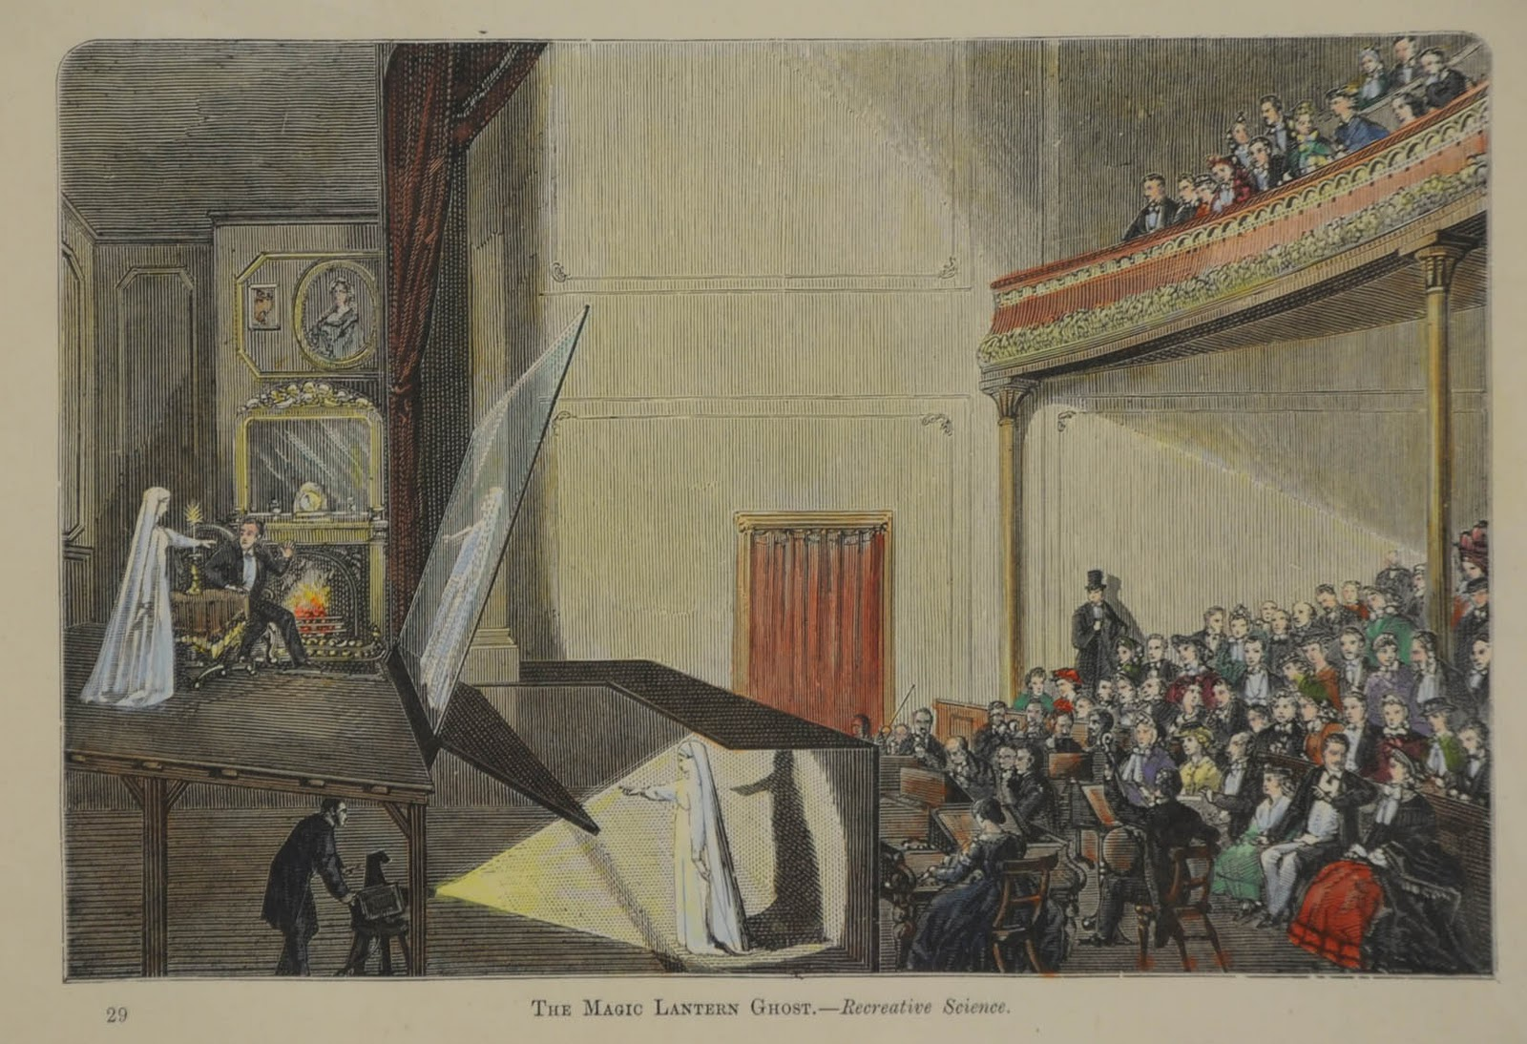
Pepper’s Ghost, 1862

Slide 21
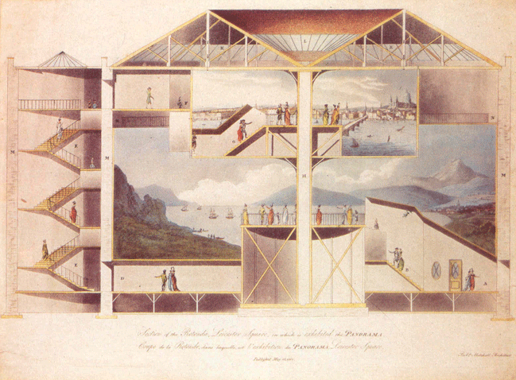
Cross section of Robert Barker's two-level panorama at Leicester Square.
Colored aquatint by the architect, Robert Mitchell, c. 1793. British Museum, London.

Slide 22
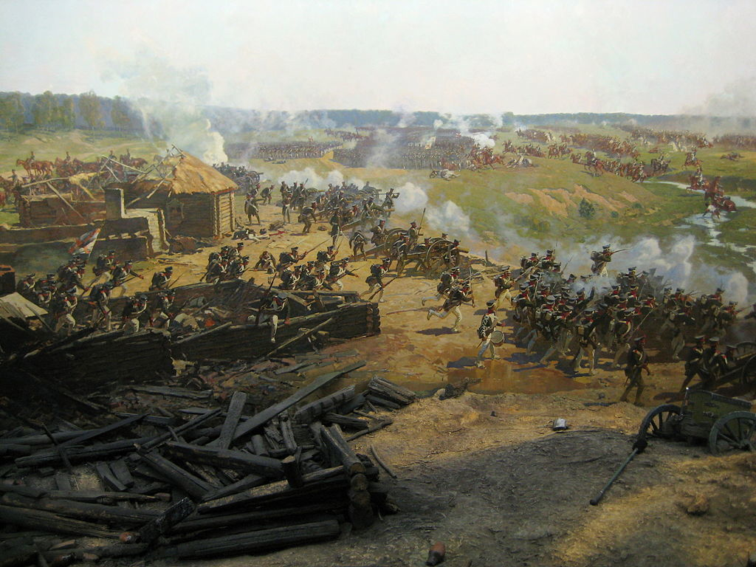
Franz Roubaud, Battle of Borodino 1912

Slide 23
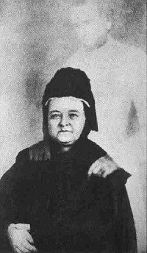
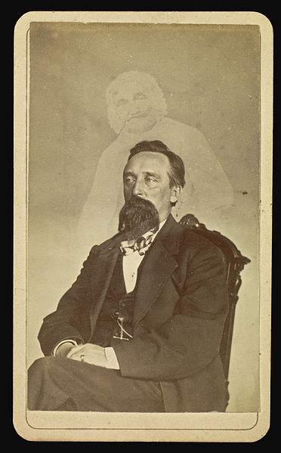
In what ways does spirit photography reflect the self critical nature of modernist aesthetics?
  What types of claims to truth does it make?
  What role did the debunking of spirit photographs play in redefining photography’s claims to objectivity?
What are some of the implications of the history of spirit photography for contemporary media and culture?
William Mumler, Mary Todd Lincoln with the "ghost" of her husband, c. 1869
William Mumler, John J. Glover, c.1862-75

Slide 24
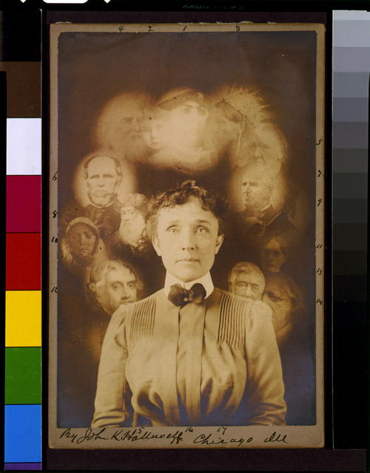
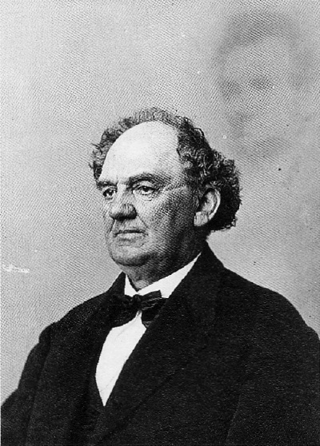
W Fallis, "Spirit" photograph, supposedly taken during a seance, actually a double exposure or composite of superimposed cut-outs, showing woman with portraits of men and women around her head, 1901
Abraham Bogardus, P T Barnum with the Ghost of Lincoln, 1869

Slide 25
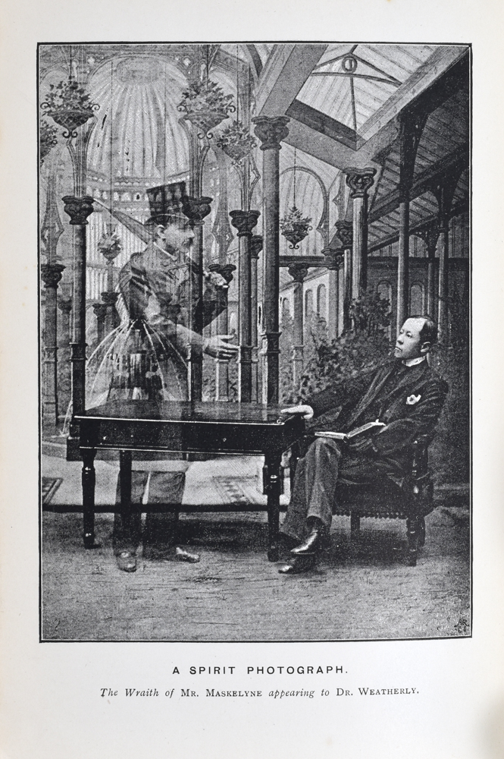
“A Spirit Photograph: The Wraith of Mr. Maskelyne Appearing to Dr. Weatherly’ Frontispiece to Lionel A. Weatherly, The Supernatural? (Bristol, 1891)

