Slide 1
“All the World’s a Stage”
The Spatial Politics of 19th Century Architecture and World’s Fairs

Slide 2
Key Terms
Eclecticism
Gothic Revival
Chicago School
Chicago Fire 1871
Cornice
Discursive practice
Heterotopia
Ethnographic display

Slide 3
Discussion Question
In what ways is the crisis of modernity reflected in architectural trends of the 19th century?
How did Worlds Fairs consolidate and advance the cultural and political identities of the countries that hosted them? (architecture, materials, layout)
As we view these works, do our acts of critical viewership also implicate us in the dynamics of pleasure and power intrinsic to their creation?

Slide 4
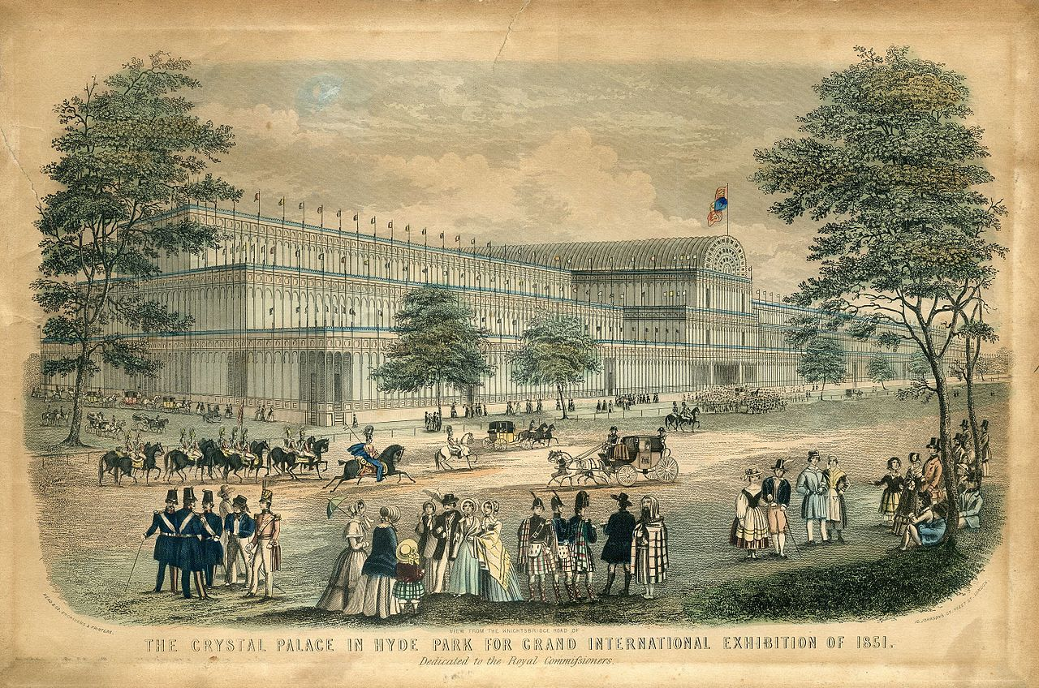
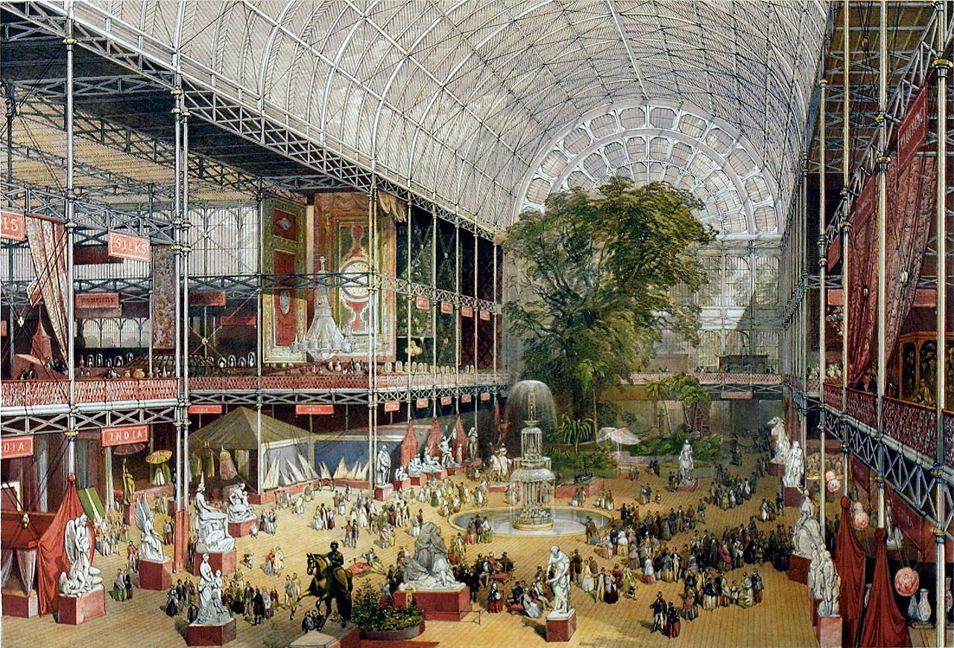
Read & Co. Engravers & Printers, View from the Knightsbridge Road of The Crystal Palace in Hyde Park for Grand International Exhibition of 1851, 1851
J McNeven,The transept from the Grand Entrance, Souvenir of the Great Exhibition, 1851

Slide 5
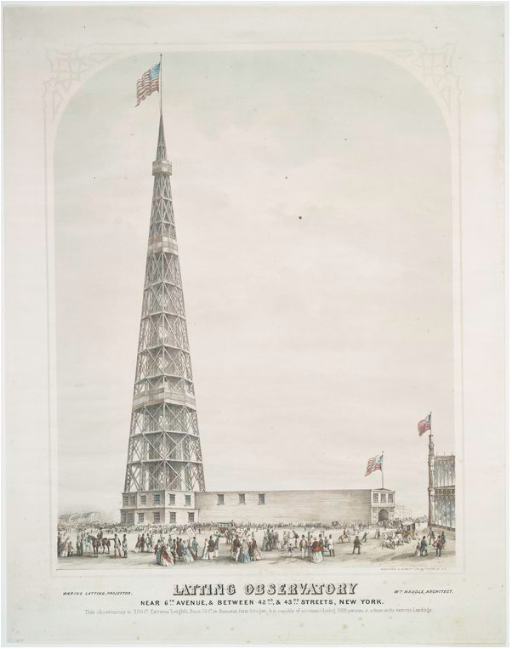
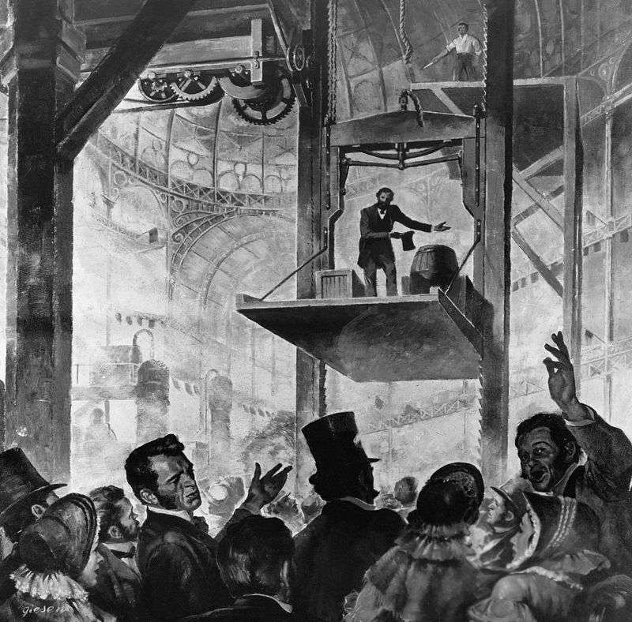
Latting Observatory, Exhibition of the Industry of All Nations, 1853
Elisha Otis free-fall safety demonstration in 1853

Slide 6
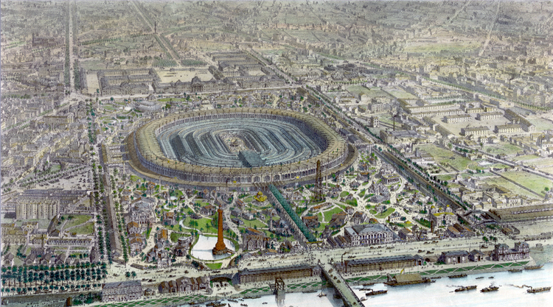
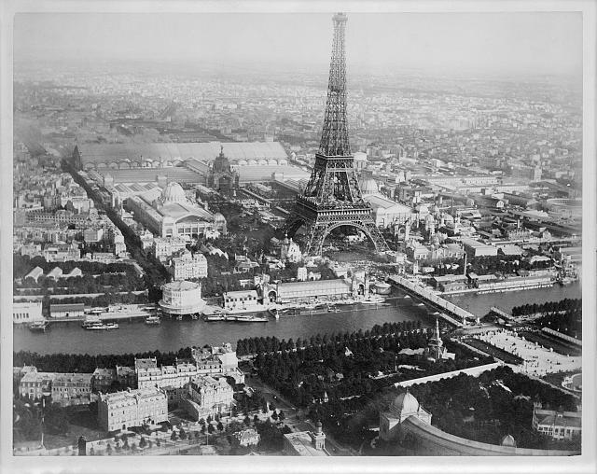
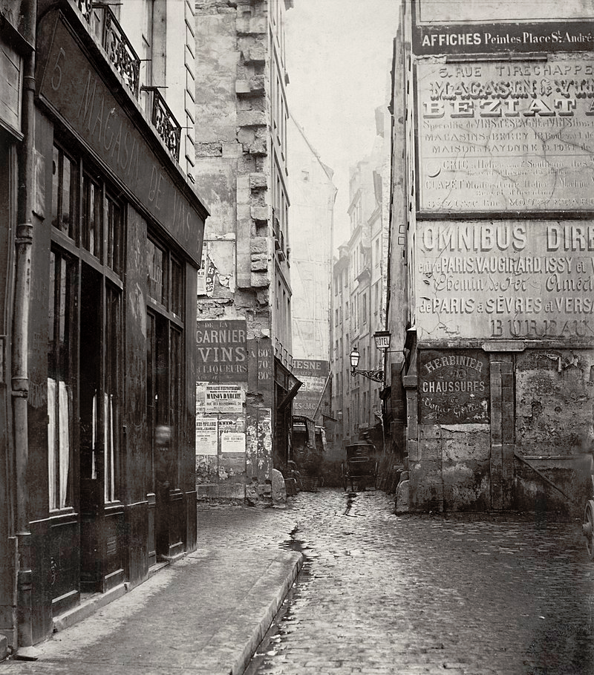
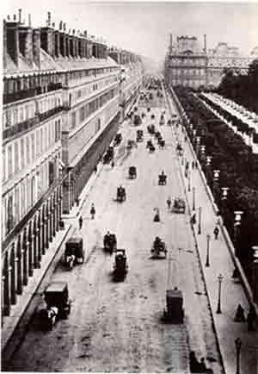
Panorama of the main exposition building, Exposition Universelle, Paris 1867
A Liebert, Aerial view of Paris, France, from a balloon, showing the Seine River and the Eiffel Tower at center, and buildings of the Exposition universelle, 1889

Slide 7
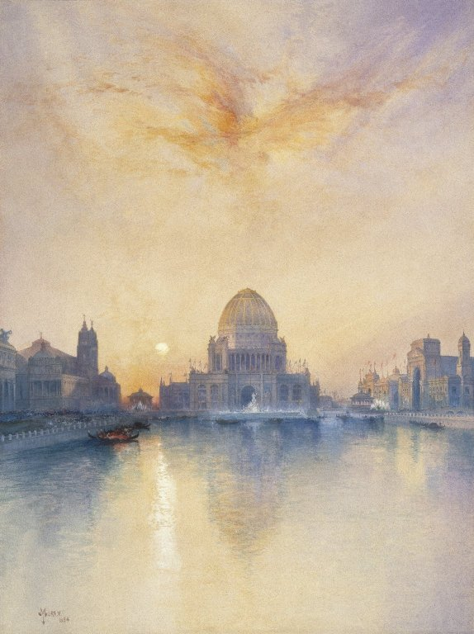
Edouard Manet, View of the 1867 Exposition Universelle, 1867
Thomas Moran, Chicago World’s Fair, 1894

Slide 8
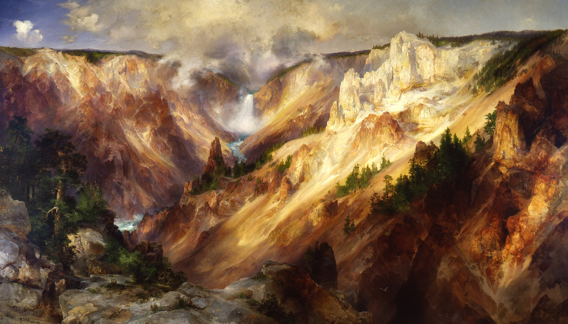
Thomas Moran, Grand Canyon of the Yellowstone, 1872
Thomas Moran, Chicago World’s Fair, 1894

Slide 9
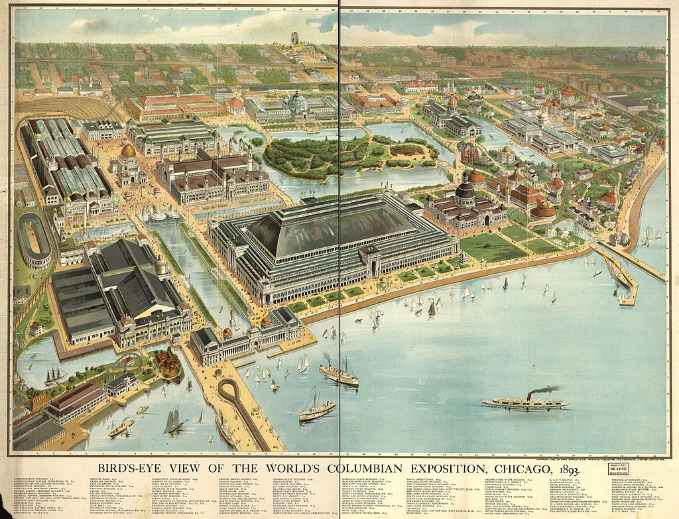
A Liebert, Aerial view of Paris, France, from a balloon, showing the Seine River and the Eiffel Tower at center, and buildings of the Exposition universelle, 1889

Slide 10
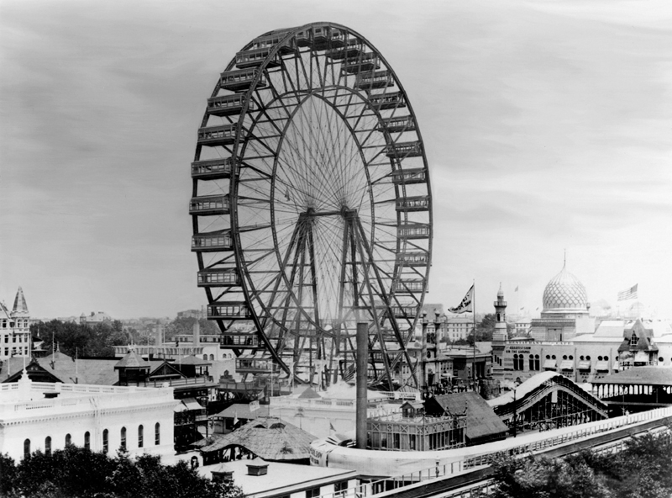
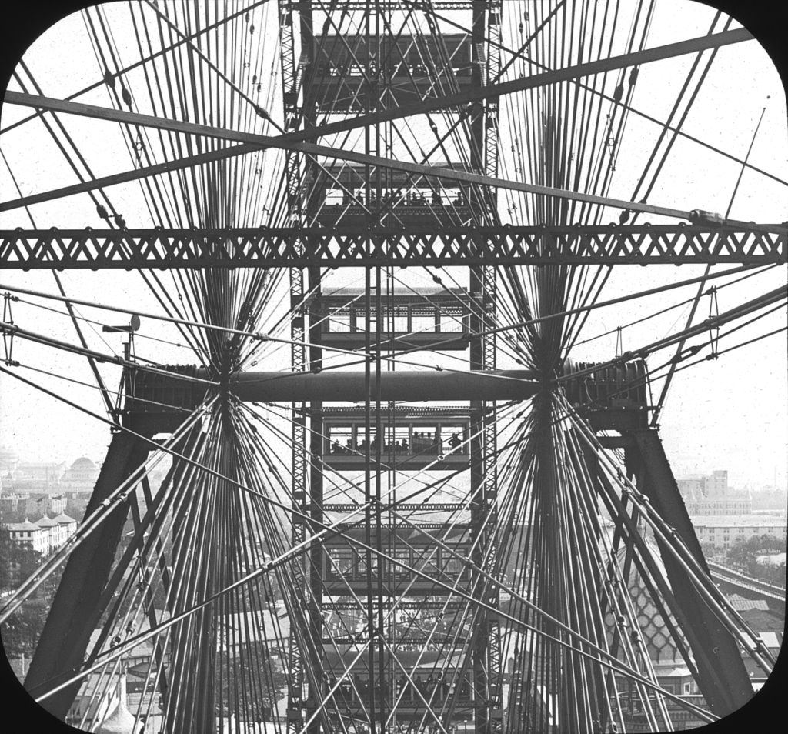
George Washington Gale Ferris Jr., The Original Ferris Wheel, 1893

Slide 11
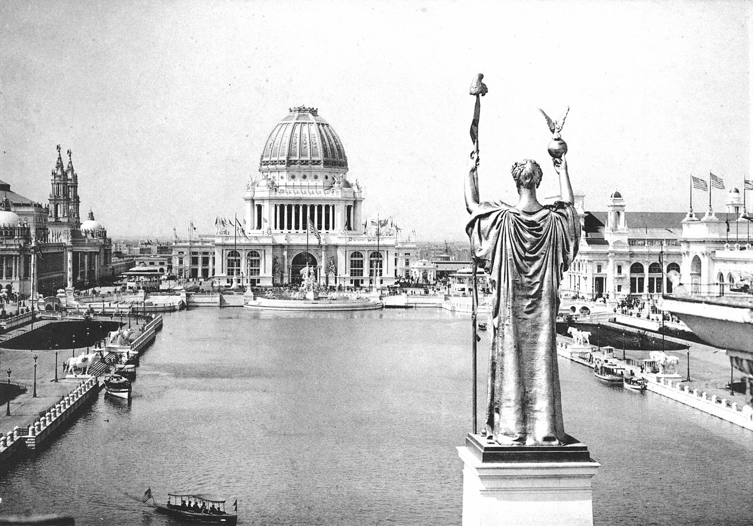
Looking West From Peristyle, Court of Honor and Grand Basin of the 1893 World's Columbian Exposition

Slide 12
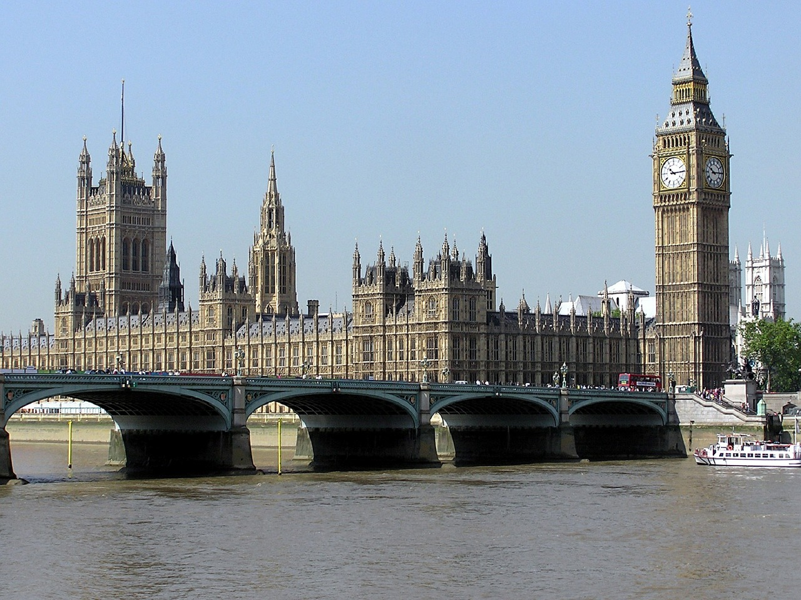
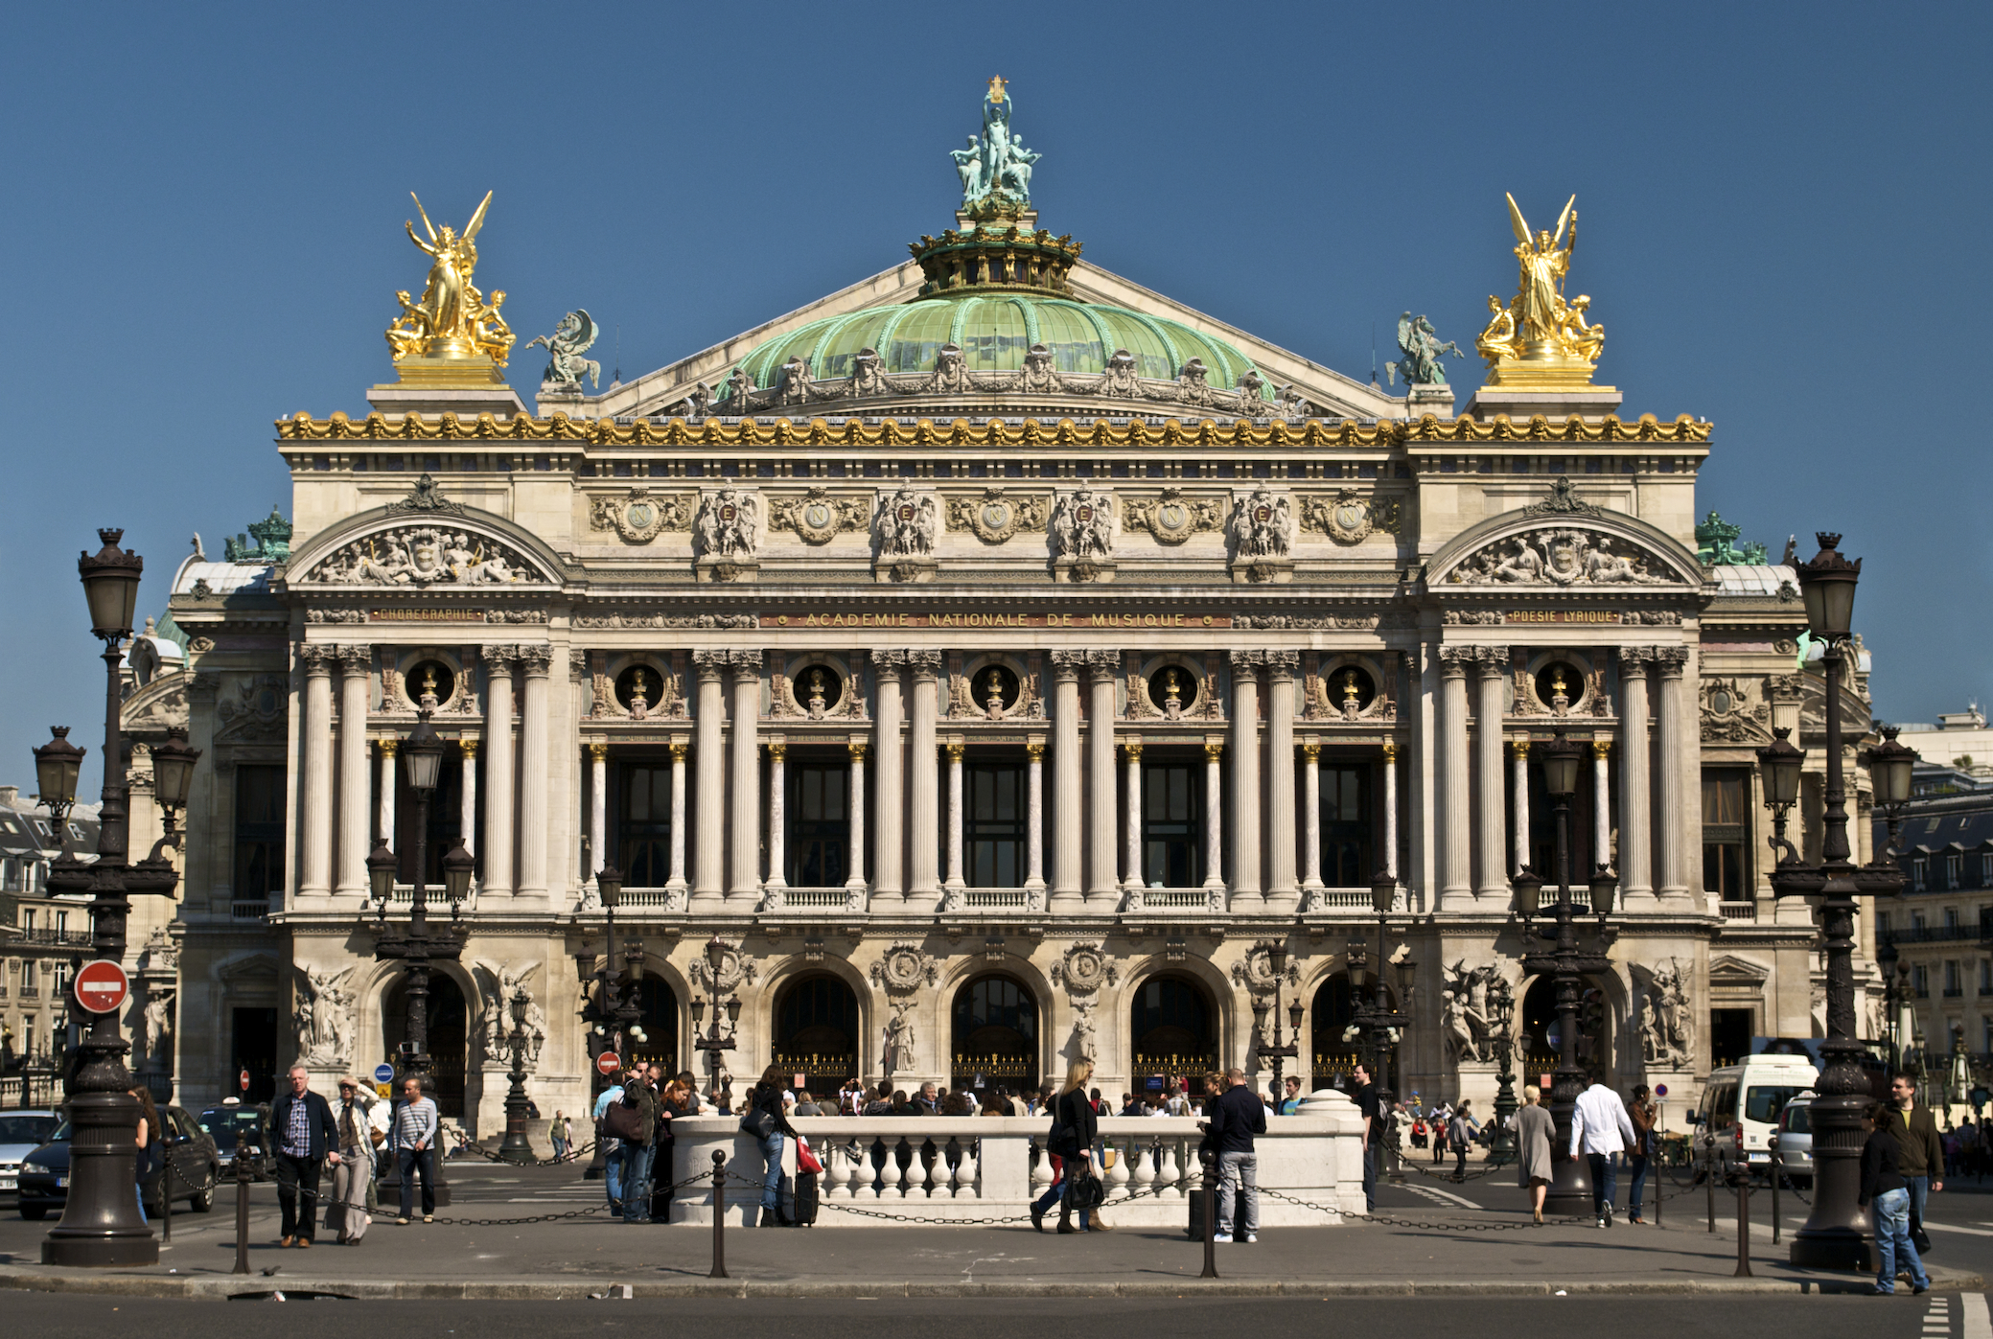
Gothic Revival
Eclecticism
Charles Barry and Augustus W. N. Pugin, Houses of Parliament, 1836-58
Charles Garnier, Palais Garnier, 1861-74

Slide 13
Jean- Baptiste Carpeaux, The Dance, 1868
Charles Garnier, Palais Garnier, 1861-74

Slide 14
Jean- Baptiste Carpeaux, The Dance, 1868
Johann Justin Preissler, Allegories of the Four Continents (after Edme Bouchardon), 1730-91

