Slide 1
“Why Born Enslaved!”
The Spatial Politics of Race in 19th Sculpture

Slide 2
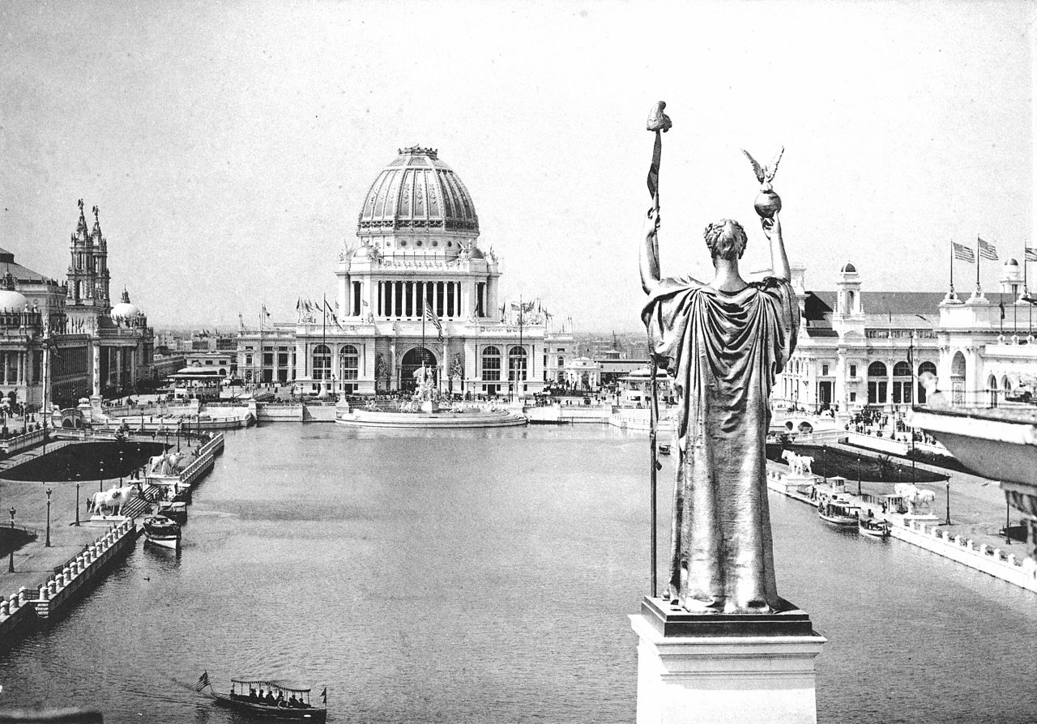
Looking West From Peristyle, Court of Honor and Grand Basin of the 1893 World's Columbian Exposition

Slide 3
Jean- Baptiste Carpeaux, The Dance, 1868
Johann Justin Preissler, Allegories of the Four Continents (after Edme Bouchardon), 1730-91

Slide 4
Jean-Baptiste Carpeaux, The Seasons turning the celestial Sphere, Fountain of the Observatory, Jardin du Luxembourg, 1872
Pietro Tacca, Quatro Mori (the Four Moors), 1621-26

Slide 5
Pietro Tacca, Quatro Mori (the Four Moors), 1621-26
Pietro Tacca, Quatro Mori (the Four Moors), 1621-26

Slide 6
Pietro Tacca, Quatro Mori (the Four Moors), 1621-26
Josiah Wedgwood, Antislavery Medallion, after 1787
Design by William Hackwood

Slide 7
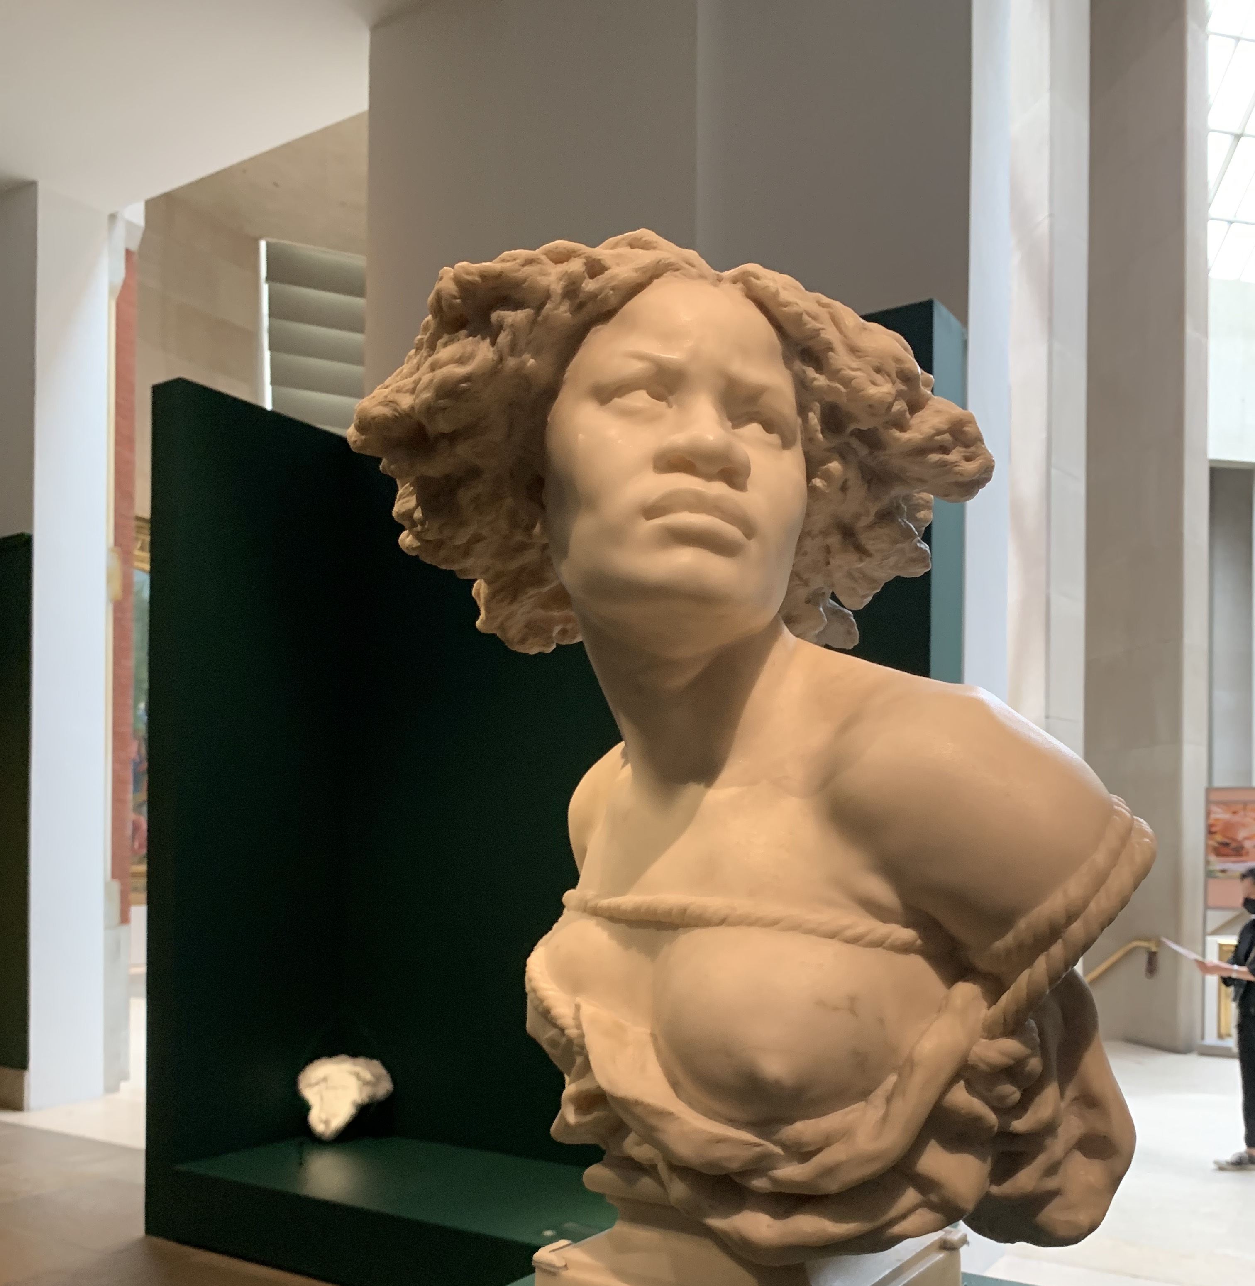
Michelangelo Buonarroti, The Rebellious Slave, 1513-15
Jean-Baptiste, Carpeaux, Why Born Enslaved! (Negresse), Modeled 1868, Carved 1873

Slide 8
John Quincy Adams Ward, The Freedman, Modeled 1863, cast 1891
Josiah Wedgwood, Antislavery Medallion, after 1787
Design by William Hackwood

Slide 9
Edmonia Lewis, Forever Free, 1867
Jean-Baptiste, Carpeaux, Why Born Enslaved! (Negresse), Modeled 1868, Carved 1873

