Slide 1
Art Nouveau and Modernismo

Slide 2
Key terms
Fin-de-siecle
Arts and Crafts
Aestheticism
Gesamtkunstwerk
Art Nouveau
Modernismo
Ensanche

Slide 3
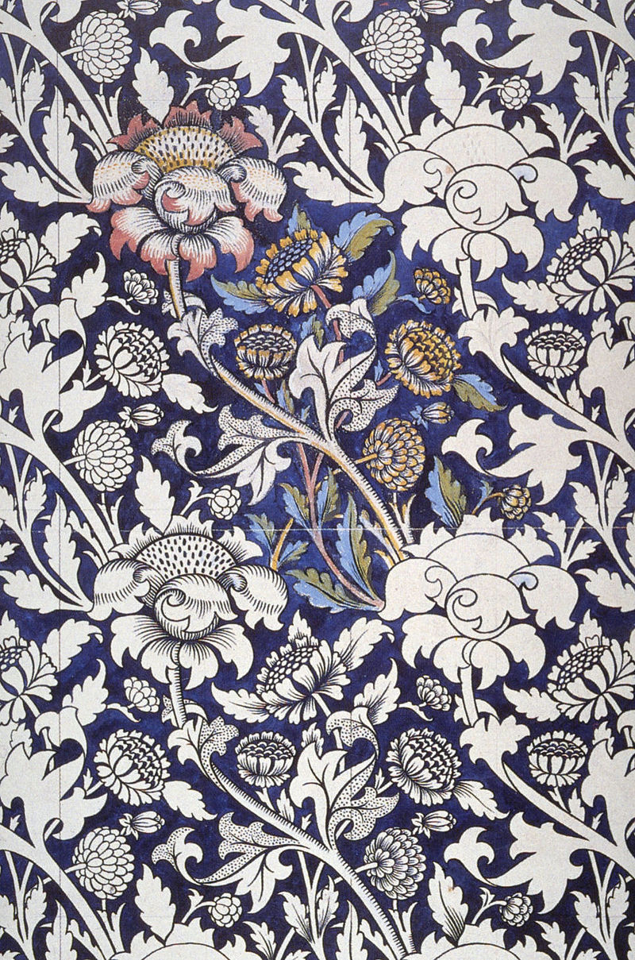
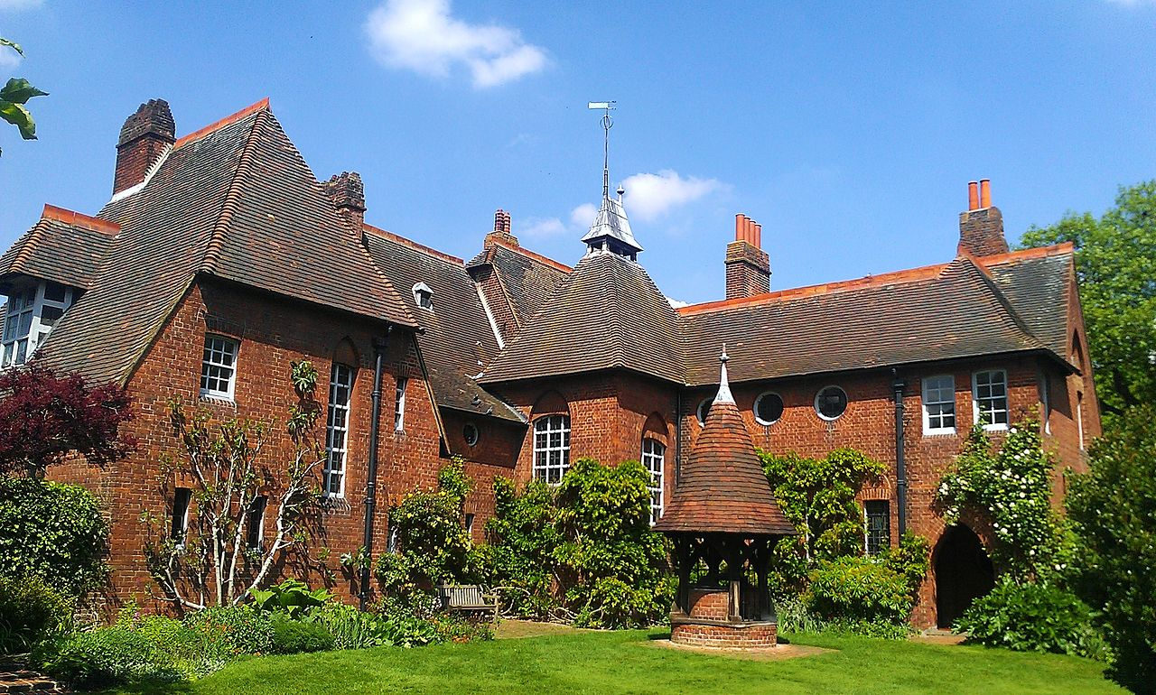
William Morris and Philip Webb, The Red House, 1859
William Morris, Printed Textile, 1883

Slide 4
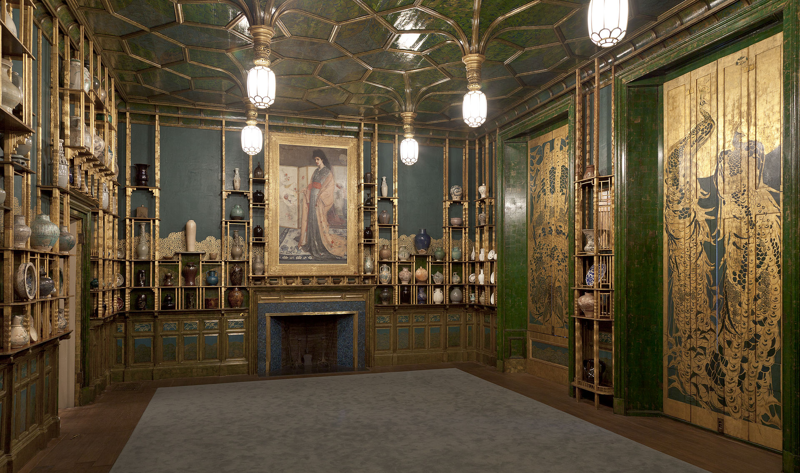
James McNeill Whistler, Harmony in Blue and Gold: The Peacock Room, 1876–77 (with Whistler’s Princess in the Land of Porcelain, 1865)

Slide 5
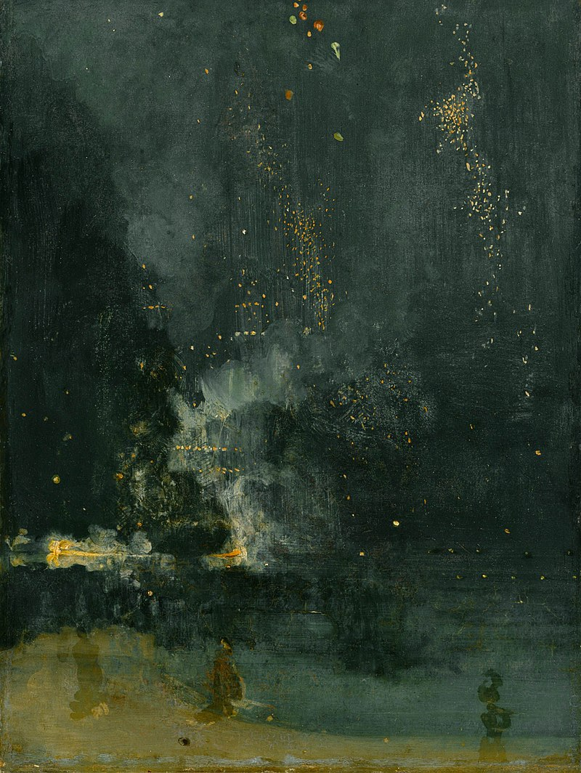
James McNeill Whistler, Nocturne in Black and Gold: The Falling Rocket, 1874

Slide 6
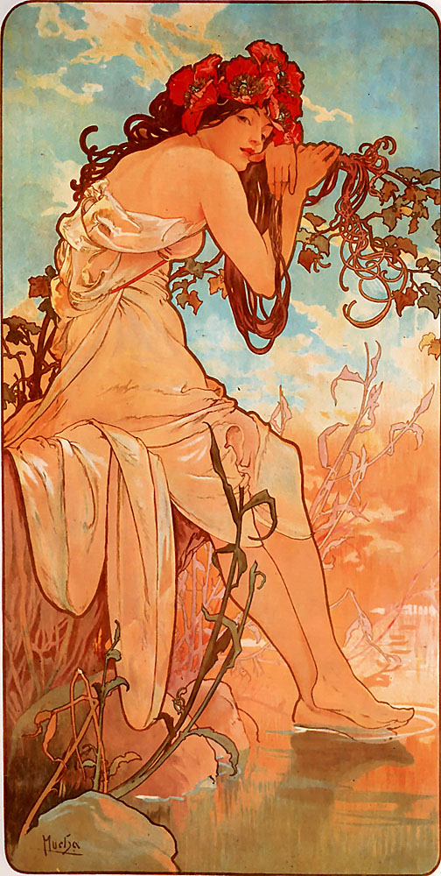
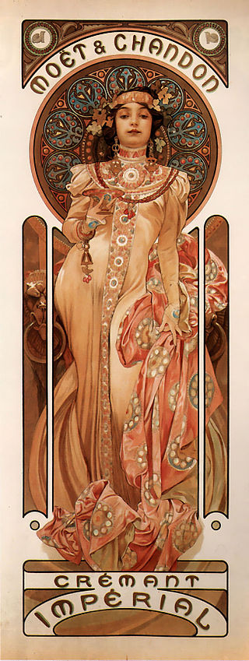
Alfons Maria Mucha, Summer, 1896
Alfons Maria Mucha, Moët & Chandon Crémant Impérial, 1899

Slide 7
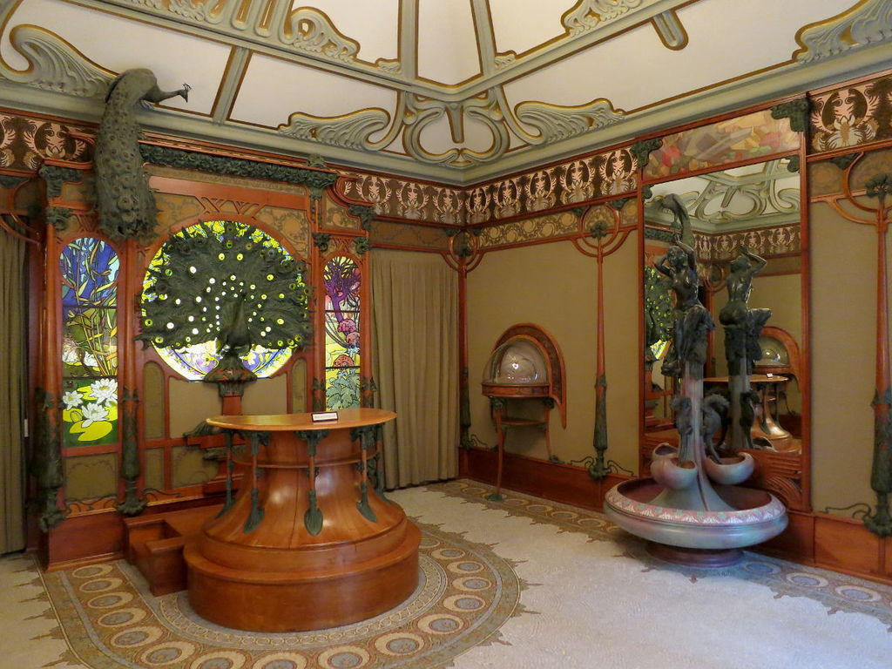
Alfons Maria Mucha, Interior Georges Fouquet jewellery on rue Royale in Paris

Slide 8
Ensanche Plan, Barcelona, 1859

Slide 9
Lluís Domènech i Montaner, The Casa Lleó Morera, c. 1902
Casa Amatller, Josep Puig i Cadafalch, 1875
Antoni Gaudi, Casa Batllo, 1904

Slide 10
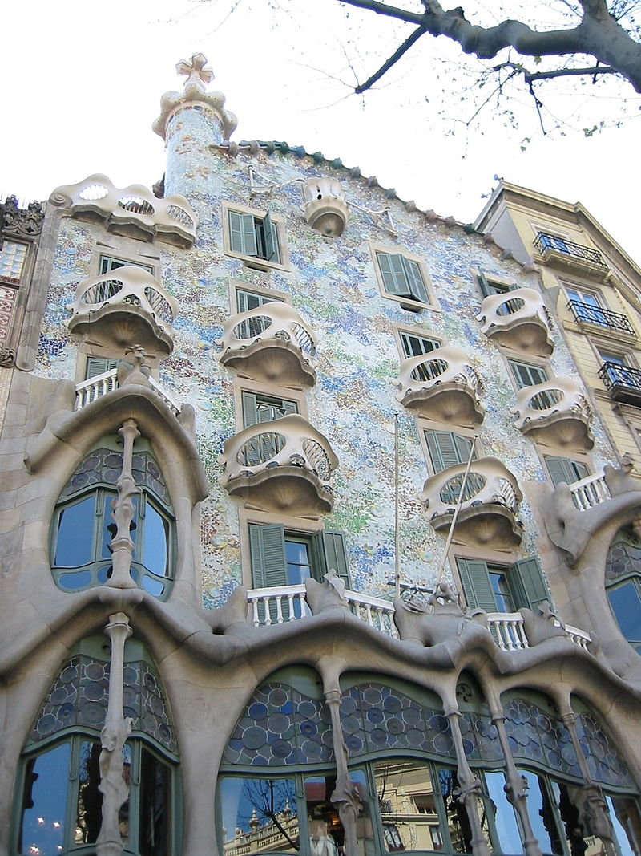
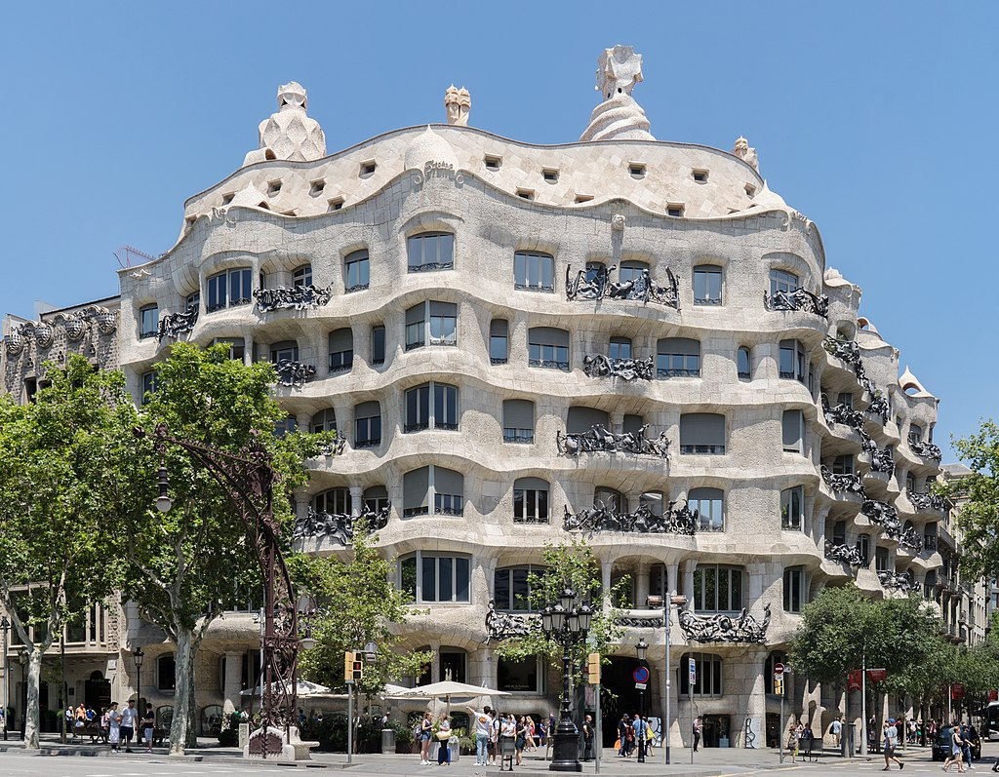
Antoni Gaudi, Casa Batllo, 1904
Antoni Gaudi, Casa Mila, 1906- 1912

Slide 11
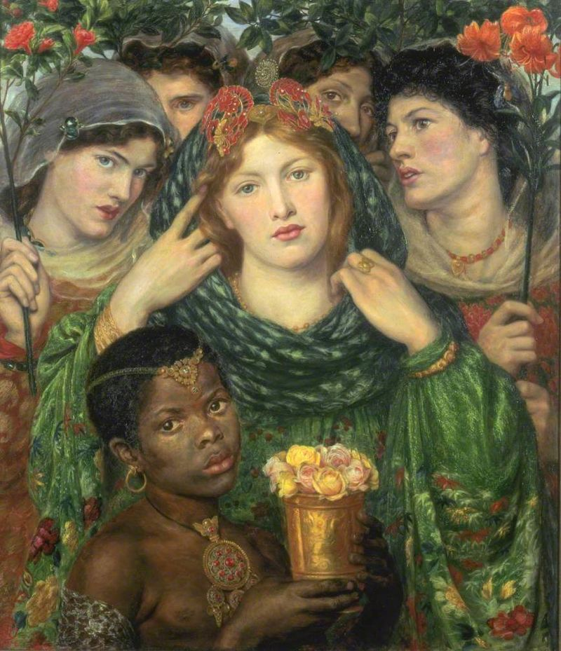
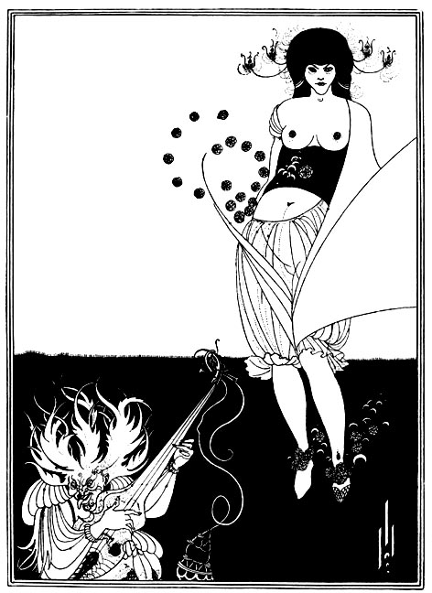
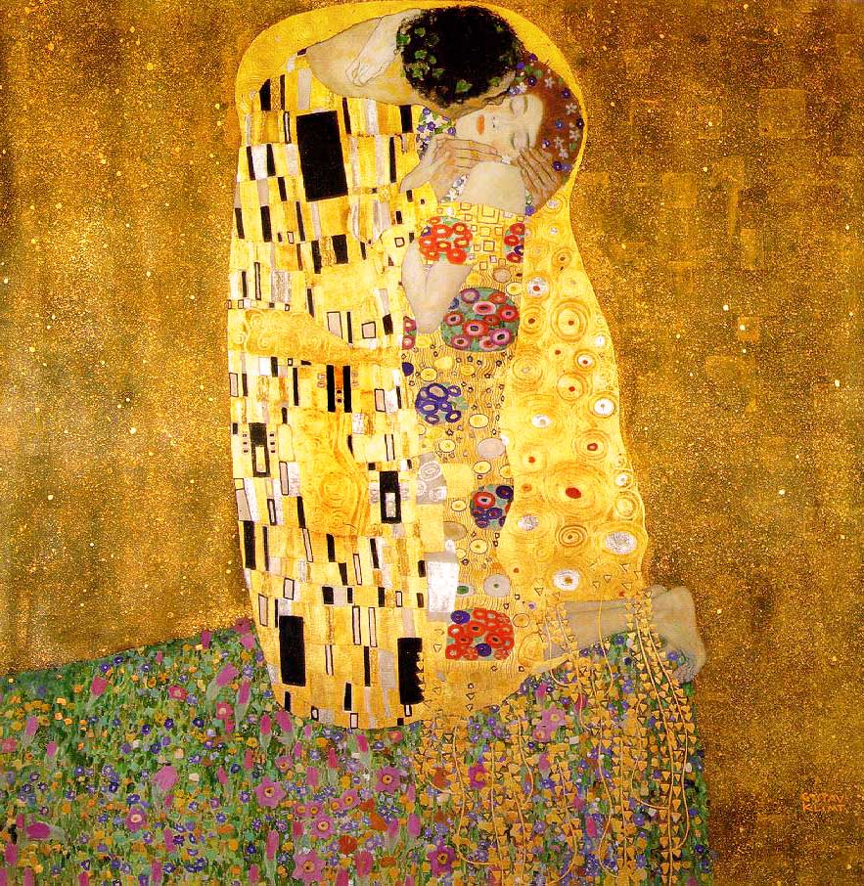
For Thursday
Consult Moodle. Complete the assignment: Painting at Century’s End
Aubrey Beardsley, The Stomach Dance, 1893
Dante Gabriel Rosetti, The Beloved, 1865
Gustav Klimt, The Kiss, 1907-1908

