Slide 1
Experiments in Color and Form

Slide 2
Key Terms
Cloisonnism
Synthetism
The Nabis
les fauves
la belle époque
ethnography
odalisque
anti-naturalism
empirical
positive vs. negative space

Slide 3
Vincent van Gogh
Vincent Van Gogh, The Potato Eaters, 1885
Vincent Van Gogh, The Night Cafe, 1888

Slide 4
Vincent van Gogh, Trees in the Garden in Front of the Entrance to Saint-Paul Hospital 1889
Vincent van Gogh, The Olive Trees, 1889

Slide 5
Vincent van Gogh, Portrait of Père (Julien François) Tanguy , 1887
Paul Gaugin, The Painter of Sunflowers (Portrait of Vincent van Gogh), 1888

Slide 6
Cloisonnism, Synthetism and the Nabis
Émile Bernard, Self-portrait with portrait of Paul Gauguin,1888
Paul Gauguin, Self-Portrait with Portrait of Emile Bernard (Les misérables),1888
Émile Bernard, Breton Women in a Green Pasture, Bernard, 1888
Paul Gaugin, ision after the Sermon (Jacob Wrestling with the Angel), 1888

Slide 7
Cloisonnism
Cloisonné
St. George slaying the dragon, 12th century cloisonné enamel on gold
Paul Gaugin, The Yellow Christ, 1889

Slide 8
Synthetism
“It is well to remember that a picture before being a battle horse, a nude woman, or some anecdote, is essentially a flat surface covered with colors assembled in a certain order.”
              -Maurice Denis (1890)
Features:
Abandons of faithful representation
Reflects memory of the subject
Attends to the emotional and psychological state of mark making
Application pure color to the canvas
Elimination of techniques of perspective and modeling
Emulates Cloisonné: flat forms separated by dark contours,
Priviledges geometrical compositions
Reduction of unnecessary detail/decoration
Paul Serusier, The Talisman, 1888
The Chestnuts a design for a stained-glass window for Louis Tiffany, 1894-95

Slide 9
Édouard Vuillard, Large Interior with Six Persons, 1897

Slide 10
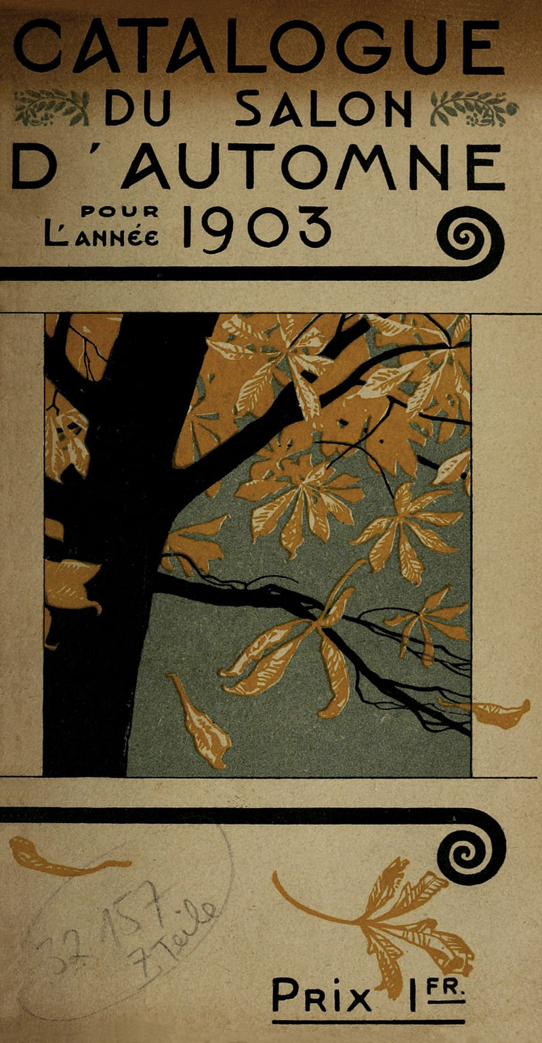
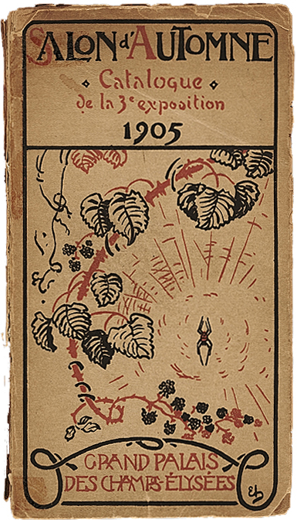

Slide 11
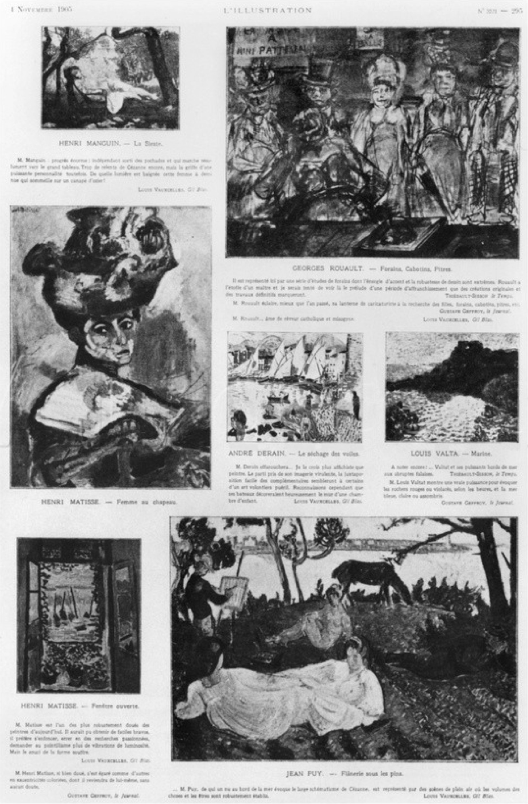
Les Fauves: Exhibition at the Salon d'Automne, in L'Illustration, 4 November 1905

Slide 12
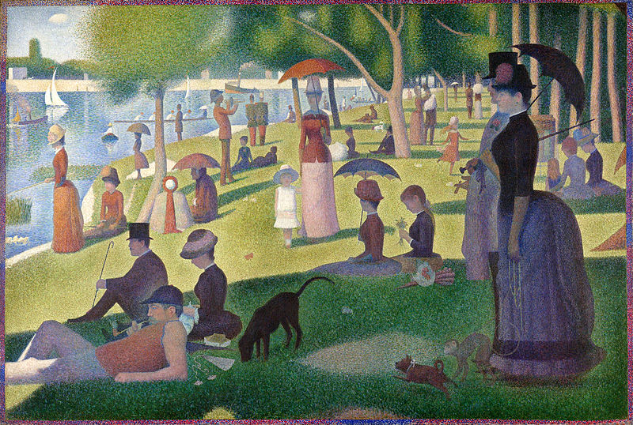
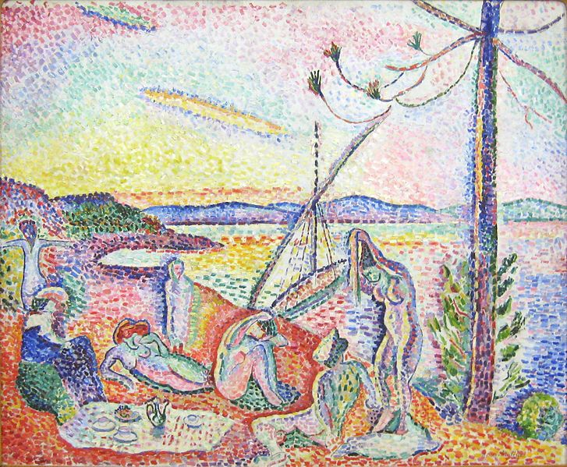
Henri Matisse, Luxe, calme et volupté, 1904-05

Slide 13
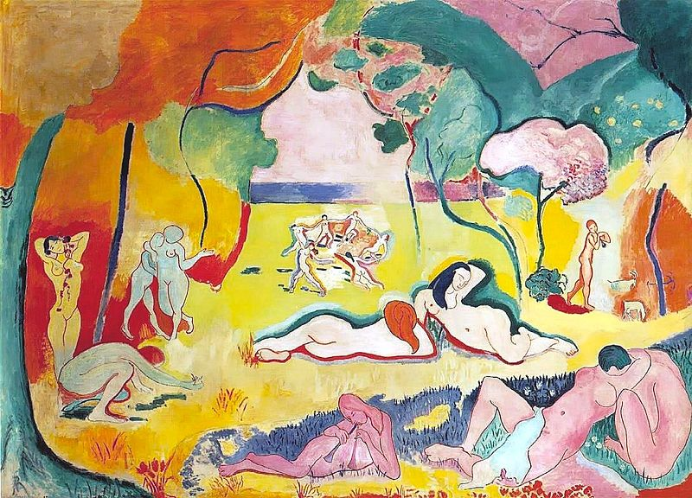
Henri Matisse, Le Bonheur de vivre (The Joy of Life), 1905-06

Slide 14
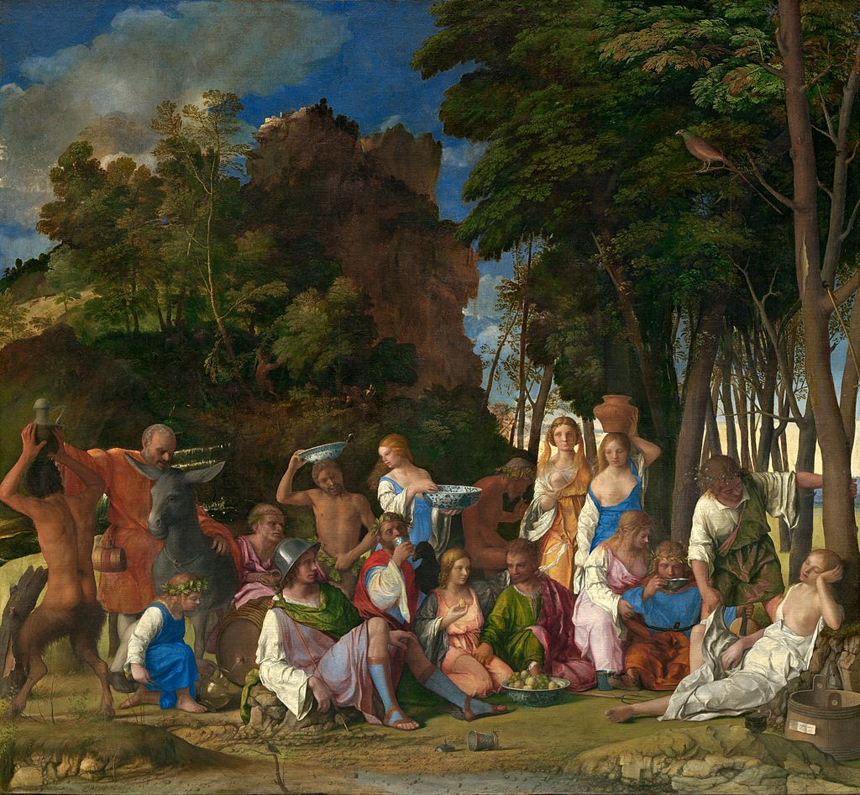
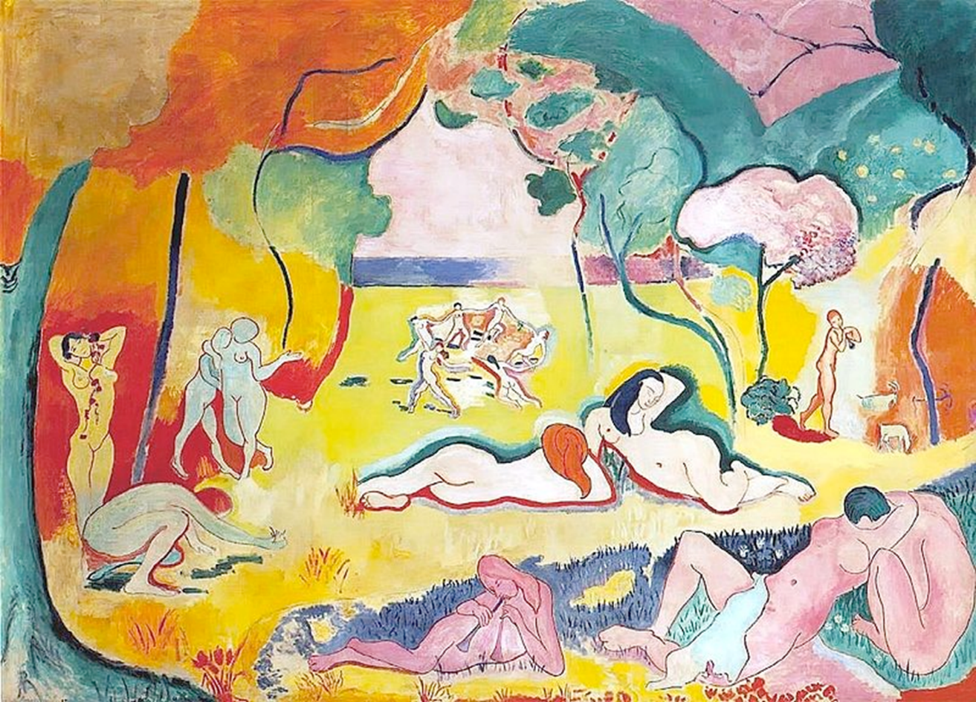
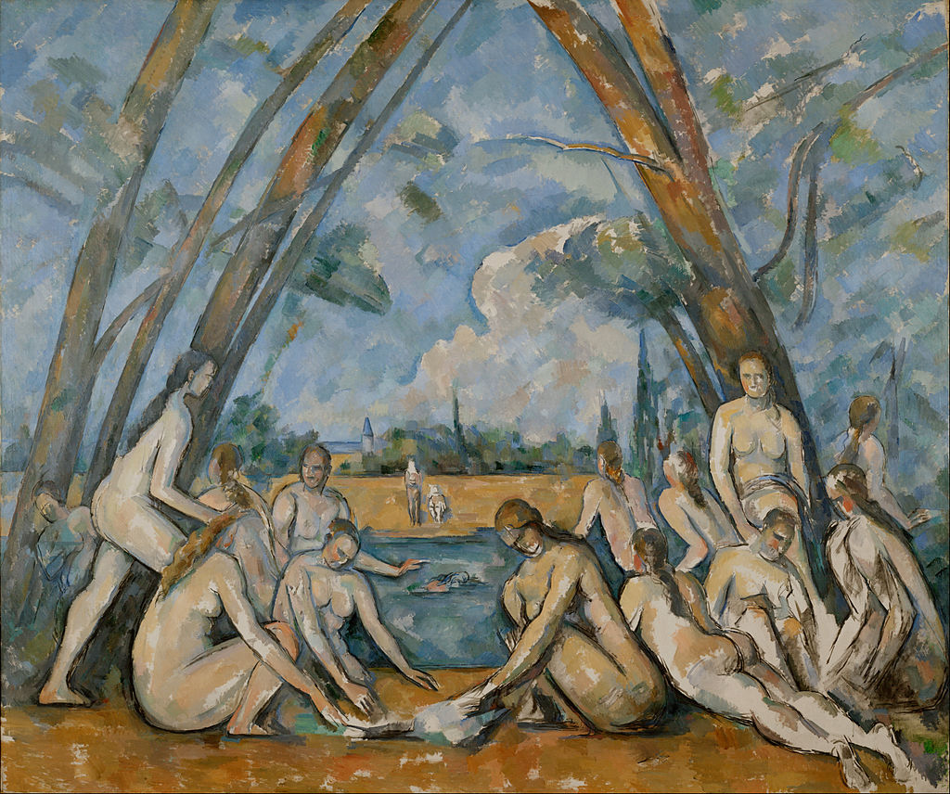
Giovanni Bellini, Feast of the Gods, 1514-29
Paul Cézanne, French - The Large Bathers, 1898-1905

Slide 15
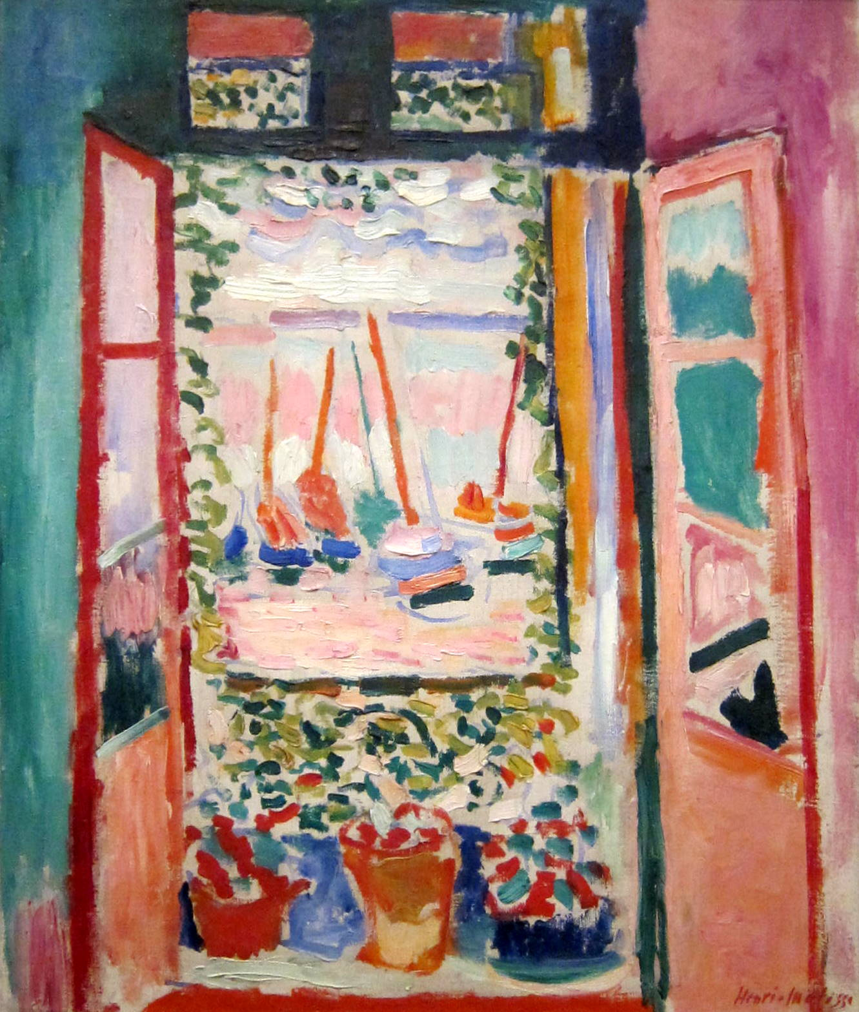
Édouard Vuillard, Large Interior with Six Persons, 1897
Henri Matisse, The Open Window, 1905

Slide 16
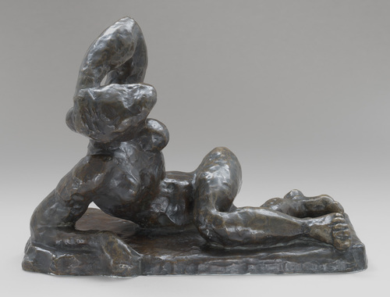
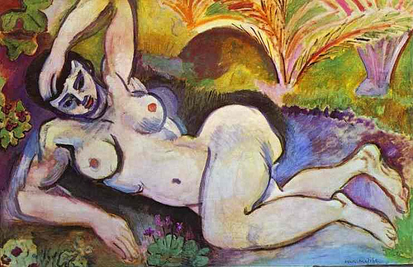
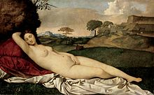
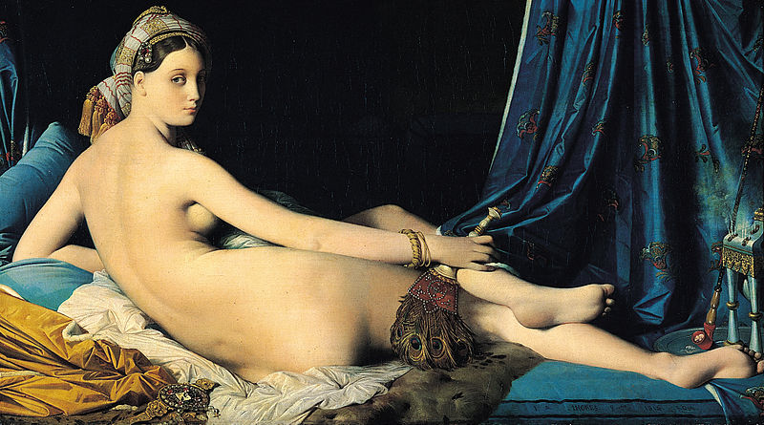
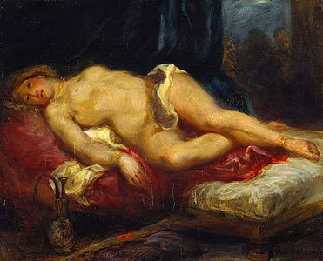
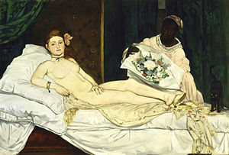
Henri Matisse, Reclining Nude, I, 1907
Henri Matisse, Blue Nude: Memory of Biskra, 1907
Giorgone, Sleeping Venus, c. 1510
Ingres, The Grand Odalisque, 1814
Delacroix, Odalisque, 1825
Manet, Olympia, 1863

Slide 17
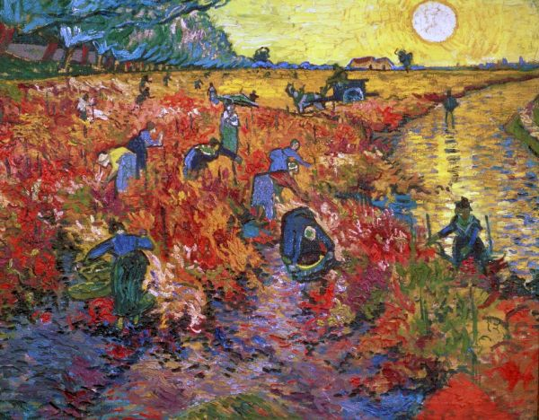
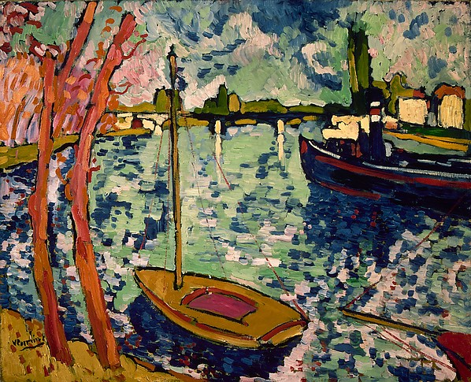
Vincent Van Gogh, The Red Vineyard at Arles, 1888
Maurice de Vlaminck, The Seine at Chatou, 1906

Slide 18
In what ways do the Fauve’s response to the innovations of the Impressionists and Neo-Impressionists experiments with color and form reveal new ideological investments in artistic production?

Slide 19
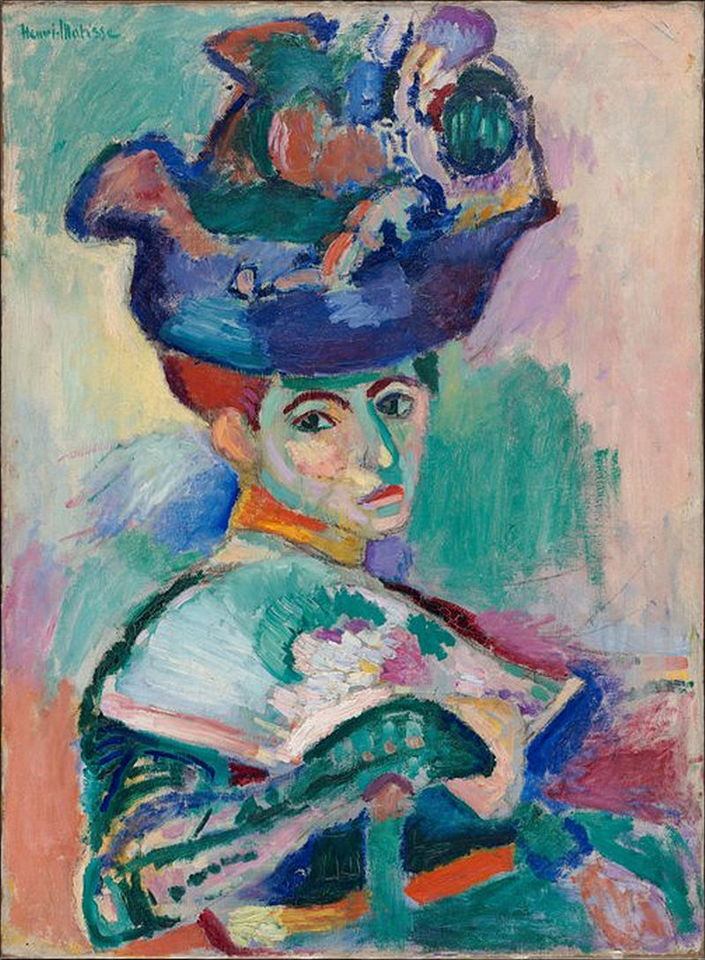
Vincent van Gogh, Portrait of Joseph Roulin, 1889
Henri Matisse, Woman with a Hat, 1905

Slide 20
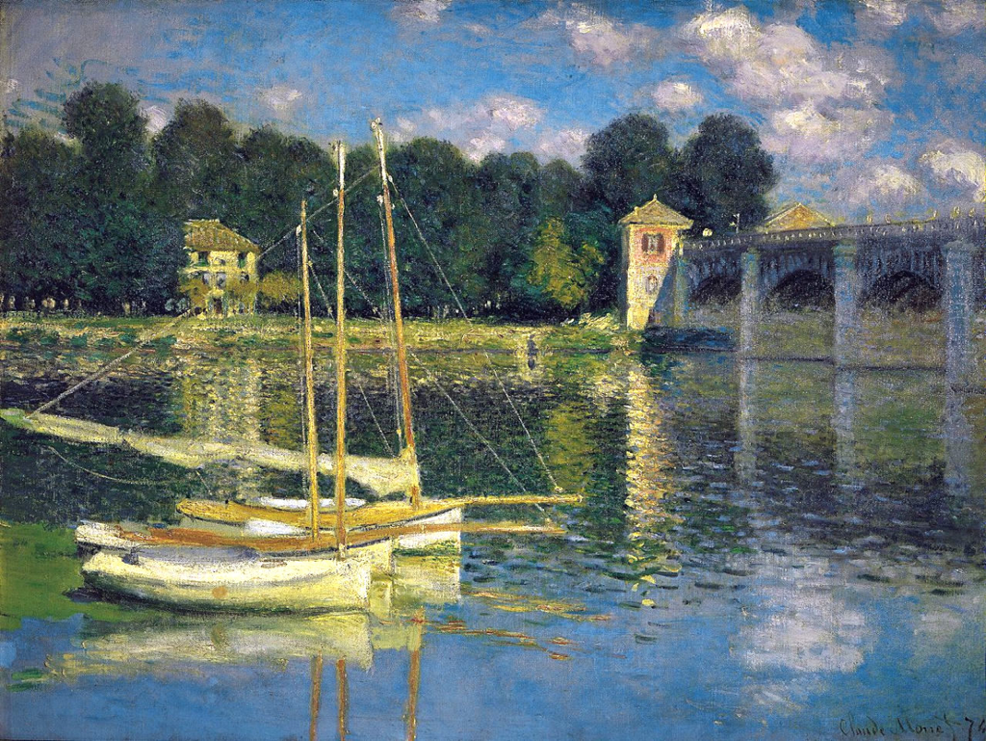
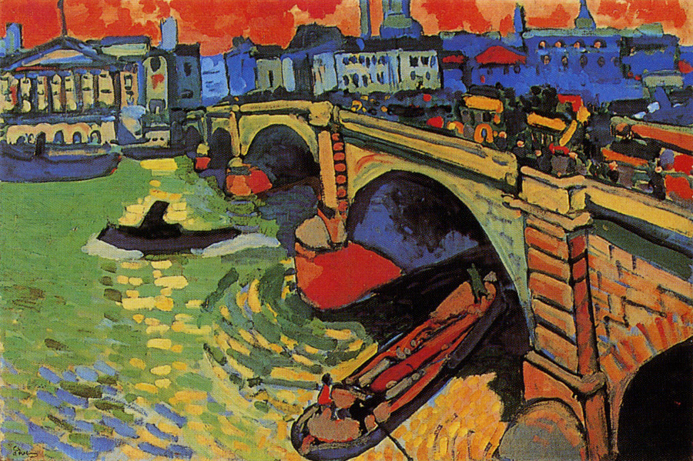
Claude Monet, The Argenteuil Bridge, 1874
André Derain, London Bridge, 1906

Slide 21
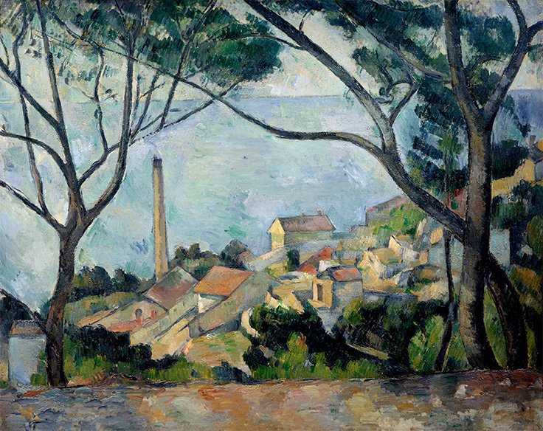
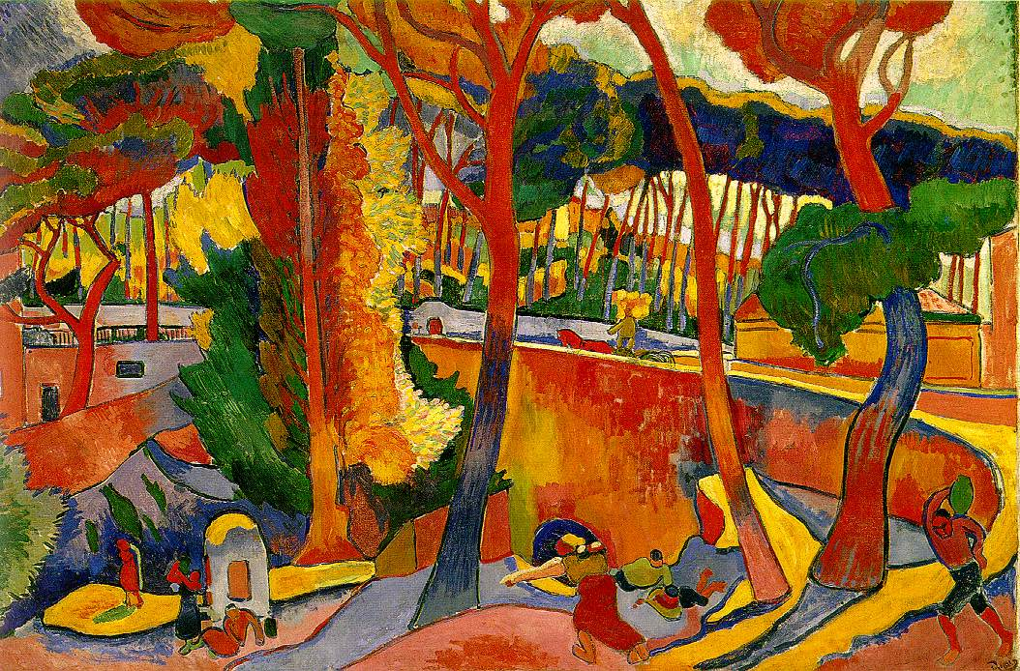
Paul Cézanne, La mer a l'Estaque, 1879
André Derain, Turning Road, L’Estaque, 1906

