Slide 1
Experiments in Color
German Expressionism
““If this is not an age of decay and declining vitality, it is at least one of headlong and arbitrary experimentation:— and it is probable that a superabundance of bungled experiments should create an overall impression as of decay— and perhaps even decay itself.”
—Friedrich Nietzsche, The Will to Power, 1901

Slide 2
In what ways do the Fauve’s response to the innovations of the Impressionists and Neo-Impressionists experiments with color and form reveal new ideological investments in artistic production?

Slide 3
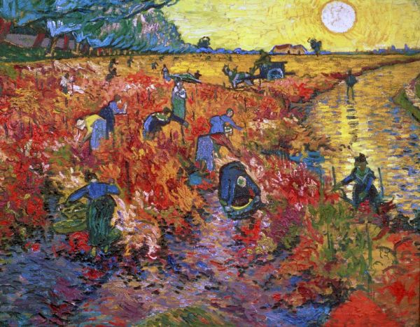
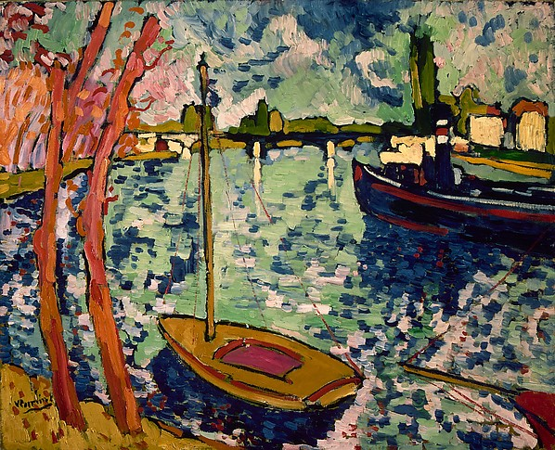
Vincent Van Gogh, The Red Vineyard at Arles, 1888
Maurice de Vlaminck, The Seine at Chatou, 1906

Slide 4
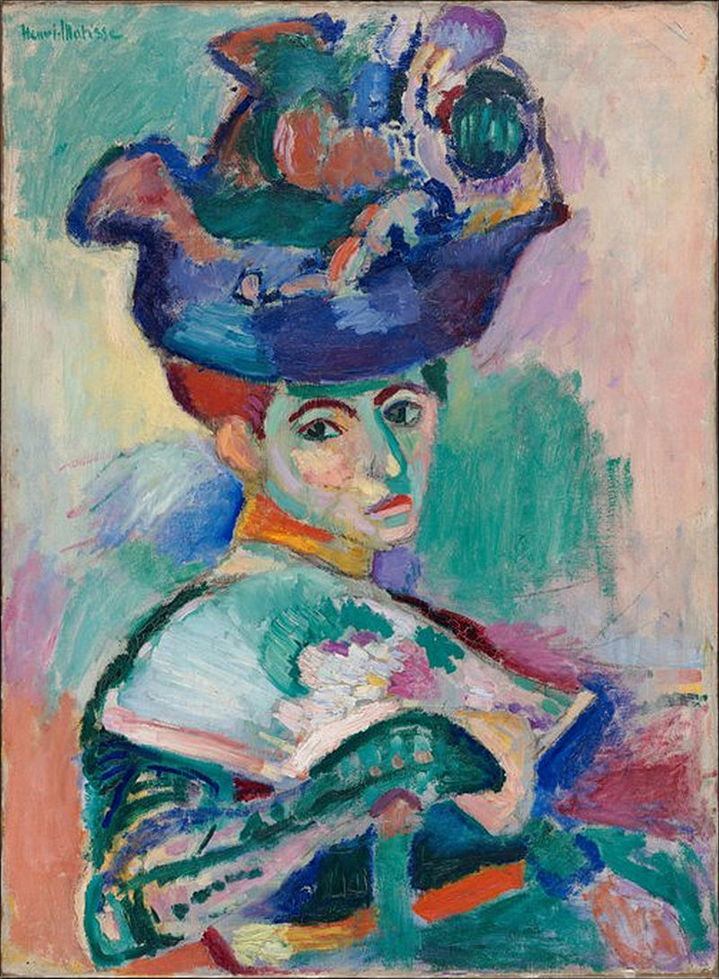
Vincent van Gogh, Portrait of Joseph Roulin, 1889
Henri Matisse, Woman with a Hat, 1905

Slide 5
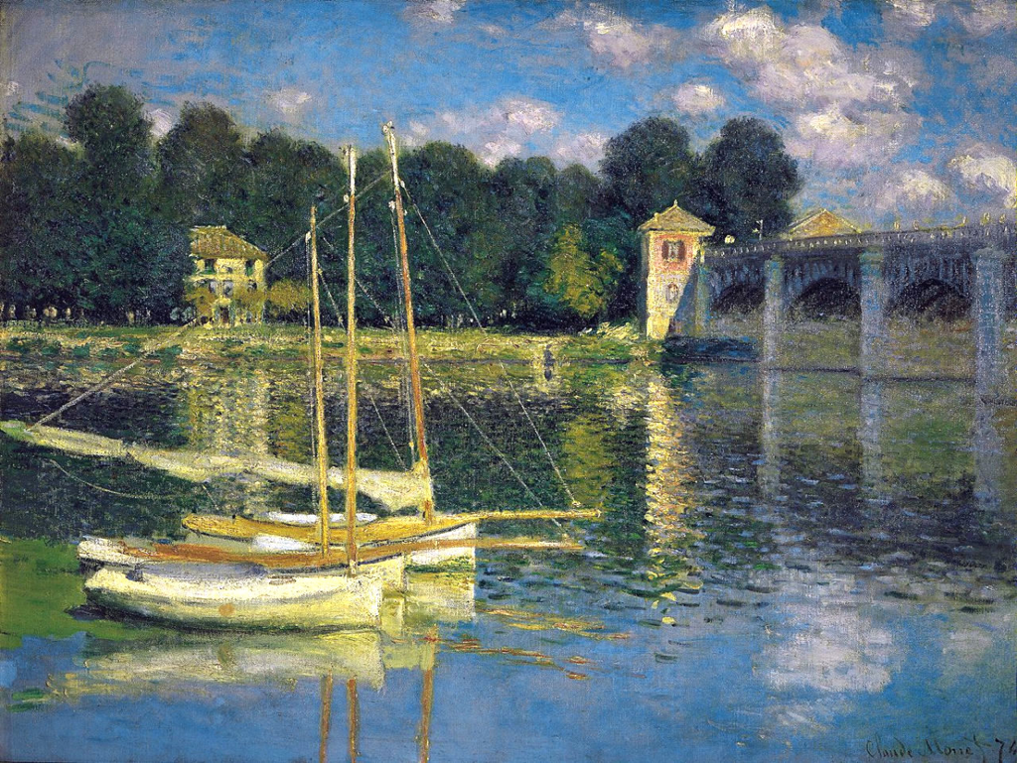
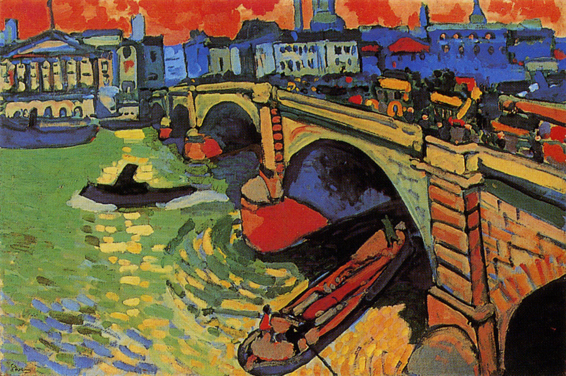
Claude Monet, The Argenteuil Bridge, 1874
André Derain, London Bridge, 1906

Slide 6
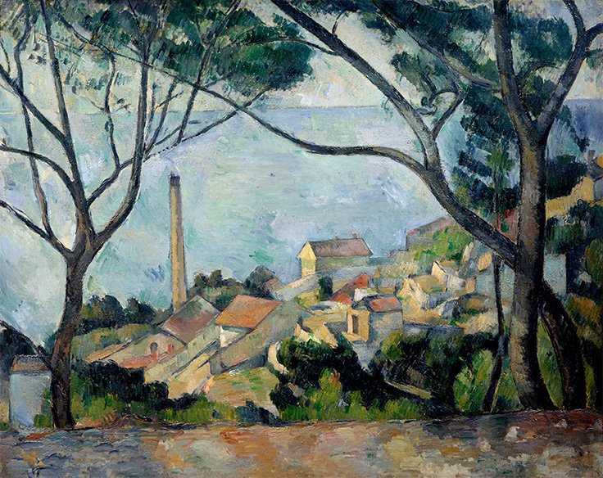
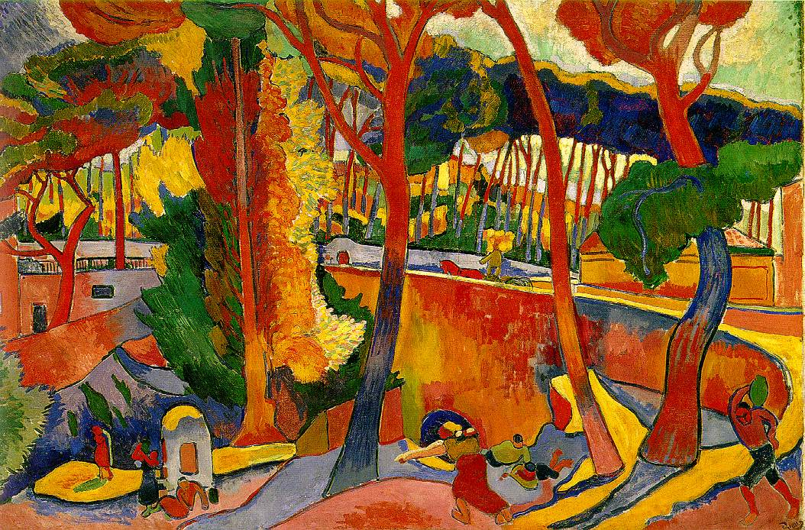
Paul Cézanne, La mer a l'Estaque, 1879
André Derain, Turning Road, L’Estaque, 1906

Slide 7
Romanticism
The Sublime
Pessimism
Desire
Nihilism
Art for Art’s Sake
Fin de siècle
Art Nouveau
Nationalism
Die Brücke
Der Blaue Reiter

Slide 8
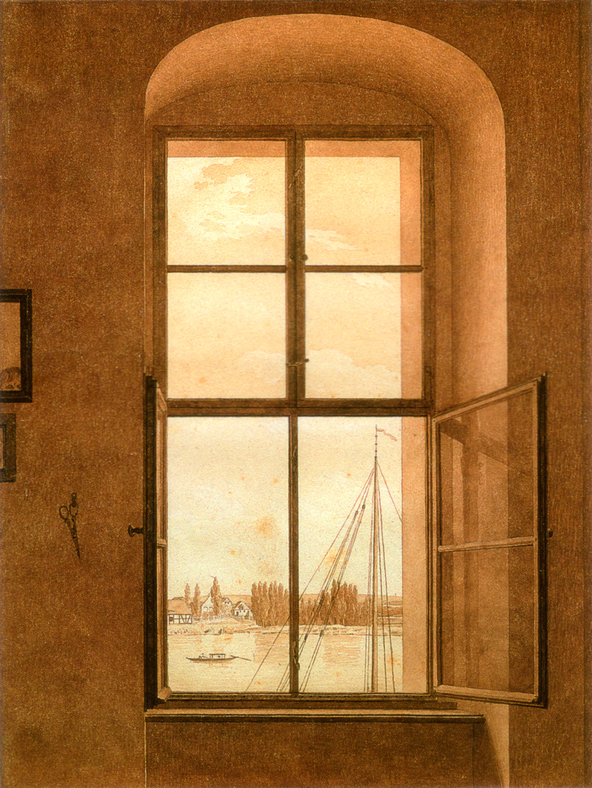
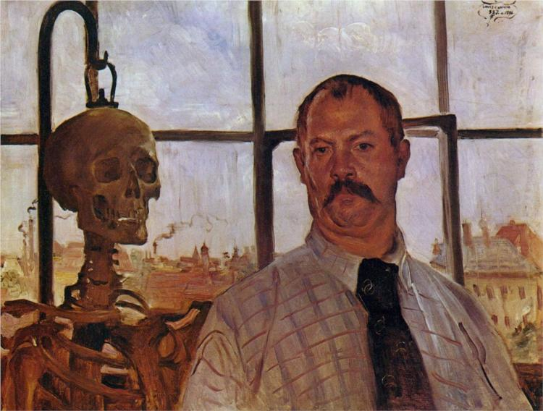
From Romanticism to Pessimism
“All satisfaction, or what is commonly called happiness, is really and essentially always negative only, and never positive. It is not a gratification which comes to us originally and of itself, but it must always be the satisfaction of a wish. For desire…is the precedent condition of every pleasure; but with the satisfaction, the desire and therefore the pleasure cease; and so the satisfaction or gratification can never be more than deliverance from pain, from a want. Such is not only every actual and evident suffering, but also every desire whose importunity disturbs our peace, and indeed even the deadening boredom that makes existence a burden to us.”————Arthur Schopenhauer, World as Will and Representation, 1818
Caspar David Friedrich, View from the Artist’s Studio, 1817
Lovis Corinth, Self-Portrait with Skull, 1896

Slide 9
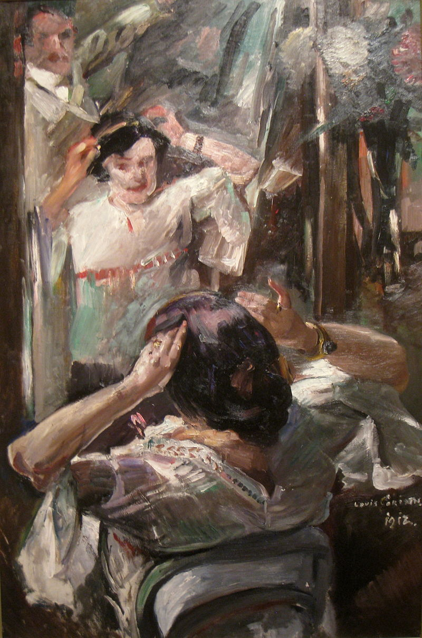
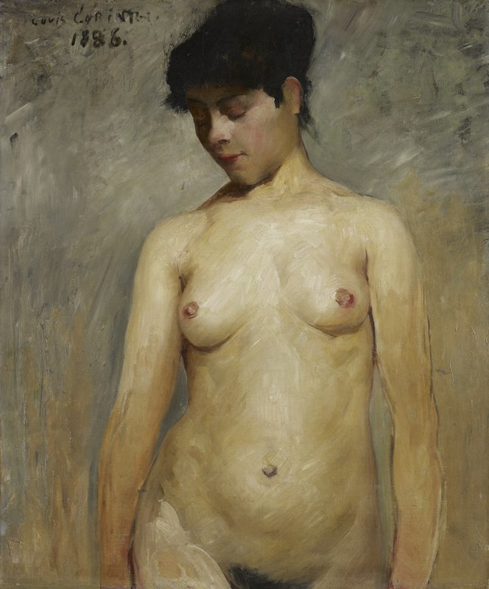
Representing the Will- Against the stimulation of desire
“If the whole world as representation is only the visibility of the will, then art is the elucidation of this visibility, the camera obscura which shows the objects more purely, and enables us to survey and comprehend them better. It is the play within the play, the stage on the stage in Hamlet.”
—— Arthur Schopenhauer, the World as Will and Representation
Lovis Corinth, Nude Girl, 1896
Pierre Bonnard, Nude Against the Light, 1906
Lovis Corinth, At the Mirror, 1912

Slide 10
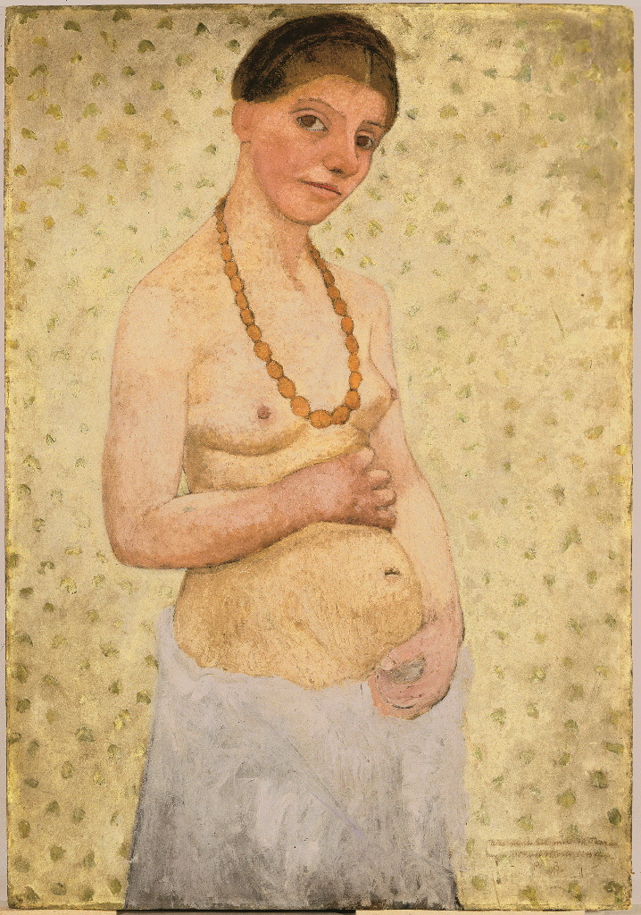
Paul Gaugin, Two Tahitian Women,1899
Paula Modersohn- Becker, Self-Portrait on Her Sixth Wedding Anniversary, 1906

Slide 11
Gerrman Expressionism
Die Blaue Reiter
The turning back to nature
Abstracted forms and prismatic colors
Belief in the mystical spiritual potential of color against the corruption and materialism of modernity
Emphasis on flattened perspective and reductive forms drawn from woodcut
Die Brucke: “we want to achieve freedom of life and action against the well established older forces.”
——1906 Manifesto. (Dresden)
Synthesis of elements of old German art, African and South Pacific tribal art with post-impressionism and fauvism to produce new anti naturalistic work expressing emotional, psychic experience
More direct relationship with nature.
Emphasis on print media
Ernst Ludwig Kirchner, Bathers at Moritzburg, 1909–26
Wassily Kandinsky, 1903, The Blue Rider (Der Blaue Reiter)

Slide 12
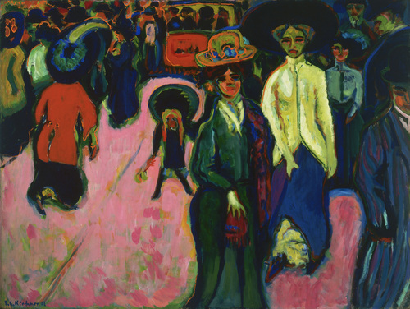
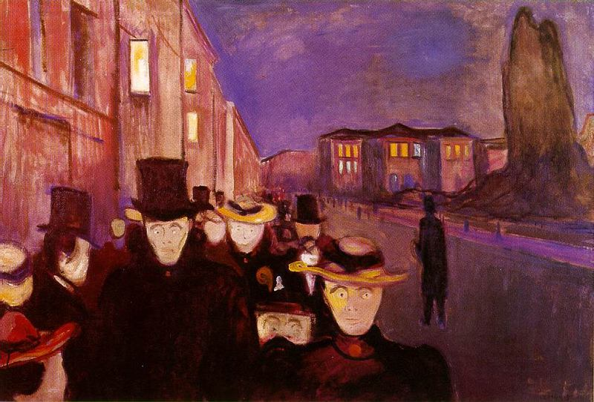
Nihilism
“Levelling:” The suppression/erasure of individuality under the conditions of Modernity (mass media, industrial production
“Leveling at its maximum is like the stillness of death, where one can hear one's own heartbeat, a stillness like death, into which nothing can penetrate, in which everything sinks, powerless. One person can head a rebellion, but one person cannot head this leveling process, for that would make him a leader and he would avoid being leveled. Each individual can in his little circle participate in this leveling, but it is an abstract process, and leveling is abstraction conquering individuality.”
                —Soren Kierkegaard, The Present Age: On the Death of Rebellion, 1846
Edvard Munch, Spring Evening on Karl Johan Street, 1892
Ernst Ludwig Kirchner, Street, Dresden, 1908

Slide 13
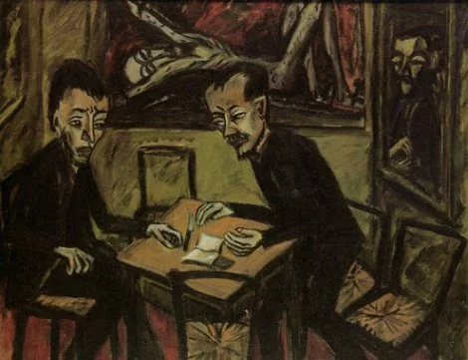
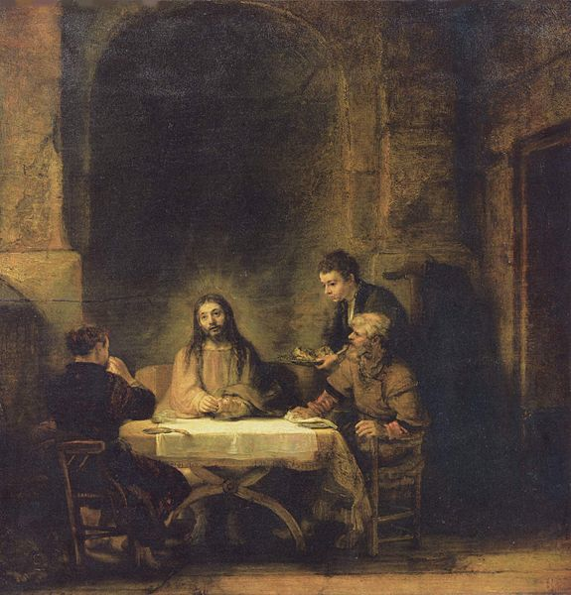
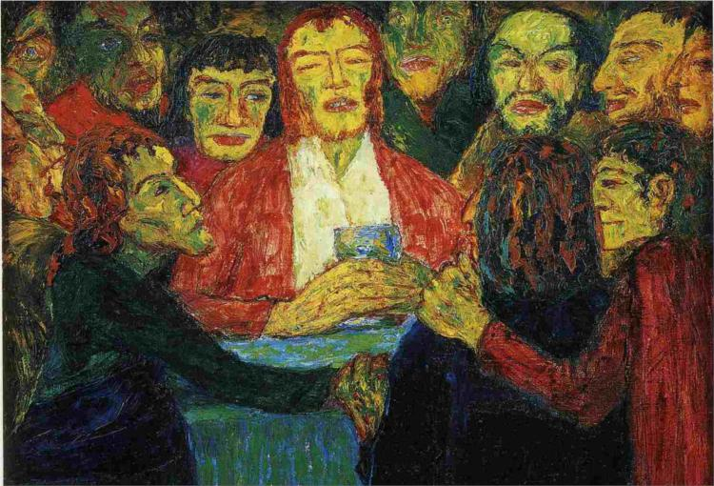
Nihilism
“Every belief, every considering something-true, is necessarily false because there is simply no true world…Nihilism is . . . not only the belief that everything deserves to perish; but one actually puts one’s shoulder to the plough; one destroys”.
“the highest values devalue themselves. The aim is lacking, and ‘Why’ finds no answer…”
                ——Friedrich Nietzsche, The Will to Power, 1888
Emil Nolde, The Last Supper, 1909
Rembrandt, Supper at Emmaus, 1648
Eric Heckel, Two Men at a Table, 1913

Slide 14
Nihilism
The terrible and wise spirit, the spirit of self annihilation and non-being,' goes on the Inquisitor, 'the great spirit of negation conversed with Thee in the wilderness, and we are told that he "tempted" Thee…
——Dostoyevski, “The Grand Inquisitor,” The Brothers Karamazov
Eric Heckel, Two Men at a Table, 1913

Slide 15
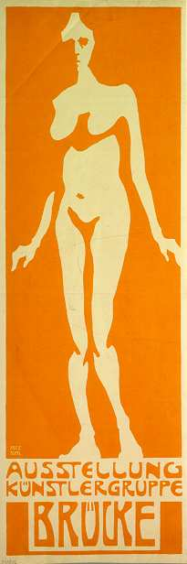
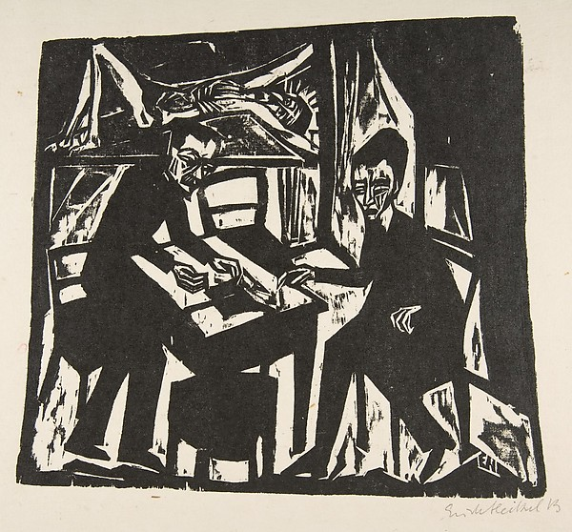
Nihilism and Nationalism
“What I relate is the history of the next two centuries. I describe what is coming, what can no longer come differently: the advent of nihilism. . . . For some time now our whole European culture has been moving as toward a catastrophe, with a tortured tension that is growing from decade to decade: restlessly, violently, headlong, like a river that wants to reach the end. . . .”
                ——Friedrich Nietzsche, The Will to Power, 1888
Eric Heckel, Two Men at a Table, 1913
Fritz Bleyl, Poster for the first Die Brücke show in 1906

Slide 16
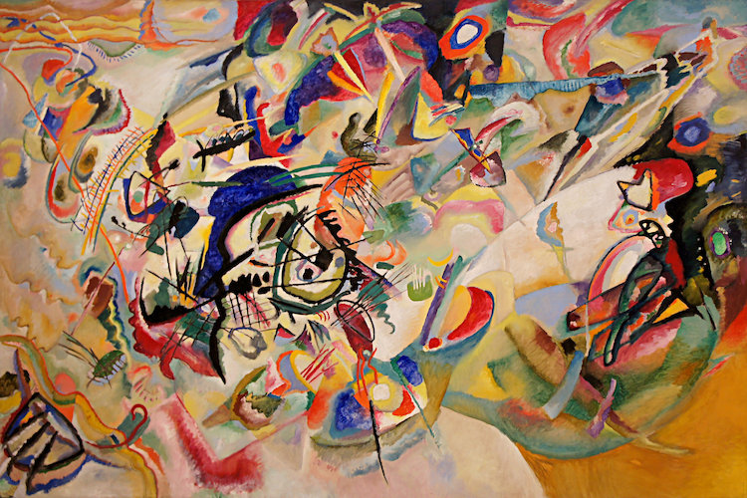
Abstraction- Sound and Vision
Synesthesia
James MacNeil Whistler, Nocturne in Black and Gold – The Falling Rocket, c. 1875
Vasily Kandinsky, Composition VII, 1913

Slide 17
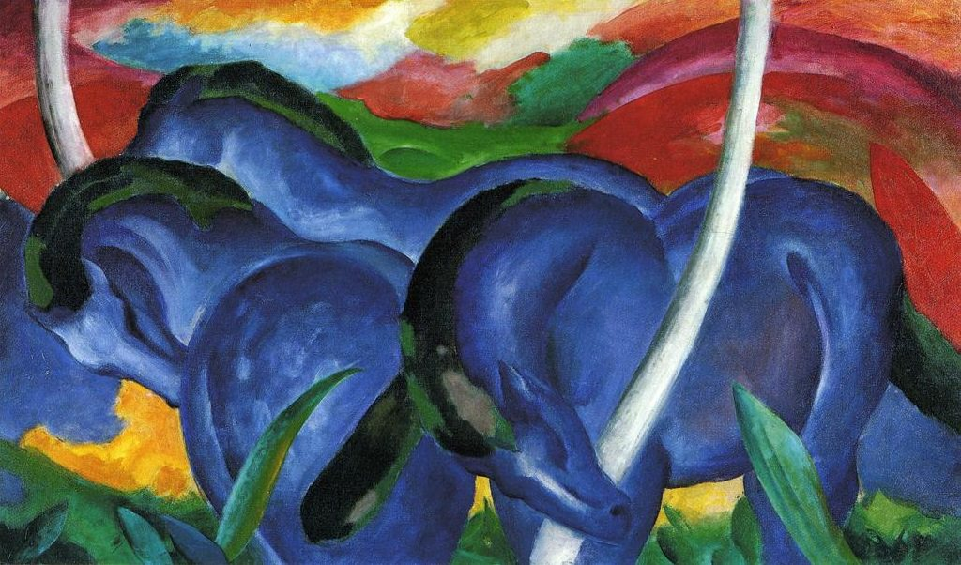
Franz Marc The Large Blue Horses, 1911

Slide 18
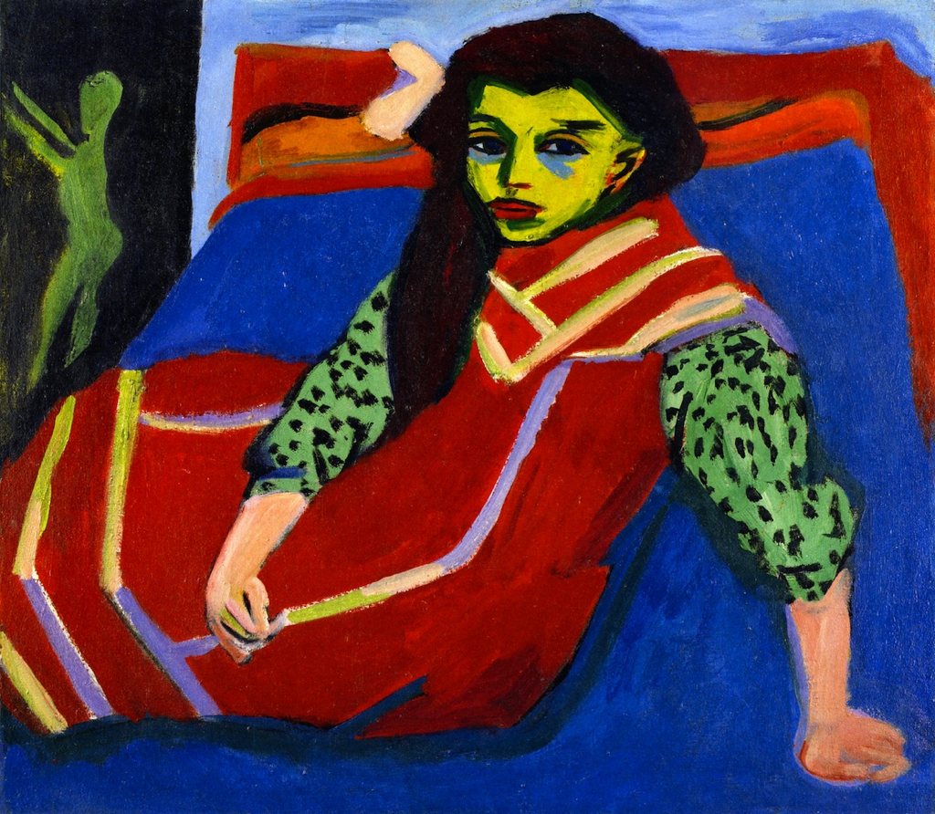
Compare and contrastive the formal characteristics of these two works. What do your findings allow you to say about the ways in which each work encodes and produces meaning?
Henri Matisse, Woman with a Hat, 1905
Ernst Ludwig Kirchner, Seated Girl, 1910

