Slide 1
An Aesthetics of Violence
Ideological Excesses and the Avant-Garde

Slide 2
Discussion Questions
How does Chave approach her critique of Les Demoiselles d’Avignon?
What role do masks and masquerade play in her analysis?
How do class and race inform Chave’s reading of the painting?
In what ways might we think about Chave’s article in terms of the violence that Picasso’s work enacts on its subjects?

Slide 3
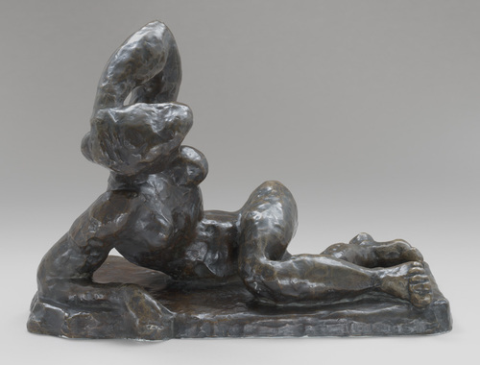

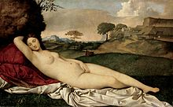
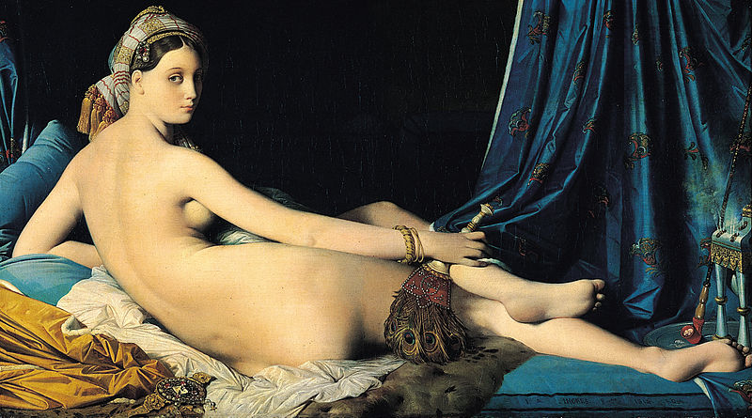
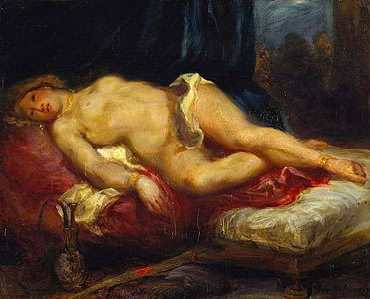
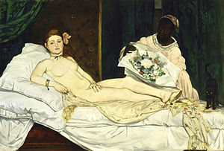
Henri Matisse, Reclining Nude, I, 1907
Henri Matisse, Blue Nude: Memory of Biskra, 1907
Giorgone, Sleeping Venus, c. 1510
Ingres, The Grand Odalisque, 1814
Delacroix, Odalisque, 1825
Manet, Olympia, 1863

Slide 4
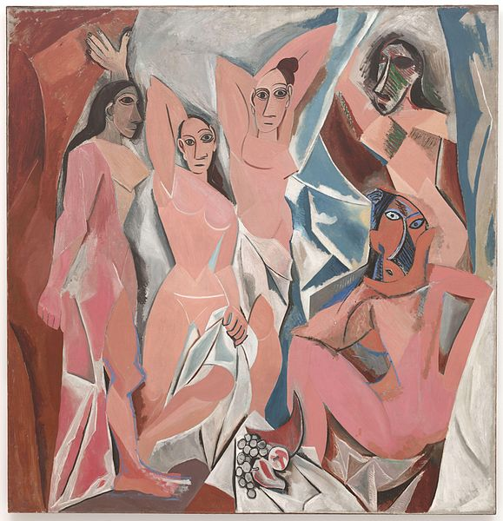
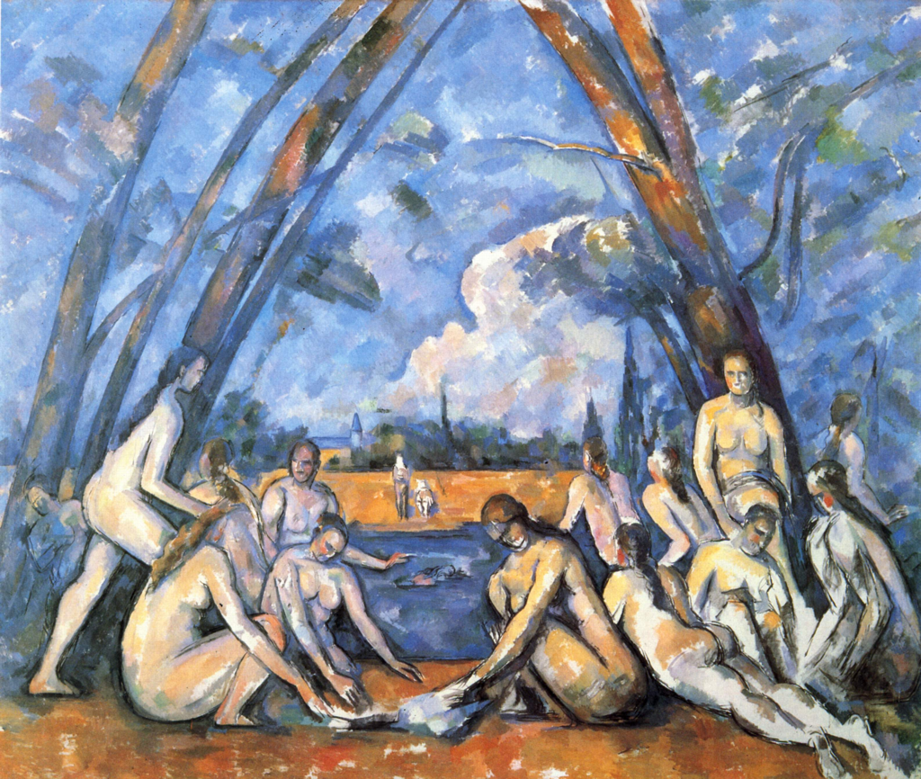
Cézanne, The Large Bathers, 1898-1905
Pablo Picasso, Les Demoiselles d’Avignon, 1907

Slide 5
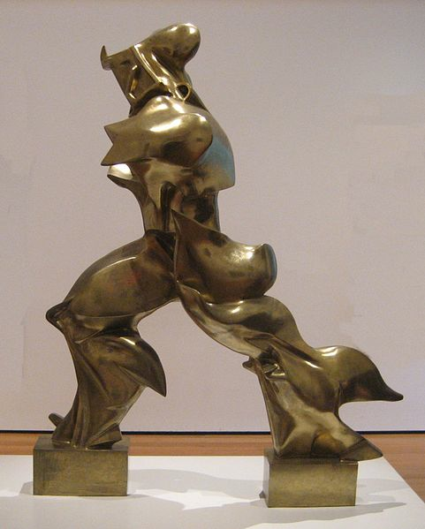
Key Terms
manifesto
Henri Bergson-
  direct experience vs. abstract rationalism
  Intuition, sensation and affect
serata
parole in libertà
Fascism
Umberto Boccioni, Unique Forms of Continuity in Space, 1913

Slide 6
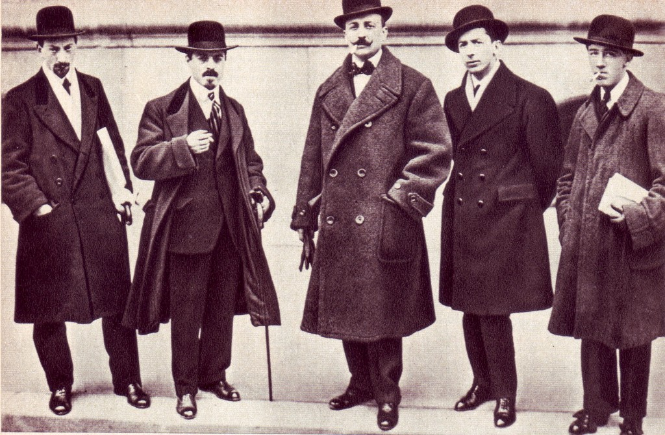
Aesthetics of Violence
“7. There is no longer beauty except in the struggle. No more masterpieces without an aggressive character. Poetry must be a violent assault against the unknown forces in order to overcome them and prostrate them before men.”
—Founding and Manifesto of Futurism, 1909
Luigi Russolo, Carlo Carrà, F. T. Marinetti, Umberto Boccioni, Gino Severini

Slide 7
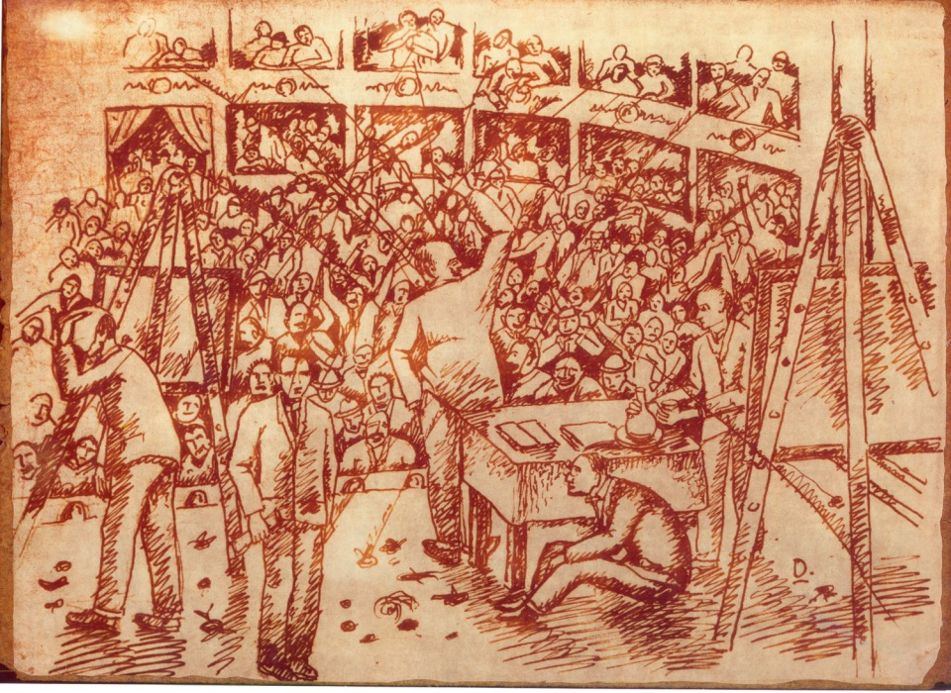
Aesthetics and Political Agitation
“It is from Italy that we are flinging this to the world, our manifesto of burning and overwhelming violence, with which we today establish ‘Futurism’, for we intend to free this nation from its fetid cancer of professors, archaeologists, tour guides, and antiquarians.”
—Founding and Manifesto of Futurism, 1909
Gerado Dottori, A Futurist Serata in Perugia 1914
Italian possessions and spheres of influence in the Horn of Africa, 1896
Italiam Irredentism

Slide 8
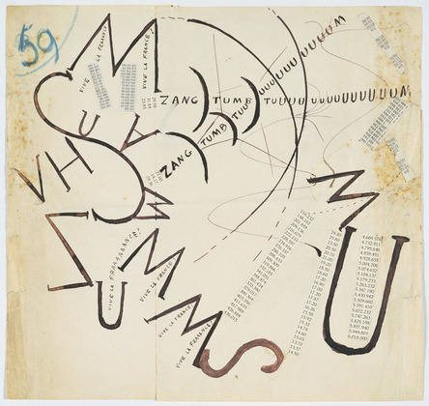
parole in libertà
“Destroy the Museum. Crack syntax. Sabotage the adjective. Leave nothing but the verb”
—FT Marinetti
Filippo Tommaso Marinetti, Vive la France, 1915

Slide 9
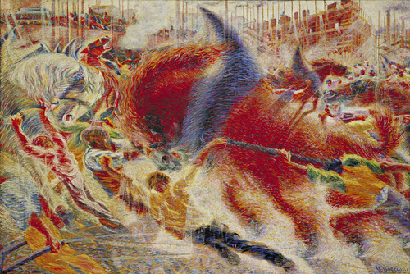
“11. We shall sing the great masses shaken with work, pleasure, or rebellion: we shall sing the multicolored and polyphonic tidal waves of revolution in the modern metropolis; shall sing the vibrating nocturnal fervor of factories and shipyards burning under violent electrical moons; bloated railroad stations that devour smoking serpents; factories hanging from the sky by the twisting threads of spiraling smoke; bridges like gigantic gymnasts who span rivers, flashing at the sun with the gleam of a knife; adventurous steamships that scent the horizon, locomotives with their swollen chest, pawing the tracks like massive steel horses bridled with pipes, and the oscillating flight of airplanes, whose propeller flaps at the wind like a flag and seems to applaud like a delirious crowd.”
—Founding and Manifesto of Futurism, 1909
Umberto Boccioni, The City Rises, 1910

Slide 10
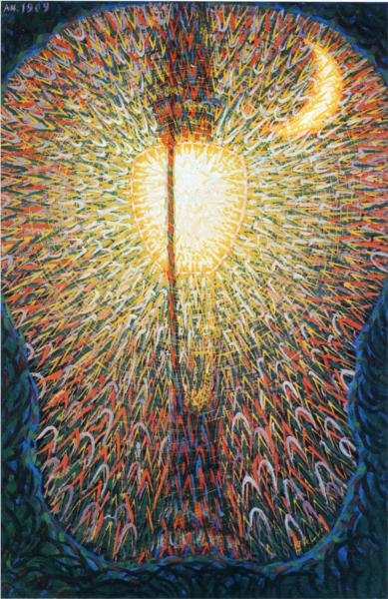
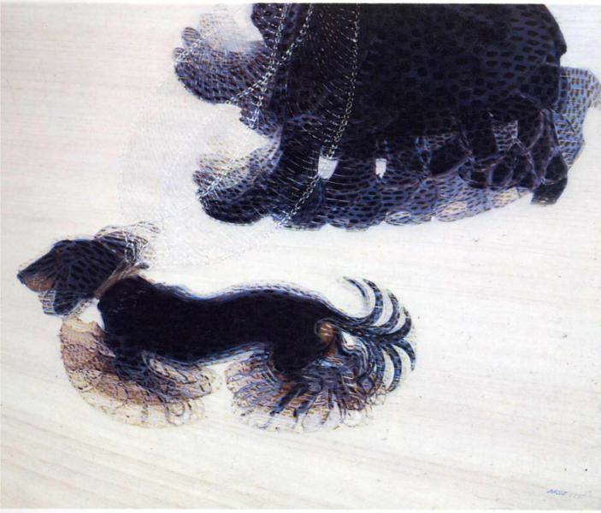
Direct experience vs. abstract rationalism
“The gesture which we would reproduce on canvas shall no longer be a fixed moment in universal dynamism. It shall simply be the dynamic sensation itself. Indeed, all things move, all things run, all things are rapidly changing” The Manifesto of Futurist Painters, 1910
Giacomo Balla, Street Light, 1909
Giacomo Balla, Dynamism of a Dog on a Leash, 1912

Slide 11
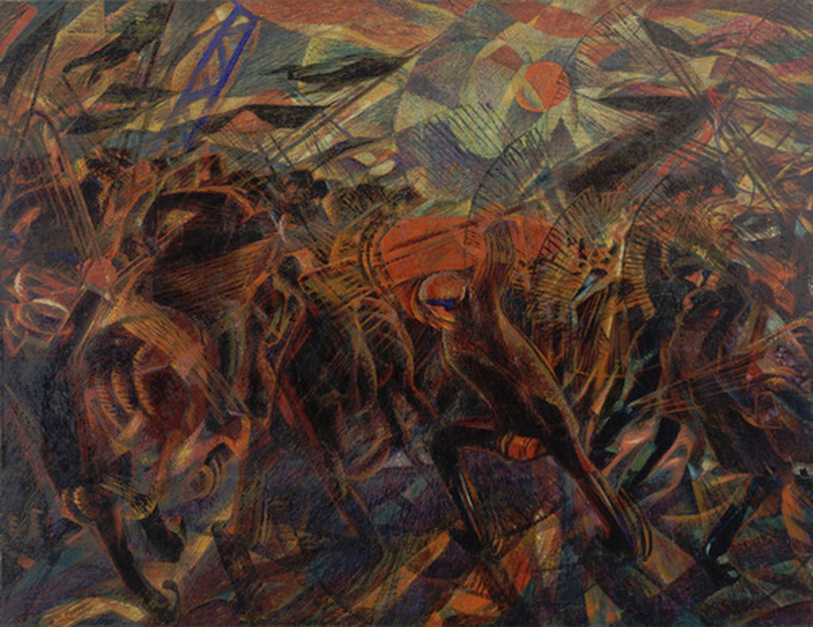
Direct experience vs. abstract rationalism
“"If we paint the phases of a riot, the crowd bustling with uplifted fists and the noisy onslaught of the cavalry are translated upon the canvas in sheaves of lines corresponding to the conflicting forces, following the general law of violence of the picture..”
—Futurism Manifesto (1912 Version)
“These force-lines must encircle and involve the spectator so that he will in a manner be forced to struggle himself with the persons in the picture”
—Futurism Manifesto (1912 Version)
“I found myself unwillingly in the centre of it, before me I saw the coffin, covered in red carnations, sway dangerously on the shoulders of the pallbearers …Deeply struck, as soon as I got home I did a drawing of what I had seen.
— Carrà, My Life, 1945
Carlo Carrà, The Funeral of Anarchist Galli, 1910-1911

Slide 12
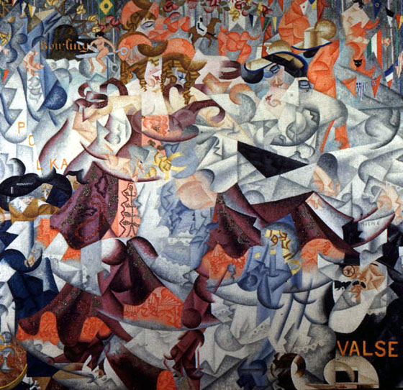
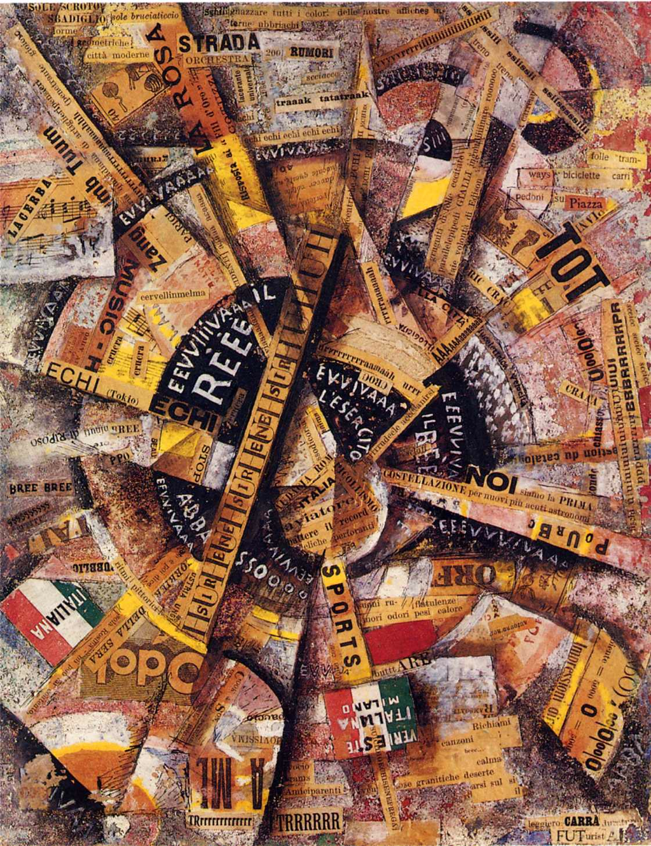
Aesthetics and Politics
“We love the indomitable bellicose patriotism that sets you apart; we love the national pride that guides your muscularly courageous race; we love the potent individualism that doesn't prevent you from opening your arms to individualists of every land, whether libertarians or anarchists.
—FT Marinetti, 'Futurist Speech to the English', lecture at the Lyceum Club of London in 1910
Gino Severini, Dynamic Hieroglyphic of the Bal Tabarin, 1912
Carlo Carrà, Patriotic Celebration, 1914

Slide 13
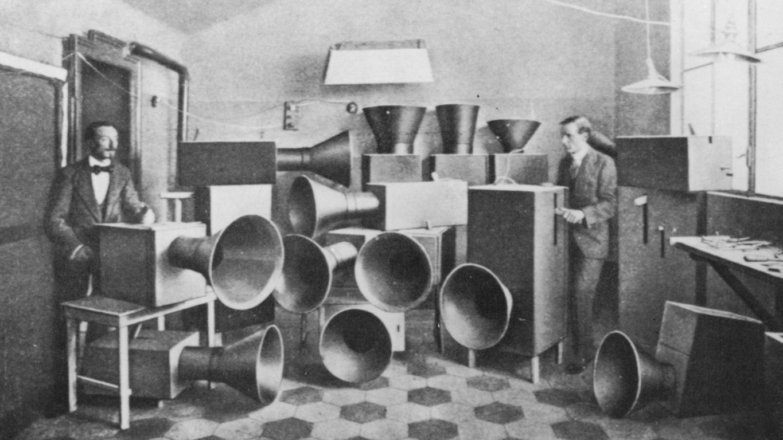
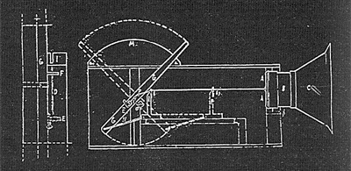
“In order to win over Paris and appear, in the eyes of all Europe, an absolute innovator, the most advanced of all, I urge you to get to work with all your heart, resolute on being bolder, crazier, more advanced, surprising, eccentric, incomprehensible, and grotesque than anybody else in music. I urge you to be a madman.”
—F T Marinetti
Luigi Russolo, Intonarumori
Intonarumori, 1914

Slide 14
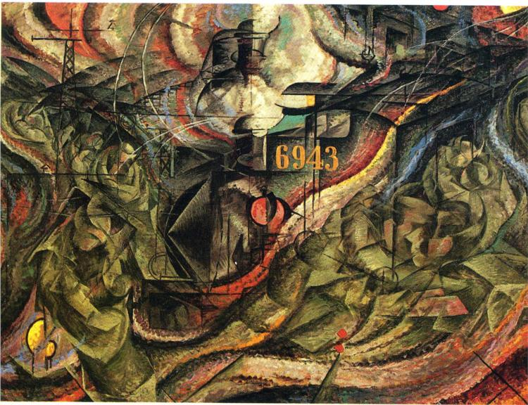
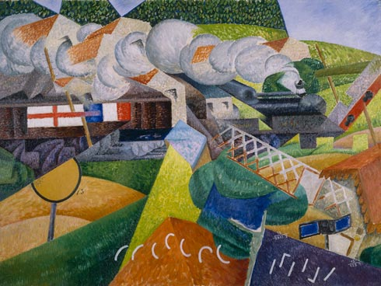
Compare and Contrast
Select one of the paintings below. Compare and contrast it with a cubist painting.
Umberto Boccioni, States of Mind I: The Farewells, 1911
Gino Severini, Red Cross Train Passing a Village, 1915

