Slide 1
The Body in Pieces
Die Neue Sachlichkeit and Dada

Slide 2
Key Terms
Die Neue Sachlichkeit (The New Objectivity), Kunsthalle Mannheim 1925
Return to order
Magic realism
DADA
Cabaret Voltaire
photomontage
simultaneity
Chance
readymade

Slide 3


Slide 4
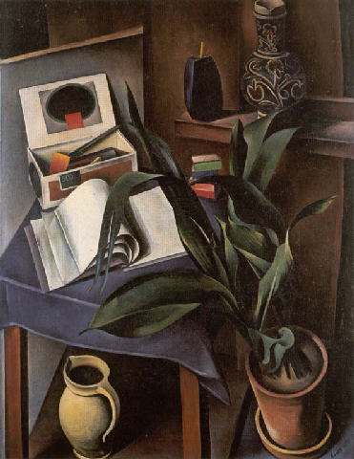
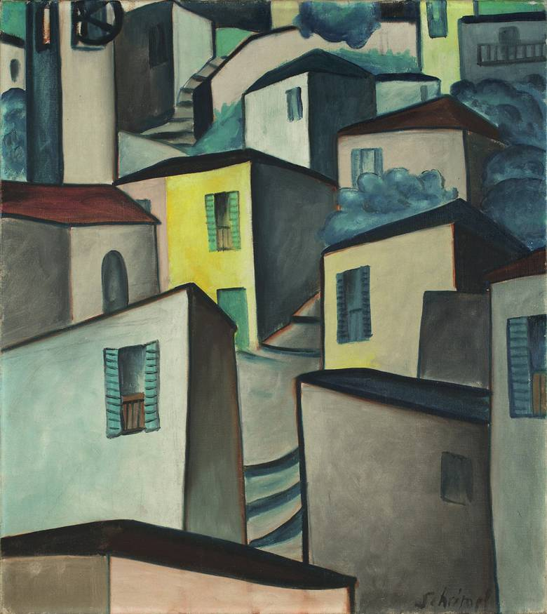
Classicists- “Magic Realism” –Franz Roh
Renewed appreciation for the thing itself
The magic wonder of material reality
Influenced by 19th century art
Georg Schrimpf, Porto Ronco, 1917
Alexander Kanoldt, Still Life II 1922

Slide 5
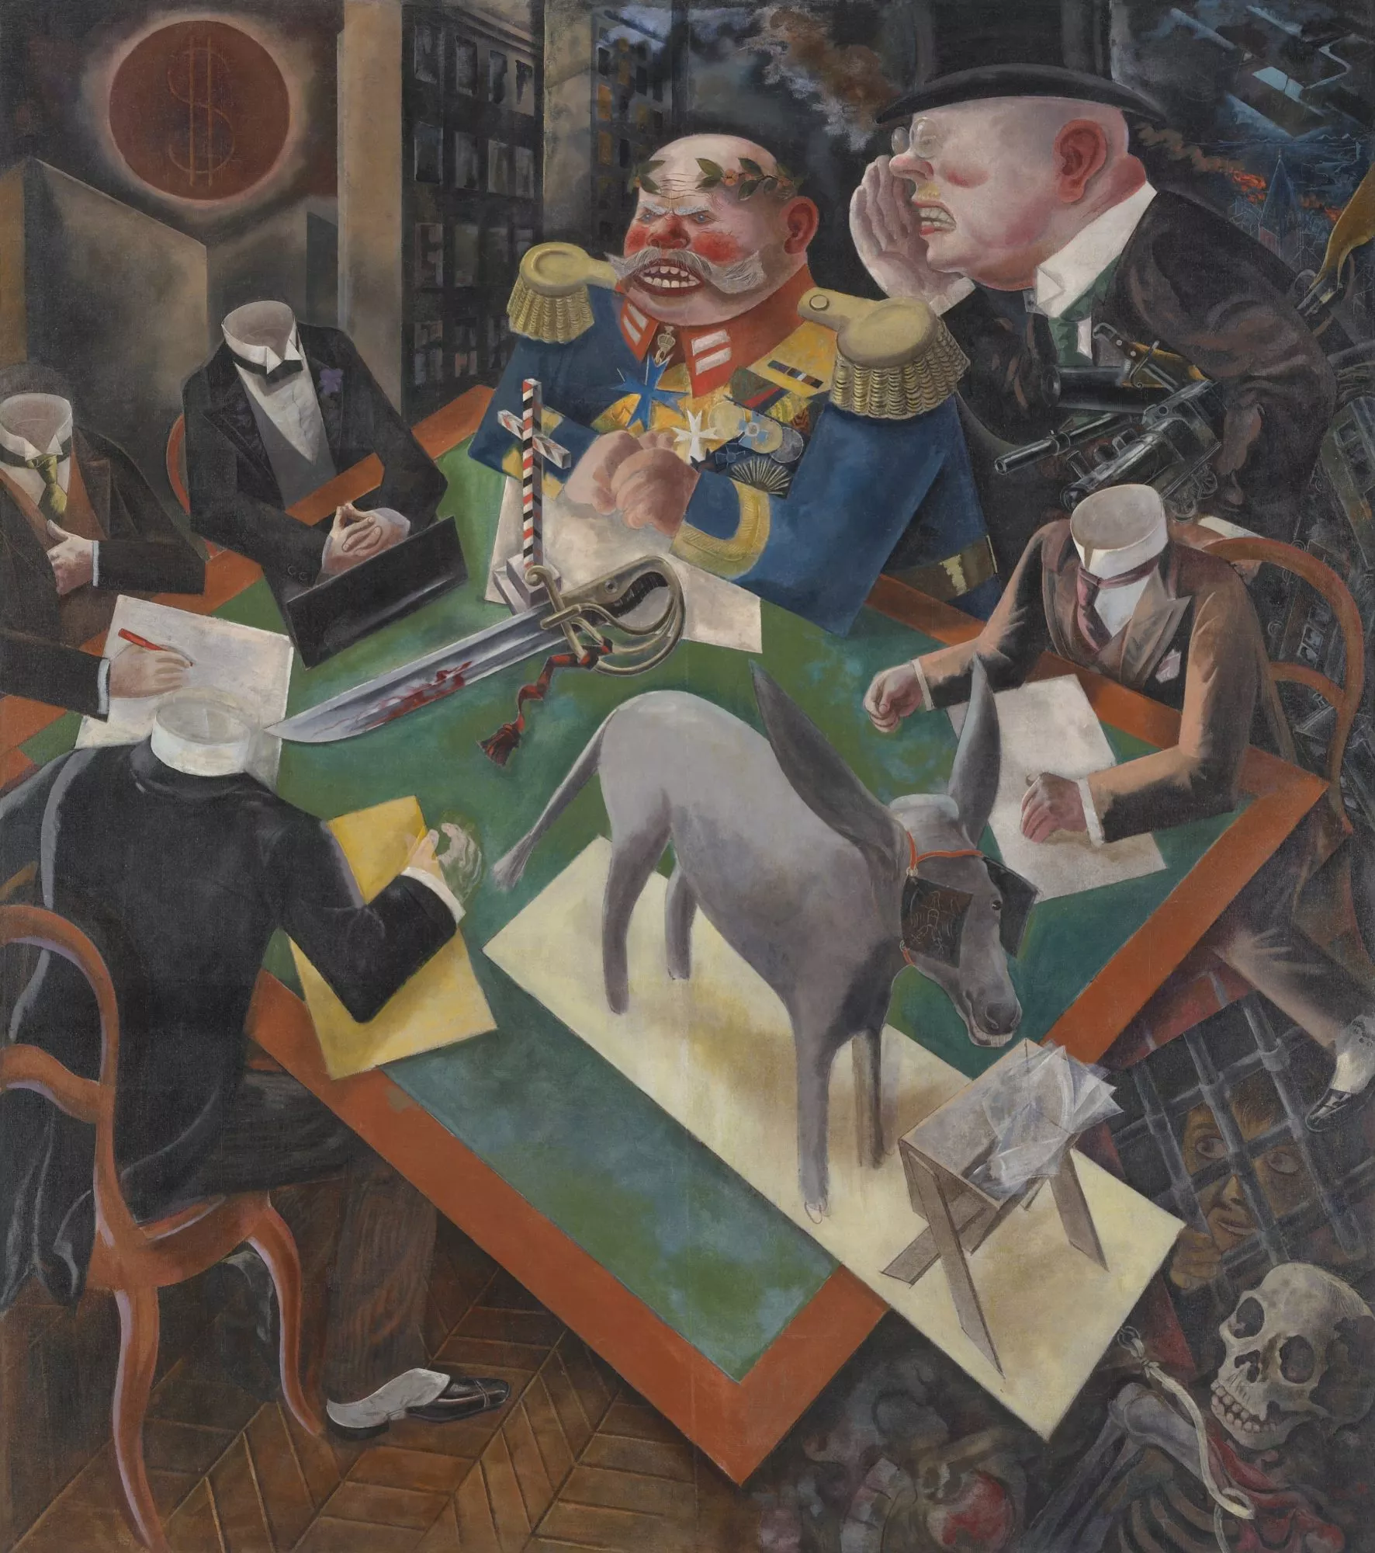
Verists-
Emphasis on the grotesque and the ugly
Provocative and satirical approach
Bearing witness to the traumas
Collage as a compositional strategy
George Grozs, The Eclipse of the Sun, 1926

Slide 6
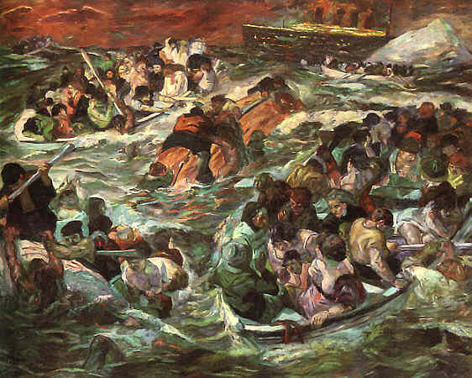
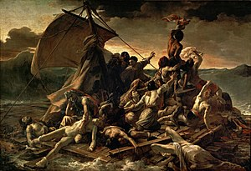
Theodore Gericault, The Raft of the Medusa, 1818
Max Beckmann, The Sinking of the Titanic, 1912

Slide 7
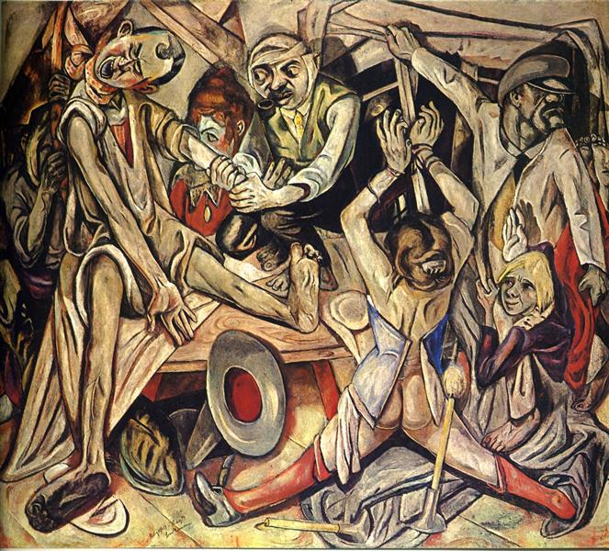
Max Beckmann, Night, 1918

Slide 8
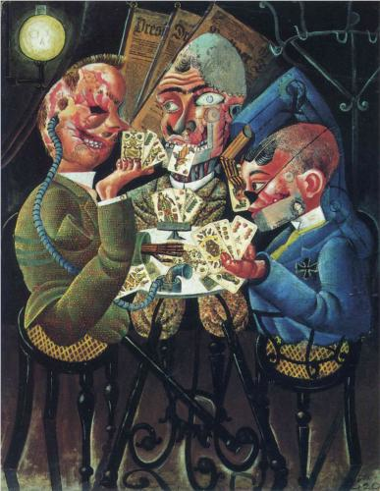
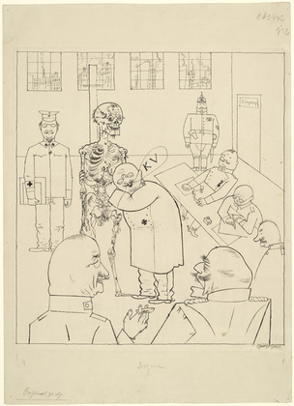
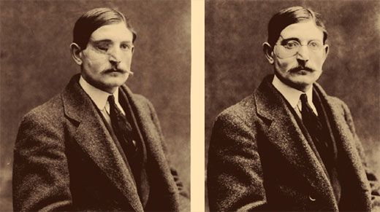
Georg Grosz, Fit for Active Service (The Faith Healers), 1916-17
Otto Dix, The Skat Players- Card Playing War Invalids, 1920

Slide 9
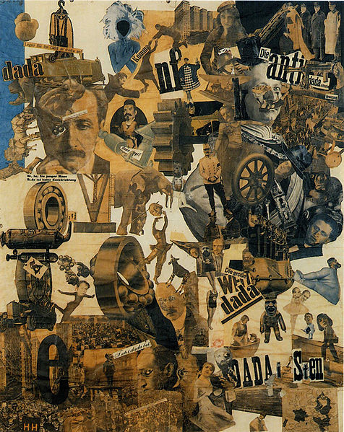
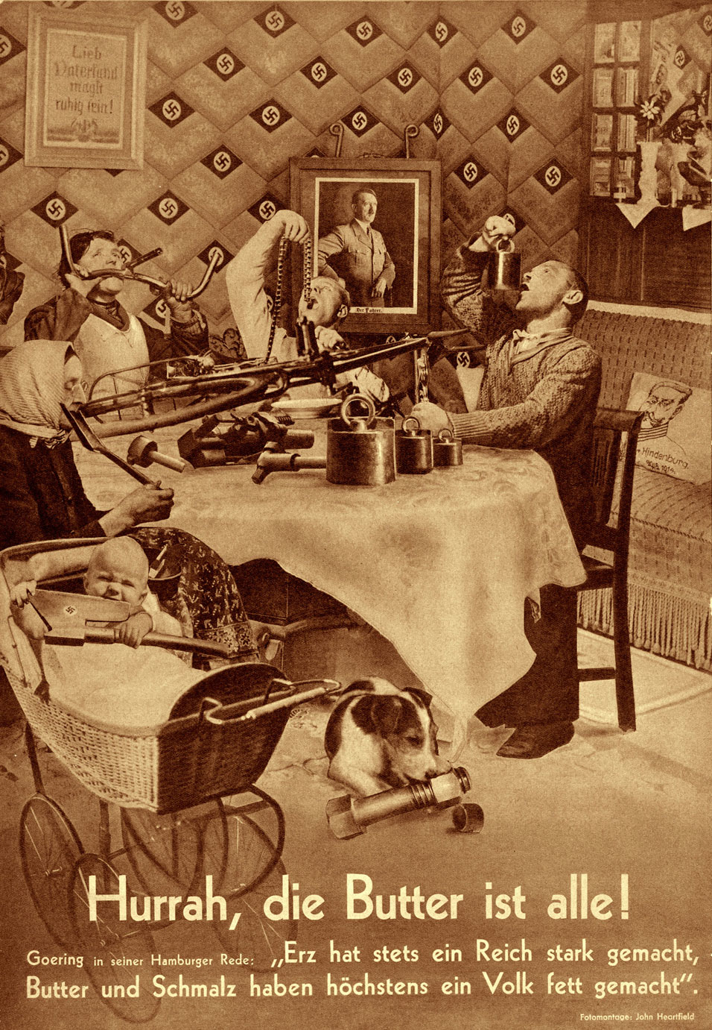
Hannah Höch, Cut with the Kitchen Knife Dada Through the Last Weimar Beer Belly Cultural Epoch of Germany, 1919-20
John Heartfield, Hurrah die Butter ist alle!, 1935

Slide 10
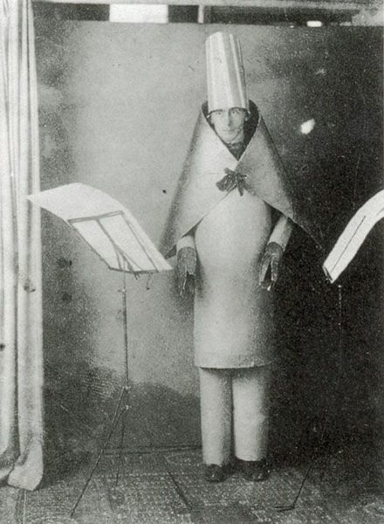
Hugo Ball reciting the poem Karawane at the Cabaret Voltaire, Zurich, 1916
https://www.youtube.com/watch?v=z_8Wg40F3yo

Slide 11
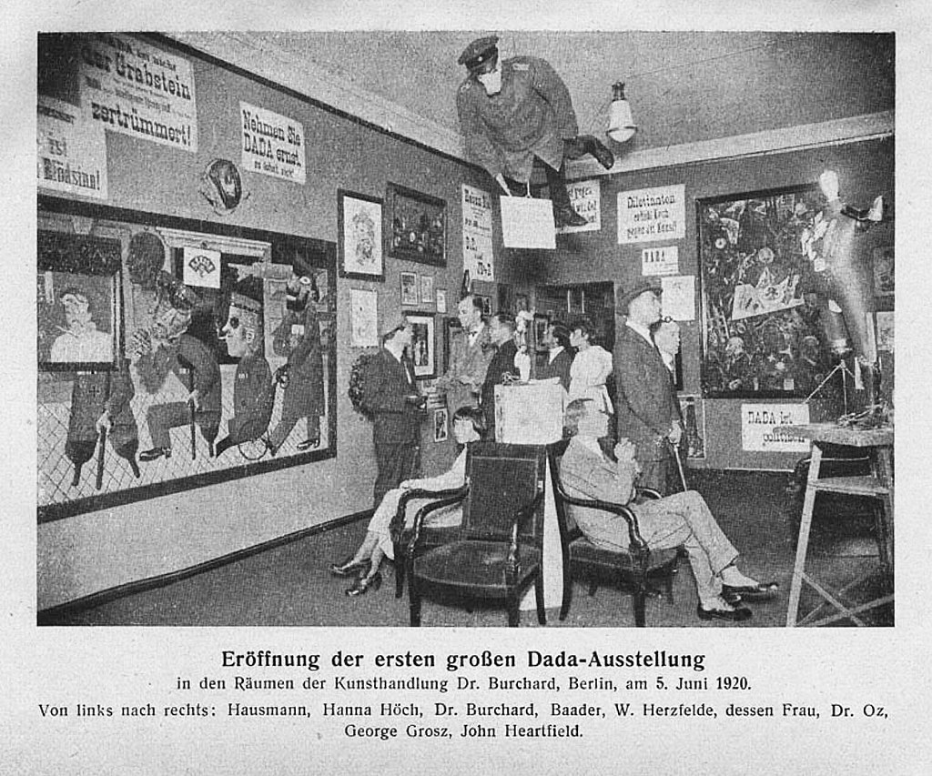
Grand opening of the first Dada exhibition: International Dada Fair, Berlin, 5 June 1920. The central figure hanging from the ceiling was an effigy of a German officer with a pig's head. From left to right: Raoul Hausmann, Hannah Höch (sitting), Otto Burchard, Johannes Baader, Wieland Herzfelde, Margarete Herzfelde, dr. Oz (Otto Schmalhausen), George Grosz and John Heartfield

Slide 12
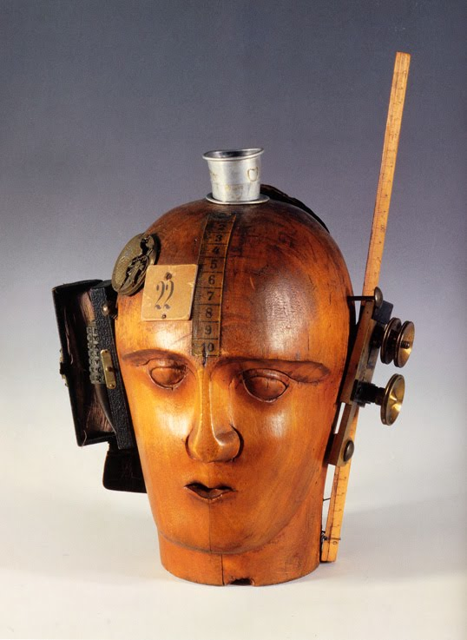
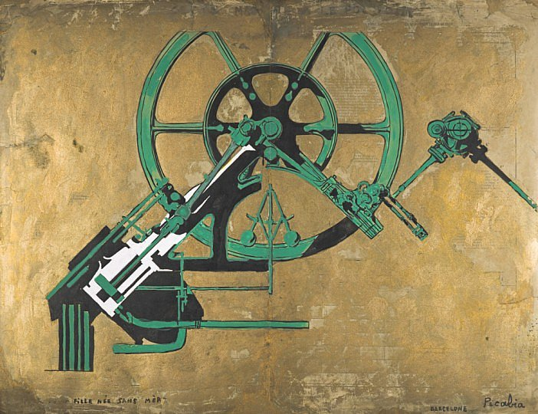
Francis Picabia, Daughter Born without Mother, 1917
Raoul Hausmann, The Spirit of Our Time (Mechanical Head), 1919

Slide 13
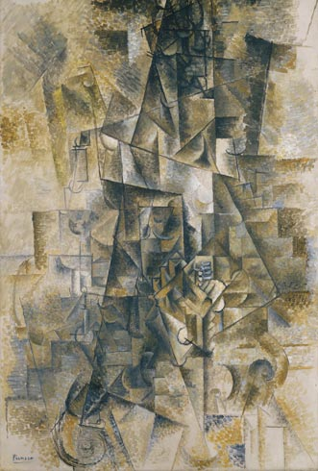
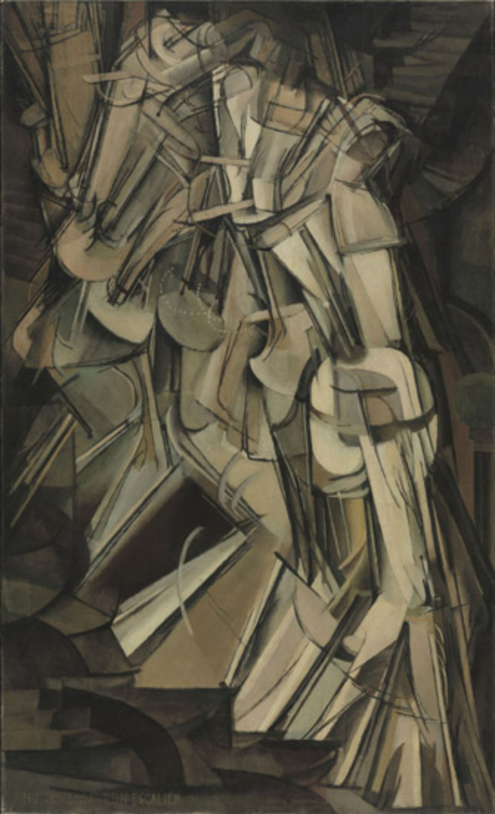
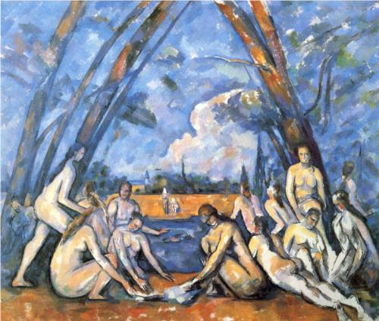
Pablo Picasso, Accordionist, 1911
Paul Cezanne, Large Bathers, 1906
Marie Laurencin,The Elegant Ball, The Dance in the countryside, 1913,
Marcel Duchamp,
Nude Descending a Staircase, No. 2 1912
Notes:
1. Early Works: retinal art, post impressionism, the burden of Cezanne, the figure of the nude

Slide 14
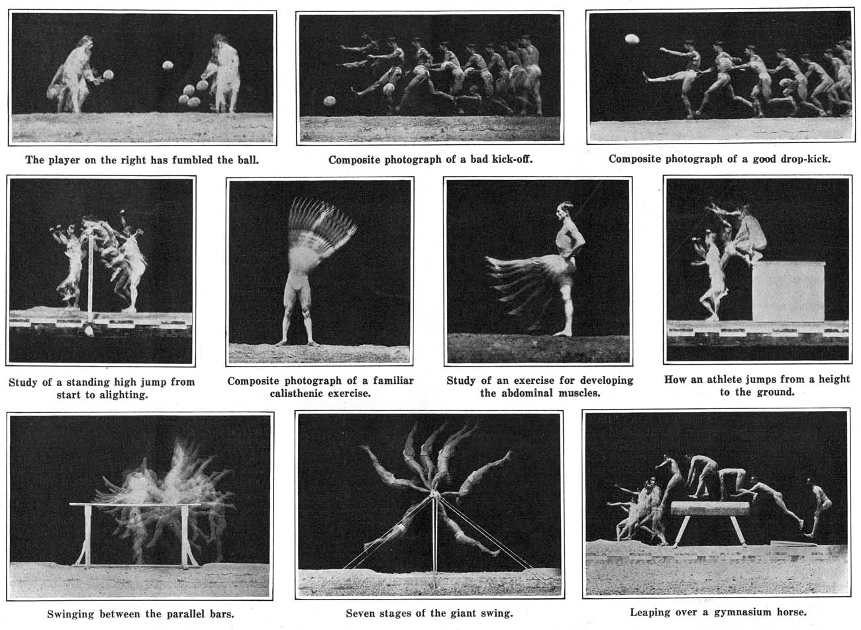
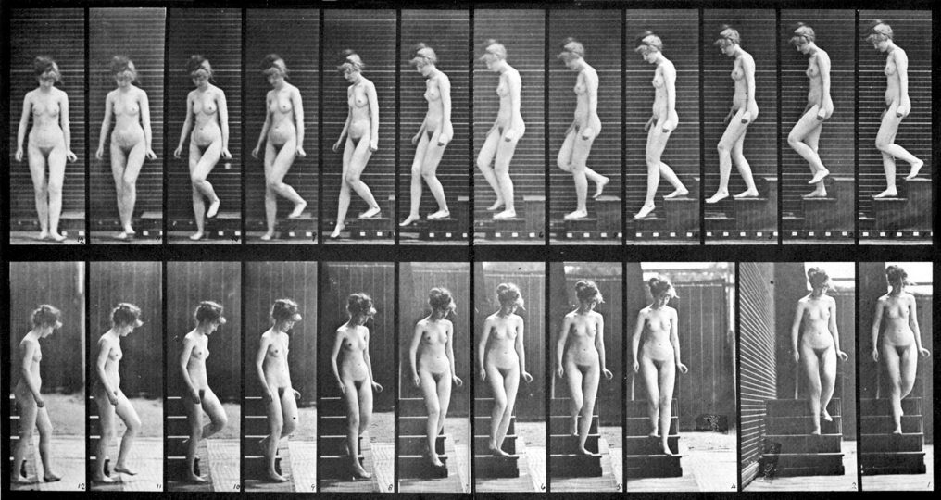
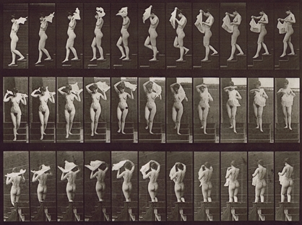
Etienne Jules Marey
Chronophotographs from "The Human Body in Action," Scientific American, 1914
Marcel Duchamp,
Nude Descending a Staircase, No. 2 1912
Edward Muybridge
Animal Locomotion Plate 133: Nude Descending Staircase
1887 ()Collotype
Notes:
2. The transgression of retinal art: Representation of temporal progress, aesthetics of technologized vision, the unholy marriage of word and image

Slide 15
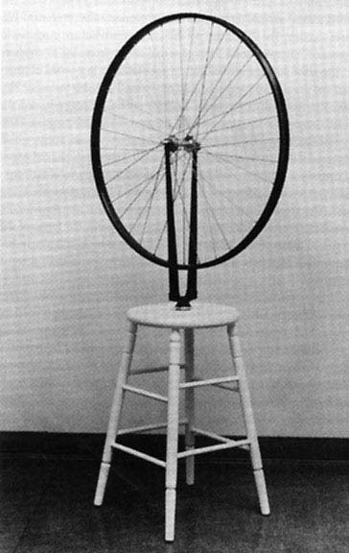
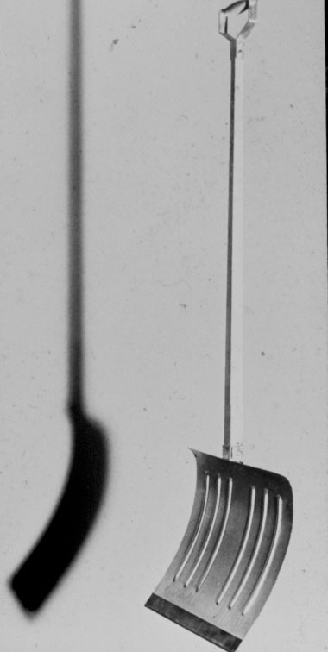
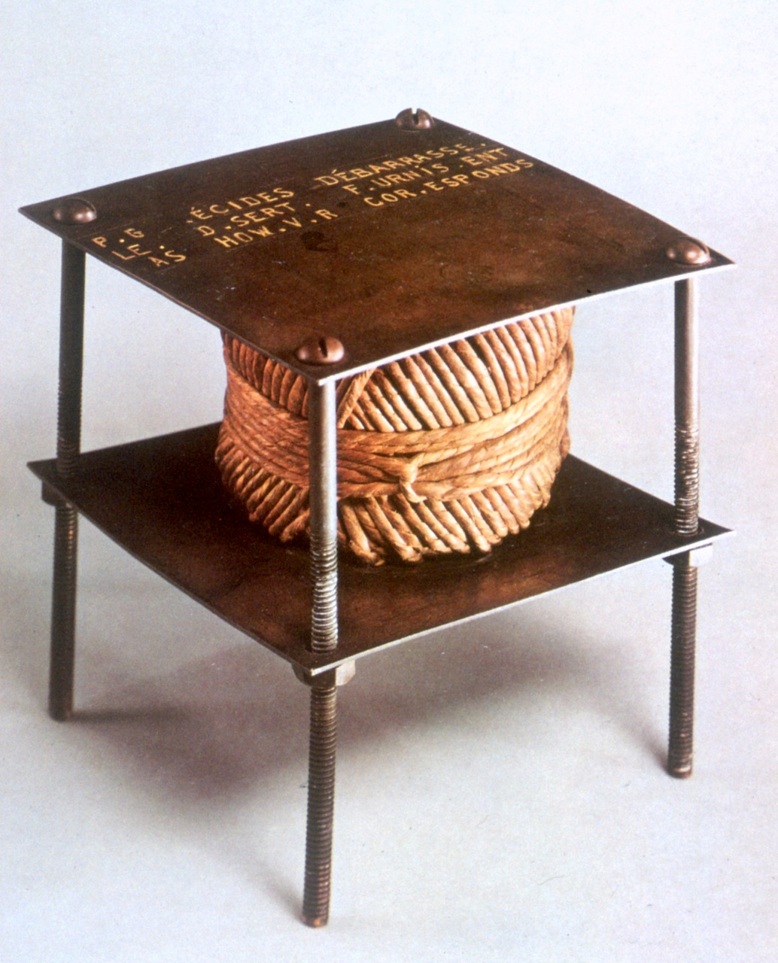
Marcel Duchamp
The Bicycle Wheel
1913
Philadelphia Museum of Art
Marcel Duchamp
In Advance of a Broken Arm
1915
Philadelphia Museum of Art
Marcel Duchamp
With Hidden Noise
1917
Philadelphia Museum of Art
Notes:
3. The Invention of the Readymade: Pictorial Nominalism, chance, indeterminacy, repetition, found art, assemblage

Slide 16
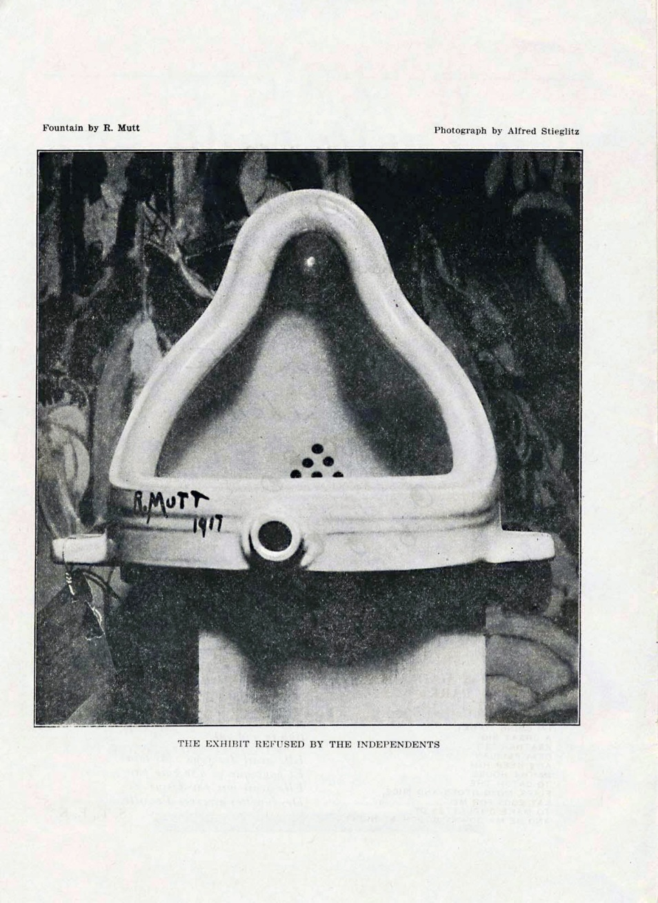
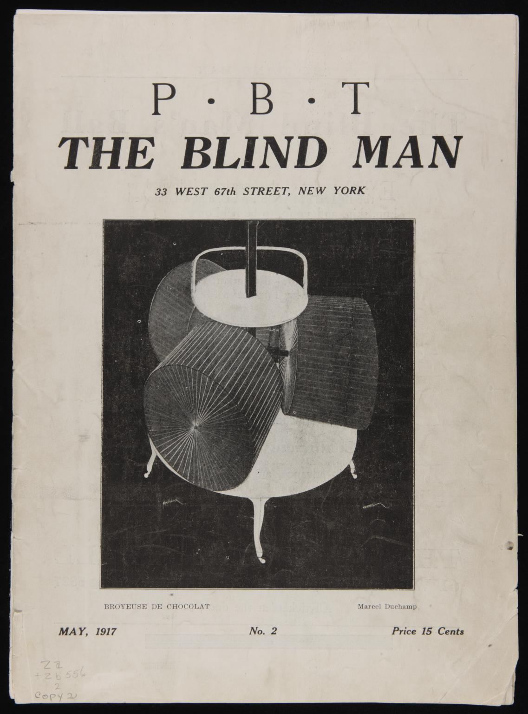
Marcel Duchamp.
Fountain
The Blind Man No. 2, page 4.. Published in New York, May 1917
Editors: Henri-Pierre Roche, Beatrice Wood, and Marcel Duchamp
Notes:
5. The Scandal of the Fountain: Interrogation of site/institution, critique of aesthetic value, photography, replica, mass produced objects

Slide 17
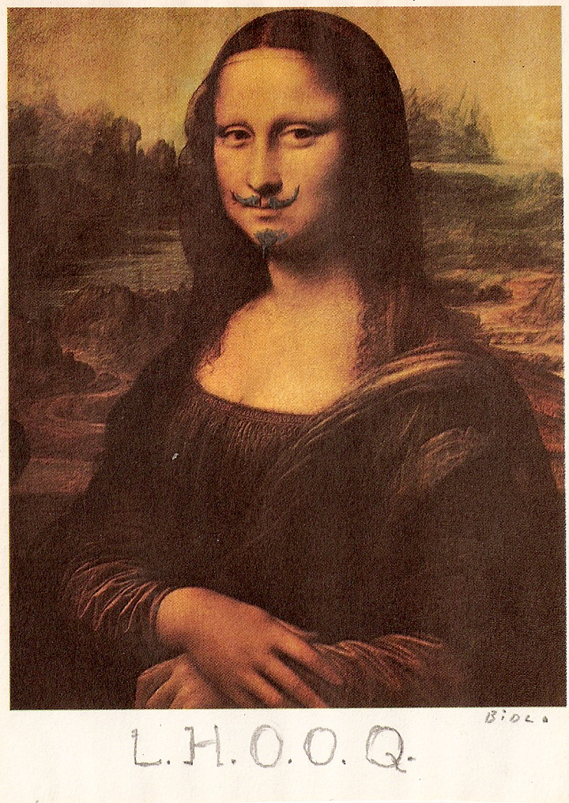
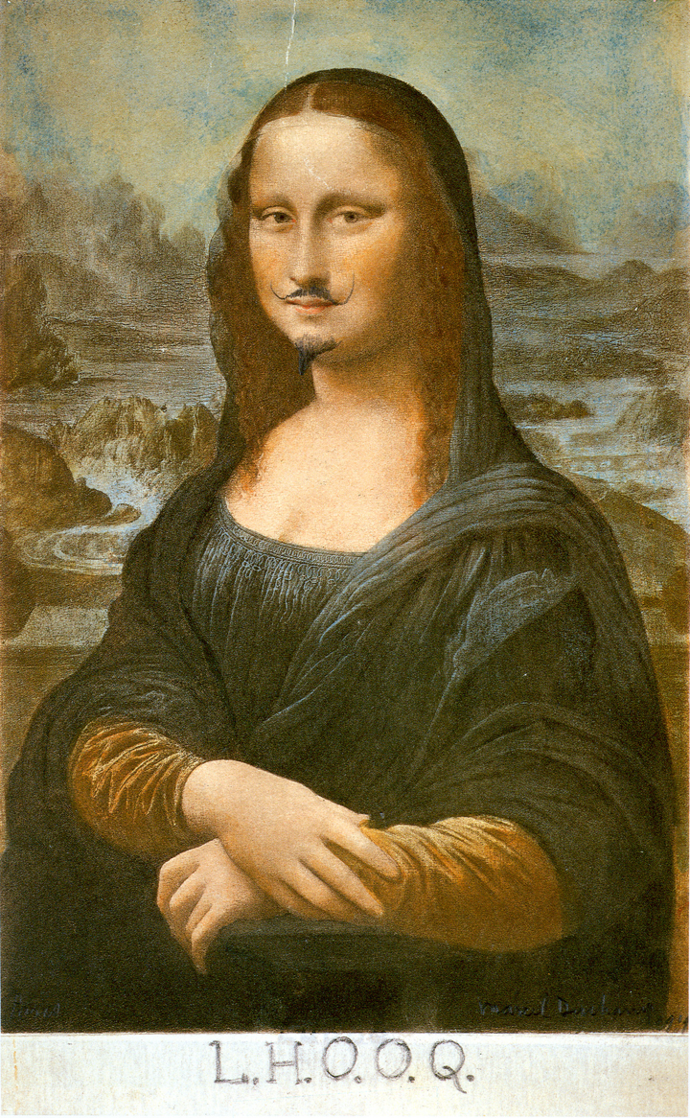
Marcel Duchamp
L.H.O.O.Q
1919
Reproduction of Leonardo da Vinci's Mona Lisa with added mustache, goatee, and title
Notes:
6. Performing gender:

Slide 18
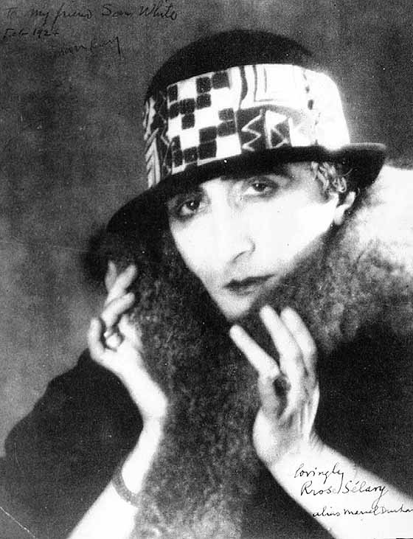
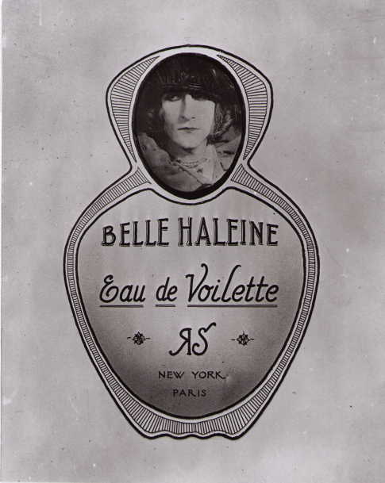
Man Ray. Duchamp as Rrose Sélavy
Man Ray, Label for the Belle Haleine Perfume Bottle, 1921
Notes:
6. Performing gender:

Slide 19
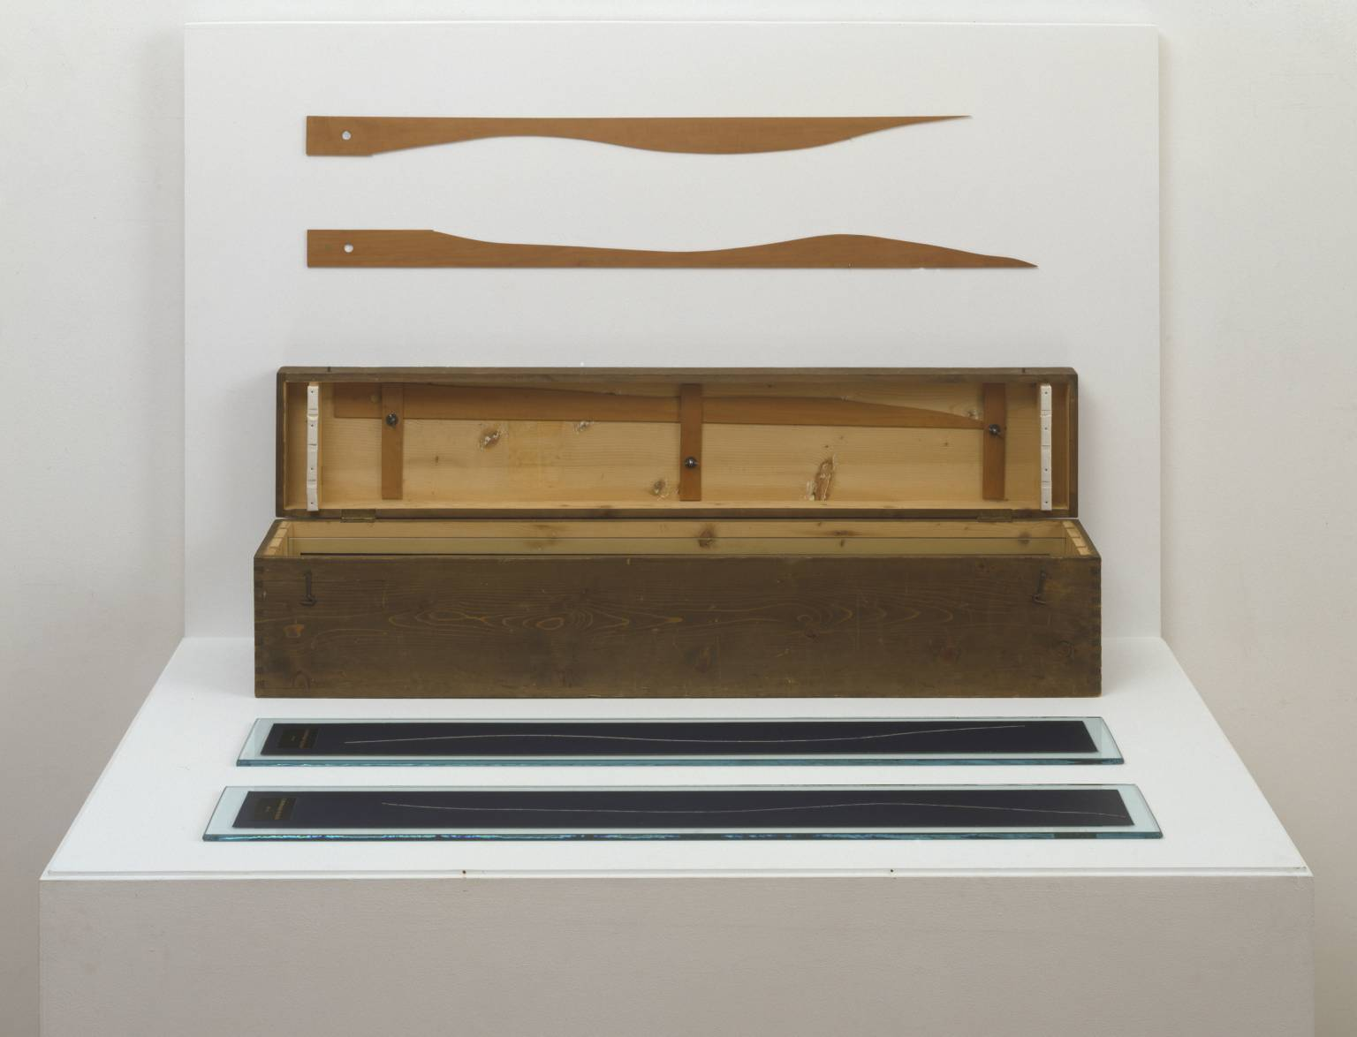
Marcel Duchamp
3 Standard Stoppages
1913-14, replica 1964
Wood, glass and paint on canvas
Tate
Notes:
3. The Invention of the readymade: Pictorial Nominalism, chance, indeterminacy, repetition,

Slide 20
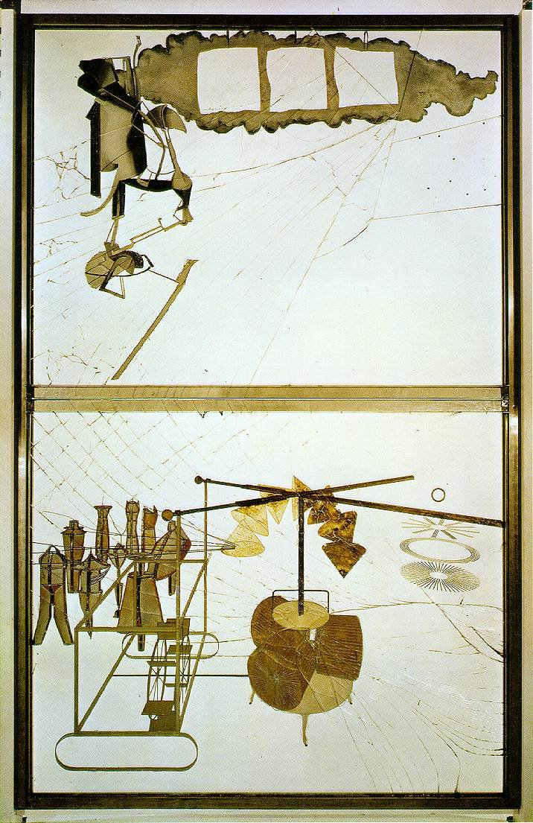
Marcel Duchamp
The Bride Stripped Bare by Her Bachelors, Even (The Large Glass)
1915-23
Oil, varnish, lead foil, lead wire, and dust on two glass panels
109 1/4" x 69 1/4"
Philadelphia Museum of Art
Notes:
4. The Large Glass:

