Slide 1
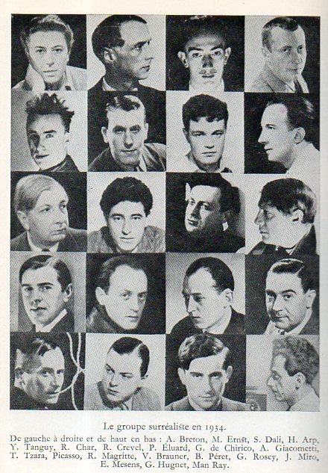
First Papers of Surrealism exhibition, showing Marcel Duchamp’s His Twine 1942, Whitelaw Reid Mansion
Dada and Surrealism
The Body in Pieces (Continued)

Slide 2
Key Terms
Techniques/strategies
Concepts/themes
Freud, The Interpretation of Dreams (1899)
The uncanny
The unconscious
Simultaneity
Chance
Readymade
Infrathin
artistic genius
Fetishism
Mise-en-abyme
Found object
exquisite corpse
psychic automatism
frottage,
grattage
“decalomania”
tromp l’oeil
rayograph

Slide 3
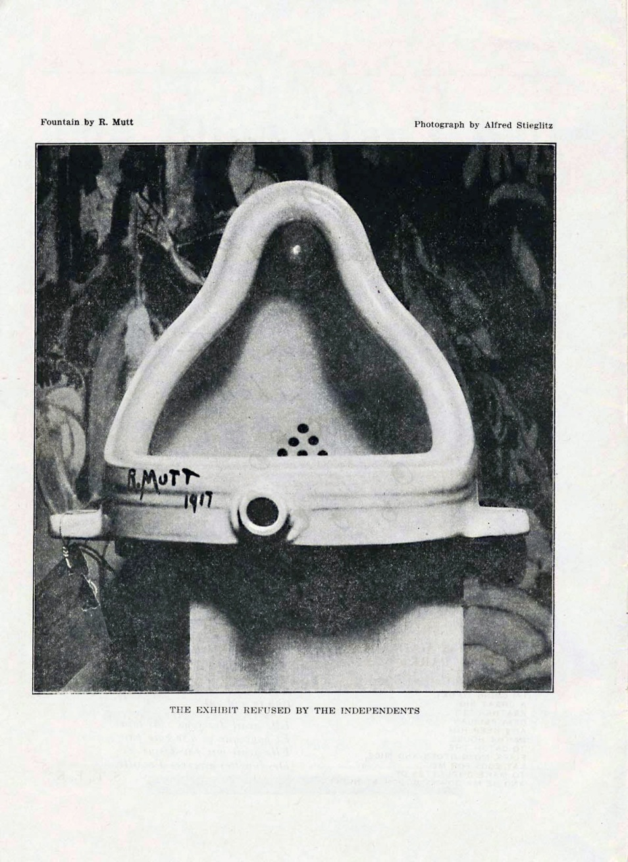
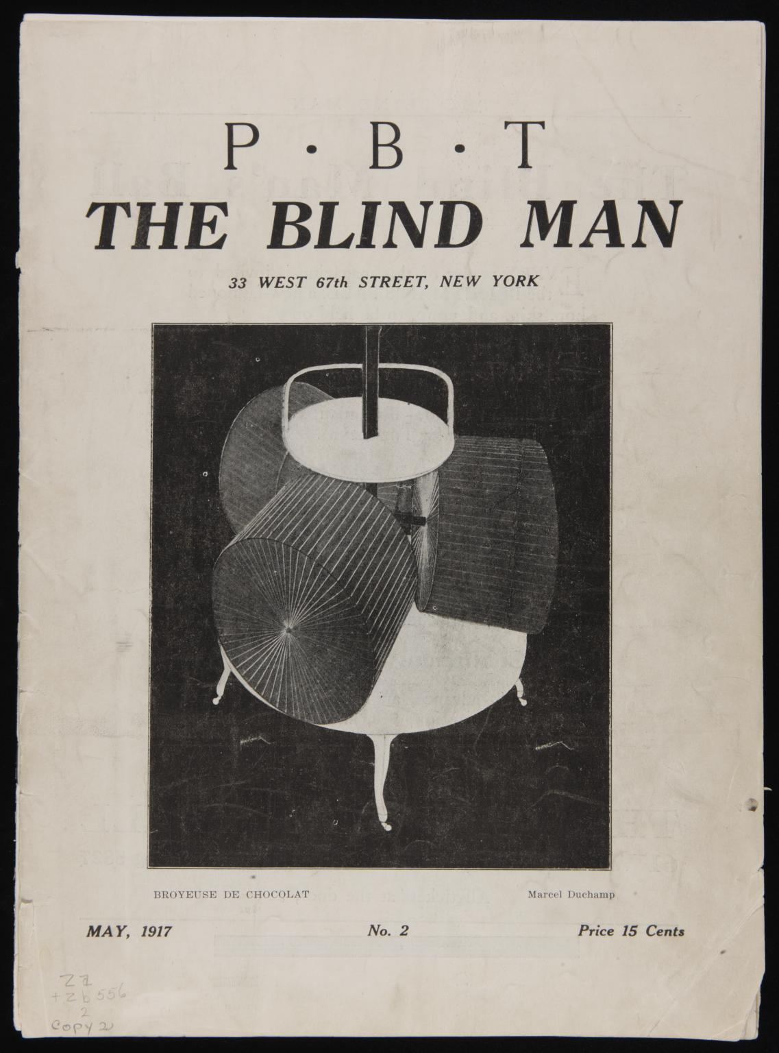
Marcel Duchamp.
Fountain
The Blind Man No. 2, page 4.. Published in New York, May 1917
Editors: Henri-Pierre Roche, Beatrice Wood, and Marcel Duchamp
Notes:
5. The Scandal of the Fountain: Interrogation of site/institution, critique of aesthetic value, photography, replica, mass produced objects

Slide 4
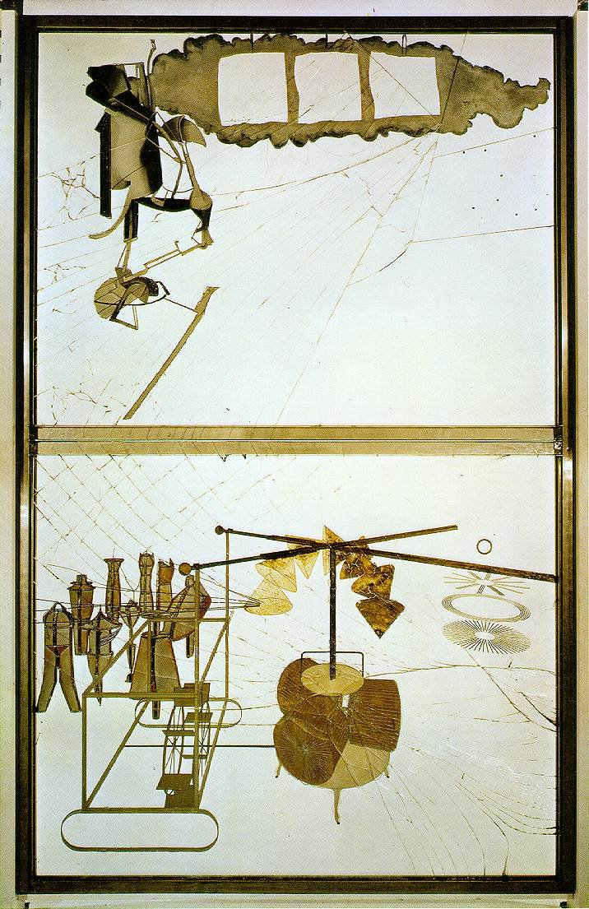
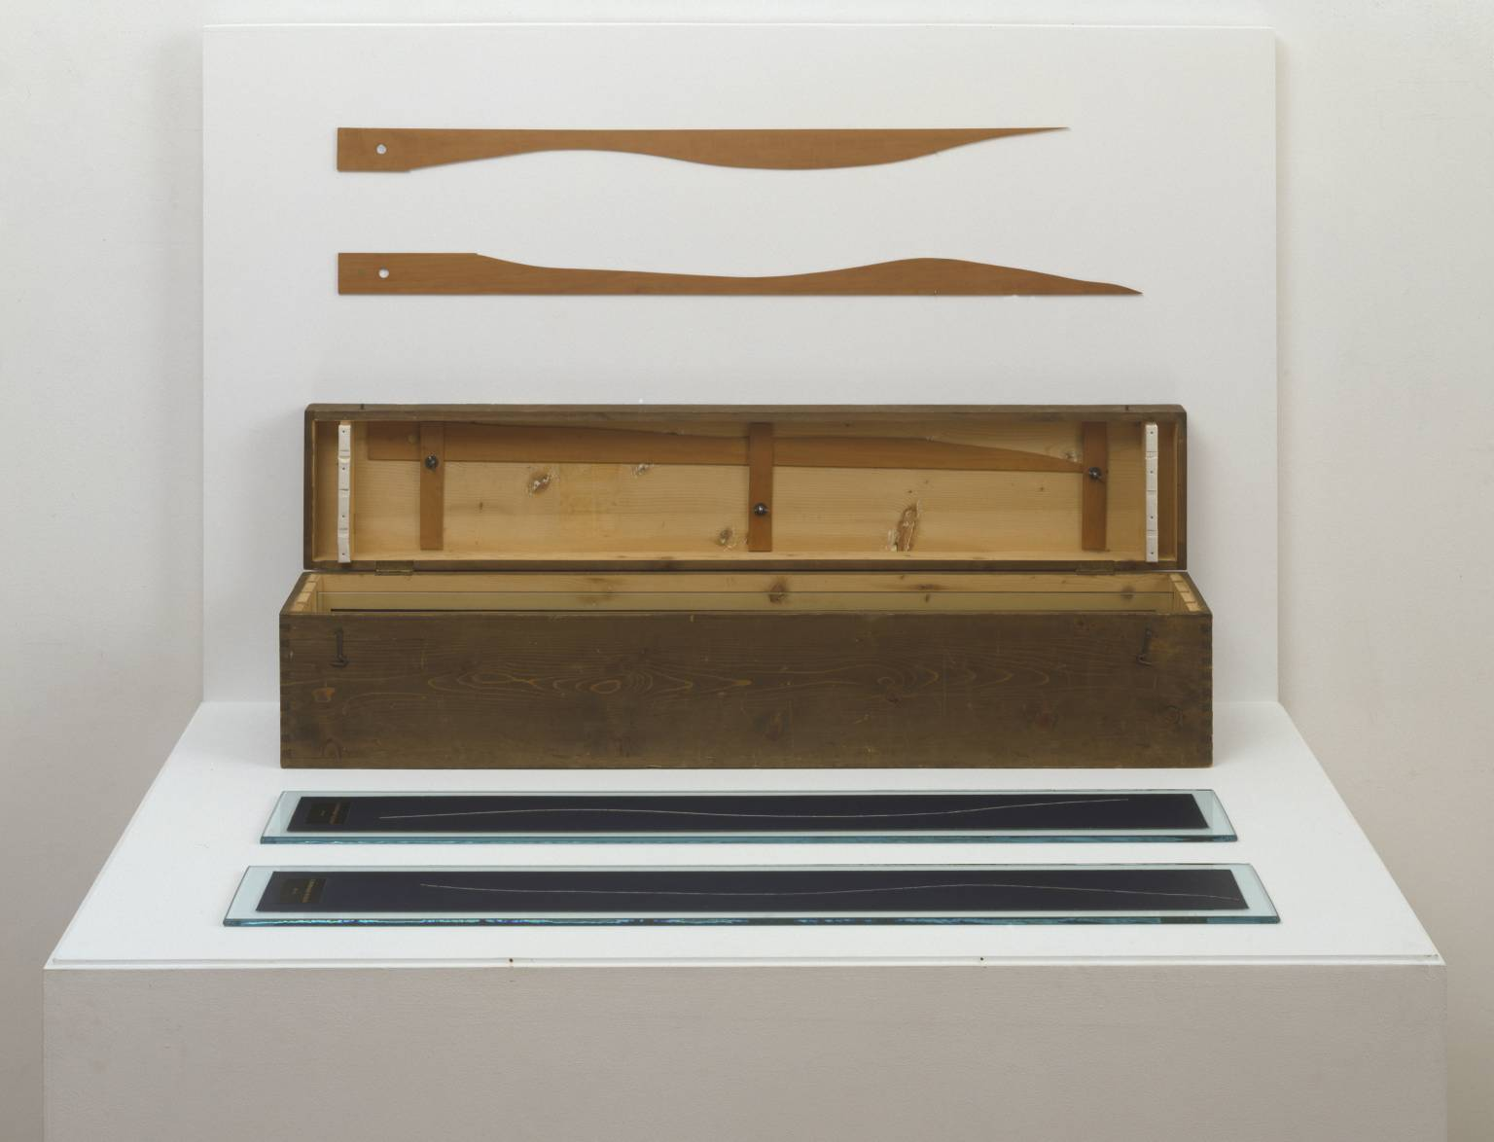
Marcel Duchamp
3 Standard Stoppages
1913-14, replica 1964
Wood, glass and paint on canvas
Marcel Duchamp,
The Bride Stripped Bare by Her Bachelors, Even (The Large Glass) ,
1915-23; Oil, varnish, lead foil, lead wire, and dust on two glass panels
Notes:
4. The Large Glass:

Slide 5
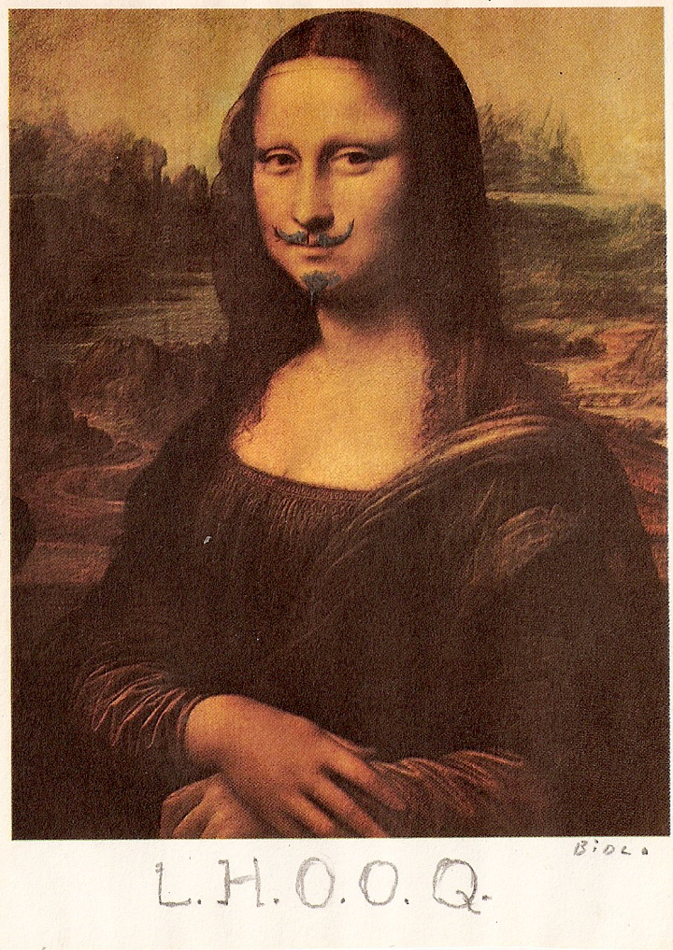
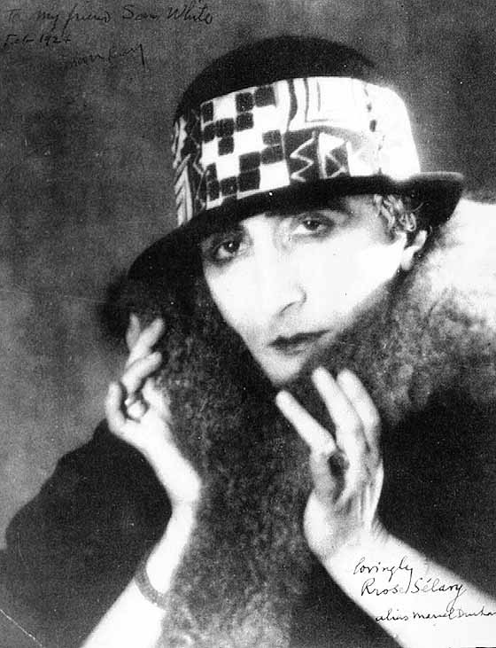
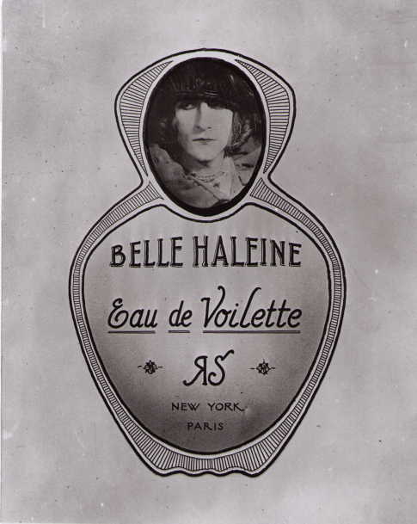
Man Ray. Duchamp as Rrose Sélavy, 1920
Man Ray, Label for the Belle Haleine Perfume Bottle, 1921
Marcel Duchamp, L.H.O.O.Q , 1919
Notes:
6. Performing gender:

Slide 7
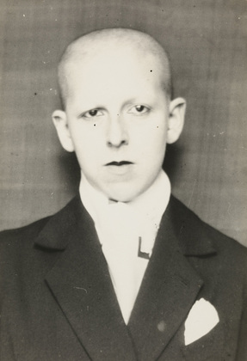
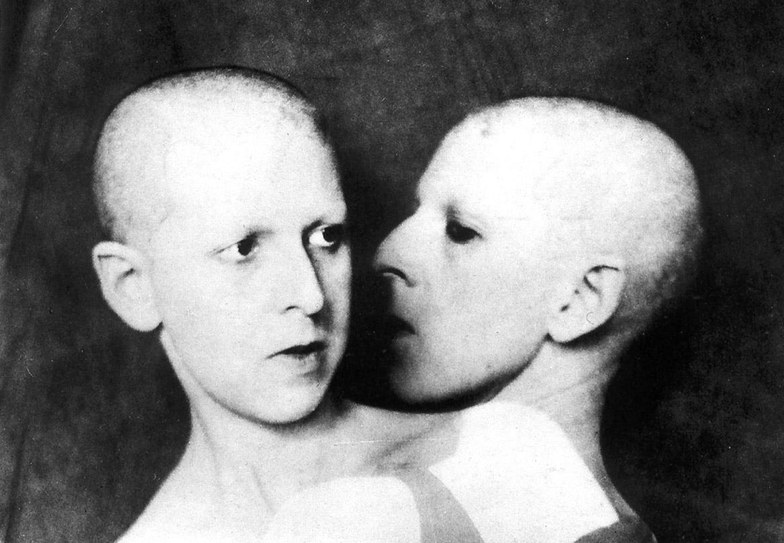
Claude Cahun, (What Do You Want From Me?), 1928
“Masculine? Feminine? It depends on the situation. Neuter is the only gender that always suits me.”
—Claude Cahun (Lucy Renee Mathilde Schwob)
Man Ray. Duchamp as Rrose Sélavy
Claude Cahun, Untitled, 1922
Notes:
6. Performing gender:

Slide 8
‘the mass production of more and more unusual objects (like microscopic forceps, which can only be used under a microscope) assures us that our present is cracking up all around us: the stultifying chain gang, the gold harness of passions will break and break again perhaps before the photographs of perishable objects exhibited before my eyes fade’— Claude Cahun, Prenez garde aux objets domestiques’, Cahiers d’Art, 1936
Claude Cahun, Untitled, 1936
Claude Cahun, Untitled, 1936

Slide 9
Claude Cahun, Self Portrait, 1928
Dora Maar, Self Portrait with Fan, 1930

Slide 10
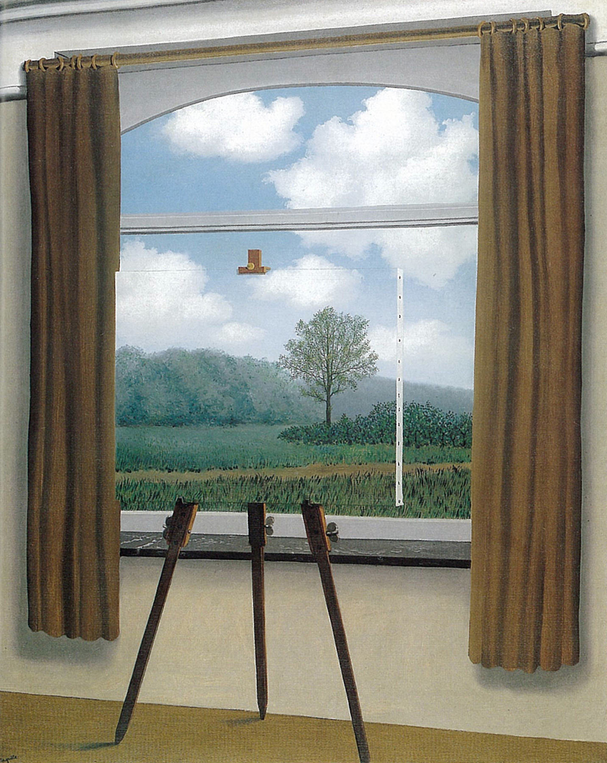
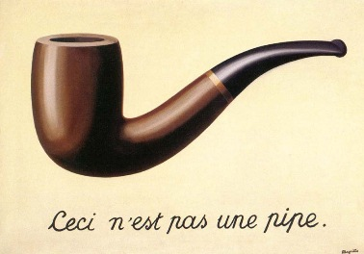
Mise-en-abyme- and the Surrealist object
Rene Magritte, Treachery of Images, 1933
Rene Magritte, The Human Condition, 1933

Slide 11
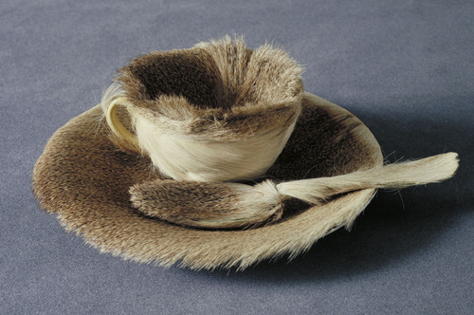
The Surrealist object
Meret Oppenheim, Object (Luncheon in Fur), 1936
Rene Magritte, Treachery of Images, 1933
Meret Oppenheim (for Elsa Schiappareli), Bracelet in Metal and Fur 1936
Dora Maar, Portrait of Ubu, 1936

Slide 12
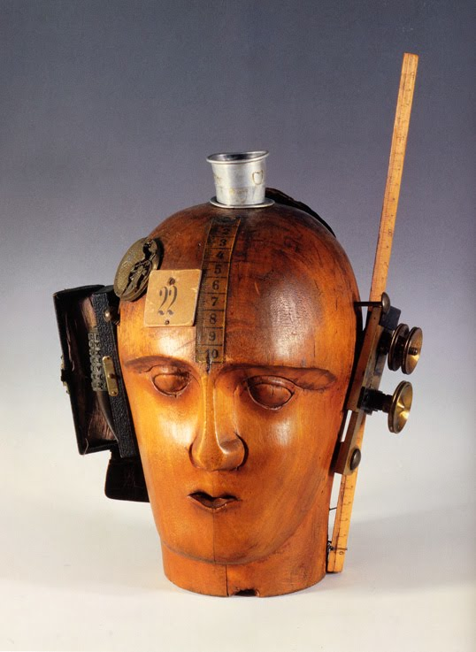
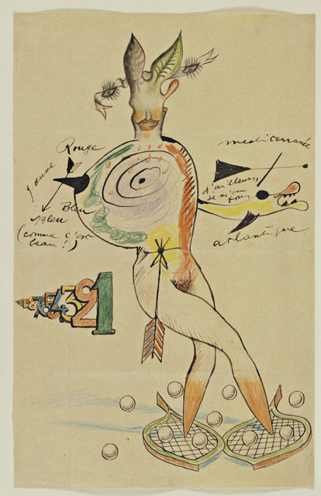
The Surrealist Object and collaboration
Exquisite corpse: “The exquisite corpse shall drink the new wine."
Remember: Dada collage
Raoul Hausmann, The Spirit of Our Time (Mechanical Head), 1919
Exquisite Corpse by Yves Tanguy, Joan Miro, Max Morise, and Man Ray, 1927

Slide 13
“Psychic automatism in its pure state, by which one proposes to express—verbally, by means of the written word, or in any other manner—the actual functioning of thought. Dictated by thought, in the absence of any control exercised by reason, exempt from any aesthetic or moral concern.”
—Andre Breton, Manifesto of Surrealism, 1924
André Masson, Automatic Drawing, 1924

Slide 14
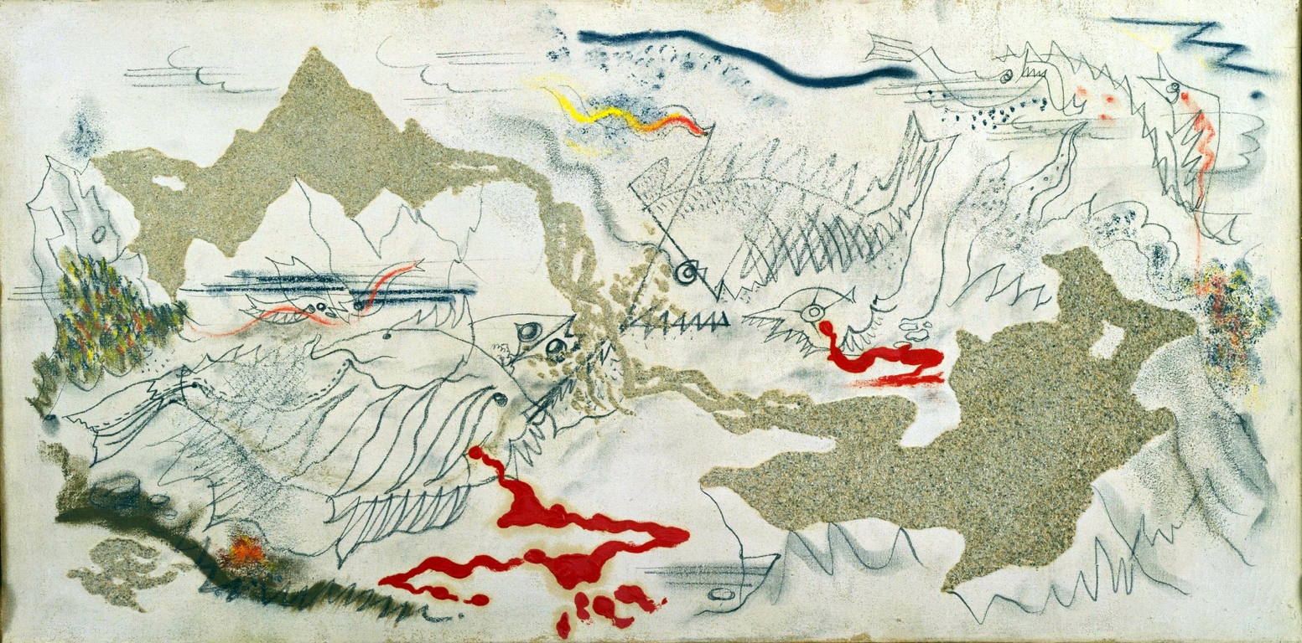
Psychic automatism, chance operations
Marcel Duchamp
3 Standard Stoppages
1913-14, replica 1964
Wood, glass and paint on canvas
Andre Masson, The Battle of the Fishes, 1926

Slide 15
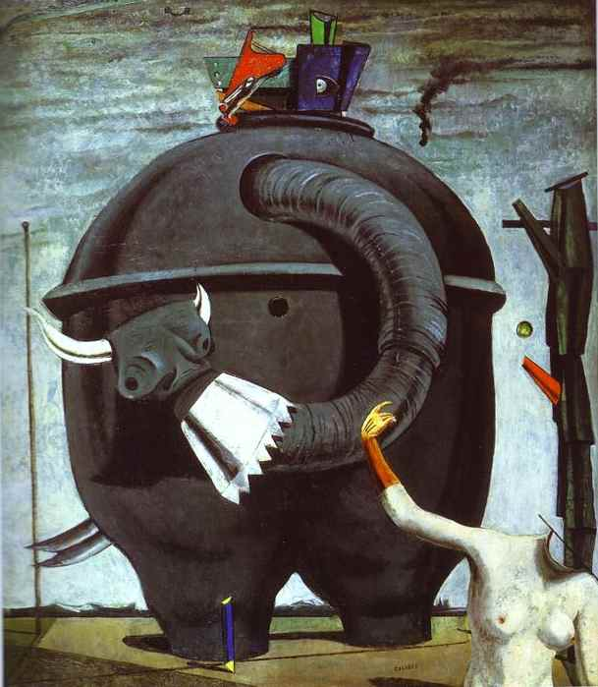
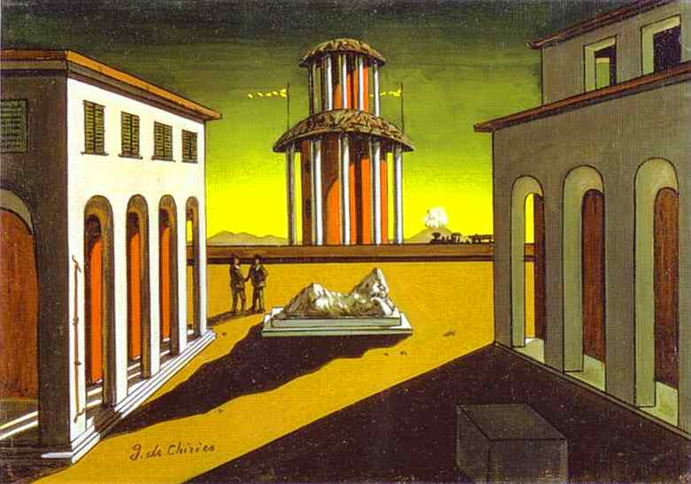
Dreamscapes: Surrealism and Painting
Scuola metafisica: concerning the “host of strange, unknown and solitary things that can be translated into painting…What is especially needed is great sensitivity: to look upon everything in the world as enigma….To live in the world as in an immense museum of strange things.”
'On the 1st of August 1914 Max Ernst died. He was resurrected on the 11 November 1918 as a young man who aspired to find the myths of his time.’ Max Ernst
Giorgio de Chirico, Piazza d’Italia, 1913
Max Ernst, The Elephant Celebes, 1921

Slide 16
Leonora Fini, The Ends of the World, 1949
Leonora Carrington, Self-Portrait, 1937-38

Slide 17
Biomorphism and the Unconscious
“I’m only interested in anonymous art, the kind that springs from the collective unconscious” —Miro
Joan Miró, Harlequin’s Carnival, 1924
Kay Sage, I Saw Three Cities, 1944
Yves Tanguy, Mama, Papa is Wounded, 1927

Slide 18
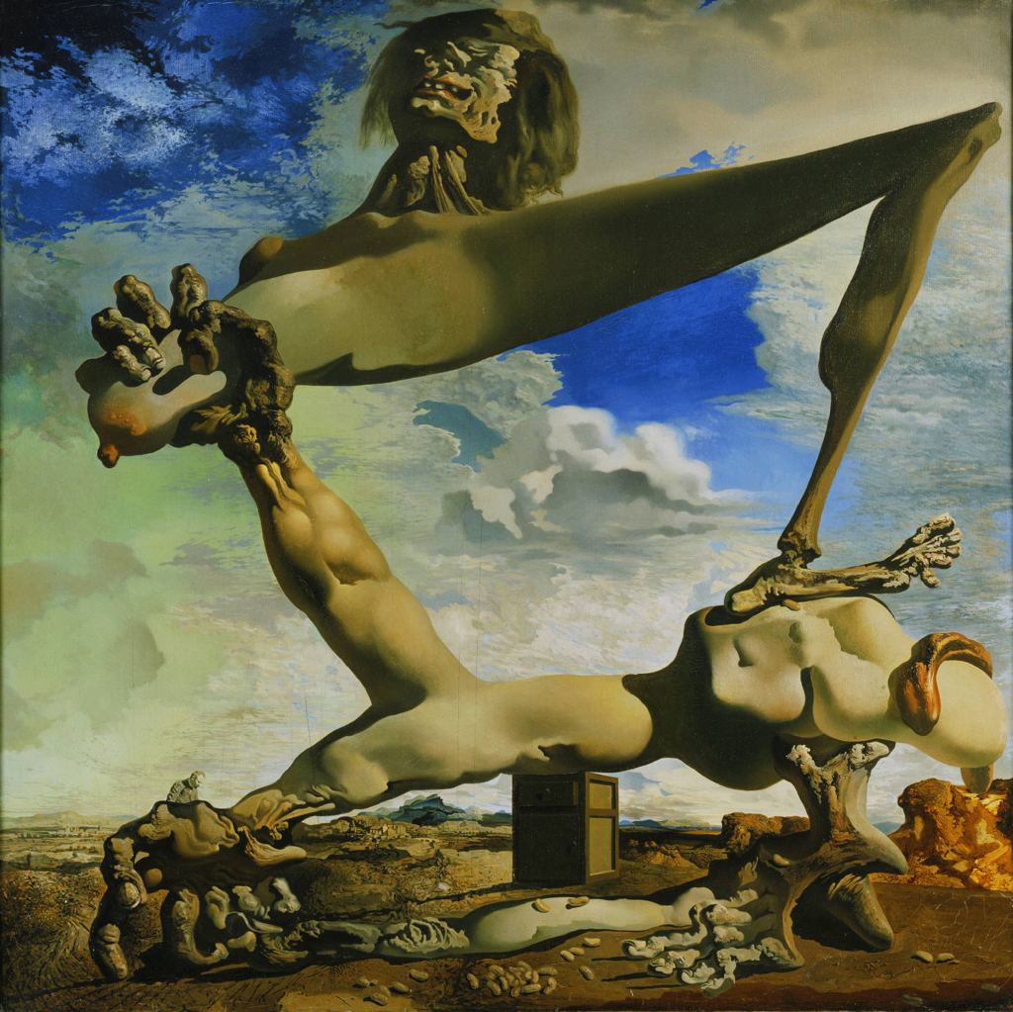
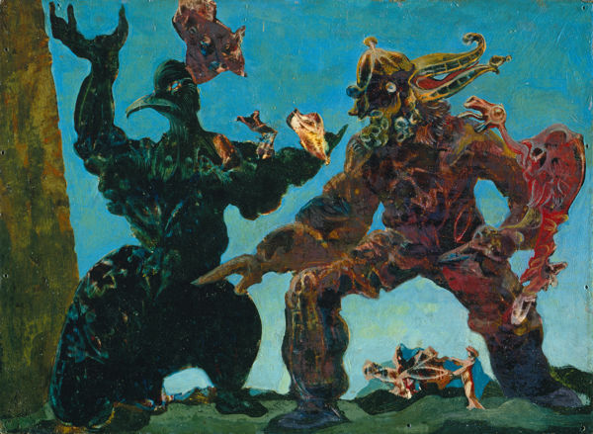
Surrealism and Politics
Grattage
Salvador Dali, Soft Construction with Boiled Beans: Premonitions of Civil war, 1936
Max Ernst, The Barbarians, 1937

Slide 19
The bombing of Gernika, 26 April 1937
Pablo Picasso, Guernica, 1937

Slide 20
“We Surrealists pronounced ourselves in favour of changing the imperialist war, in its chronic and colonial form, into a civil war. Thus we placed our energies at the disposal of the revolution, of the proletariat and its struggles, and defined our attitude towards the colonial problem, and hence towards the colour question.” Paris Group, open letter to Paul Claudel, 1925
Frida Kahlo, The Two Fridas, 1939

Slide 21
“My painting is an act of decolonization not in a physical sense, but in a mental one.” Wifredo Lam
Wilfredo Lam, The Jungle, 1943

