Slide 1
A New International Style
Translating Life and Art

Slide 2
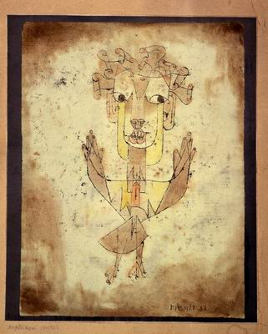
“A Klee painting named Angelus Novus shows an angel looking as though he is about to move away from something he is fixedly contemplating. His eyes are staring, his mouth is open, his wings are spread. This is how one pictures the angel of history. His face is turned toward the past. Where we perceive a chain of events, he sees one single catastrophe which keeps piling wreckage upon wreckage and hurls it in front of his feet. The angel would like to stay, awaken the dead, and make whole what has been smashed. But a storm is blowing from Paradise; it has got caught in his wings with such violence that the angel can no longer close them. The storm irresistibly propels him into the future to which his back is turned, while the pile of debris before him grows skyward. This storm is what we call progress.
—Walter Benjamin. Theses on the Philosophy of History, 1940
Paul Klee, Angelus Novus, 1920

Slide 3
Key terms
Fin-de-siecle
Arts and Crafts
Aestheticism
Gesamtkunstwerk
Art Nouveau
Modernismo
Ensanche
Concrete Art
Neo-plasticism (Mondrian)
facture
universal aesthetic
Elementarism (Van Doesberg)
Gesamtkunstwerk
Functionalism
kinetic sculpture
Rayograph (Man Ray
Rayogram (Moholy-Nagy

Slide 4
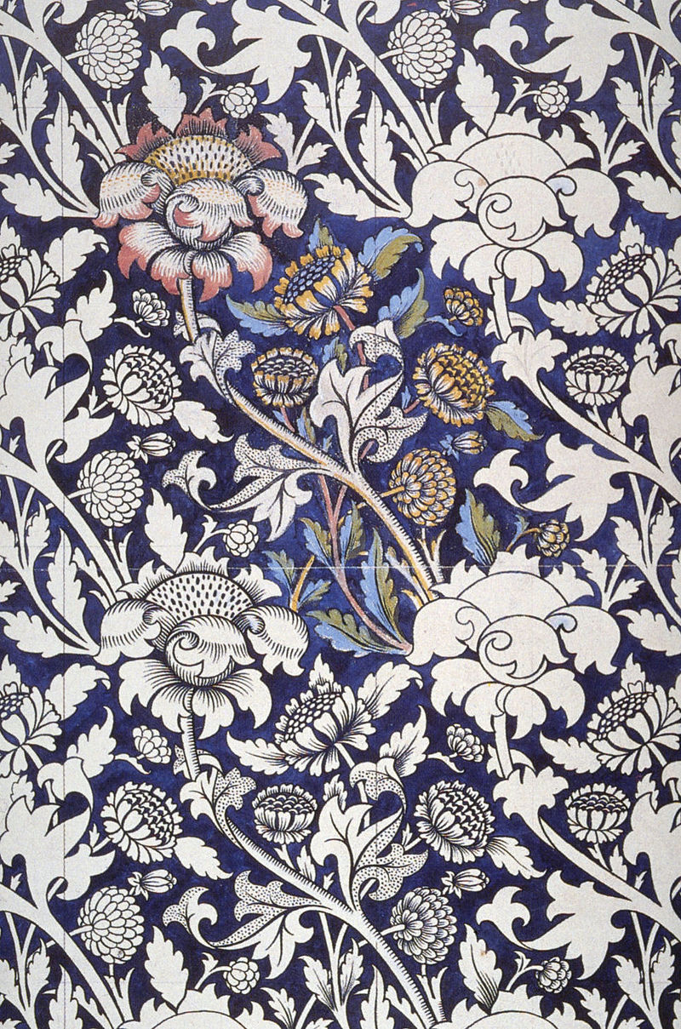
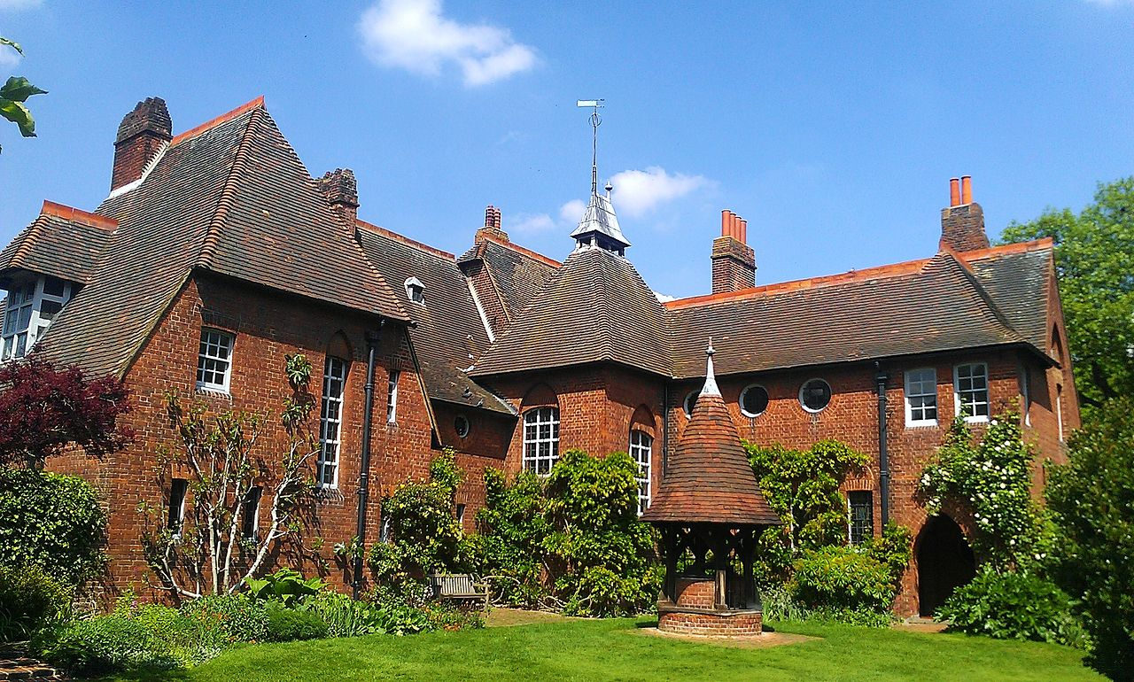
William Morris and Philip Webb, The Red House, 1859
William Morris, Printed Textile, 1883

Slide 5
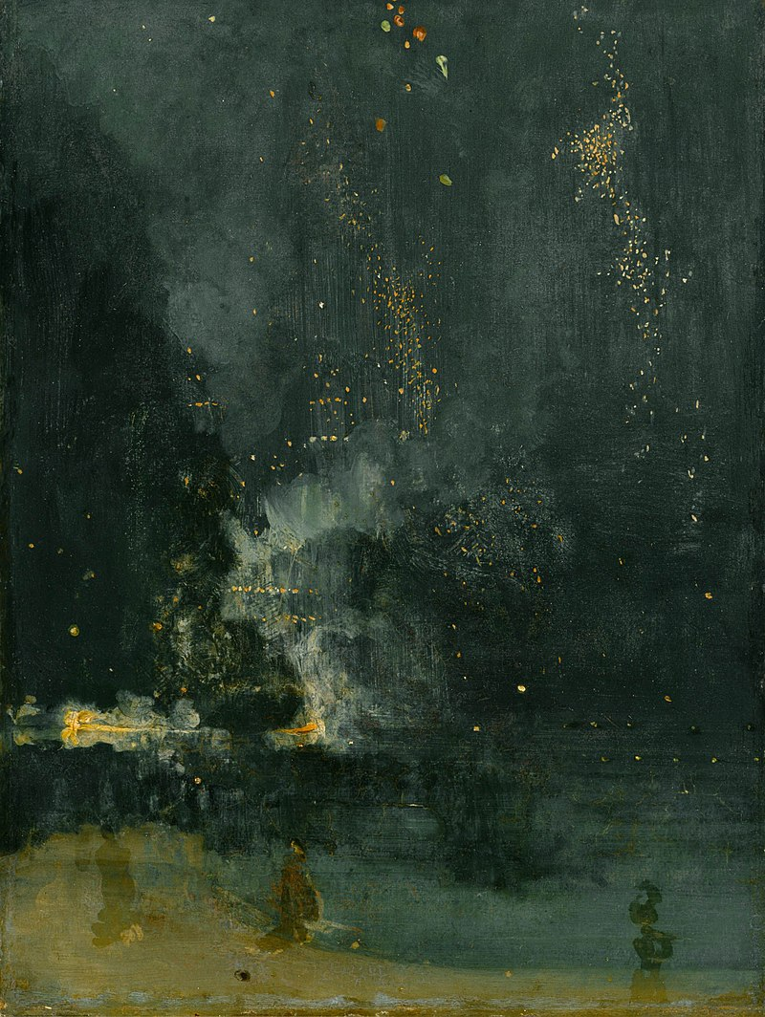
James McNeill Whistler, Nocturne in Black and Gold: The Falling Rocket, 1874

Slide 6
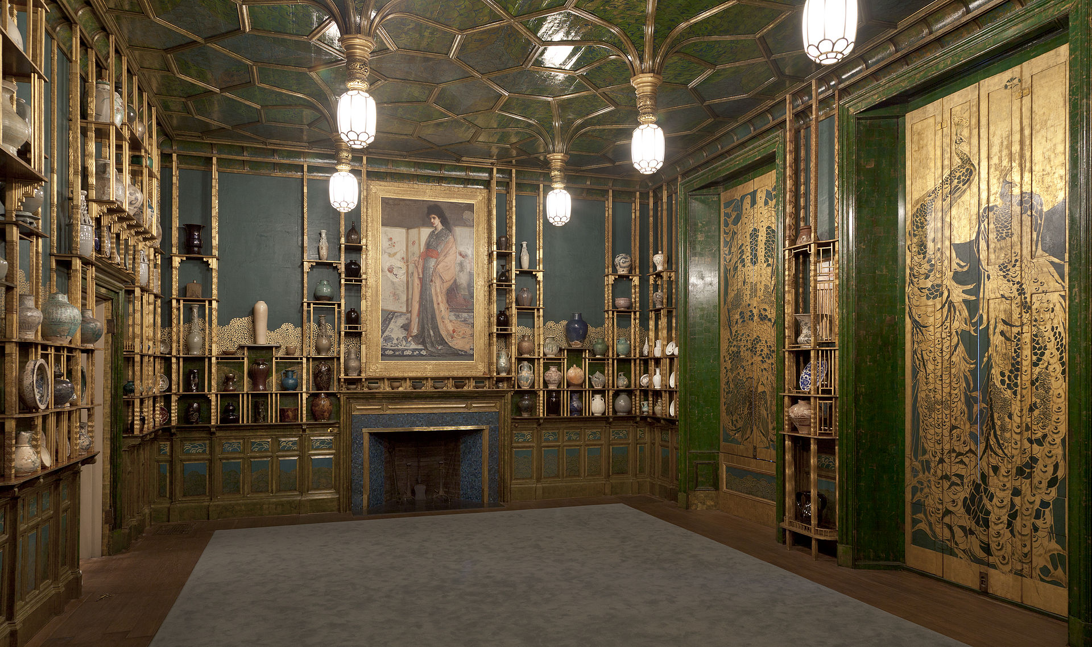
James McNeill Whistler, Harmony in Blue and Gold: The Peacock Room, 1876–77 (with Whistler’s Princess in the Land of Porcelain, 1865)

Slide 7
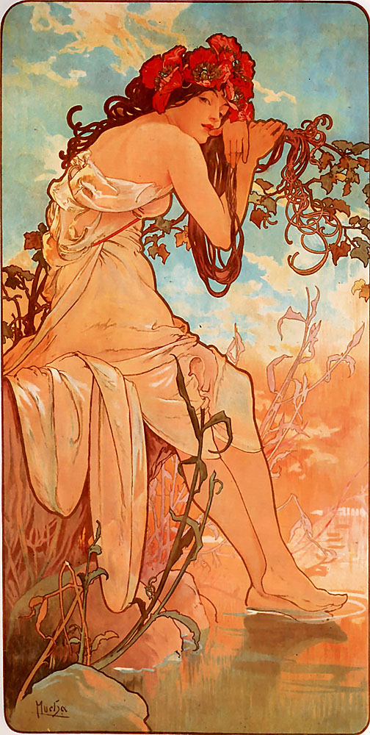
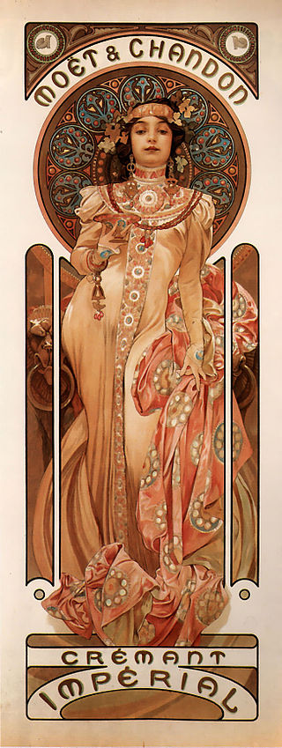
Alfons Maria Mucha, Summer, 1896
Alfons Maria Mucha, Moët & Chandon Crémant Impérial, 1899

Slide 8
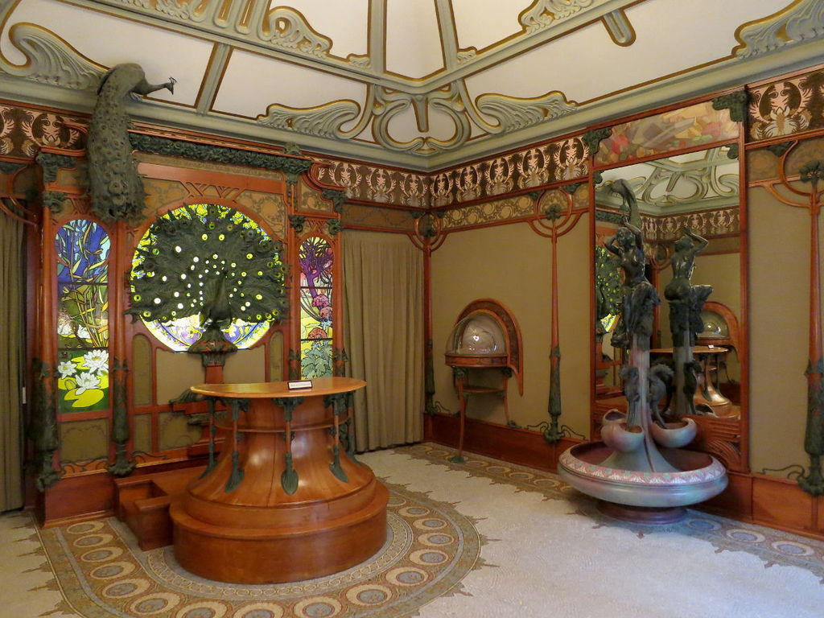
Alfons Maria Mucha, Interior Georges Fouquet jewellery on rue Royale in Paris

Slide 9
Ensanche Plan, Barcelona, 1859

Slide 10
Lluís Domènech i Montaner, The Casa Lleó Morera, c. 1902
Casa Amatller, Josep Puig i Cadafalch, 1875
Antoni Gaudi, Casa Batllo, 1904

Slide 11
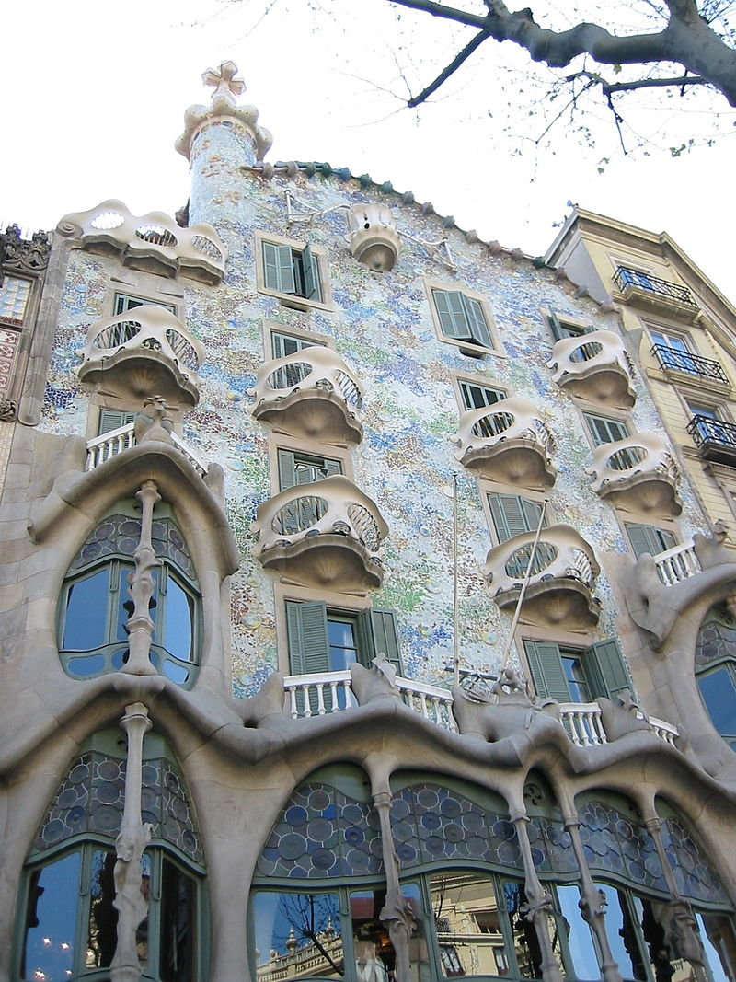
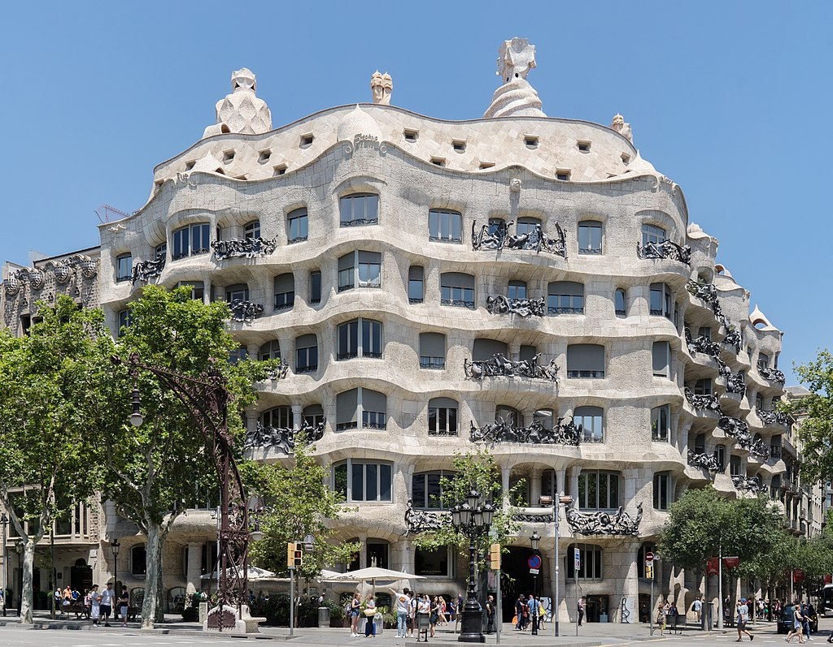
Antoni Gaudi, Casa Batllo, 1904
Antoni Gaudi, Casa Mila, 1906- 1912

Slide 12
De Stijl
“An old and new consciousness of time”
Old-> “individual”
New-> “universal”
“The war is destroying the old world”
New Art-> “Balance between the universal and the individual”
“Reformation of art and culture”
Annihilation of traditions and dogmas->abolition natural form in the plastic arts
“International unity in Life, Art, Culture”
Cooperation
Correspondence
Translation

Slide 13
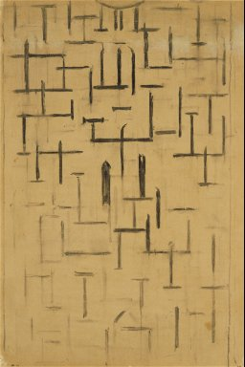
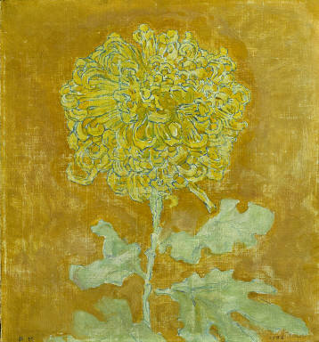
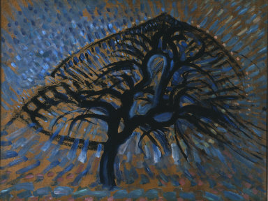
Towards Neo-Plasticism:
Form, Color, Line
Piet Mondrian, Church Facade/Church at Domburg (formerly Cathedral), 1914
Piet Mondrian, Chrysanthemum, 1906
Piet Mondrian, Apple Tree, Pointillist Version, 1908-1909

Slide 14
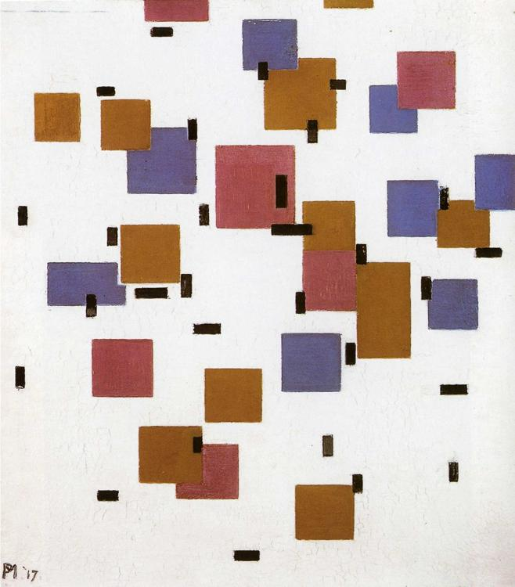
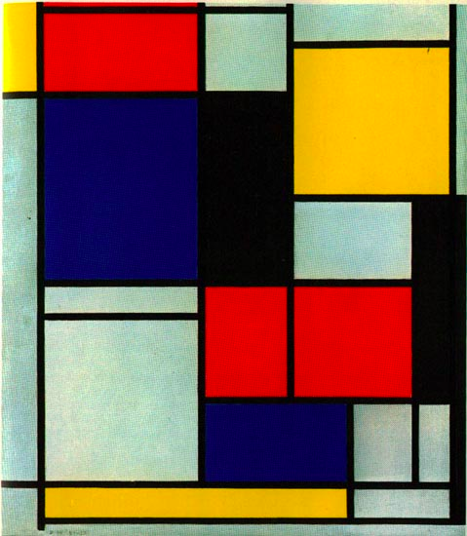
Neo-Plasticism
Strict rules of composition:
Vertical and horizontal lines—Reduced Palette—elimination of figure and ground
Piet Mondrian, Church Facade/Church at Domburg (formerly Cathedral), 1914
Piet Mondrian, Composition in Color A, 1917
Piet Mondrian, Composition, 1921

Slide 15
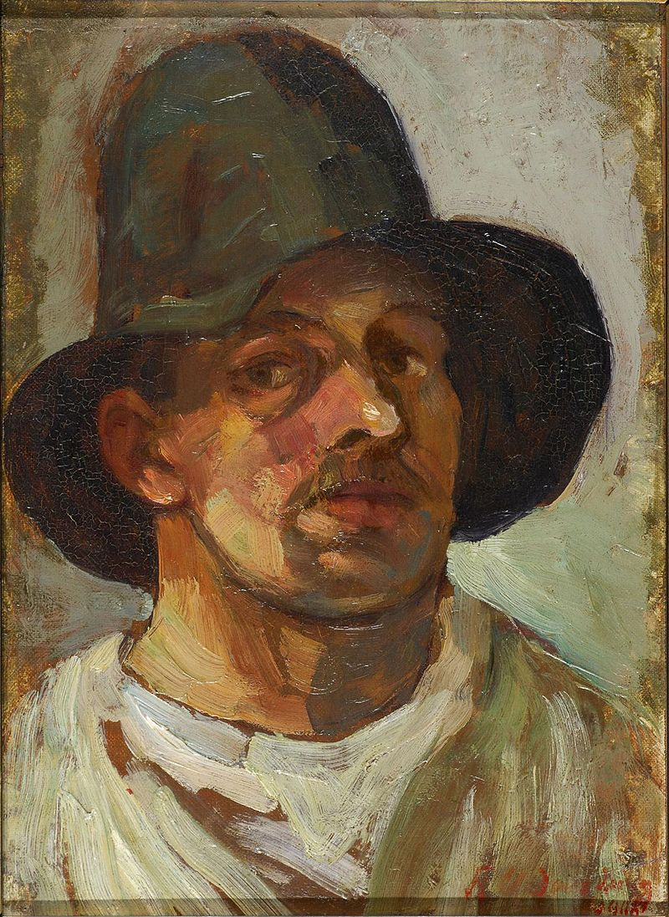
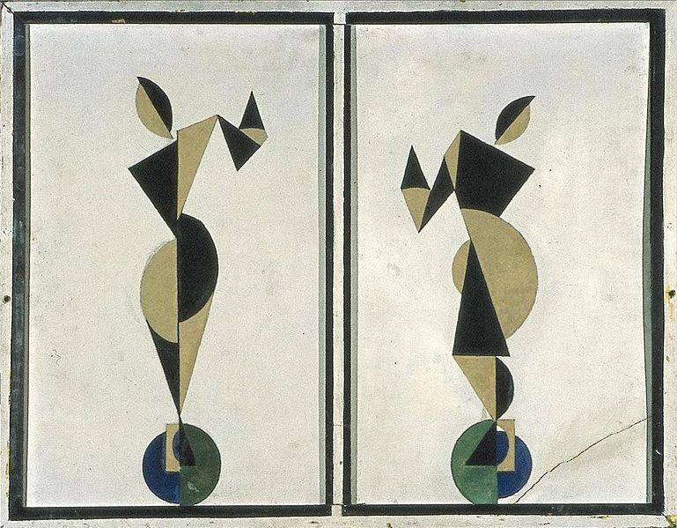
Theo van Doesberg, Self Portrait with Hat, 1906
Theo van Doesberg, Dancers, 1916

Slide 16
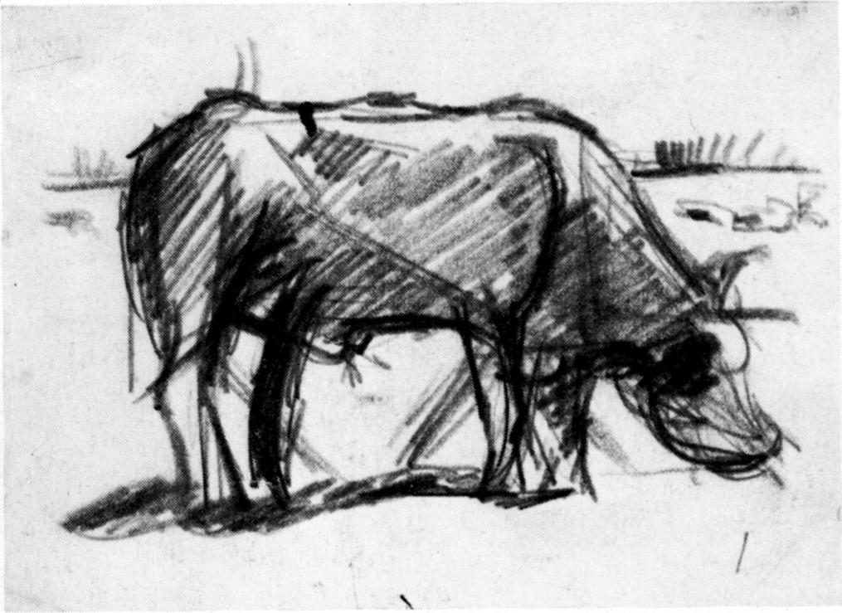
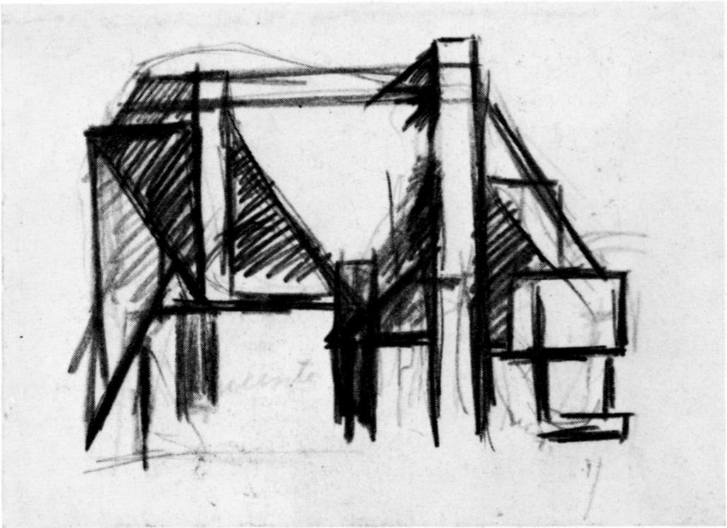
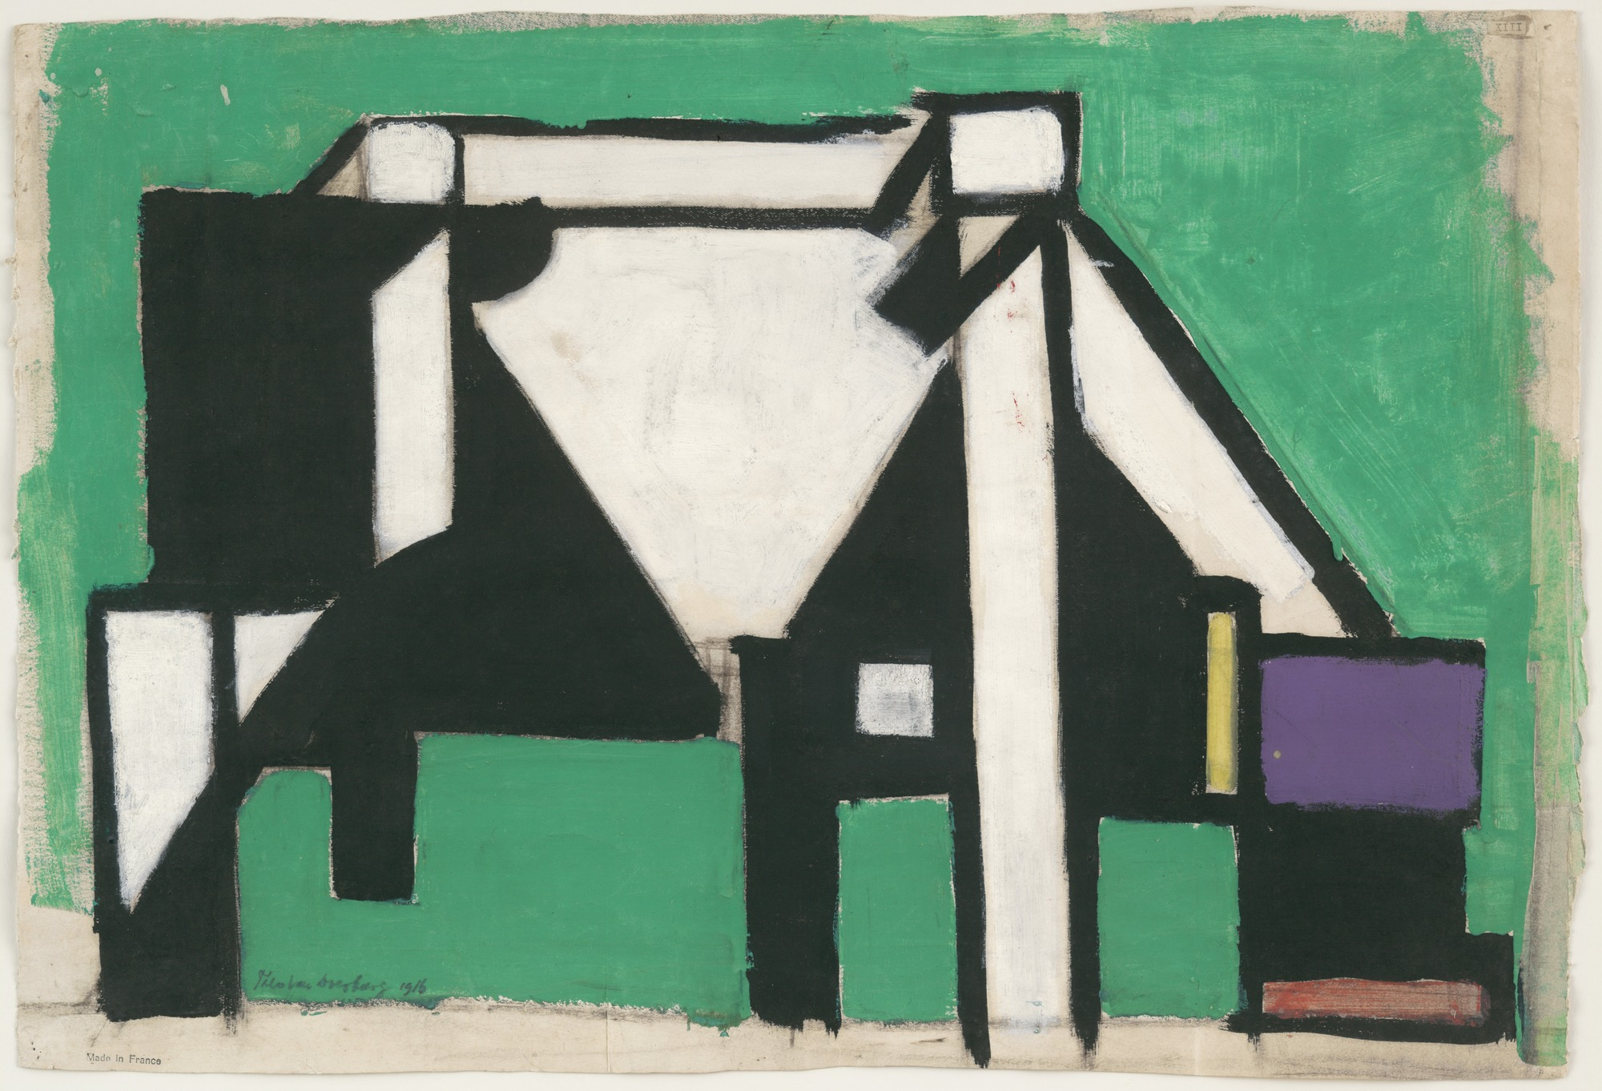
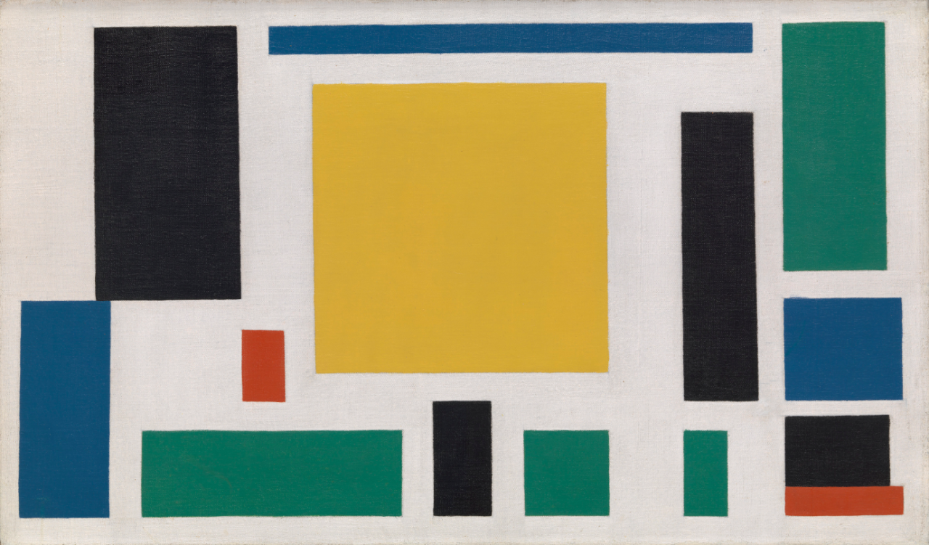
Composition VII, c. 1918
Theo van Doesberg, The Cow, 1917

Slide 17
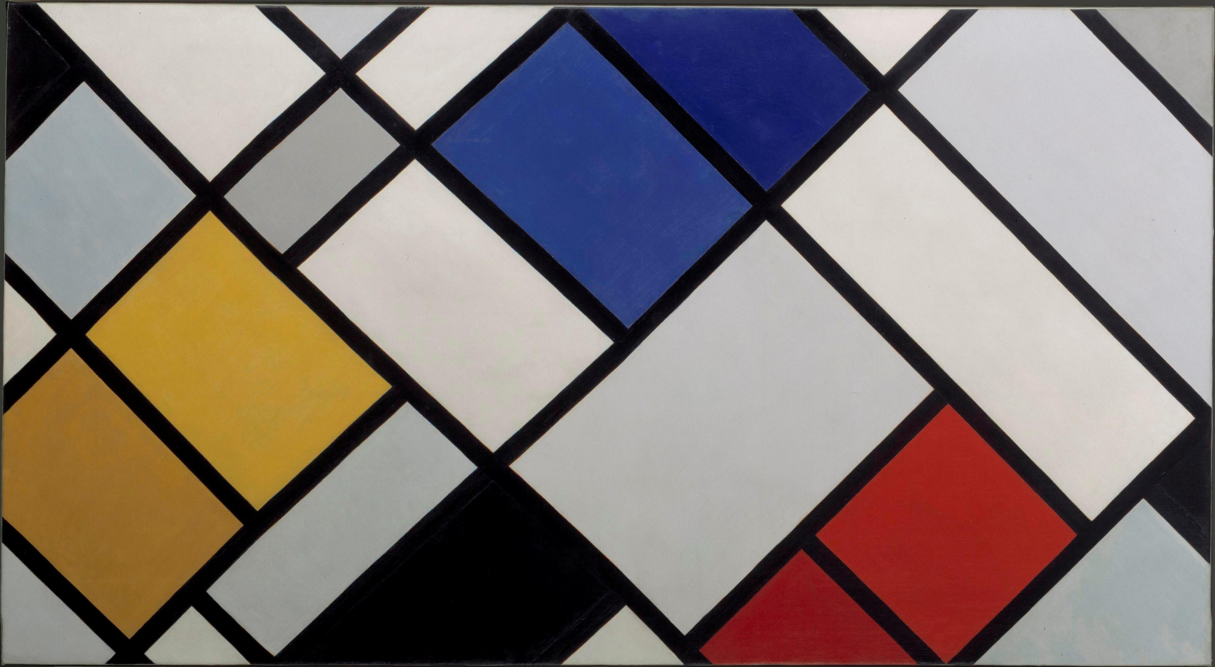
Elementarism vs. Neo-Plasticism:
Theo van Doesberg, Counter composition VI, 1925
Piet Mondrian, Composition, 1921

Slide 18
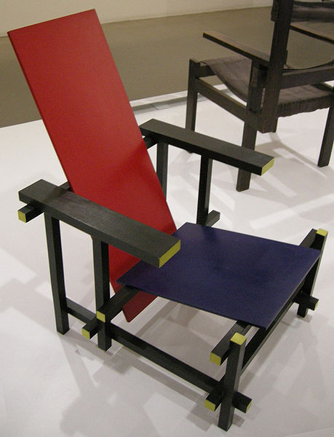
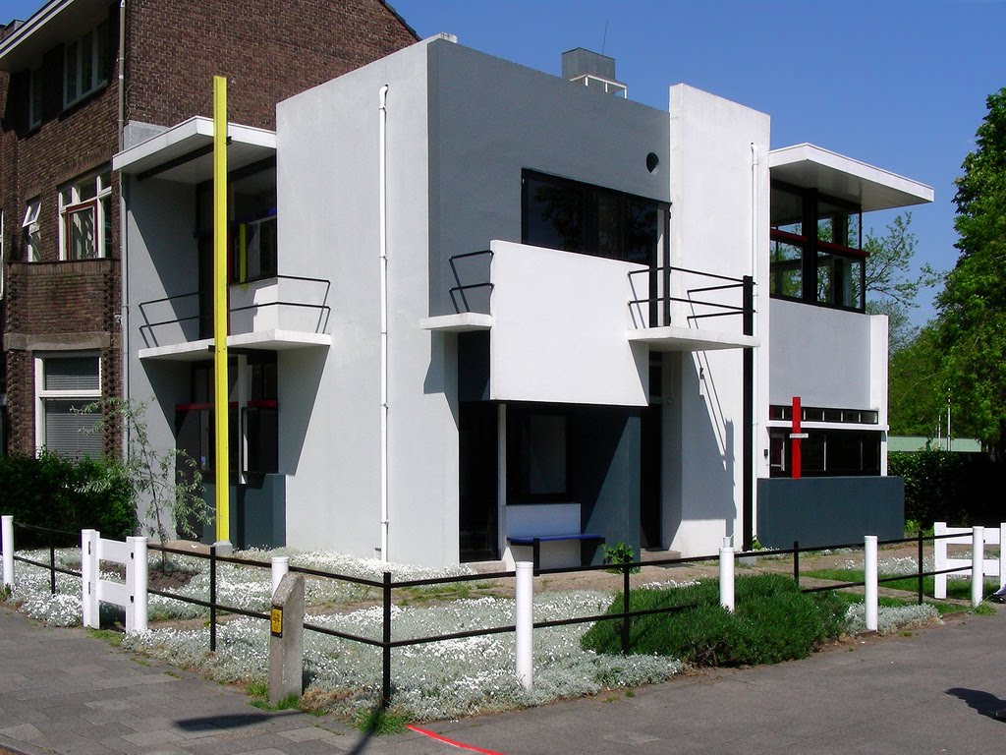
Gesamtkunstwerk - Synthesis of the Arts
“we have established the true place of colour in architecture and we declare that painting without architectural construction (that is, easel-painting) has no further reason for existence.” Doesburg, Towards a Collective Construction, 1924
Gerrit Rietveld, Red Blue Chair, 1923
Gerrit Rietveld, Rietveld Schroder House, Utrecht, 1924
Rietveld Shroder House Website

Slide 19
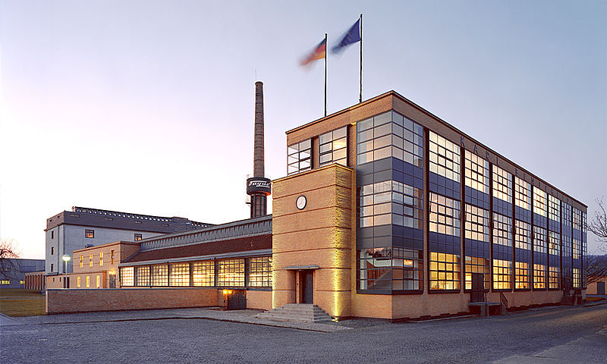
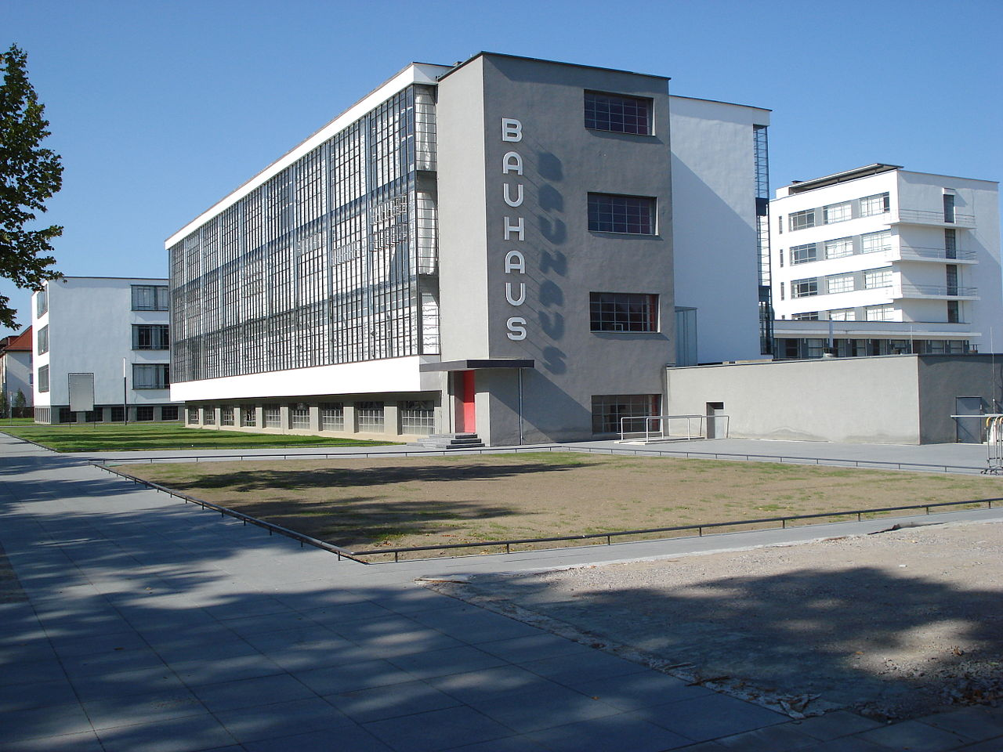
Bauhaus——> International Style
Weimar Germany (1919)——> Dessau (1925-1931)——> Berlin (1932-1933
Walter Gropius, Fagus Factory, 1911-1913
Bauhaus building Dessau, Germany 1919-25

Slide 20
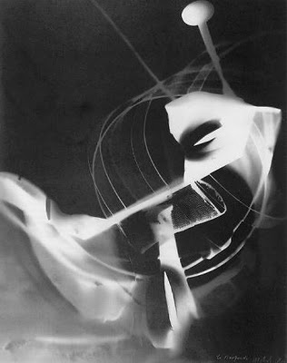
Man Ray, (Emmanuel Radnitzky), Rayograph, 1922
Lazlo Moholy-Nagy, Portrait of Lucia Moholy, c. 1926-29

Slide 21
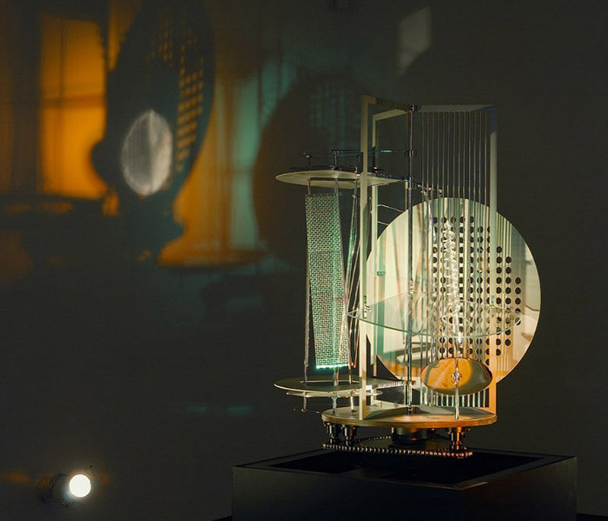
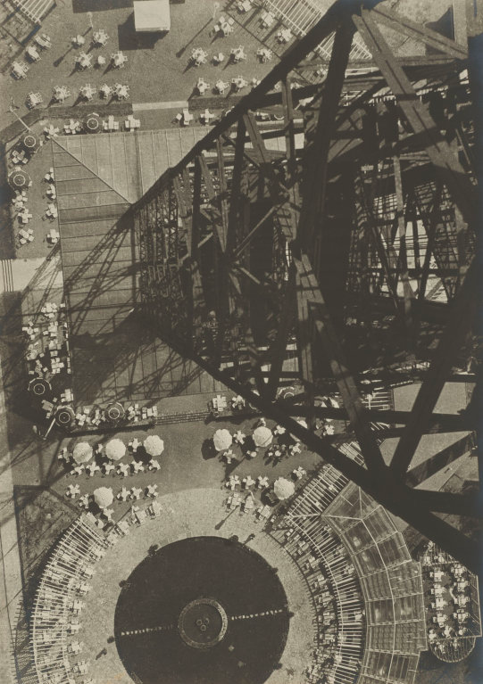
Lazlo Moholy-Nagy, Light Space Modulator, 1922
Lazlo Moholy-Nagy, Berlin Radio Tower, c. 1928

Slide 22
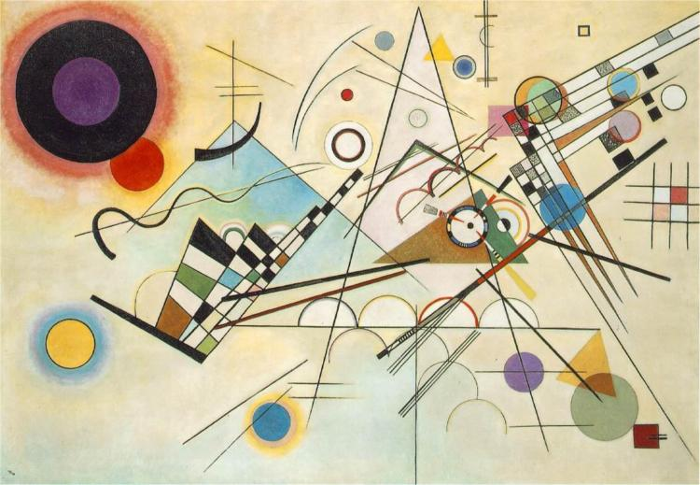
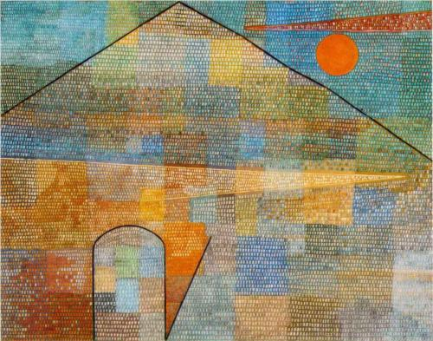
Wassily Kandinsky, Composition VIII, 1923
Paul Klee, Ad Parnassum, 1932

Slide 23
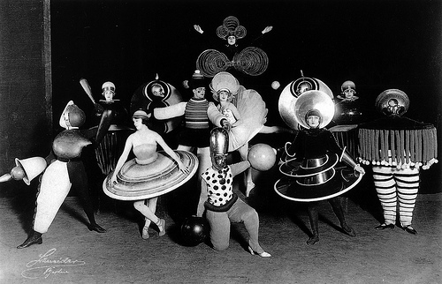
Oskar Schlemmer, Triadic Ballet, 1927

