Slide 1
Surrealism Wrap Up

Slide 2
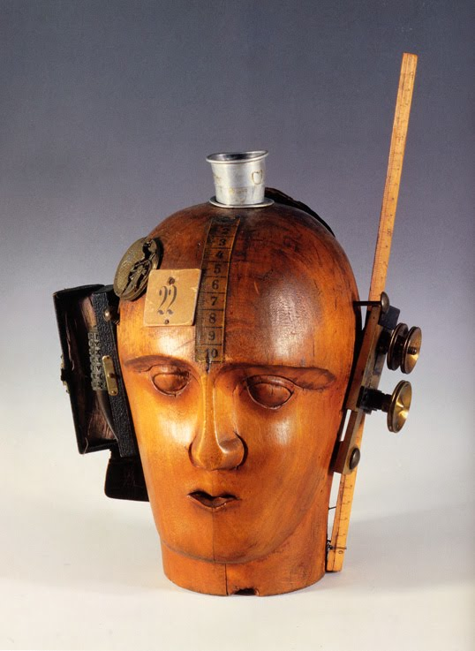
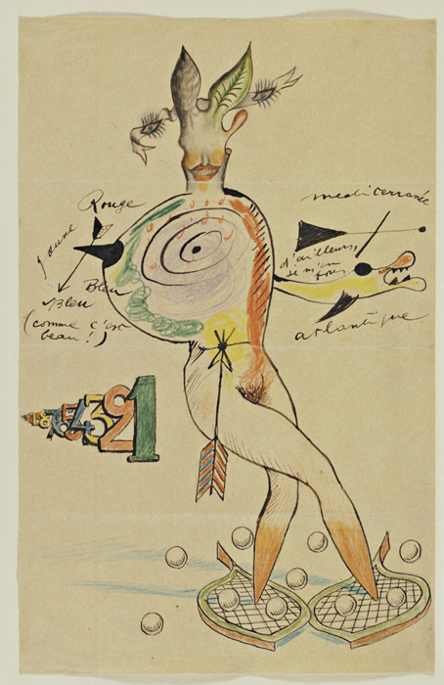
The Surrealist Object and collaboration
Exquisite corpse: “The exquisite corpse shall drink the new wine."
Remember: Dada collage
Raoul Hausmann, The Spirit of Our Time (Mechanical Head), 1919
Exquisite Corpse by Yves Tanguy, Joan Miro, Max Morise, and Man Ray, 1927

Slide 3
“Psychic automatism in its pure state, by which one proposes to express—verbally, by means of the written word, or in any other manner—the actual functioning of thought. Dictated by thought, in the absence of any control exercised by reason, exempt from any aesthetic or moral concern.”
—Andre Breton, Manifesto of Surrealism, 1924
André Masson, Automatic Drawing, 1924

Slide 4
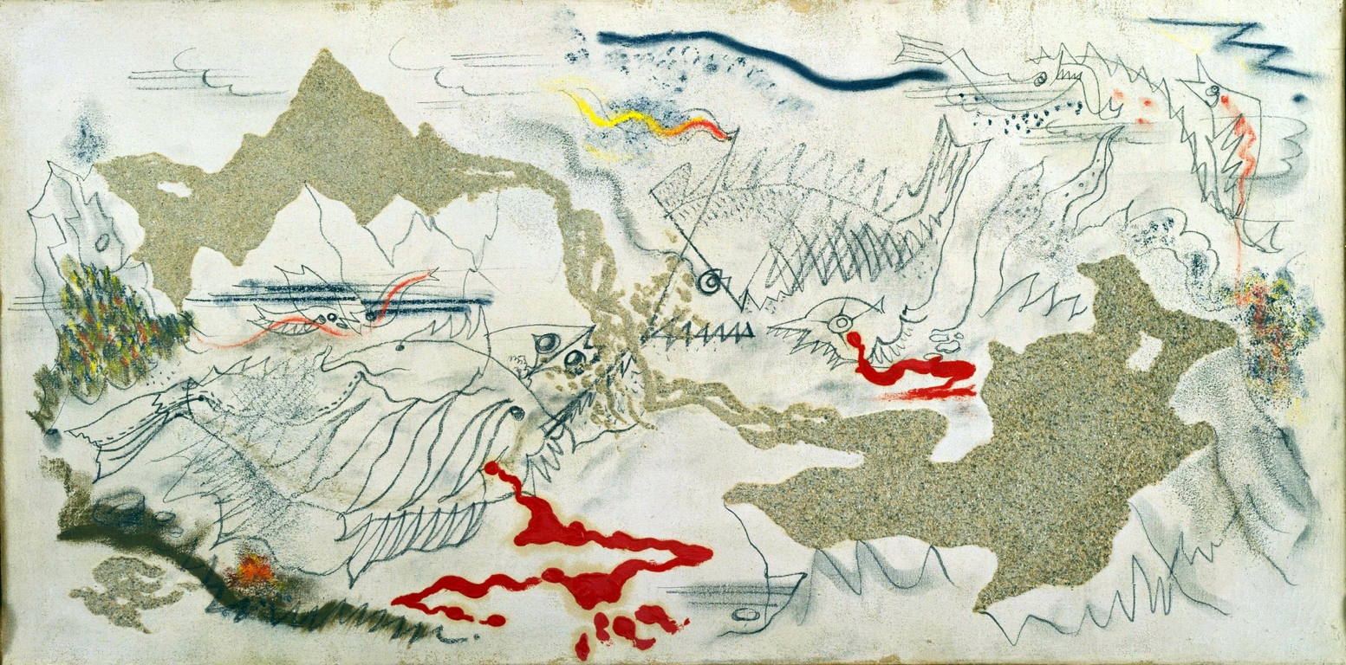
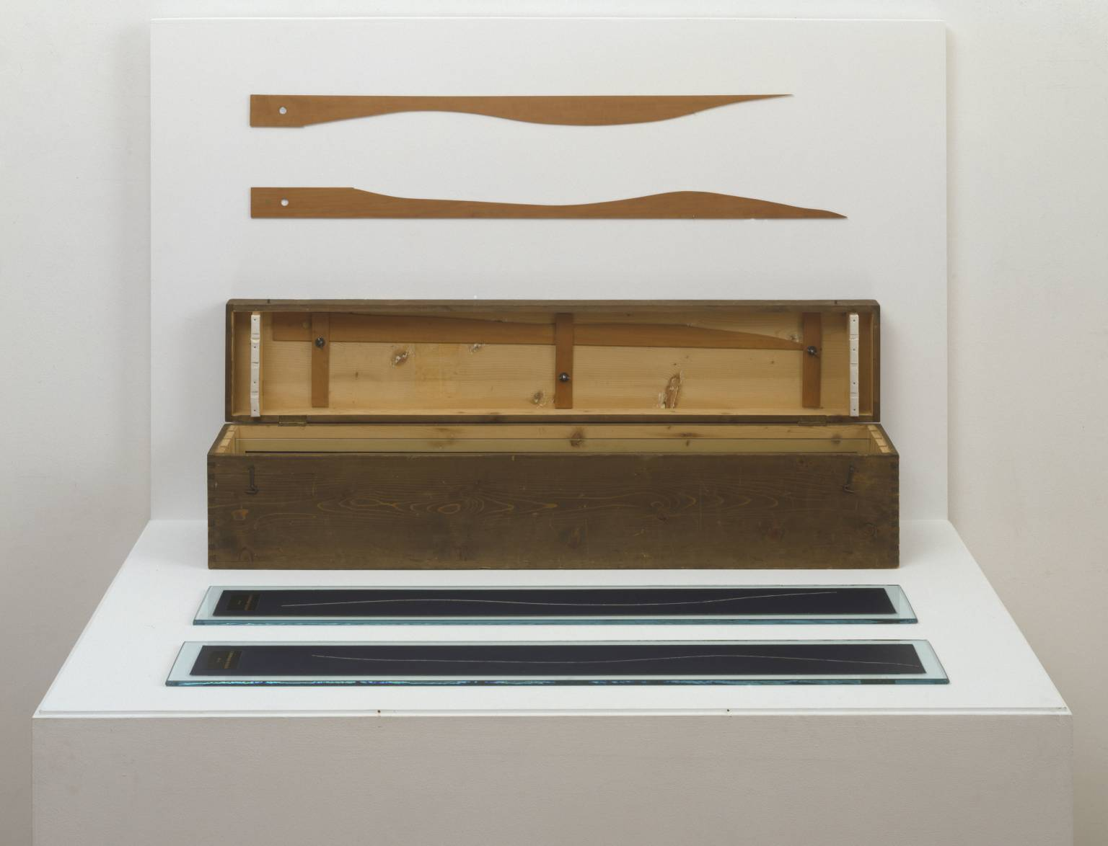
Psychic automatism, chance operations
Marcel Duchamp
3 Standard Stoppages
1913-14, replica 1964
Wood, glass and paint on canvas
Andre Masson, The Battle of the Fishes, 1926

Slide 5
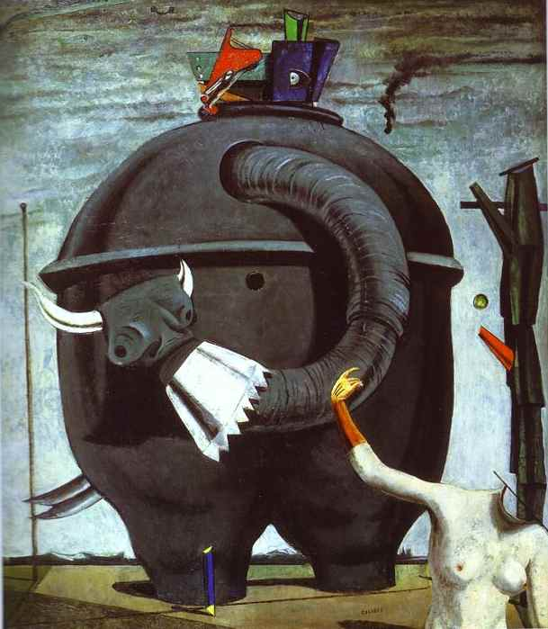
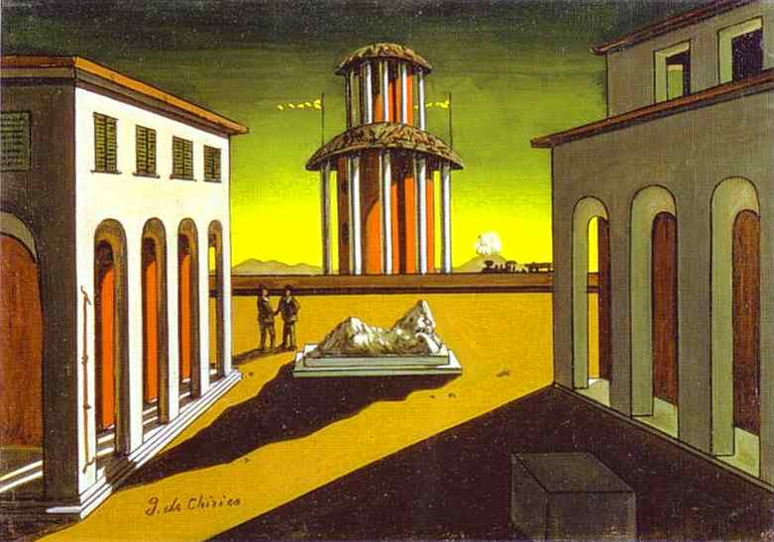
Dreamscapes: Surrealism and Painting
Scuola metafisica: concerning the “host of strange, unknown and solitary things that can be translated into painting…What is especially needed is great sensitivity: to look upon everything in the world as enigma….To live in the world as in an immense museum of strange things.”
'On the 1st of August 1914 Max Ernst died. He was resurrected on the 11 November 1918 as a young man who aspired to find the myths of his time.’ Max Ernst
Giorgio de Chirico, Piazza d’Italia, 1913
Max Ernst, The Elephant Celebes, 1921

Slide 6
Leonora Fini, The Ends of the World, 1949
Leonora Carrington, Self-Portrait, 1937-38

Slide 7
Biomorphism and the Unconscious
“I’m only interested in anonymous art, the kind that springs from the collective unconscious” —Miro
Joan Miró, Harlequin’s Carnival, 1924
Kay Sage, I Saw Three Cities, 1944
Yves Tanguy, Mama, Papa is Wounded, 1927

Slide 8
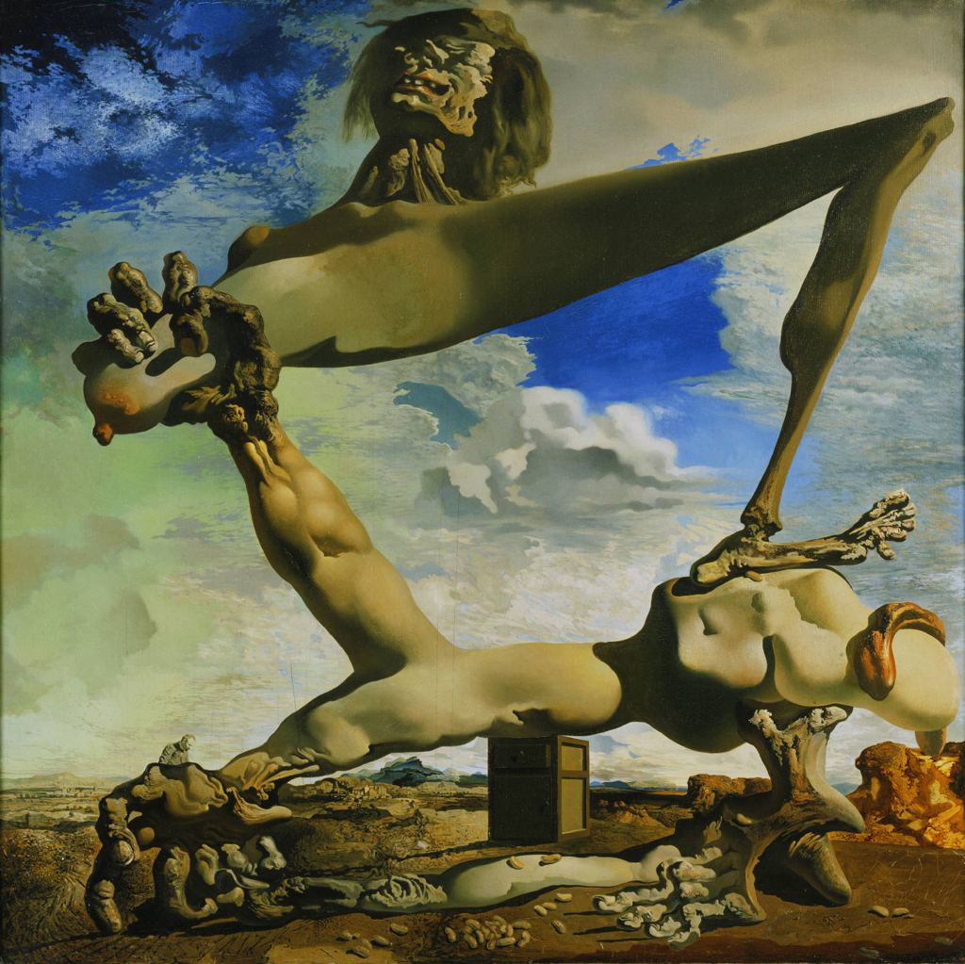
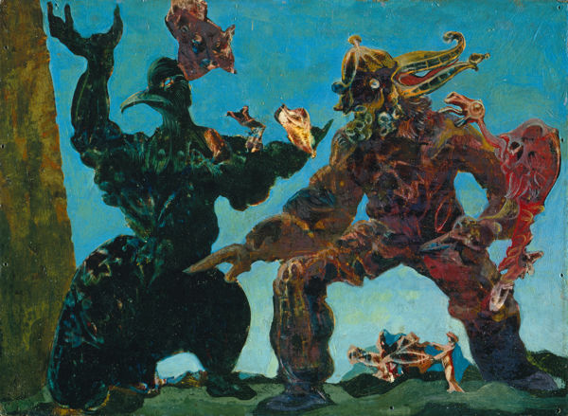
Surrealism and Politics
Grattage
Salvador Dali, Soft Construction with Boiled Beans: Premonitions of Civil war, 1936
Max Ernst, The Barbarians, 1937

Slide 9
The bombing of Gernika, 26 April 1937
Pablo Picasso, Guernica, 1937

Slide 10
“We Surrealists pronounced ourselves in favour of changing the imperialist war, in its chronic and colonial form, into a civil war. Thus we placed our energies at the disposal of the revolution, of the proletariat and its struggles, and defined our attitude towards the colonial problem, and hence towards the colour question.” Paris Group, open letter to Paul Claudel, 1925
Frida Kahlo, The Two Fridas, 1939

Slide 11
“My painting is an act of decolonization not in a physical sense, but in a mental one.” Wifredo Lam
Wilfredo Lam, The Jungle, 1943

