Slide 1
Modernism and American Art

Slide 2
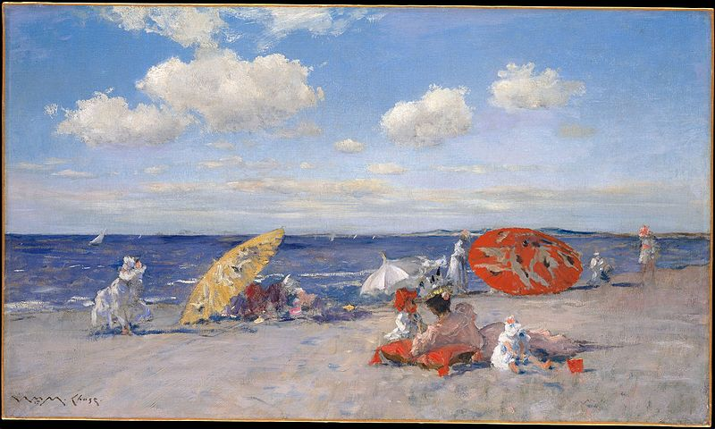
William Merritt Chase, At the Seaside, c. 1892

Slide 3
Henry Osawa Tanner, The Annunciation,1898
Henry Osawa Tanner, Tangier,1912

Slide 4
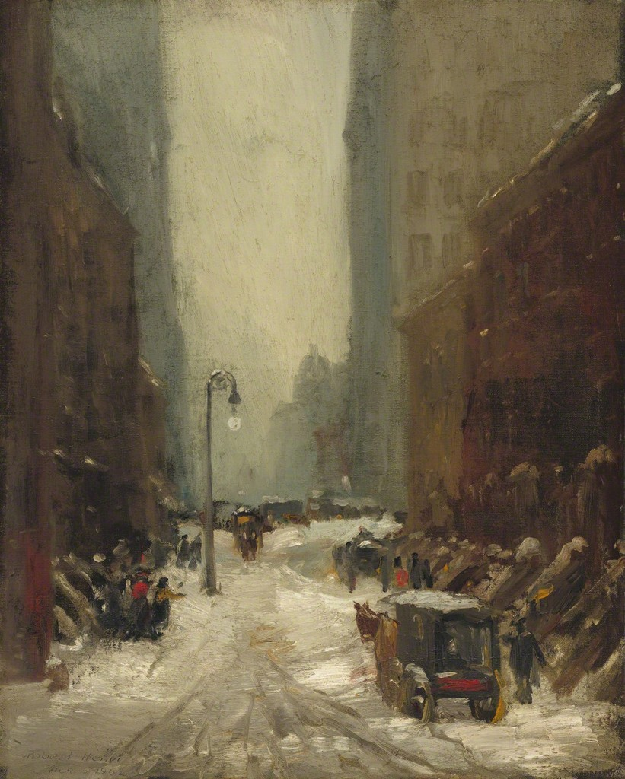
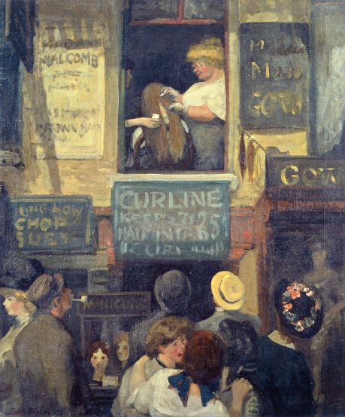
Ashcan School
Robert Henri, Snow in New York, 1902
John Sloan, Hairdresser’s Window, 1907

Slide 5
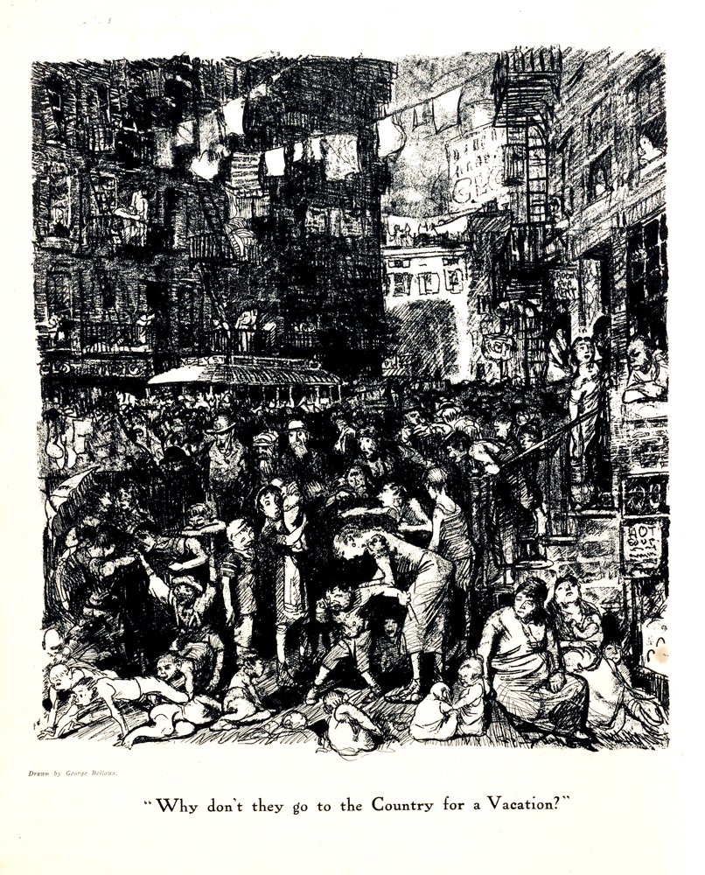
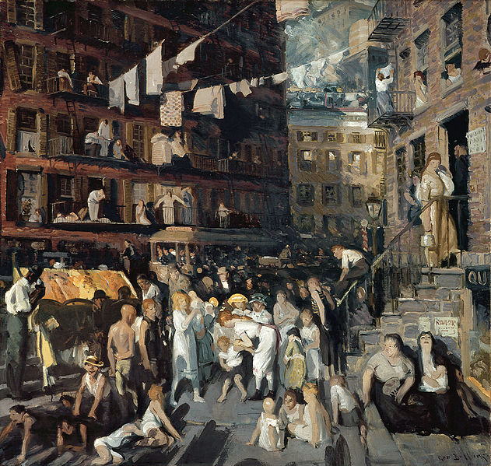
George Bellows, Why Don’t they Go to the Country for a Vacation, 1913
George Bellows, Cliff Dwellers, 1913

Slide 6
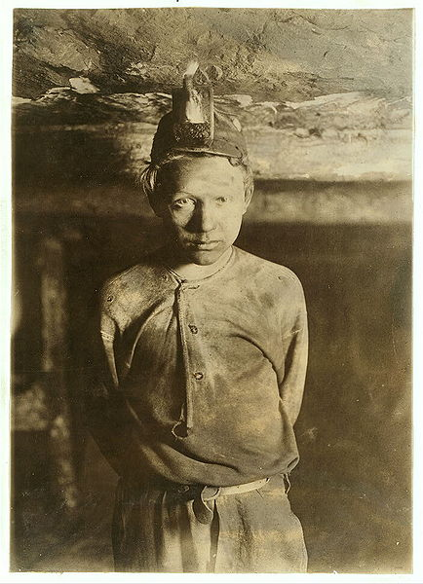
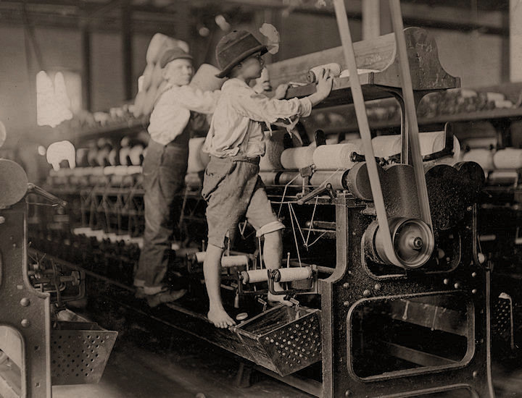
National Child Labor Committee
Lewis Hine 488 Macon, Ga. Bibb Mill No. 1 Many youngsters here. Some boys were so small they had to climb up on the spinning frame to mend the broken threads and put back the empty bobbins. 1909
Lewis Hine, Trapper Boy, Turkey Knob Mine, Macdonald, W. Va.1908

Slide 7
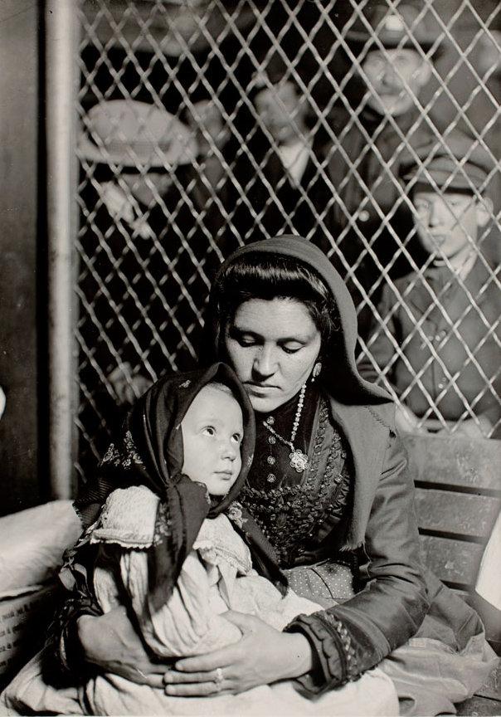
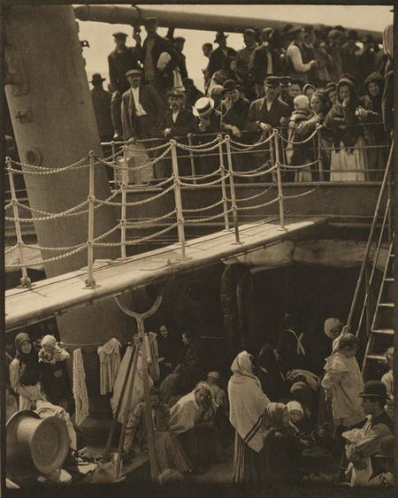
Lewis Hine, Italian Madonna: Immigrant Mother and Child, Ellis Island, New York 1905
Alfred Stieglitz, The Steerage, 1907

Slide 8
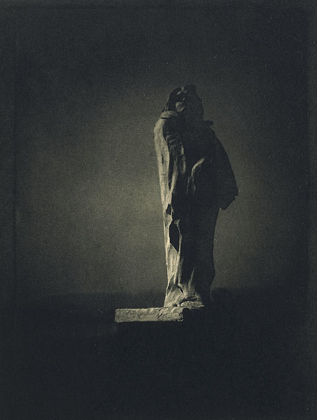
The Avant-garde in America
The Little Galleries of the Photo-Secession and 291 Gallery
Edward Steichen, Balzac- The Open Sky, 1908
Alfred Stieglitz, The Steerage, 1907

Slide 9
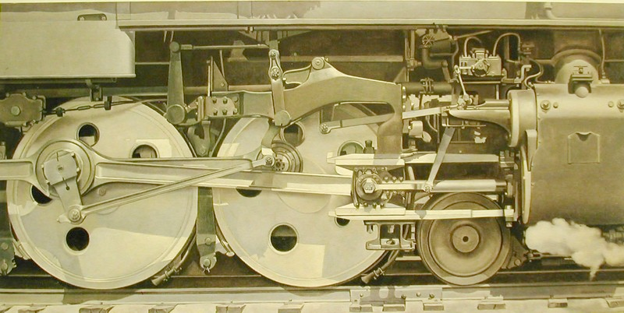
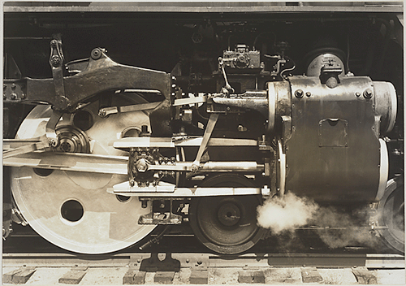
Charles Sheeler, Rolling Power, 1939
Charles Sheeler, Drive Wheels, 1939

Slide 10
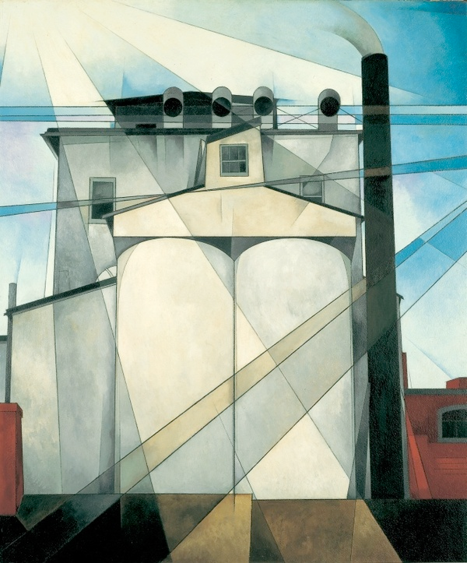
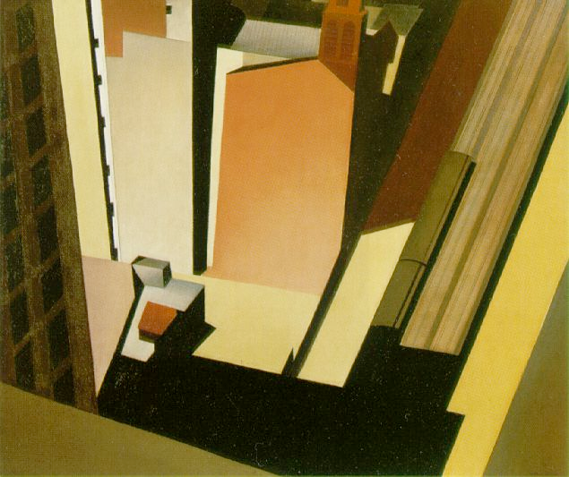
Precisionism
Charles Sheeler, Church Street El, 1920
Charles Demuth, My Egypt, 1927

Slide 11
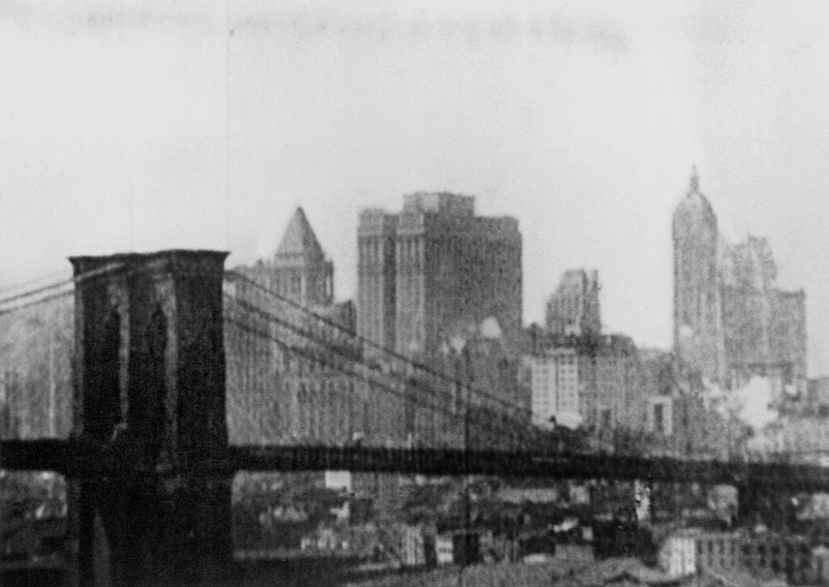
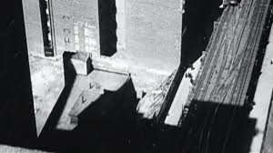
City Symphony
Charles Sheeler and Paul Strand, Manhatta, 1921
https://www.youtube.com/watch?v=tHqb1dXER-0

Slide 12
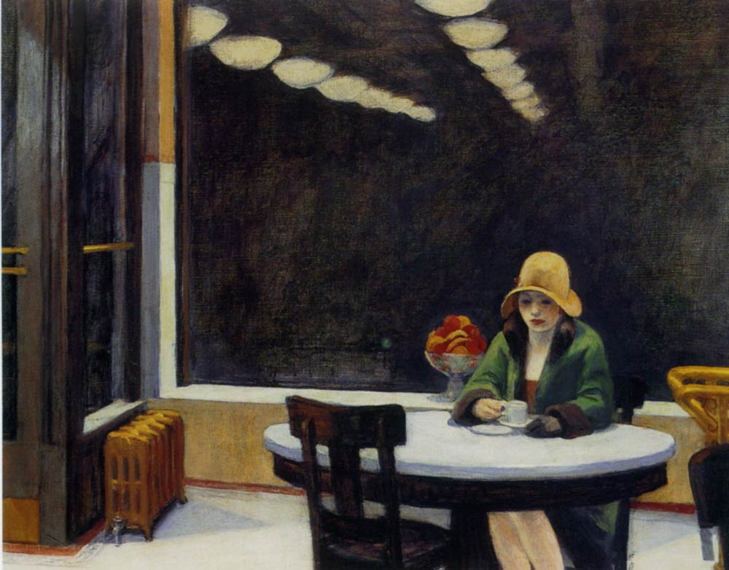
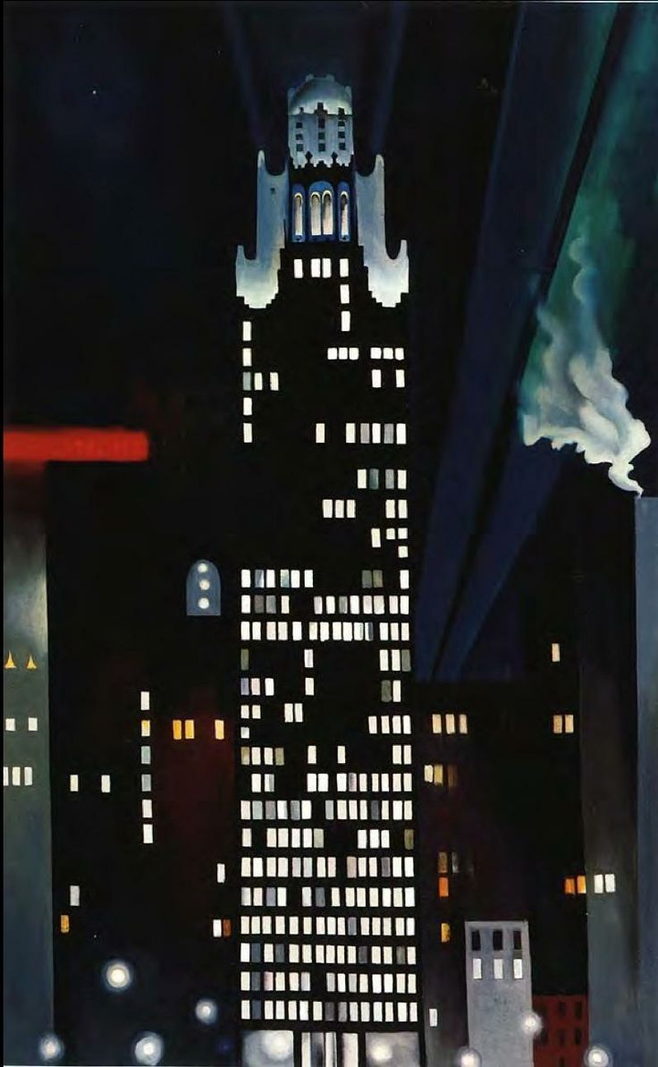
Georgia O’Keefe, Radiator Building - Night, New York, 1927
Edward Hopper, Automat, 1927

Slide 13
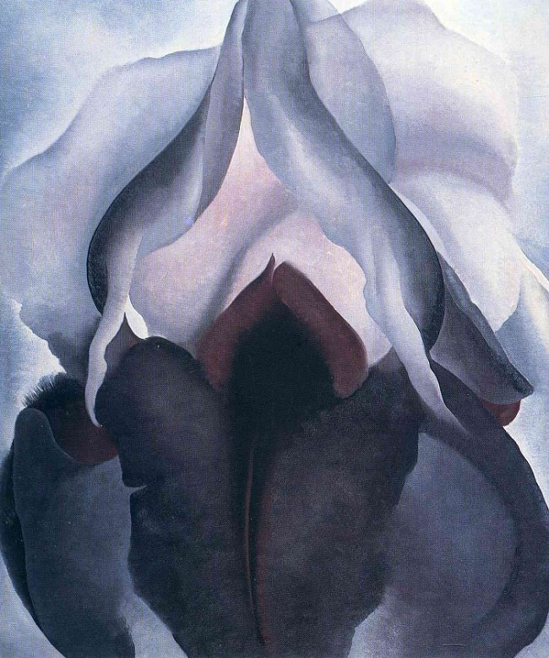
Georgia O'Keeffe, Black Iris III, 1926
Georgia O’Keefe, Radiator Building - Night, New York, 1927

Slide 14
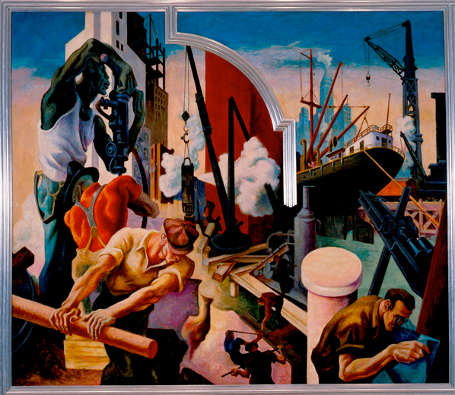
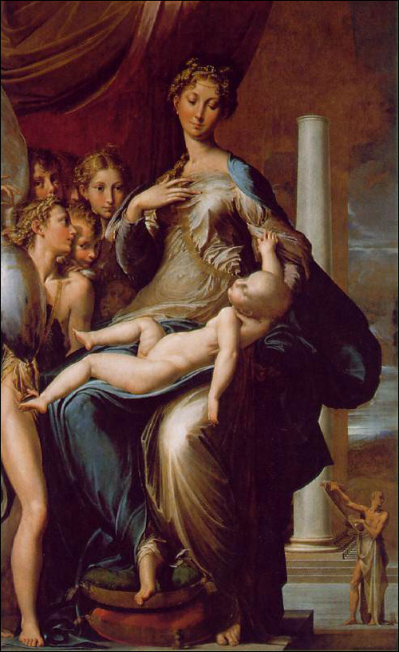
American Regionalism
Thomas Hart Benton, America Today: City Building, 1930
Parmigianino, Madonna and Child with Angels and St. Jerome, 1535-40

Slide 15
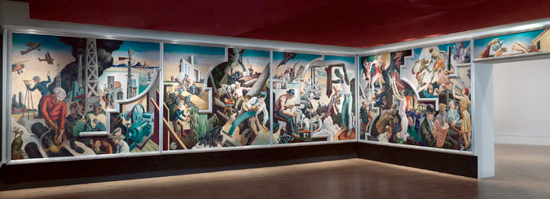
Original commission by Alvin Saunders Johnson in 1929 for The New School of Social Research Boardroom

Slide 16
Thomas Hart Benton, The Arts of the West, 1932
Jackson Pollock, Going West, 1934-35

Slide 17
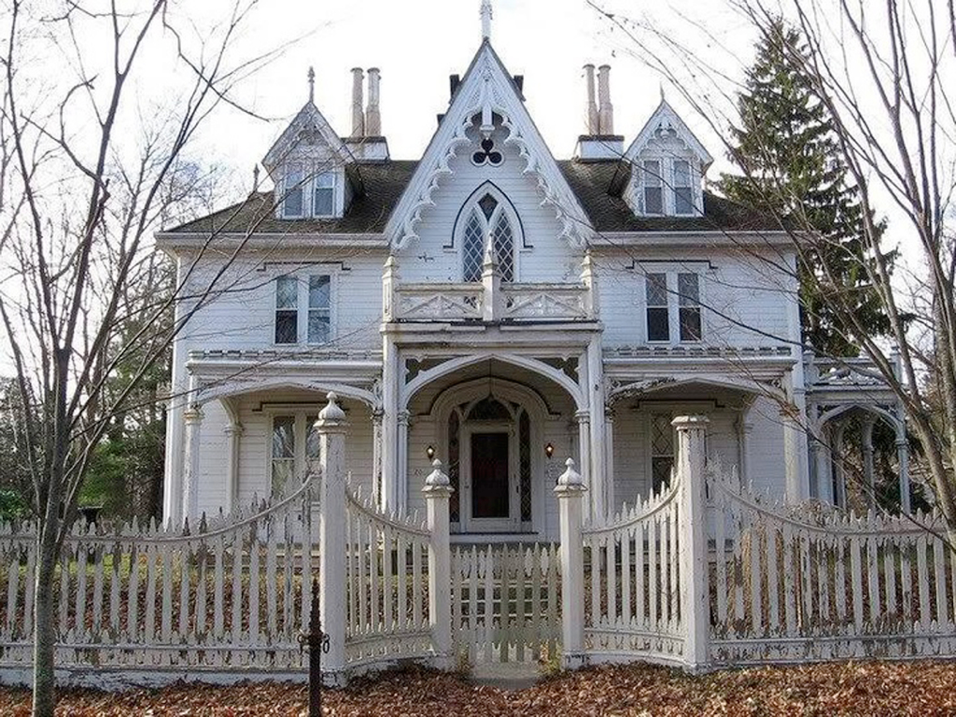
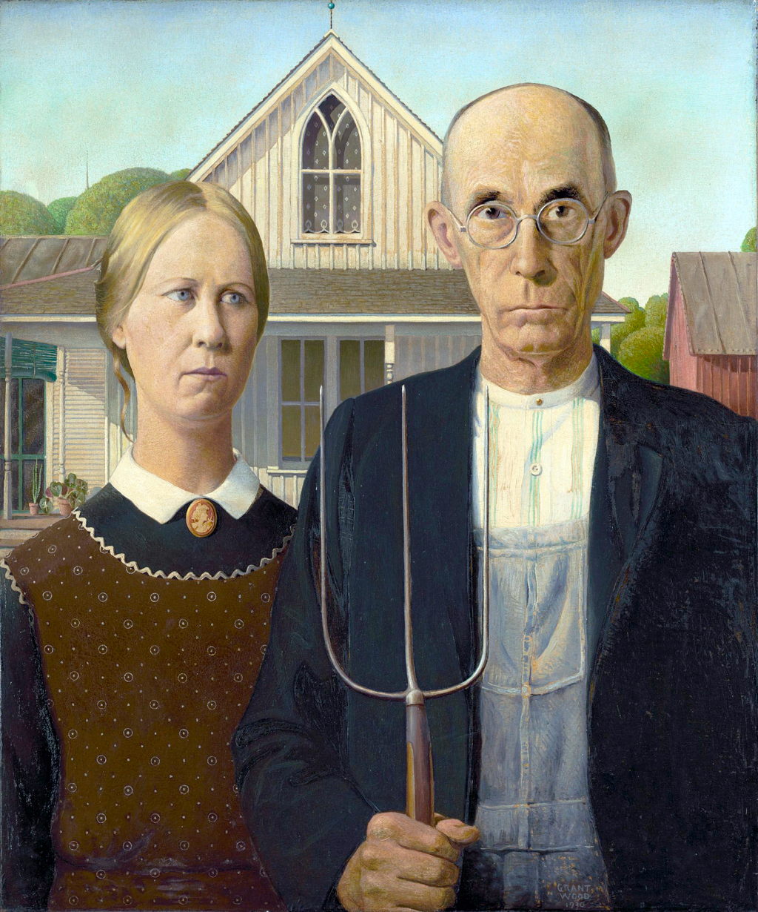
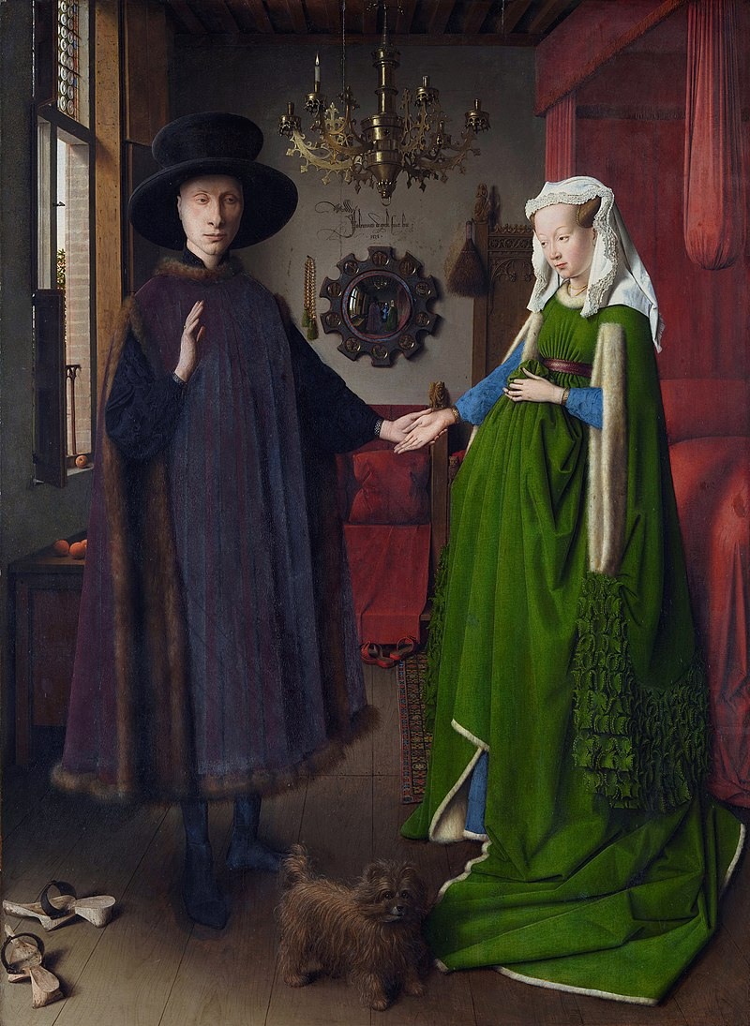
Carpenter Gothic
Jan van Eyck, The Arnolfini Portrait, 1434
Grant Wood, American Gothic, 1930

Slide 18
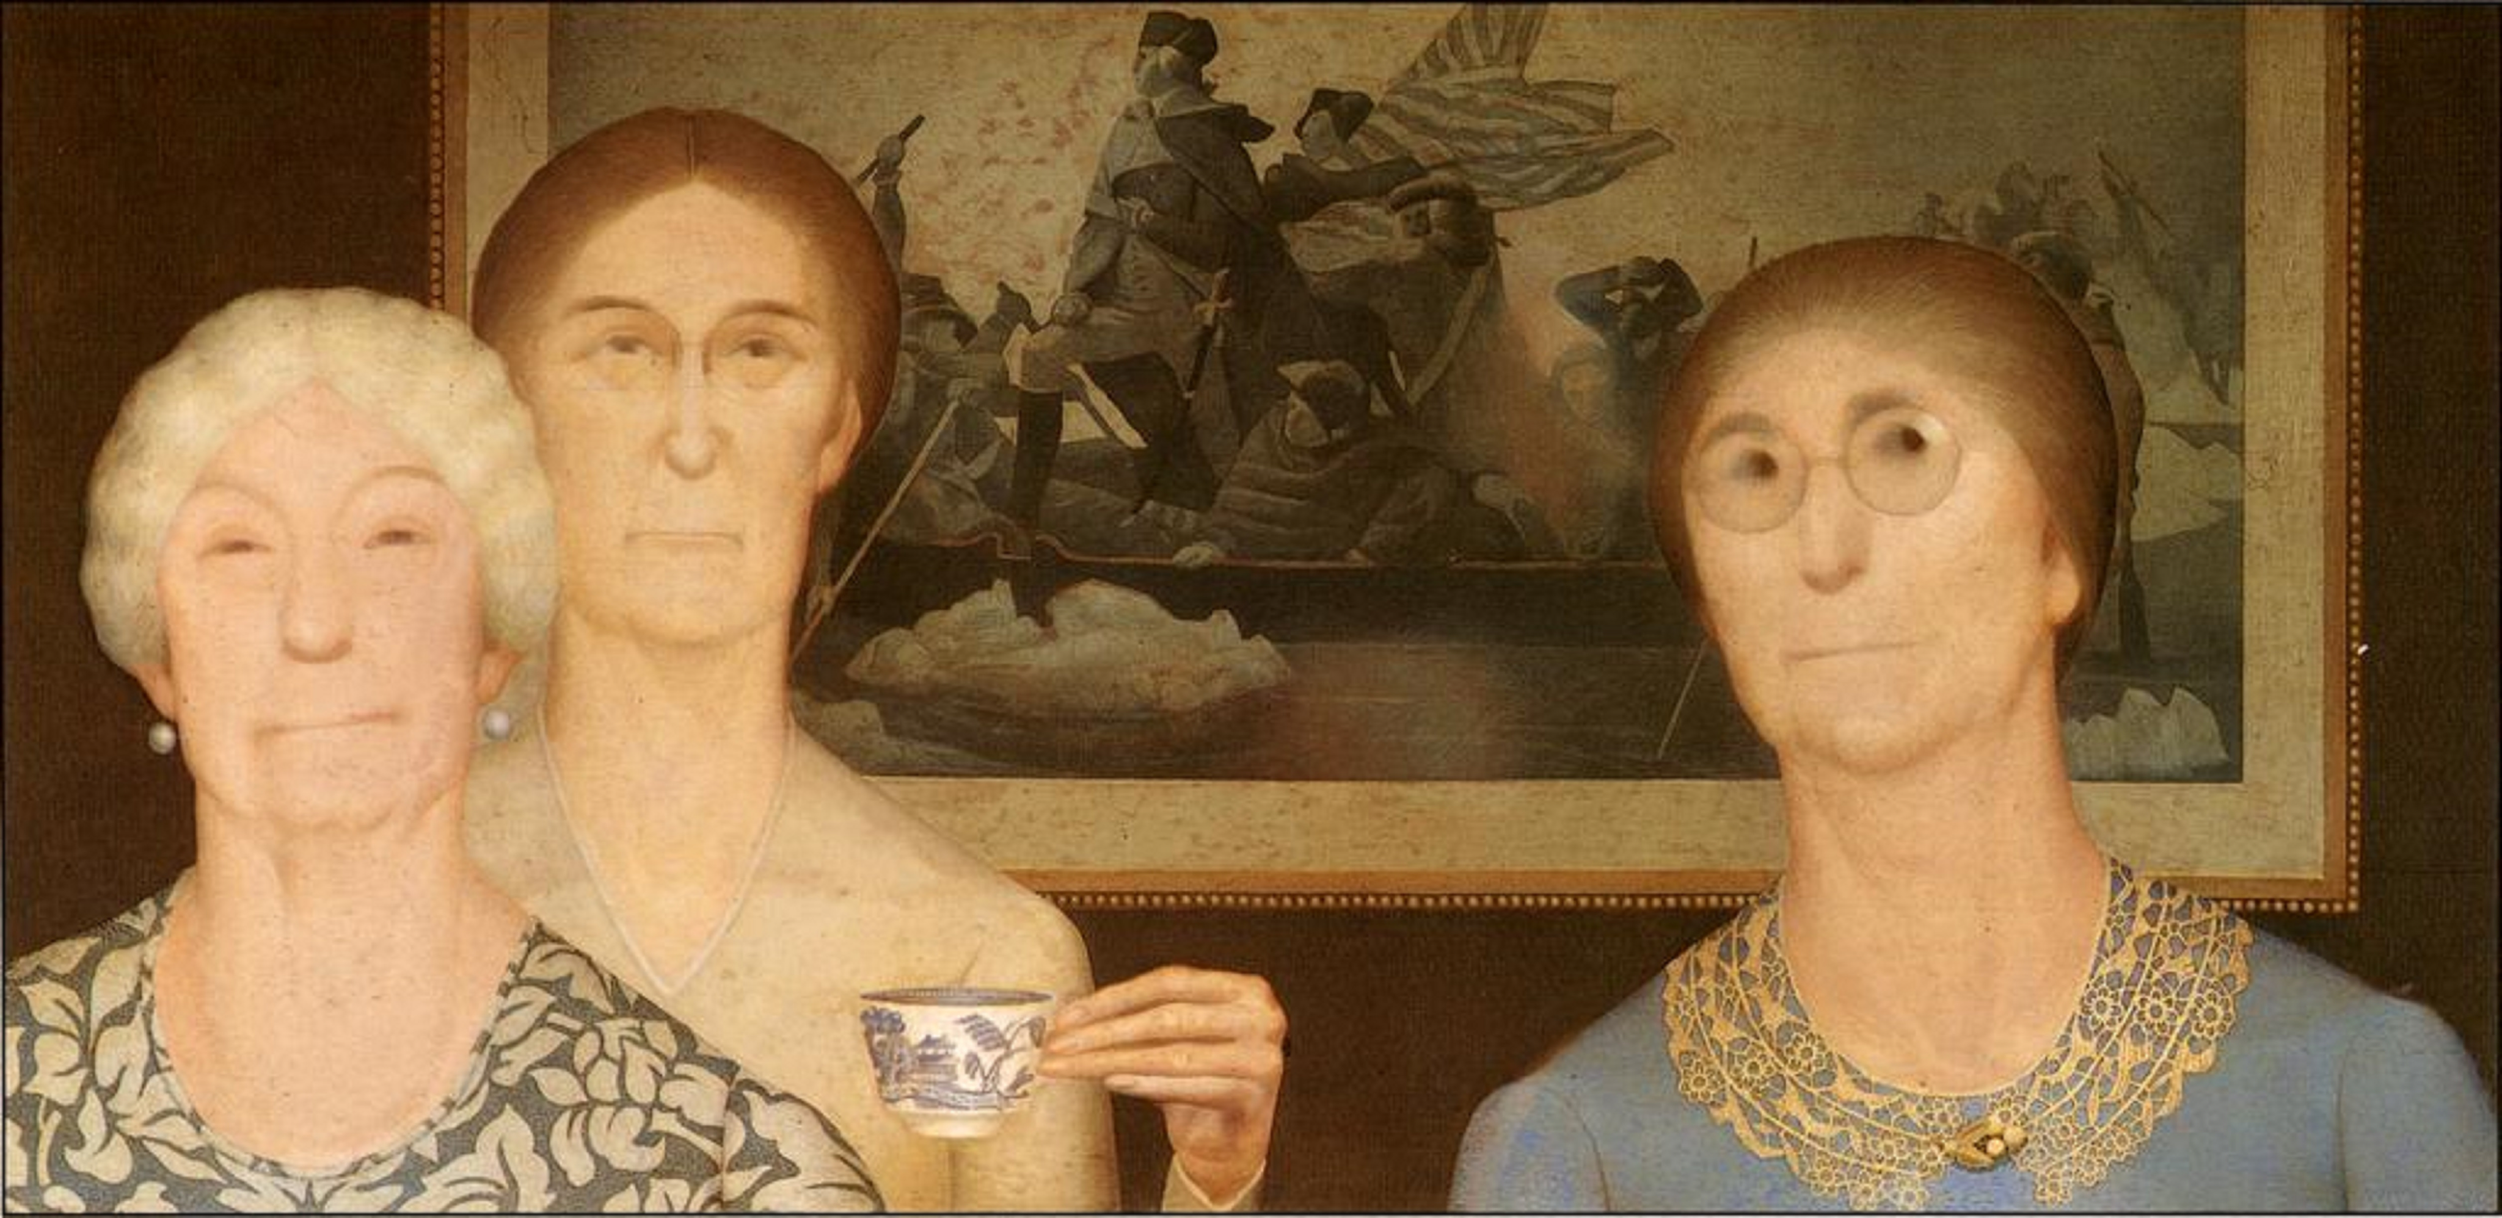
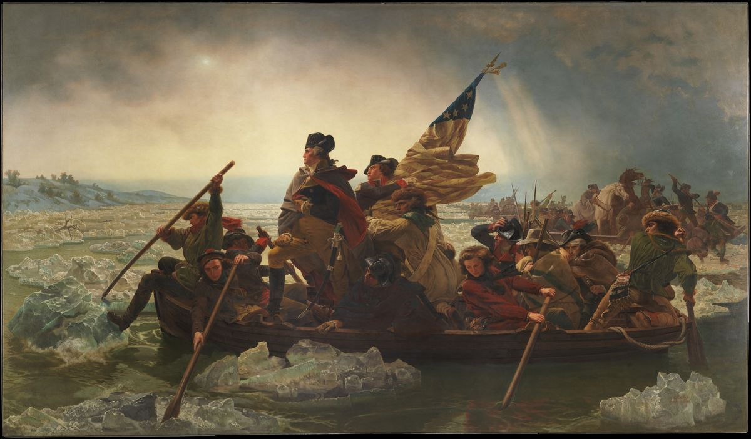
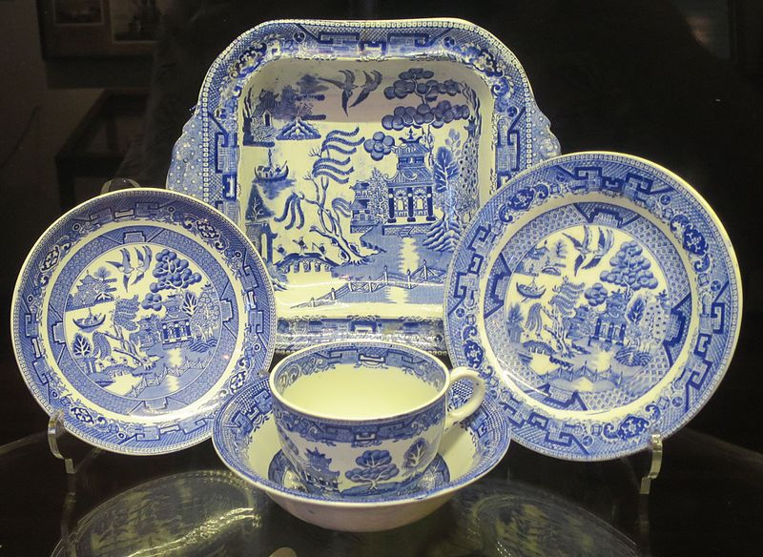
Grant Wood, Daughters of Revolution, 1932
Emanuel Leutze, Washington Crossing the Delaware, 1851
English Blue Willow Porcelain

Slide 19
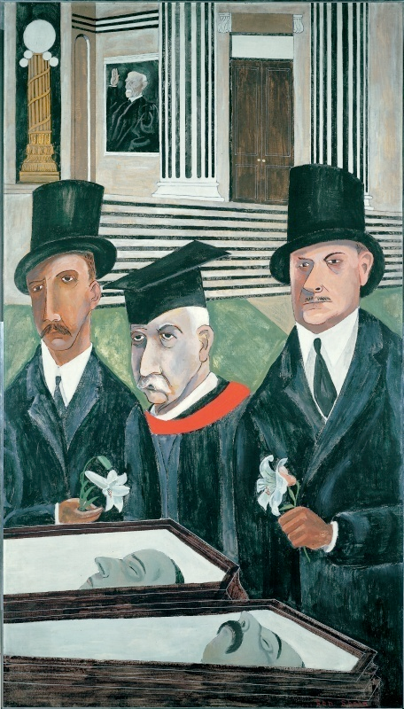
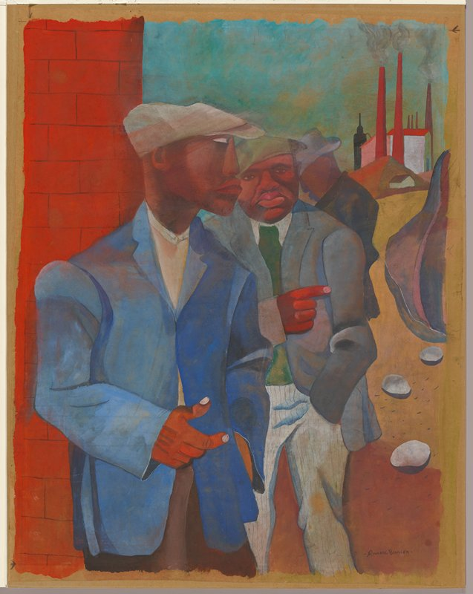
Social realism
Ben Shahn, The Passion of Sacco and Vanzetti, 1931-32
Romare Bearden, Factory Workers, 1942

Slide 20
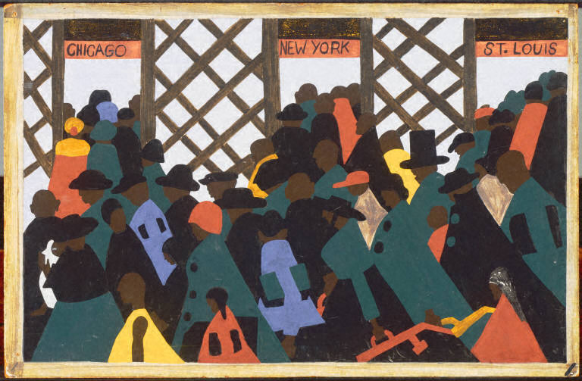
Jacob Lawrence, Migration series, Panel No. 1: During World War I there was a great migration north by Southern African Americans, 1940-41

Slide 21
“We Surrealists pronounced ourselves in favour of changing the imperialist war, in its chronic and colonial form, into a civil war. Thus we placed our energies at the disposal of the revolution, of the proletariat and its struggles, and defined our attitude towards the colonial problem, and hence towards the colour question.” Paris Group, open letter to Paul Claudel, 1925
Frida Kahlo, The Two Fridas, 1939

Slide 22
“My painting is an act of decolonization not in a physical sense, but in a mental one.” Wifredo Lam
Wilfredo Lam, The Jungle, 1943

Slide 23
Diego Rivera, Man Controller of the Universe, 1933

Slide 24
30 Rockefeller Plaza (1932

Slide 25
Diego Rivera, Man Controller of the Universe, 1934

Slide 26
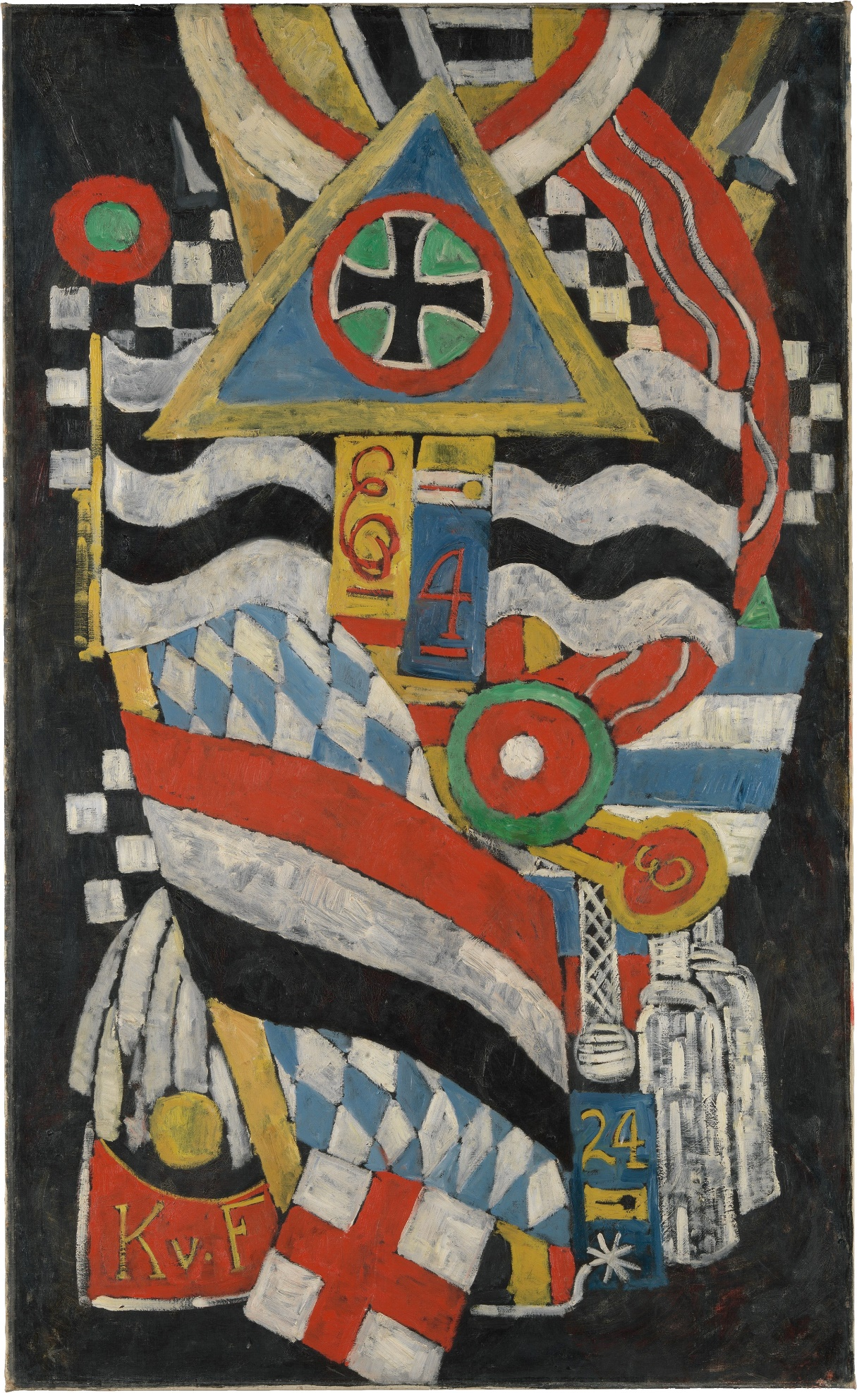
For Further Consideration
In what ways is this a portrait of Karl von Freiburg?
Visual Elements:
"K.v.F."
His regiment number, 4
His age at death, 24
Posthumous Iron Cross
Marsden Hartley, Portrait of a German Officer, 1914

