Slide 1
Modernism in America
Social Realism, Mexican Muralism and Abstract Expressionism

Slide 2
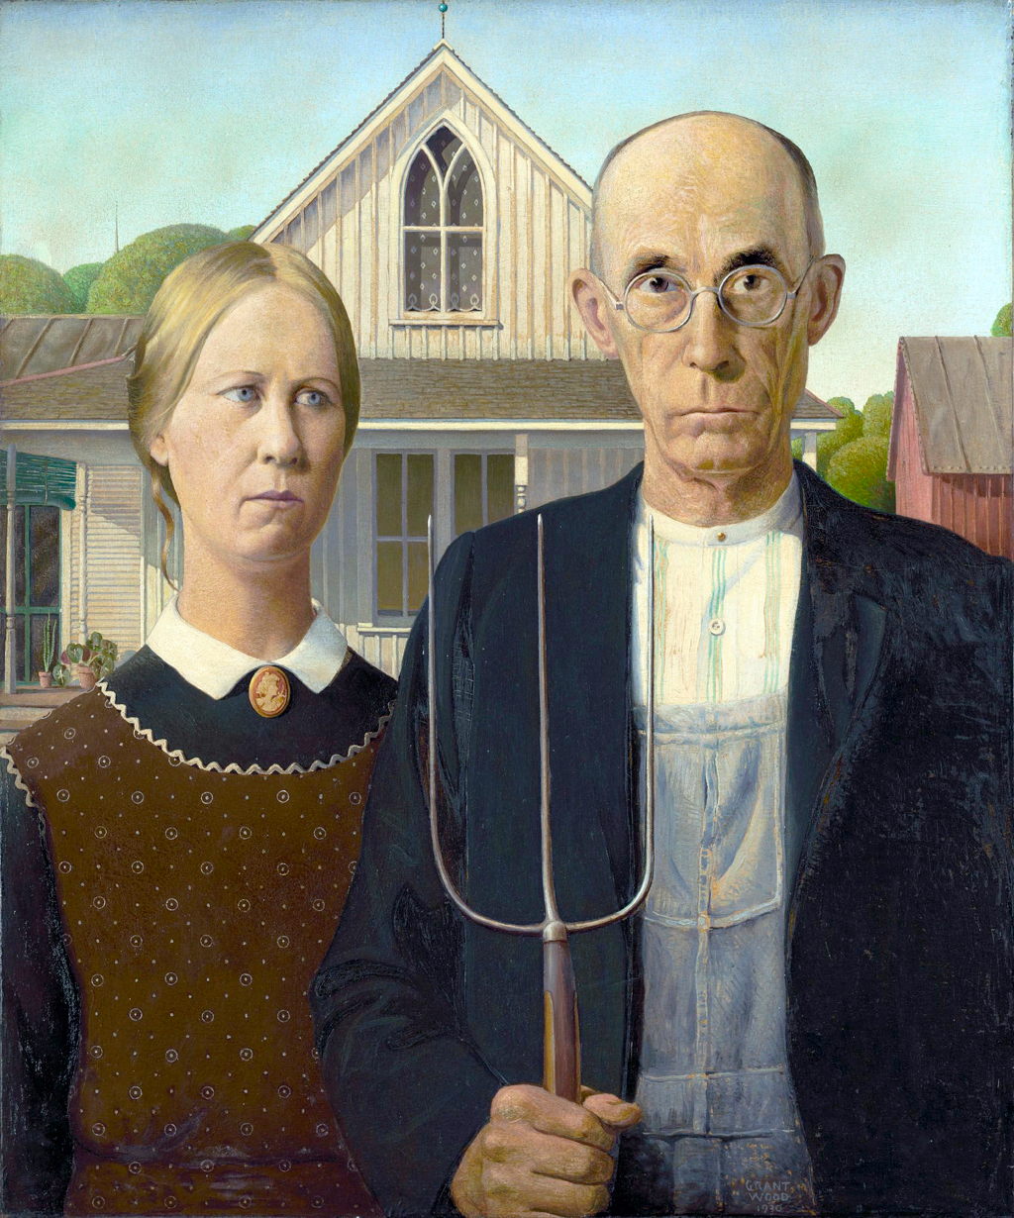
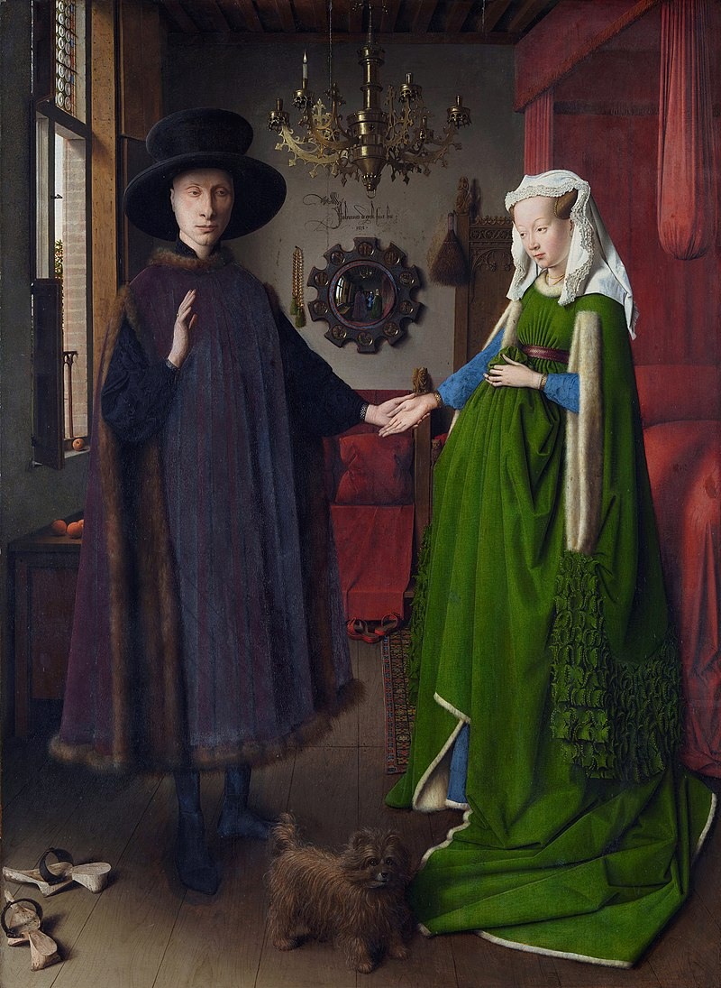
American Regionalism
Dibble House, Eldon, Iowa
“Carpenter Gothic”
Jan van Eyck, The Arnolfini Portrait, 1434
Grant Wood, American Gothic, 1930

Slide 3
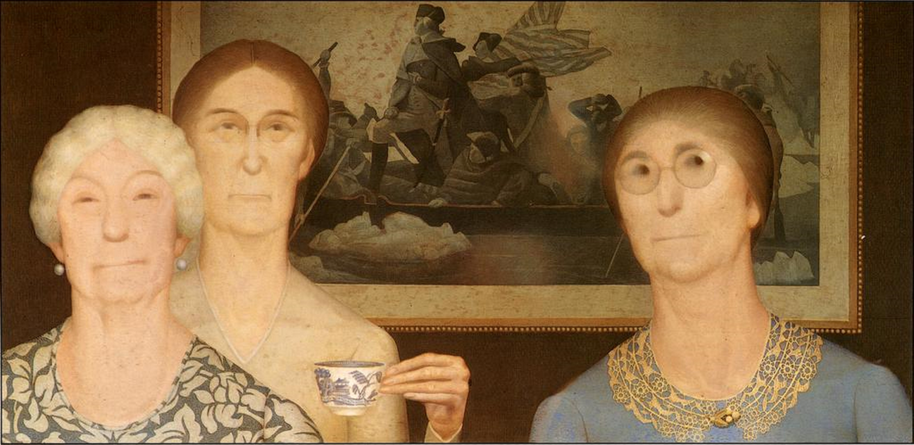
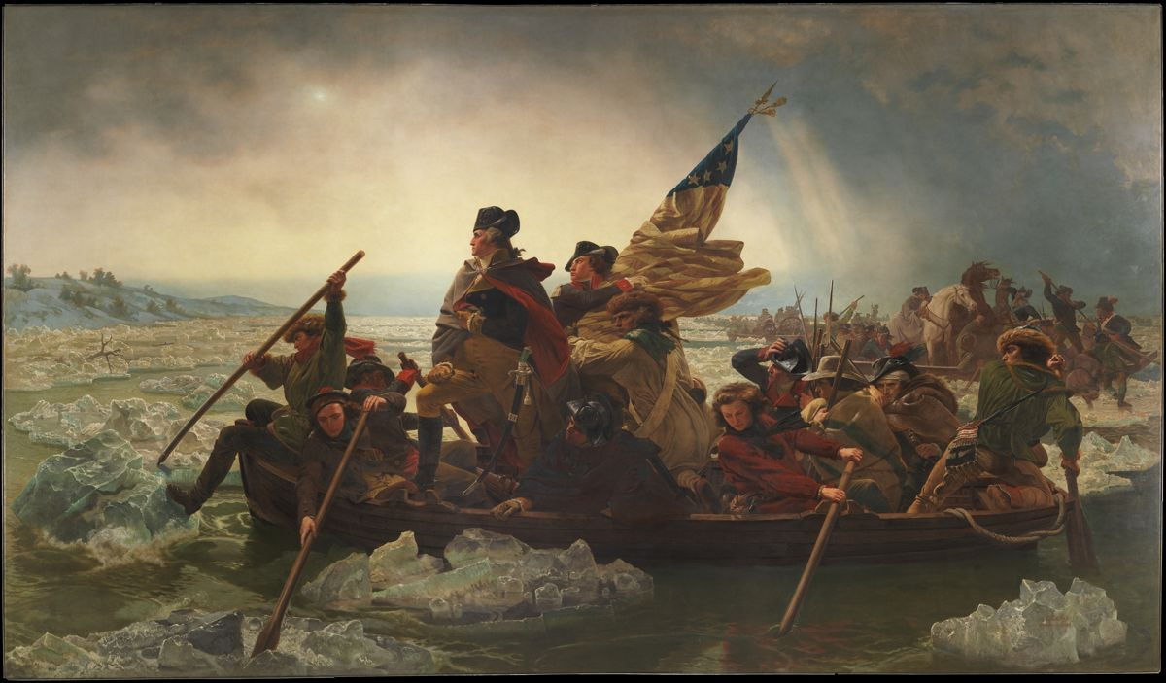
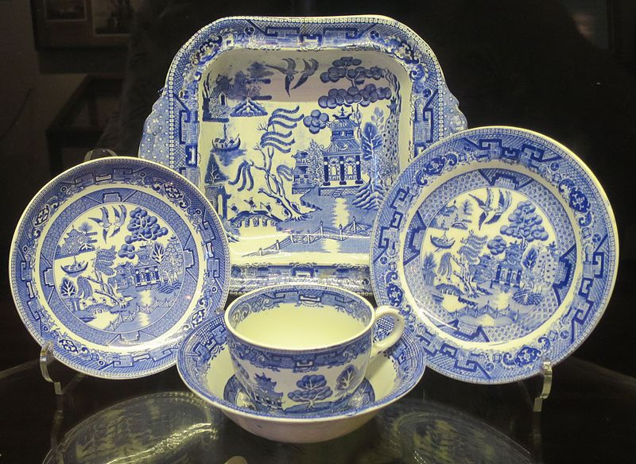
Grant Wood, Daughters of Revolution, 1932
Emanuel Leutze, Washington Crossing the Delaware, 1851
English Blue Willow Porcelain

Slide 4
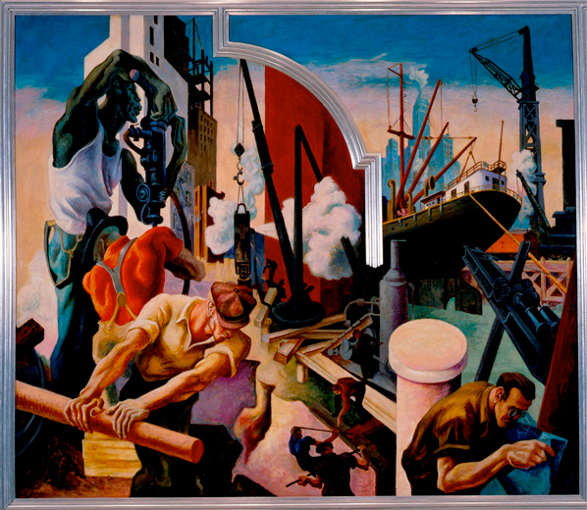
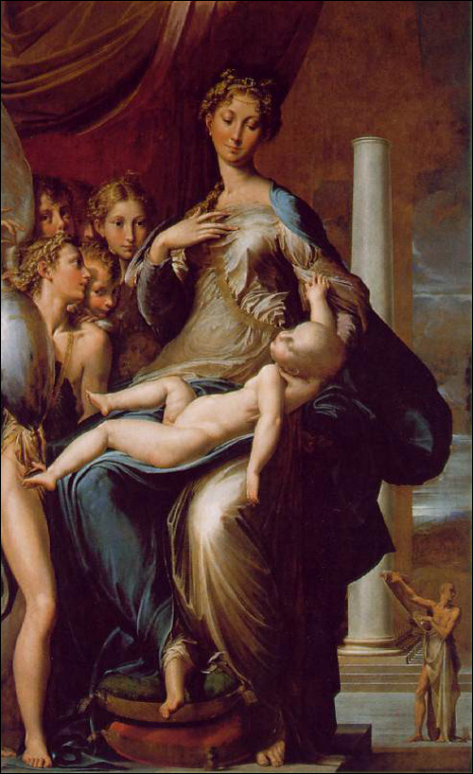
Thomas Hart Benton, America Today: City Building, 1930
Parmigianino, Madonna and Child with Angels and St. Jerome, 1535-40

Slide 5
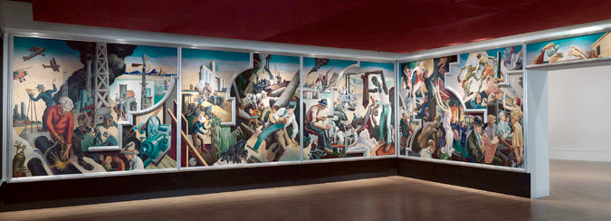
Original commission by Alvin Saunders Johnson in 1929 for The New School of Social Research Boardroom

Slide 6
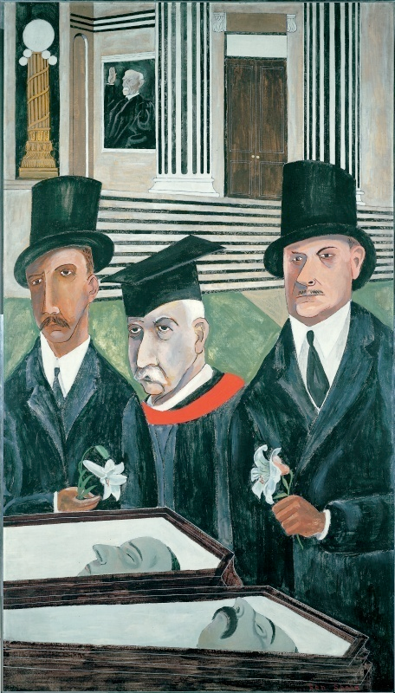
Social realism
Webster Thayer
Ben Shahn, Bartolomeo Vanzetti and Nicola Sacco, 1931-32
Ben Shahn, The Passion of Sacco and Vanzetti, 1931-32
Bartolomeo Vanzetti and Nicola Sacco in 1923

Slide 7
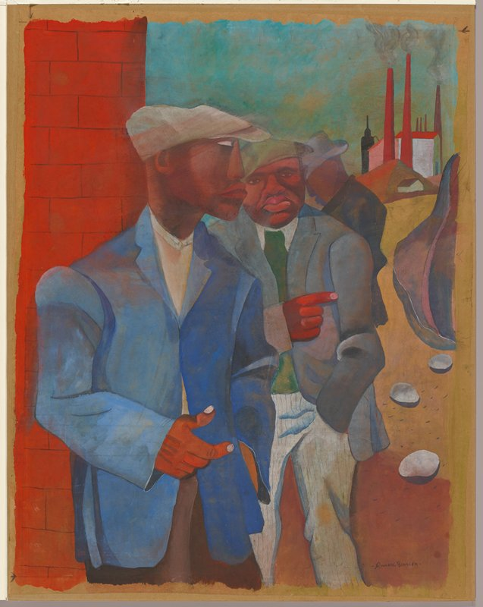
Social realism
Ben Shahn, The Passion of Sacco and Vanzetti, 1931-32
Romare Bearden, Factory Workers, 1942

Slide 8
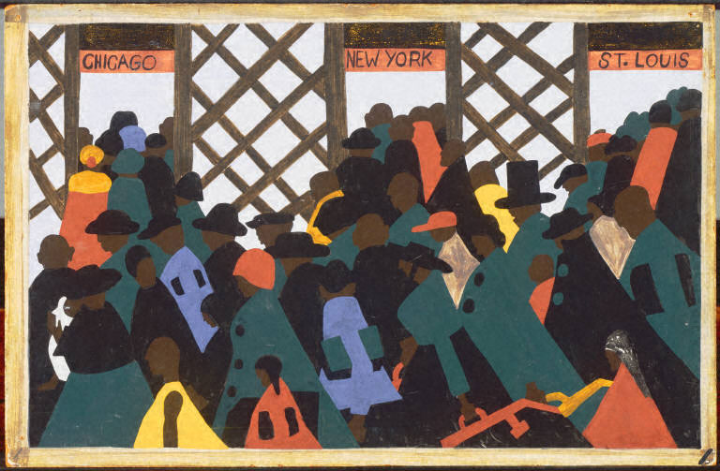
Jacob Lawrence, Migration series, 1940-41
Panel No. 1: During World War I there was a great migration north by Southern African Americans
Panel No. 15: There Were Lynchings

Slide 9
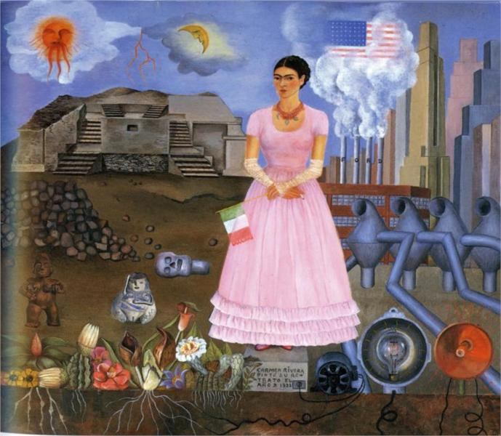
“We Surrealists pronounced ourselves in favour of changing the imperialist war, in its chronic and colonial form, into a civil war. Thus we placed our energies at the disposal of the revolution, of the proletariat and its struggles, and defined our attitude towards the colonial problem, and hence towards the colour question.” Paris Group, open letter to Paul Claudel, 1925
Frida Kahlo, Self Portrait on the Border Between Mexico and the United States, 1932
Frida Kahlo, The Two Fridas, 1939

Slide 10
“My painting is an act of decolonization not in a physical sense, but in a mental one.” Wifredo Lam
Wilfredo Lam, The Jungle, 1943

Slide 11
Diego Rivera working on the fresco
30 Rockefeller Center, NYC

Slide 12
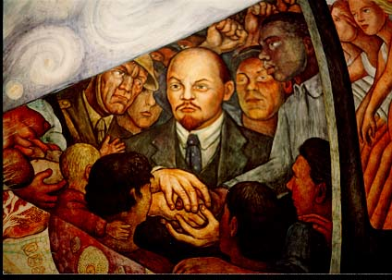
Diego Rivera, Man Controller of the Universe, 1933

Slide 13
Diego Rivera, Man Controller of the Universe, 1934
Palacio de Bellas Artes, Mexico City

Slide 14
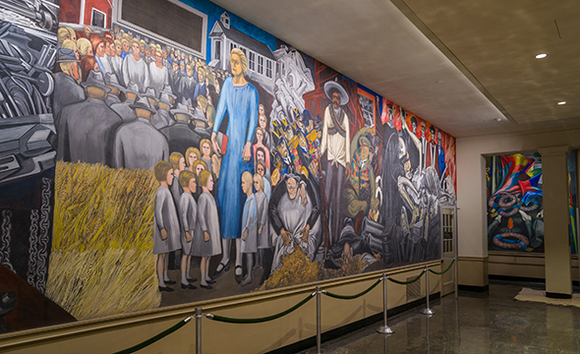
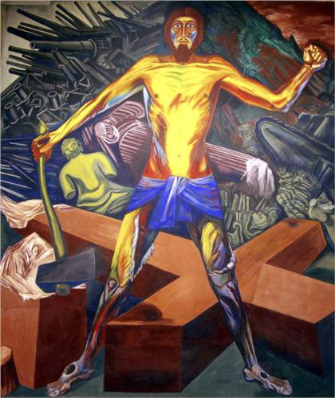
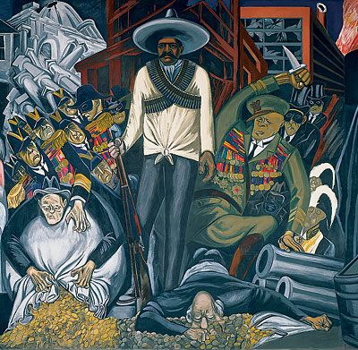
José Clemente Orozco, The Epic of American Civilization, 1934 Reading Room, Baker Memorial Library, Dartmouth College
Modern Migration of the Spirit
Hispano-America

Slide 15
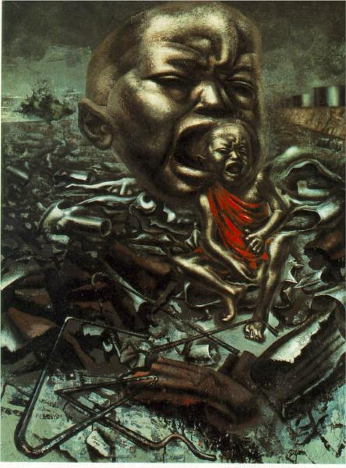
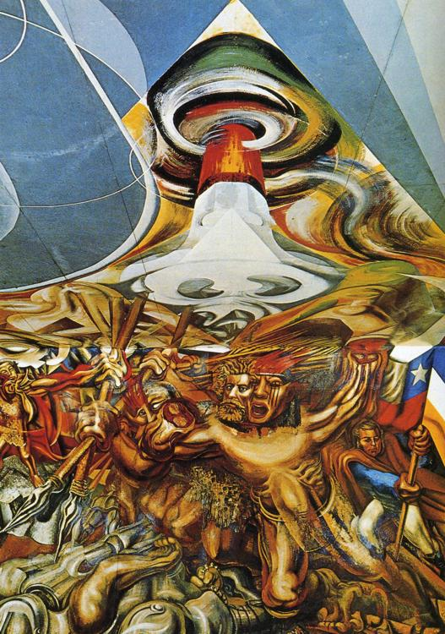
David Alfaro Siqueiros, Echo of a Scream, 1937
David Alfaro Siqueiros, Death to the Invaders, 1941-42

Slide 16
Towards Abstract Expressionism
Jackson Pollock, Going West, 34-35
Jackson Pollock, Guardians of the Secret, 1943
Pablo Picasso, Guernica, 1937
Rufino Tamayo, Animals, 1941

Slide 17
Gestural abstraction
Formal exploration of the medium
“To achieve autonomy, painting has had above all to divest itself of everything it might share with sculpture, and it is in its effort to do this, and not so much…to exclude the representational or literary, that painting has made itself abstract.”
Clement Greenberg, “Modernist Painting,” 1960
Jackson Pollock, Mural, 1943
Action painting- painting as a performance
“At a certain moment the canvas began to appear to one American painter after another as an arena in which to act. What was to go on the canvas was not a picture but an event.”
Harold Rosenberg, “The American Action Painters,” 1952
Jackson Pollock Autumn Rhythm: Number 30, 1950

Slide 18
“The New York School”
All over composition
Flattening of the pictorial space
Changing relationship between figure and ground
Lee Krasner, Shattered Color, 1947
Lee Krasner, Night Creatures, 1965

Slide 19
Towards chromatic abstraction
Mark Rothko, Entrance to the Subway, 1938
Mark Rothko, Oedipus, 1940

Slide 20
Joan Miró, Harlequin’s Carnival, 1924
Mark Rothko, Slow Swirl at the Edge of the Sea, 1944

Slide 21
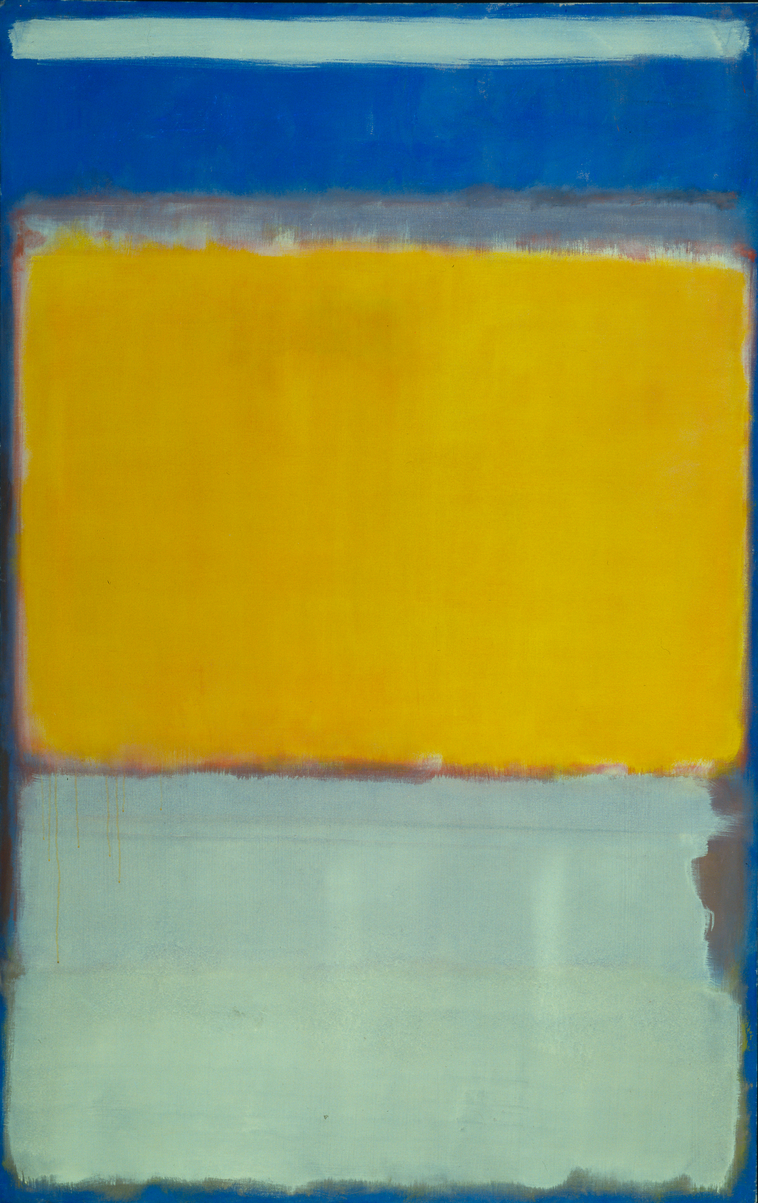
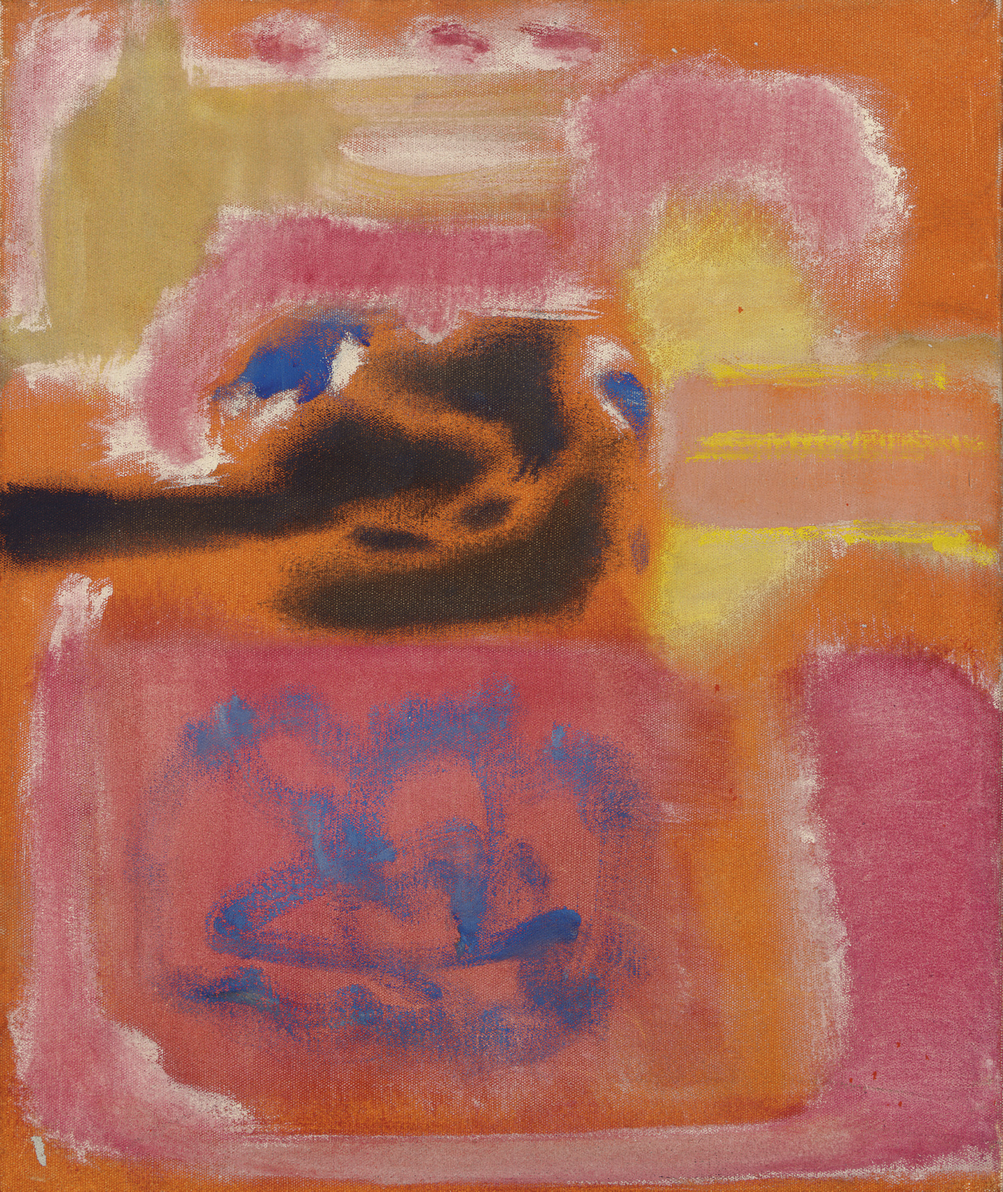
multiforms
Mark Rothko, No. 9, 1947
Mark Rothko, No. 10, 1950

Slide 22
Chromatic Abstraction and Color Field Painting
Robert Rosenblum, “The Abstract Sublime,” 1961
Mark Rothko, No. 16 (Red, Brown, and Black), 1958

Slide 23
“zip”
Barnett Newman, The Beginning, 1946
Barnett Newman, Onement I, 1948

Slide 24
Barnett Newman, Vir heroicus sublimis, 1950-51, 1948

