Slide 1
Postwar Abstraction
From Abstract Expressionism to Post-painterly Abstraction and Minimalism

Slide 2
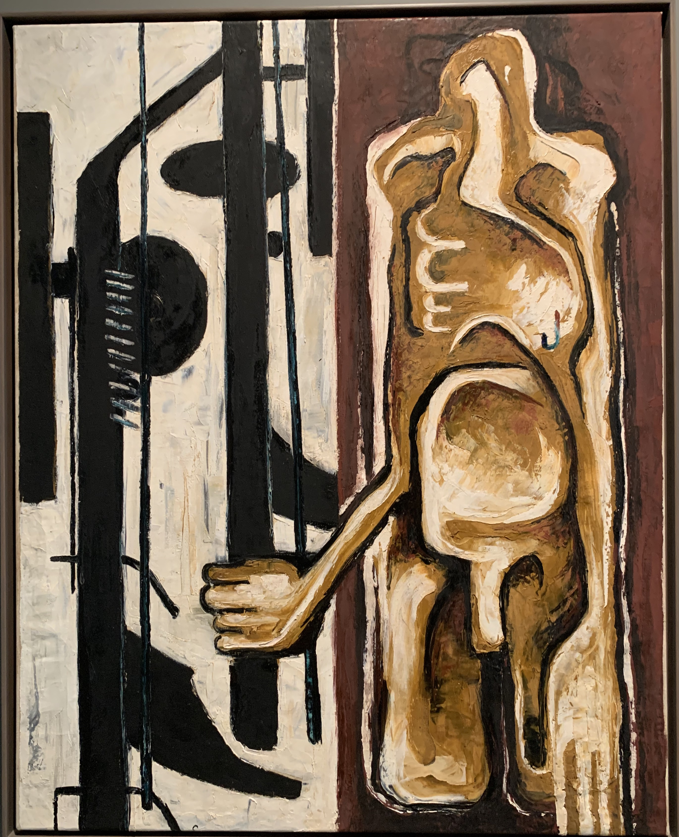
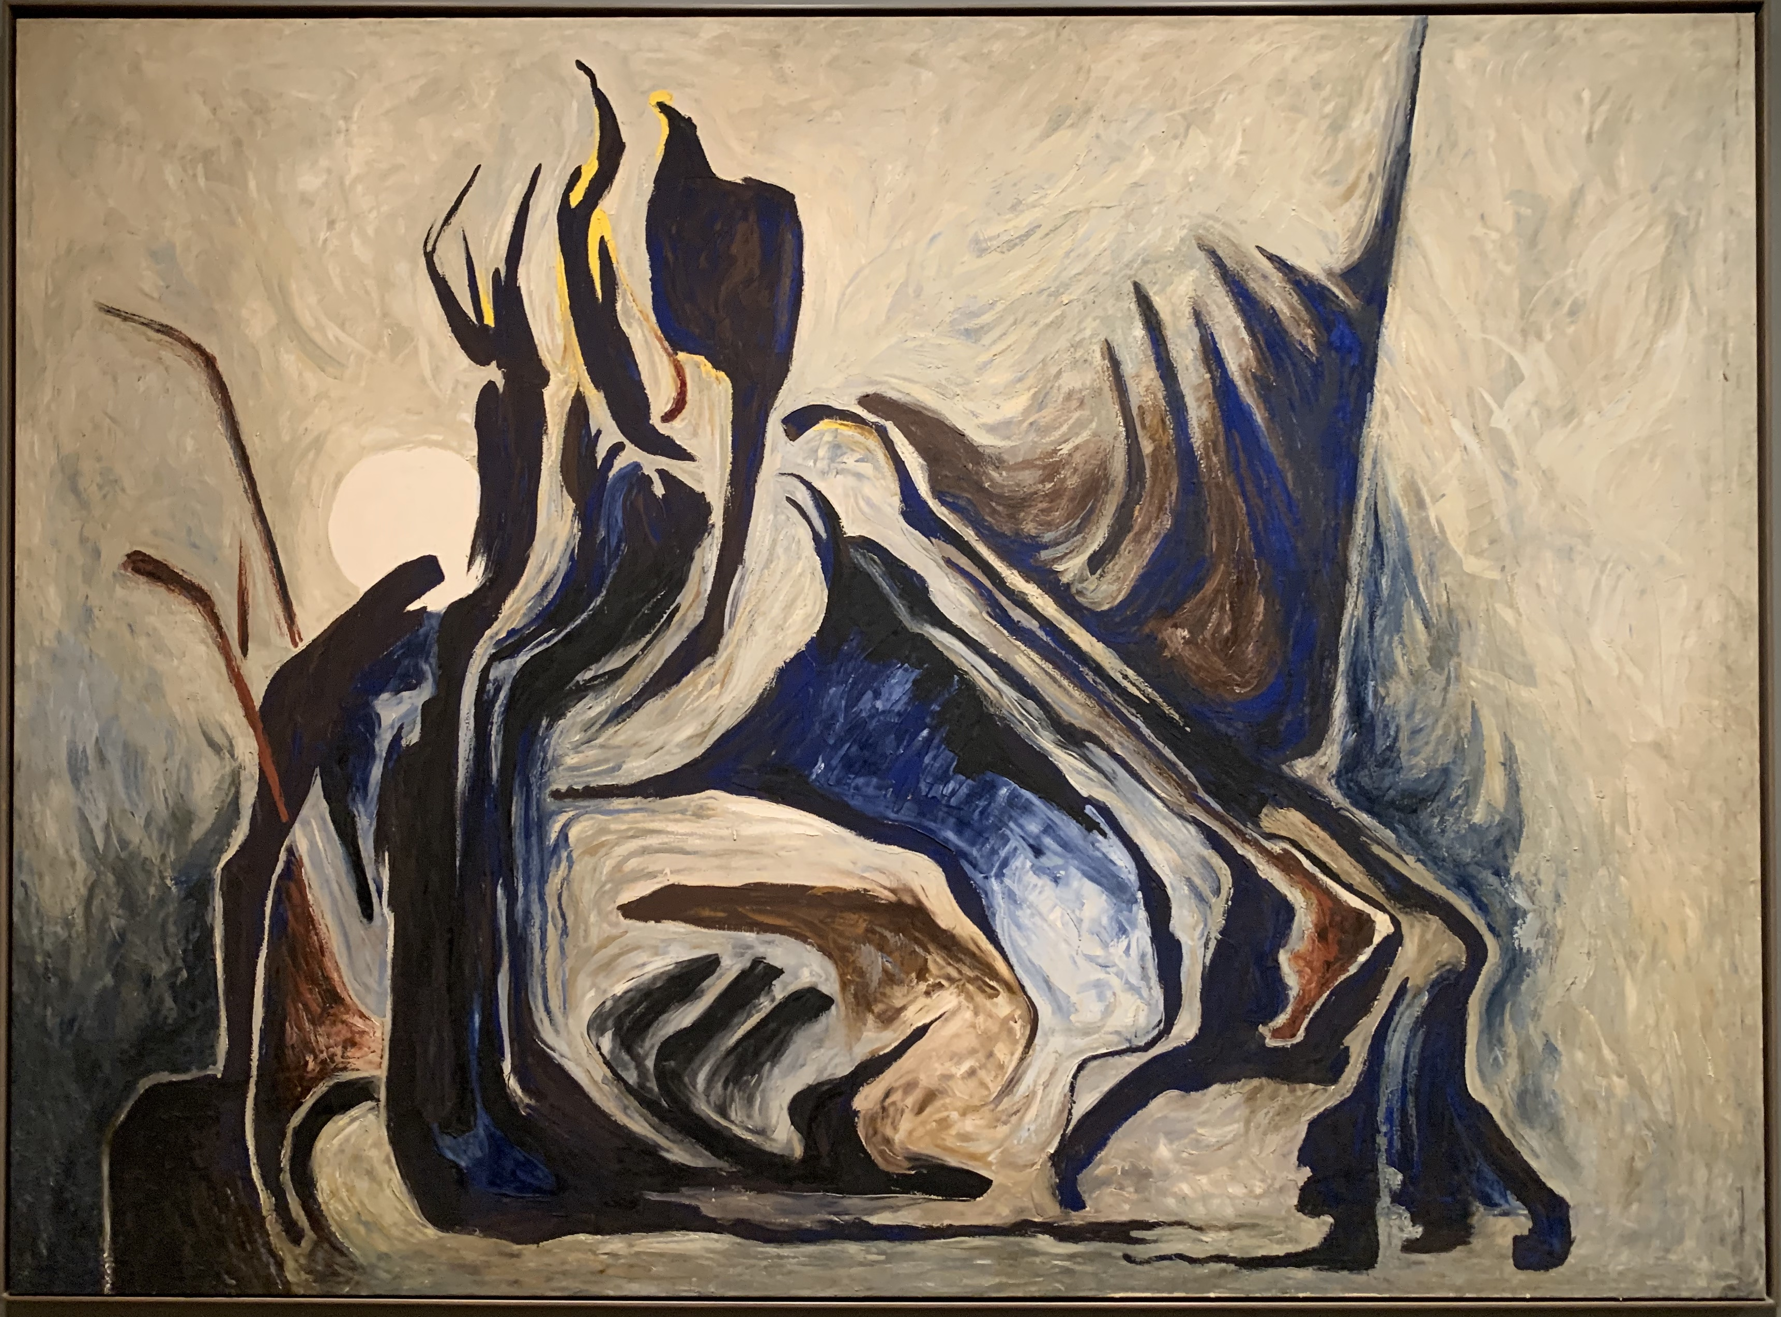
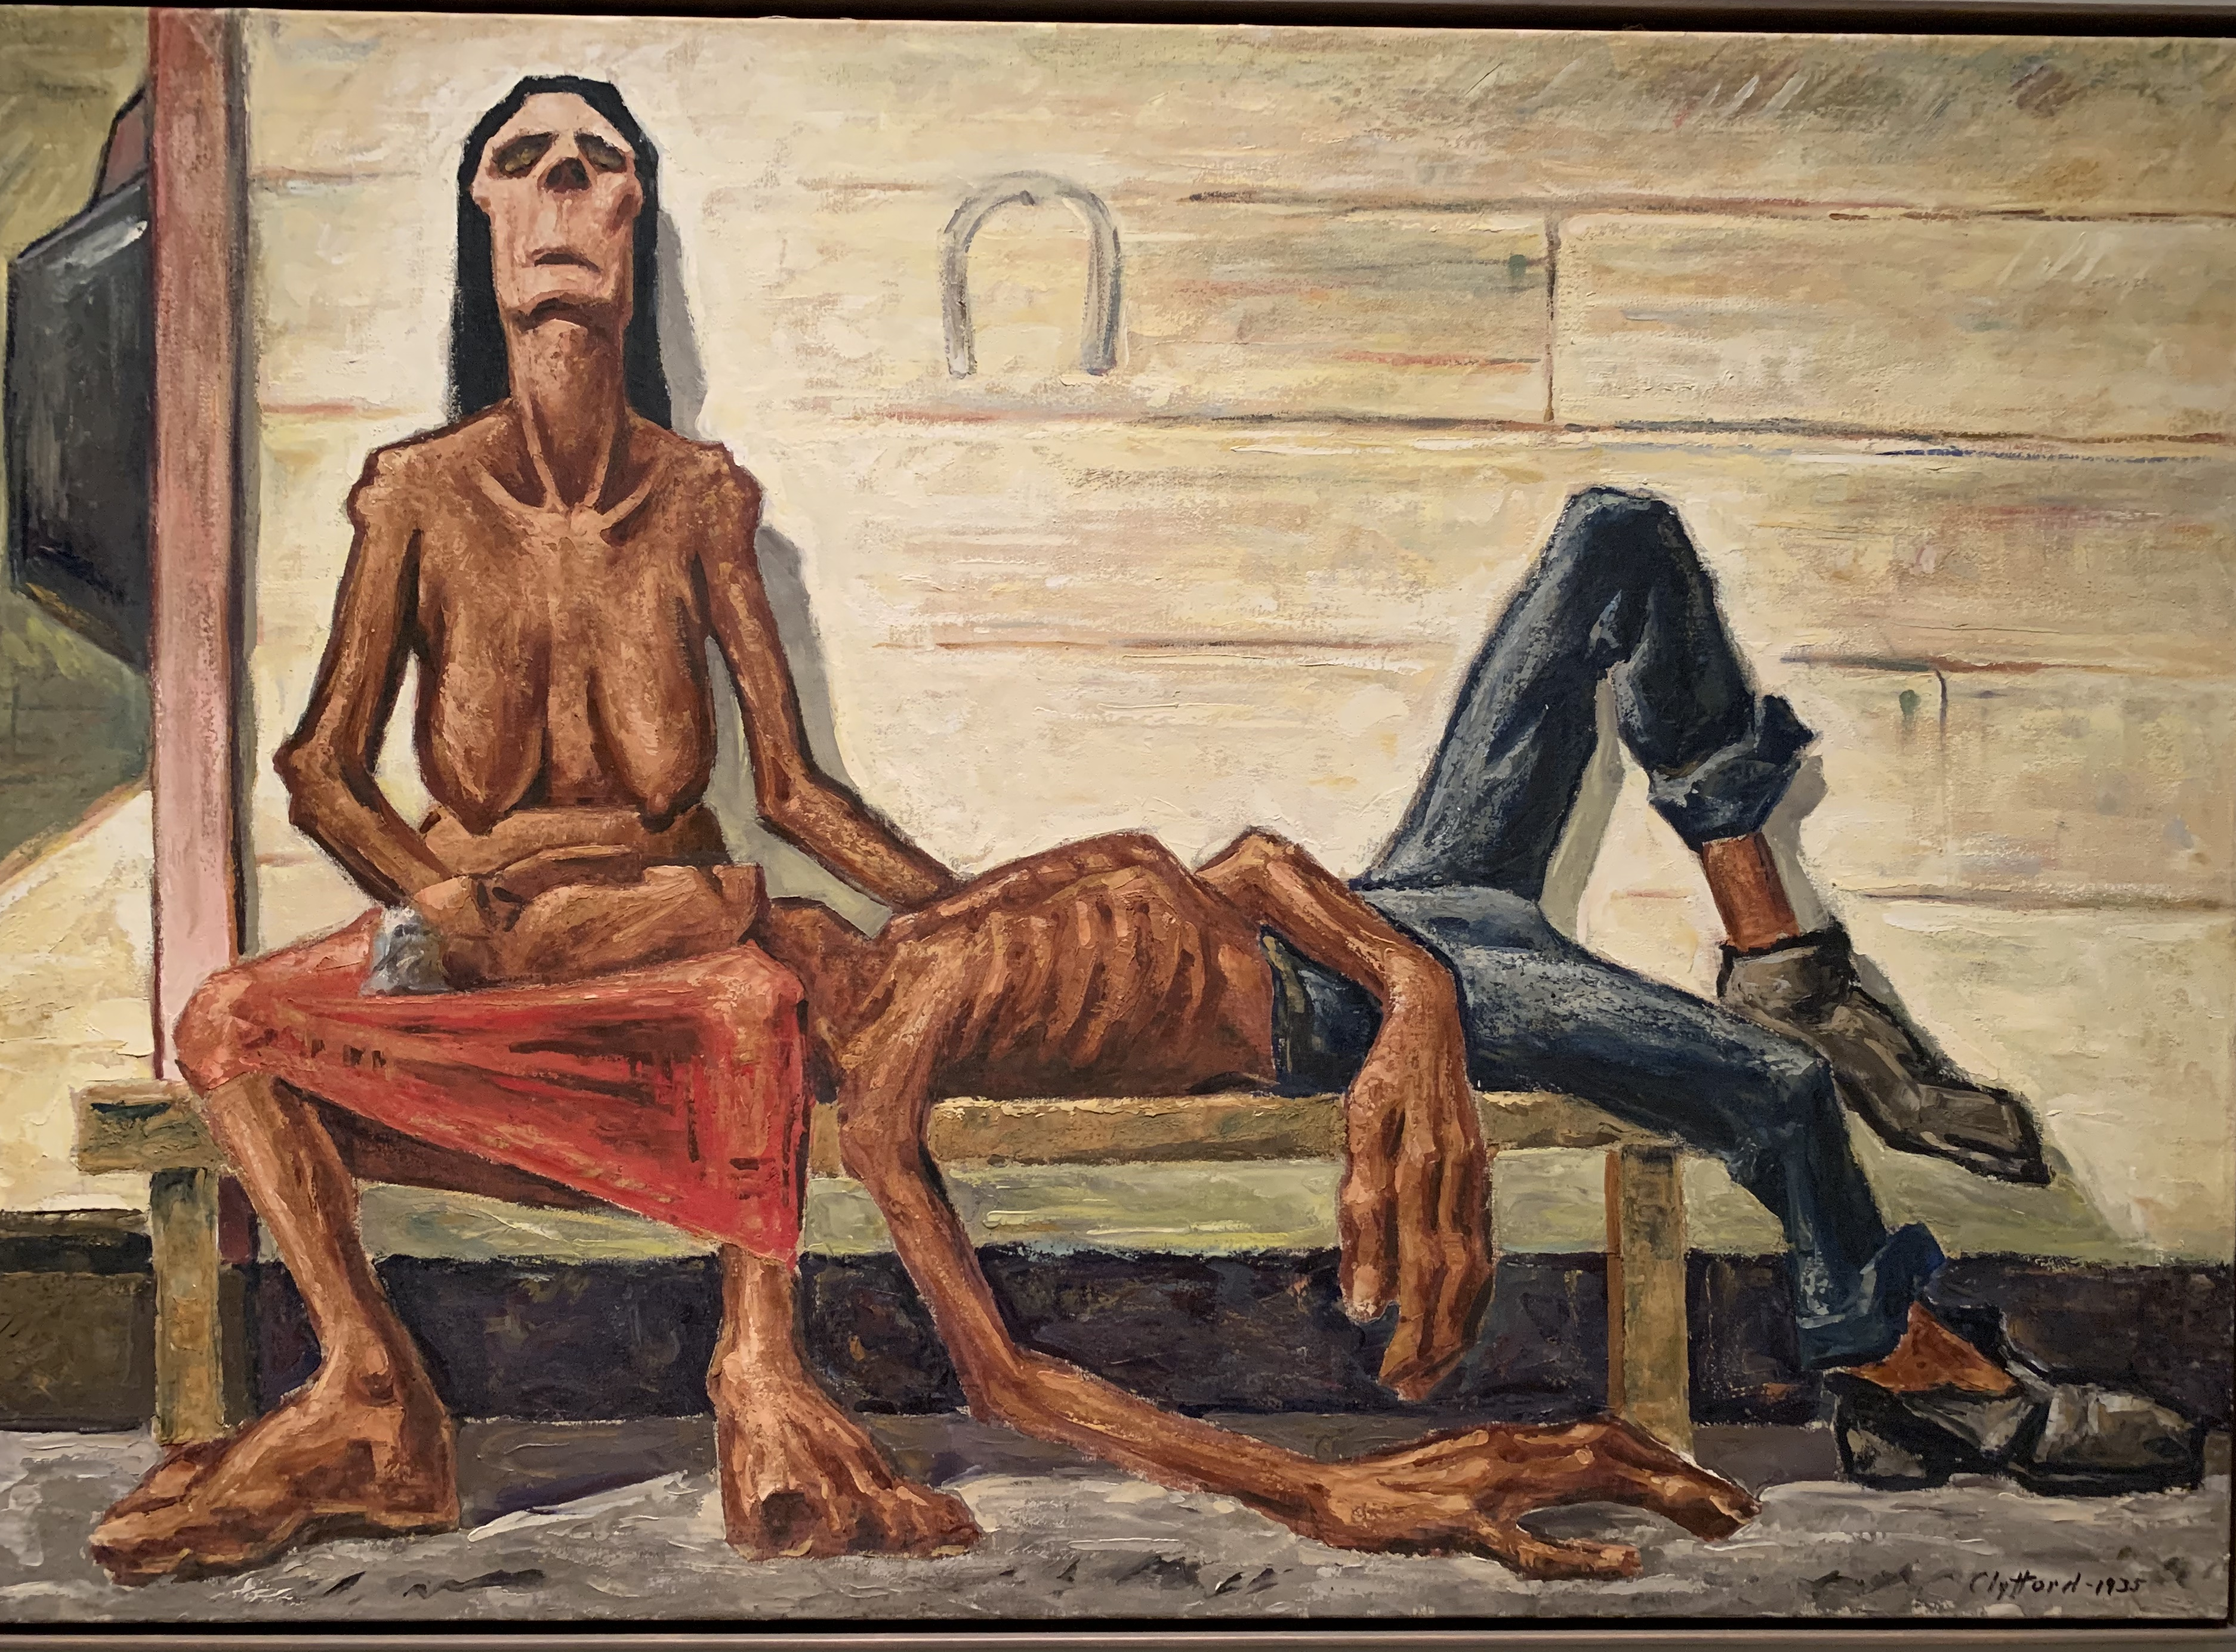
Towards Abstraction: Clyfford Still
Clyfford Stll, PH-79, 1935
Clyfford Still, PH-343, 1937
Clyfford Still, PH-255, 1944

Slide 3
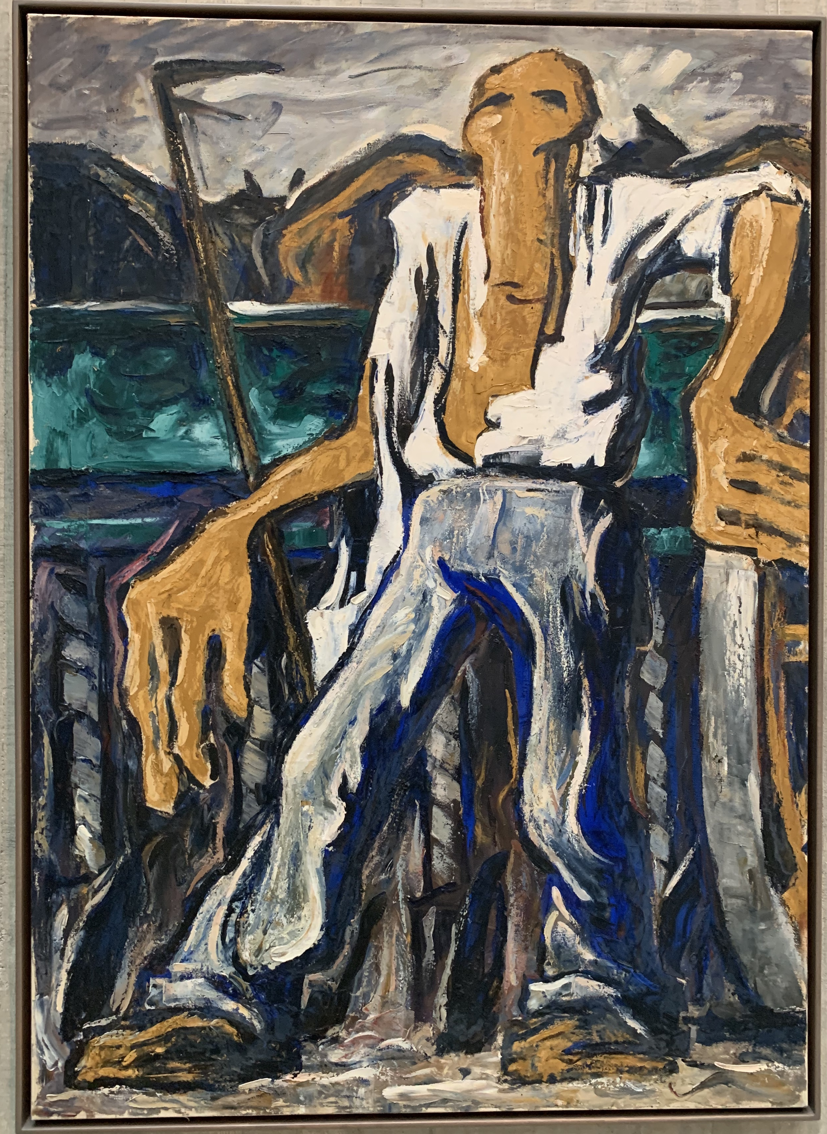
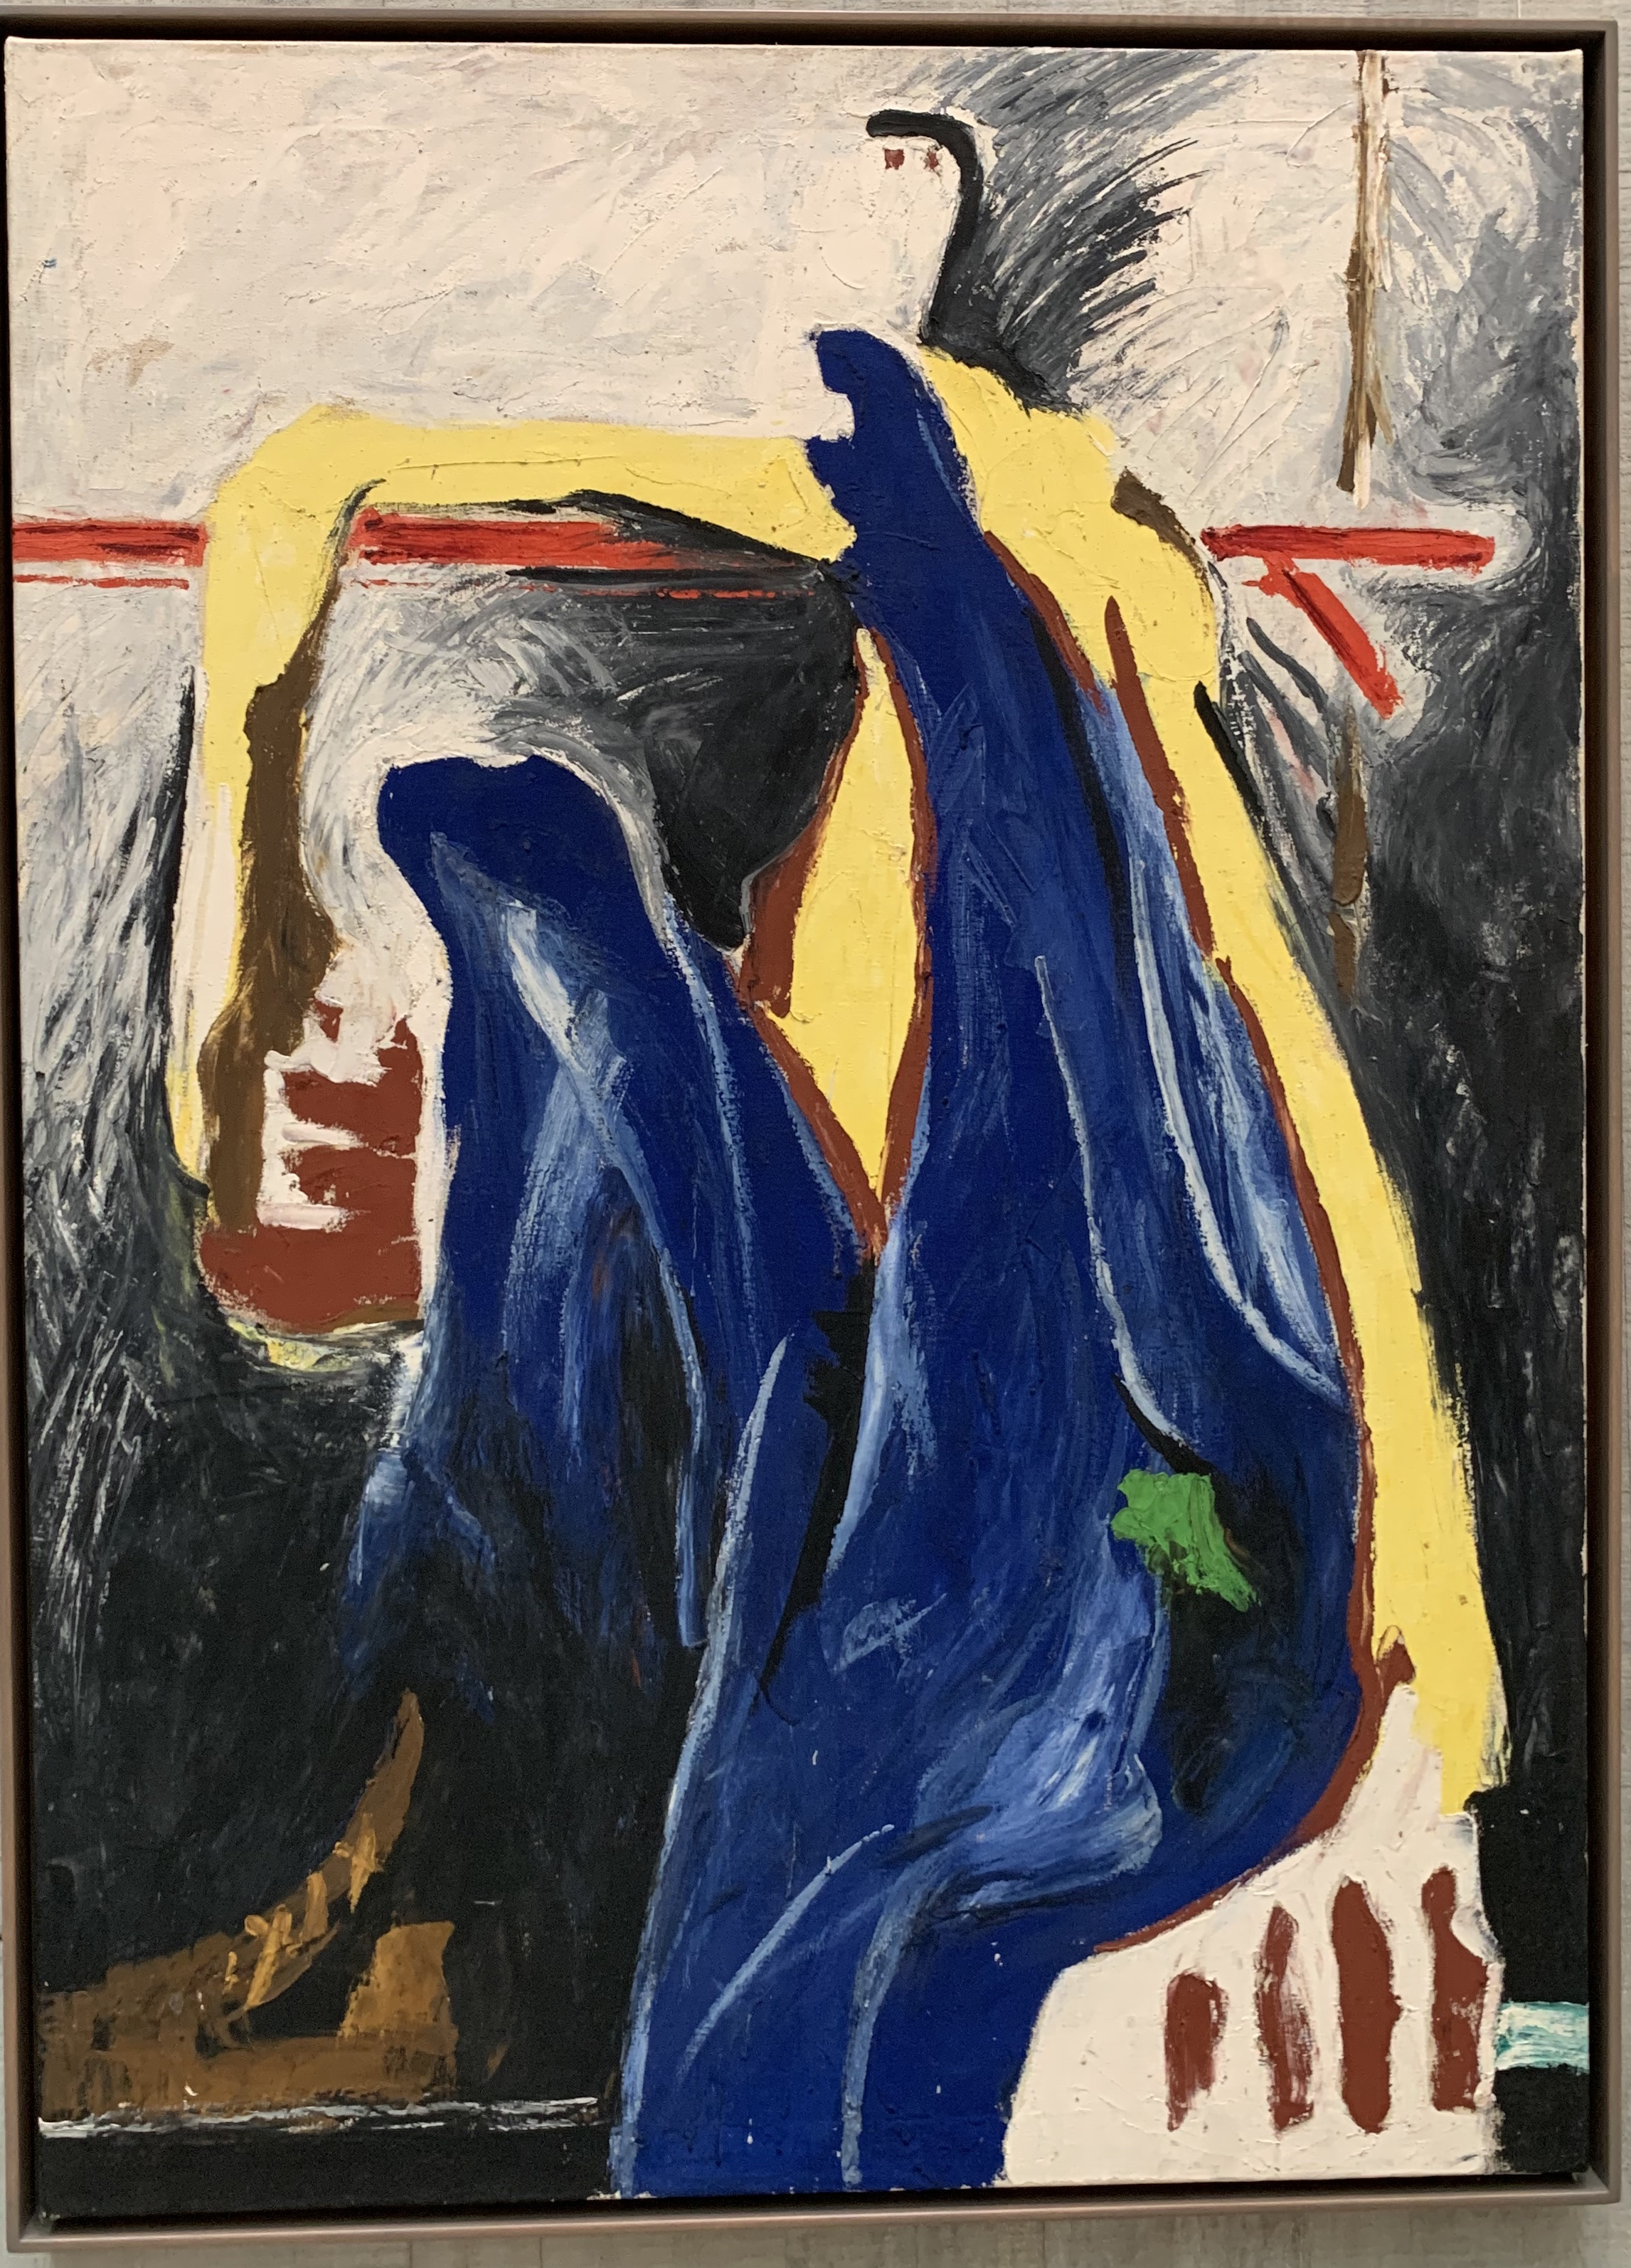
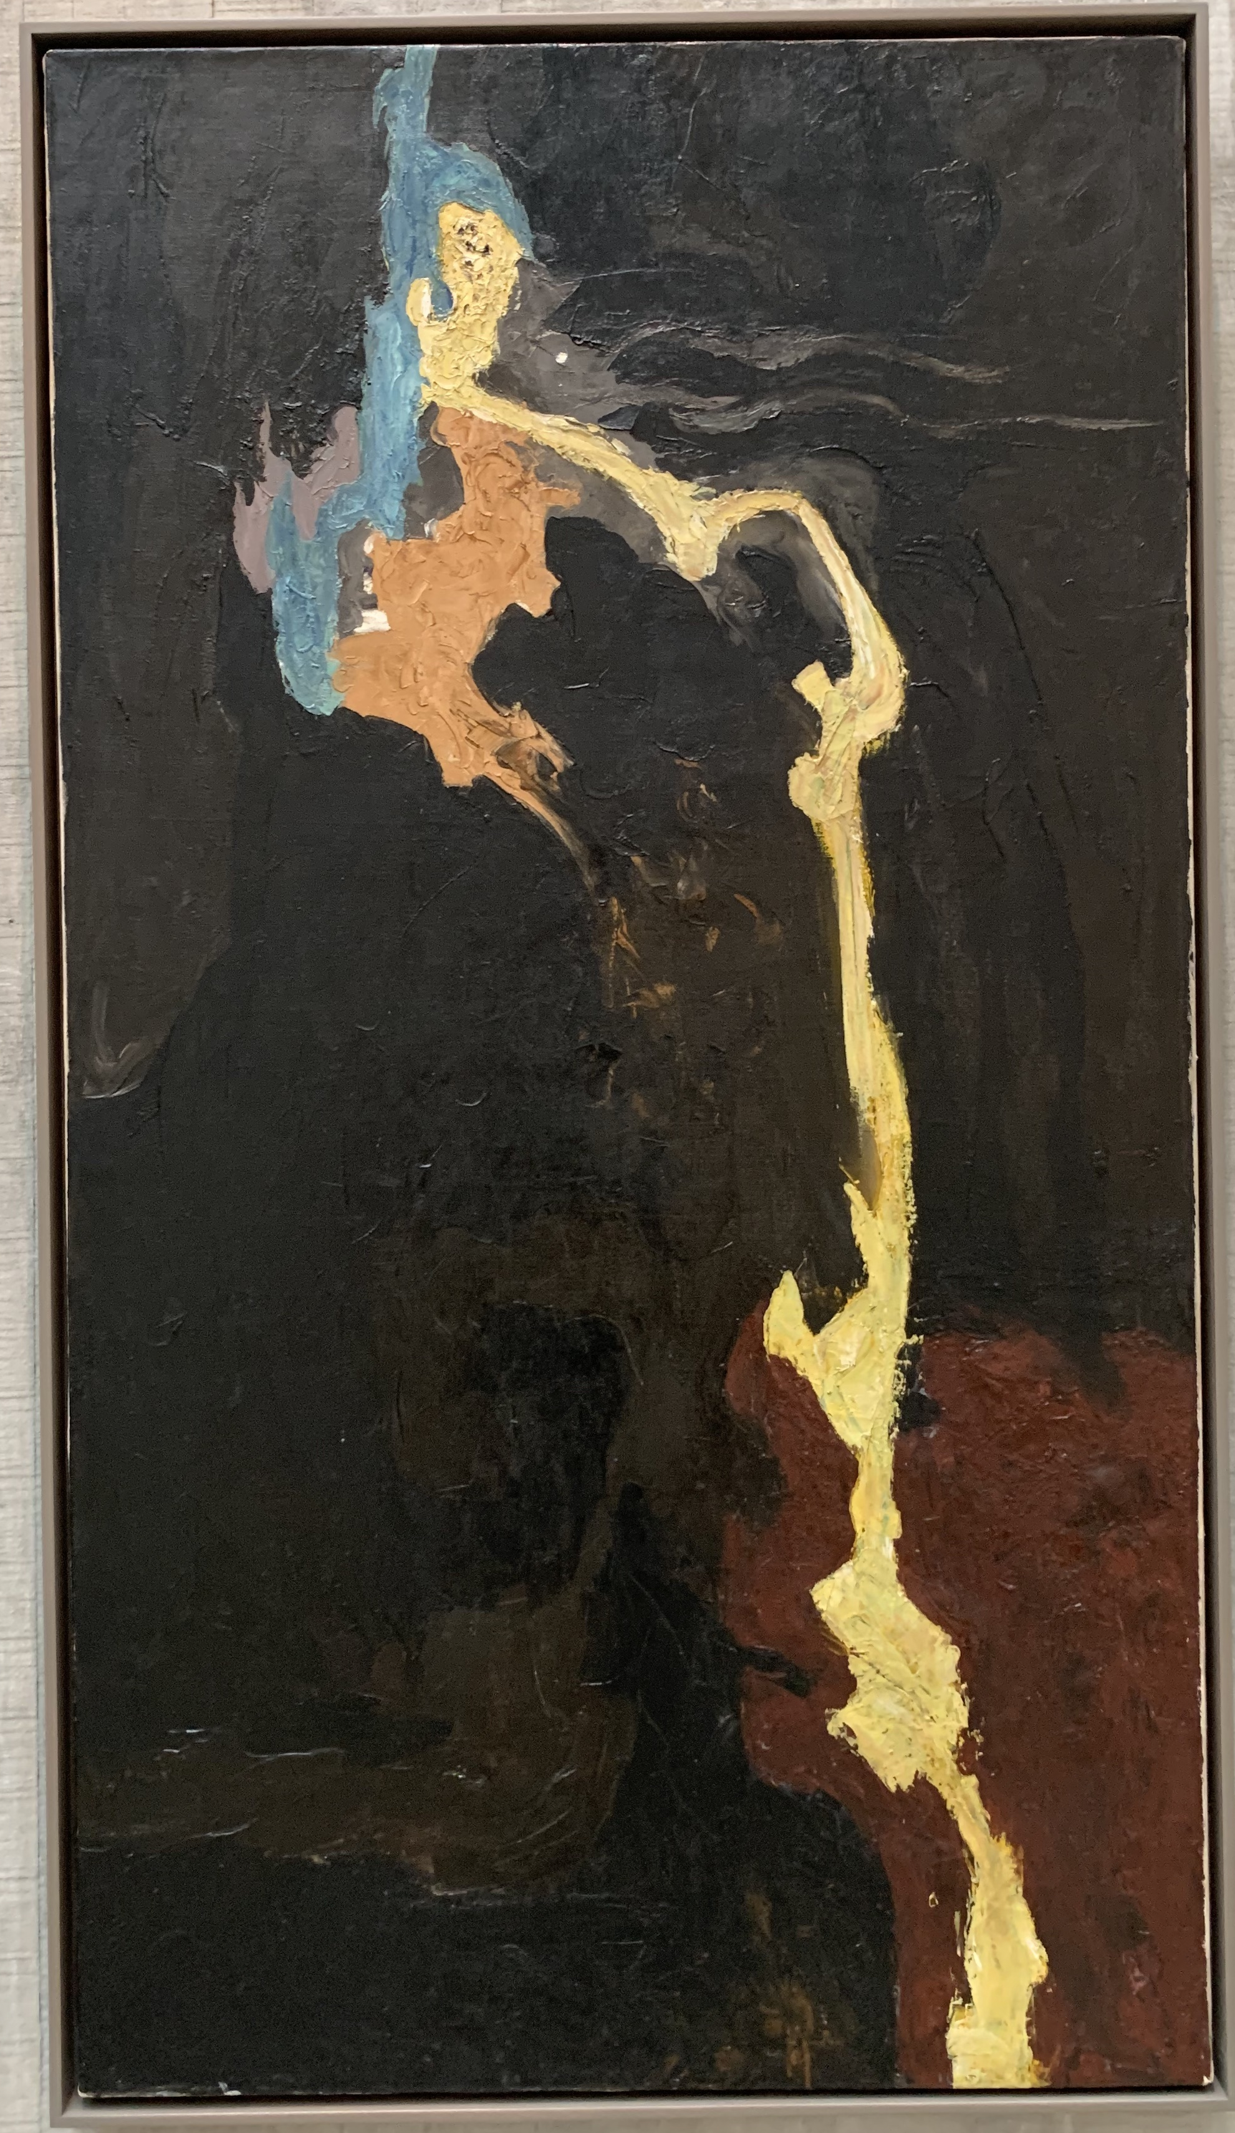
Abstracting the figure
“Lifeline”
Clyfford Still, PH-341, 1936
Clyfford Still, PH-324, 1936
Clyfford Still, PH-68, 1945

Slide 4
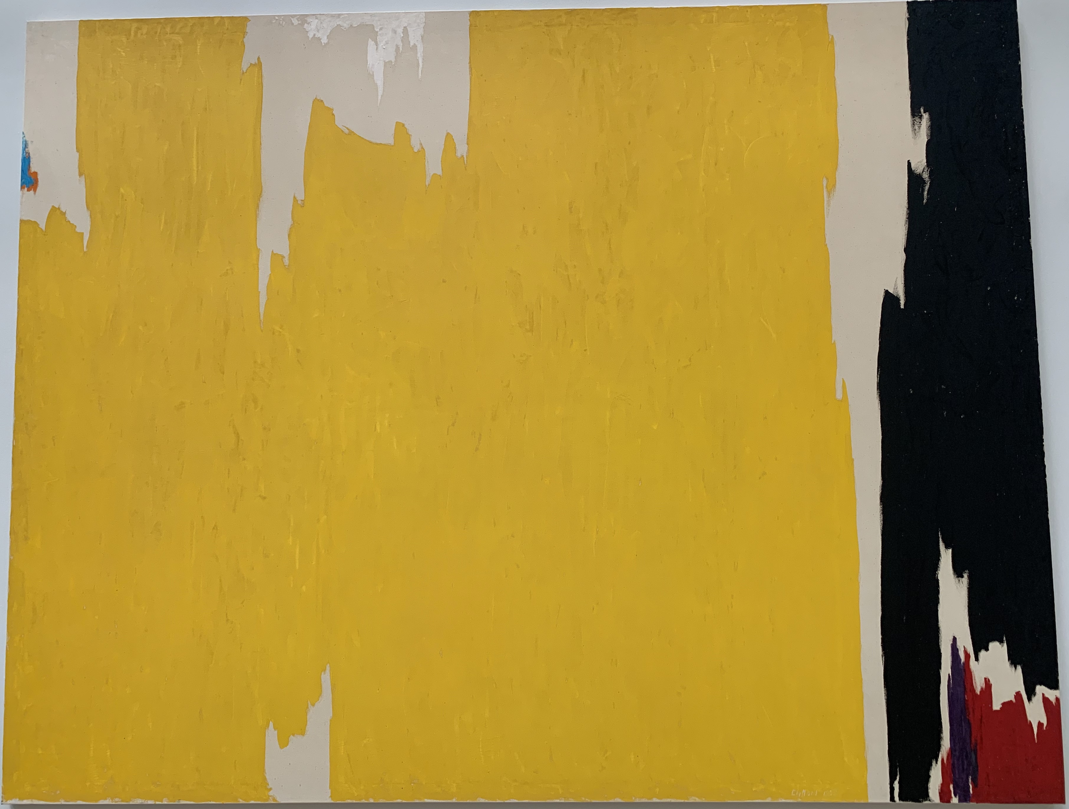
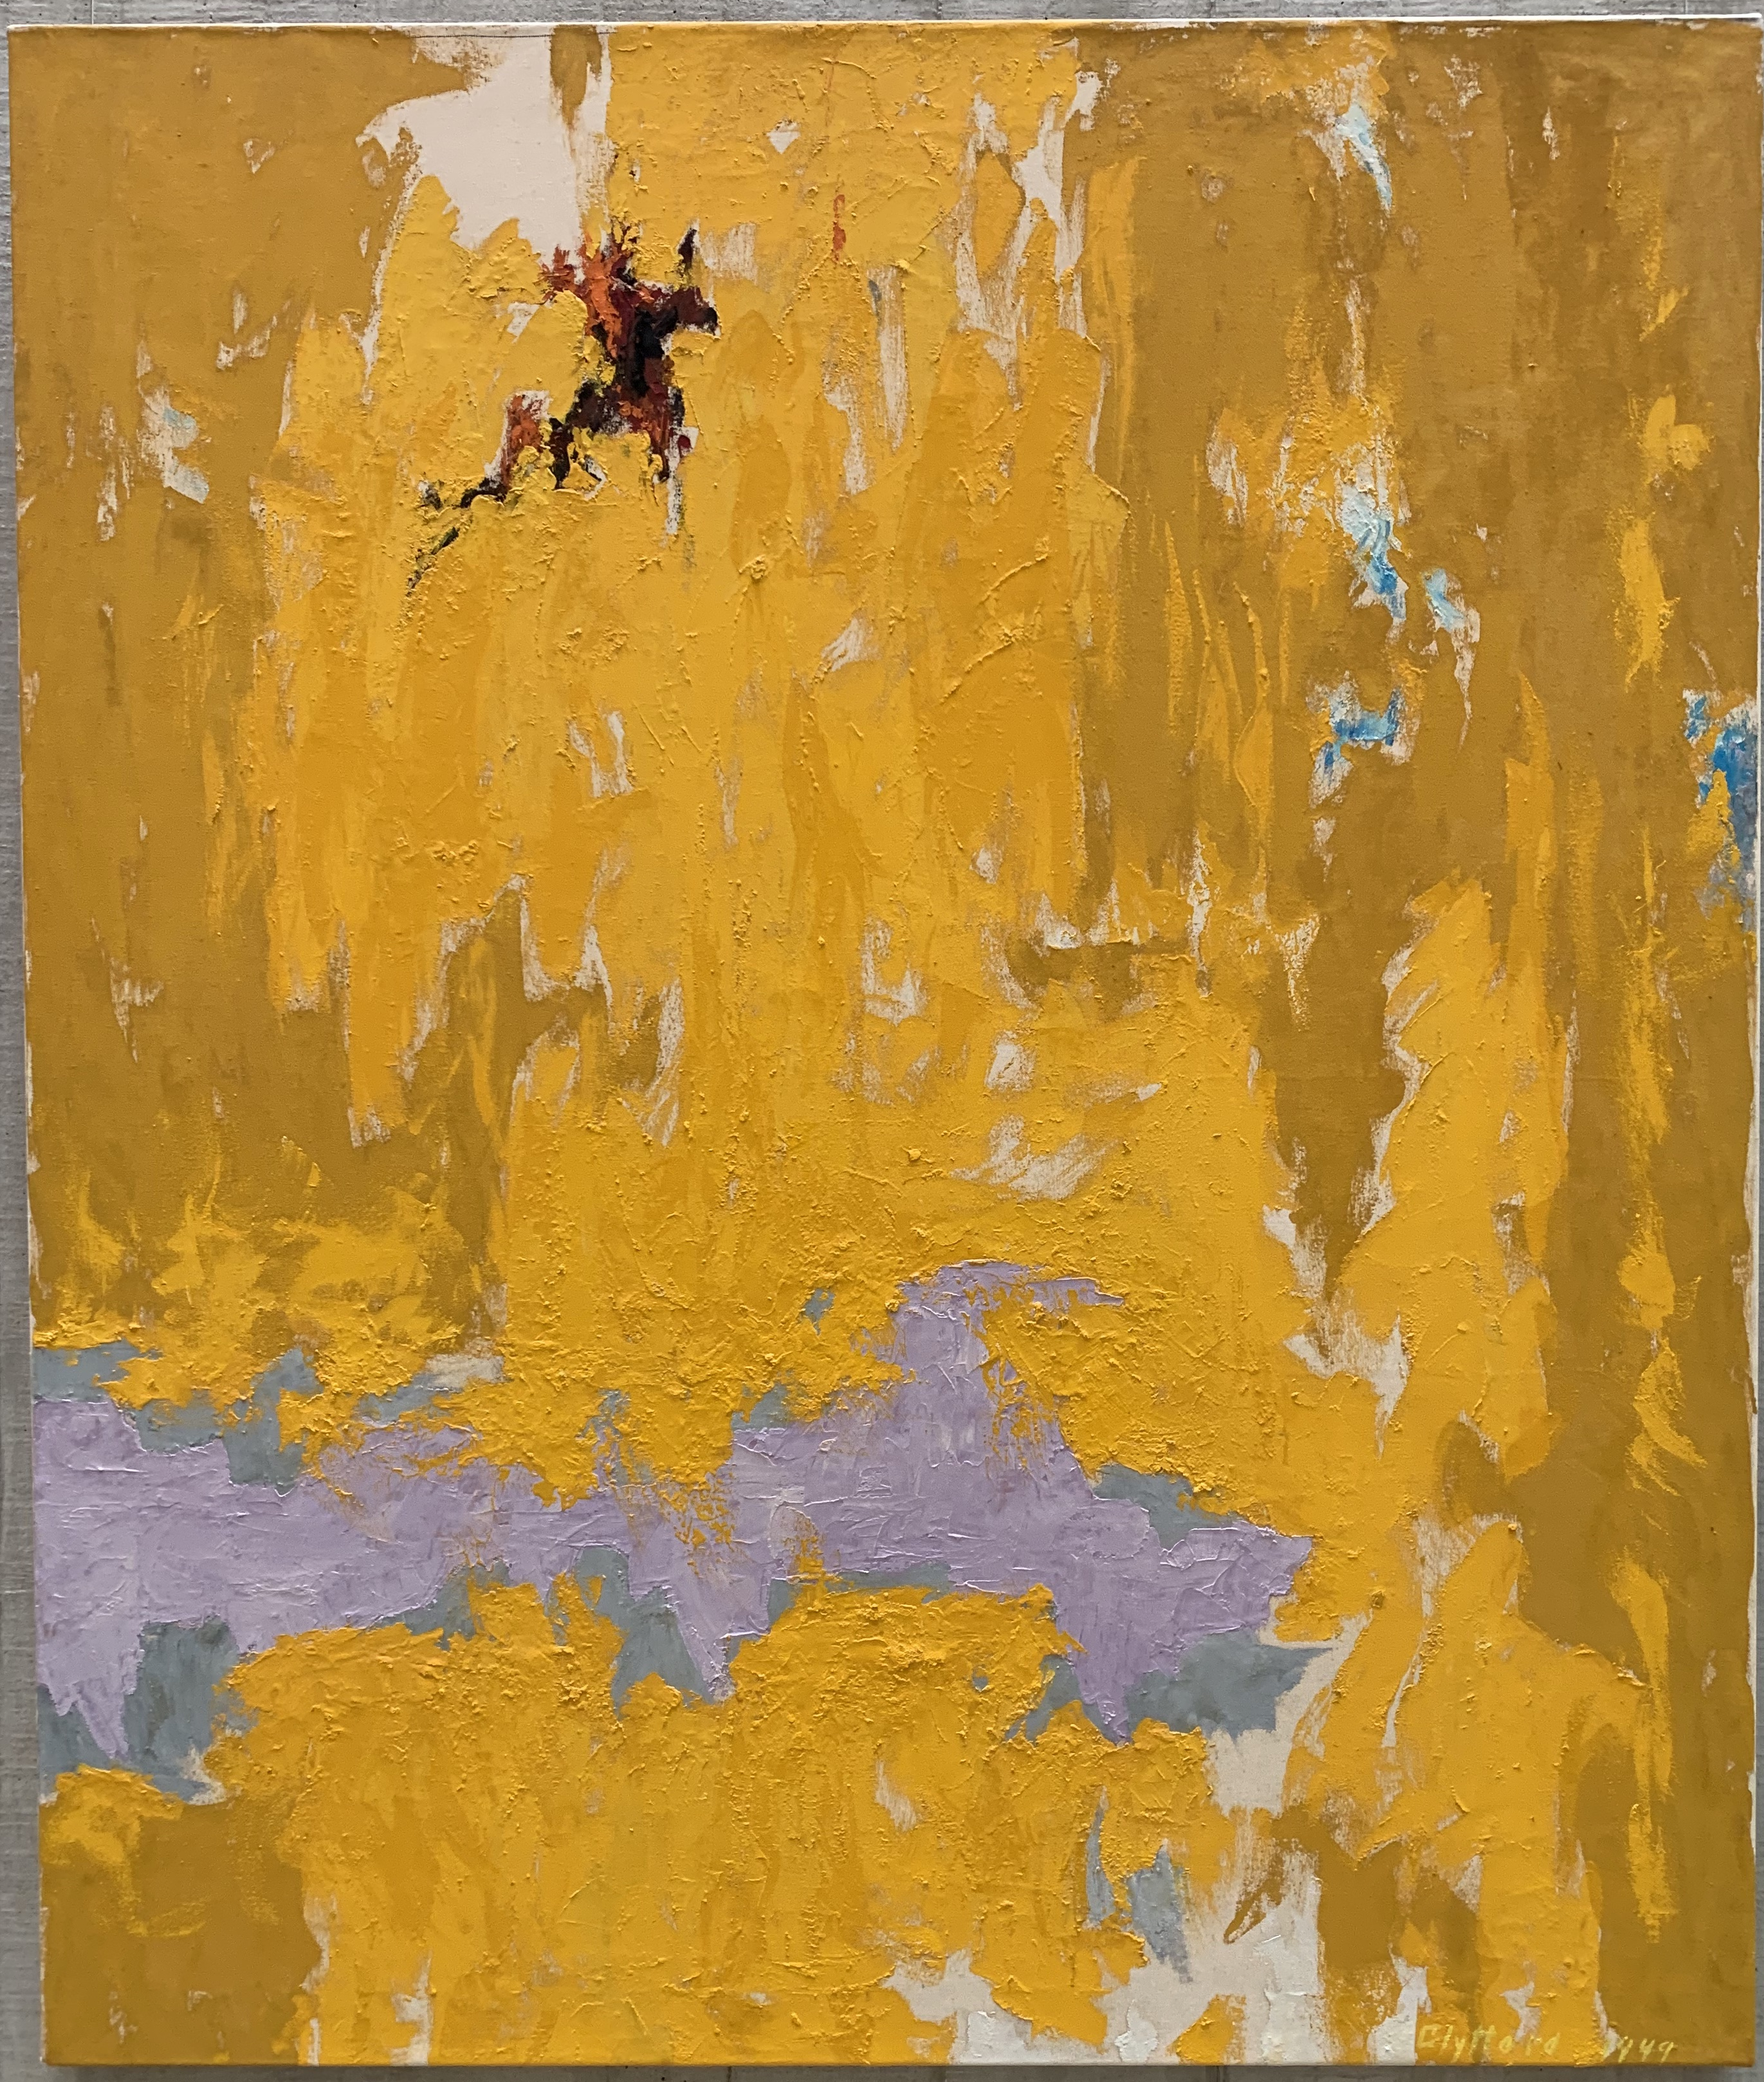
Clyfford Still, PH-129, 1949
Clyfford Still, PH-977, 1957

Slide 5
Towards chromatic abstraction: Mark Rothko
Mark Rothko, Entrance to the Subway, 1938
Mark Rothko, Oedipus, 1940

Slide 6
Joan Miró, Harlequin’s Carnival, 1924
Mark Rothko, Slow Swirl at the Edge of the Sea, 1944

Slide 7
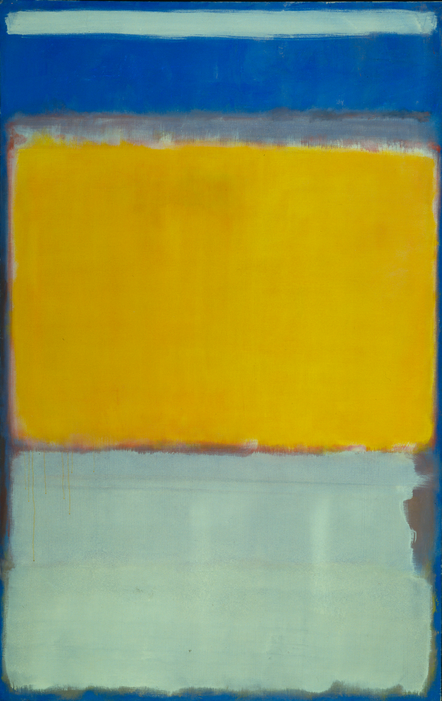
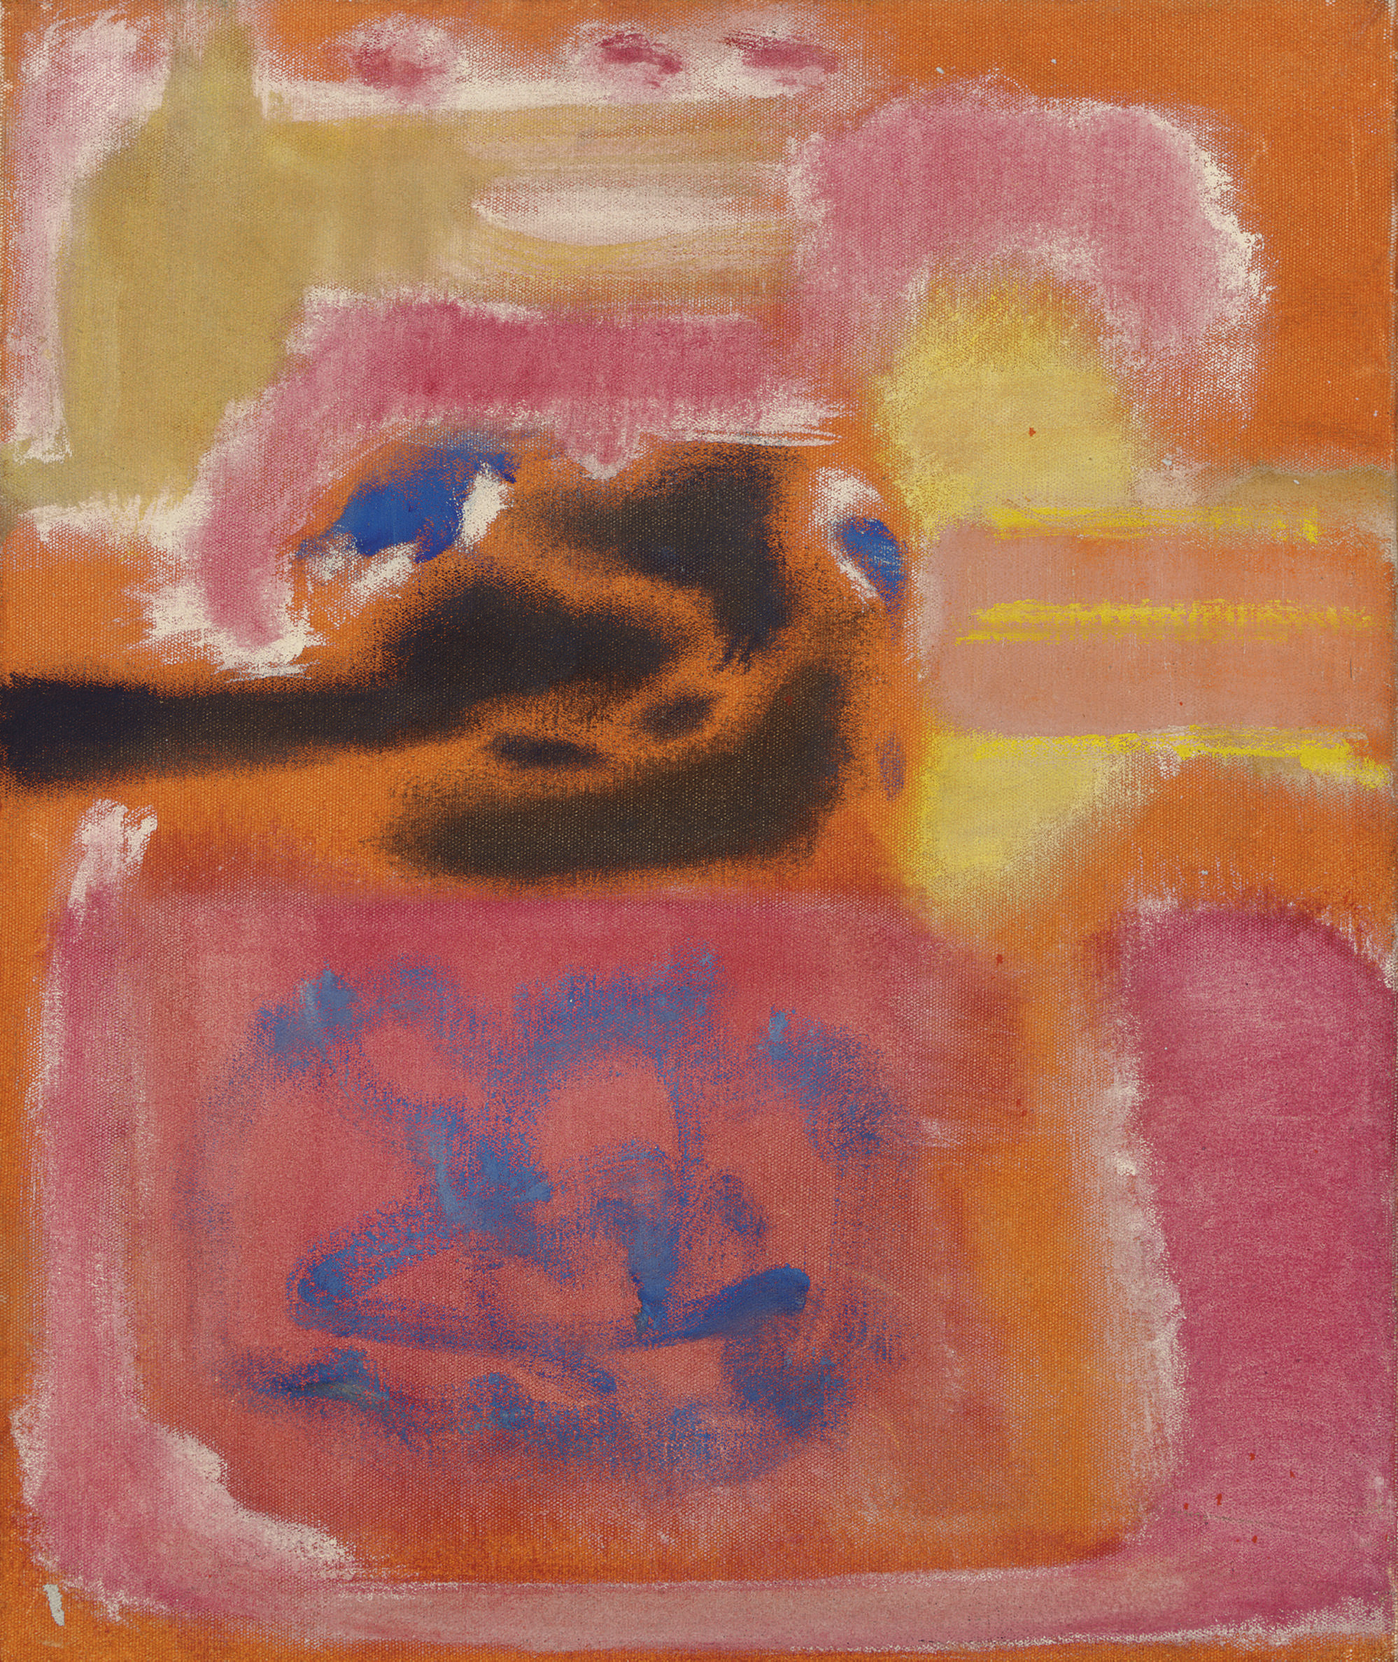
multiforms
Mark Rothko, No. 9, 1947
Mark Rothko, No. 10, 1950

Slide 8
Chromatic Abstraction and Color Field Painting
Robert Rosenblum, “The Abstract Sublime,” 1961
Mark Rothko, No. 16 (Red, Brown, and Black), 1958

Slide 9
Towards Abstraction: Barnett Newman
“zip”
Barnett Newman, Pagan Void, 1946
Barnett Newman, The Beginning, 1946
Barnett Newman, Onement I, 1948

Slide 10
Barnett Newman, Vir heroicus sublimis, 1950-51, 1948

Slide 11
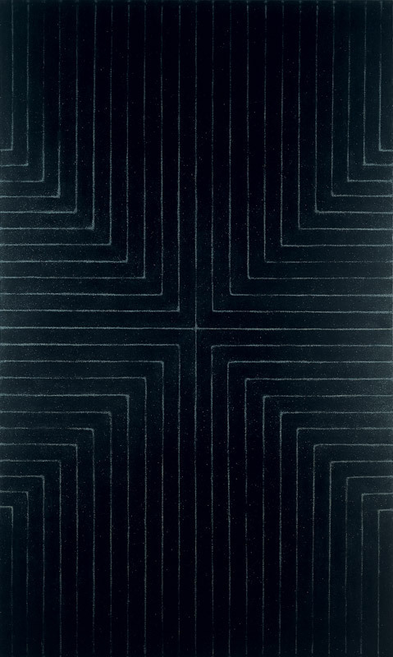
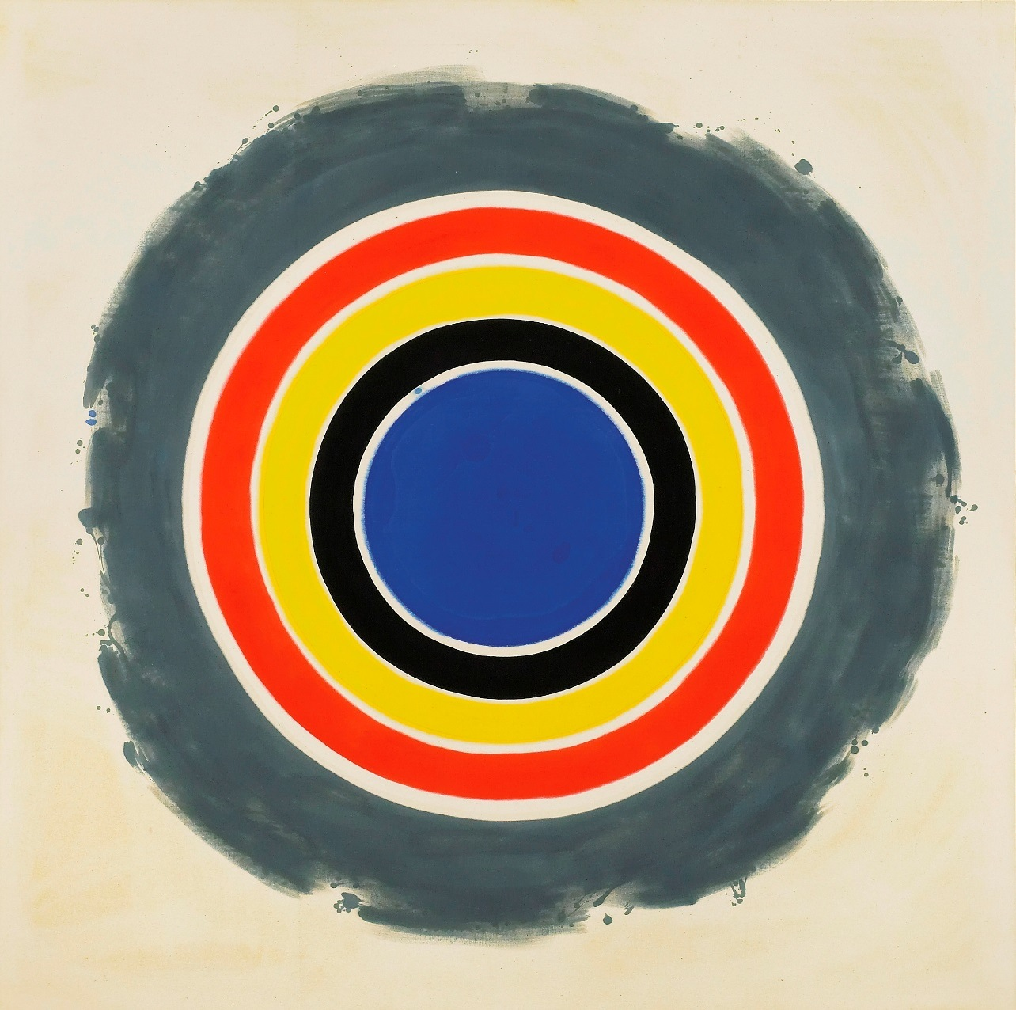
Post Painterly Abstraction
Kenneth Noland, That, 1958-59
Frank Stella, Die Fahne Hoch!, 1959

Slide 12
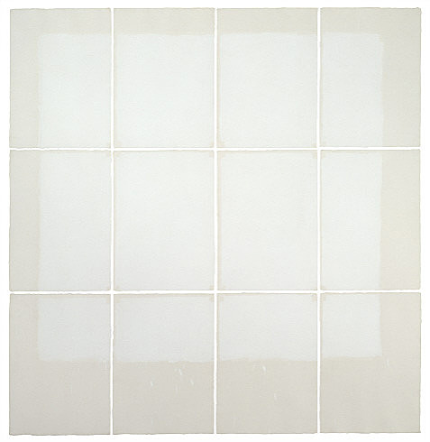
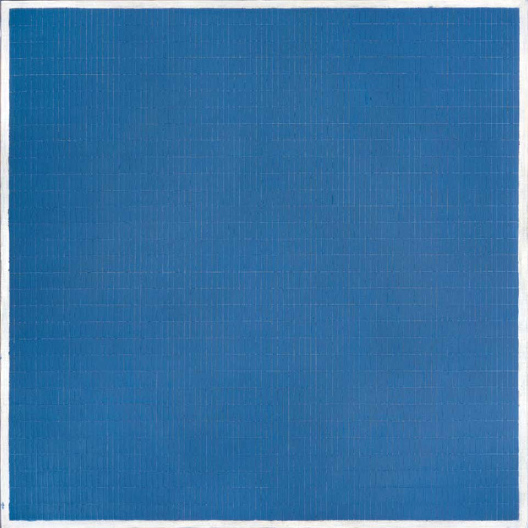
Minimalism and the grid: Modularity and seriality
Robert Ryman, Classico IV, 1968
Agnes Martin, Night Sea, 1963

Slide 13
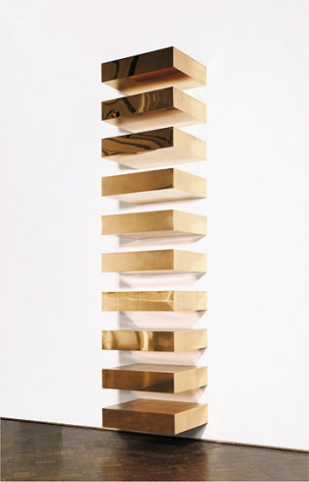
Donald Judd, Untitled, 1969
Notes:
http://www.guggenheim.org/new-york/collections/collection-online/artwork/1741

Slide 14
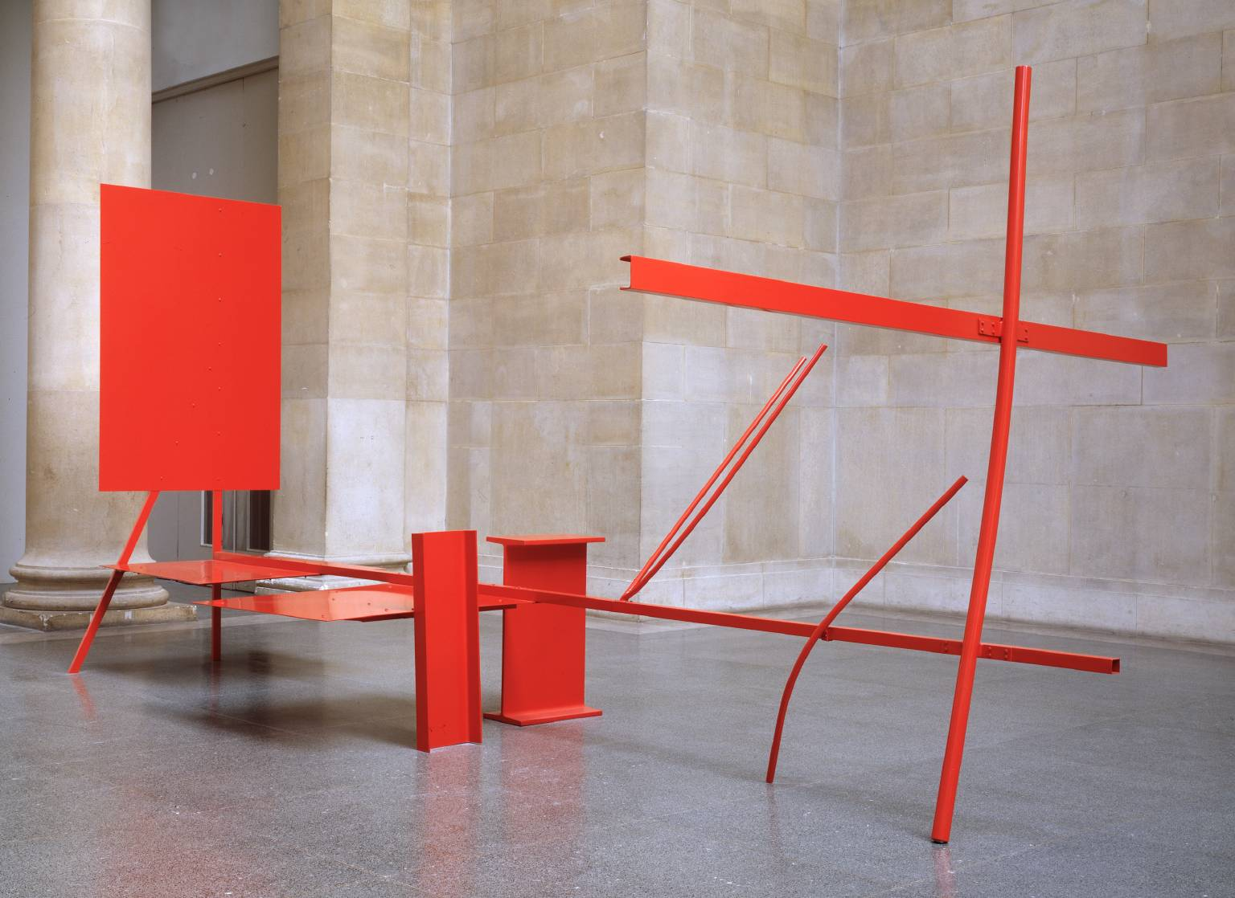
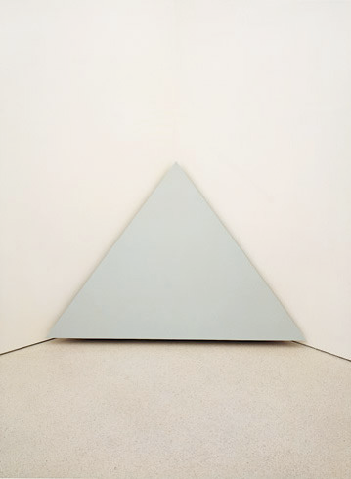
Minimalism
“Art and Objecthood”- Michael Fried
Art (absorption)
Object (theatricality)
Anthony Caro, Early One Morning, 1962
Robert Morris, Corner Piece, 1964

Slide 15
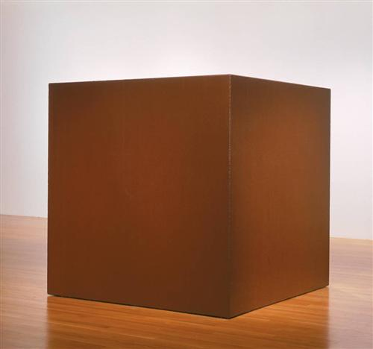
Minimalism
“Specific Objects”- Donald Judd
Tony Smith, Die, 1962
Robert Morris, Corner Piece, 1964
Notes:
http://www.nga.gov/content/ngaweb/Collection/art-object-page.127623.html
http://www.guggenheim.org/new-york/collections/collection-online/artwork/3063

Slide 16
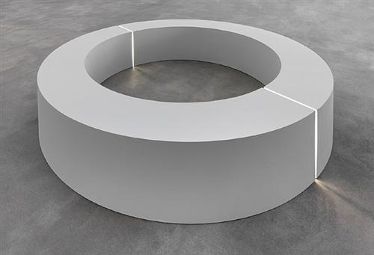
Minimalism
Anthropomorphism
Robert Morris, Untitled (Ring with Light), 1966
Robert Morris, Mirrored Cubes, 1965-71
Notes:
http://www.tate.org.uk/art/artworks/morris-untitled-t01532
http://www.walkerart.org/collections/artists/robert-morris

Slide 17
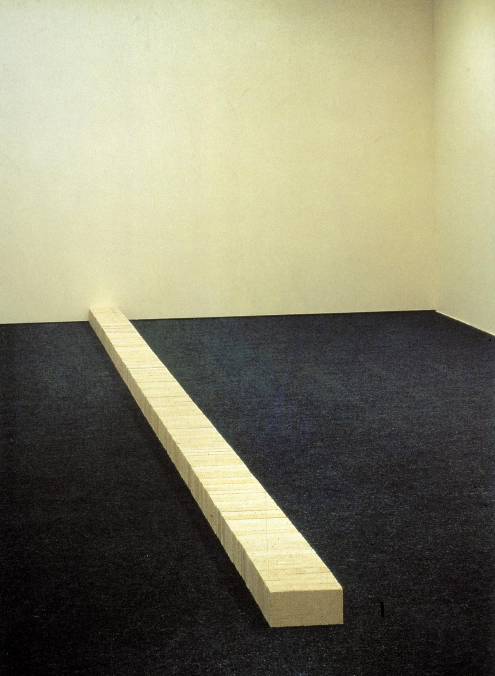
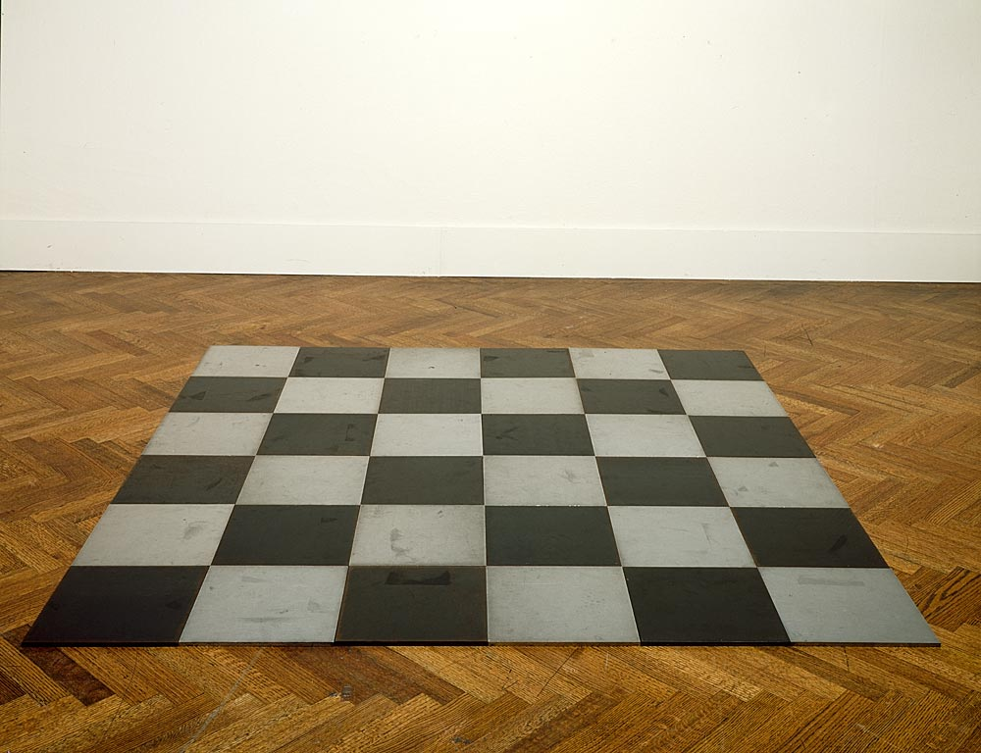
Carl Andre, Lever, 1966
Carl Andre, Steel Magnesium Plain, 1969
Notes:
http://www.independent.co.uk/arts-entertainment/art/news/how-to-build-controversy-from-a-pile-of-bricks-2277359.html
http://www.moma.org/collection/artist.php?artist_id=174

Slide 18
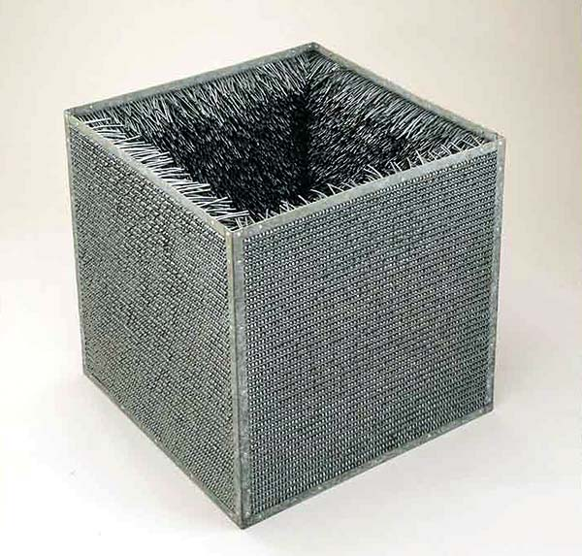
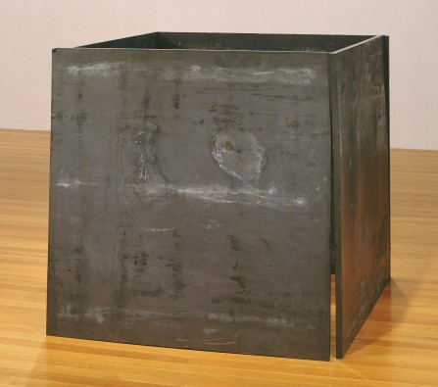
Eve Hesse, Accession II, 1968
Approx 30”x30”x30"
Richard Serra, One Ton Prop (House of Cards), 1969
Lead antimony, 48x48x48

Slide 19
Art Informel
Jean Dubuffet, Will to Power, 1946
Pierre Alechinsky, Vanish, 1959

