Slide 1
Towards Abstract Expressionism

Slide 2
Diego Rivera working on the fresco
30 Rockefeller Center, NYC

Slide 3
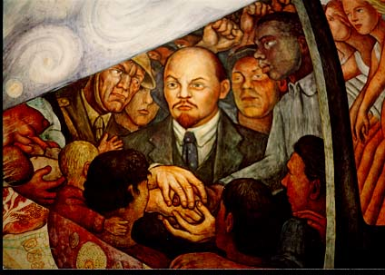
Diego Rivera, Man Controller of the Universe, 1933

Slide 4
Diego Rivera, Man Controller of the Universe, 1934
Palacio de Bellas Artes, Mexico City

Slide 5
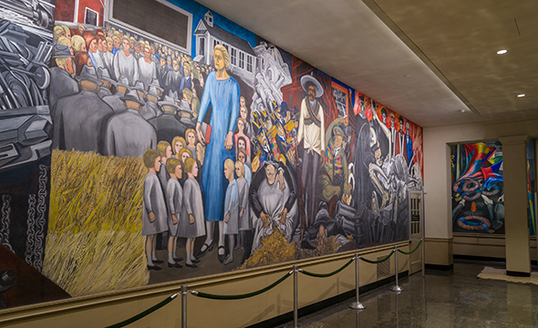
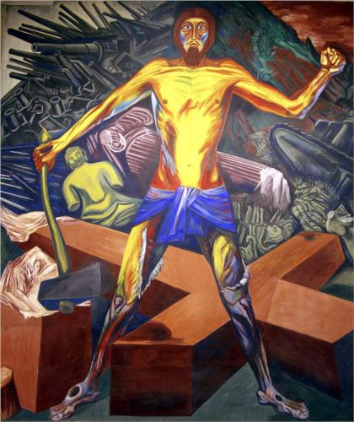
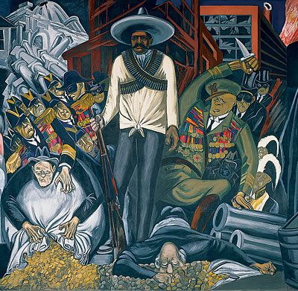
José Clemente Orozco, The Epic of American Civilization, 1934 Reading Room, Baker Memorial Library, Dartmouth College
Modern Migration of the Spirit
Hispano-America

Slide 6
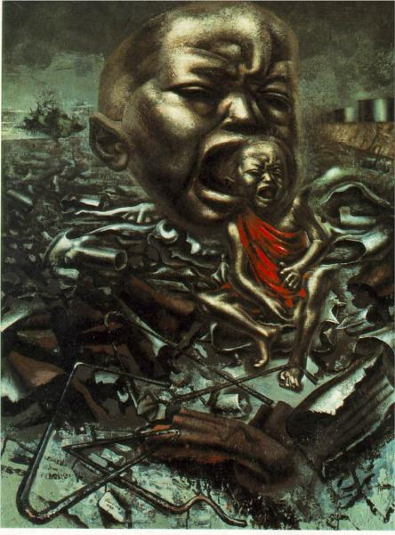
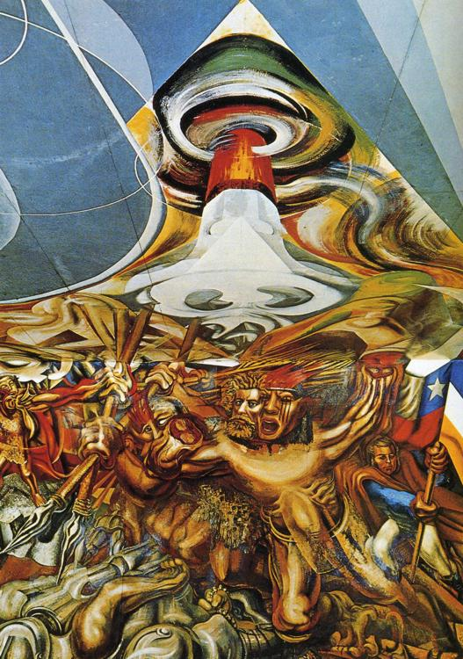
David Alfaro Siqueiros, Echo of a Scream, 1937
David Alfaro Siqueiros, Death to the Invaders, 1941-42

Slide 7
Towards Abstraction: Jackson Pollock
Thomas Hart Benton, The Arts of the West, 1932
Jackson Pollock, Going West, 1934-35

Slide 8
Pablo Picasso, Guernica, 1937
Jackson Pollock, Guardians of the Secret, 1943
Rufino Tamayo, Animals, 1941

Slide 9
Wilfredo Lam, The Jungle, 1943
Jackson Pollock, Guardians of the Secret, 1943

Slide 10
Gestural abstraction
Jackson Pollock, Mural, 1943

Slide 11
Action Painting
Jackson Pollock Autumn Rhythm: Number 30, 1950

Slide 12
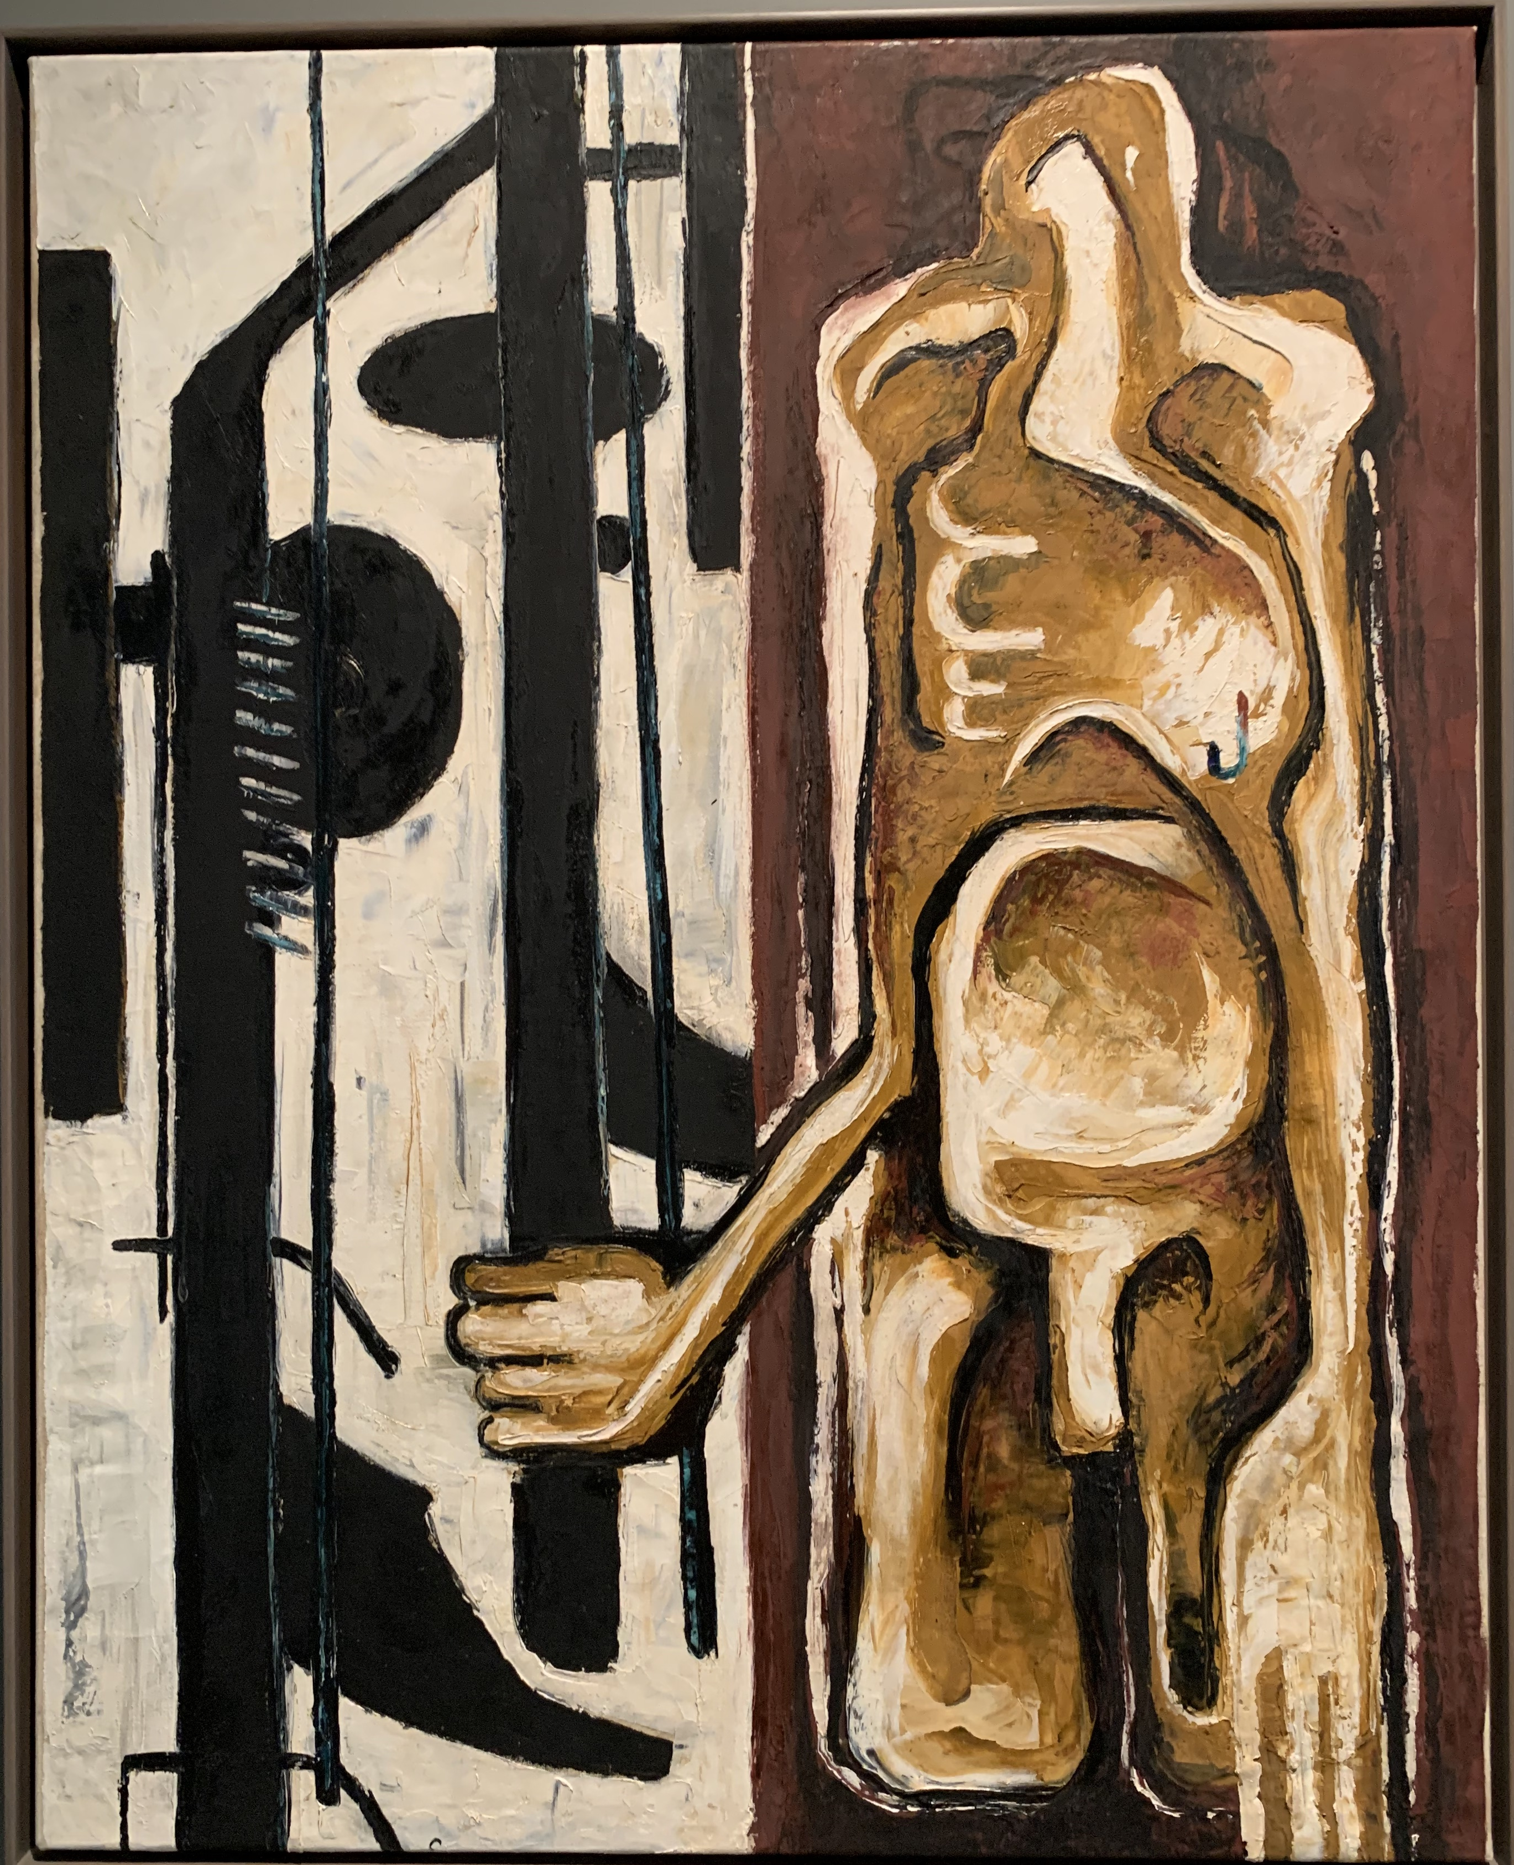
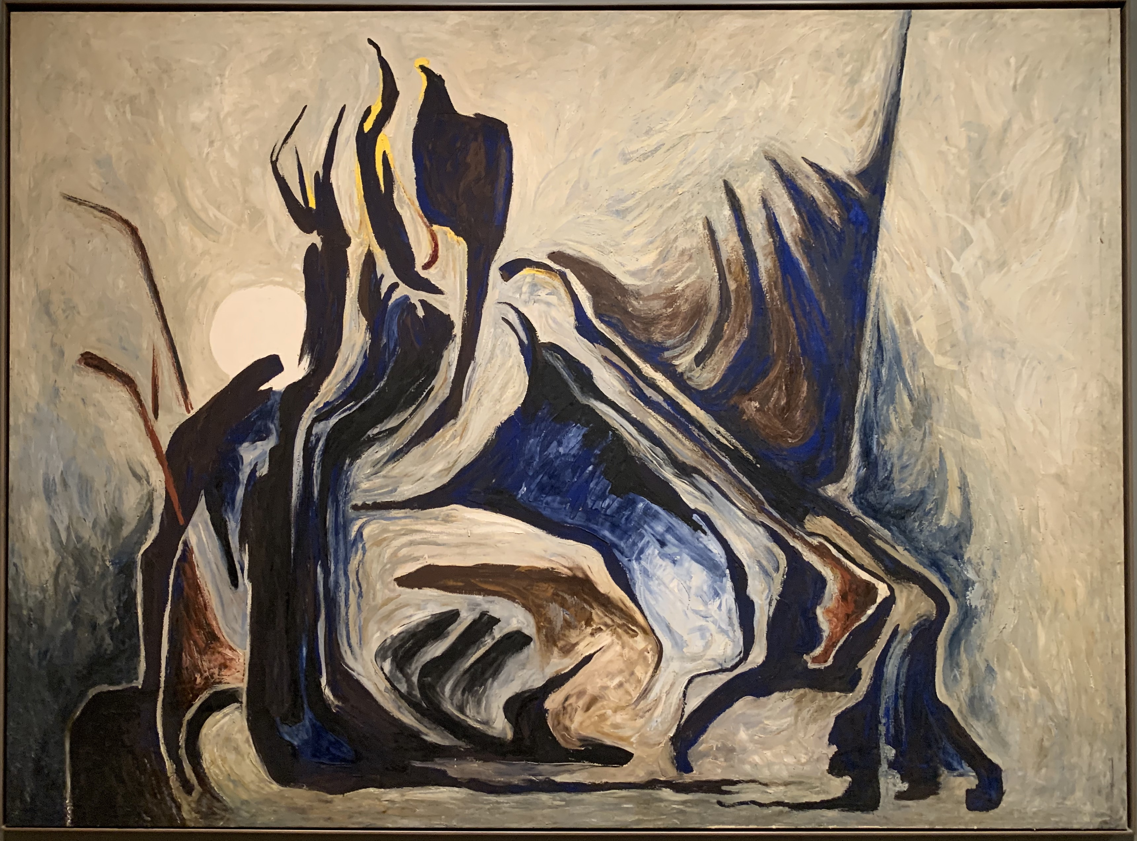
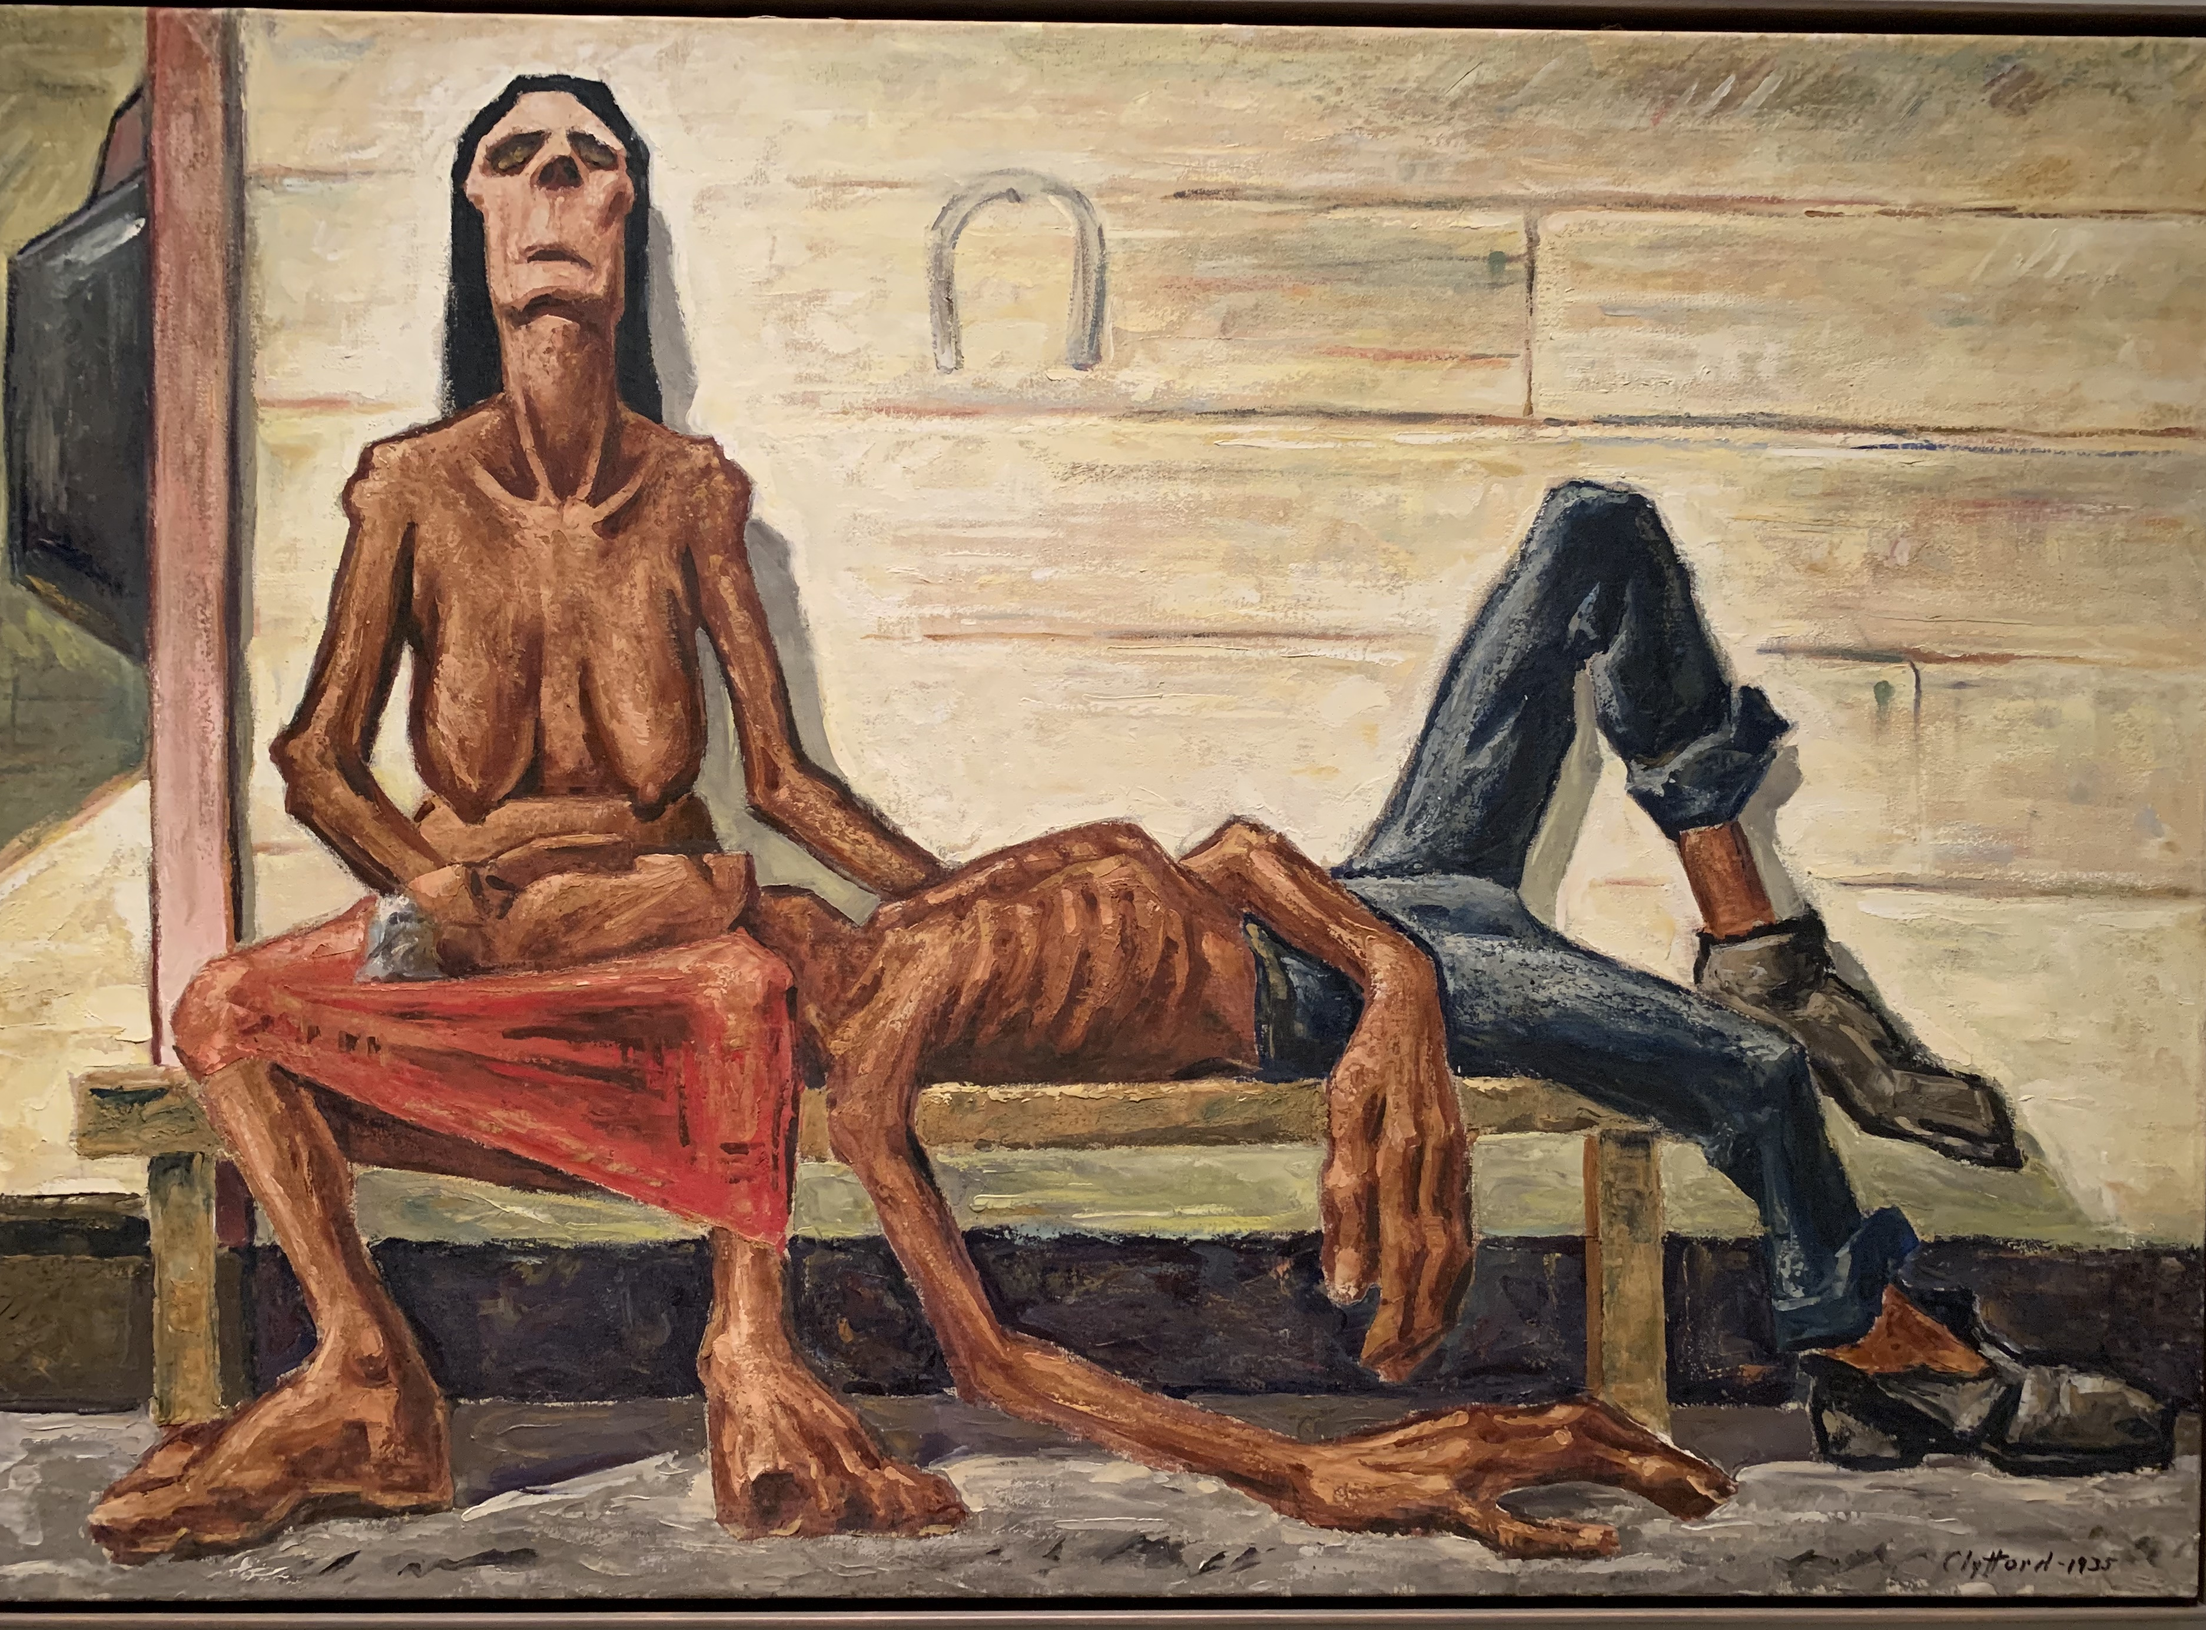
Towards Abstraction: Clyfford Still
Clyfford Stll, PH-79, 1935
Clyfford Still, PH-343, 1937
Clyfford Still, PH-255, 1944

Slide 13
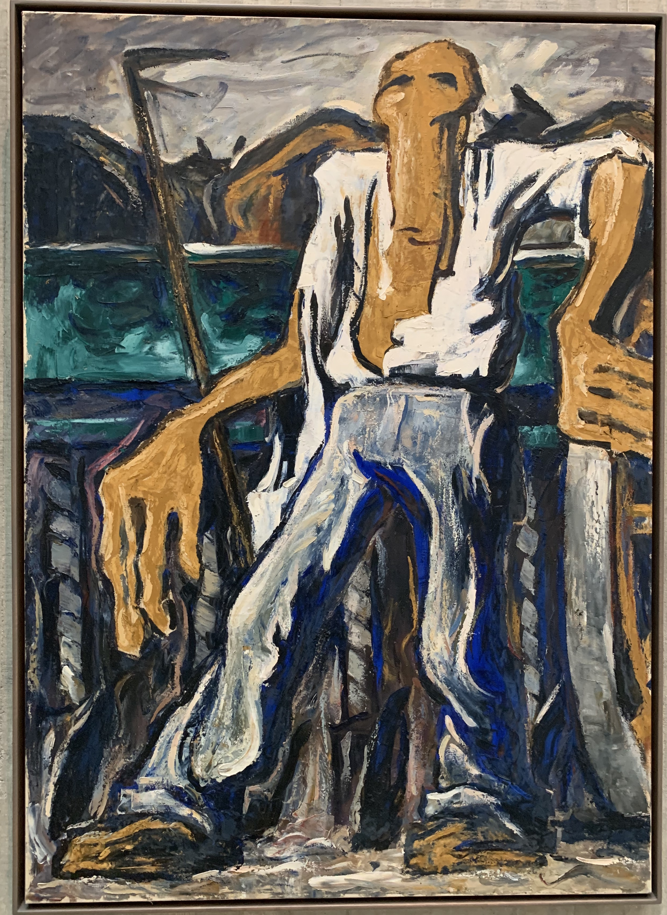
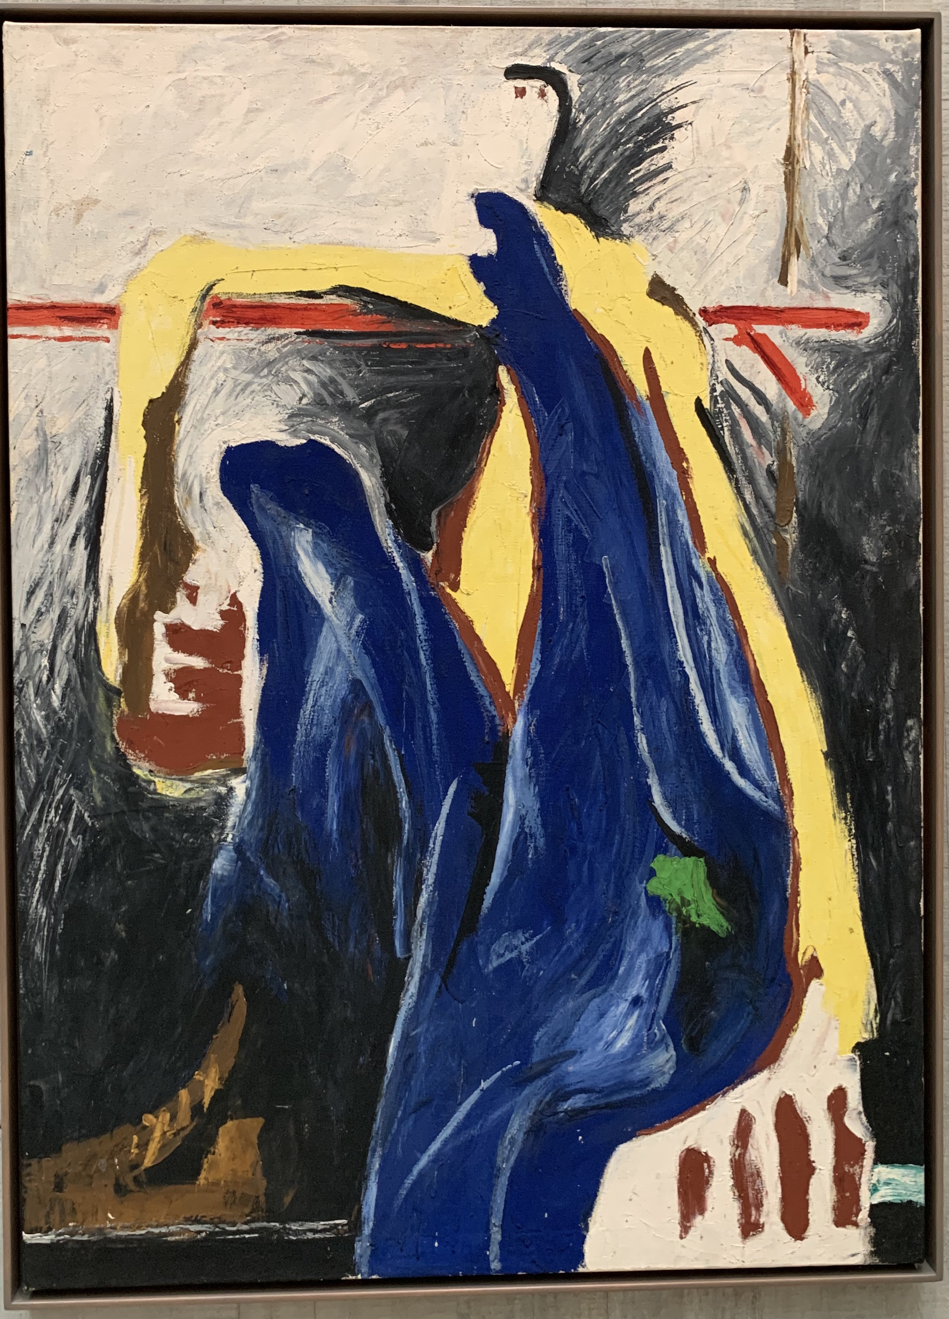
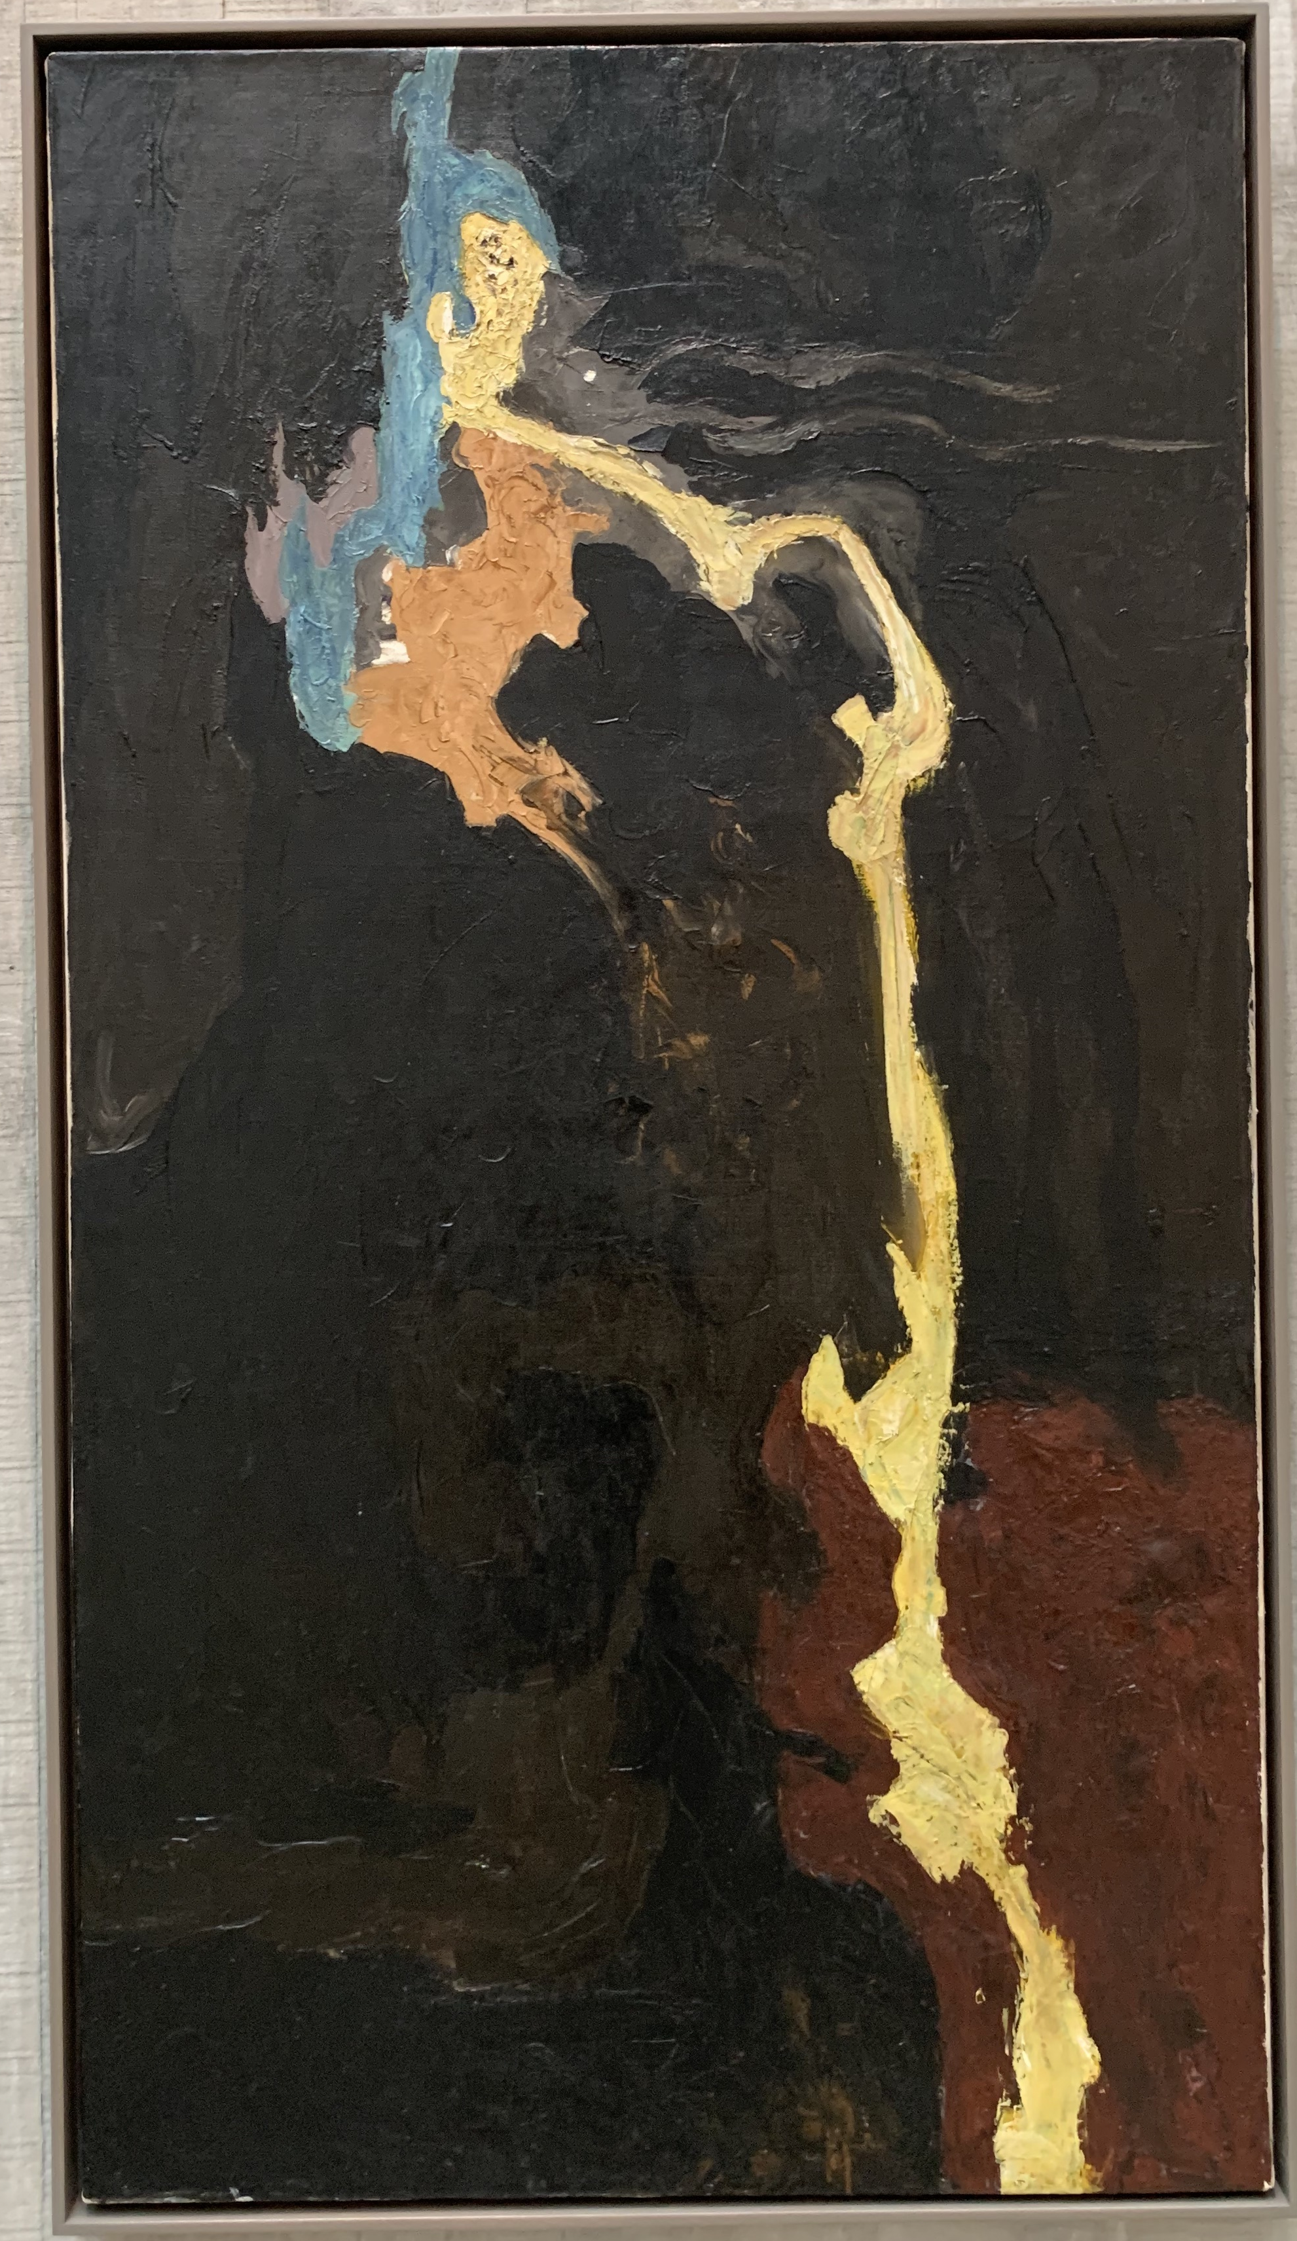
Abstracting the figure
“Lifeline”
Clyfford Still, PH-341, 1936
Clyfford Still, PH-324, 1936
Clyfford Still, PH-68, 1945

Slide 14
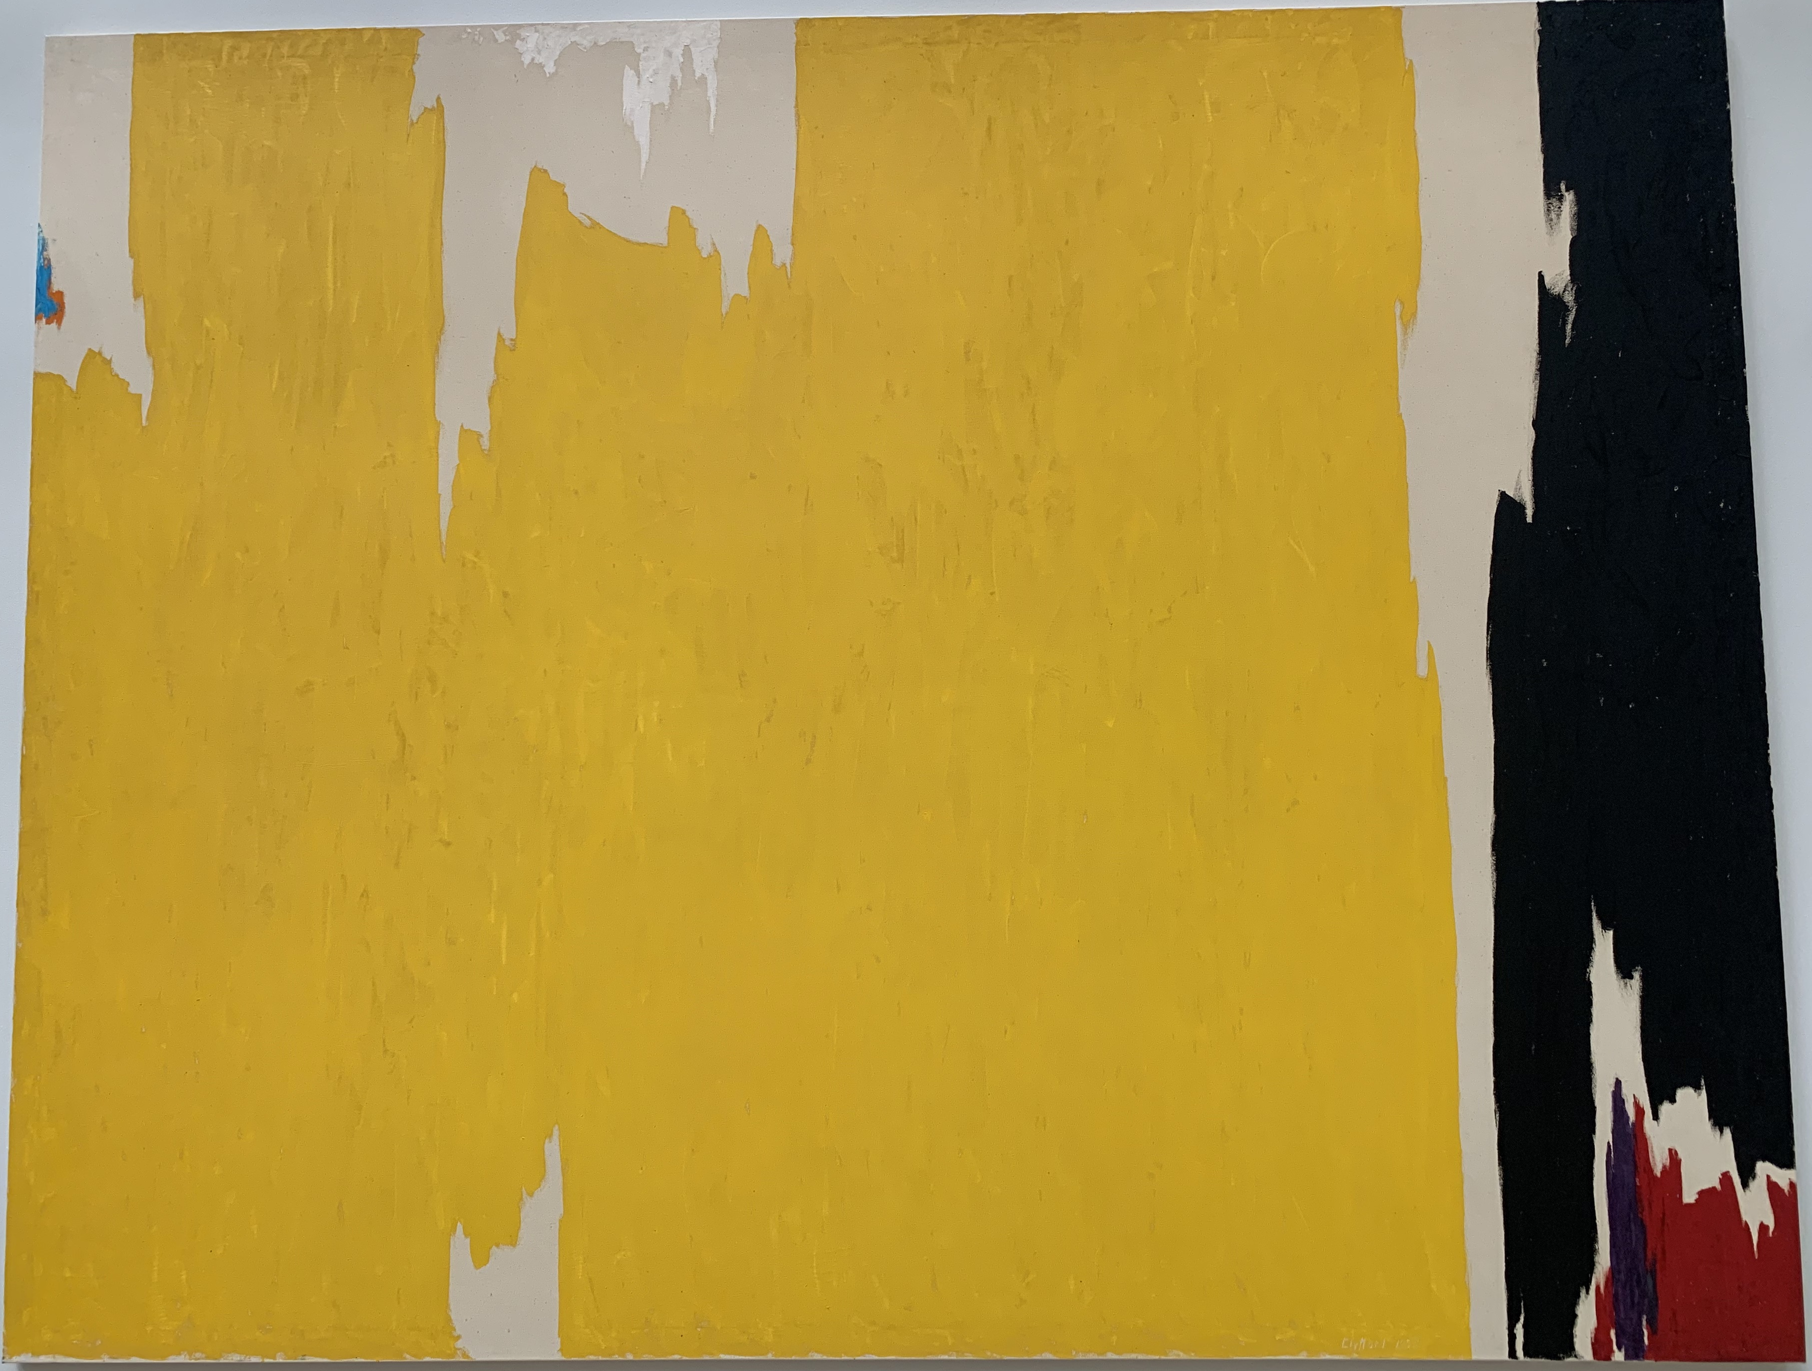
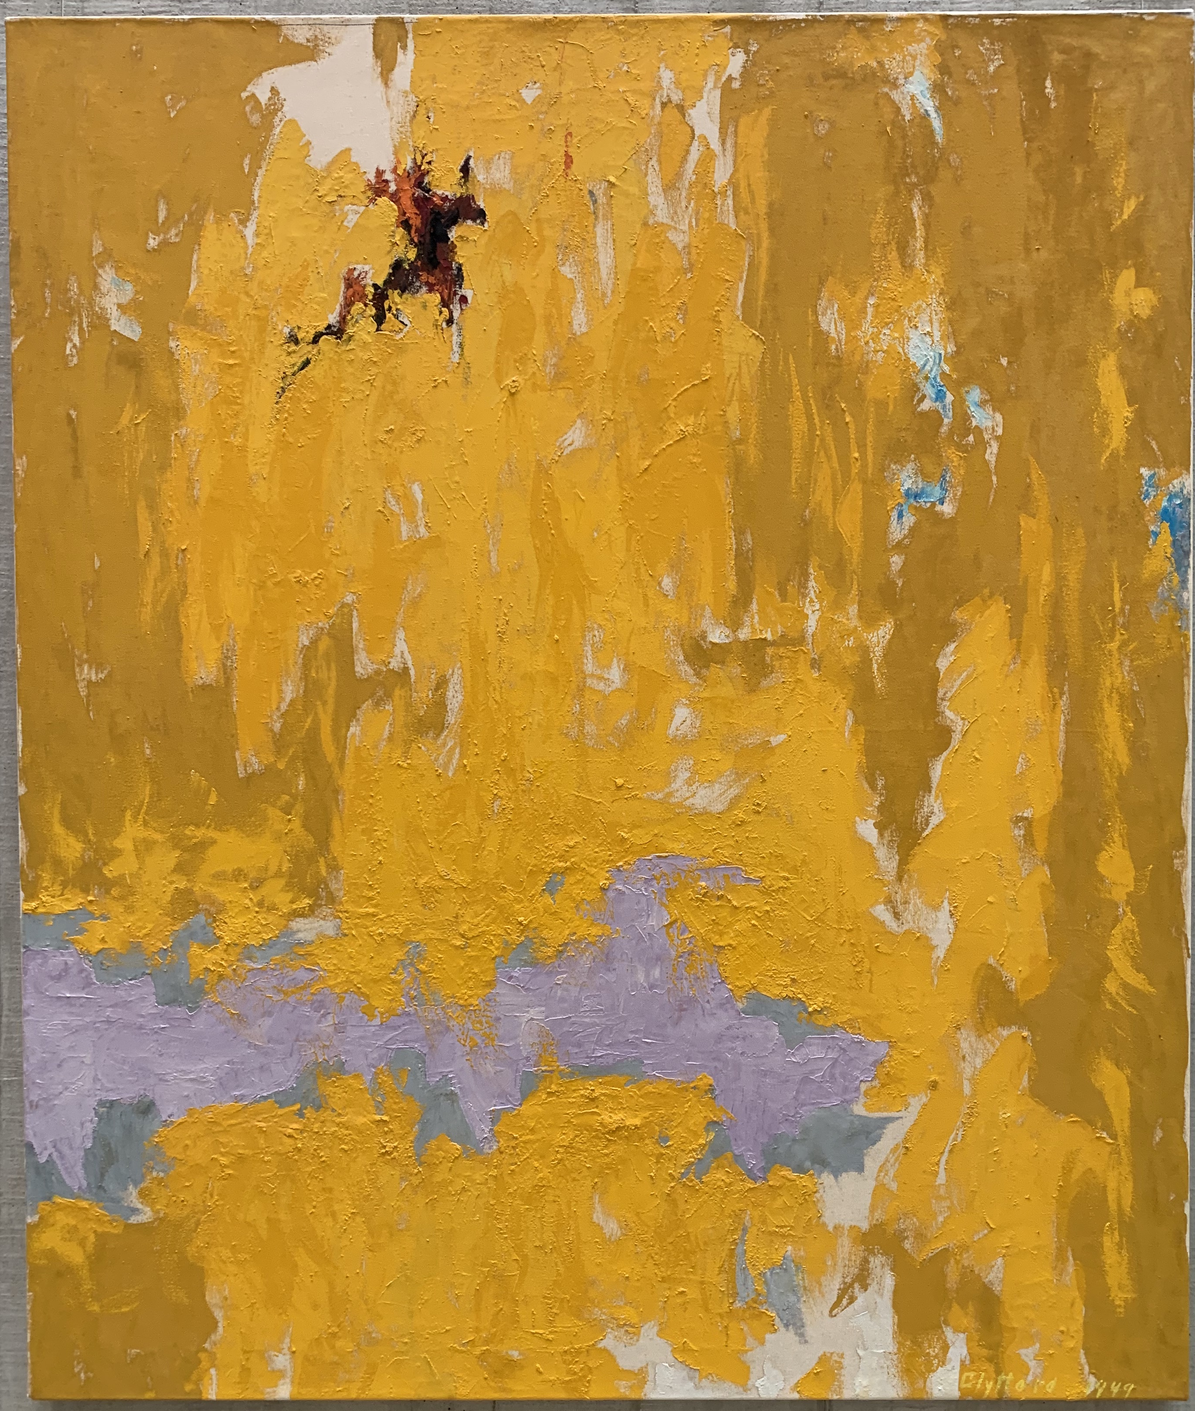
Clyfford Still, PH-129, 1949
Clyfford Still, PH-977, 1957

Slide 15
Towards chromatic abstraction: Mark Rothko
Mark Rothko, Entrance to the Subway, 1938
Mark Rothko, Oedipus, 1940

Slide 16
Joan Miró, Harlequin’s Carnival, 1924
Joan Miro, The Family, 1924
Mark Rothko, Slow Swirl at the Edge of the Sea, 1944

Slide 17
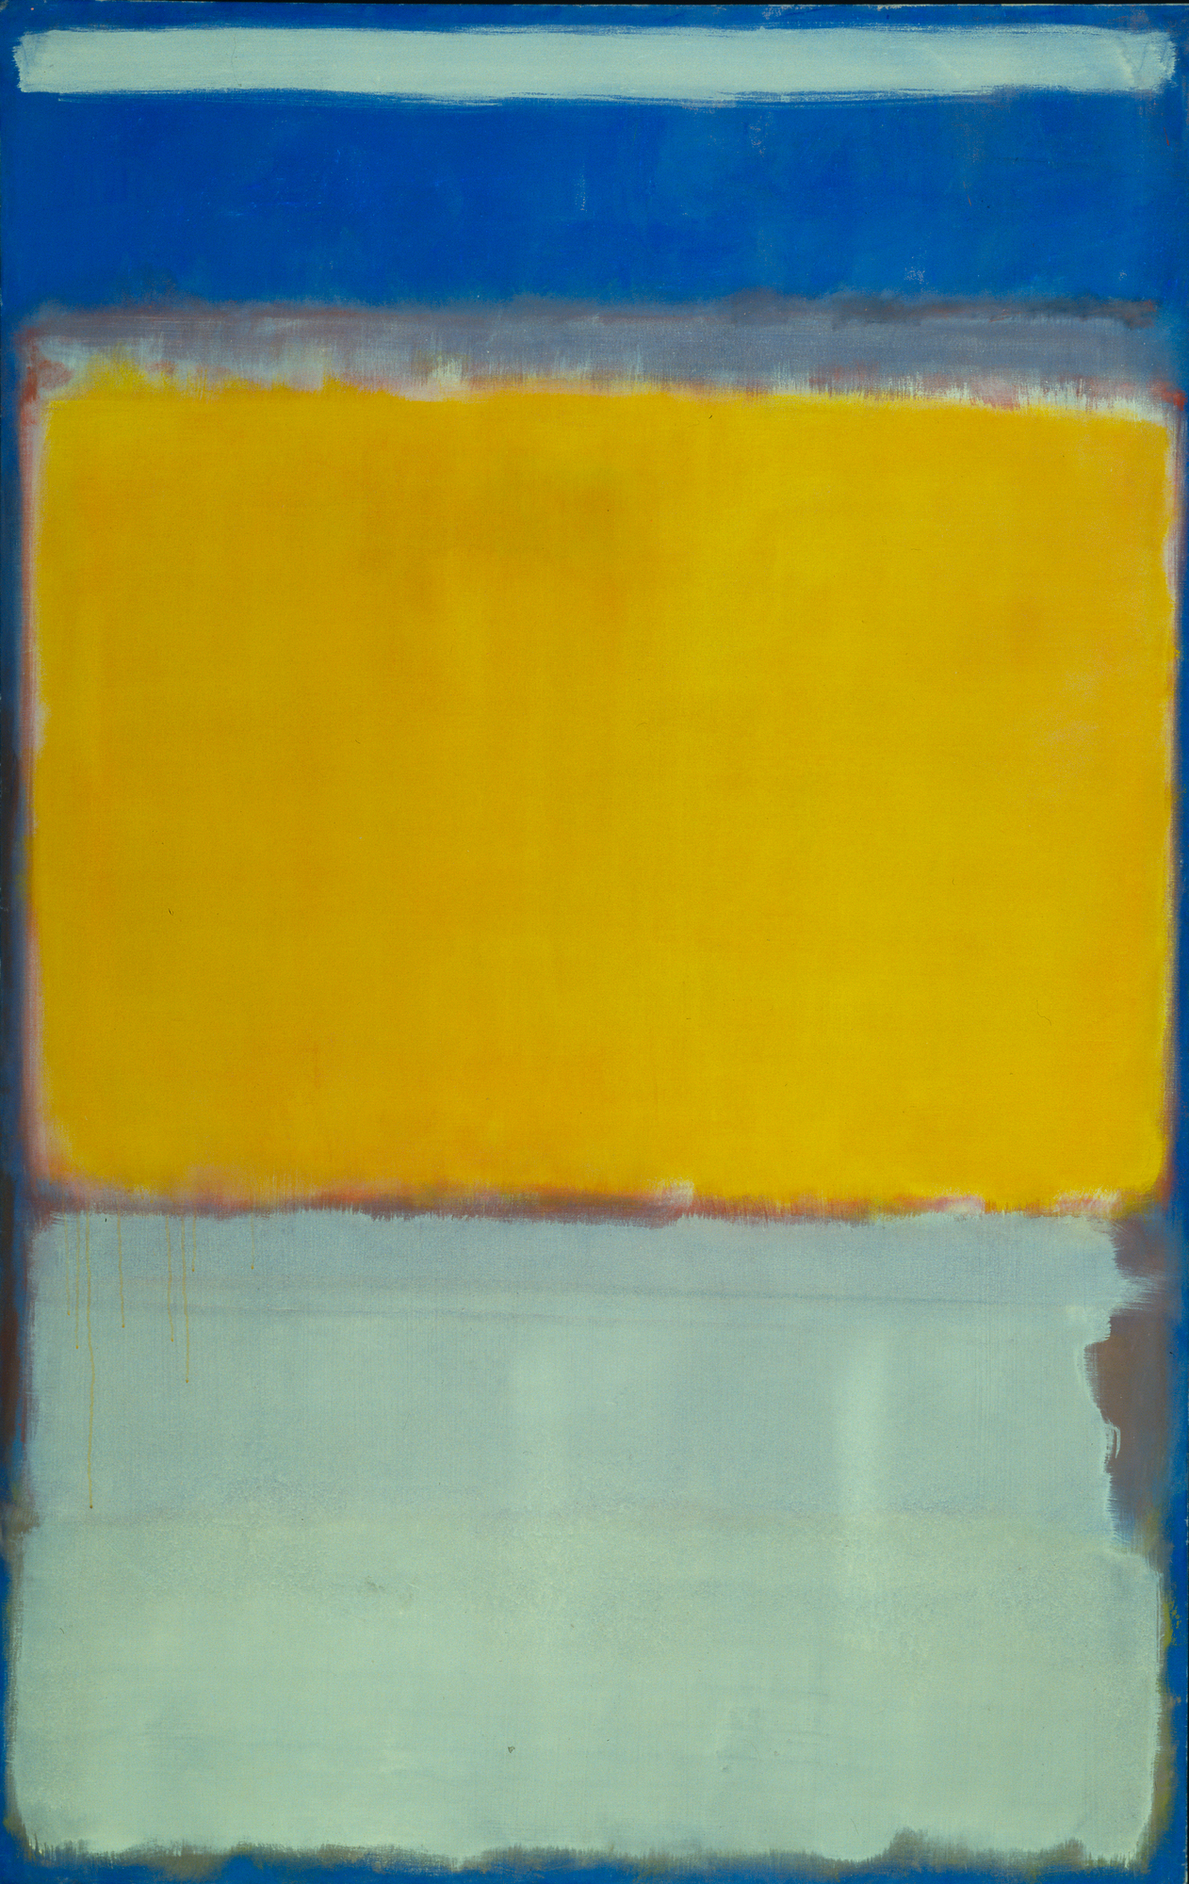
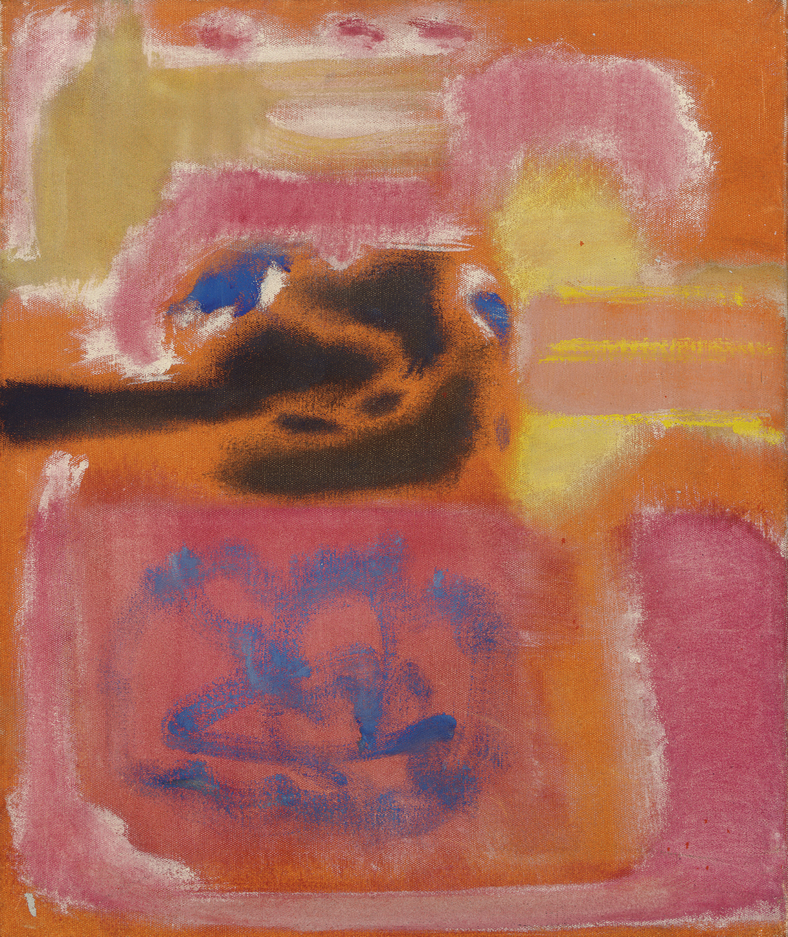
multiforms
Mark Rothko, No. 9, 1947
Mark Rothko, No. 10, 1950

Slide 18
Chromatic Abstraction and Color Field Painting
Mark Rothko, No. 16 (Red, Brown, and Black), 1958

Slide 19
Towards Abstraction: Barnett Newman
“zip”
Barnett Newman, Pagan Void, 1946
Barnett Newman, The Beginning, 1946
Barnett Newman, Onement I, 1948

Slide 20
Barnett Newman, Vir heroicus sublimis, 1950-51, 1948

