Slide 1
A Duchampian (Re)Turn
(to the floor)
Marcel Duchamp, In Advance of a Broken Arm, 1915
Jasper Johns, Target with Four Faces, 1955

Slide 3
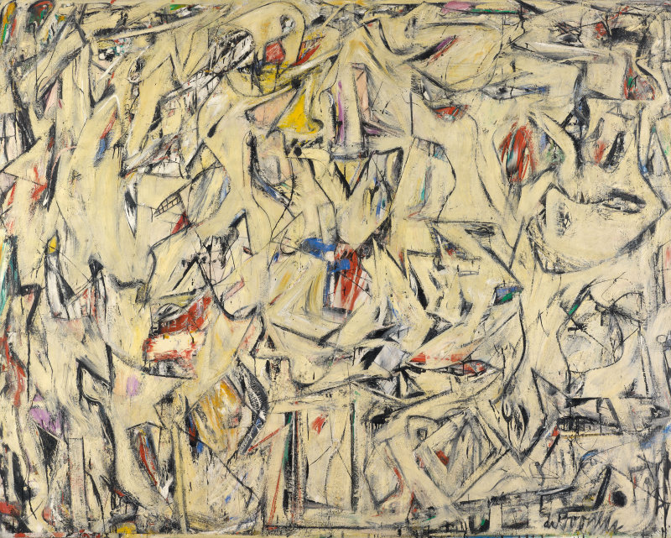
Verticality and the picture plane
“[From the Old Masters] through Cubism and Abstract Expressionism …the conception of the picture as representing a world…[corresponded to] the erect human posture. The top of the picture corresponds to where we hold our heads … its lower edge gravitates to where we place our feet. Even …Picasso’s Cubist collages [imply] …acts of vision, something that was once actually seen…the Renaissance picture plane affirms verticality …And the concept of the picture plane as an upright surface survives…Pictures by Rothko, Still, Newman, de Kooning, and Kline are still addressed to us head to foot… Leo Steinberg, Other Criteria
Georges Braque, Pitcher and Violin, 1909-1910
Willem de Kooning, Excavation, 1950

Slide 4
Art Informel
Nicolas de Staël, View of Agrigente, 1954

Slide 5
Art Informel and CoBrA
Pierre Alechinsky, Vanish, 1959
Asger Horn, Letter to My Son, 1956

Slide 6
Horizontality
Trebuchet (Trap).
Photo by Henri Pierre Roche, c.1916-1918
Notes:
http://eipcp.net/transversal/0910/ashford/en/print

Slide 7
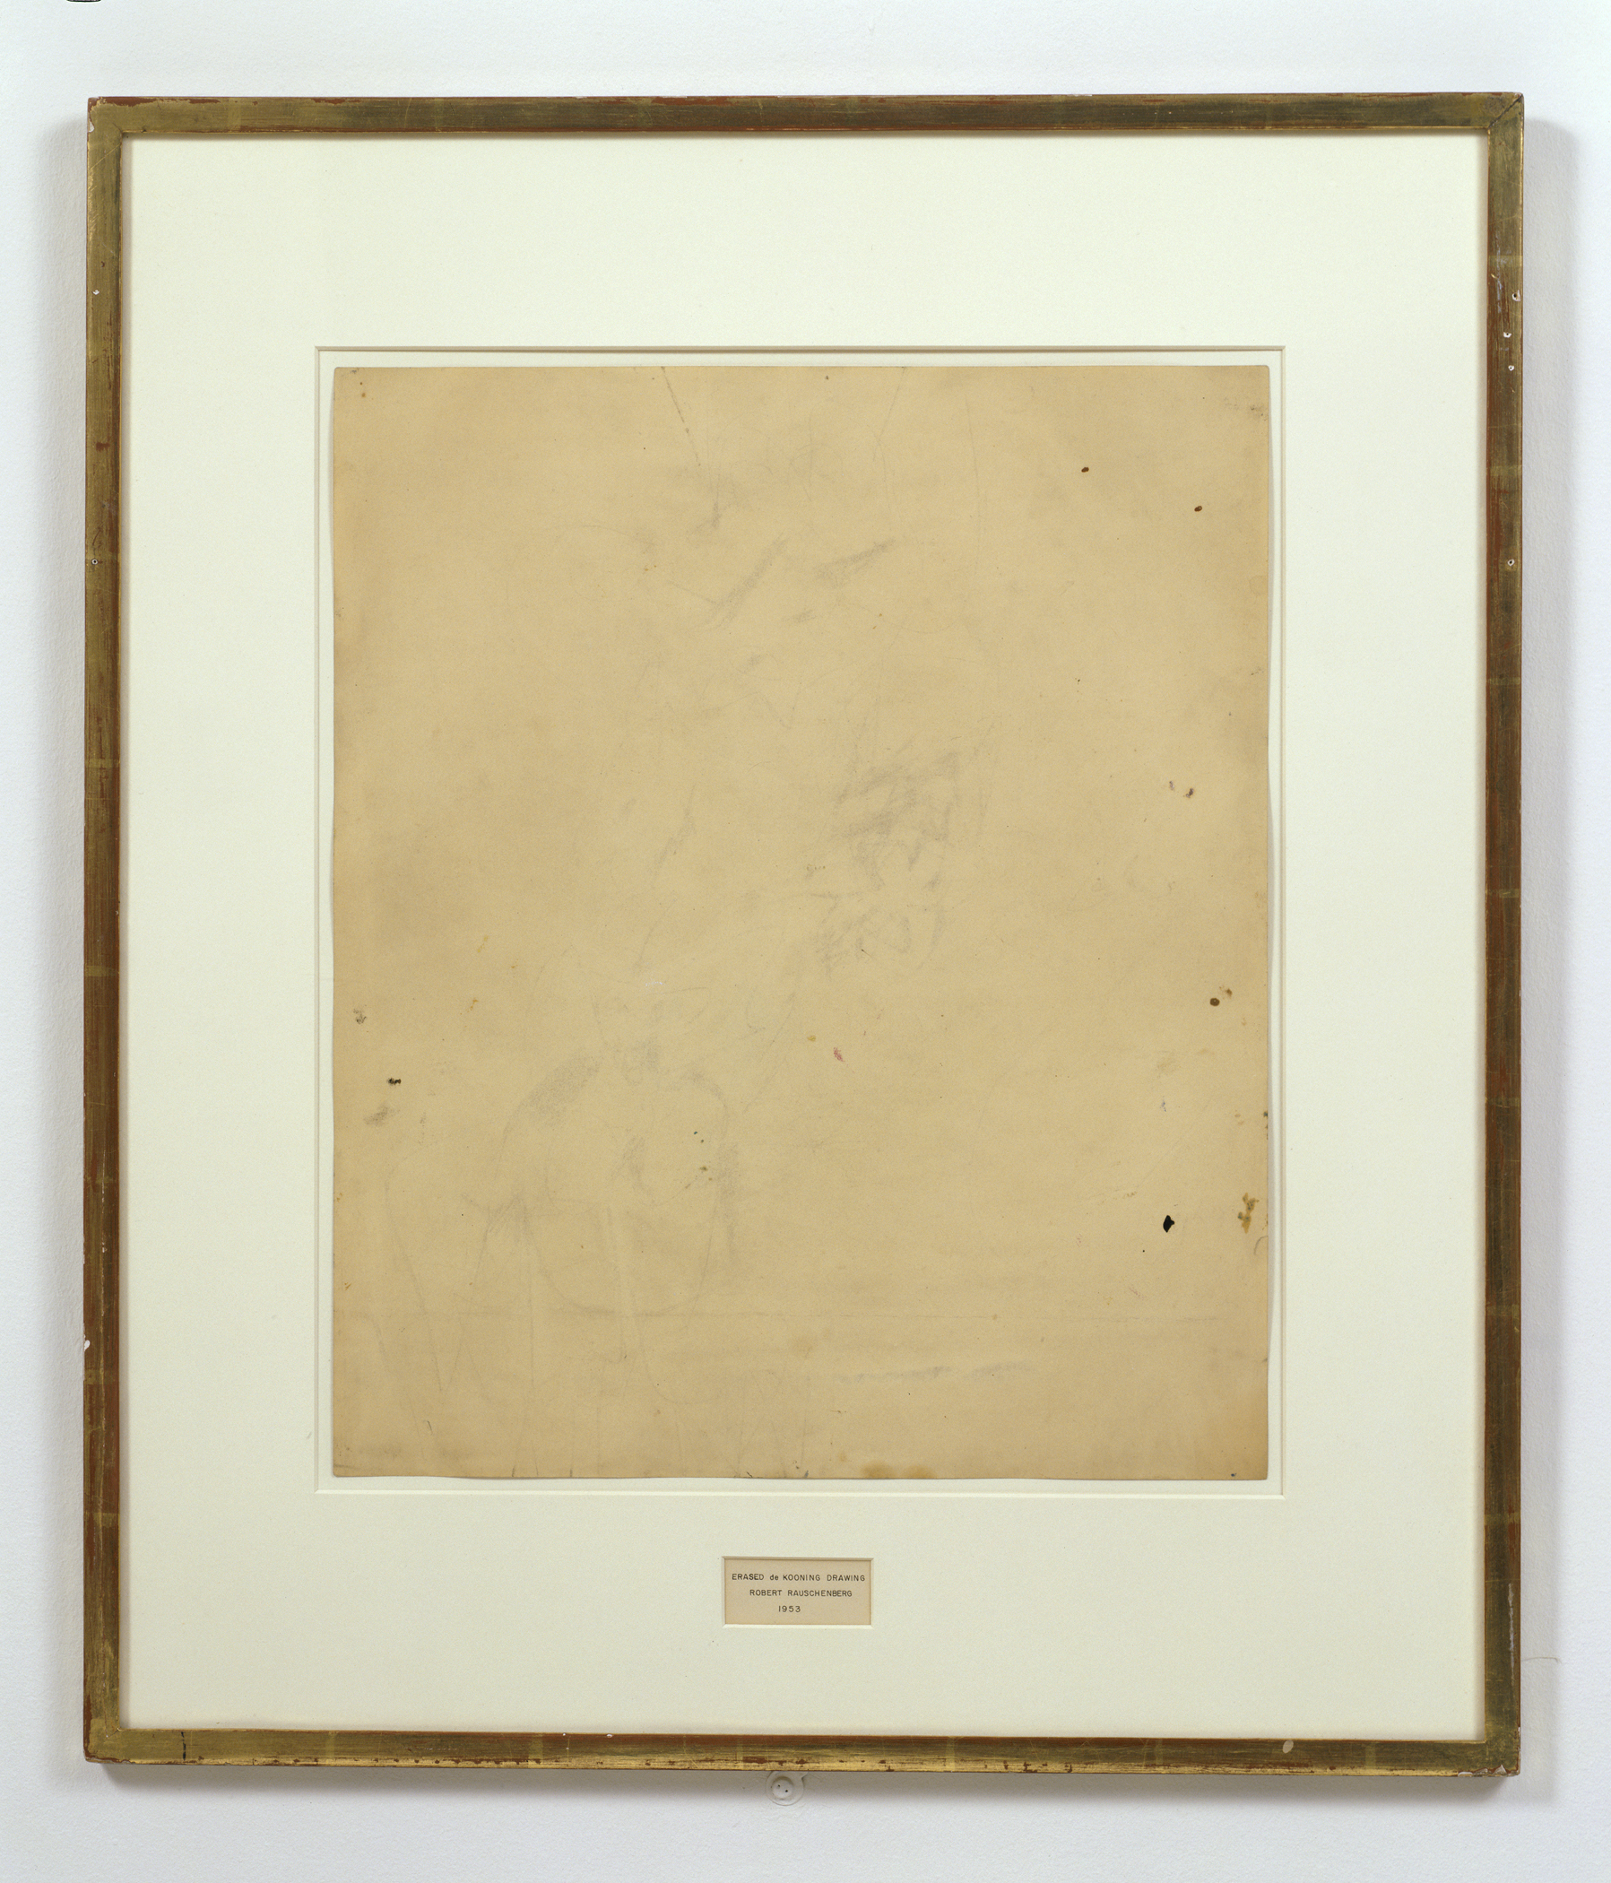
“flatbed picture plane”
I borrow the term from the flatbed printing press—‘a horizontal bed on which a horizontal printing surface rests’ (Webster). And I propose to use the word to describe the characteristic picture plane of the 1960s—a pictorial surface whose angulation with respect to the human posture is the precondition of its changed content.
Leo Steinberg, Other Criteria
Robert Rauschenberg, Automobile Tire Print, 1953
Robert Rauschenberg, Erased De Kooning Drawing, 1953
Notes:
http://www.sfmoma.org/explore/collection/artwork/25845

Slide 8
“…something happened in painting around 1950… in the work of Robert Rauschenberg and Dubuffet. We can still hang their pictures—just as we tack up maps and architectural plans, or nail a horseshoe to the wall for good luck. Yet these pictures no longer simulate vertical fields, but opaque flatbed horizontals.”
Leo Steinberg, Other Criteria
Robert Rauschenberg, Canyon, 1959
Jean Dubuffet, Will to Power, 1946

Slide 9
Jean Dubuffet, Will to Power, 1946

Slide 10
Art Brut
CoBrA
Asger Jorn, The Disquieting Duck, 1959
Jean Dubuffet, Will to Power, 1946

Slide 11
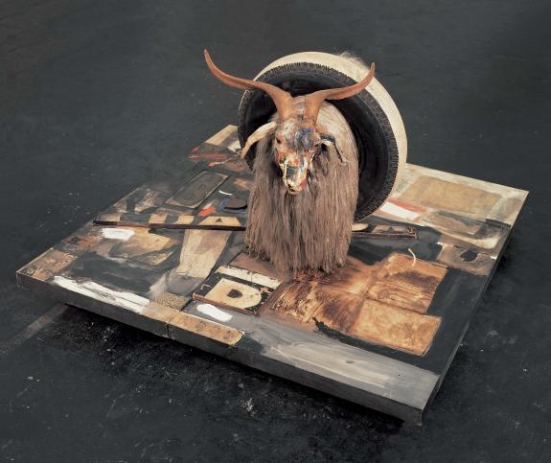
“They no more depend on a head-to-toe correspondence with human posture than a newspaper does. ‘The flatbed picture plane makes its symbolic allusion to hard surfaces such as tabletops, studio floors…”
Leo Steinberg, Other Criteria
Robert Rauschenberg, Monogram, 1955

Slide 12
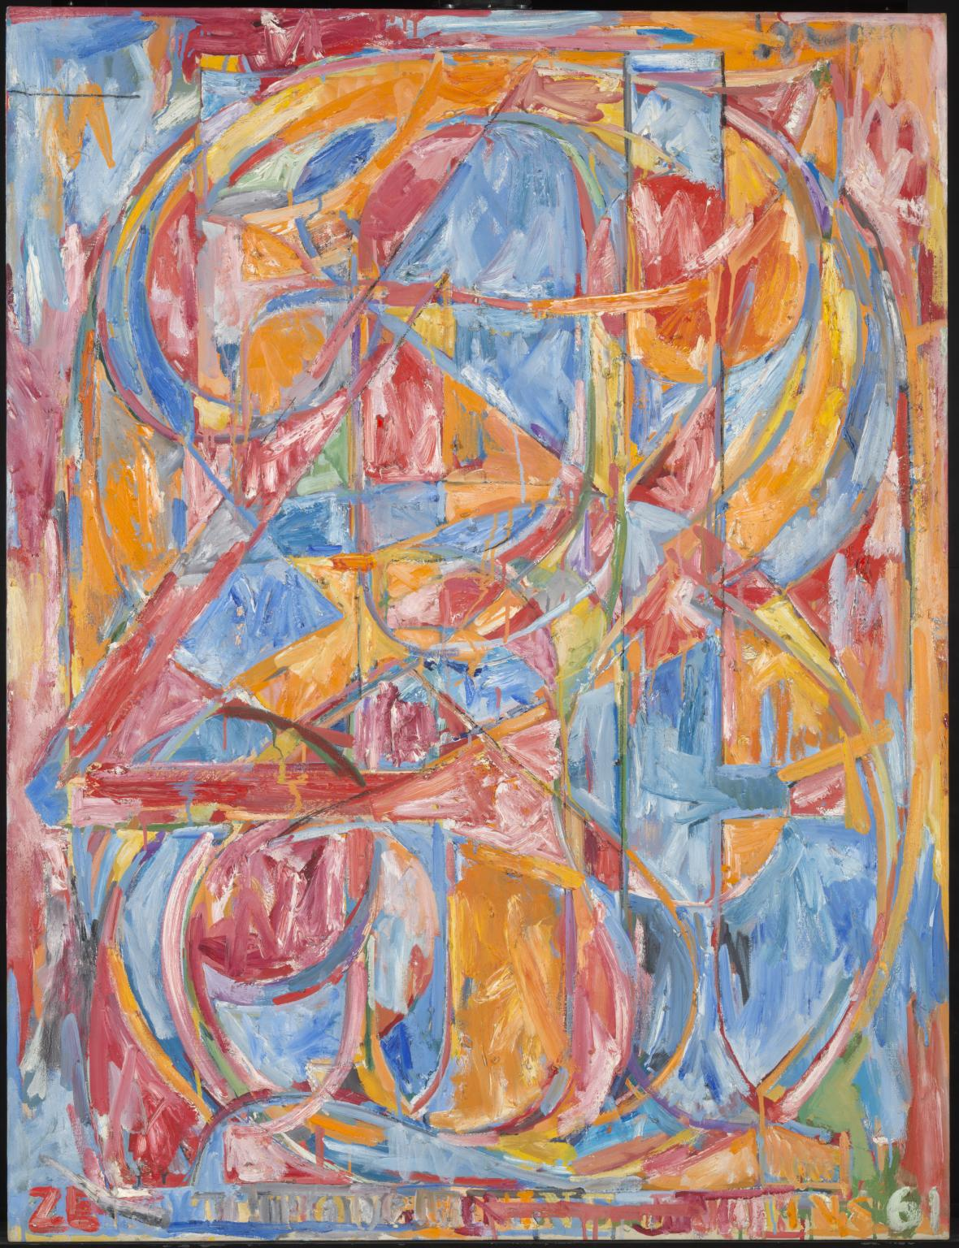
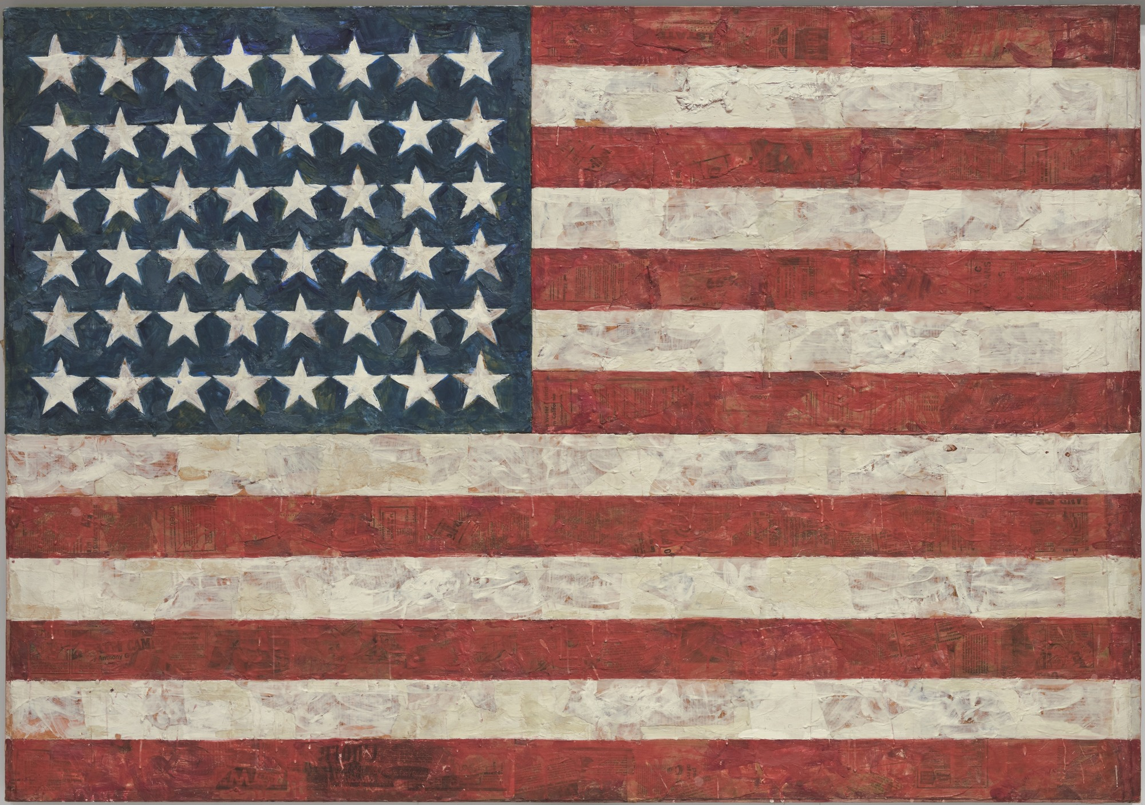
…charts, bulletin boards—any receptor surface on which objects are scattered, on which data is entered, on which information may be received, printed, impressed—whether coherently or in confusion…”.
Leo Steinberg, Other Criteria
Jasper Johns, Flag, 1954-55
Jasper Johns, 0-9, 1960

Slide 13
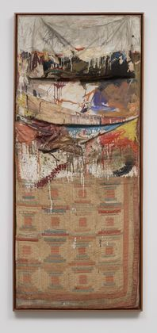
To repeat: it is not the actual physical placement of the image that counts. There is no law against hanging a rug on a wall, or reproducing a narrative picture as a mosaic floor. What I have in mind is the psychic address of the image, its special mode of imaginative confrontation, and I tend to regard the tilt of the picture plane from vertical to horizontal as expressive of the most radical shift in the subject matter of art, the shift from nature to culture.
Leo Steinberg, Other Criteria
Hans Naimuth, Jackson Pollock Painting, 1950
Robert Rauschenberg, Bed, 1955

Slide 14

Nouveau réalisme
Vs. Abstract Expressionism
Yves Klein, IKB 79, 1959
Mark Rothko, No. 1 (Royal Red and Blue, 1954

Slide 15
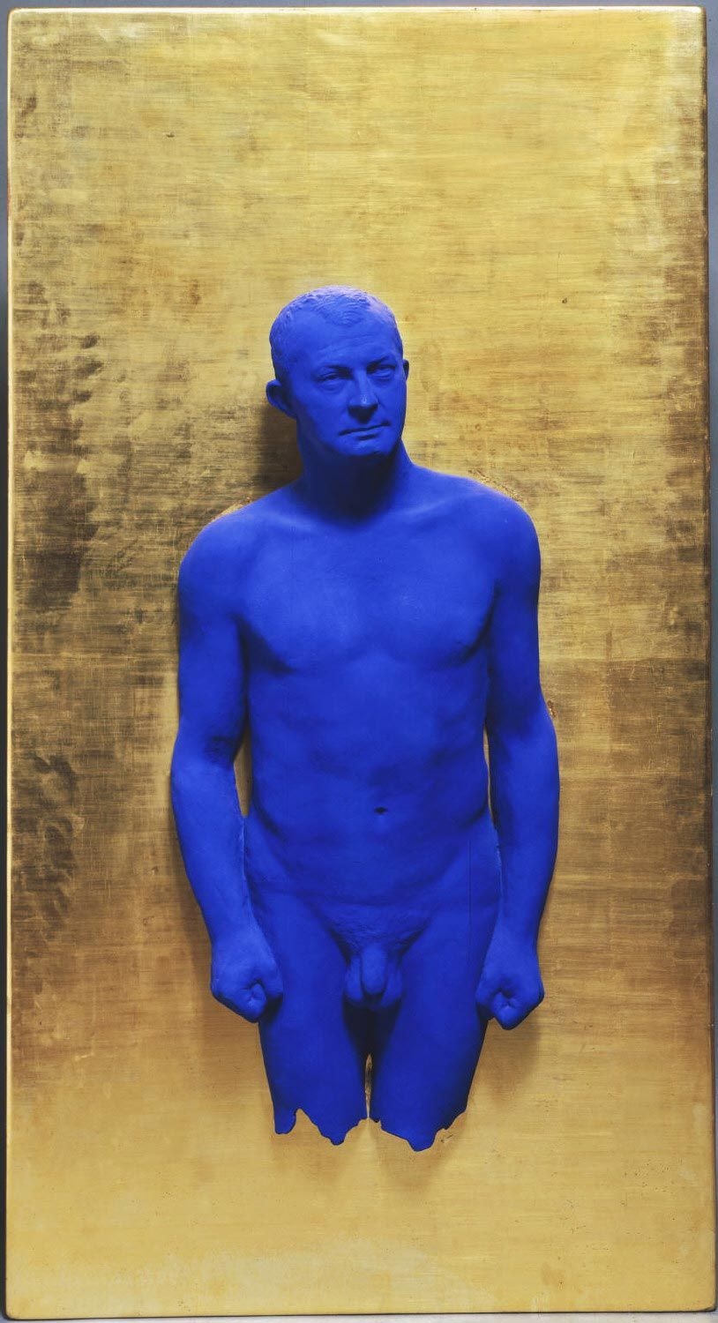
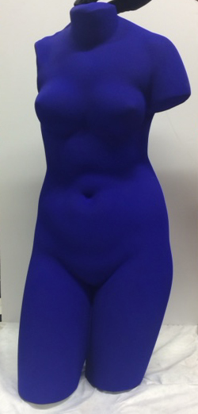
Yves Klein, Blue Venus, c. 1961
Yves Klein, Portrait Relief I: Arman -, 1962

Slide 16
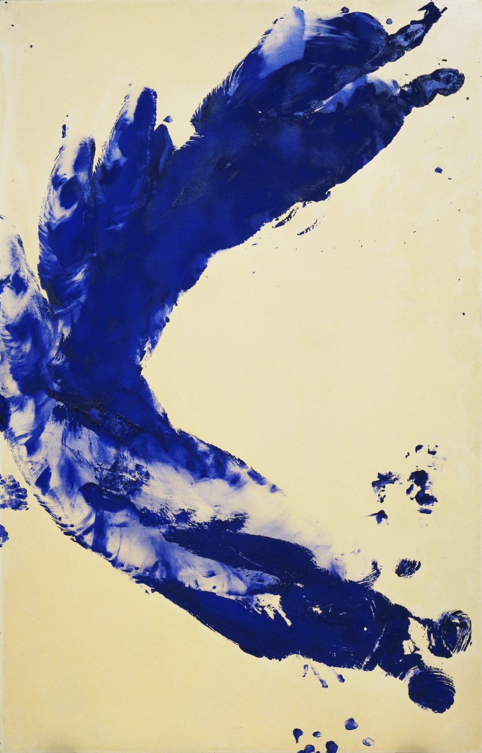
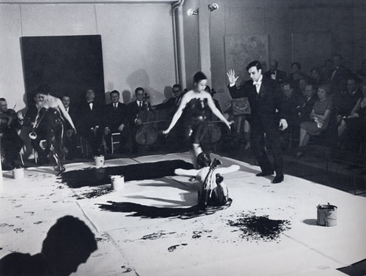
Yves Klein, Anthropometry: Princess Helena, 1960
Yves Klein's performance, “Anthropometries of the Blue Period” 1960
https://www.tate.org.uk/art/artists/yves-klein-1418/yves-klein-anthropometries

Slide 17
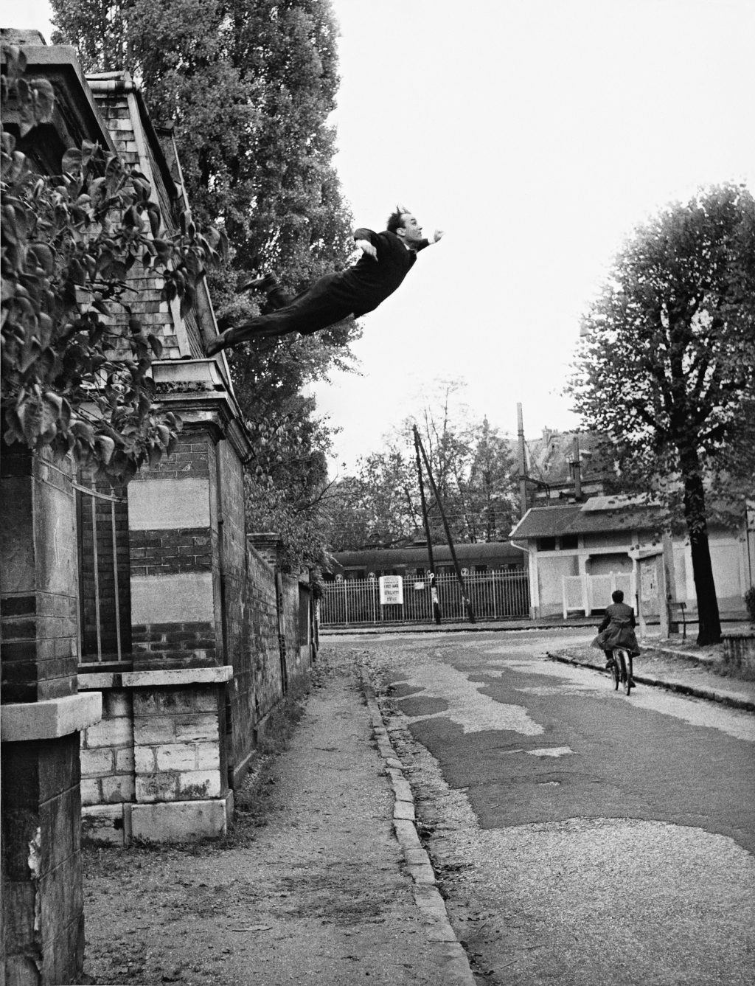
Yves Klein (Photographed by Harry Shunk and János (Jean) Kender) Leap into the Void, October 1960

Slide 18
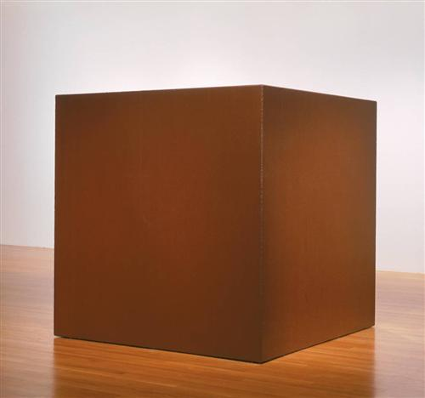
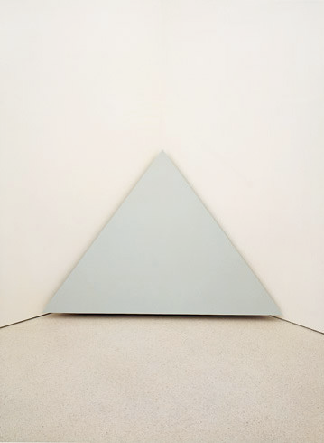
Minimalism
“Specific Objects”- Donald Judd
Art is a specific type of object that occupies the same space as the viewer.
The provocation of the “specific object" is:
Epistemological- how do I define what I am encountering. (Knowledge/classification)
Phenomenological: how do I understand the type of spatiotemporal dynamics of the object vis a vis my own bodily perception
Primary forms
Materials-
Commercial/industrial
Coreten steel
Painted plywood
Conditions of Display
Lack of a frame/plinth
Spatial contiguity
Tony Smith, Die, 1962
Robert Morris, Corner Piece, 1964
Notes:
http://www.nga.gov/content/ngaweb/Collection/art-object-page.127623.html
http://www.guggenheim.org/new-york/collections/collection-online/artwork/3063

Slide 19
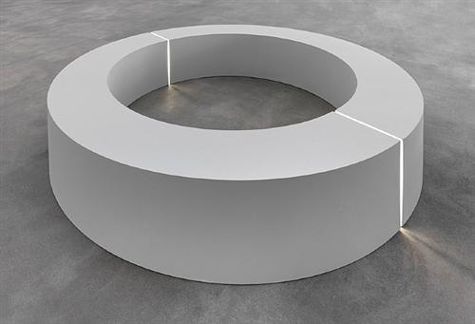
Minimalism
Anthropomorphism
The object behaves/performs like a body
Interiority
Scale
Robert Morris, Untitled (Ring with Light), 1966
Robert Morris, Mirrored Cubes, 1965-71
Notes:
http://www.tate.org.uk/art/artworks/morris-untitled-t01532
http://www.walkerart.org/collections/artists/robert-morris

Slide 20
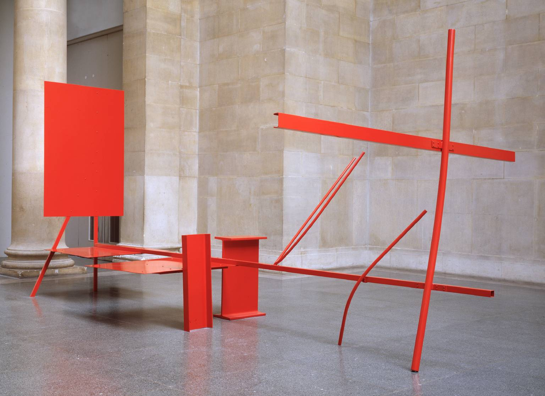
Minimalism
“Art and Objecthood”- Michael Fried
“We are all literalists most or all of our lives. Presentness is grace.”
Art (absorption)
Object (theatricality)
Out of time/timeless
Aesthetic composition-articulated elements that can be grasped all at once from a single unique perspective
In time/ the experience of the work unfolds in time.
Literal object that insists on the “gestalt” of the object.
Anthony Caro, Early One Morning, 1962
Robert Morris, Corner Piece, 1964

Slide 21
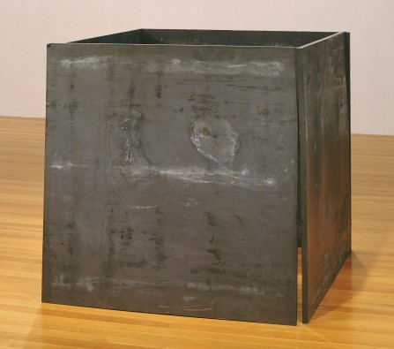
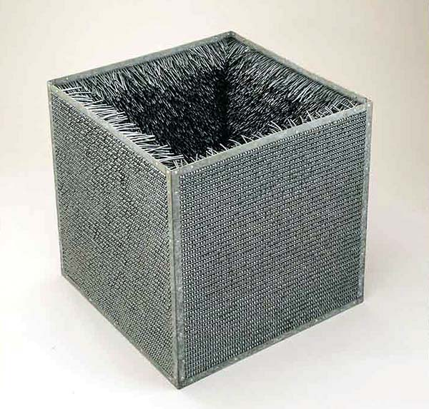
Process Art
Lucy Lippard“Eccentric Abstraction,”
Richard Serra, One Ton Prop (House of Cards), 1969 Lead antimony, 48x48x48
Eve Hesse, Accession II, 1968
Approx 30”x30”x30"

Slide 22
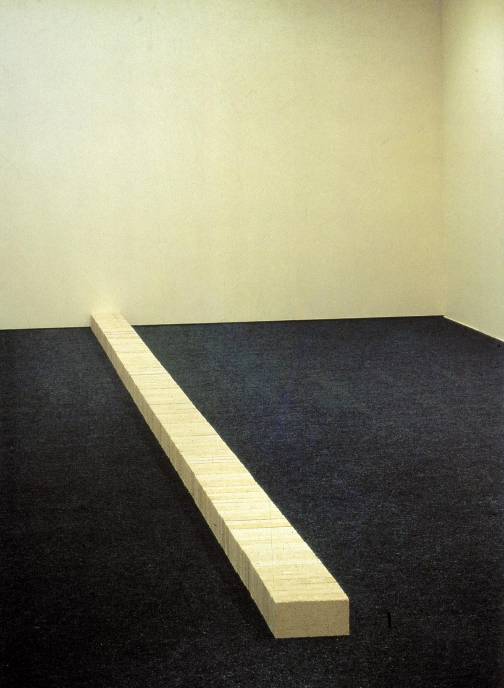
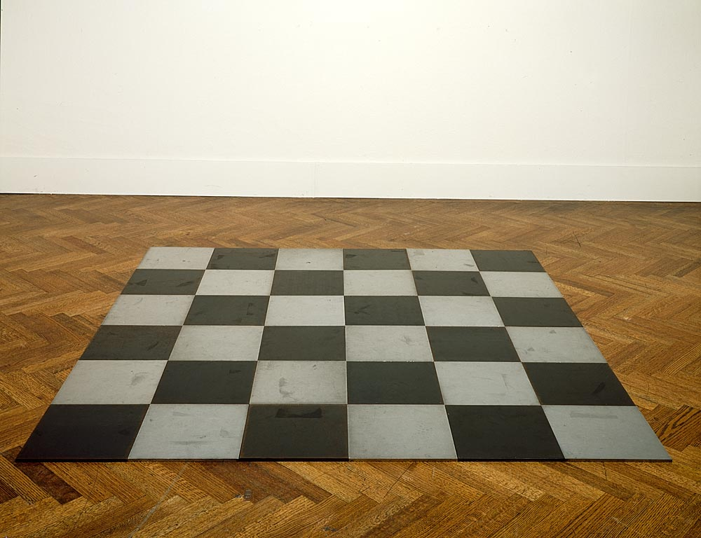
Minimalism
Process Art
Lucy Lippard“Eccentric Abstraction,”
Carl Andre, Lever, 1966
Carl Andre, Steel Magnesium Plain, 1969
Lynda Benglis, Contraband, 1969
Notes:
http://www.independent.co.uk/arts-entertainment/art/news/how-to-build-controversy-from-a-pile-of-bricks-2277359.html
http://www.moma.org/collection/artist.php?artist_id=174

Slide 23
Ana Chave, “Minimalism and Biography”
Carl Andre, Lever, 1966
Carl Andre, Steel Magnesium Plain, 1969
Ana Mendieta, Untitled: Silueta Series, 1978
Eve Hesse, Untitled, 1970
Notes:
http://www.independent.co.uk/arts-entertainment/art/news/how-to-build-controversy-from-a-pile-of-bricks-2277359.html
http://www.moma.org/collection/artist.php?artist_id=174

