Slide 1
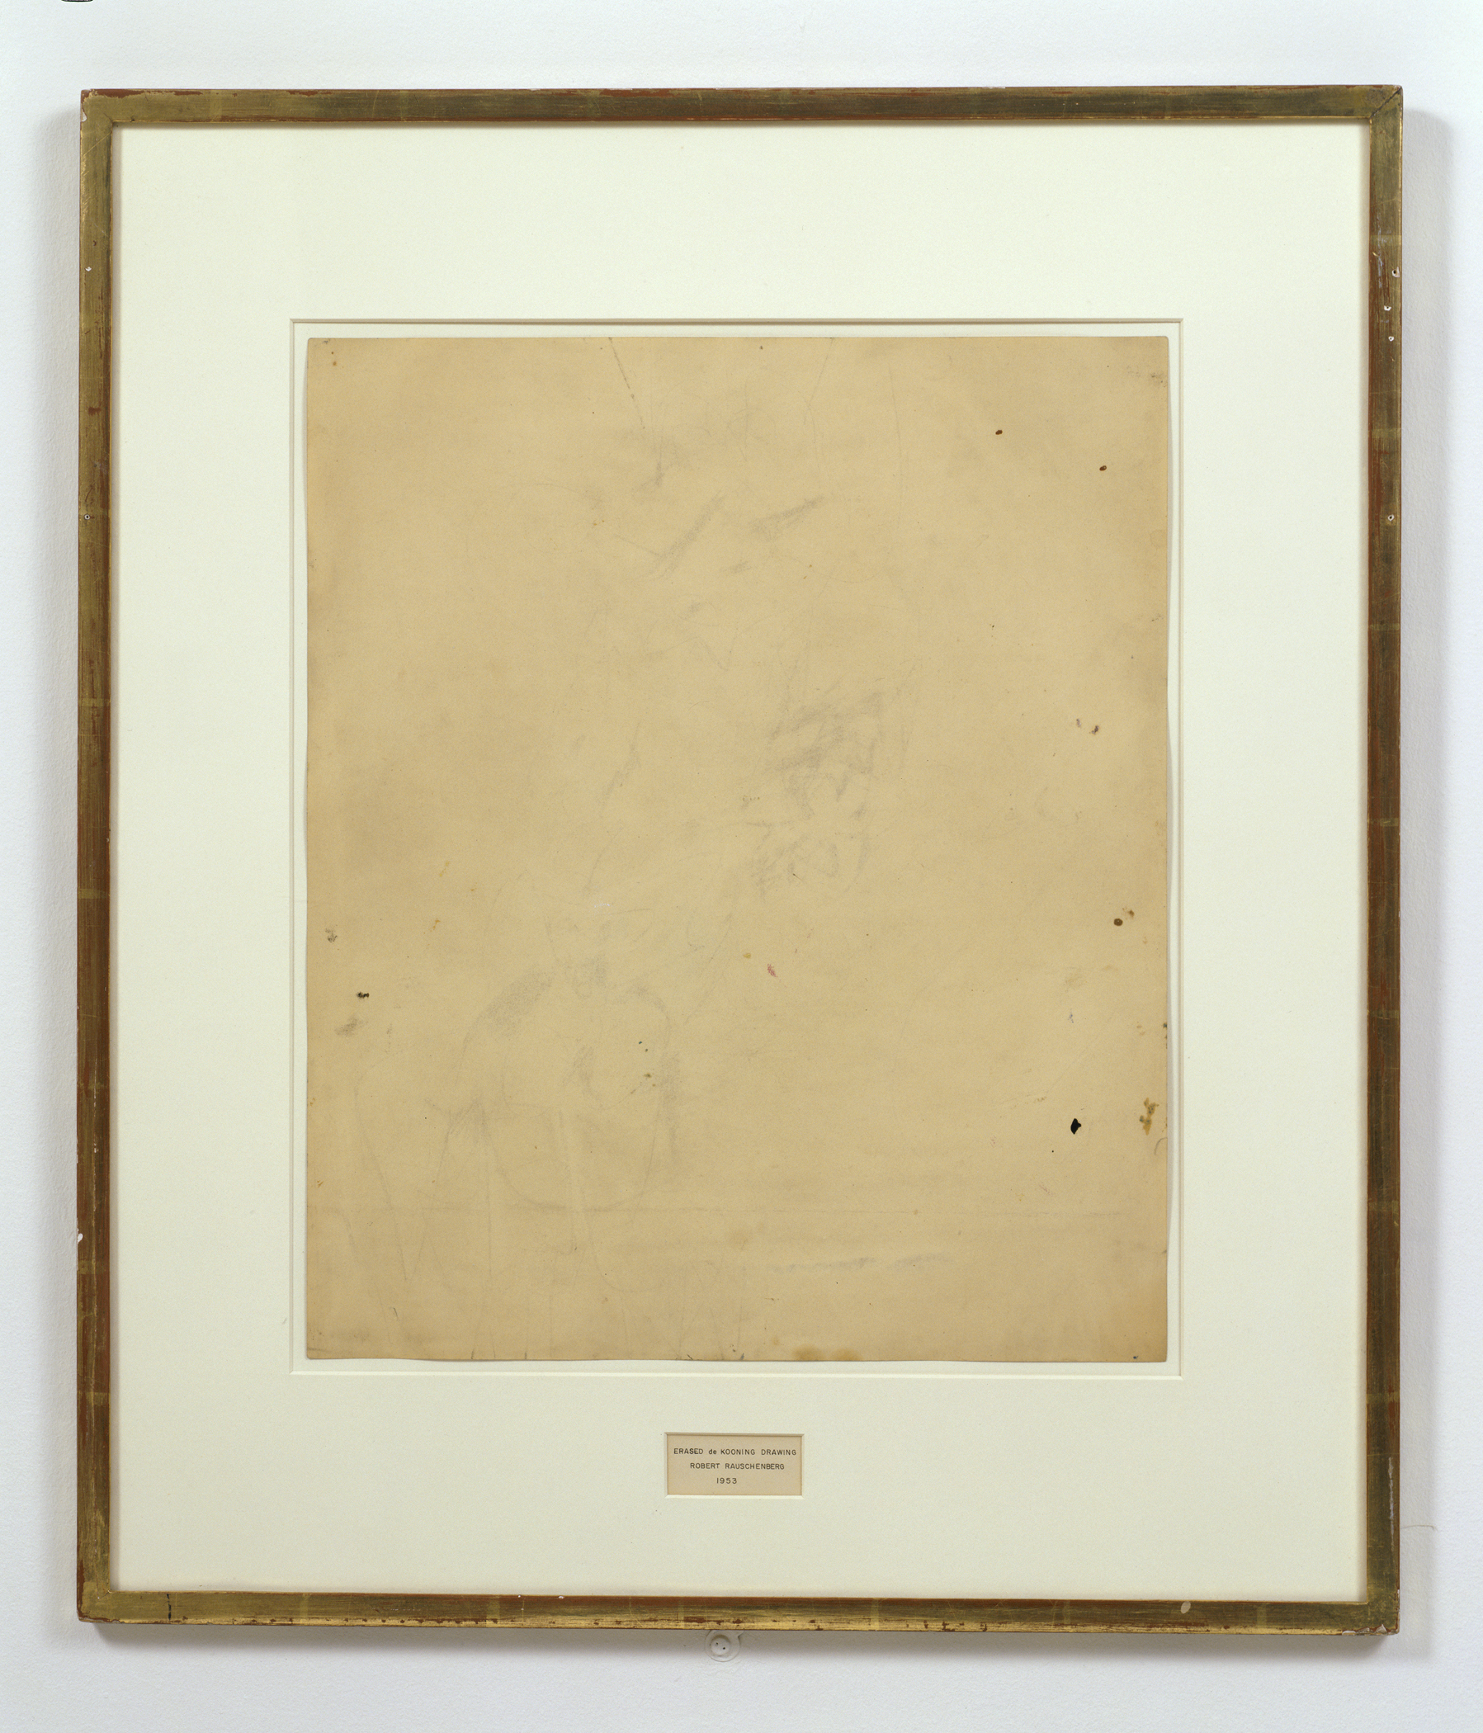
A Duchampian (Re)Turn
Nouveau réalisme and “Neo-Dada”
Marcel Duchamp, In Advance of a Broken Arm, 1915
Robert Rauschenberg, Erased De Kooning Drawing, 1953

Slide 3
Trebuchet (Trap).
Photo by Henri Pierre Roche, c.1916-1918
Notes:
http://eipcp.net/transversal/0910/ashford/en/print

Slide 4

Nouveau réalisme
Vs. Abstract Expressionism
Yves Klein, IKB 79, 1959
Mark Rothko, No. 1 (Royal Red and Blue, 1954

Slide 5
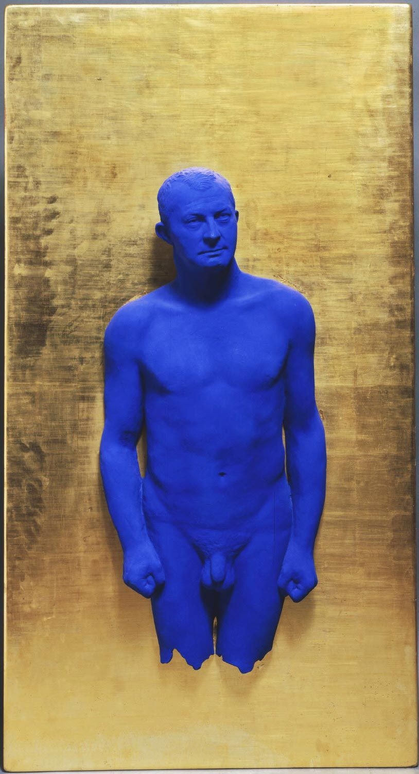
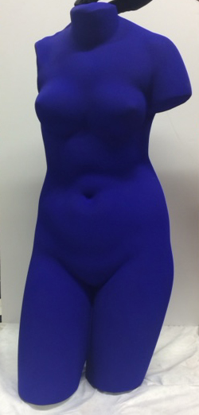
Yves Klein, Blue Venus, c. 1961
Yves Klein, Portrait Relief I: Arman -, 1962

Slide 6
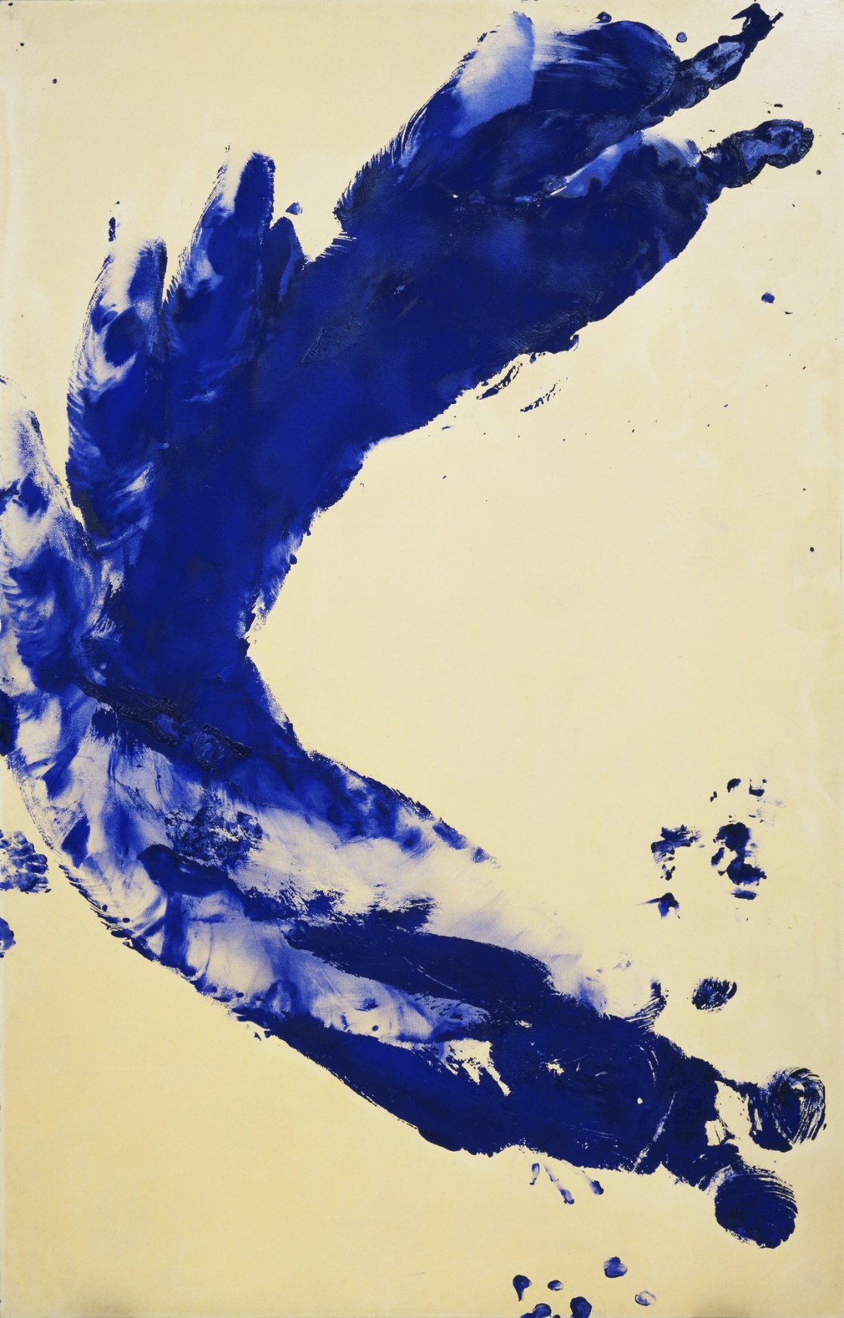
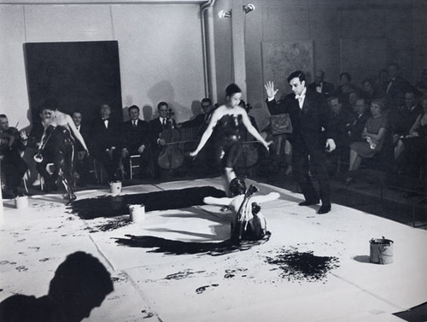
Yves Klein, Anthropometry: Princess Helena, 1960
Yves Klein's performance, “Anthropometries of the Blue Period” 1960
https://www.tate.org.uk/art/artists/yves-klein-1418/yves-klein-anthropometries

Slide 7
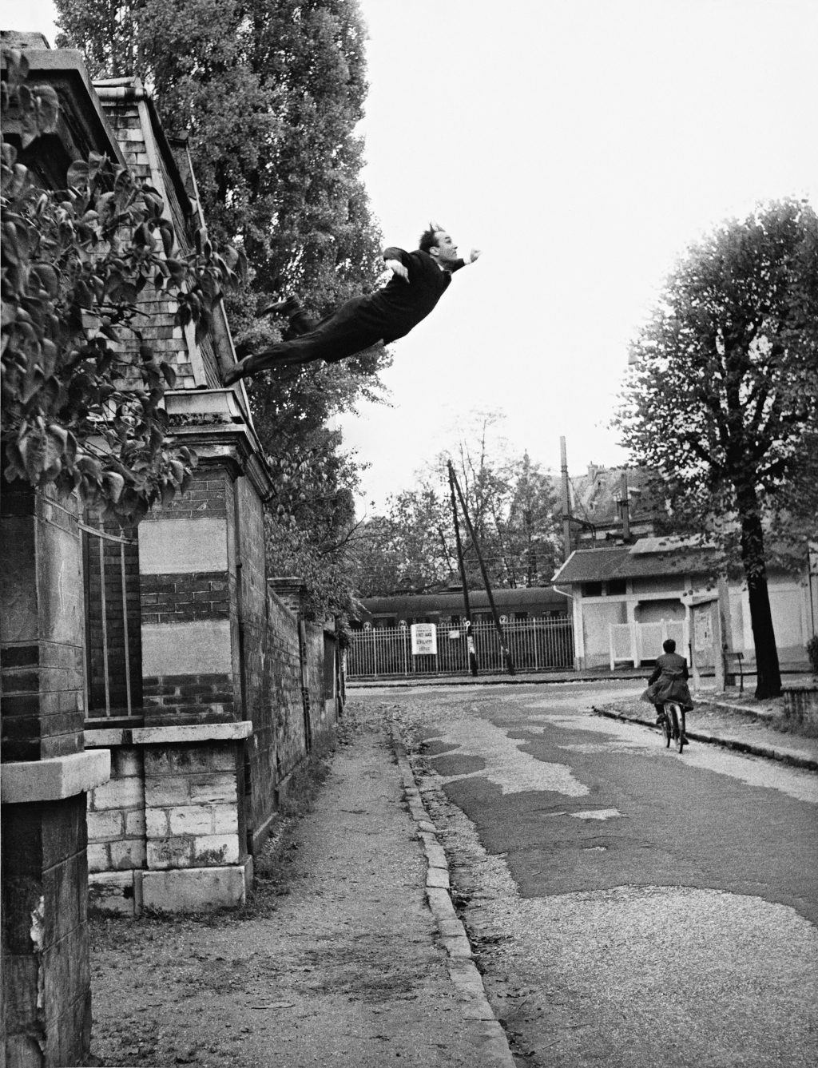
Yves Klein (Photographed by Harry Shunk and János (Jean) Kender) Leap into the Void, October 1960

Slide 8
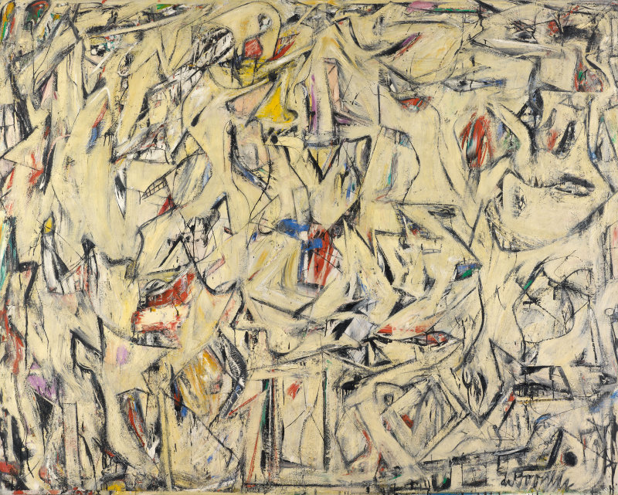
It was suggested earlier that the Old Masters had three ways of conceiving the picture plane. But one axiom was shared by all three interpretations, and it remained operative in the succeeding centuries, even through Cubism and Abstract Expressionism: the conception of the picture as representing a world…which reads on the picture plane in correspondence with the erect human posture. The top of the picture corresponds to where we hold our heads aloft; while its lower edge gravitates to where we place our feet. Even in Picasso’s Cubist collages … there is still a harking back to implied acts of vision, to something that was once actually seen… Therefore the Renaissance picture plane affirms verticality as its essential condition. And the concept of the picture plane as an upright surface survives the most drastic changes of style. Pictures by Rothko, Still, Newman, de Kooning, and Kline are still addressed to us head to foot—as are those of Matisse and Miró… Leo Steinberg, Other Criteria
Georges Braque, Pitcher and Violin, 1909-1910
Willem de Kooning, Excavation, 1950

Slide 9
“flatbed picture plane”
I borrow the term from the flatbed printing press—‘a horizontal bed on which a horizontal printing surface rests’ (Webster). And I propose to use the word to describe the characteristic picture plane of the 1960s—a pictorial surface whose angulation with respect to the human posture is the precondition of its changed content.
Leo Steinberg, Other Criteria
Robert Rauschenberg, Erased De Kooning Drawing, 1953
Robert Rauschenberg, Automobile Tire Print, 1953
Notes:
http://www.sfmoma.org/explore/collection/artwork/25845

Slide 10
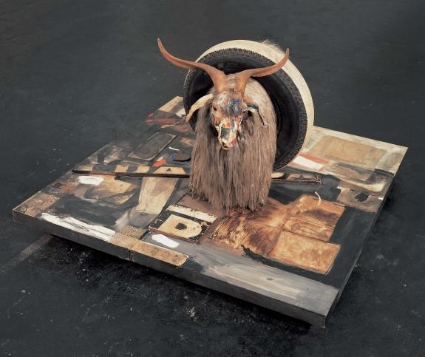
“…something happened in painting around 1950… in the work of Robert Rauschenberg and Dubuffet. We can still hang their pictures—just as we tack up maps and architectural plans, or nail a horseshoe to the wall for good luck. Yet these pictures no longer simulate vertical fields, but opaque flatbed horizontals. They no more depend on a head-to-toe correspondence with human posture than a newspaper does. ‘The flatbed picture plane makes its symbolic allusion to hard surfaces such as tabletops, studio floors, charts, bulletin boards—any receptor surface on which objects are scattered, on which data is entered, on which information may be received, printed, impressed—whether coherently or in confusion…”. Leo Steinberg, Other Criteria
Robert Rauschenberg, Monogram, 1955

Slide 11
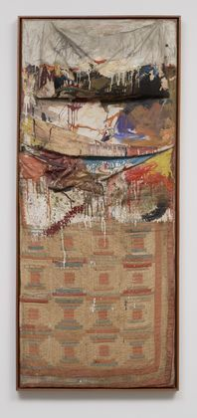
To repeat: it is not the actual physical placement of the image that counts. There is no law against hanging a rug on a wall, or reproducing a narrative picture as a mosaic floor. What I have in mind is the psychic address of the image, its special mode of imaginative confrontation, and I tend to regard the tilt of the picture plane from vertical to horizontal as expressive of the most radical shift in the subject matter of art, the shift from nature to culture.
Hans Naimuth, Jackson Pollock Painting, 1950
Robert Rauschenberg, Bed, 1955

Slide 12
Robert Rauschenberg, Canyon, 1959

Slide 13
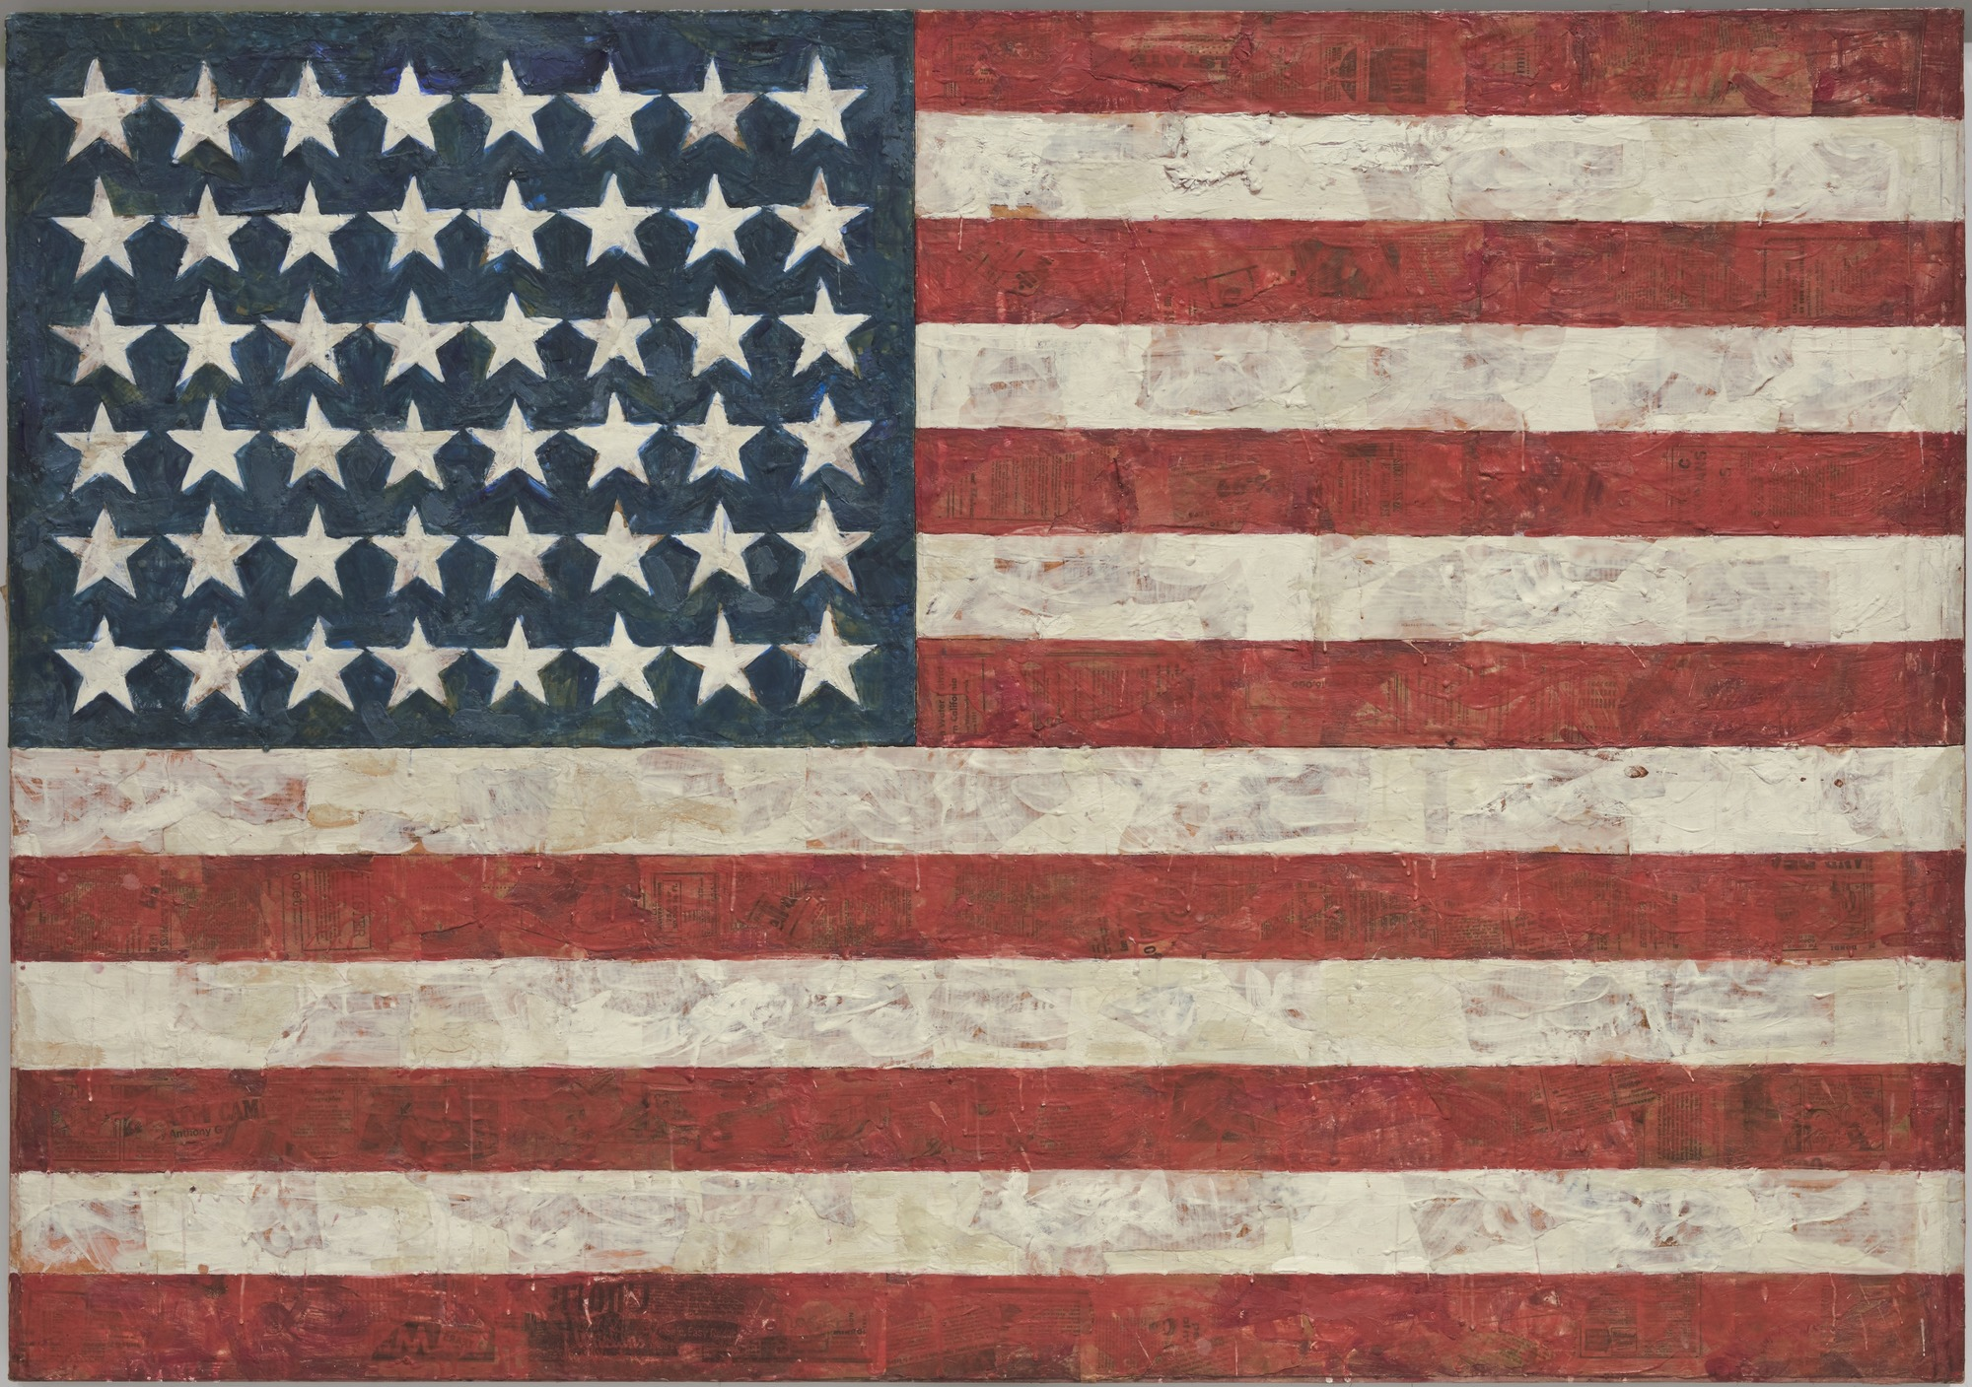
Jasper Johns, Flag, 1954-55

Slide 14
Jasper Johns, Target with Four Faces, 1955
Notes:
http://www.moma.org/collection/browse_results.php?criteria=O%3AAD%3AE%3A2923&page_number=2&template_id=1&sort_order=1

Slide 15
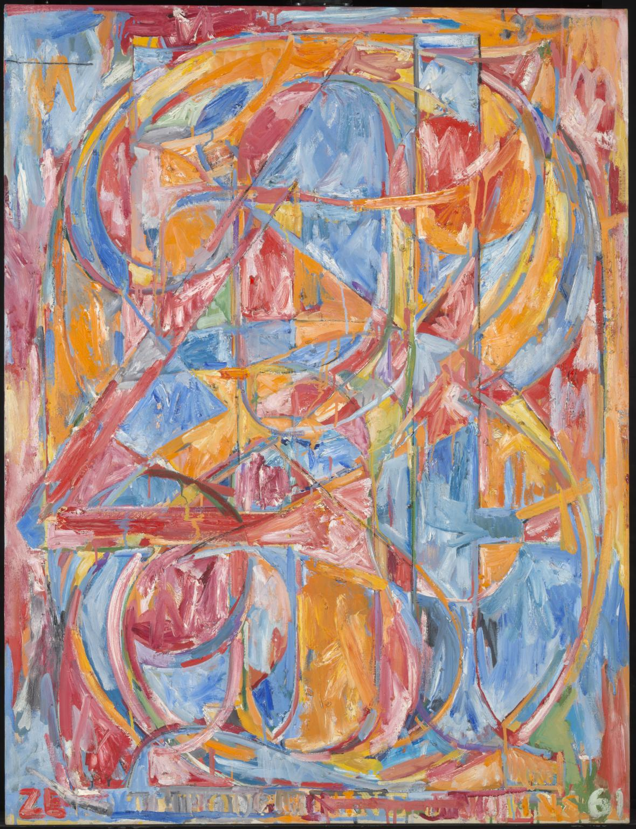
Jasper Johns, 0-9, 1960

