Slide 1
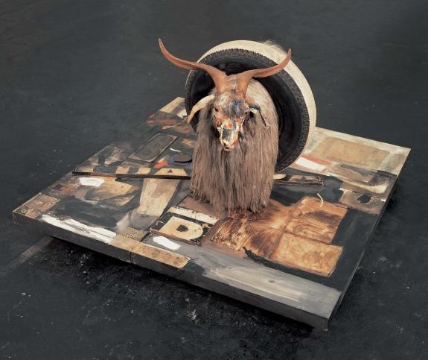
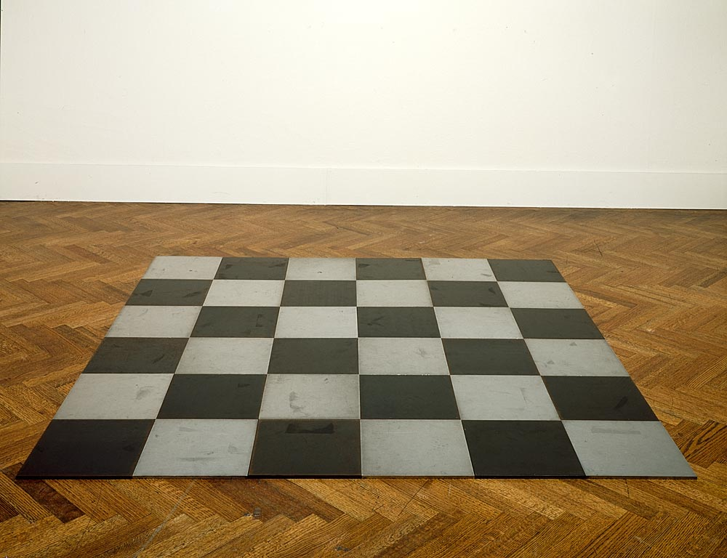
Minimalism and Pop

Slide 2
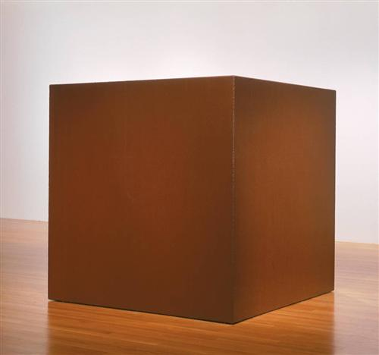
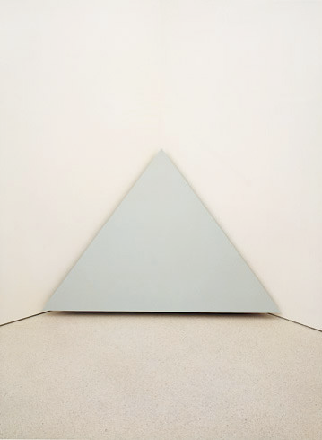
Minimalism
“Specific Objects”- Donald Judd
Art is a specific type of object that occupies the same space as the viewer. The provocation of the “specific object" is:
Formal: reduction to “primary structures”
Epistemological- how do I define what I am encountering. (Knowledge/classification)
Phenomenological: how do I understand the spatiotemporal dynamics of the object vis a vis my own bodily perception
Simplified structures
Cube/pyramid
Materials-
Commercial/industrial
Coreten steel
Painted plywood
Conditions of Display
Lack of a frame/plinth
Spatial contiguity
Tony Smith, Die, 1962
Robert Morris, Corner Piece, 1964
Notes:
http://www.nga.gov/content/ngaweb/Collection/art-object-page.127623.html
http://www.guggenheim.org/new-york/collections/collection-online/artwork/3063

Slide 3
Minimalism
Anthropomorphism
The object behaves/performs like a body
Interiority
Scale
Robert Morris, Two Columns, 1961; Corner Piece, 1964 ; Untitled (Ring with Light), 1966
Notes:
http://www.tate.org.uk/art/artworks/morris-untitled-t01532
http://www.walkerart.org/collections/artists/robert-morris

Slide 4
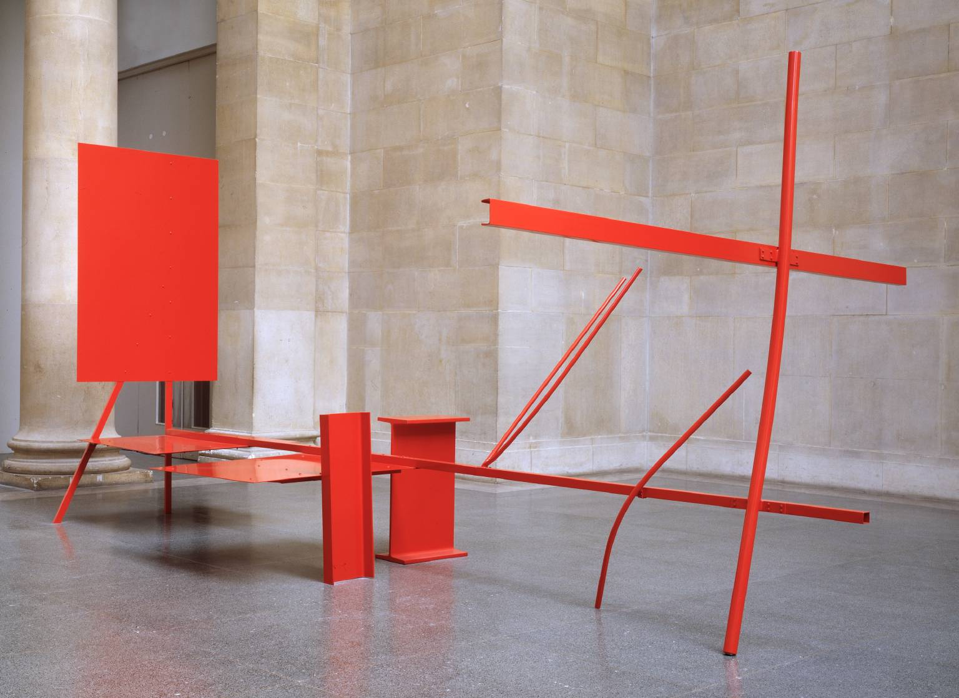
Minimalism
“Art and Objecthood”- Michael Fried
“We are all literalists most or all of our lives. Presentness is grace.”
Art (absorption)
Object (theatricality)
Out of time/timeless
Aesthetic composition-articulated elements that can be grasped all at once from a single unique perspective
In time/ the experience of the work unfolds in time.
Literal object that insists on the “gestalt” of the object.
mise-en-abyme
Anthony Caro, Early One Morning, 1962
Robert Morris, Mirrored Cubes, 1965-71

Slide 5
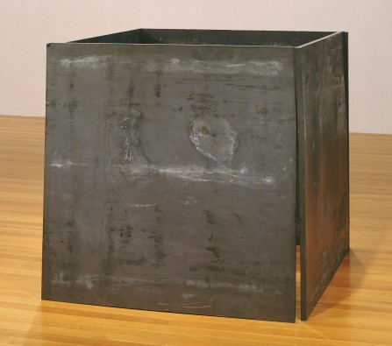
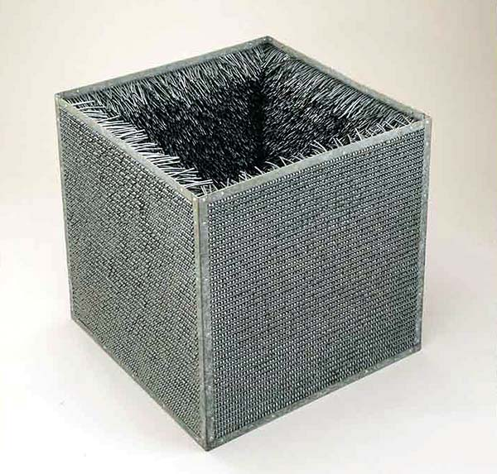
Minimalism
Lucy Lippard“Eccentric Abstraction,”
Aggressive/muscular forms of being in time
Organic
Richard Serra, One Ton Prop (House of Cards), 1969 Lead antimony, 48x48x48
Eve Hesse, Accession II, 1968 Approx 30”x30”x30"

Slide 6
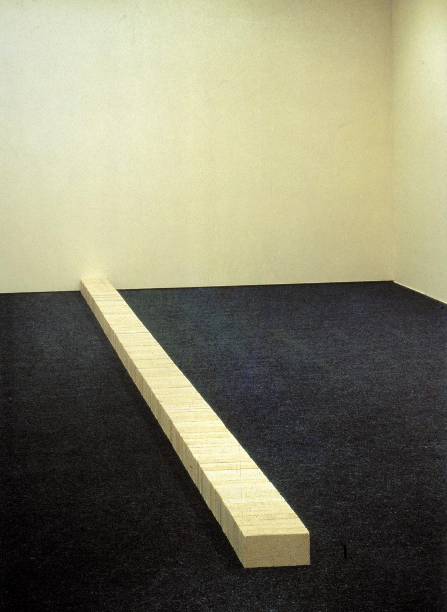
Minimalism
Process Art
Carl Andre, Lever, 1966
Carl Andre, Steel Magnesium Plain, 1969
Lynda Benglis, Contraband, 1969
Notes:
http://www.independent.co.uk/arts-entertainment/art/news/how-to-build-controversy-from-a-pile-of-bricks-2277359.html
http://www.moma.org/collection/artist.php?artist_id=174

Slide 7
Ana Chave, “Minimalism and Biography”
Carl Andre, Lever, 1966
Carl Andre, Steel Magnesium Plain, 1969
Ana Mendieta, Untitled: Silueta Series, 1978
Eve Hesse, Untitled, 1970
Notes:
http://www.independent.co.uk/arts-entertainment/art/news/how-to-build-controversy-from-a-pile-of-bricks-2277359.html
http://www.moma.org/collection/artist.php?artist_id=174

Slide 8

Abstract Expressionism
Nouveau réalisme
Hard edge painting
Mark Rothko, No. 1 (Royal Red and Blue,) 1954
Yves Klein, IKB 79, 1959
Ellsworth Kelly, Red Blue Green, 1963

Slide 9
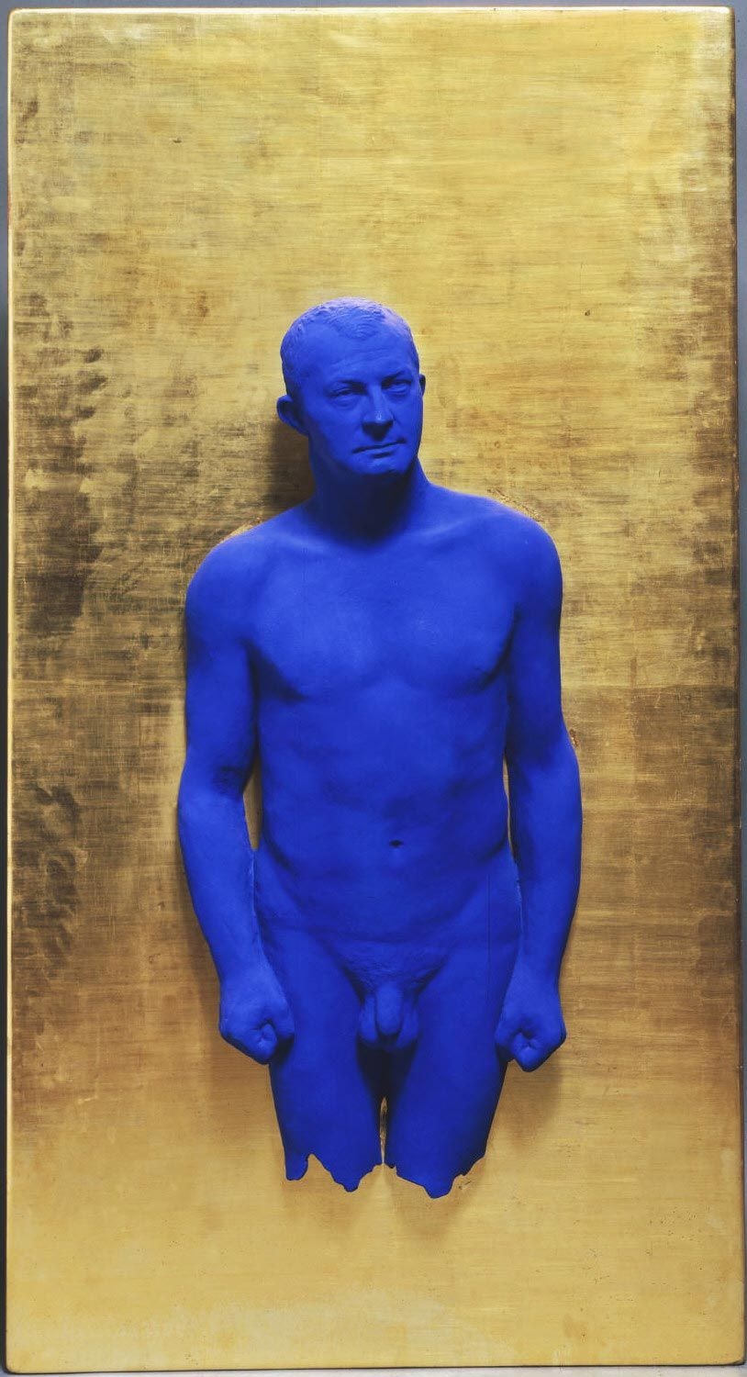
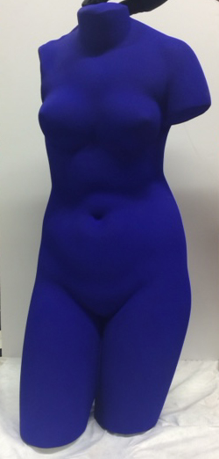
Yves Klein, Blue Venus, c. 1961
Yves Klein, Portrait Relief I: Arman -, 1962

Slide 10
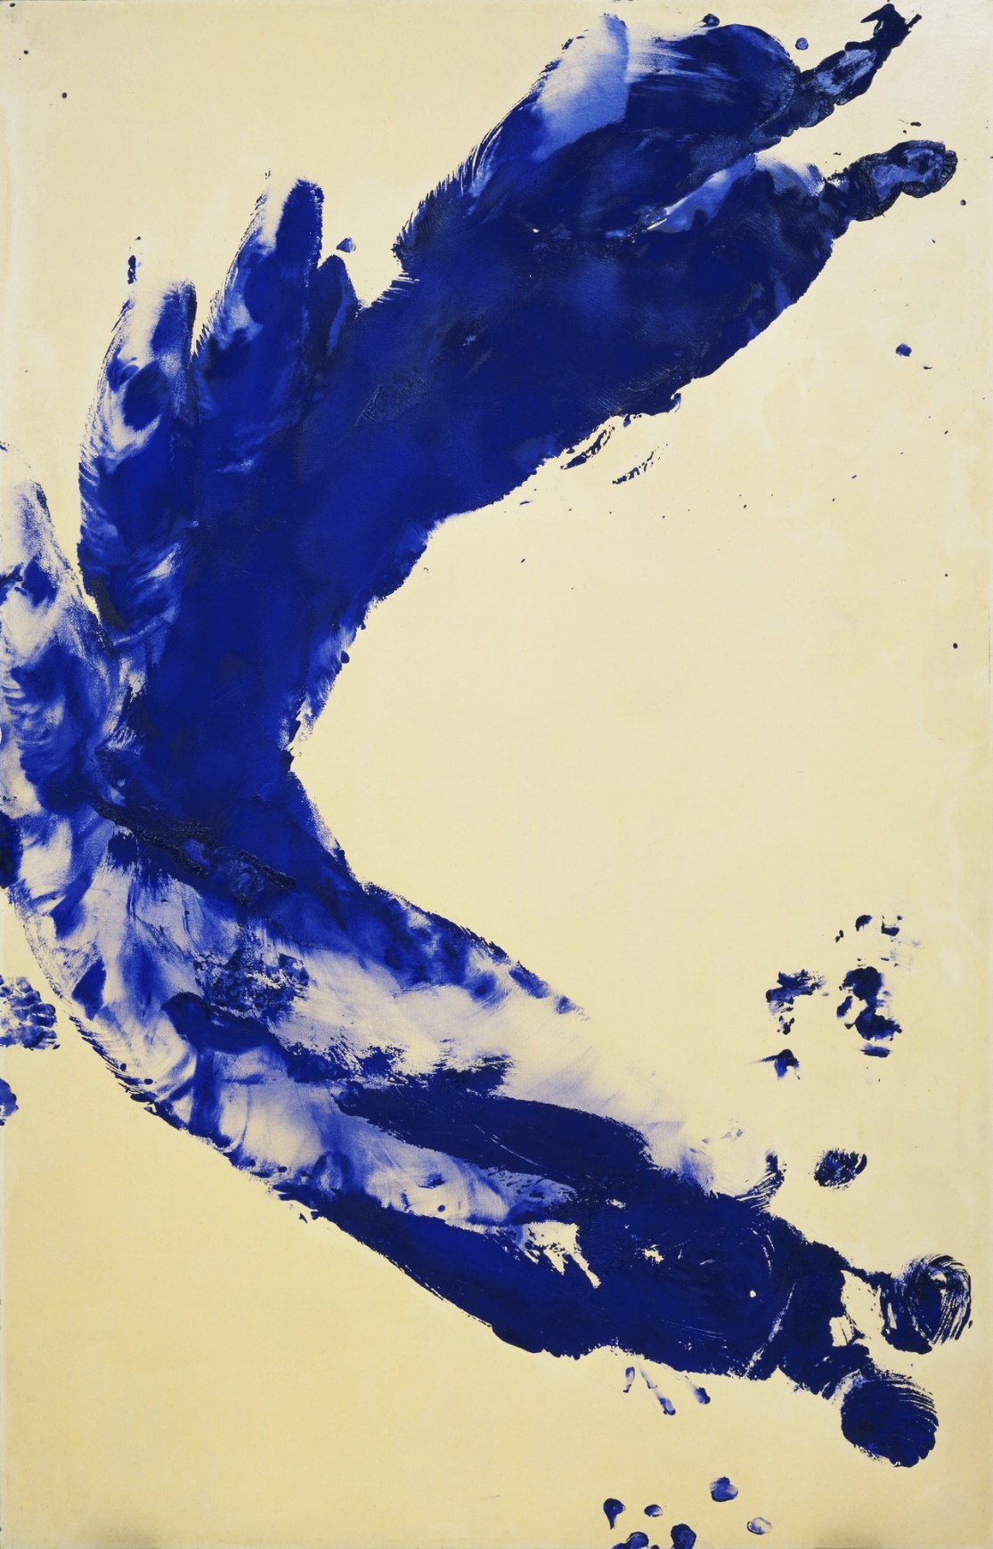
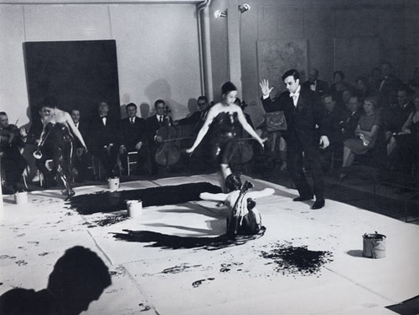
Yves Klein, Anthropometry: Princess Helena, 1960
Yves Klein's performance, “Anthropometries of the Blue Period” 1960
https://www.tate.org.uk/art/artists/yves-klein-1418/yves-klein-anthropometries

Slide 11
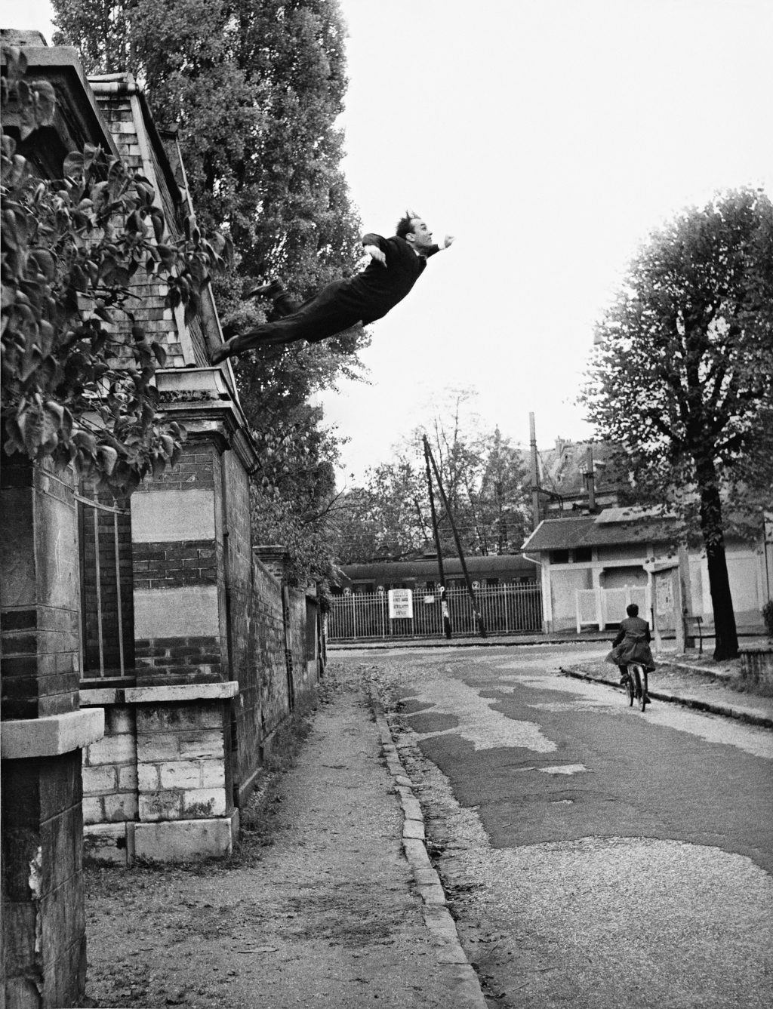
The spectacular nature of the artist
celebrity, mass media, consumer/popular culture
Yves Klein (Photographed by Harry Shunk and János (Jean) Kender) Leap into the Void, October 1960
Andy Warhol lounging in the “Silver Factory”(63-67)

Slide 12
Popular culture-repetition and reproduction- Simulacra: a copy without an original
Andy Warhol, Campbell Soup Cans, (1962) Oil on canvas

Slide 13
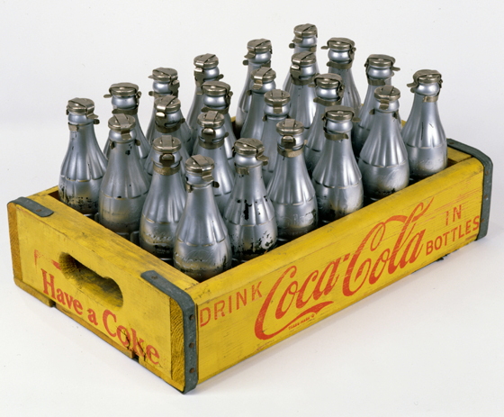
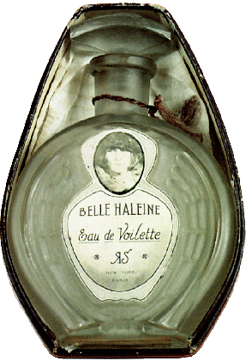
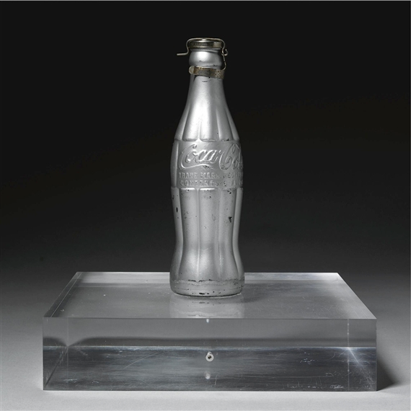
Consumer culture and commodification-repetition and reproduction
Marcel Duchamp. Belle Haleine eau de Voilette or Beautiful Breath: Veil Water (1921). Perfume bottle with collage label inside oval violet cardboard box assisted readymade.
Andy Warhol, You’re In, (1967) Silver paint on glass bottles in printed wooden crate

Slide 14
The intersections of fine art and popular culture: celebrity
Painting Problems at Warhol’s studio, 1984
Jean Michel Basquiat and Andy Warhol

Slide 15
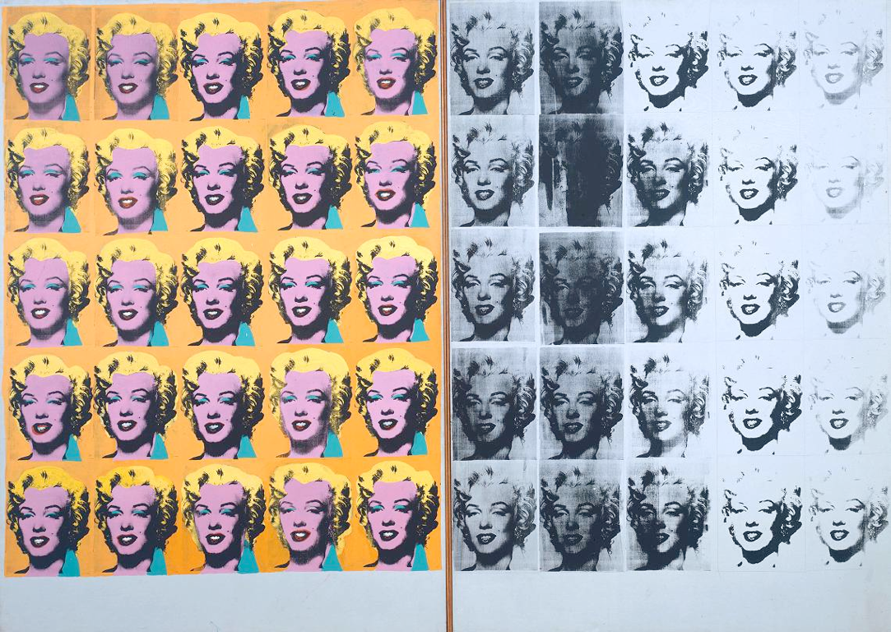
Thomas Crow “Saturday Disasters”
Warhols Humanism-> traumatized subject-queer identity-political agency
Andy Warhol, Marilyn Diptych, (1962) Oil on canvas

Slide 16
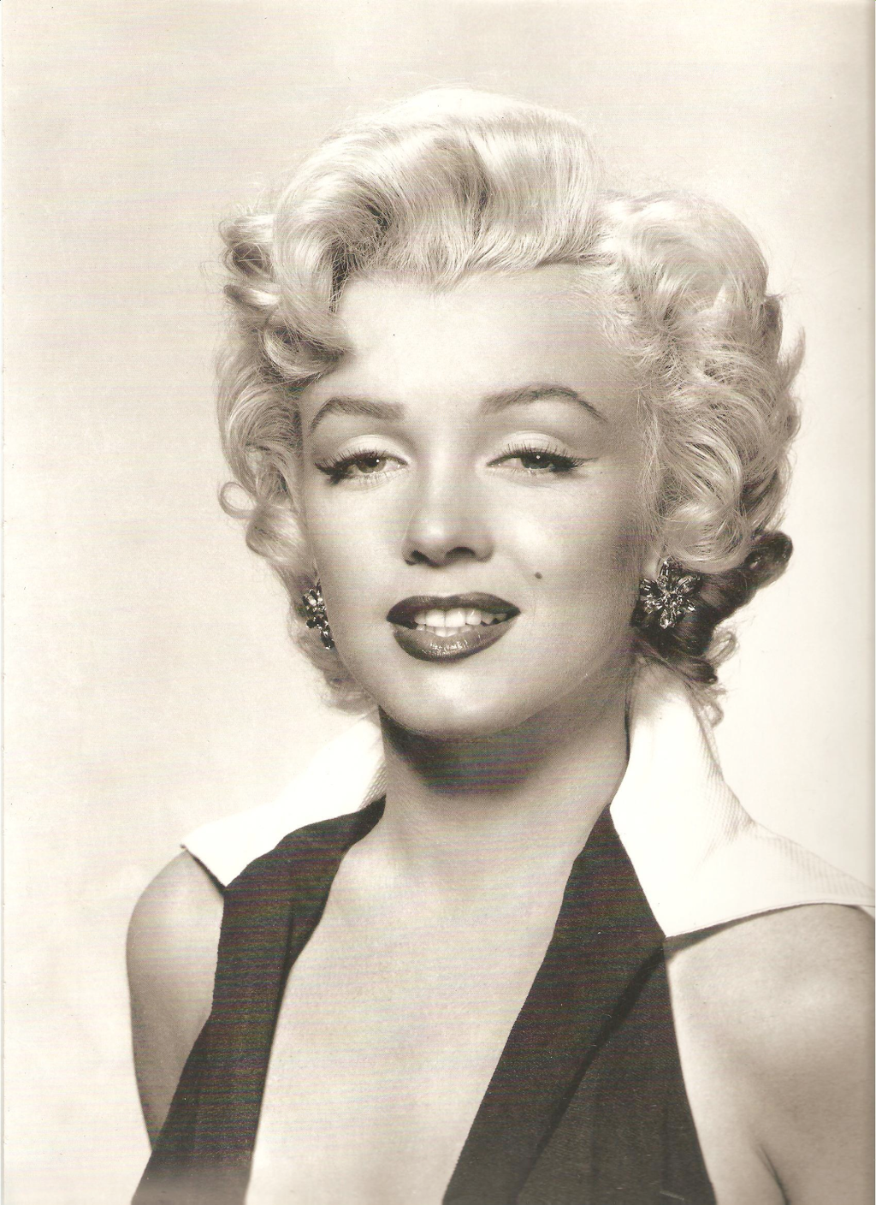
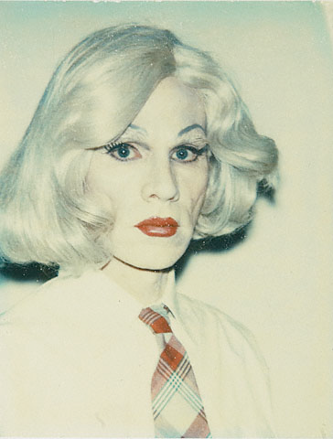
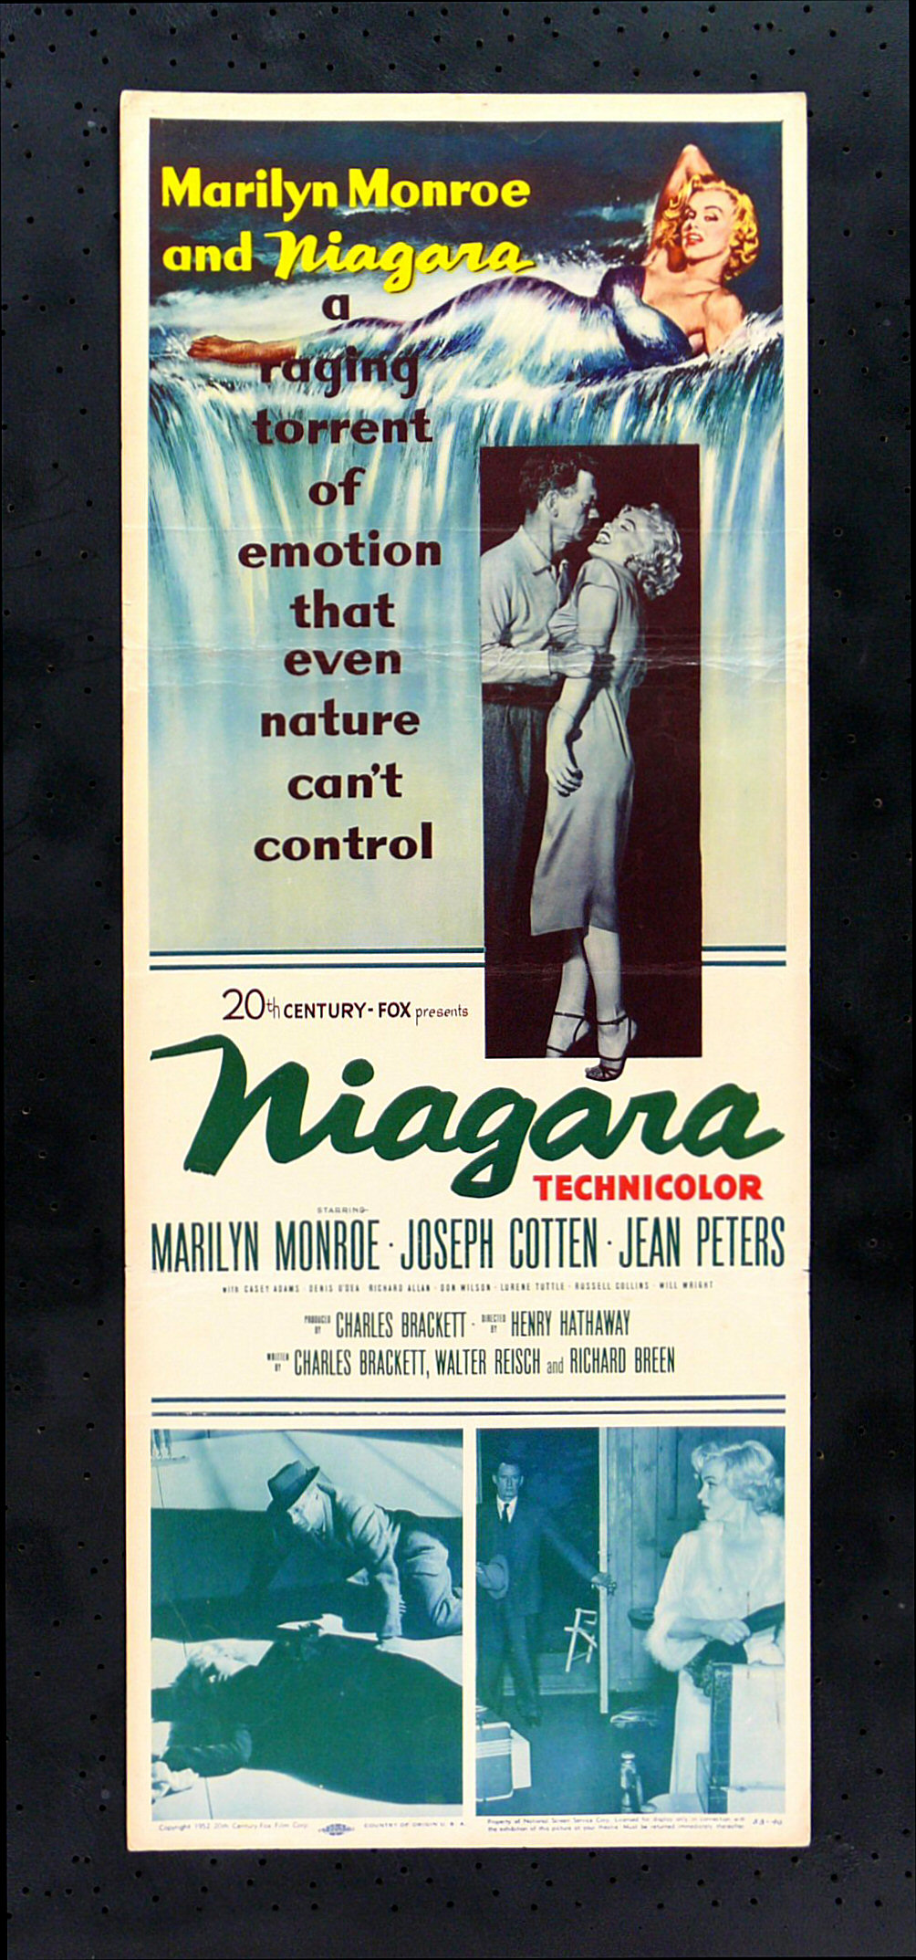

Slide 17
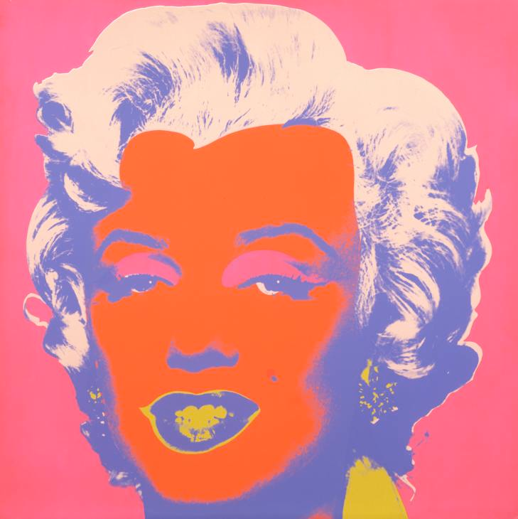
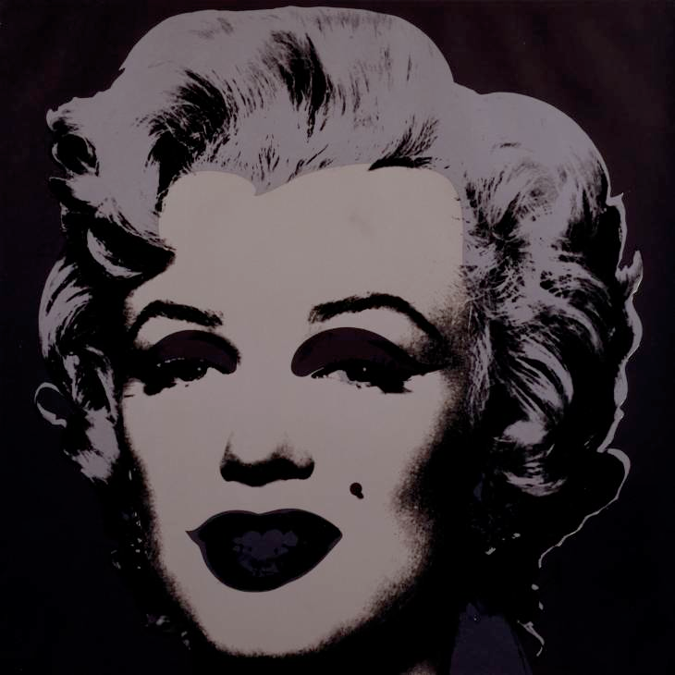
Hal Foster, “Traumatic Realism”
Andy Warhol. Self Portrait in Drag (1981). Polaroid

Slide 18
Walter Benjamin (Critical Theory)
“The Work of Art in the Age of its Technological Reproducibility”
The optical unconscious- new technologies of reproducibility reveal domains of experience previously invisible.
Edweard Muybridge, The Horse in Motion, 1878
Andy Warhol. Empire(1964).
Shot at 24 FPS-6.5hrs
Projected at 16 FPS=8hrs5min

Slide 19
Semiotics
Jacques Lacan (Psychoanalysis)
The three registers(orders) of the subject.
Three types of signification
->The Imaginary (image/picture)
->The Symbolic (language/story)
->The Real (the thing itself/everything that escapes representation)
Roland Barthes
“Camera Lucida”
  Studium
  Punctum
Andy Warhol, Ambulance Disaster, Silkscreen on canvas, 1963

Slide 20
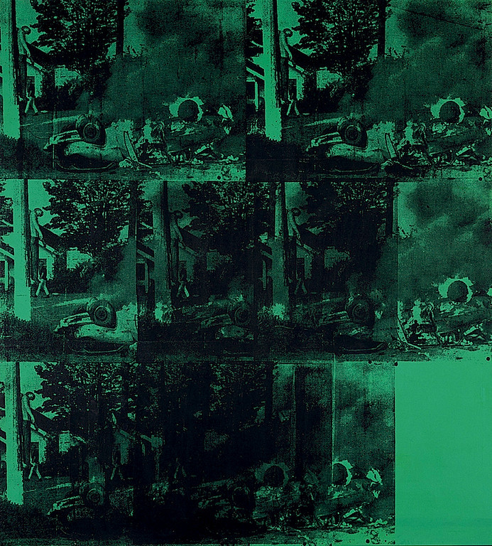
Optical Unconscious——- (Imaginary/Symbolic/Real)———— (Studium/Punctum)
Andy Warhol. Green Car Crash (Green Burning Car I) (1963). Synthetic polymer, silkscreen ink and acrylic on linen.
Andy Warhol, White Burning Car III, Silkscreen on canvas, 1963

