Slide 1
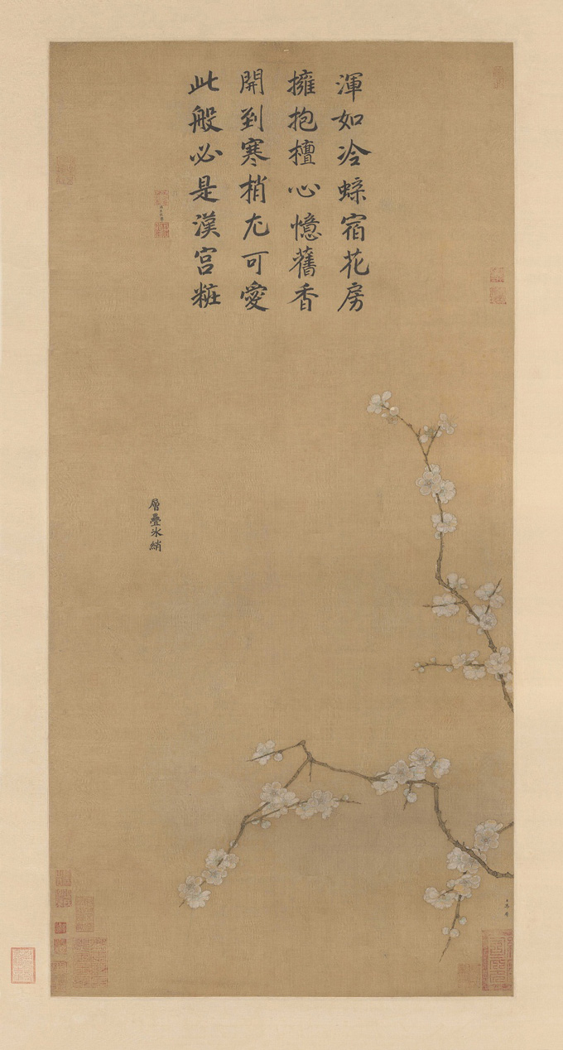
Ma Lin, Layers of Icy Silk, 1216, Hanging scroll, ink and color on silk
Inscription by Yuang Mei-zi, consort of emperor Song Lizong (Emperor Li) :
“Like a chilled butterfly resting in the corolla,
Embracing the rouge heart, remembering former fragrance.
Blossoming to the tip of the cold branch, it is most loveable:
This must be the makeup that adorned the Han palace.”
Notes:
Femininity; framing interpretation; non-visual senses.

