Slide 1
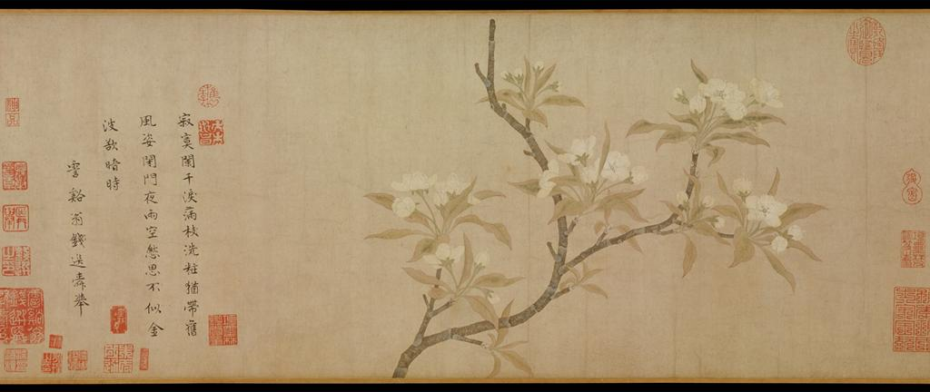
Qian Xuan, Pear Blossoms, ca. 1280, Handscroll; ink and color on paper
“All alone, by the veranda railing, teardrops drenching the branches,
Though her face is unadorned, her old charms remain;
Behind the locked gate, on a rainy night, how she is filled with sadness.
How different was the time when she bathed in the gold waves (of moonlight) just before total darkness fell.”
Notes:
Emotions; imaginations; temporality

