Slide 1
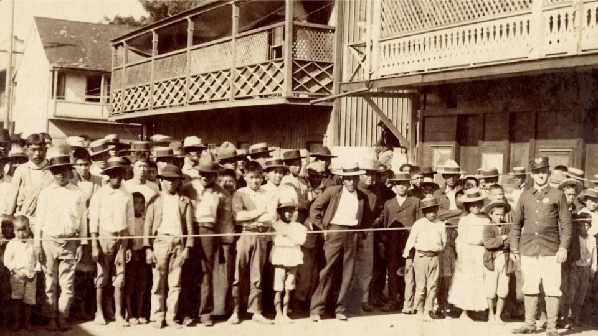
Plagues, History and the Medical Humanities
Residents of Chinatown behind a police guarded cordon during the Bubonic plague outbreak of 1900

Slide 2
Class Activity
Divide yourself into four groups.
Group 1: Public Health Care Workers trying to control COVID-19 outbreak in a city focusing on contact tracing, hospitalization and vaccination- What would be your plan of action?
Group 2: A community of mixed demographic group comprising racial minorities, religious groups and people mostly belonging to lower-socio economic communities who are being encouraged to get vaccinated but the uptake of vaccines have been low- what could be the reasons?
Group 3: It is April 2020; COVID has broken out and you are a group of tourists from an East Asian nation visiting the US- but you are facing a lot of stress. Your country has imposed travel bans and you people have been unkind to you in the US too. You have seen that people often avoid you and look at you suspiciously. There have been news and media discussion about the “China Virus”- Unpack the situation with reference to the readings.
Group 4: You are a group of diverse set of people who live in neighborhood X. A lot of people in your area have been sick with COVID and there have been a few serious cases of respiratory issues and even death among the elderly and immunocompromised. Most people in your area have been taking precautions, some have even been vaccinated, but still there have been cases of individuals not being able to find hospital beds or procure oxygen?- Who is to be blamed for this situation? Have the people been irresponsible or are there greater factors at play?

Slide 3
Pandemics, epidemics and history
1) Jones calls pandemics “a sampling device for social analysis” (Jones 2020, 1682). How or why do you think pandemics/epidemics serve such a purpose?
2) The article compared the trajectory of pandemics/epidemics to a drama where a group of people often end up blamed for the outbreak. Who do you think are often selected for such blame? Does it have anything to do with issues of social marginalization?
3) Jones cites the views of Allan Brandt who famously said that “the promise of the magic bullet has never been fulfilled” (Jones 2020, 1682). What is the “magic bullet” here and why have its hopes/promises remained unfulfilled- article cites examples of smallpox, syphilis, HIV.
4) Learning how historians have reacted to pandemics and the lessons they have drawn from it, how has your view on the evolution or trajectory of pandemics changed?

Slide 4
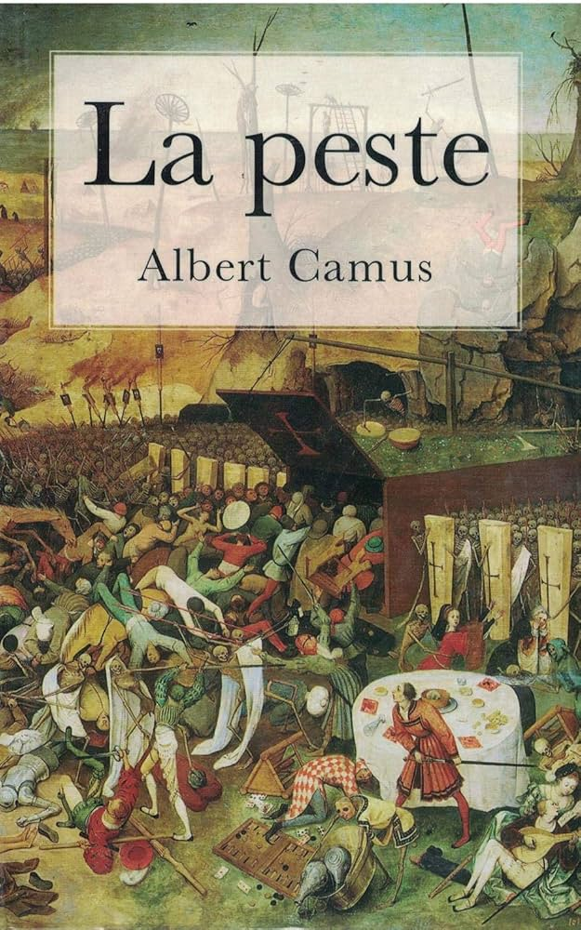
Pandemics and their Historical Patterns
Epidemics as a dramatic act- refusal to accept the reality, blaming those who are socially/culturally/economically disadvantaged.
The issue of stigma and how it repeats itself in history- Jews(black death), Asian/Americans (1900 San Francisco plague, SARS, COVID), homosexuals (HIV).
Epidemics/Pandemics expose social fissures and tensions- litmus test for nations/societies
The failure of one-stop solutions- magic bullets- and the need for paying attention to “structural factors”- public health infrastructure, ability of public to access that infrastructure, social/cultural relationships or biases.
The future of pandemics and that of humanity.

Slide 5
Pandemics, COVID-19 and the Medical Humanities
Macnaughton asks this important question- how can a non-biomedical approach to diseases like COVID help and intervene in solutions along with biomedicine? How do you think paying attention to social, economic and cultural factors help when it comes to confronting issues such as vaccine hesitancy?
Are individuals alone to blame or responsible for their illness or wellbeing- do social structures matter? How would you think of this with respect to the COVID 19 pandemic and this idea of the “anticipatory episteme”(Macnuaghton 2023, 548).
“Breathlessness” was used a metaphor throughout the article- for the pandemic, for the killing of George Floyd in May 2020 as well as for a study helping people with breathing issues. How does this metaphor explain the idea of centering people’s experiences or voices in dealing with disease/broader issues?

Slide 6

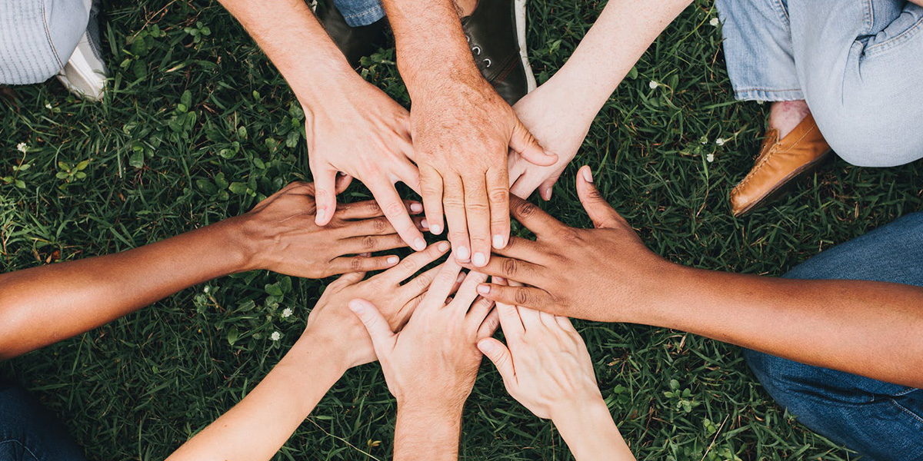
Centering the “human” in medicine
COVID- 19 was not an equalizer, and diseases do not affect all of us in the same way- dependent on class, race, gender, socio-economic conditions(structural factors)
Issues of trust and healthcare culture equally vital for treatment and well-being
Focusing on both the individual and the population as a whole, the individual and the structural is important.
Individual experiences and voices, one’s narrative, their stories and a sense of community can be incorporated in biomedical treatment regimen to create an effective and holistic sense of care.

Slide 7
References
Jones, David S. 2020. “History in a Crisis — Lessons for Covid-19.” New England Journal of Medicine 382 (18): 1681–83.
Macnaughton, Jane. 2023. “Does Medical Humanities Matter? The Challenge of COVID-19.” Medical Humanities 49 (4): 545–52.

